Slide 1

Pregnant healthcare website
Supervisor: Nguyễn Tất Trung
Team members: Hà Đăng Tiến
Đào Anh Tuấn
Trần Thanh Tùng
Nguyễn Văn Dũng
Nguyễn Việt Hùng

Slide 2
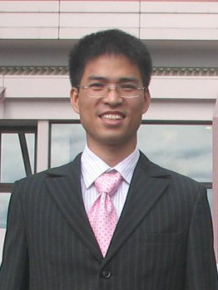


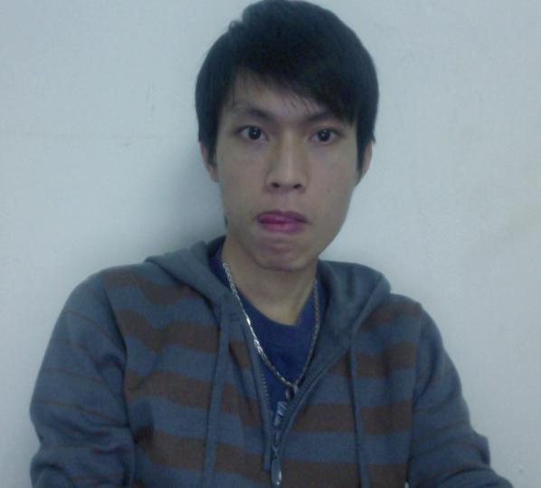
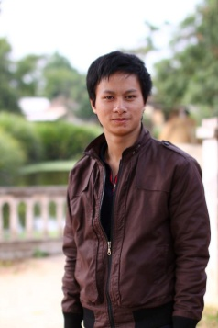

Members
Nguyễn Việt Hùng (Tester)
Hà Đăng Tiến (PM)
Nguyễn Tất Trung
(Supervisor)
Nguyễn Văn Dũng (Dev)
Trần Thanh Tùng (Dev)
Đào Anh Tuấn (Dev)

Slide 3
Outline of content
1. Introduction
2. Project Management
3. Software Requirement Specification
4. Software Design Description
5. Testing
6. Lesson Learned
7. Demo
8. Q&A

Slide 4
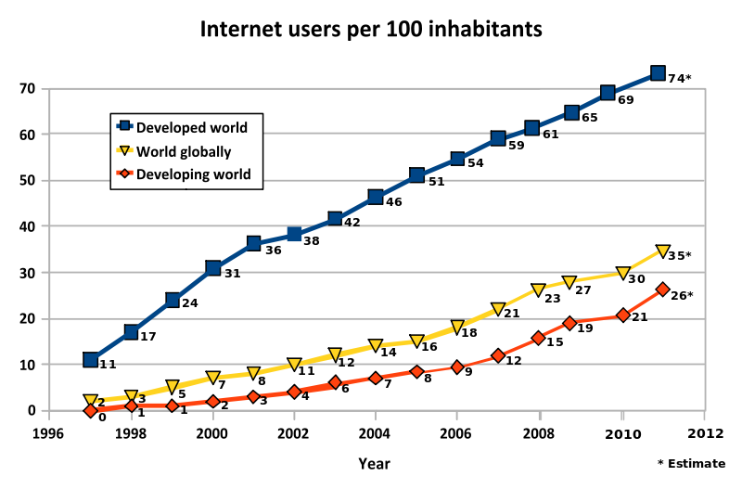

I – Introduction
Internet users per 100 inhabitants
Quality of life

Slide 5

I – Introduction (cont.)
PHP is accessible.
It's quick to develop in PHP.
Programmers of Java, PERL, BASIC, and other popular
languages can find many parallels to ease transition to PHP.
PHP is flexible. Use OOP or not. Use naming convention(s)
or not.
It runs on many different operating systems.
….

Slide 6
I – Introduction ( cont.)
Idea
The demand for searching information of pregnant healthcare
Build a website combine content management system with a page like social network.
Become a convenient website.
Provide specific of function for schedule management

Slide 7
I – Introduction ( cont.)
Our proposals
Vietnamese users
Contribution and opinion from all users
Give the best information they need
Vietnamese
Information
Network
User Friendly
More interesting
Make the system user-friendly
Have best performance

Slide 8
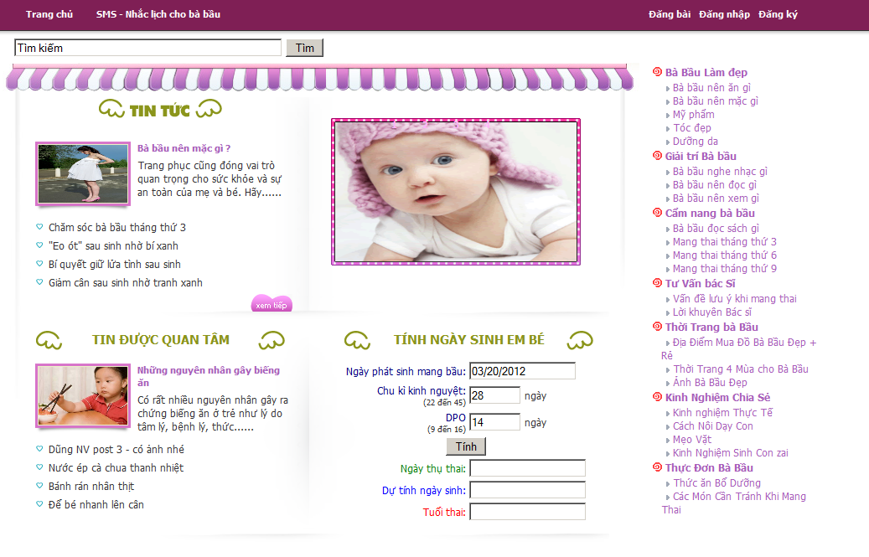

I – Introduction ( cont.)
Products
Mobile apps
Website
(out of scope)

Slide 9
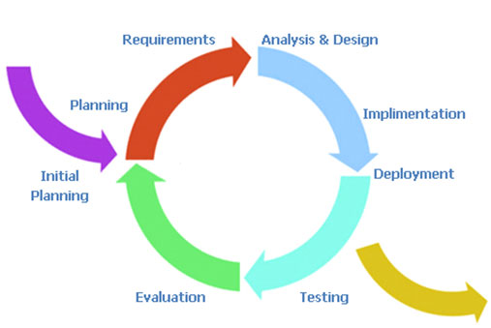
II – Project Management
Software Process Model
Incremental delivery
Easy for team members who don’t have much experience
Easily identify the source of last error
Less time for corrections
Report 3
Report 2
Report 4
Report 1
Report 6
Report 5

Slide 10





II – Project Management (cont.)
Team Work
Time: 8 hours/day, 6 days/week
Location: school, home ,office , cafe
Communication
Meeting minutes

Slide 11



II – Project Management (cont.)
Development Tools
Hardware
Framework: NO
Server :Apache/2.2.17 PHP/5.3.6
IDE: Dreamweaverer 8.0
Dropbox
Design: Visio 2007
    Enterprise Architect 7.5
Software
Personal computers for developing with the minimum configuration:1 Gb of RAM, 60 Gb of hard disk, Core Duo 1.6 GHz.
A server computer for testing with the minimum configuration: 4 Gb of RAM, 100 Gb of hard disk, Core 2 Duo 2.0 GHz.

Slide 12
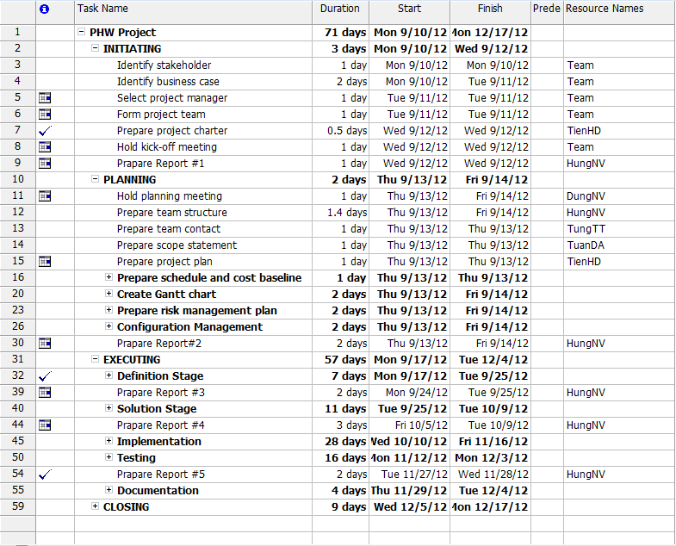
II – Project Management (cont.)
Detail Plan – WBS

Slide 13
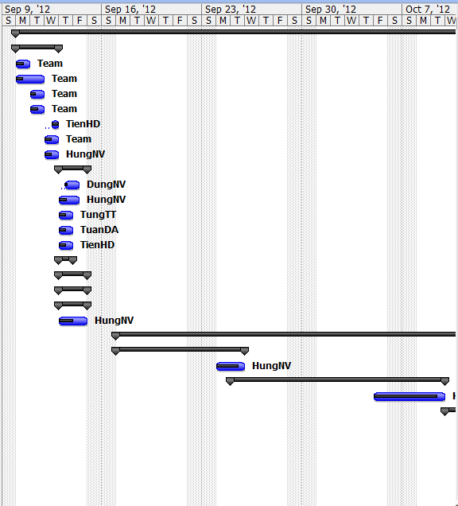
II – Project Management (cont.)
Detail Plan – Gantt Chart

Slide 14
II – Project Management (cont.)
Quality Plan
Estimated | Quantity
Defect density | 5 bugs per kLOC
TEST

Slide 15
II – Project Management (cont.)
Risk Management
ID | Risk Description | Avoidance | Contingency Plan | Status
1 | Member is ill at critical times in the project­­­ | Organize team so that there is more overlap of work and people therefore. | Using buffer time (Saturday and Sunday) to recover jobs. | Closed
2 | Team members conflict with each others. | Increase number of communication channels that will help team members understand each other’s better. | - PM has responsibility to find the root cause and help to solve conflict between individuals. - Team-building is also an essential activity. | Closed
3 | Failure to meet scope | - Study technical and assign research task for each member. - Learning from Mr.TrungNT (lecturer) and person have technology expert. | - Spend more time for research about technology. - Reference from the experience of lecturer for support and research solution. - Inform to lecturer to reduce scope | Closed
4 | Failure to meet agree schedule | - PM control task and push member finish task daily. - Member: Daily Report and raise issue when mistake have or not solve. - Learning from TrungNT (lecturer) or other Group: how to manage time and task. | - Create buffer in Plan - Use Saturday and Sunday as Buffer time. | Closed

Slide 16




III – Software Requirement
Functional Requirement
CMS
News
WALL
Users Communication
POST - REVIEW
SMS
Pregnancy Remind

Slide 17
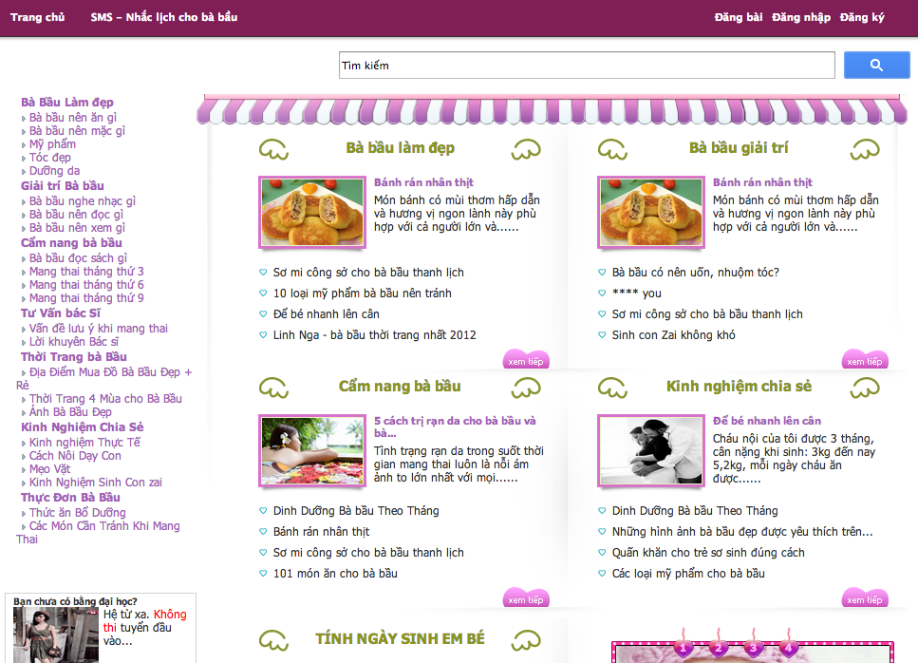
III – Software Requirement (cont.)
CMS – News : Index
- News
- Categories
- Image slider
- Due date calculator
- Advertiser
- Search

Slide 18
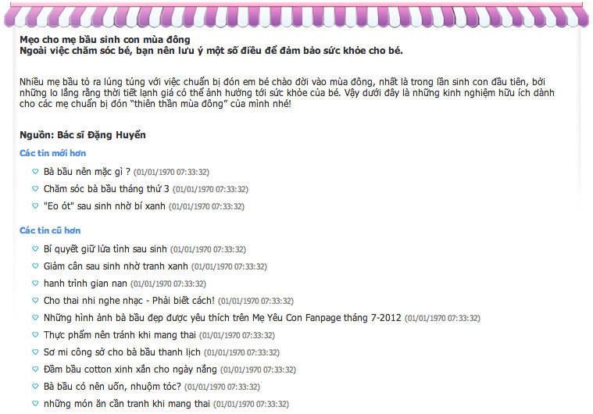
III – Software Requirement (cont.)
CMS – News: Index
News
+ Title
+ Content
+ Date
+ Source
+ Relation news

Slide 19
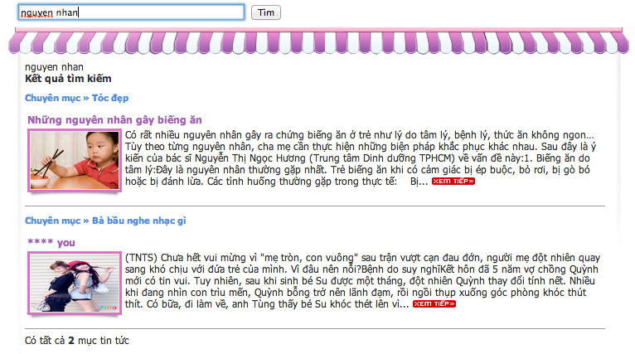
III – Software Requirement (cont.)
CMS – News: Index
Index – Search
+ Search by news title,
news content

Slide 20
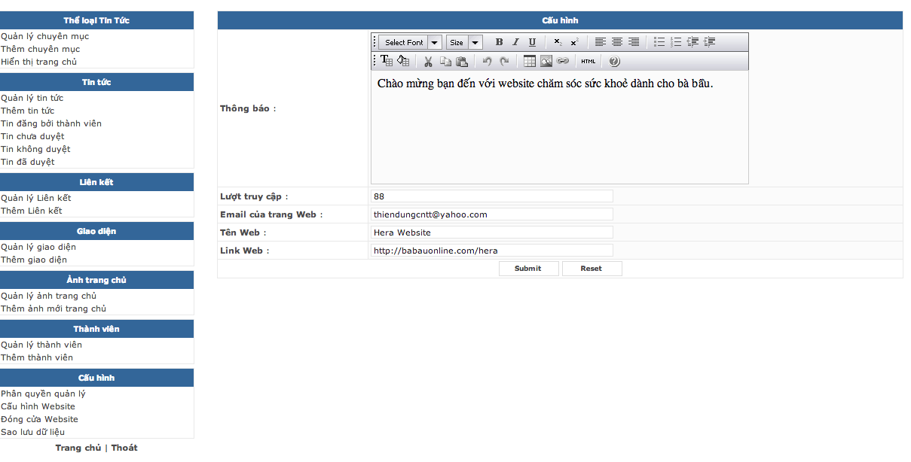
III – Software Requirement (cont.)
CMS – News: Admin
Categories
News
Users
Templates
Home images (out of scope)
Advertises (out of scope)
Configurations
Backup database

Slide 21
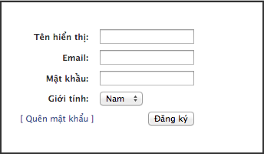
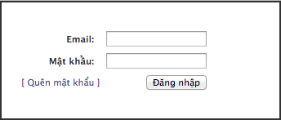
III – Software Requirement (cont.)
Wall – Users communication
+ Register
+ User name
+ Email
+ Password
+ Gender
+ Login
+ Forgot password
+ Logout

Slide 22
III – Software Requirement (cont.)
Wall – Users communication
+ Register
+ User name
+ Email
+ Password
+ Gender
+ Login
+ Forgot password
+ Logout

Slide 23
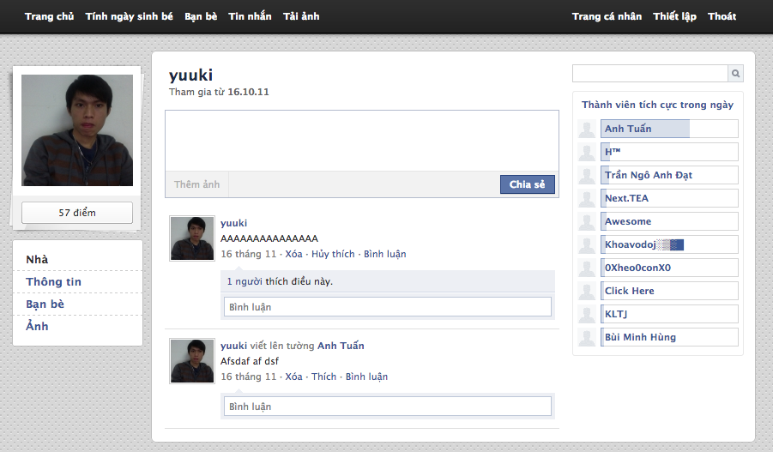
III – Software Requirement (cont.)
Wall – Users communication
+ User home page
+ Avatar
+ Information
+ Friends
+ Messages
+ Pictures
+ Stories

Slide 24
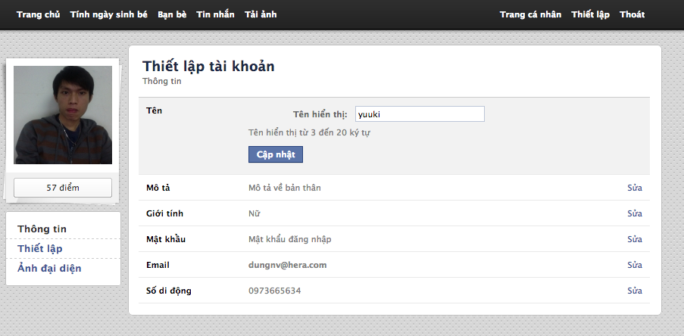
III – Software Requirement (cont.)
Wall – Users communication
User configuration page

Slide 25
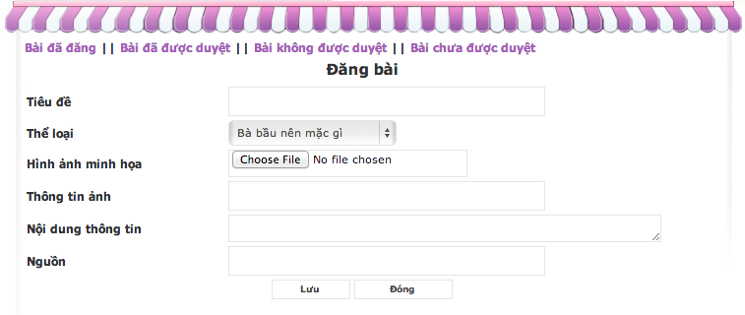
III – Software Requirement (cont.)
Post – Review: Post news
+ News post form
+ Title
+ Type
+ Picture
+ Content
+ Source
+ News posted
+ News have been reviewed
+ News haven’t been reviewed
+ News haven’t been reviewed yet

Slide 26
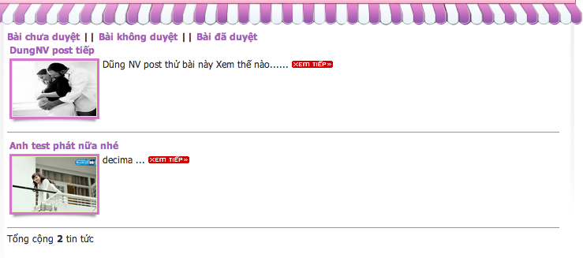
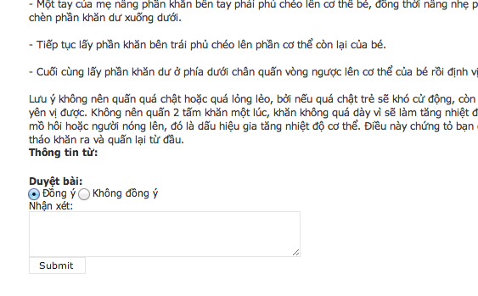
III – Software Requirement (cont.)
Post – Review: Review news
+ News post form
+ News information
+ Accept/Reject
+ Comment
+ News haven’t reviewed yet
+ News rejected
+ News reviewed

Slide 27
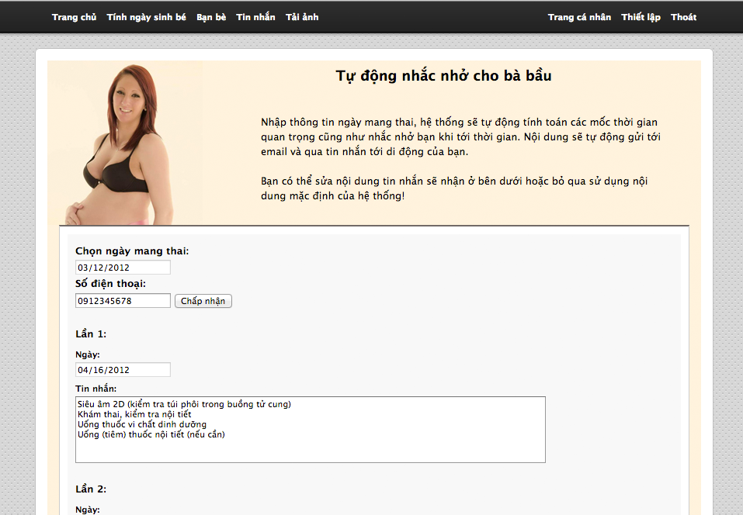
III – Software Requirement (cont.)
SMS – Pregnancy Remind
Automatic send remind
message 6h AM
1. Member input date
2. Input phone number
3. Click “Chấp nhận”

Slide 28
III – Software Requirement (cont.)
Non-Functional Requirement
Usability
  Vietnamese language
  UI: simple, out-standing
  Searching tool: full text search
Reliability
  Data collected, reviewed carefully and correctly.
  Database and files: backed up regularly

Slide 29
III – Software Requirement (cont.)
Non-Functional Requirement
Security
  User password: invisible even to admin
Availability
  Install on two different server
  Can be turned off when upgrading
Maintainability
  Coding convention
  Source structure

Slide 30
IV – Design Description
Structural Diagram
Common
Presentation and Bussiness
Exception
templates
stylesheet
javascript
images
Content management
Session component
Admin control panel
User control panel
Logging
user home page
user activity
sms & email sender
Ajax
(JQuery1.8.3)
Utilities
Data Access
DBAccess
(config.php & dbconnect.php)
Database
HeraDB (Mysql-5.5.10)

Slide 31
IV – Design Description (cont.)
Send SMS Component
Scheduled Task
Business Logic
Send SMS API
Database

Slide 32
IV – Design Description (cont.)
Class diagram example

Slide 33
IV – Design Description (cont.)
Sequence diagram example

Slide 34
IV – Design Description (cont.)
Database design
Business tables: user, comment…
Support tables: template, config…
Every table has a PRIMARY_KEY named _id which is of type: INT NOT NULL AUTO_INCREMENT
Indexing for better performance: posterId, cat_id…

Slide 35
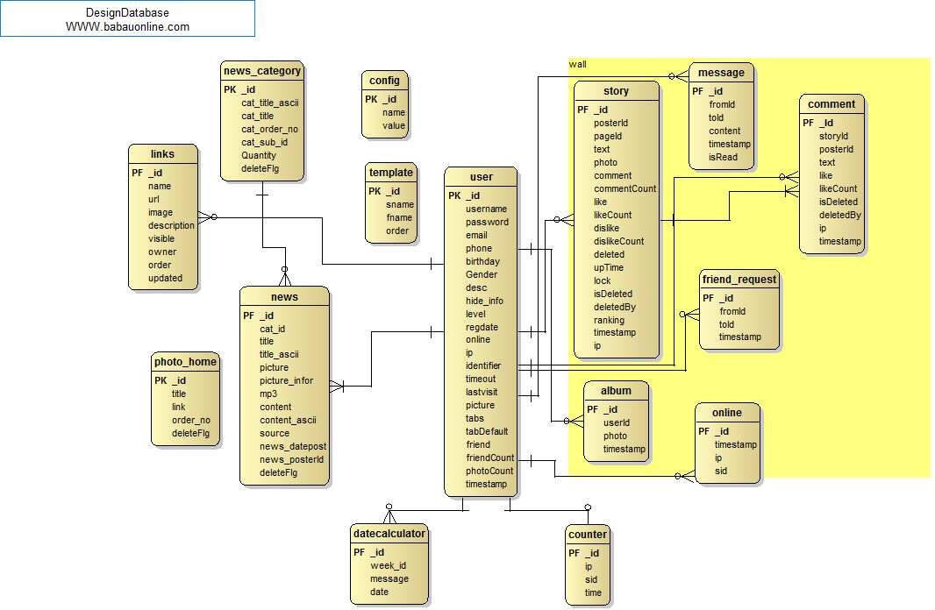
IV – Design Description (cont.)
Database design

Slide 36
V – Test
Test process
Test plan
Create test case
Review TC
Execute test
Test Report

Slide 37
V – Test (cont.)
Test phases
Software Development Phases
Test Execute Phases
User Requirement
Acceptance Test
29/11-10/12
System Requirement Spec
System Test
24/11-28/11
Architectural
Design Spec
Integration Test
19/11-23/11
Unit Test
15/11-18/11
Detail Design Spec
Coding & Review

Slide 38
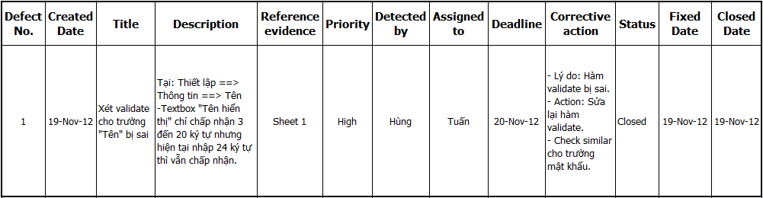
V – Test (cont.)
Defect log
  Using excel to log defect, sample:

Slide 39
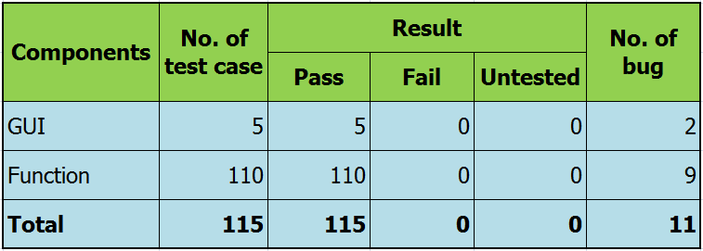
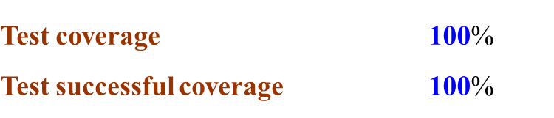
V – Test (cont.)
Test result

Slide 40

V – Test (cont.)
Acceptance test result
PHW
User
Release
29/11
Acceptance Test
30/11 – 03/12
Fix bugs on time
Inform bug
(Total : 2 bugs)
Release (2nd)
05/12
Acceptance Test (2nd)
06/12 – 10/012

Slide 41
VI – Lesson Learned
Item | Success criteria
Working in group | Resolve conflicts Communication
Management skills: | Organize Negotiate Make plan apply working-in-group knowledge into the project.

Slide 42

VII – Demo

Slide 43

VIII – Q&A

Slide 44


