Slide 1
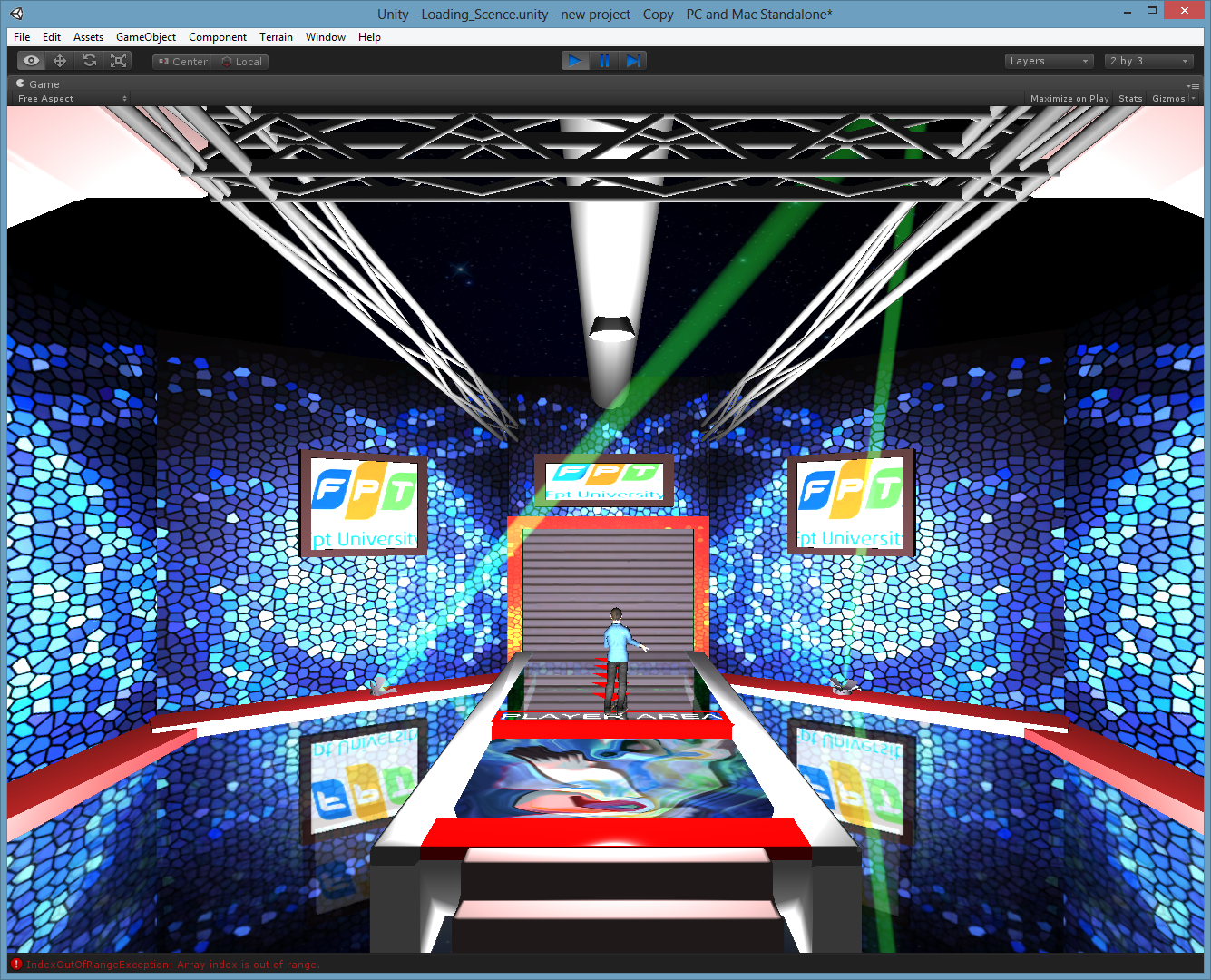
Kinect Game : HOLE IN THE WALL
Supervisor: Nguyen Van Hien
Team members:
Le Duc Dat
Dao Ba Hoang
Nguyen Huu Huy
Nguyen Quang Minh
Tran Tuan Nghia
FPT University
Capstone Project

Slide 2
Outline of content
2
Introduction
Project management
Requirement specifications
Technology
Test
Demo
Q&A

Slide 3
I - Introduction
3
Project information
  Problem abstract
Hope that can play game using body in PC
Want to play game using body
Don’t have an Xbox
Not easy to resolve

Slide 4
I - Introduction (cont.)
4
Resolving
Create a game using Kinect sensor in Window 7 or 8
Just only need a Kinect sensor
Convenient to play game
Easy to play game

Slide 5
I - Introduction (cont.)
Kinect Game
Create a game using Kinect sensor
Create a game using body to play
Computer
Our proposal

Slide 6
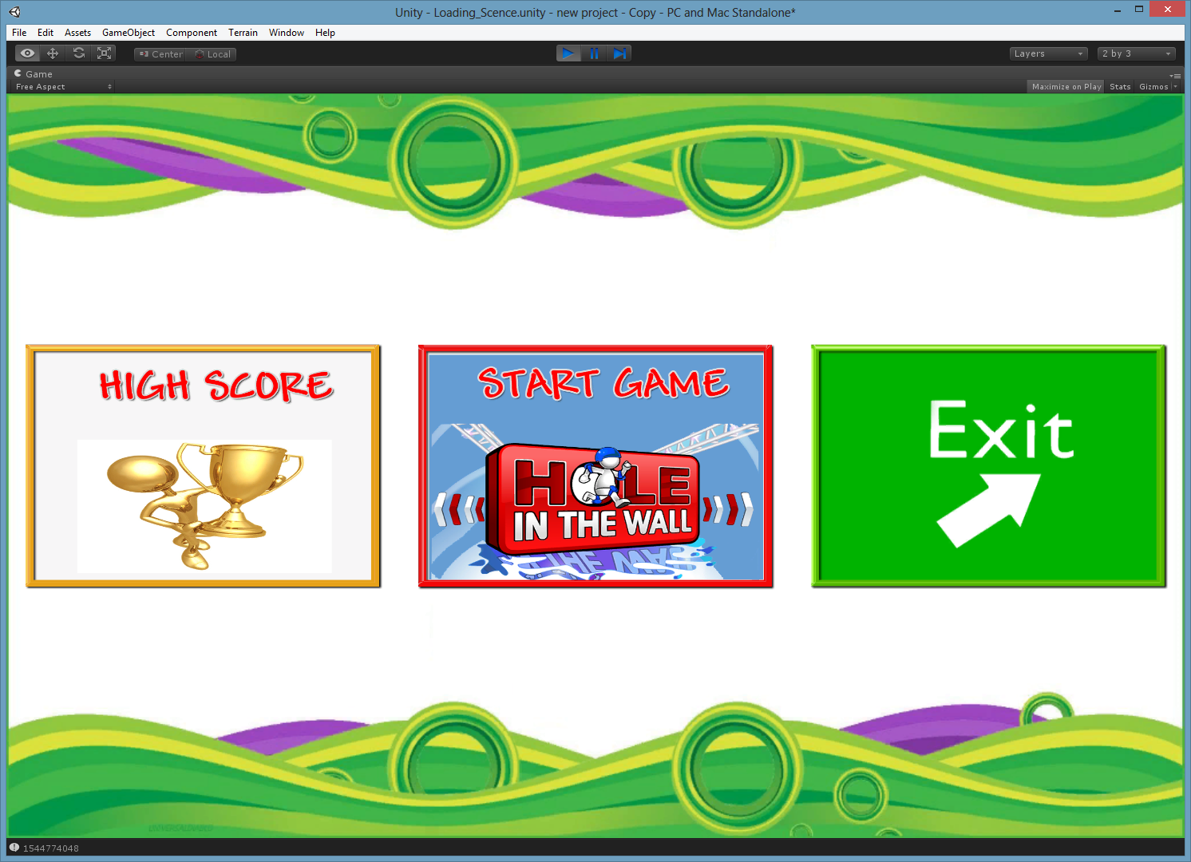
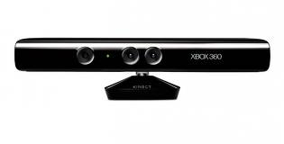
I - Introduction (cont.)
6
Project information

Slide 7

I - Introduction (cont.)
Similar Product
  Xbox Game ‘Hole in the wall ’
    Currently on sale for $24.97 in Wal-Mart
    Support for 10 player multiplayer
    HD support: 720p, 1080i, and 1080p.

Slide 8
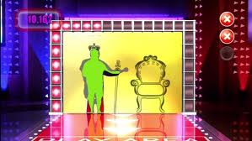
I - Introduction (cont.)
Similar Product (cont.)
  Xbox Game ‘Hole in the wall ’ (cont.)
    This product using shadow detect technique.

Slide 9
II - Project management
Development Environment
  Hardware
  Software
Kinect sensor
4 Gb of RAM
100Gb of hard disk
Core i3 2.0 Ghz
Category | Software name | Version
Operating System | Microsoft Window | 7
 | Microsoft Window | 8
Code | Unity3D | 3.5
Graphic | Photoshop | CS5
 | 3Ds-Max
Source Control | Drop box

Slide 10
II - Project management (cont.)
Project organization
Le Duc Dat
PM
Dao Ba Hoang
Technical Leader
Nguyen Huu Huy
Dev
Le Duc Dat
Dev
Nguyen Quang Minh
Test Leader
Tran Tuan Nghia
QA
Dao Ba Hoang
Dev

Slide 11
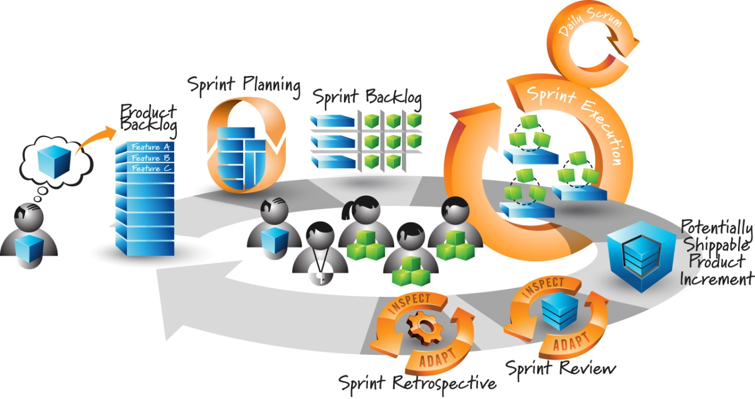
II - Project management (cont.)
Process
  Follow Agile process model

Slide 12
II - Project management (cont.)
Project Planning

Slide 13
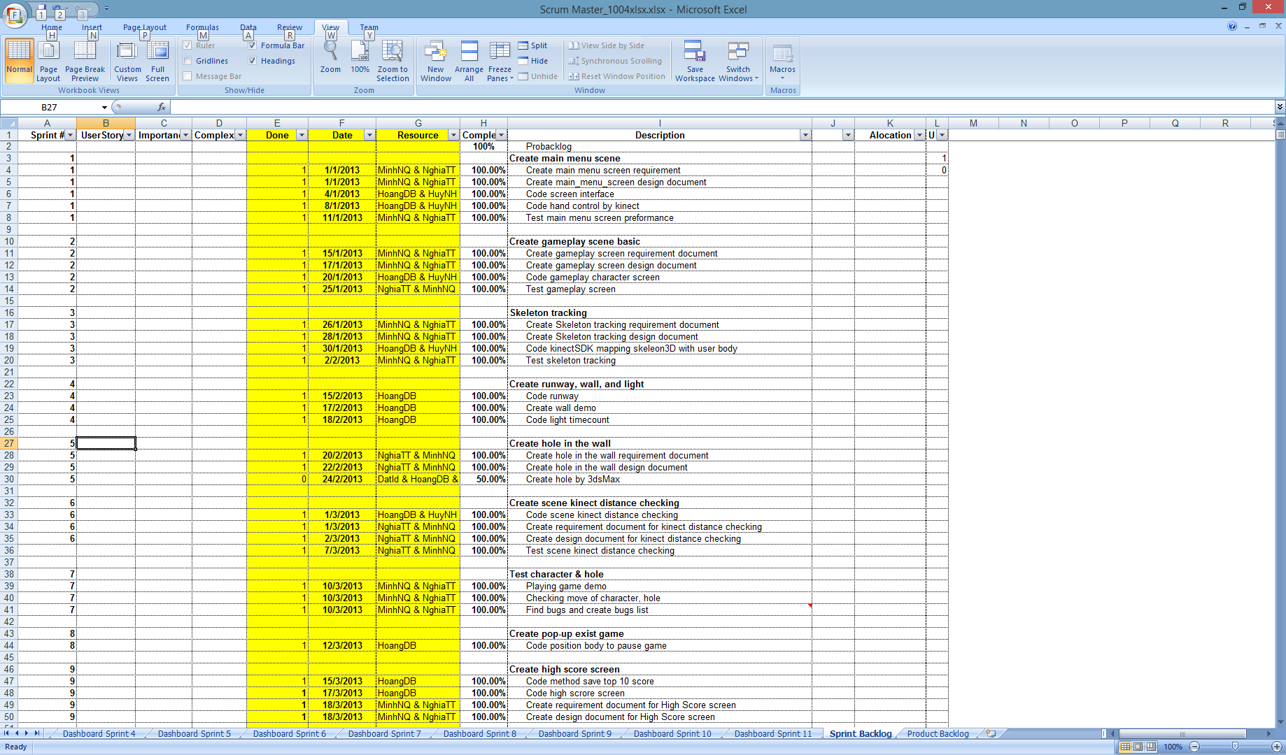

Slide 14
III - Software requirements
Basic scene
Skeleton Tracking
High Score
Stage
Menu Game
Distance checking
Holes
Wall, runway, light, etc

Slide 16
III - Software requirements(cont.)
  Functional requirements
Kinect game ’Hole in the wall’ requirements
  Consist of these following functions:
Hand controller Make character reflect player’s actions Check distance between player and Kinect sensor Check pass or not pass when play
Notes:
iCardPro is the application installed on users’ individual product (iPhone) that support users to manage business cards smartly. It makes a job of managing business cards become more effective and easily. It will contain following functions:
Capturing: Allow users to use iPhone‘s built-in camera to snap a picture of business card.
Editing: Allows users to edit the card images before processing them to improve accuracy of detect module.
Card Holder: Allows users to manage business card in convenience way (view card detail, group management,update,delete,add new card to card holder).
Contact via card holder: Making a phone call, send SMS, view websites, view address on map.
Sync: Synchronize contact data between iPhone client and server.
iCardPro system includes 2 parts: The client and the server:
The client: The client will include iCardPro application will be installed on users’ devices and an iCardPro website for administrative purpose. It supports two kind of user: End-user and administror. End-user can use iCardPro application and iCardPro website to manage business card and administrator can use iCardPro website for administrative purpose.
The server: Server is web servicewhich will be responsible for storing contact data and handling business of the application.

Slide 17
III - Software requirements (cont.)
Hand controller
  Determine player’s right hand position
  Combine with Kinect sensor to capture position of player’s right hand
Make character reflect player’s action
  Create joints for character
  Base on joints of character and combine with Kinect sensor capture player’s actions for reflect player’s actions to character

Slide 18
III - Software requirements (cont.)
Check distance between player and Kinect sensor
  Determine player position
  Combine Kinect sensor to check distance
Check pass or not pass when play
  Determine coordinate of all points surround character and coordinate of all points surround hole
  Check collision between player and hole by find the same coordinate between player and hole

Slide 19
III - Software requirements (cont.)
Non-functional requirements
  Character’s image
  Hole’s image
  Background
  Light effect
  Music effect

Slide 20
IV - Technology
We choose four following technologies to work:
  Unity3D.
  MonoDevelop – Unity.
  Photoshop( CS5 ).
  3Ds-Max.

Slide 21
IV – Technology (cont.)
Risk:
  How to use those tools ?
  Knowledge about graphic design.
  Knowledge and how to use Kinect.
  Out of control.
Solution:
  Take participate in some forums to learn, ask what we don’t understand.
  Ask some people have experience and knowledge.
  Google, Youtube search.

Slide 22
VI - Test
Consists of 3 test levels:
Integration test
System test
Unit Test

Slide 23
Features to be tested
Functional requirements
Area Name | Feature Name | Function to be tested
Skeleton tracking | Virtual character | Movements of character
Distance checking | Kinect Distance Checking screen | Check distance between player and Kinect sensor
Menu Screen | Menu screen | Hand control, active button
High Score | High Score screen | Display top 5 highest score, compare score
Game play | Game play screen | Display wall, add score, check pass, fail, collision, activities of game
GUI | GUI play screen | Interface of game play screen

Slide 24
Functional requirements
Results
Module code | Pass | Fail | Untested | N/A | Number of test cases
Total | 53 | 3 | 0 | 0 | 56
Menu screen | 5 | 0 | 0 | 0 | 5
Skeleton tracking | 5 | 3 | 0 | 0 | 8
Kinect distance checking | 8 | 0 | 0 | 0 | 8
High Score screen | 3 | 0 | 0 | 0 | 3
Game play | 13 | 0 | 0 | 0 | 13
GUI play screen | 12 | 0 | 0 | 0 | 12
Scenario | 7 | 0 | 0 | 0 | 7

Slide 25
VII – Summary
Potential Improvement Points
  Improve the GUI for ease of use.
  Improve the quantity and quality of walls.
  Optimize algorithms.
  Create some another modes for game.
  Update the number of player can take participate in.

Slide 26
VII – Demo and Q&A

Slide 27


