Slide 1

Management System for a Construction materials Shop
Group Members | 00695 – Lê Hải Long
 | 00732 – Hoàng Minh Khải
 | 00680 – Lê Bá Long
 | 00682– Vũ Thế Vịnh
 | 00448 – Nguyễn Thanh Tùng
Supervisor | Trần Bình Dương

Slide 2

Outline of content
I- Introduction
II- Project Management
III- Software Requirement Specification
IV- Software Design Description
V- Testing
VI- Lesson Learned
VII- Demo
VIII- Q&A

Slide 3


1. Introduction
Nowadays, cities are expanding very fast. Besides, there is very big importance of construction industry.

Slide 4
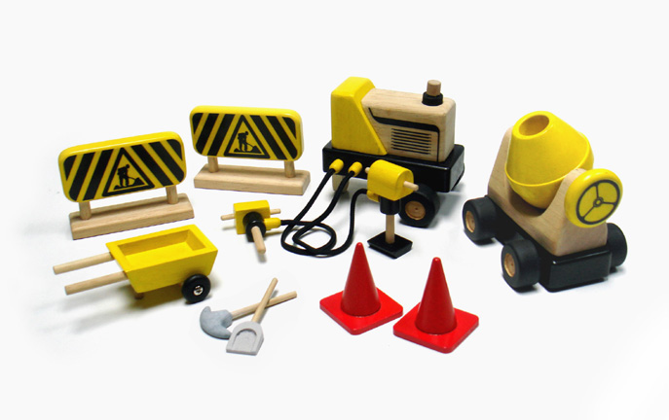
1. Introduction
In this situation, small and medium commercial models of construction materials are appearing more and more. However, management of these commercial models has many limits, they cannot control completely and closely sales, deliveries, storing. With many complicate processes, diversion of material categories, handwork management has a lot of problems.

Slide 5

1. Introduction
Web base construction material management:
  Because users need only web browser and internet connectivity so they can work anytime and anywhere.
  The data is updated quickly, exactly.
  The deployment is easy, simple
  Collaboration effectively, users easy to share data and share works to each other’s

Slide 6
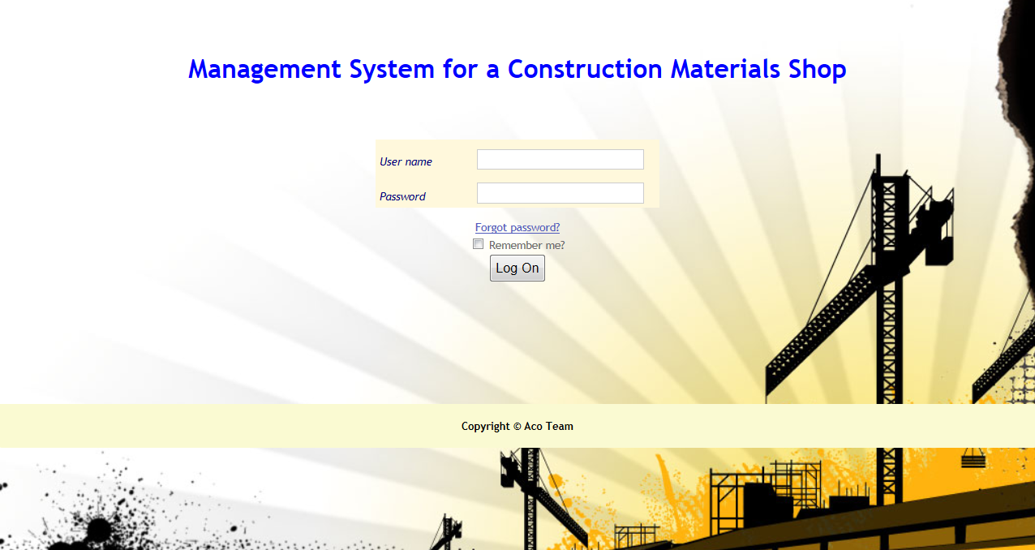
1. Introduction
Our Product:
Website

Slide 7
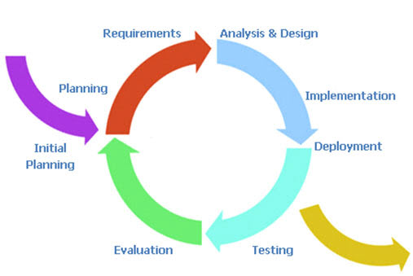
2. Project Management
Process Model
We’ll always have a running
version of the program.
Suitable for new developer.
Meet the changing.
The Iterative and Incremental model

Slide 8




2. Project Management
Team Work
  Time: 6 days/week , 2 days buffer
  Location: school, home
  Communication
  Meeting minutes

Slide 9
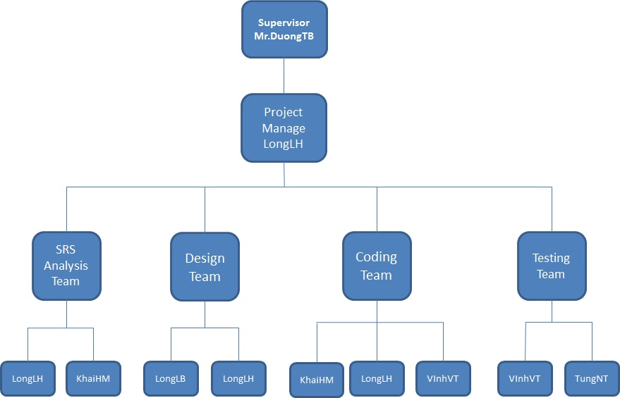
Organisation

Slide 10
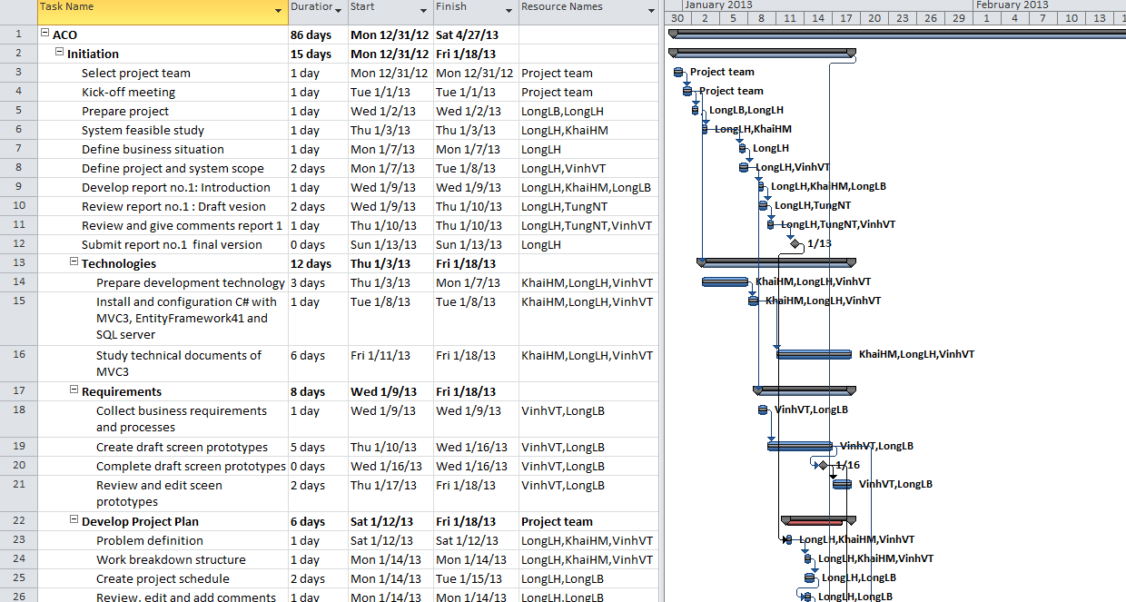
2. Project Management
Detail Plan – WBS

Slide 11
2. Project Management
ID | Description | Possibility | Effect | Prevent | Solution
1 | Team members are sick, they cannot complete task under deadline | HIGH | SERIOUS |  | -Increase project team’s working effort in “peace period”. -Allow all team members clear about what others do, so that they can cover the tasks when necessary
2 | Conflictions between team members. | HIGH | SERIOUS |  | - Setup an open-talk environment in project team. - “Do not criticize” is set as a rule. - Organize team-building more often.
3 | Team members are lack of coding skill, technical knowledge and soft skill, so they can have mistake when they develop functions of system. | HIGH | SERIOUS |  | -Provide a short training course before applying new technique. -Let those members do other non-coding works.
4 | Underestimate project scope, tasks’ difficulty level and risks’ effectiveness. | HIGH | SERIOUS |  | - Estimate project scope with instructor and experience persons. -Assign task weight value to make task evaluation easier. Discuss in group about tasks’ difficulty level. -Involve all team members in risk management process and reference to instructor’s opinions.
5 | Lost data of project | HIGH | SERIOUS |  | data stored on the computer of the members

Slide 12
3.Software requirement specification
Main function of system:
Order management
Employee management
Customer management
Supplier management
Store management
Account management
Import/Export.
Reporting management
Payment management
Statistic management

Slide 14
3.Software requirement specification
Employee management .
  Admin can insert, edit, delete and set rank of employee, set the task for employee by day, month, and year … Change location work of employee to another shop in system.

Slide 15
3.Software requirement specification
Customer management
  Manage customer is function about customer, show all relationship, description, history … of customer. This function can mark and auto remind customer if they have debt.

Slide 16
3.Software requirement specification
Supplier management
  Manage Supplier is function about Supplier, show all relationship, description, history … of Supplier.

Slide 17
3.Software requirement specification
Account management
  This function provide for admin manage account, insert, edit, delete, change permission account.

Slide 18
3.Software requirement specification
Order Management
StoreManagement
Import/Export
Payment

Slide 19
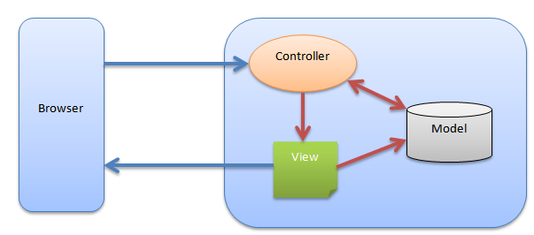
4.Software Design Description
Architectural Diagram

Slide 20
4.Software Design Description
Component Diagram
  The overall architecture of ACO.Web component will be depicted as the following diagram:

Slide 21
4.Software Design Description
Class diagram example

Slide 22
4.Software Design Description
Sequence diagram example

Slide 23
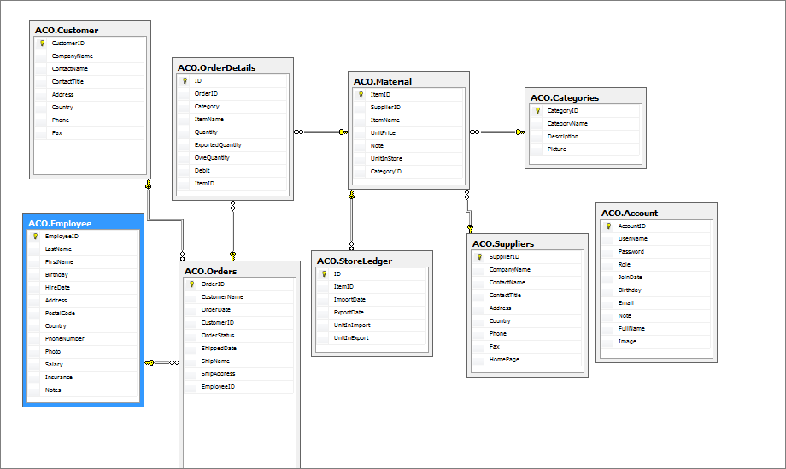
4.Software Design Description
Database design

Slide 24
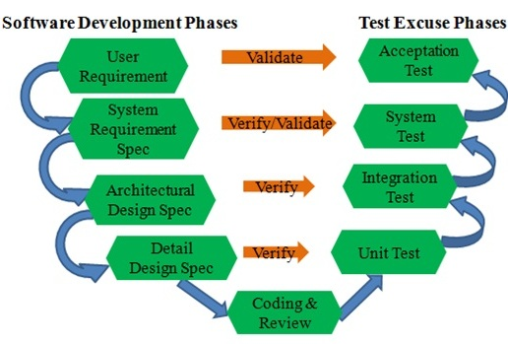
5.Test
Testing phases

Slide 25
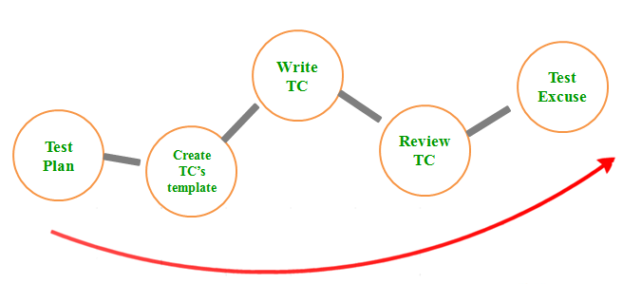
Testing Process

Slide 26
5.Test
Test case example
Testcase ID | Description | Procedure | Expected Result | Priority | Tester | Tested Date | Status | Tester | Tested Date
List Suppliers
001-001 | Test "Suppliers Management" page | 1.Look at information of fields | "Supplier Management" page is displayed with the following informations: - Title: Suppliers Management - A Table with columns: + ID + Company Name. + Contact Name. + Contact Title. + Address. + Phone Number. + Note + HomePage - Button: View, Edit, Delete, Add new Suppliers, Cancel | High
001-002 |  | 1. Click "Edit" button. | Redirect to "edit Suppliers" form | High
001-003 |  | 1. Click "Add new suppliers" Button | Redirect to "add new Suppliers" form | High
001-004 |  | 1. Click "View" button | Redirect to "View Suppliers" form. | High
001-005 |  | 1. Click "Delete" button | Show messagebox confirm: - OK: Delete Suppliers. - Cancel: Don’t delete Suppliers. | High

Slide 27
5.Test
Test result
No | Module code | Pass | Number of test cases
1 | Employee Management | 16 | 16
2 | Store Management | 16 | 16
3 | Customer Management | 18 | 18
4 | Order Management | 17 | 17
5 | Suppliers Management | 18 | 18
6 | Import, Export Management | 9 | 9
7 | Payment Management | 4 | 4
8 | Account Management | 22 | 22
 | Sub total | 120 | 120
Test coverage: 100%
Test successful coverage: 100%

Slide 28
5.Test
Acceptance test result
CMS
User
Release
Acceptance Test
Fix bugs on time
Inform bug
(Total : 2 bugs)
Release (2nd)
Acceptance Test (2nd)

Slide 29
6.Lesson Learned
Item | Success criteria
Working in group | Resolve conflicts Communication
Management skills: | Organize Negotiate Make plan apply working-in-group knowledge into the project.

Slide 30

7.Q&A

Slide 31

8.Demo

Slide 32


