Slide 1
Hanoi gourmet restaurants
Supervisor: La Ngoc Quang
Team members:
Dao Manh Tuan
Truong Duc Ngoc
Tran Duc Anh
Nguyen Duy Phuong
Dao Trung
Capstone Project

Slide 2
Outline of content
2
Introduction
Project management
Requirement specifications
Design description
Test
Demo
Q&A

Slide 3
I - Introduction
3
Team members
Dao Manh Tuan
Truong Duc Ngoc
Tran Duc Anh
Nguyen Duy Phuong
Dao Trung

Slide 4
I - Introduction (cont.)
4
Background
Vietnam topped the Asia-Pacific region on the proportion of people preferred to spend money on eating and entertainment (89%).
The group sees the potential blueprint for the restaurant service industry in Vietnam and made ​​a preliminary survey of the search habits of young restaurant in Hanoi
Notes:
Link: http://vtc.vn/1-277766/kinh-te/ntd-viet-dan-dau-chau-a-ve-chi-tieu-an-uong-giai-tri.htm

Slide 5
I - Introduction (cont.)
5
Do you often go eat in a restaurant or bar snacks?
=> 77% choose “Sometime”
You know the restaurants from ?
=> 44% choose internet and 88% choose “friends”
Did you search restaurants before a meal with your friends?
=> 56% for ”sometimes”, 19% for “frequently” and 8% for “never”
When looking / listening information about restaurants / snack, what information that you are interested in?
=> 58.33% for “price”, 47.22% for “location(near/far)”, 38.89% for “main food”, 25% for “discount” and 61.11% for “feedback from friends”
If there is a free application that provides information about restaurants, food in Hanoi, will you use when deciding what to eat?
=> 91.67% for “yes
Notes:
Link: http://vtc.vn/1-277766/kinh-te/ntd-viet-dan-dau-chau-a-ve-chi-tieu-an-uong-giai-tri.htm

Slide 6
I - Introduction (cont.)
6
The same searching restaurants system
Torontorestaurants.com
Foody.vn

Slide 7
I - Introduction (cont.)
7
1. Torontorestaurants.com
All the restaurants in the system are added by the administrator
Comment function must be consented to post by admin
Lack functional restaurant reviews by users
2. Foody.vn
Foody.vn store restaurants information in many cities

Slide 8
I - Introduction (cont.)
8
# | Learn from experience
1 | User has the right to add a restaurant. The problem of wrong data the user will be informed to the admin to resolve. Similar to the "Report violation" in the site
2 | User should be allow to sent comments timely
3 | System should have evaluate function to evaluate the quality of restaurant
4 | Users can post comments timely and name or alias of user who post comments must be display
5 | The system should only focus on a local, namely Hanoi

Slide 9
II - Project management
Development Environment
Hardware
Software
4 Gb of RAM
100Gb of hard disk
Core 2 Duo 2.0 Ghz
iPhone 3/3GS/4/4S
3 Gb of RAM
100Gb of hard disk
Core 2 Duo 2.0 Ghz
Category | Software name | Version
Operating System | Mac OS X Lion | 10.7
 | Windows Server | 2008
 | iOS | 5.0
Web Server | IIS | 7
Framework | .NET Framework | 4.0
 | ASP .NET Web Services | 2.0
 | Cocoa | 2011
 | UIKit | 2011
IDE | Visual Studio | 2010
 | Xcode | 4.0
Source Control | Tortoise SVN | 1.7.6
UML Tool | Enterprise Architect | 7.5
Notes:
Cần update lại

Slide 10
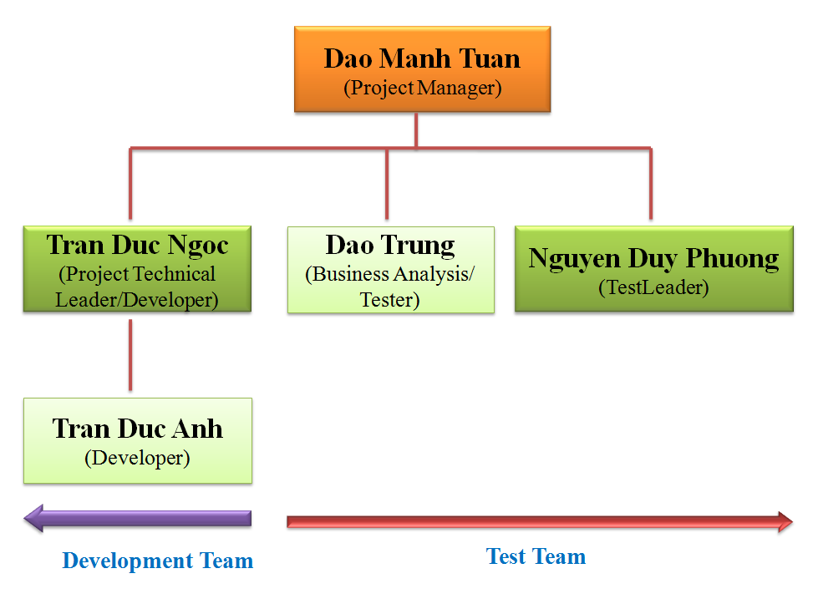
II - Project management (cont.)
Project organization

Slide 11
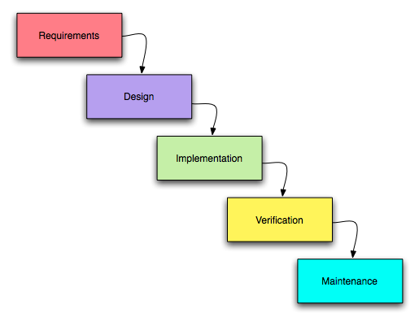
II - Project management (cont.)
Process
Follow Water fall process model

Slide 12
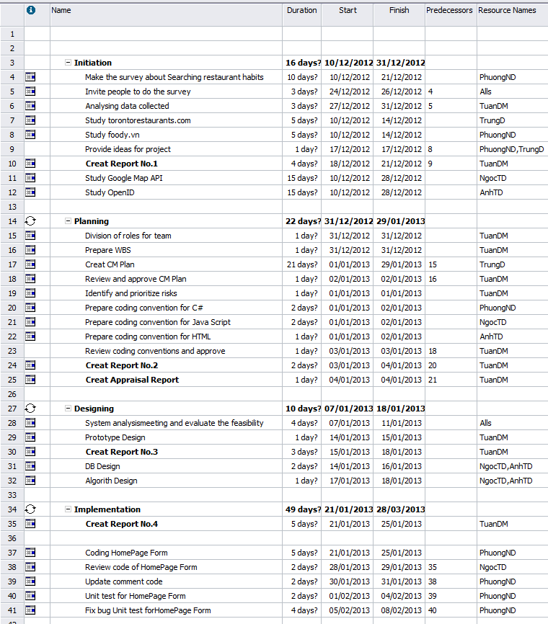
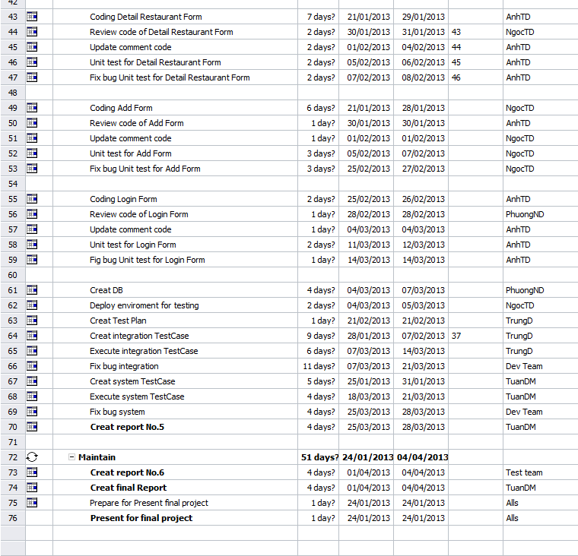
II - Project management (cont.)
Project Planning

Slide 13
II - Project management (cont.)
Configuration Management Plan
CI Identification &Naming convention
Version numbering
Directory structure & Access right
Other rules
Title : [HGR] Title mail
Meeting minutes : [HGR] Meeting minutes xx/xx/20xx
Daily report : [HGR] Dailyreport Name of member xx/xx/20xx

Slide 14
II - Project management (cont.)
Risks
ID | Risk Description | Probability | Effect | Status
1 | Group has no hard developer. Team development with little experience | High | Tolerable | Responded
2 | People do not have experience working on two new technologies: Google map API and OpenID | Very high | Serious | Occurred
3 | Application may be more complex than estimated. | High | Tolerable | Potential
4 | Project duration is too short so it is difficult to complete all projects’ tasks on time. | Moderate | Serious | Potential
5 | Project Manager lacks of project management skill | Moderate | Serious | Potential
6 | Team member lack of software development experience | Moderate | Insignificant | Not relevant
7 | System is not tested in large data environment | Moderate | Insignificant | Not relevant

Slide 15
III - Software requirements
User requirement
Search restaurants
Manage restaurants
Manage dishes
Manage comments
Rating
Manage users

Slide 16
III - Software requirements (cont.)
Environment requirements
WebService requirement
Receive request from client
Process request
Return result to client
Save information of requests to database
Administration Website requirement
View information of requests (translation requests)
Filter by time, device or languages
Graphs
Notes:
Update lại

Slide 17
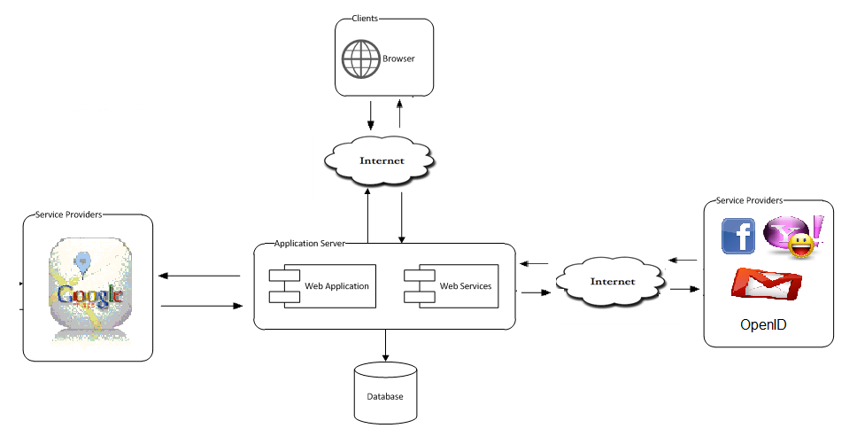
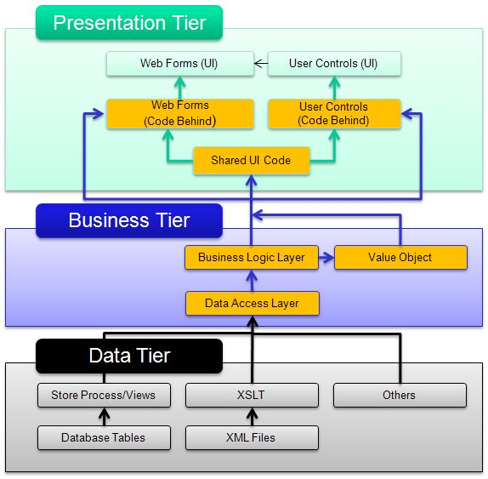
IV - Software Design Description
Architecture overview

Slide 18
IV - Software Design Description (cont.)
Technology:
Tool:
Tools | Verion
MS SQL Server 2008 | R2
Windows XP/2K3/Vista/7 | 2008
Visual Studio | 2010

Slide 19
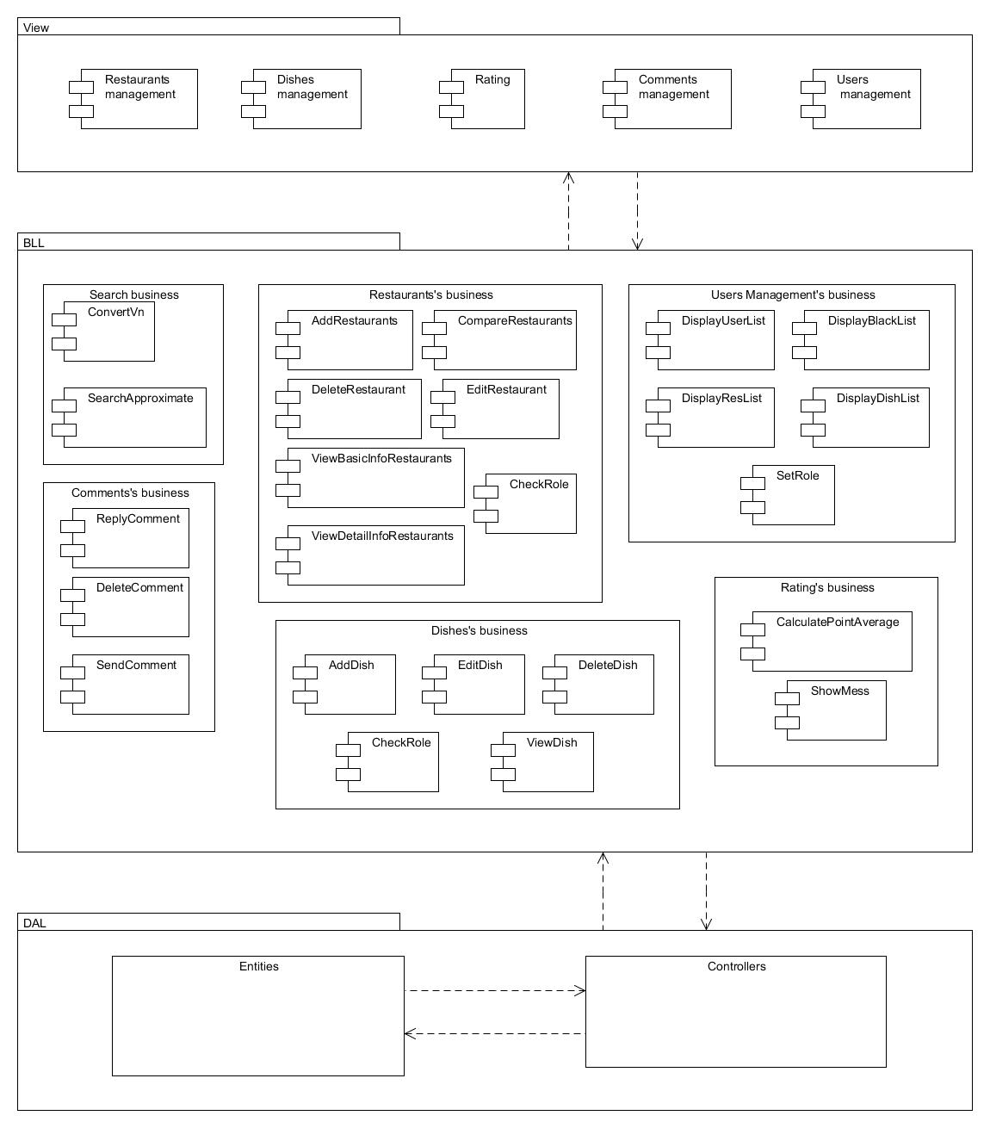
IV - Software Design Description (cont.)
Component diagram

Slide 20
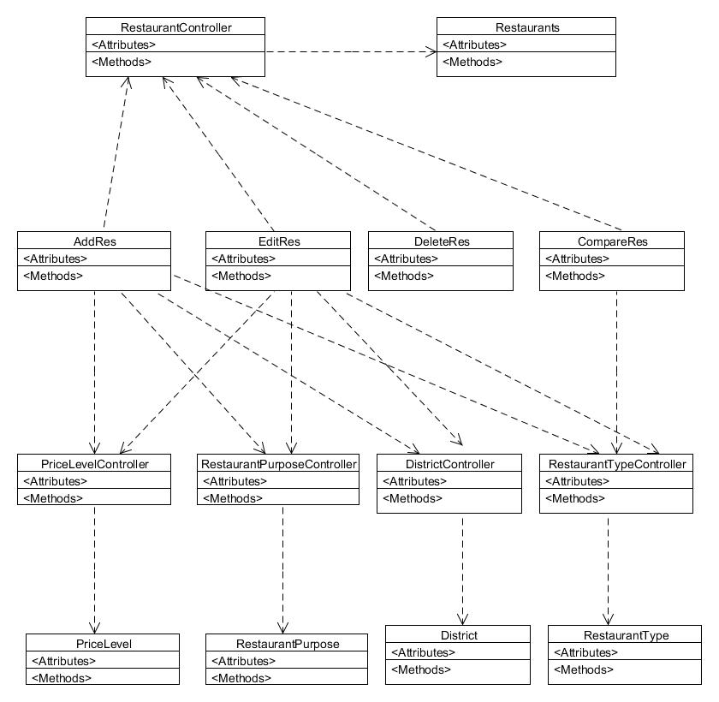
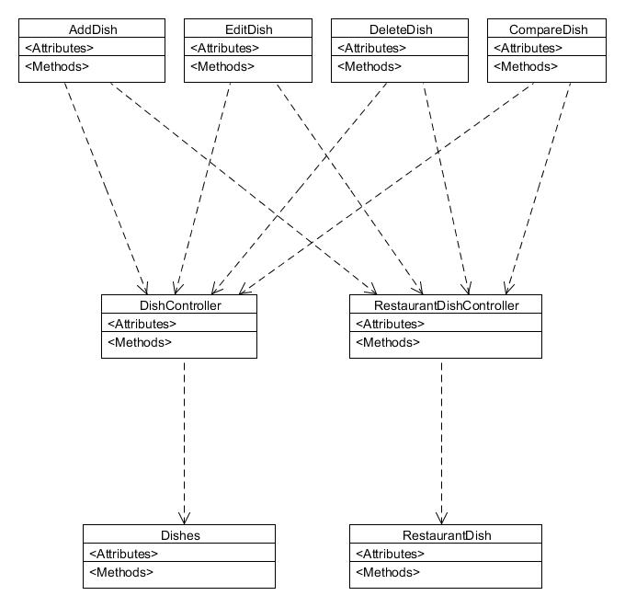
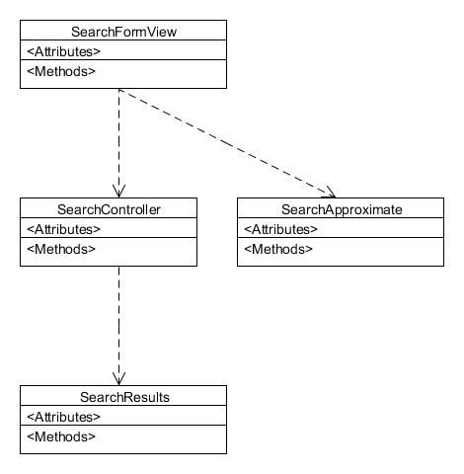
IV - Software Design Description (cont.)
Class diagram
Search
Manage restaurants
Manage dishes

Slide 21
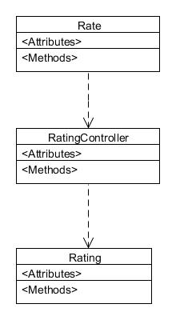
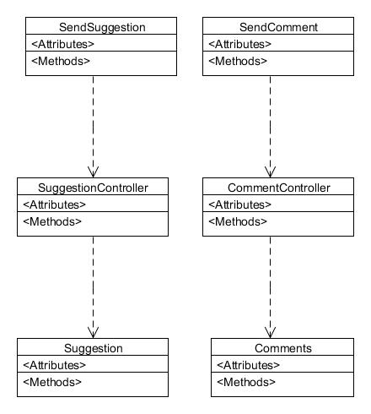
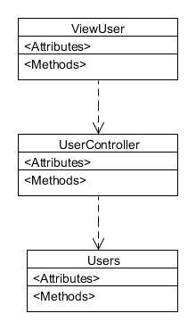
IV - Software Design Description (cont.)
Class diagram (cont.)
Manage comments
Rating
Manage User

Slide 22
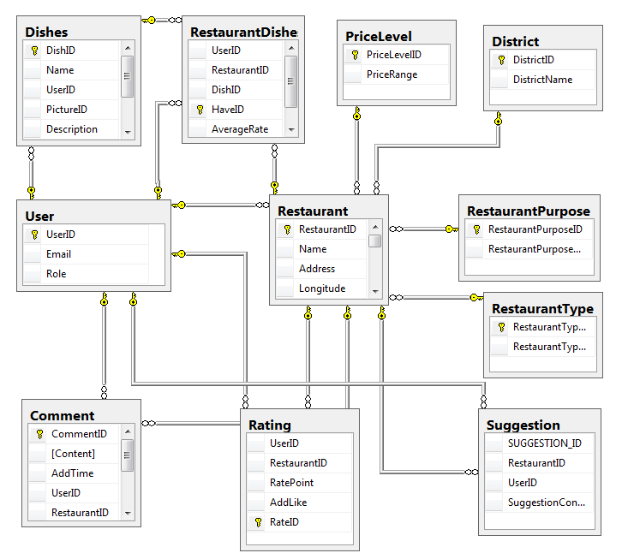
IV - Software Design Description (cont.)
DB Design
Notes:
Check lại cái mới nhất

Slide 23
VI - Test
Consists of 2 test levels:
Unit test: validate input
System test:
GUI
Function
Unit test
System test

Slide 24
VI – Test (cont.)
Features to be tested
Search restaurants
Normal search
Advanced search
Manage restaurants
Add restaurant
Edit restaurant‘s information
View basic information of restaurant
View detail information of restaurant
Delete restaurant
Compare restaurants
Manage users
Log in
Log out
Assign sponsor
Cancel sponsor
Block user
Unblock user
View users
View sponsors
View blacklist
View restaurants
View dishes
Rating
Like a Restaurant
Like a Dish
Rate for a restaurant
Manage comments
Send comment
Reply comment
Delete comment
Send suggestion
Send violence report
Manage dishes
Add dish
Edit dish‘s information
Delete dish
View dish

Slide 25
VI – Test (cont.)
Functional requirements
Results
Test Execution Summary
 | Pass | Fail | Untested | Accepted | N/A | Number of Test cases
GUI | 28 | 9 | 0 | 0 | 0 | 37
Validate | 32 | 32 | 0 | 0 | 0 | 64
Function | 110 | 110 | 0 | 0 | 0 | 220
Total | 170 | 151 | 0 | 0 | 0 | 321
Test coverage
Test coverage |  |  |  |  |  | 100%
Test successful coverage |  |  |  |  |  | 53%
Round 1
Test Execution Summary
 | Pass | Fail | Untested | Accepted | N/A | Number of Test cases
GUI | 36 | 1 | 0 | 0 | 0 | 37
Validate | 63 | 1 | 0 | 0 | 0 | 64
Function | 202 | 18 | 0 | 0 | 0 | 220
Total | 301 | 20 | 0 | 0 | 0 | 321
Test coverage
Test coverage |  |  |  |  |  | 100%
Test successful coverage |  |  |  |  |  | 94%
Round 2

Slide 26
VI – Test (cont.)
Functional requirements (cont.)
Results
Test Execution Summary
 | Pass | Fail | Untested | Accepted | N/A | Number of Test cases
GUI | 37 | 0 | 0 | 0 | 0 | 37
Validate | 64 | 0 | 0 | 0 | 0 | 64
Function | 220 | 0 | 0 | 0 | 0 | 220
Total | 321 | 0 | 0 | 0 | 0 | 321
Test coverage
Test coverage |  |  |  |  |  | 100%
Test successful coverage |  |  |  |  |  | 100%
Round 3

Slide 27
VII – Demo and Q&A
Notes:
Paste giao diện mới vào đây

