Slide 1
Fall Detecting Device
FDD Project

Slide 2
Project Team
Project Instructor
Phan Duy Hung (PhD)
Project Team
Nguyen Ngoc Hai: PM/Developer
Nguyen Khanh Linh: QA/Developer
Hoang Thi Kim Anh: Developer/Tester
Ma Chi Dinh: Developer/Tester
Le Nguyen Vinh Hien: Developer/Tester

Slide 3
Table of content
Introduction
Project Management
Requirement
Design and Implementation
Testing
Conclusion

Slide 4
Introduction
FDD Project

Slide 5
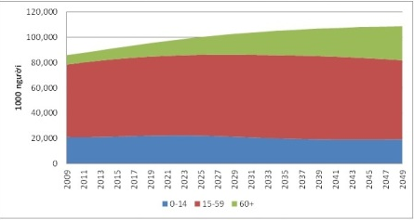
Context
A large increasing proportion of senior citizens
70% of the accidental deaths
Reducing overall casualty by real-time detection
http://thongke.info.vn/Desktop.aspx/Co-so-du-lieu-Xuat-ban-pham/Co-so-du-lieu-dia-ly-nhan-khau/Chi_so_co_cau_dan_so_phan_1/
www.fallcam.be

Slide 6
Current Available Solution
 | Wearable Device | Acoustic Based | Surveillance cameras
Weight on User | 100-200 g | None | None
Cost | Low | Medium- High | High
Location dependency | Everywhere | Fixed area | Fixed area
Power | Battery | Use AC Power | Use AC Power
Diansheng Chen, Wei Feng, Yu Zhang , Xiyu Li, and Tianmiao Wang, A Wearable Wireless Fall Detection System with Accelerators
Cambul, G. 2006 Automatic Fall Detection in Real Time Video Based Applications
Yun Li 2011 Acoustic Fall Detection Using a Circular Microphone Array

Slide 7
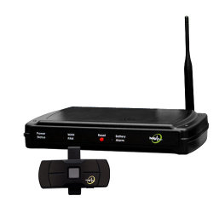
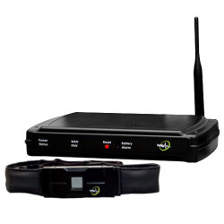
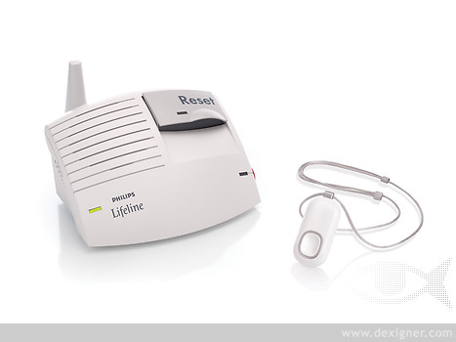
Existing Wearable Device
myHalo Complete
myHalo Clip
Philips Lifeline AutoAlert
http://www.reuters.com/article/2009/09/15/idUS171594+15-Sep-2009+BW20090915
http://www.aldea.com/Products/stay%20well/page14/page14.html
http://www.lifelinesys.com/content/lifeline-products/auto-alert

Slide 8
Wearable Devices Comparison
 | myHalo Clip | myHalo Complete | Philips Lifeline AutoAlert
Wear On | Belt | Chest | Pendant (Chest)
Monthly Charges | $49.00/Month | $59.00/Month | $54.00/Month
Installation Charges | Free Self Installation | Free Self Installation | Free Self Installation. $60.00 Shipping/Handling Charge $12.95 Enrollment Fee
Message and monitor | Via SMS, Web | Via SMS, Web | Warning by call center, monitor via Web
Additional Function | No | Monitor Health rate | No
http://www.reuters.com/article/2009/09/15/idUS171594+15-Sep-2009+BW20090915
http://www.aldea.com/Products/stay%20well/page14/page14.html
http://www.lifelinesys.com/content/lifeline-products/auto-alert

Slide 9
Project Objective
Current devices’ disadvantages:
Expensive
Not portable
Require monthly subscription
FDD will have these features:
Low cost
Portable device
Fast and accurate detection
Independent on location

Slide 10
Capstone Project Scope
Fall detecting solution measuring and evaluating
Prototype: Detecting fall and Sending a SMS message
Limited Testing environment

Slide 11
Project management plan
FDD Project

Slide 12
Development Model
Iterative and incremental development
Easy to break project into phases
Easy to change requirement/ design
Suitable for inexperience team
http://en.wikipedia.org/wiki/Iterative_and_incremental_development

Slide 13
Organization
Dr. HungPD (Instructor)
HaiNN (PM/Dev)
LinhNK (Dev/QA)
AnhHTK (Dev/Tester)
DinhMC (Dev/Tester)
HienLNV (Dev/Tester)

Slide 14
Project Phases
Core device
Design
Communication
Design
Fall detection
Design
Implementation
Testing
Implementation
Testing
Implementation
Testing

Slide 15
Other
Quality Control
Group review
Unit test
Acceptance Test
Communication
Daily meeting
Weekly Report
E-mail

Slide 16
Risk
PCB order can be late
Member can be unavailable at some time
Take time to learn soldering
Cost for equipment and electrical component is high for students

Slide 17
Requirement
FDD Project

Slide 18
Functional requirement
Detect falling events
Real time detection
Send SMS in at most 30 seconds after the fall
Set phone numbers via PC Application
Support up to 2 number
Battery life: at least 8 hours

Slide 19
Non-functional requirements
Small, light-weighted device
Low cost
Hard case
Firmly attached electronic components

Slide 20
Design
FDD Project

Slide 21
Case design

Slide 22
Case design

Slide 23
PC Application Interface
List of COM port
Connect/Disconnect button
Edit/Save button
2 phone numbers

Slide 24
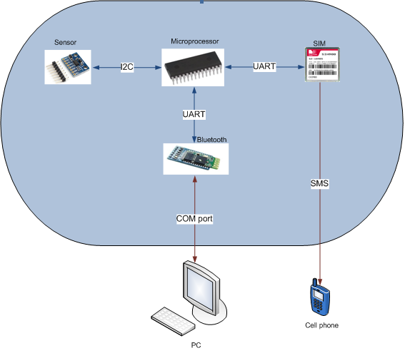
Proposed System Architecture

Slide 25
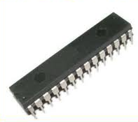
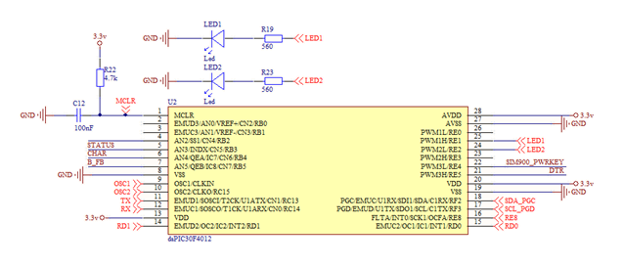
Circuit Design
dsPIC30f4012

Slide 26
Circuit Design
LM1117MP-3.3V

Slide 27
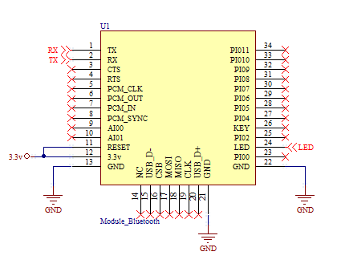
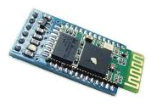
Circuit Design
Bluetooth HC-06

Slide 28
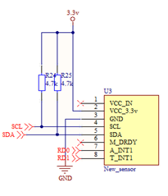
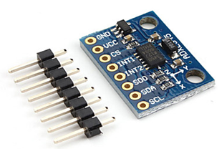
Circuit Design
Sensor interface: GY-291 ADXL345
Using acceleration range from -8g to +8g

Slide 29
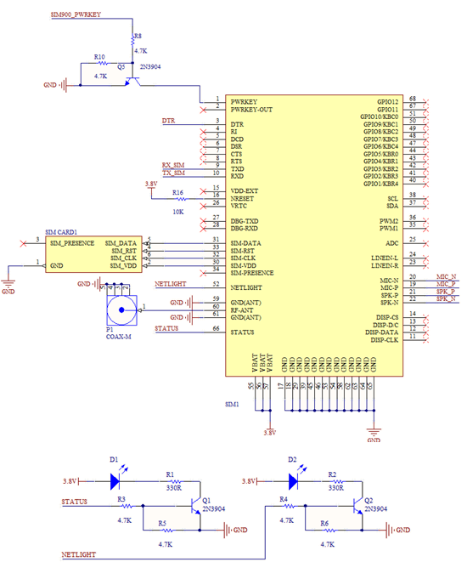
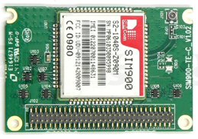
Circuit Design
SIM900 Module

Slide 30
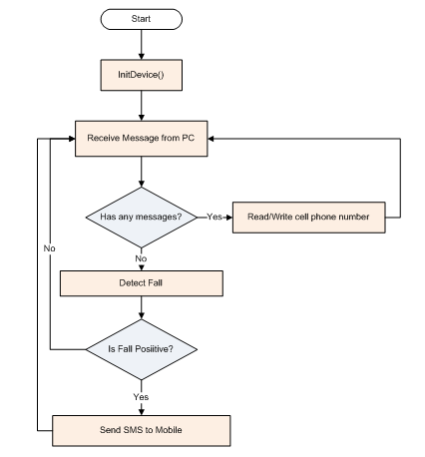
Firmware Design

Slide 31
Development environment

Slide 32
Algorithms
FDD Project

Slide 33
Existing Algorithms
Fall Detecting Existing methods:
Using Tri-axis Accelerometer
Using Tri-axis Accelerometer and Gyrometer
Hidden Markov Model (HMM) and Support Vector Machine (SVM) to detect Fall Vectors

Slide 34
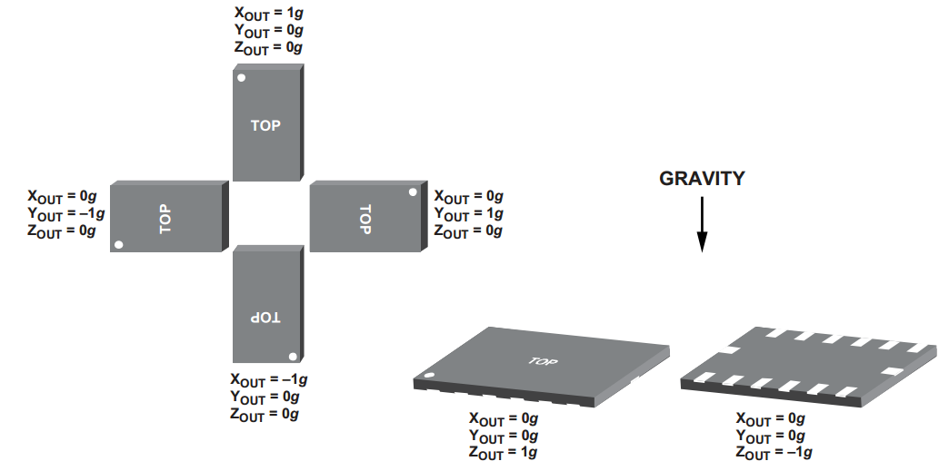
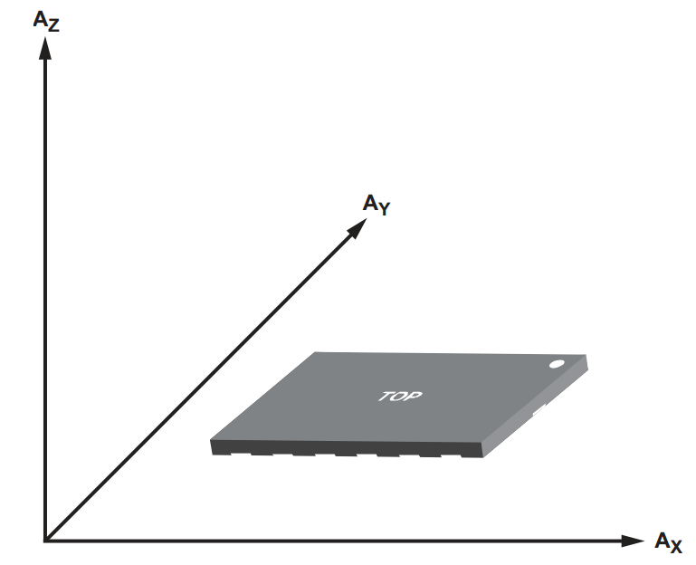
Using Tri-axis accelerometer
Resolution: ± 8g (g=9.8 m/s²)

Slide 35
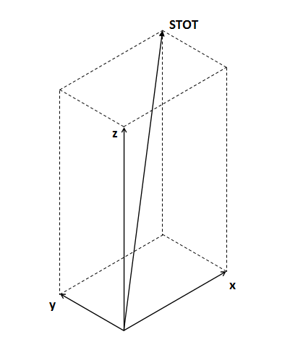
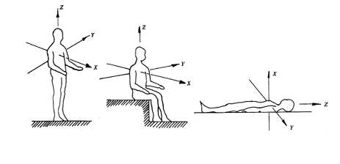
Using tri-axis accelerometer
The Total Sum of Acceleration Vector (STOT)
Z-axis Value: Vertical acceleration (Az)

Slide 36
Falling events

Slide 37
STOT in falling and ADL events

Slide 38
Using tri-axis accelerometer
Only 1 sensor
Threshold is easily defined
Can be done real-time without the help of a PC
Accuracy: >90%

Slide 39
Using both Accelerometer & Gyrometer
Gyrometer: calculate Angle velocity of three axis.
Total Sum of Angle Velocity (wTOT)
Still use STOT: Total sum of Acceleration

Slide 40
wTOT in Falling and ADL Events

Slide 41
Using both Accelerometer & Gyrometer
Can be done real-time without PC
Higher cost (2 sensors)
Threshold hard to define
Accuracy: <90%

Slide 42
Using machine learning
Training:
- Record falling event & ADL events
- Vectorize the data
- Divide data into 2 classes: fall-positive & fall-negative
- Train data to machine

Slide 43
Using machine learning
Recognizing:
- Each set of data will be vectorized
- Compare the data with data in the two classes, calculate matching rate
- Decide which class has higher matching rate
- Train the data set to machine

Slide 44
Using machine learning
Requires large data sample, thus more storage space and longer processing time
Cannot cover all real life cases
Accuracy depends on the size and accuracy of the data sample.
Hard to implement on microprocessor

Slide 45
Choose method: Using one accelerometer

Slide 46
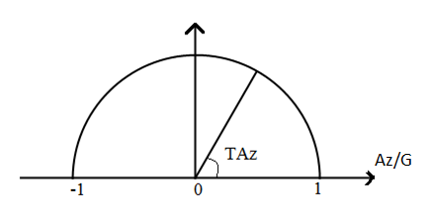
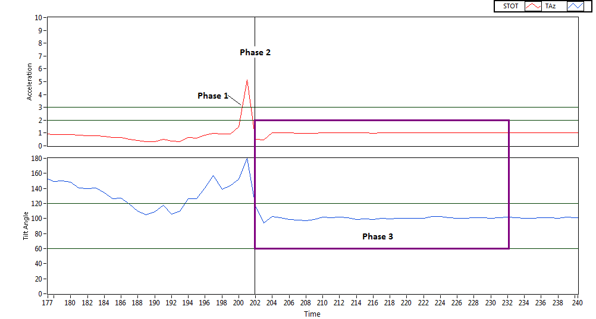
Implementation
Use TAz instead of Az

Slide 48
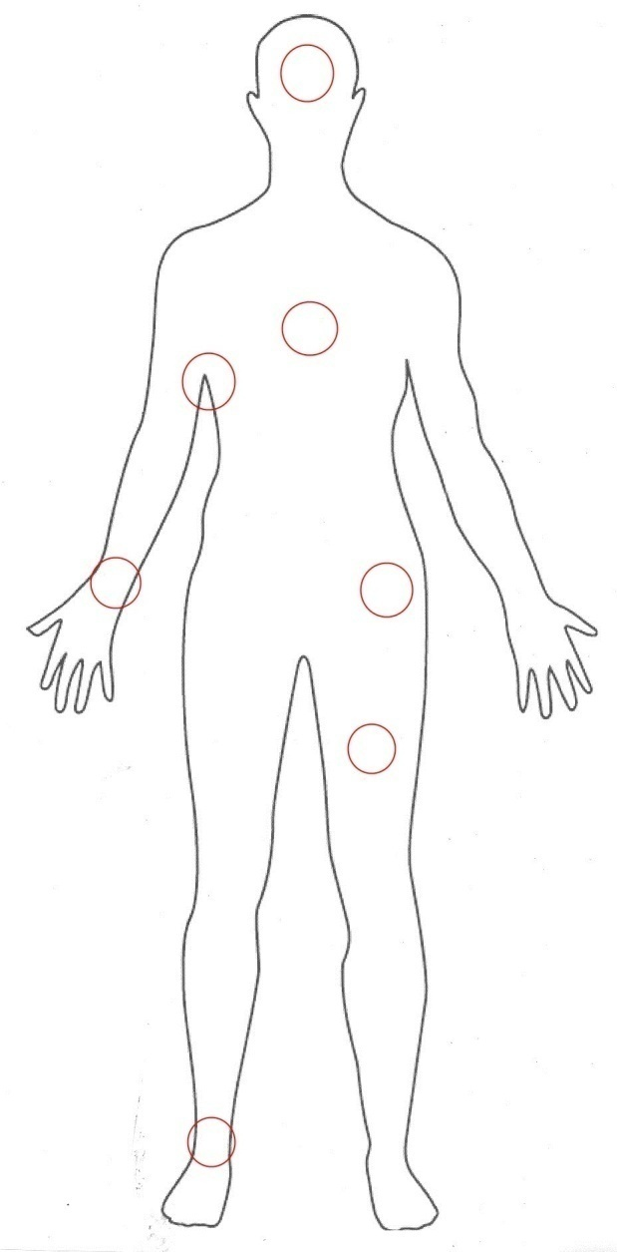
Investigate position of device
Head
Chest
Under-arm
Wrist
Waist
Thigh
Ankle

Slide 49
Investigate position of device
The higher the position, the higher the fall impact values
The nearer the position to gravity center, the more accurate
Limbs have lots of noise
Usability: waist > arm > chest > head > thigh > ankle

Slide 50
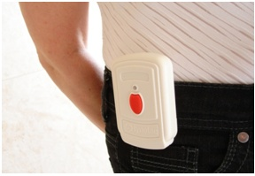
Investigate position of device
Device position is chosen based on criteria:
Distance to the body’s centre of gravity
Exception of movements of the arms and legs
Comfort
Chosen: Waist
Gsm-uk.co.uk

Slide 51
Testing
FDD Project

Slide 52
Testing
Goal: guarantee all the features of Fall Detection Device are working properly and minimize the defects when used
Document included:
+ Test scope
+ Test plan
+ Test case
+Test report

Slide 53
Test Scope
Device:
+ Detect fall algorithm
+ Send message to mobile
+ Communication with PC
+ Save mobile phone’s number
PC app:
+ Installation
+ Communication with device
+ Load existed mobile phone’s number
+ Edit mobile phone’s number
+ Send mobile phone’s number

Slide 54
Testing Tool & Environment

Slide 55
Test Strategy
Focus on Acceptance test and Algorithm test
Hardware Unit test:
+ After assemble hardware components
+ Use Voltmeter to check connections
Software Unit test:
+ Check I/O of each function
+ Performed by developer

Slide 56
Test method
5 Subjects, age 21-24
Device worn on belt
Laboratory environment using mattress
Fall started at the same level as the surface of the mattress
Fast and slow repetitions for each ADL case
80 falls & 90 ADL movements

Slide 57
LabView
Highly productive graphical programming environment
Data acquisition, block diagram
http://en.wikipedia.org/wiki/LabVIEW

Slide 58
Sample Signal - Jumping
Meet STOT threshold many times
Do not detect lying phase

Slide 59
Sample Signal – Lying down
STOT never meets the threshold

Slide 60
Sample Signal - Fall
Meet STOT threshold 2 times
Satisfied lying phase condition on the second time

Slide 61
Test report - Falls
No. | Test Case Description | Test times | Passing percentage
TC_01 | Fall Backward | 10 | 100%
TC_02 | Fall Backward and stand up | 10 | 90%
TC_03 | Fall Forward | 10 | 100%
TC_04 | Fall Forward and stand up | 10 | 90%
TC_05 | Fall to Left | 10 | 100%
TC_06 | Fall to Left and stand up | 10 | 90%
TC_07 | Fall to Right | 10 | 90%
TC_08 | Fall to Right and stand up | 10 | 90%

Slide 62
Test Report - ADL
No. | Test Case Description | Test times | Passing percentage
TC_09 | Sit down | 10 | 100%
TC_10 | Stand up | 10 | 100%
TC_11 | Run | 10 | 100%
TC_12 | Walk on flat surface | 10 | 100%
TC_13 | Lay down on bed | 10 | 100%
TC_14 | Get up from bed | 10 | 100%
TC_15 | Jump | 10 | 100%
TC_16 | Go down stair | 10 | 100%
TC_17 | Go up stair | 10 | 100%

Slide 63
Summary and conclusion
FDD Project

Slide 64
Risk and Limitation
Power button.
Battery indicator
Fail SMS
Limited testing environment lead to limited accuracy

Slide 65
Solution and Future Development
A power button to turn off the device when not in used.
A speaker to warn user when battery is low and also goes off when fall is detected.
A button to send SMS to relatives manually in case of other dangers.
Improve algorithm to reduce chance of undetected falls

Slide 66
Conclusion
The prototype meets the functional requirement.
Detection algorithm is evidentially effective.
Device is quite small and light, though many non-functional requirement is not satisfied
The prototype can be developed more to become real-life product.

Slide 67
Thank you for listening
FDD Project

