Slide 1

Capstone Project
Final Presentation
HUMAN RESOURCE ENTRY
Hanoi, April 27th, 2013
Tsunami team

Slide 2
CONTENTS
Introduction
Software Project Management Plan
Software Requirement Specifications
Software Design Description
Software Testing
Summary
Demonstration
Q & A

Slide 3
INTRODUCTION TO HRM PROBLEM
A FACTOR of
VITAL IMPORTANCE
Could not be acquired & managed easily!
Human Resources
Infrastructure
Technology
Advances
Capital
Borrow & Use
Purchase & Manage
Learn & Apply

Slide 4
INTRODUCTION TO HRM PROBLEM
Human Resource Management
Traditional
Complex
Not complete
Various
Ubiquitous
……

Slide 5
INTRODUCTION TO THE CONTEXT
Telsoft is a medium-size (100-500) software company located in Hanoi, Vietnam.
The company now is looking for an digital solution to manage human resources effectively.
The new human resource management system must be:
  Purchasable
  Advanced feature supported
  Customizable (to fit the needs of the company)

Slide 6
EXISTING SOLUTIONS
In-house Development
Tinhvan Corporation
FPT Software Co. Ltd.
Domestic Solutions
Perfect HRM
Paradise
Foreign Solutions
ERP Solutions (SAP, Oracle)
Open Source Solutions
MISA HRM

Slide 7
DOMESTIC SOLUTIONS
Advantages:
    Inexpensive (affordable for Vietnamese enterprises)
Drawbacks:
    Support fundamentals features only (PIM, Time, Performance).
    Not very trustworthy.
    Sometimes platform-dependent (Windows applications can only run on Windows OS for instance)

Slide 8
ERP SOLUTIONS FROM WORLD-WIDE PROVIDERS
Advantages
    Supports functionalities fully.
    Trustworthy (the quality is guaranteed).
    Flexible configurations.
    Good customer supports.
Drawbacks
    Very expensive.
    Time, effort consuming on deployment.
    Too many features such that enterprises must purchase for all while using some only.

Slide 9
IN-HOUSE DEVELOPMENT SOLUTIONS
Advantages
    Meet exactly business requirements.
    Information security guaranteed.
Drawbacks
    Risks of failure in development.
    Expensive but quality is not guaranteed.
    Time & effort consuming.

Slide 10
HUMAN RESOURCE ENTRY
An HRM System
A Web Application
Mobile Version Supported
HUMAN RESOURCE
ENTRY
Inexpensive
Advanced Features Supported
Platform-independent
Customizable
(Purchase on Needs)
Good customer supports
Trustworthy

Slide 11
WHAT IS NEW?
Rapid Vacancy Fulfiller
Useful Dashboards
Easy Surveys

Slide 12
WHAT TO DEVELOP
Administrator
PIM (Personal Information Manager)
Leave
Recruitment
Performance
Dashboards
Survey
Helps
Time

Slide 13
WHAT TO DEVELOP
Human Resource Entry
Web-Access
(Chrome, Firefox, IE, Opera)
Native-App-Like Web Application on Mobiles

Slide 14
SOFTWARE PROJECT MANAGEMENT PLAN
Development Environment
Hardware Requirement
External Environments
Software Requirement
Operation Systems & Frameworks
Database Tools
Development Tools
Document Tools
Communications Tools

Slide 15
HARDWARE REQUIREMENTS
Development Machine
CPU Frequency: 2.0 GHz or more required
Random Access Memory (RAM): 1 GB or more required.
Deployment Machine – Web Server
CPU Frequency: 2.0 GHz or more required
Random Access Memory: 2 GB or more required.
Deployment Machine – Database Server
CPU Frequency: 2.0 GHz or more required.
Random Access Memory: 4 GB or more required.

Slide 16
SOFTWARE REQUIREMENT – DEVELOPMENT ENVIRONMENT
No. | Item | Value
1 | Operating Systems | Ubuntu 10.04, Windows 7 Professional
2 | Development Kit | Java Development Kit (JDK) 1.6
3 | Web Server | Apache Tomcat 6.0.29
4 | Database Management System (DBMS) | MySQL 5.0
5 | Development Frameworks | Jakarta Struts 1.3, Hibernate 3.0.2, Spring 3.0.2, ExtJS 3.4, Sencha Touch 2

Slide 17
SOFTWARE REQUIREMENT – DEPLOYMENT ENVIRONMENT
No. | Item | Value
1 | Operating Systems | CentOS 6.1
2 | Runtime Environment | Java Runtime Environment (JRE) 1.6
3 | Web Server | Apache Tomcat 6.0.29
4 | Database Management System (DBMS) | MySQL 5.0

Slide 18















TOOLS

Slide 19








TECHNOLOGIES

Slide 20
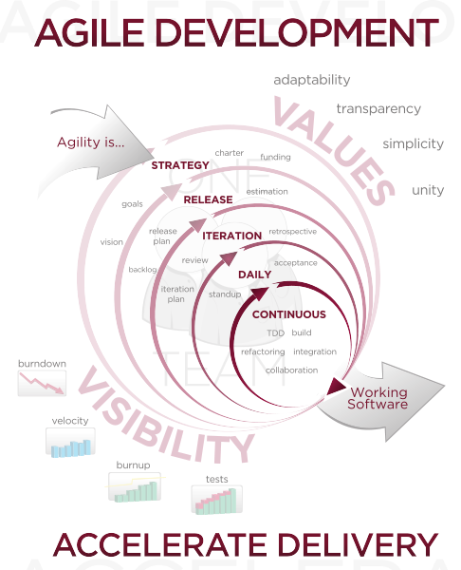
SOFTWARE PROCESS MODEL
SCRUM model (Agile Methodology):
Appropriate for small and medium-size projects
Low risk even in the case the project team members are not so experienced
Costs less than other models
High-quality products by valued-oriented activities
Adapts better with changes

Slide 21
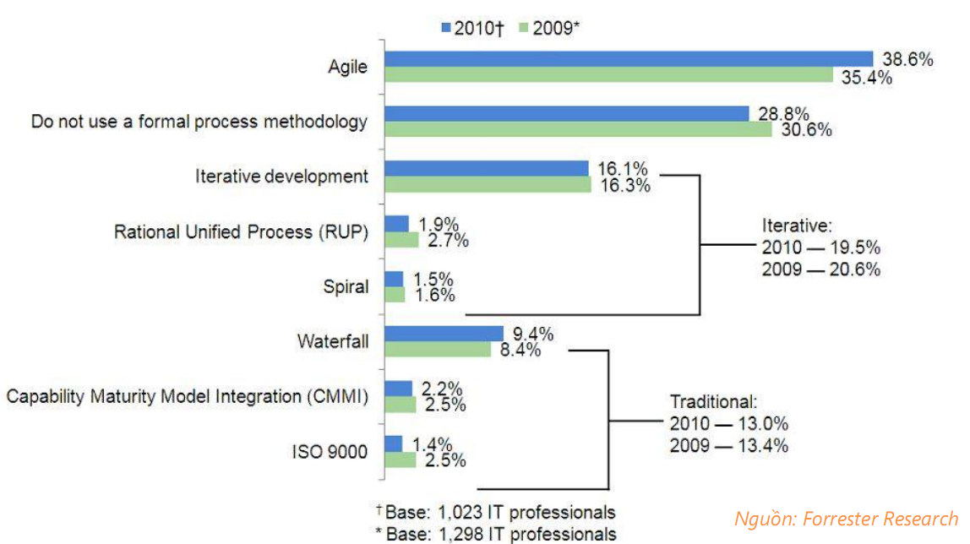
SOFTWARE PROCESS MODEL

Slide 22
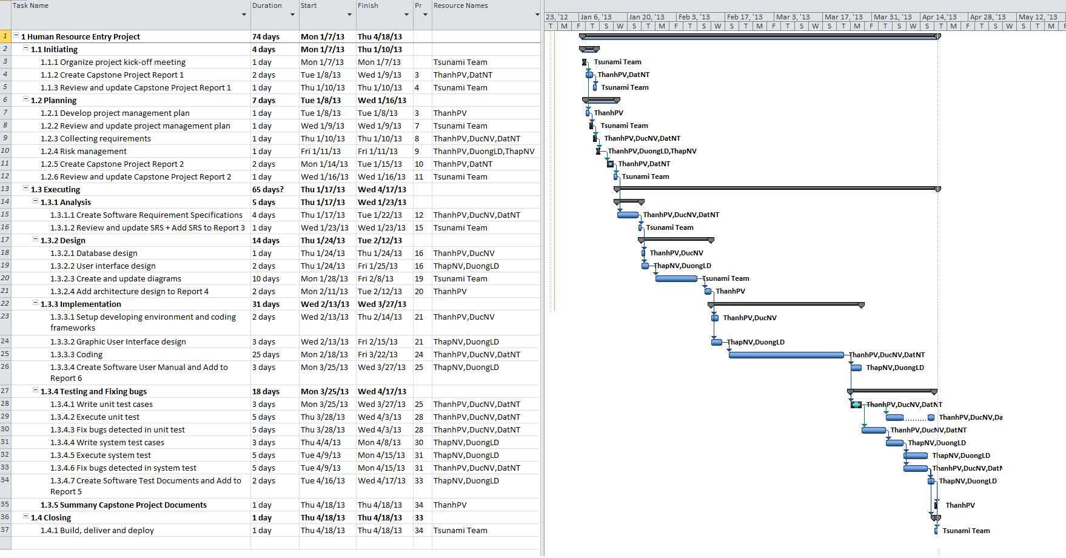
DETAILED PLAN

Slide 23

TEAMWORK MANAGEMENT
Work 8 hours/day and 5 days/week
Locations: School, Home
Communication: Internet (Skype, Yahoo, Email), phones
Meetings: Daily meetings (daily scrum), Sprint summary meetings, Sprint improvement meetings

Slide 24
RISK MANAGEMENT
No. | Risk Description | Risk type | Risk Strategy | Resolution
1 | Member’ weakness | People | - Build a reasonable working schedule, avoid overloading | - PTL and PM monitor other members’ tasks and always ready to do these tasks if necessary. - Using buffer time (Saturday and Sunday) to recover works
2 | Conflict between members | People | - Engage teamwork. - Team-building | - Hold meeting to find root causes and help team members resolve conflicts - Create team’s policies: rewards and punishments
3 | Computer crash | Hardware | - Commit code to server regularly | - Use another computer, get latest code from server before working
4 | Source server on update, error, not accessible | Software | - Choose a stable source server - Backup source code everyday | - Temporarily code offline if possible or waiting until server gets available.

Slide 25
SUCCESS CRITERIA
No | Item | Success Criteria
1 | Time | - Be able to catch up with deadline of milestones - All high-priority functions defined in the requirement specification must be finished at the end of project
2 | Product | - All functions in project scope meet qualification requirements.
3 | Study | - Studied and applied successfully project management, technical knowledge into capstone project. - Perceive processes, working methodology in a project and to implement a project in a professional manner.

Slide 26
SOFTWARE REQUIREMENT SPECIFICATIONS
Functional Requirements
Non-functional Requirements

Slide 27
FUNCTIONAL REQUIREMENTS
ADMIN
Manage general information of organization
Manage location information of organization
Manage organization structure
Manage job titles, job categories, pay grades, employment status
Manage skills, education levels, licenses, languages, majors
Manage nationalities
Manage users
Manage compensation quota
Manage payroll
Manage role groups
Manage configurations
Manage termination reasons, reporting methods

Slide 28
FUNCTIONAL REQUIREMENTS
PERSONAL INFORMATION MANAGER (PIM)
Manage personal information (Name, ID Card, gender, marital status, nationality, date of birth…)
Manage contact details (Addresses, zip/postal code, province/city, district, phone numbers, email addresses…)
Manage login detail
Manage emergency contacts
Manage dependents
Manage jobs

Slide 29
FUNCTIONAL REQUIREMENTS
PERSONAL INFORMATION MANAGER (PIM)
Manage jobs (job title, employment status, joined date, sub unit, location, start date, end date, terminated or not, contract file)
Manage salary (salary component, amount…)
Manage compensation (KPI, amount of compensation…)
Manage supervisors (name, reporting method)
Manage subordinates (name, reporting method)

Slide 30
FUNCTIONAL REQUIREMENTS
PERSONAL INFORMATION MANAGER (PIM)
Manage work experience
Manage education
Manage skills
Manage languages
Manage licenses
Manage curriculum vitae file

Slide 31
FUNCTIONAL REQUIREMENTS
LEAVE
Manage leave requests
Allow leave approvals
Allow summarize leaves
Allow leave information adjustment
Manage quota of paid leaves

Slide 32
FUNCTIONAL REQUIREMENTS
RECRUITMENT - CANDIDATES
Manage personal information (name, email, contact number, image, CV file, ID card, gender, marital status, address, district, province/city, nationality, date of birth)
Manage education
Manage skills
Manage languages
Manage licenses
Manage work experience

Slide 33
FUNCTIONAL REQUIREMENTS
RECRUITMENT – VACANCIES
Manage basic information of vacancies (job title, hiring manager, description, no. of positions, status…)
Manage advanced options of vacancies used to filter candidate
Filter candidates to show the most appropriate candidates for a specific vacancy.

Slide 34
FUNCTIONAL REQUIREMENTS
RECRUITMENT – INTERVIEWS
Manage basic information of interviews (vacancy, candidate, time, status, result, interviewers, attachment file)
Allow employing a candidate (move a candidate to be an employee)

Slide 35
FUNCTIONAL REQUIREMENTS
DASHBOARDS
View human resource status of the company
View the statistics of leaves by department, by period or by leave type…
View the progress of recruitment (how many vacancies is now active, how many have been fulfilled…)

Slide 36
FUNCTIONAL REQUIREMENTS
SURVEYS
Allows creating dynamic survey with unlimited number of questions
Allows manage information of surveys including start date, end date, departments whose employees will be asked to take the surveys
Allows people to take surveys
Allows the creators to view the summary of all the answers
Allows mail notifications for all people whose are asked to take surveys.

Slide 37
FUNCTIONAL REQUIREMENTS
HELPS
Introduces to the project in About section
Provides the instructions of usage to users to help them work better with the system.

Slide 38
NON-FUNCTIONAL REQUIREMENTS
RELIABILITY
Rate of fault occurrence: 0.005 or less is acceptable
Accuracy: precision of floating number should be rounded to 0.01
Maximum bugs & defect rate: 5 bugs/KLOC

Slide 39
NON-FUNCTIONAL REQUIREMENTS
AVAILABILITY
Mean time to update new version (re-deploy): 4 hours
Mean time to recover after failure: 1 day

Slide 40
NON-FUNCTIONAL REQUIREMENTS
SECURITY
Privacy: User information must NOT be available for any party that is not a part of the system. Users’ passwords are invisible to HR employees and/or administrators.
Security attacks must be prevented: SQL injections…
Password protection: Secure mechanism is available to recover password when users loss, lock account when violating rules…

Slide 41
NON-FUNCTIONAL REQUIREMENTS
MAINTAINABILITY
Coding convention: Outputs of project must conform all the conventions defined in the SPMP
Design: Loose coupling & high coercion
Logging: All errors, exceptions must be logged when occurred. Sensitive situations should also be logged.

Slide 42
NON-FUNCTIONAL REQUIREMENTS
PORTABILITY
Platform-independent: The system is platform-independent such that it could be deployed on any OS (Linux, Windows, Solaris…)
Device-independent: The system could be access from PC, laptop, mobile devices running on different platform (iOS, Android, Blackberry…)

Slide 43
NON-FUNCTIONAL REQUIREMENTS
PERFORMANCE
Loading time: Mean time to load a page is 1.5 seconds and the maximum time is 5 seconds.
Search result: Search results must be available within 3 seconds after users’ clicks.
Data cache: Frequently accessed data must be cached
Thread pool: Thread pool mechanism guarantees the limitation of number of threads.
Notifications: Notifications appear immediately to user after a subscribing event occurred
System load: System must be able to perform operations by 50 users at the same time.
Compatibility: The system should provide elegant displays for common screen resolutions: 1024*768, 1280*800, 1366*768

Slide 44
SOFTWARE DESIGN DESCRIPTION
Overall System Architecture
Component Diagram
Architecture Design
Class Diagram
Sequence Diagram
Database Design

Slide 45
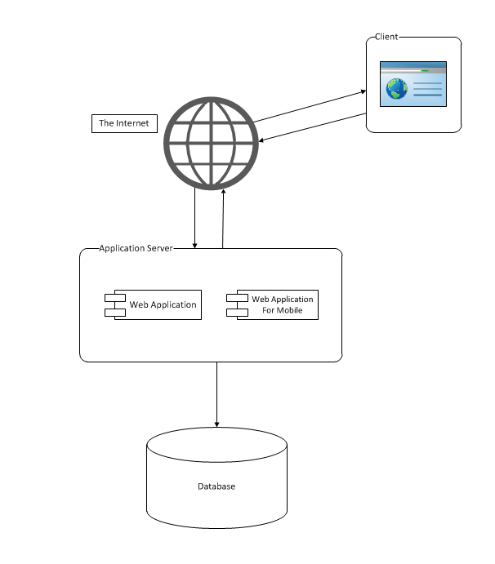
OVERALL SYSTEM ARCHITECTURE

Slide 46
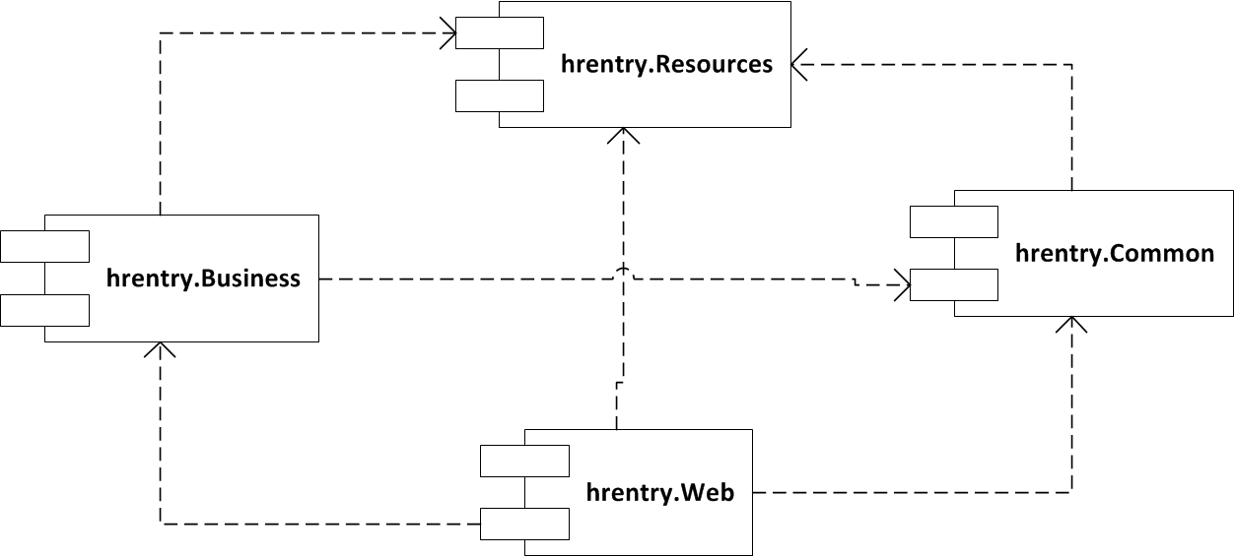
COMPONENT DIAGRAM

Slide 47
COMPONENT DIAGRAM
Common
  Helpers
  Cryptography
  Logging
  Caching
Business
  Services
  Entities

Slide 48
COMPONENT DIAGRAM
Resources
  Application resources
Web
  Model
  View
  Controller

Slide 49
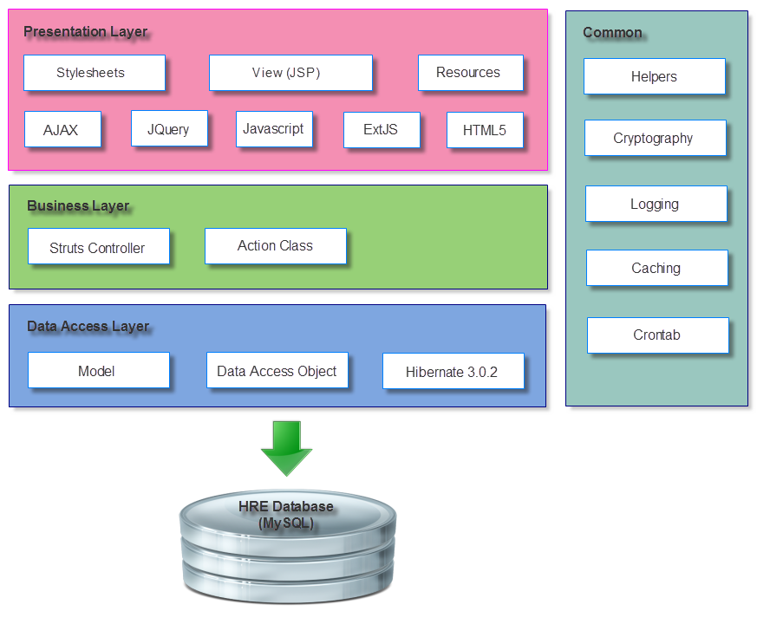
ARCHITECTURE DESIGN

Slide 50
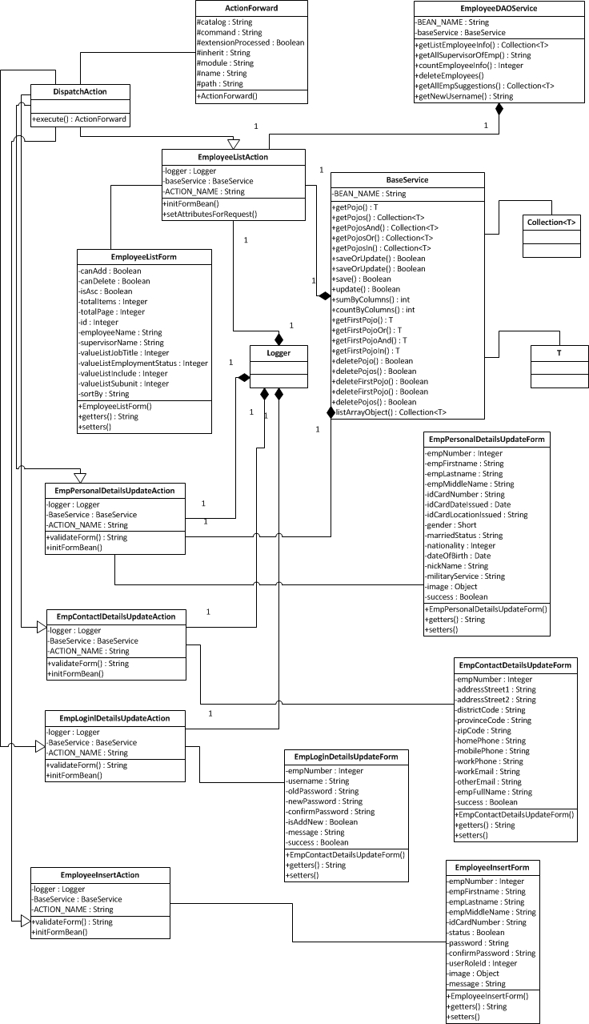
CLASS DIAGRAM
Employee
  Action Forwards
  Action Errors
  Dispatch Action
  Base Service
  Employee List Action
  Employee List Form
  Employee Insert Action
  Employee Insert Form
  Personal Detail Update Action
  Personal Detail Update Form
  Contact Detail Update Action
  Contact Detail Update Form
  Login Detail Update Action
  Login Detail Update Form

Slide 51
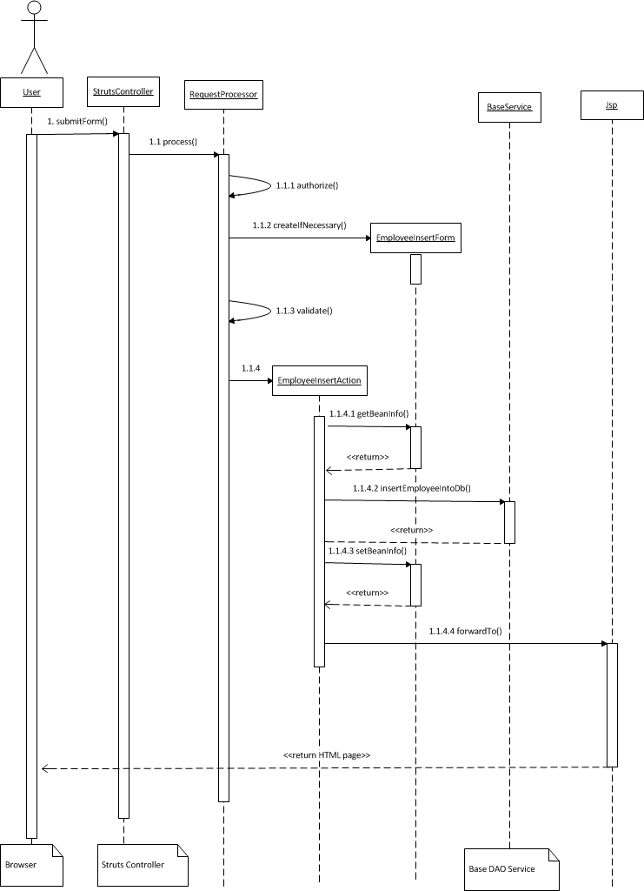
SEQUENCE DIAGRAM
Add Employee
  User
  Struts Controller
  Request Processor
  Base Service
  JSP Processor

Slide 52
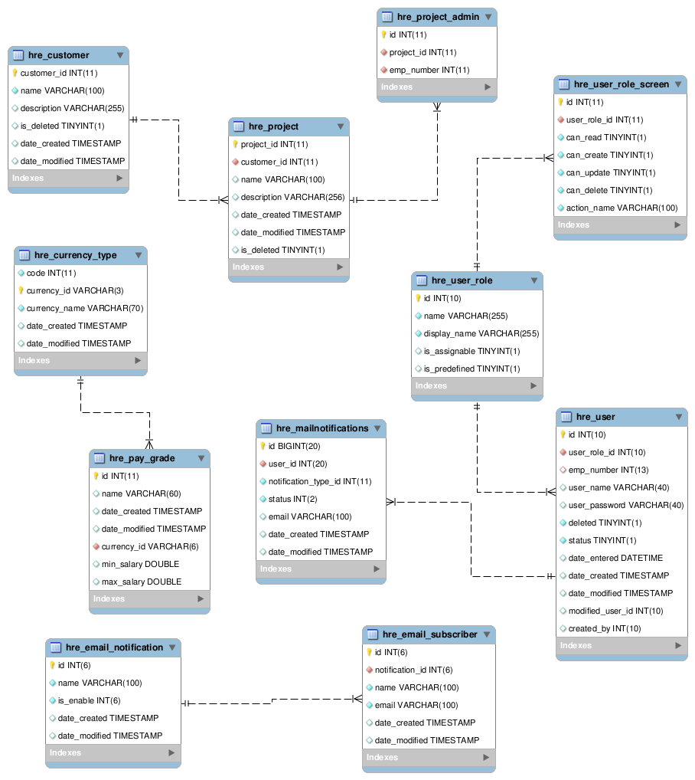
DATABASE DESIGN

Slide 53
SOFTWARE TESTING
Testing Process
Test Cases
Issue Tracking
Test Procedure
Test Results

Slide 54
TESTING PROCESS
REQUIREMENT
ANALYSIS
TEST PLAN
TEST EXECUTION
TEST REPORT
BUG FIXING
Test Closure

Slide 55
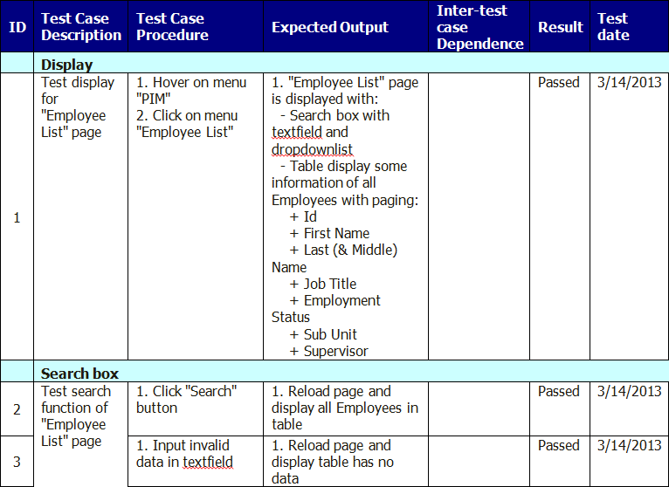
TEST CASES

Slide 56
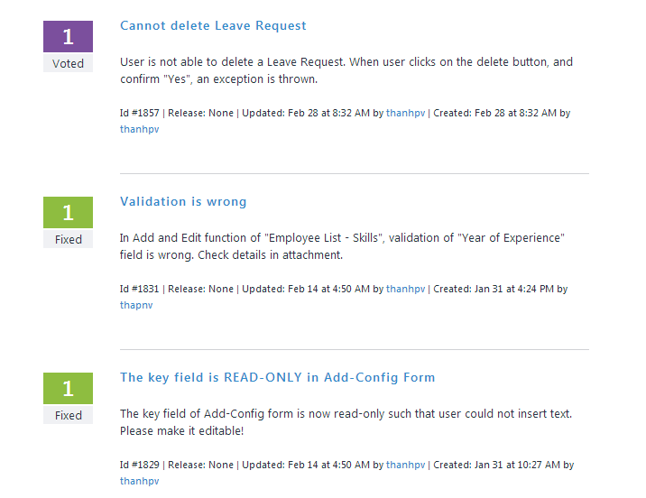
ISSUE TRACKER

Slide 57
TEST RESULTS
No. | Module | Passed | Failed | Untested | No. of Test Cases
1 | Admin | 361 | 0 | 0 | 361
2 | PIM | 349 | 0 | 0 | 349
3 | Leave | 36 | 0 | 0 | 36
4 | Recruitment | 244 | 0 | 0 | 244
5 | Dashboards | 31 | 0 | 0 | 31
6 | Survey | 42 | 0 | 0 | 42
7 | Helps | 2 | 0 | 0 | 2
 | Total | 1065 | 0 | 0 | 1065

Slide 58
LESSON LEARNED & FUTURE DEVELOPMENT
Lesson Learned
What expected to develop
What have developed
Project Statistics

Slide 59



LESSON LEARNED
Project Management Skills
Plan Creating
Activity Organization
Time management, Resource management
Working In Groups
Communication Skills
Conflict Resolutions
Technologies:
Java (Struts, Hibernate, Spring…)
Ajax, CSS, HTML, JS, JQuery
MySQL, Ubuntu

Slide 60
EXPECTED TO DEVELOP
Administrator
PIM (Personal Information Manager)
Leave
Recruitment
Performance
Dashboards
Survey
Helps
Time

Slide 61
WHAT HAVE DEVELOPED
Administrator
PIM (Personal Information Manager)
Leave
Recruitment
Performance
Dashboards
Survey
Helps
Time

Slide 62
PROJECT STATISTICS
Expected duration: 100 days (7/1/13 to 17/4/13)
Actual duration: 90 days (7/1/13 to 7/4/13)
Expected modules: 5
Developed modules: 7
Total lines of code (Java & JSP): 55,511 lines (8,198 lines auto-generated)
Total issues raised: 30 (voted, fixed and closed)
Defect rate: 0.54 bug/KLOC (maximum 5 bug/KLOC allowed)

Slide 63
WHAT TO DEVELOP
Human Resource Entry
Web-Access
(Chrome, Firefox, IE, Opera)
Native-App-Like Web Application on Mobiles

Slide 64
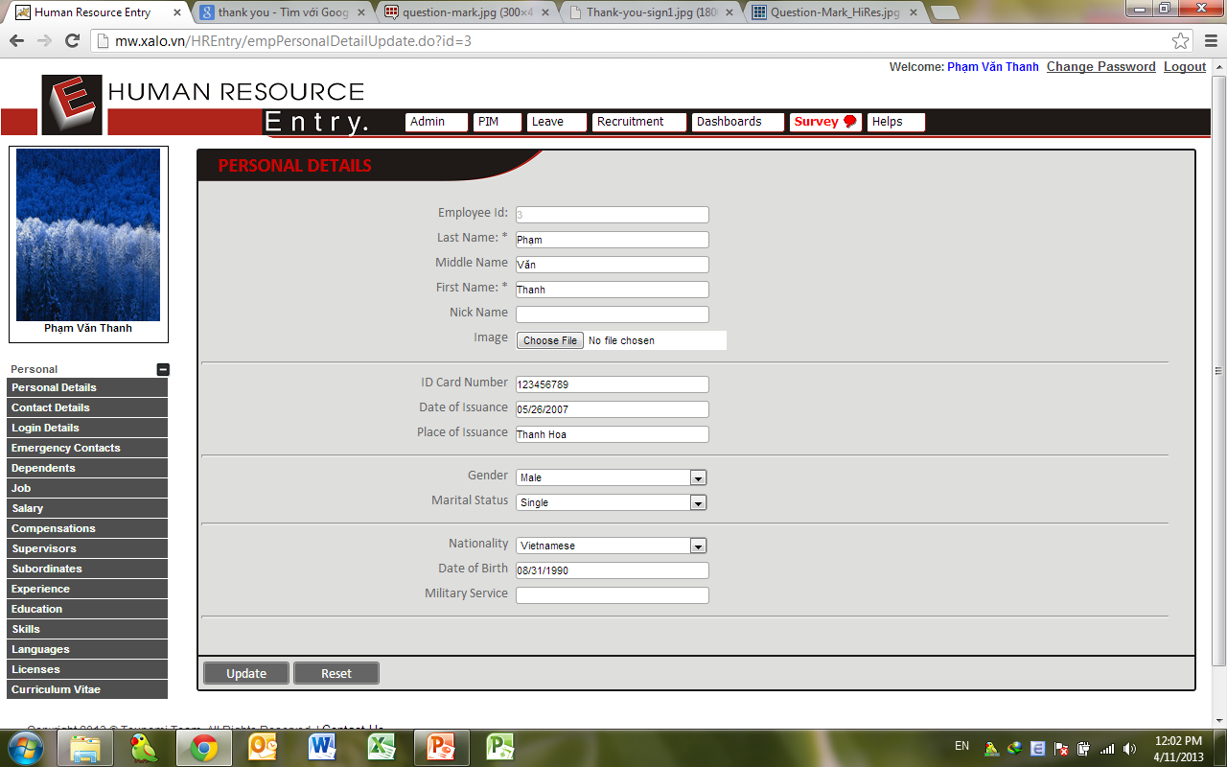
DEMONSTRATION

Slide 65

Q & A

Slide 66

THE END

