Slide 1

Human resource system of IRS
SieuTa FPT
Notes:
Giới thiệu (5p – Béo)
Giới thiệu nhóm + các thành viên
Giới thiệu đồ án

Slide 2


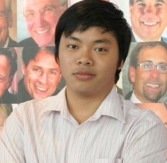



M
Nguyễn Ngọc Khanh
Designer
Phạm Thái Hoàng
BA
Trần Minh Thắng
Tester
Nguyễn Văn Chiến
PTL
Trần Quang Thịnh
PM
Vũ Quốc Minh
Core Developer

Slide 3
Contents
1
Introduction
2
Recruitment – actual situation & solution
3
Technical solution
3.1
Software Process Model
3.2
ERD & Database
4
Demo
3.3
System Architecture Design
5
Q&A
3.4
Components
3.5
Page flow
3.6
Testing
Notes:
Giới thiệu nội dung trình bày
ERP và HRM (5p – Hoàng)
Recruitment (15p – Hoàng) [hết phần này là mất 25p]
Technical Solution (40p)
Software Process Model (5p – Ki)
ERD (5p – Bông)
System Architecture design (5p - Khanh)
Components (5p - Minh)
Database (5p - Bông)
Page flow (5p – Ki)
Testing (5p – Béo) [hết phần này mất 65p, còn 25p]
Demo (15p – Khanh, Ki, Minh)
Q&A (10p – Béo vs các đồng đội) [vừa đẹp :D]

Slide 4
What is HIRS?
Human Resource
International Royal Securities
Notes:
Giới thiệu HR
Giới thiệu IRS: Công ty chứng khoán hoàng gia
Cty trẻ - đội ngũ trẻ
Vì mới nên chưa có hệ thống quản lý tốt

Slide 5








Human Resource
Performance
Recruitment
Training
Insurance
Orientation
Salary
Labor relation
Notes:
- HR là phòng ban chăm lo tất cả các công việc có liên quan đến nguồn lực, nhân sự trong 1 cty hay 1 tổ chức

Slide 6

Human Resource Management
HRM is really important
Notes:
Nếu coi Tổ chức là 1 thực thể thì mỗi nhân viên là 1 tế bào của thực thể đó. Muốn thực thể khỏe mạnh thì mỗi tế bào trong nó cũng phải khỏe mạnh.
=> Việc quan tâm đến nhân viên, tổ chức quản lý nhân lực là yếu tố quan trọng trong chiến lược phát triển của tổ chức.

Slide 7
Business Process View
Notes:
Mô hình kinh doanh. Phải trải qua các bước
Plan Attract onboard – lên kế hoạch tuyển dụng, thu hút ứng viên, phỏng vấn và quyết định
Assess design develop – theo dõi performance, đánh giá năng lực thái độ, đào tạo nâng cao
Optimize track monitor – sắp xếp vị trí để tận dụng hết khả năng và năng suất làm việc
Plan incent reward – lương, khen thưởng và đề bạt, chế độ đãi ngộ và nghỉ hưu

Slide 8


IRS
International Royal Security
A young company: security service provider
Top 20 of HOSE
Top 10 of HNX
Average age of company is young Dynamic and full of zeal

Slide 9



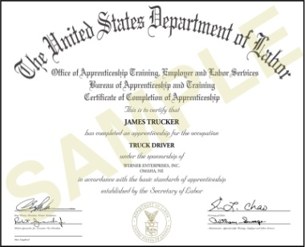




What is a Profile?
Experience
Skills
People
& Roles
Licenses & Certificates
Attributes
Memberships
Knowledge
Other
Company-defined Content
Notes:
Để quản lý tốt vòng đời nhân viên từ tuyển dụng đến lúc nghỉ hưu, cần nắm bắt được mọi thông tin liên quan đến nhân viên đó.
Mỗi tổ chức khác nhau có cách quản lý thông tin khác nhau. Tuy nhiên có 1 số thông tin cơ bản cần quản lý

Slide 10
The Talent Life Cycle
Planning
Measure
and Report
Recruiting
Analyze
Plan
Plan
Talent Profiles
Lead
Compensation
Evaluate
Performance
Evaluate candidates against established Job Profile requirements
Leverage candidate info to create initial profile
Initial gap analysis to identify specific new hire learning requirements
Advance
Develop
Learning
Succession Planning
Career
Development
Notes:
In recruiting, you can use job or role profiles to ensure you have standard criteria against which to measure your candidates. Imagine being able to simply pull profile content directly into a job opening, then make that available to candidates so they all understand the expectations. Throughout the recruiting process, you gather information about an applicant’s skills, background and experience, so that by the time you hire them, you have a pretty good understanding of their capabilities. With profile manager, you can leverage that information to create an initial employee profile, then, rather than simply send all your new hires through a standard “one size fits all” orientation program, you could perform a gap analysis to target specific learning requirements for each person.

Slide 11

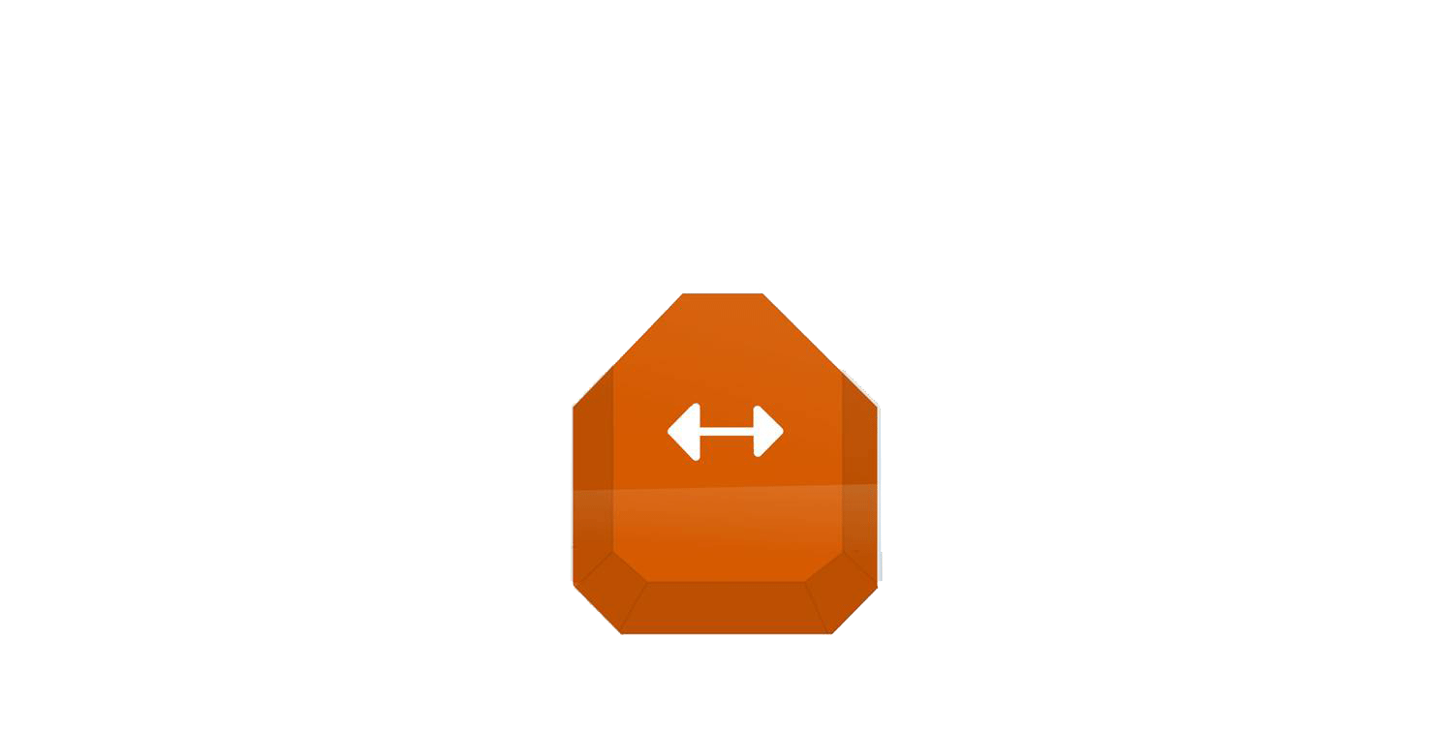





Recruitment
Profile Management
Talent Plan
Requirement
Development
Gap Analysis
Job Profile
Person Profile
Organizational Strategy
Notes:
Tuyển dụng là tìm kiếm các ứng viên phù hợp với yêu cầu công việc => việc matching là rất quan trọng

Slide 12
Recruitment Process
Creating new Recruitment Proposal
Planning
Attracting candidates
Application screening
Interviewing
Offer
Recruitment decision
Recruitment
Notes:
Các bước cơ bản trong quy trình tuyển dụng
Sẽ chi tiết về role ở phần sau
Application screening is the initial process a recruiter goes through once receiving an employment application. During the initial screening, the recruiter checks for completeness of the application, along with a comparison against the job requirements.
Once the application is screened, and it is determined that the application meets the initial requirements, the recruiter can move the candidate forward to the next step of the hiring process. If an application is not deemed a proper fit to continue, the company will disqualify the candidate.

Slide 13
Advantage of HIRS
Actual situation | After deploying HIRS
1. Allow only hard-copy submitting | 1. Allow Online and hard-copy submitting
2. Application screening by worker | 2. Automatic application screening
3. Applicant’s profile cannot be up-to-date | 3. Applicant’s profile can be up-to-date
4. Inefficient profile management | 4. Efficient profile management
5. Difficult for reporting | 5. Easy for reporting

Slide 14
Technic
1
Software Process Model
2
ERD & Database
3
System Architecture Design
4
Components
5
Page flow
6
Testing
Notes:
Software Process Model - Kiki
Spiral Model
ERD - Bông
Describe relationships between objects
System Architecture design - Khanh
MVC
Components - Minh
Describe components and relationships
Database - Bông
Adventure Works
Page flow - Kiki
Each page is collaborative with
Test plan + Defect log - Béo

Slide 15
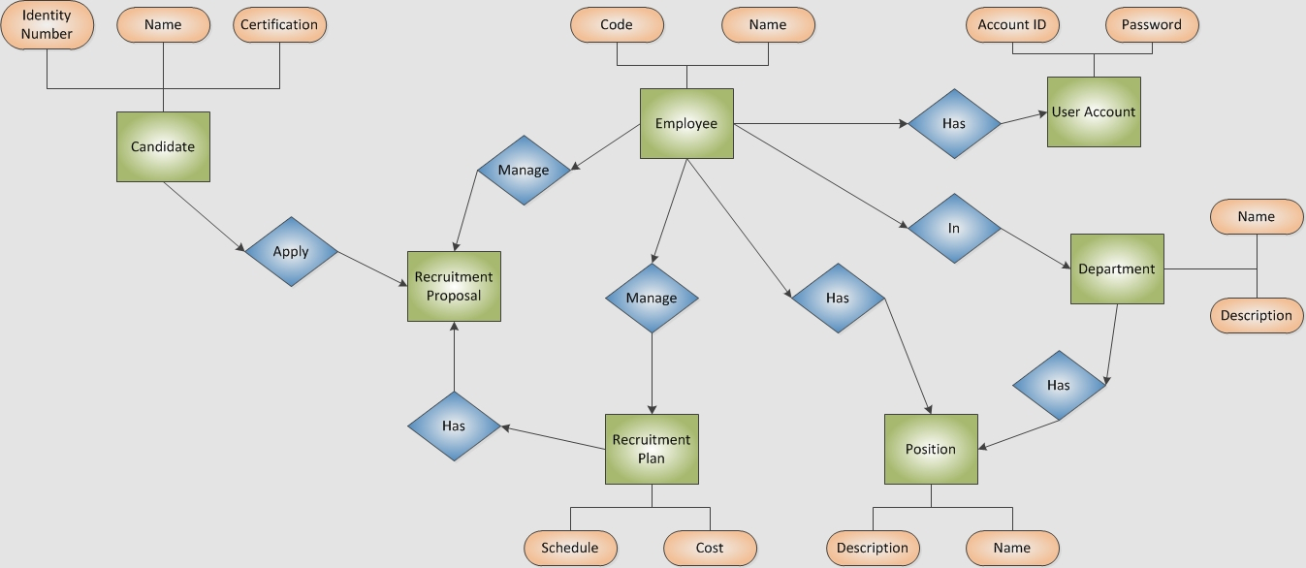
ERD & Database
Notes:
Describe relationships between objects

Slide 16
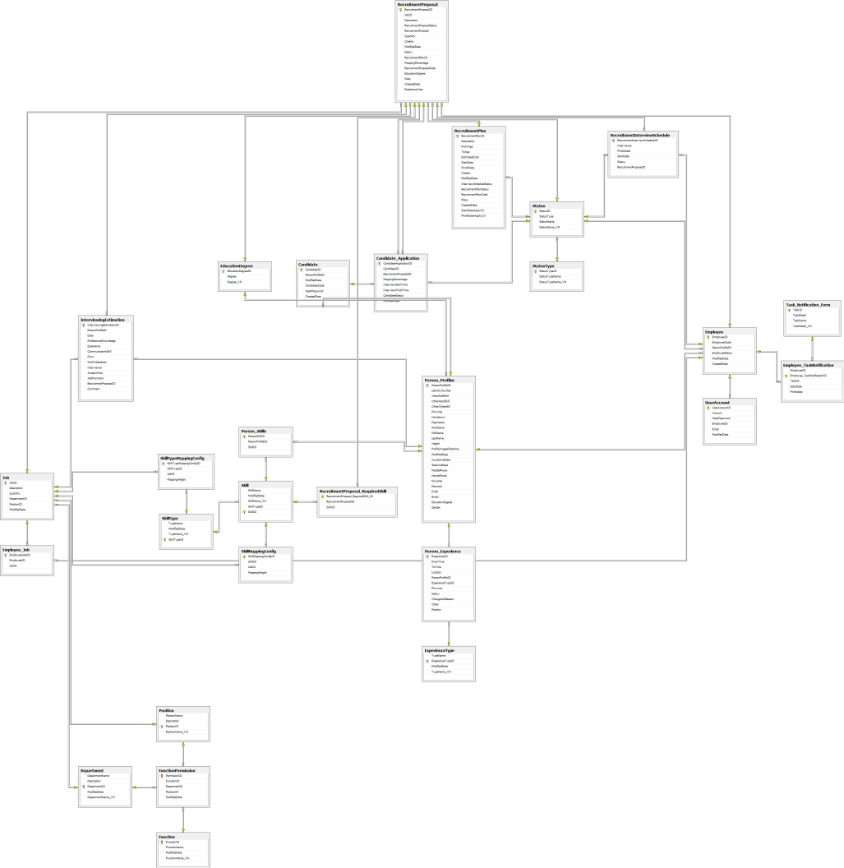
ERD & Database
Notes:
Describe relationships between objects

Slide 17
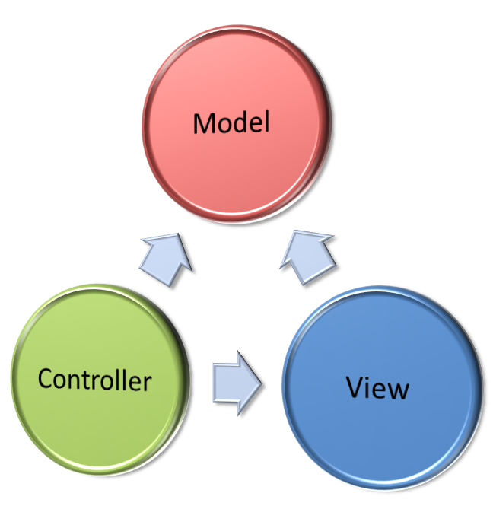
System Architecture Design
Notes:
Advantages of MVC
1. There's no duplicated code.
2. The business logic is encapsulated; hence the controller code is transparent and safer.
3. The business logic can be used in several front ends like Web pages, Web services, Windows applications, services, etc.
4. Exception handling is well managed showing the user only digested error messages.
5. Testing every part of an application is easier as it can be done separately using automated methods.
6. Application changes are easier to apply as they are focused in one part of the architecture only.

Slide 18
Component
Notes:
Describe relationships between objects

Slide 19
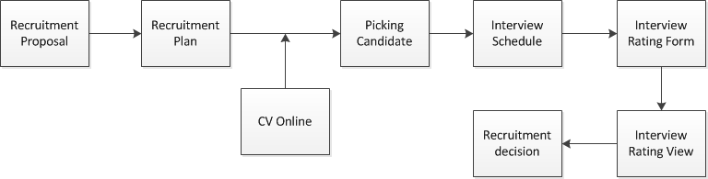
Screen Flow
Notes:
Each page is collaborative with

Slide 20
ID | Test Case Description | Test Case Procedure | Expected Output | Result
GUI 1 | Display field’s name label | Look at label name in the screen | Each field has its label name | Pass
GUI 2 |  |  | End with “:” | Pass
GUI 3 | Alignment | Look at the screen | Field’s name label has alignment with others? | Pass
GUI 4 | Label display | Look at label on every page | The first character is capital | Pass
GUI 5 |  |  | The title: All characters are capital | Pass
GUI 6 |  |  | Section name is bold | Pass
GUI 7 | Dropdownlist’s option view | Click on dropdownlist | All options are display fully | Pass
GUI 8 | Dropdownlist pre-selected | Look at dropdownlist on the screen | Each dropdownlist has its own default selected attribute | Pass
GUI 9 | Combo box’s option view | Look at combo box on the screen | All options are display fully | Pass
GUI 10 | Combo box pre-selected | Look at dropdownlist on the screen | No box is pre-selected | Pass
Testing
 | TEST REPORT
 | Project Name | Human Resource for IRS |  | Creator |  |  | Trần Minh Thắng
 | Project Code | HIRS |  | Reviewer/Approver
 | Document Code | HIRS_Test Report_vx.x |  | Issue Date |  |  | <Date when this test report is created>
 | Notes | <List modules included in this release> ex: Release 1 includes 2 modules: Module1 and Module2
 | No | Module code | Pass | Fail | Untested | N/A | Number of test cases
 | 1 | Recruitment Proposal | 23 | 0 | 0 | 0 | 23
 | 2 | RecruitmentProposalList | 11 | 1 | 0 | 0 | 12
 | 3 | Recruitment Proposal View | 24 | 0 | 0 | 0 | 24
 | 4 | Recruitment Plan | 28 | 0 | 0 | 0 | 28
 | 5 | CV Online | 34 | 1 | 0 | 0 | 35
 | 6 | Picking Candidate | 15 | 0 | 0 | 0 | 15
 | 7 | Interview Schedule | 15 | 2 | 0 | 0 | 17
 | 8 | Candidates List | 17 | 0 | 0 | 0 | 17
 | 9 | Profile List | 16 | 1 | 0 | 0 | 17
 | 10 | RatingForm | 12 | 0 | 0 | 0 | 12
 | 11 | Rating View | 21 | 0 | 0 | 0 | 21
 | 12 | Rating Summary | 9 | 0 | 0 | 0 | 9
 |  | Sub total | 225 | 5 | 0 | 0 | 230
 |  | Test coverage |  | 100.00 | %
 |  | Test successful coverage |  | 97.83 | %
  Test Strategy
    User Interface Testing:
    Ensure that it meets its written specifications
    Friendly and easy to use for user
    Function Testing
    Functional testing is a type of black box testing that bases its test cases on the specifications of the software component under test

Slide 21
 | INTEGRATION TEST REPORT
 | Project Name | Human Resource for IRS |  | Creator |  |  | Phạm Thái Hoàng
 | Project Code | HIRS |  | Reviewer/Approver
 | Document Code | HIRS_Test Report_vx.x |  | Issue Date |  |  | <Date when this test report is created>
 | Notes | <List modules included in this release> ex: Release 1 includes 2 modules: Module1 and Module2
 | No | Module code | Pass | Fail | Untested | N/A | Number of test cases
 | 1 | Recruitment Proposal | 33 | 0 | 0 | 0 | 33
 | 2 | Recruitment Plan | 41 | 0 | 0 | 0 | 41
 | 3 | CVOnline | 33 | 4 | 0 | 0 | 37
 | 4 | Candidate | 11 | 1 | 0 | 0 | 12
 | 4 | Interview | 17 | 0 | 0 | 0 | 17
 |  | Sub total | 118 | 5 | 0 | 0 | 123
 |  | Test coverage |  | 100.00 | %
 |  | Test successful coverage |  | 95.93 | %
Testing
    Integration Testing
    Integration testing is to verify functional, performance, and reliability requirements placed on major design items
    System Testing:
    The System tests will focus on the behavior of the HIRS system. Test Case will be executed against the system as well as screen mapping and error message testing
    User Acceptance Test
to confirm that the system is developed according to the specified user requirements and is ready for operational use

Slide 22
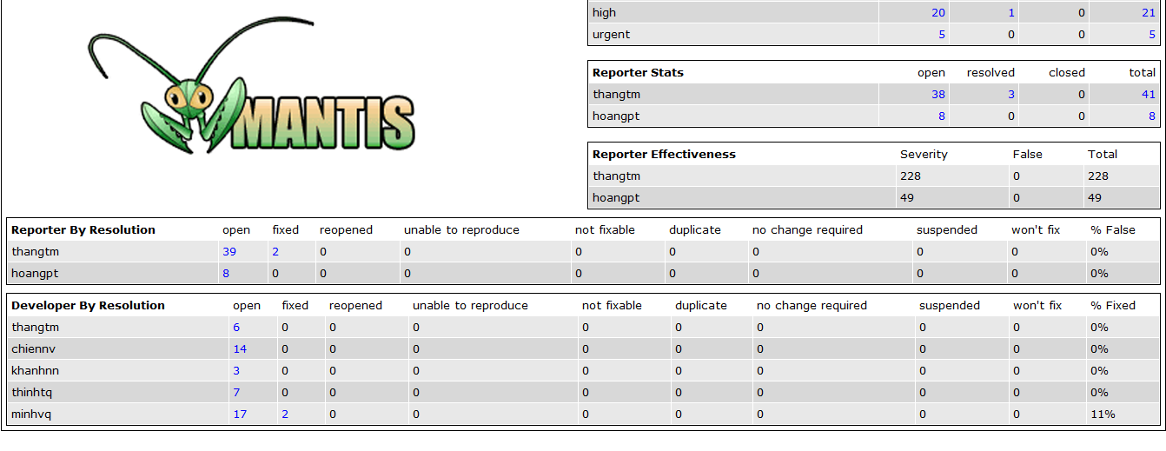
Testing

Slide 23
Notes:
Phần này thêm, chưa biết có cần ko. Nói về thiếu sót so với dự định ban đầu.
Show luôn hướng phát triển, thể hiện tầm nhìn
History comment - ở CV profile UV, sau phỏng vấn sẽ có comment… Việc này giúp DN và UV gần nhau hơn, UV biết được điểm thiếu sót của mình nếu trượt phỏng vấn, UV có thể update hồ sơ để cho lần apply sau. Cũng từ đó, DN

Slide 24

Demo

Slide 25
Q&A

