Slide 1
Software for parking management using rfid technology and camera
Supervisor:
Phan Duy Hùng
Group Member:
Trần Văn Phát 00503
Phạm Quang Hào 01221
Nguyễn Hồng Đức 01296
Nguyễn Bảo Trung 00512

Slide 2
Contents
Introduction
Project management
Requirement
Software design
Algorithm explanation
Implementation
Test & Results
Demo & QA

Slide 3
I. Introduction
Idea.
Existing product.
Scope.

Slide 4
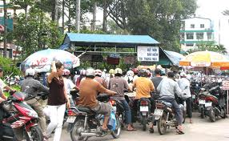
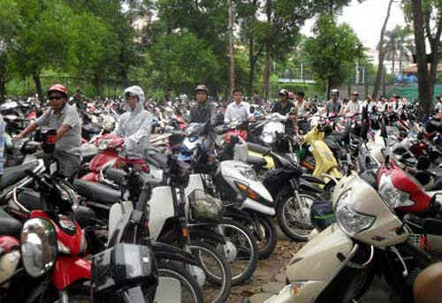
Idea
High traffic density, vehicle management also becomes more difficult
The regular inconvenience caused by the parking.
IT application in management.

Slide 5
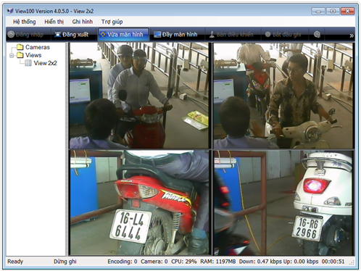
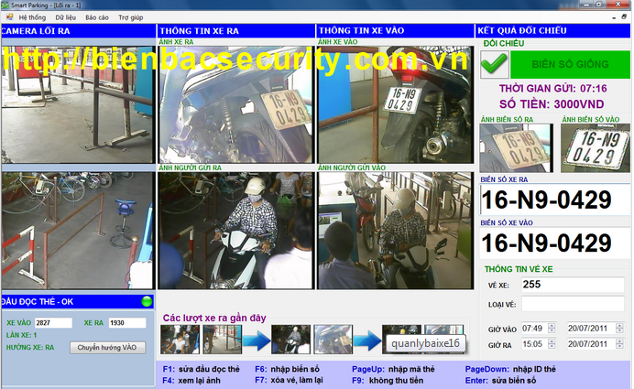
Existing product (1)
Being designed flexibly, easily to match with different structures.
System of reporting is diversified, variable to the demand.
System of hardware is numerous, gives customers the plural choices and the convenience.
Being designed based on the characteristics of space, size, level of investment.
http://www.bienbacsecurity.com.vn/

Slide 6
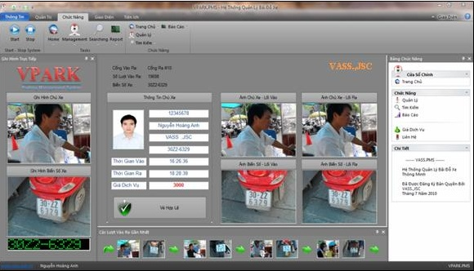
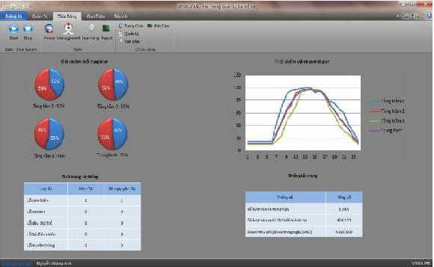
Existing product (2)
Being designed flexibly, easily to match with different structures
The software is mixed with the system of auto instruction for motorbike in parking.
Giving the professional reports.
Remote managing via Internet.
Warning the errors by SMS.
http://www.vpark.vn/home/

Slide 7
Scope
This system will support the following features :
  Monitoring and Manage the in/out motorbike (using ID Card and image of number plate).
  Giving the list of current parking motorbike and the available places.
  Managing the staffs by the time in work.

Slide 8
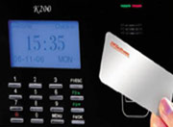

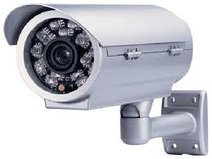
  These are its components:
  1 camera
  1 computer
  1 card reader

Slide 9
II. Project management
Process
Organization
Planning

Slide 10
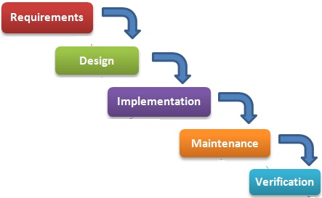
Process
Follow Waterfall model
  Make clear ideas
  Easy to manage working as phases

Slide 11
Project planning
Phases and Deadline:
  Requirement Specification : 28/1/2013
  Detail Design : 15/2/2013
  Coding:20/3/2013
  QA&Test : 4/4/2013
  Prepare to presentation: 17/4/2013

Slide 12
Organization
Roles and Responsibilities
  Trần Văn Phát
    Role : Project Manager and developer
  Nguyễn Bảo Trung
    Role: Developer
  Nguyễn Hồng Đức
    Role: Developer and tester
  Phạm Quang Hào
    Role: QA & Tester

Slide 13
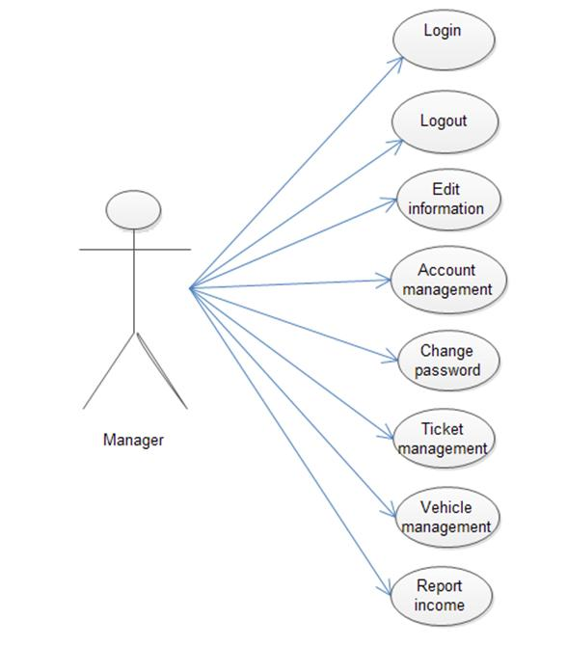
III. Requirement
Functional Requirement
Use case 1

Slide 14
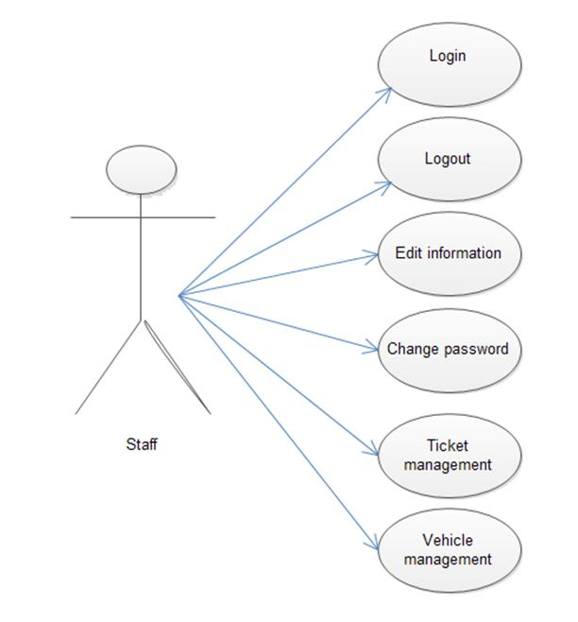
Use case 2

Slide 15
Non function requirement
GUI is friendly.
Security in using.
Fast process.
Correct.

Slide 16
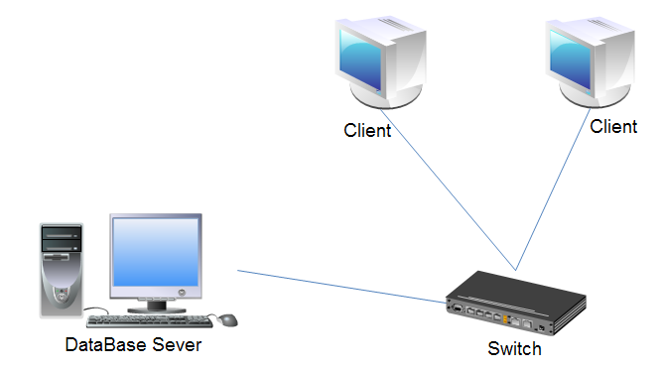
IV. System Design
System architecture

Slide 17
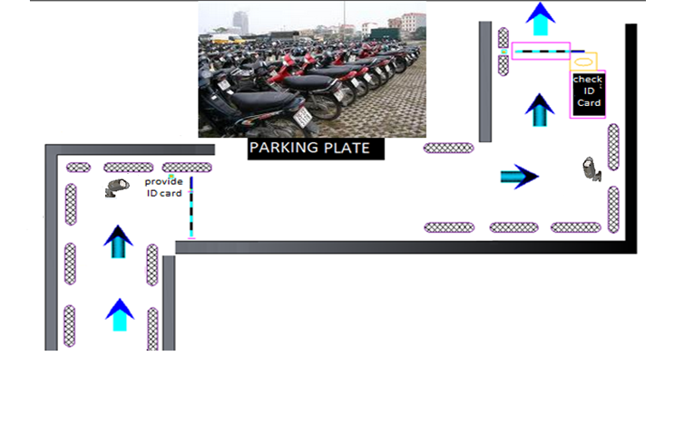
System deployment structure

Slide 18
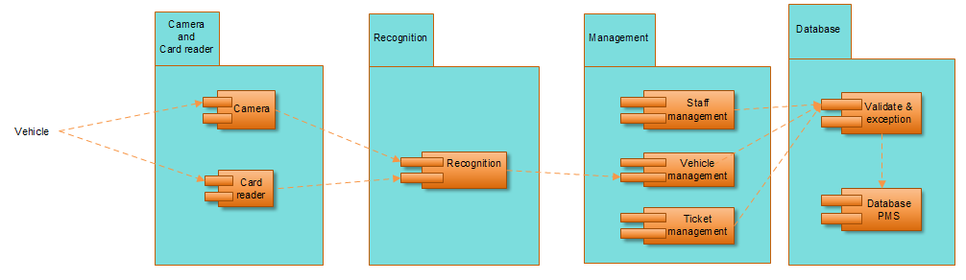
System component:

Slide 19
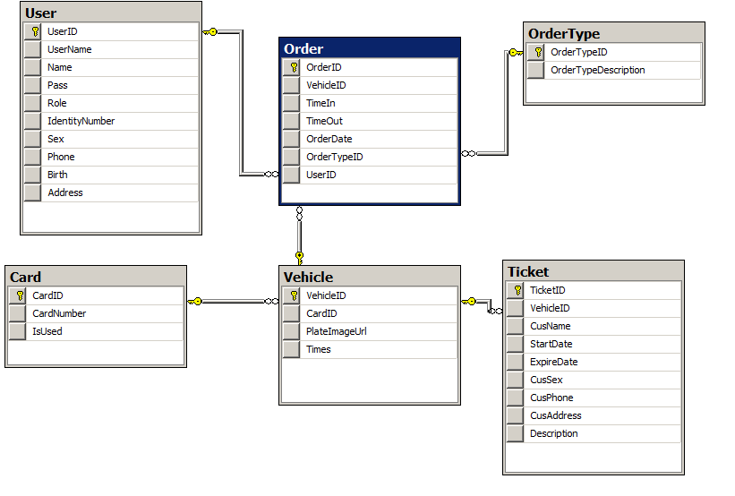
Class diagram

Slide 20
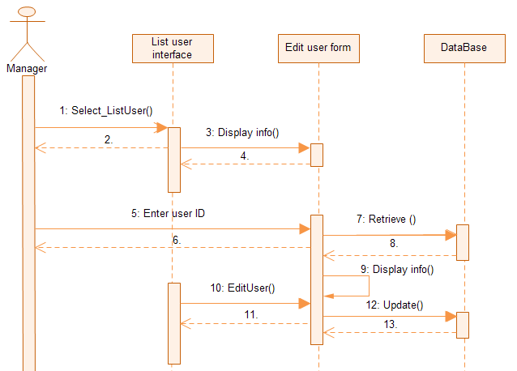
Sequence edit user

Slide 21
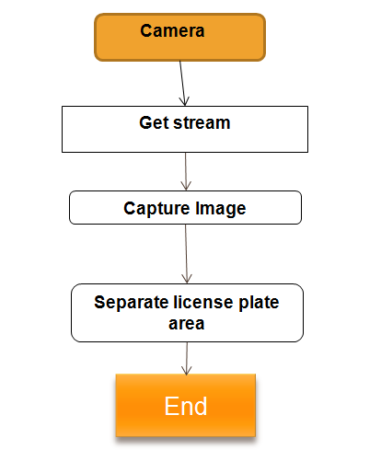
V. Algorithm explanation
License plate recognition

Slide 22
License plate description
A rectangle with two lines of words
Characters : 0-9 ; A-Z ; “-” , “.”
Size: 50cm x 40cm
White background & black characters.

Slide 23
Algorithm
(Fast Fourier Transform)
Input= Image catured from camera.
Output= separated image.
Function fft ( image)
{
i=0; flag=0;
for (i=0; i<image.Height;i++)
{
If (P>= threshold)
If (flag=1) height=height+1;
else
{ top=i; flag=1; }
else if (height>=h) bottom=i;
}
i=0; flag=0;
for (i=0; i<image.Width;i++)
{
If (P>= threshold)
If (flag=1)width=width+1;
else
{ left=i; flag=1; }
else if (width>=w) right=i;
}
License Plate Image= new Image with top , bot , left , right values
}

Slide 24
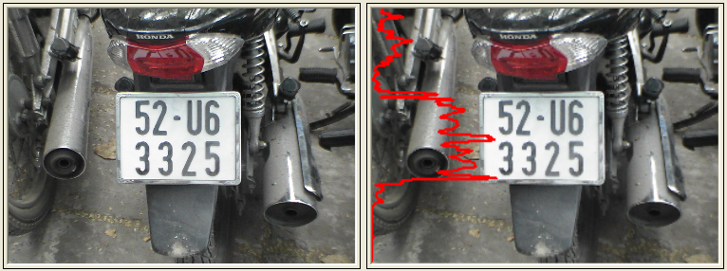
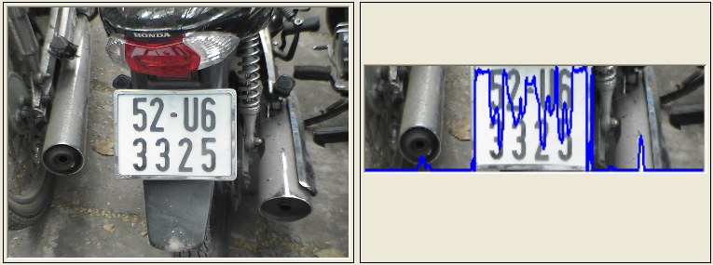
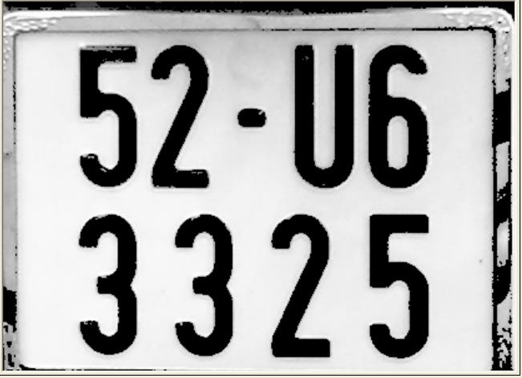
License plate separation
Width Analysis
Height Analysis and Separate

Slide 25
VI. Implementation
Technologies
Tools

Slide 26
Technologies
SQL Server
C#
.Net Framework 4.0
Emgu CV 2.4.9Library
Tesseract OCR Engine

Slide 27
Tools
Microsoft Visual Studio 2010
Microsoft SQL Server 2008
Tortoise SVN

Slide 28
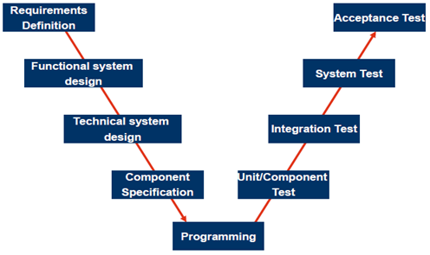
VII. Test & Result

Slide 29
Test Approach
Unit testing
Integration testing
System testing
Acceptance testing

Slide 30
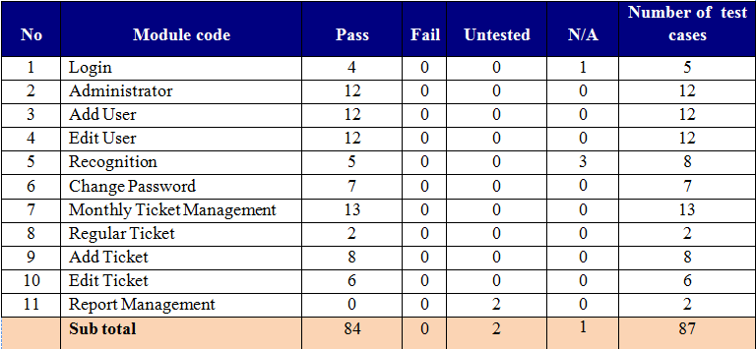
Result

Slide 31
Demo & QA

Slide 32
                Thank you !

