Slide 1
Searching Electronic Products
August 2012

Slide 2
Supervisor
Mr. Nguyễn Hồng Kỳ

Slide 3
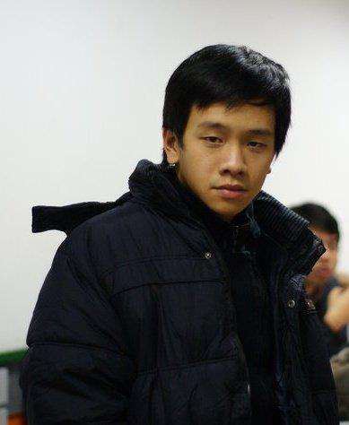
Members
DongTS
00963
AnhDB
00910
PhucNV
00715
HangNLT
00948
KhoiVQ
00878

Slide 4
Contents
Project managements
Requirements
Design and implementation
Testing
Lesson learn
Demo
Overview
1
2
3
4
5
6
7

Slide 5
Overview

Slide 6
Background
Shopping online become a new trend
Many shops, providers
Many products
Hard to cover all products and providers
Google product does not support Vietnamese product

Slide 7
Literature Review

Slide 8
Literature Review
1
Smart
2
Does not have Vietnam’s products
3
Not popular in Vietnam

Slide 9
Literature Review
1
Vietnamese interface
2
Products from Vietnam’s providers
3
Out of date information

Slide 10
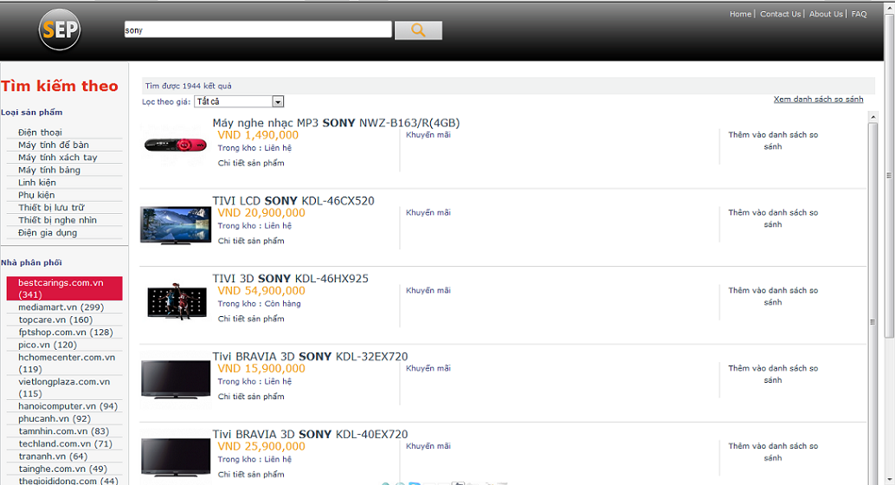
Our Product

Slide 11
Project Managements

Slide 12
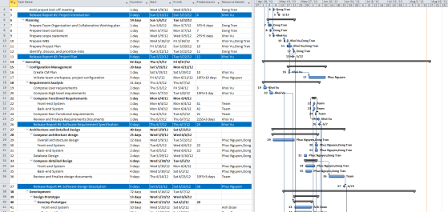
Team management
Weekly meeting: 2pm on Wednesday and Saturday at Khoi’s house
Checking task and update project plan at meeting
Communication: group mail, skype

Slide 13
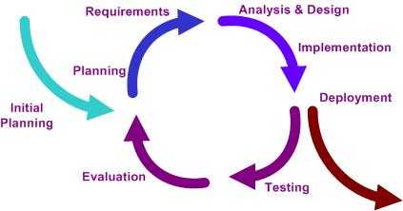
Software Development process model
Iterative Software Process Model

Slide 14
Role and Responsibilities

Slide 15
Role and Responsibilities
 |  |  |  | Project Team Member
 |  | Project Instructor |  | Tran Son Dong | Vu Quang Khoi | Nguyen Viet Phuc | Doan Bao Anh | Ngo Le Thu Hang
1 | Initiation
 | Identify Business cases and key stakeholders | C |  | A | R | S | S | S
 | Prepare Project Charter | C |  | A
 | Hold project kick-off meeting | I |  | A | R | R | R | R
2 | Planing | C |  | A | R | S |  | S
3 | Executing
 | Requirement Analysis | C |  | A | R | R |  | I
 | Architecture Design | C |  | A | R | S | S
 | Detailed Design | C |  | A | S | R | S
 | Test Plan | C |  | A | I | I | S | R
 | Create Test Case | C |  | A | I | I | S | R
 | Coding | C |  | A | R | R | R
 | Testing | C |  |  | S | S | S | R
 | Create Test Report | C |  | A |  |  | R | R
 | Documentation | C |  | S | R |  | S | S
4 | Controlling
 | Quality Mangament |  |  | A
 | Progress Report |  |  | A

Slide 16
Risk management
ID | Risk Description | Propability | Effect | Status
1 | Technology: System user very complex technology like crawler. | Moderate | Serious | Potential
2 | Project Management skill: Project Manager lacks of project management skill | Moderate | Serious | Potential
3 | Hardware availability: Project architecture is client-server, so a server is needed to perform system test and performance test | Very high | Serious | Occured
4 | Resource Experience: Team member lack of software development experience | Moderate | Insignificant | Not relevant

Slide 17
Requirements

Slide 18
Requirements
Front-end
Back-end
Product database
SEP Admin
SEP User
SEP Site
Database

Slide 19
Functional Requirement
Actors Functions | SEP User | SEP Administrator
Search for Electronic Product | X | X
Add To Compare List | X | X
Configure Link To Get Data |  | X

Slide 20
Non-Functional Requirement
Usability
Availability
Scalability
Maintainability

Slide 21
Design & Implementation

Slide 22
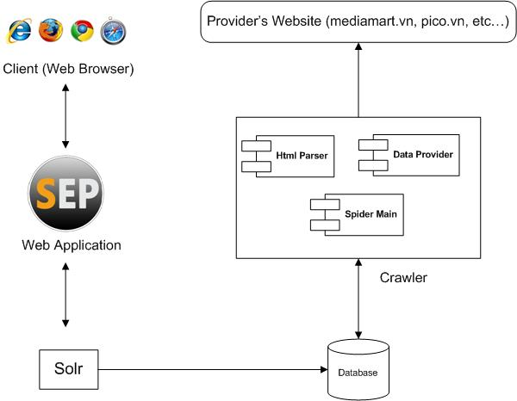
Overall System Architecture

Slide 23
Overall System Architecture
Provider

Slide 24
Overall System Architecture
Listing data
Search component
Auto complete component
Suggestion component
Highlight component
Facet component

Slide 25
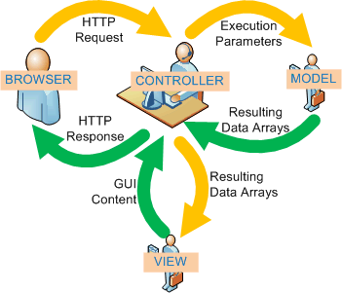
Web Architectural Design
Model View Controller (MVC)

Slide 26
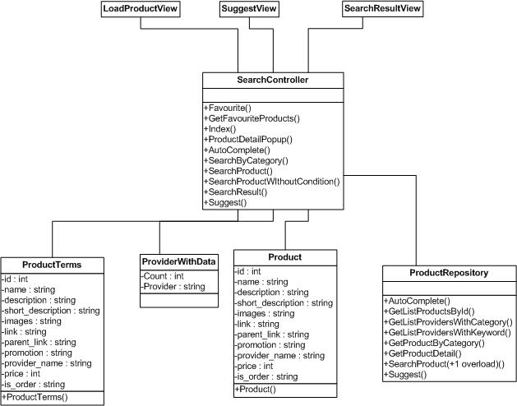
Web Class Diagram

Slide 27
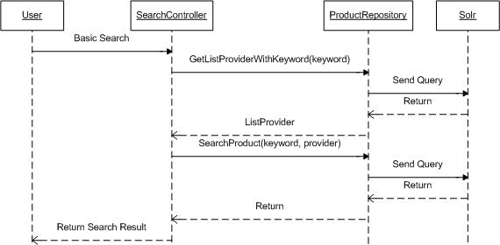
Sequence Diagram

Slide 28
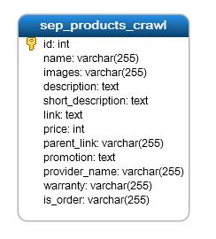
Database Design: Web

Slide 29
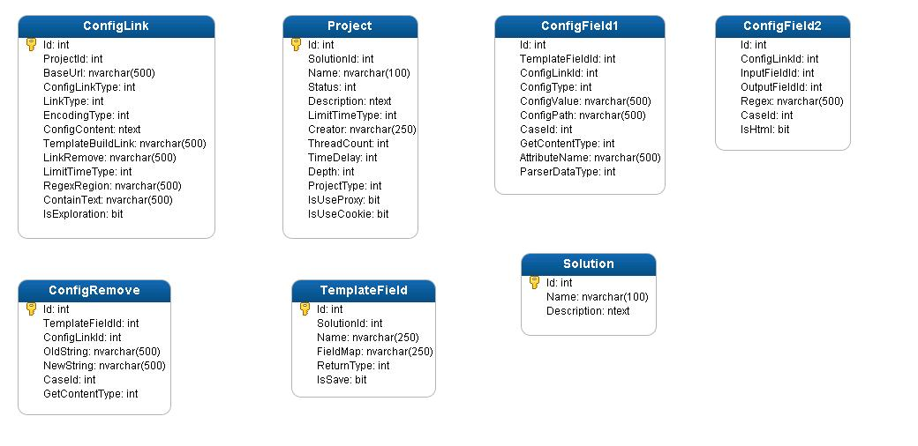
Database Design: Spider

Slide 30
Testing

Slide 31
Testing
Unit test
Integration test
System test
Performed by developers.
Individual units of source code are tested.
Performed by test team.
The separate modules will be tested.
Performed by all team members.
Checking if the integrated product meets the specified requirements
Acceptance test
Performed by User.
Determine whether a system meet all the requirements

Slide 32
Test Environment

Slide 33
Test Management
Searching
Comparison
Reliability
Add to comparison
Filter by category/ price/ providers
Performance
Graphic User Interface
Item to be Tested

Slide 34
Test Management
SEP on browser that not [IE, Chrome, Firefox]
Security testing
Maintainability
Localization testing
Item not to be Tested

Slide 35
Test Result
Test Result | Distribution | PASS | FAIL | Untested | Number of TCs
 | Google Chrome | 152 | 0 | 0 | 152
 | Mozila FireFox | 152 | 0 | 0 | 152
 | Internet Explorer | 152 | 0 | 0 | 152

Slide 36
Lesson & Learn
Team Communication
Project Management Skill
Project Scope Management

Slide 37
Demo

Slide 38
SEP

