Slide 1
Image Sharing Site
ISS Team Group Member
  Nguyễn Nhật Minh - 01432
  Nguyễn Khắc Khu - 00707
  Phạm Ngọc Hiếu - 00427
  Nguyễn Ngọc Khánh - 00426
  Nguyễn Thanh Tùng – 00232
Supervisor : Mr. Bùi Đình Chiến
Capstone Project code: ISS

Slide 2
        Image Sharing Site
Project Instructor – Supervisor:
Mr. Bùi Đình Chiến
Project team member
Project Manager
MinhNN
Development Team
MinhNN, KhanhNN, KhuNK, HieuPN
Analysis and Design Team
MinhNN
TungNT
QA Team
MinhNN, TungNT, KhuNK

Slide 3
Content
Introduction
Software project management plan
Software Requirement Specifications
Software Design Details
Project Test Documentation
Appendix

Slide 4
Introduction
    Project information:
    Project name: Image sharing Site
    Project code: ISS
    Product type: Website
    Timeline: From May 8th 2012 to August 2012

Slide 5
Introduction (2)
    Purpose:
    Capstone project
    A first completed Social Network Image Sharing for Vietnamese

Slide 6
Introduction(3)
Background
Literature review
  Overview of the similar existing solutions
  Overview of the existing systems
  Proposal

Slide 7
Software project management plan
Problem Definition
Project Overview
Project Organization
Project Management Plan
Risk Management
Issues
Coding conventions

Slide 8
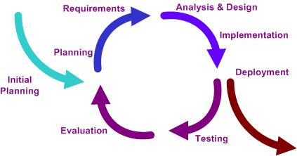
  Software project management plan
  Software Process Model
Iterative Process Model
All following steps are repeated during project development process:
  Requirements
  Design
  Implementation & Testing
  Evaluation
  Re-plan

Slide 9
Software project management plan
Roles
Project Manager
MinhNN
Development Team
MinhNN, KhanhNN, KhuNK, HieuPN
Analysis and Design Team
MinhNN
TungNT
QA Team
MinhNN, TungNT, KhuNK

Slide 10
Software project management plan
Responsibilities
RASCI Model
  R – Responsible – Those who are responsible for the task, ensuring that it is done as per the Approver. There is typically one role with a participation type of Responsible, with others delegated to assist as the 'Support' in the work required. (RASCI separately identifies those who participate in a supporting role).
  A – Accountable – Those who are ultimately accountable for the correct and thorough completion of the deliverable or task, and the one to whom Responsible is accountable. In other words, an Accountable must sign off (Approve) on work that Responsible provides. There must be only one Accountable specified for each task or deliverable.
  S – Support – Resources allocated to Responsible. Unlike Consulted, who may provide input to the task, Support will assist in completing the task.
  C – Consulted – Those whose opinions are sought; and with whom there is two-way communication.
  I – Informed – Those who are kept up-to-date on progress, often only on completion of the task or deliverable; and with whom there is just one-way communication.

Slide 11
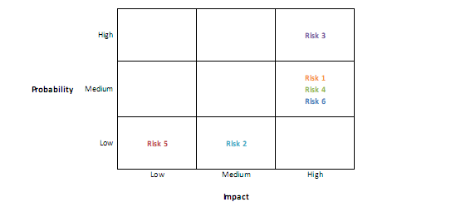
Software project management plan
Risk Evaluation
  We assigned them a numeric value on a scale:
  Probability: 1-Low, 2-Medium, 3-High
  Impact: 1-Low,2- Medium, 3- High
  In order to list the relative probability of a risk occurring on one side and the relative impact of the risk occurring on the other, I used probability/impact matrix or chart.

Slide 12
Software project management plan
Risk Response Strategy
Risk avoidance – eliminate a specific threat by eliminating its causes;
Risk acceptance – accept the consequences in case a risk occurs;
Risk transference – shifting the consequence of a risk and responsibility for its management to a third party;
Risk mitigation – reducing the impact of a risk event by reducing the probability of its occurrence. For positive risks, we also have four basic response strategies:
  Risk exploitation – doing whatever we can to make sure the positive risk happens;
  Risk sharing – allocating ownership of the risk to another party;
  Risk enhancement – changing the size of the opportunity by identifying and maximizing key drivers of the positive risk;
  Risk acceptance – applies to positive risks when the project team cannot or chooses not to take any actions toward a risk.

Slide 13
Software Requirement Specifications
User Requirement Specification
User Requirements
Administration requirements
Comment requirement
Image Requirement
Search Requirement

Slide 14
Software Requirement Specifications
System Requirement Specification
External Interface Requirements
  User Interfaces
  Hardware Interfaces
  Software Interfaces
  Communications Protocol (HTML)
System Features
Software System Attributes

Slide 15
Software Requirement Specifications
Software System Attributes
Usability
  GUI – (Vietnamese and easy to use), Usability for end-users, Usability for admin and staff
Reliability
Availability
Security
Maintainability
  Coding standards and naming conventions, Design, Logging, Email.
Portability
Performance
  Load time, Mailing system, Capacity, Compatibility

Slide 16
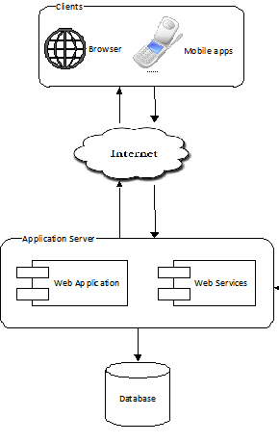
Software Design Details
System Architectural Design (1)
Overall System Architecture
  Database store:
  Application Server
  Clients

Slide 17
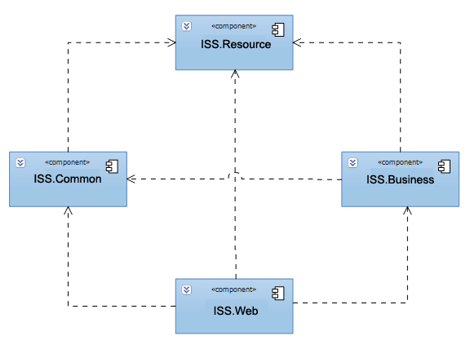
Software Design Details
System Architectural Design (2)
Web Application Architecture
    ISS.Common
    ISS.Resources
    ISS.Business
    ISS.Web

Slide 18
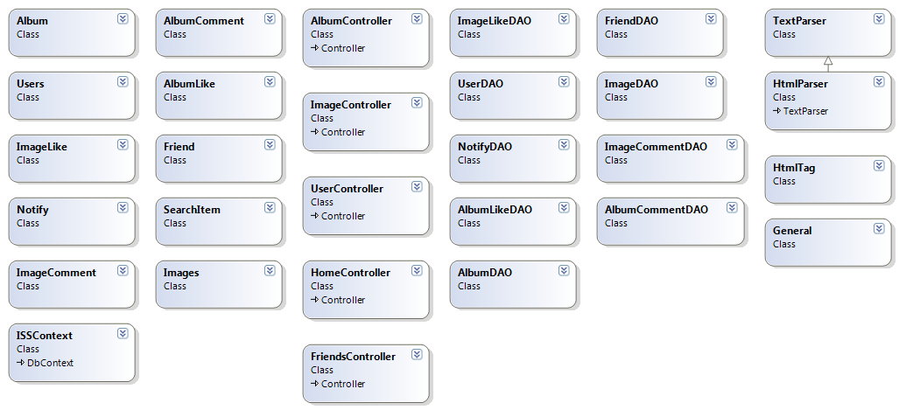
Software Design Details
Class Diagram

Slide 19
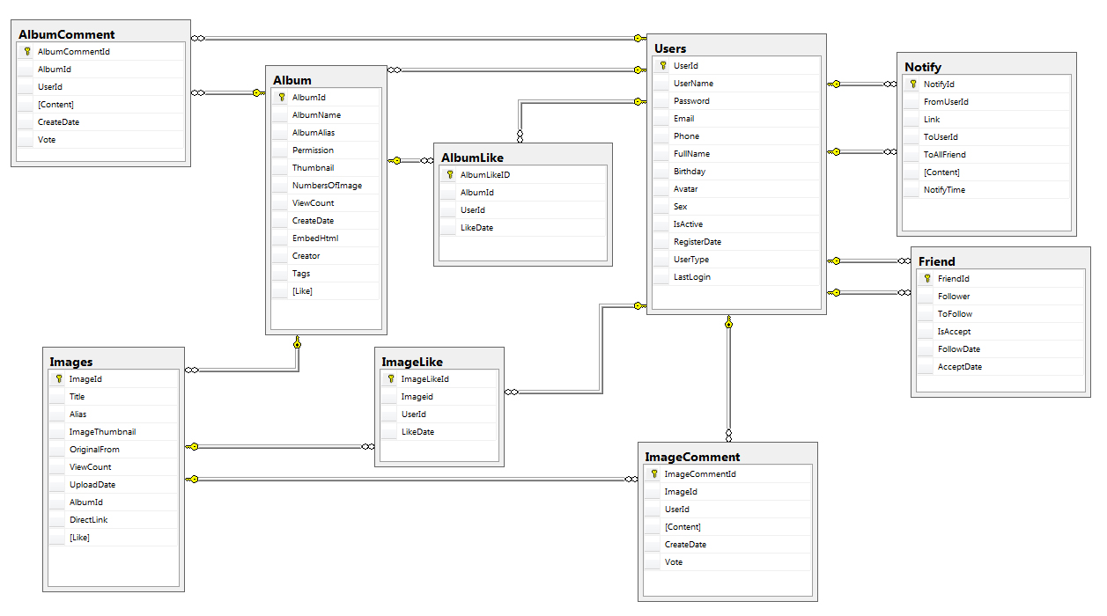
Software Design Details
Entity Relationship Diagram

Slide 20
Project Test Documentation
Introduction:
System Overview
Test Approach

Slide 21
Project Test Documentation (2)
Test Plan:
Resources/Roles and Responsibilities
Testing Tools and Environment
Features to be tested
Features not to be tested

Slide 22
Question
&
Answer

Slide 23
Thank You!
The End

