Slide 1
Family2School
Sổ liên lạc điện tử

Slide 2
Group members
HưngPT
HanhNV
CuongHA
LongPT
BinhNT

Slide 3
Content
1. Project Ideas
2. Features
3. Technologies
4. Q&A

Slide 4

1. Project Ideas
The needs of communicating between family and school is very high.
Increase the convenience in communication.
Other existing product have limitations.
Why don’t we build a website to satisfy these family needs.
➔ Family2School Project – Help family know about student’s progress.

Slide 5
1. Project Ideas
COMPARISON
Products Functions | ECTSchool | Vn2C | NeoSchool | Family2School
Using SMS | ✓ | ✓ | ✓ | ✓
Using Email | ✓ | ✓ | ✓ | ✓
Using website | ✓ |  | ✓ | ✓
Send information daily | ✓ | ✓ | ✓ | ✓
Send information monthly |  | ✓ | ✓ | ✓
Calculating grade |  |  |  | ✓
Managing Information |  |  | ✓ | ✓
Ranking |  |  |  | ✓

Slide 6
1. Project Ideas
COMPARISON
Products Functions | ECTSchool | Vn2C | NeoSchool | Family2School
View Student Process Chart |  |  |  | ✓
Student Function | ✓ | ✓ | ✓
Teacher Function |  |  | ✓
Register process | Complex | Complex | Complex | Simple
Who has responsibility | Manager | Homeroom Teacher | IT Man | Manager

Slide 7

2. FEATURES
FUNCTIONS | METHOD
Manage class | Input from excel following format year-block-class
Manage subject | Input from excel following format subject name-kind of grades
Manage Grade | Build form input according to each subject for each class
Manage Schedule | Import from excel
Manage announcement | Only need to make a simple form for user to input announcement
Manage Attendance | Make a form for teacher to take attendance each day
Manage Account | Input account from excel file. After that a page appeared with added account. Manager can edit account password and information

Slide 8
2. FEATURES
FUNCTIONS | METHOD
Manage pupil Information | Input from excel If you want to edit any specific pupil you can use search function to find that pupil and edit.
Search function | The result is related with what you input in search box. It contains pupil, class, account
SMS | This is an automatic function. System will get information from database and auto send to family registered mobile Manger can configure sending time. It will send monthly and daily.
Email | This is an automatic function. System will get information from database and auto send to family email. Manger can configure sending time. It will send monthly and daily

Slide 9

2. FEATURES
FUNCTIONS | METHOD
View Grade | Family can view grade of their child following each subject or overview of all subject and the position of their child in his(her) class
View Chart | System will automatic get grade of each student follow each subject and make a comparison under chart form to show student's result is increasing or decreasing
View Attendance | View attendance following date time
View Announcement | Family when log in will see new announcements posted in front page
View Schedule | When family log in, schedule of their child class will be posted on the right top of the page
View Profile | Family can view their information and they can change their password

Slide 10
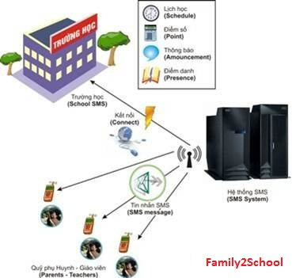
2. FEATURES

Slide 11
3. Technologies
PROCESS MODEL
Scrum Process
  Scrum is an iterative and incremental agile software development method for managing software projects and product or application development.
Why Scrum?
  Flexibility and adaptability
  Developers are free to devise ideas and solutions
  High product quality, low cost, low risk
Role
  Product Owner
  Scrum Master
  Developers

Slide 12
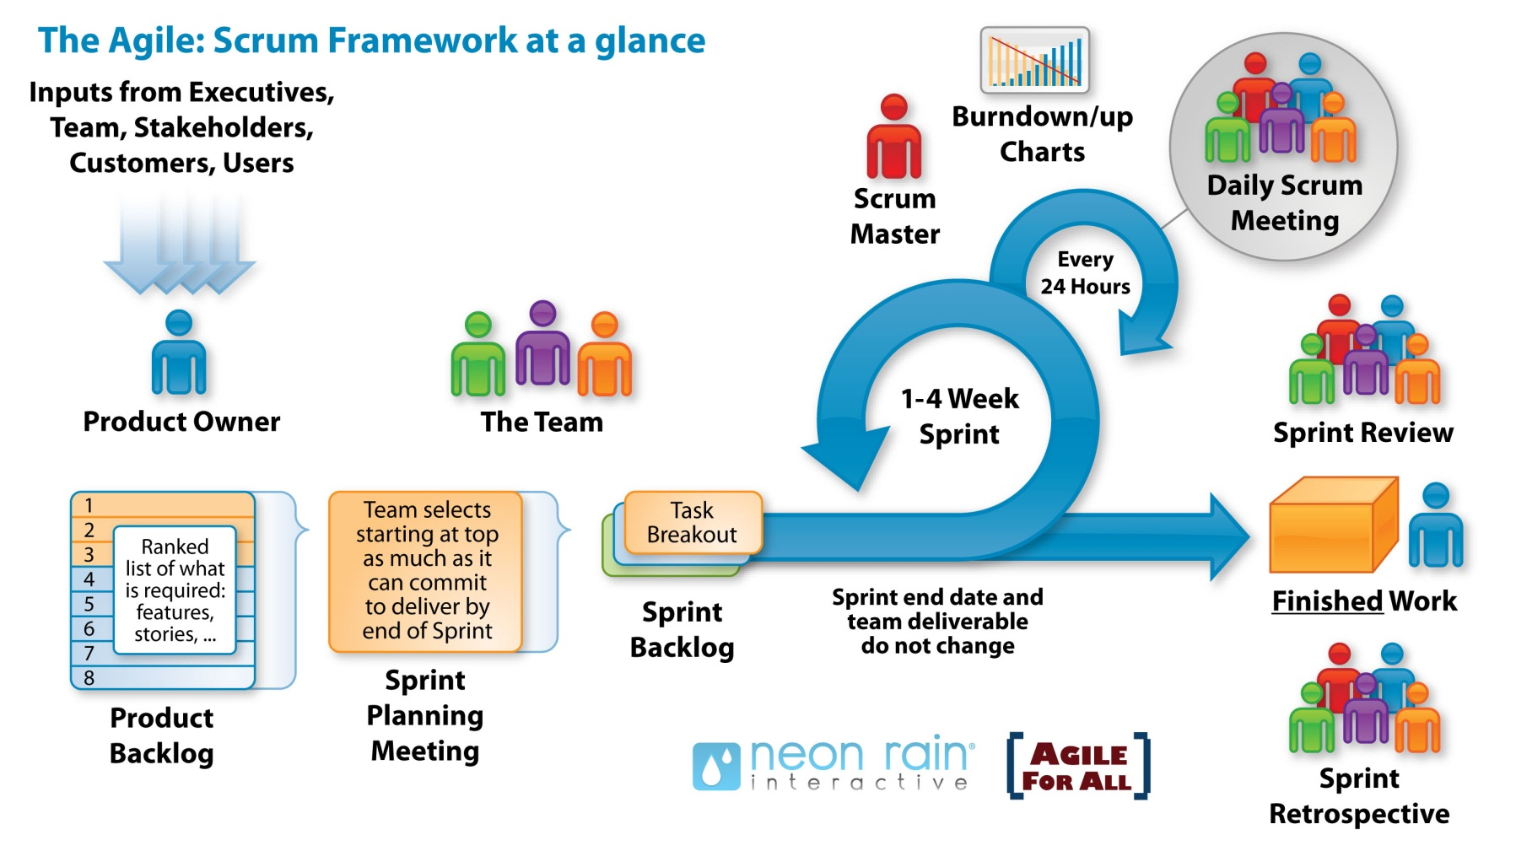
3. Technologies
PROCESS MODEL

Slide 13

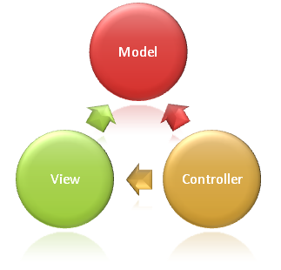
3. Technologies
PROGARMING LANGUAGE
MVC

Slide 14

4. Q&A

