Slide 1
`
Capstone Project
W-CMS

Slide 2
Capstone Project Code | W-CMS
Group members | Ngô Đức Hùng – 00346 Ngô Đức Anh – 00827 Nguyễn Đình Trần Hoàng – 01390 Đào Trọng Thái Dương – 01366
Supervisor | Ms. Lã Ngọc Quang

Slide 3
CONTENTS
Introduction
Software design
Testing
Problem Definiton
Project orgnization
Project plan
Requirement
Demo

Slide 4
Introduction
What’s CMS
A Content Management System (CMS) is a computer system that allows publishing, editing, and modifying content as well as site maintenance from a central page

Slide 5
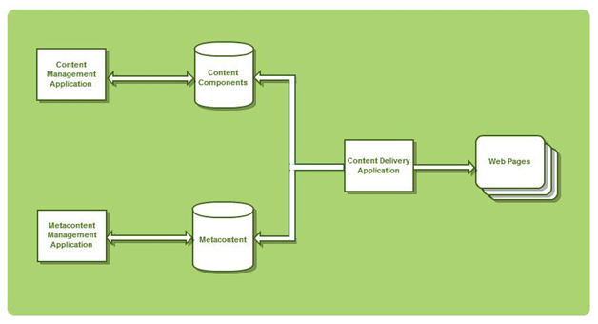
Introduction
CMS’s Elements
Content Management Application (CMA)
Metacontent Management Application (MMA)
Content Delivery Application (CDA)

Slide 6
Introduction
What’s CMS
CMA
CMS’s Elements

Slide 7
Introduction
What’s CMS
MMA
CMS’s Elements

Slide 8
Introduction
What’s CMS
CDA
CMS’s Elements

Slide 9
Introduction
Existing CMS
Joomla
Wordpress
DotNet Nuke
Drupal

Slide 10
Introduction
W-CMS

Slide 11
Problem Definition
The current system
No current system
Using open Text Editor (CKEditor)

Slide 12
Problem Definition
The proposed system
The system directs to quickly, easily create a small, medium website
It can be a website of a company, organization or website of information, news…

Slide 13
Problem Definition
Boundaries of the system
Direct to small and medium website that have little module
Have three templates that fixed in W-CMS. User can choose around the templates.

Slide 14
Problem Definition
Development Environment
OS: Window 7
Framework: .NET Framework 4.0
IDE: Microsoft Visual Studio 2010 Ultimate
DBMS: Microsoft SQL Server 2008 R2
Source Control: SVN

Slide 15
Project organization
Software project model
Waterfall software process model

Slide 16
Project organization
Role and responsibilities
No | Student name | Email | Role
1 | Ngô Đức Hùng | hungnd00346@fpt.edu.vn | Team lead, Developer
2 | Ngô Đức Anh | anhnd00827@fpt.edu.vn | Developer, Tester
3 | Đào Trọng Thái Dương | duongdtt01366@fpt.edu.vn | Developer, Designer
4 | Nguyễn Đình Trần Hoàng | hoangndt01390@fpt.edu.vn | Developer, Designer

Slide 17
Project organization
Tool and techniques
Programming Language: C#.NET
IDE: Microsoft Visual Studio 2010 Ultimate
Text Editor: CKEditor (o pen-source text editor)
DBMS: Microsoft SQL Server 2008 R2
Microsoft Office 2007
Microsoft Project 2007 Professional
SVN

Slide 18
Project plan
Task
Project duration in plan: 96 working days (it includes six working day per week)
Start Date: 07/05/2012- End Date: 25/08/2012
Initiation: 10 days
Planning: 5 days
Executing: 54 days
- Create SRS Document: 17 days
- Software Design Description: 17 days
- Coding: 24 days
- Testing 17 days
Closing project: 18 days

Slide 19
Project plan
Risk
No | Risk Description | Probability | Effect
1 | Hardware Availability: Personal computer is main device to develop this project. Our computers are all quite old and may unexpected failure. | High | Serious
2 | Project Management Skill: Lack of management skill may badly impact to project schedule | High | Tolerable
3 | New Technology: This project required to use many new technologies that our team members do not have experience on it such as HTML5, javascript… | Medium | Tolerable
4 | Lack of experience: Project team members are lack of experience in real world working environment | High | Insignificant
5 | Work together: Our team has never worked together before, so it is difficult to work together efficiency in initial. | Moderate | Tolerable

Slide 20
Requirement
Functional requirement
Article management
Category management
Menu management
User management
Module management
Template management

Slide 21
Requirement
Non-functional requirement
Usability
Reliability
Availability
Security
Maintainability
Portability
Performance

Slide 22
Software design
System Architecture

Slide 23
Software design
ERD diagram

Slide 24
Software design
Database diagram

Slide 25
Testing
Test approach

Slide 26
Testing
Test plan
Features to be tested
Functional requirement
System allows guests view websites.
System allows user create editor accounts.
System allows user create pages
System allows user create modules.
System allows user create menus.
System allows user create articles.
System allows user upload media.
System allows user create categories.

Slide 27
Testing
Test plan
Features to be tested
Non-functional requirement
No | Feature’s name | Brief descriptions
1 | Security | - The system shall not allow operation unless account corresponding to each particular right id completely valid. - Users not authorized should not obtain access to the system
2 | Performance | The system should respond to any user action that the user would expect to be instantaneous( i.e. 90% of responses should be within 2 seconds)

Slide 28
Testing
Test plan
Features to be tested
Interface
No | Feature’s name | Brief descriptions
1 | View | Check look and feel of View
2 | Form(screen elements) | Check display of elements
3 | Common screen layout | Check screen layout
4 | Function | Check the display of items after executing functions

Slide 29
Testing
Test Plan
Features not to be tested
The following items listed will not be tested by test team:
No need to verify on all OS.
No need test all function on each web browsers.
Maintainability.

Slide 30
Testing
Test Plan
Testing tool and environment
 | Basic Configuration
CPU | Intel core i3 2.67ghz
RAM | DD RAM II 2 Gb
Operation System | Windows 7 Ultimate
Web browser | Internet Explorer 7.0 Firefox 3.0 Chrome 10.0
Connection | LAN

Slide 31
Testing
Test report

