Slide 1
ONLINE SHOP MANAGEMENT SYSTEM
Supervisor: Mr Tran Dinh Tri
Project’s member:
Vo Duc Anh
Nguyen Van Trung
Bui Hoang Thai
Nguyen Viet Anh

Slide 2
Table of content
1
Introduction
2
Software Project Plan
3
Software Requirement Specification
4
Software Design
5
Software Testing
6
Demo and QA

Slide 3
1. Introduction
1.1 Team Introduction
Võ
Đức
Anh
Nguyễn
Văn
Trung
Bùi
Hoàng
Thái
Nguyễn
Việt
Anh

Slide 4
1. Introduction
1.2 Project Introduction
Idea
There a lot of small and medium restaurants in VietNam.
Almost of them don’t have management tool.
The customer is not supported to book online.
OSMS is developed to provide management tool for restaurant and help customer easy to book online.
OSMS (Online shop management system)
Web-based system
Providing tool to manage shop especially for restaurant
Being divided into two part
Web application for general management
Desktop application for selling activities
Providing “booking page” for customer book online

Slide 5
2. Software Project Plan
2.1 Proposed system and scope
Propose
Providing tool to manage restaurants
Providing booking service
Scope
Manage employees
Manage products
Selling activities management
Statistic and Report

Slide 6
2. Software Project Plan
2.2 Project Organization
Business Analyst
Developer
Designer
Tester
ThaiBH
AnhNV
TrungNV
ThaiBH
AnhNV
HungHH
HungHH
AnhVD
TrungNV
Project Manager (AnhVD)

Slide 7
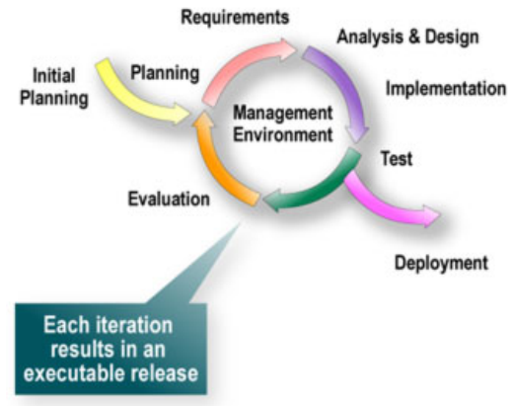
2. Software Project Plan
2.3 Software Model
Iterative Approach to Development

Slide 8
2. Software Project Plan
2.4 Plan
May | June | July | August
Idea
User Administration
Project Plan
1
2
3
4
Requirement
Design
Code
Test
Shop Management
1
2
3
4
Requirement
Design
Code
Test
Selling Activites management
1
2
3
4
Requirement
Design
Code
Test
Booking
1
2
3
4
Requirement
Design
Code
Test
Package & Deploy

Slide 9
2. Software Project Plan
2.5 Technology Platform
PHP and .NET
PHP for Website
.NET for Desktop
Application

Slide 10
2. Software Project Plan
2.6 Tools
Microsoft Windows 7 Ultimate x32
MySQL 5.0 or later x32
Microsoft Visual Studio 2010 Ultimate x32
Eclipse – SDK – 3.7.2 x32
PHP 5.0 or later, framework Yii 1.8 or later
Apache
Microsoft Internet Browser 9
Microsoft Office 2010 Professional Plus
Tortoise SVN
Skype

Slide 11
2. Software Project Plan
2.7 Risk Management
Estimate
Requirement
Change
Communication

Slide 12
3. Software Requirement Specification
1
User requirement
2
Functional requirement
3
Non_functional requirement
4
Data Structure

Slide 13
3. Software Requirement Specification
3.1 User requirement
User Administration
Manage User
Manage Employees
Selling Acitivities Management
Manage Table
Booking
Booking online
Manage Account
Billing
Shop Management
Manage Products
Manage Report
Manage Order

Slide 14
3. Software Requirement Specification
3.2 Functionality
Administration System
Manage User Accounts
Manage Home page
Administrator

Slide 15
3. Software Requirement Specification
3.2 Functional Requirement
Server System
Human resource management
Account management
Products management
Order management
Manager

Slide 16
3. Software Requirement Specification
3.2 Functional Requirement
Client System
Selling activities
Order management
Staff

Slide 17
3. Software Requirement Specification
3.3 Non_functional Requirement
Reliability
Availability
Security
Maintainability
Performance
Usability
Software system attribute

Slide 18
4. ArchitEctual Design
4.1 Software Structure

Slide 19
4. ArchitEctual Design
4.2 Component Diagram
Web application

Slide 20
4. ArchitEctual Design
4.2 Component Diagram
Desktop application

Slide 21
4. ArchitEctual Design
4.3 Class Diagram

Slide 22
5. Software Testing
5.1 Test Model
Requirement Analysis
Acceptance Testing
Specifications
System Test
Detail Design
Integration Test
Code & Unit Test
V Lifecycle Model

Slide 23
5. Software Testing
5.2 Features To Be Tested
Function Testing
User Interface Testing
Business Cycle Testing
View Testing
Security and Access Control
Performance Testing

Slide 24
5. Software Testing
5.3 Test Execution
Start
Submit
Review
Valid
No
Close
Yes
Open
In progress
Finish
Fixed
Yes
Review
Valid
No

Slide 25
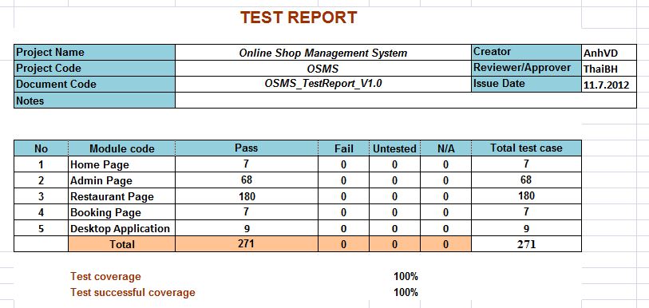
5. Software Testing
5.4 Test Report

Slide 26
5. Software Testing
5.4 Bug Report

Slide 27
6. Demo and QA

Slide 28
Thanks for listening

