Slide 1


YOFOTO WEBSITE
Capstone Project
F.U
Supervisor
Nguyễn Hồng Kỳ
Vũ Phương Dung- 00093
Lương Xuân Hải- 00476
Đào Thiện Đăng- 00700
Trần Quang Sáng- 00129
Triệu Hoàng Hà- 000500
Yofoto Team

Slide 2
Introduction
TEAM MEMBER
Vũ Phương Dung 00093 Tester (Leader)
Trần Quang Sáng 00129 Developer
Triệu Hoàng Hà 00550 Developer
Đào Thiện Đăng 00700 Developer
Lương Xuân Hải 00476 Designer

Slide 3
Introduction
YOFOTO HONGKONG CORP.
YOFOTO Ninh Ba Company established in 2004, under the Pharmaceutical Group Co., Ltd. Hong Kong Yu Fang Tang. YOFOTO Company attempts to be an international trading company with the most respect, develop Chinese medical culture, provide high quality products, build the best career, and help people get “health, happiness and harmonious human life”. Products with high quality and professional health service, company try to make healthy family life, help business staff create their own best career.
Notes:
Giới thiệu các thành viên trong nhóm và role của các thành viên

Slide 4
Contents
Introduction
Project Management
Software Requirement
Architecture
Testing
Demo

Slide 5
Introduction
Background
- YOFOTO Project is a E-commerce project that contains adequate features of an E-commerce website.
- Directly working process with the company named YOFOTO Vietnam, our project team tries to bring to customers and users the convenience, the highlight power of E-commerce, aim to create a valuable product.

Slide 6
Introduction
Purpose
The actual requirements of the company YOFOTO is necessary to build an ecommerce website for the company. This is a multi-level business company, supply health care products such as medicine, functional foods…

Slide 7
Introduction
Advantages
  Create the management pages for Mod and Admin: With visible interface and simple using way for every internet user
  Shopping Cart
  Post news, products’ information.
  - Support business management

Slide 8
Introduction
Products
The main product that our team desires to bring to customers including two website: Website for users and website for administrators.
- Website for users is commercial website display all of the contents that our team agreed with the company to bring to customers..
-Website for administrators is the website designed only for administrators..

Slide 9
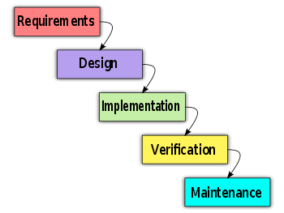
Project Management
Software Process Model

Slide 10

Project Management
Project Plan

Slide 11
Project Management
Task
1/ Create Software Requirements Specification
2/ Design Database
3/ Create Software Design Description
4/ Layout Design
5/ Coding
6/ System Test
7/ Input Initial Data

Slide 12



Project Management
Penny Auction website – Bid It Team
Team Work
Working 6h/day and 5d/week
Meeting with supervisor 1 time a week.
11 meeting minutes.

Slide 13

Project Management
Penny Auction website – Bid It Team
Meeting Schedule
Report their tasks in previous week
Issues, knowledge and rules will be shared
discuss about the plan for next week

Slide 14
Project Management
Risk Description | Risk Type | Risk Impact | Action to prevent | Action when happened
Member is not available when need | Human Resource | High | Create Team policy that contain rule penalize any absent person( without appropriate reason) | Absent person must cover undone task
In-experienced in development e-commerce website | Technique | High | - Create Studying task in Initiation phase of plan - Raise issue immediately when happened | - Using buffer time to improve quality - Get support from external expert
Do not catch up deadline | Time management | High | - Create team’s deadline sooner 1 week official deadline - Create rule that penalize the person who miss deadline | - Raise issue and find out solution - Request over time

Slide 15
Software Requirement
Website Overview
User Requirements Specification
1/ Customers website
2/ Admin website

Slide 16
Software Requirement
FUNTIONAL REQUIREMENT
SOFTWARE REQUIREMENT
NON-FUNCTIONAL REQUIREMENT

Slide 17
Software Requirement
Functional Requirement
USER WEBSITE
BACK END
LOG ON ACCOUNT
MANAGE PRODUCT
FIND PRODUCT
MANAGE INFOMATION
BUY PRODUCT
MANAGE CATEGORY
ONLINE PAYMENT
MANAGE USER

Slide 18




Software Requirement
Functional Requirement
Define Roles in Website
Custumers
Authenticated
Administrator
User

Slide 19
Software Requirement
Functional Requirement
Customers
Authenticated
User
Administrator
View
Buy product using shopping cart
- Manage back-end
Approve order
user’s page
Buy products
History shopping
- Manage Profile
Admin
User
Guest

Slide 20
Software Requirement
Functional Requirement
In user website:
- View company’s product and news
- Buy favorite product using Shopping Cart
- Calculation how much used to pay for these product

Slide 21
Software Requirement
Functional Requirement
In admin website:
- Manage user
- Manage user website interface
- Manage Buy of Sell
- Support Business manage

Slide 22
Software Requirement
Non-function Requirement
  Availability:
    Availability: 24/7
  Usability:
    Website provides help link
    Use Vietnamese language
  Reliability:
    User can view log file

Slide 23
Software Requirement
Non-function Requirement
  Security:
    Limit SQL injection
    MD5 for encrypt password
  Maintainability:
    All code must follow code convention
  Performance
    Close connection when users don’t interact with website in 2 minutes (changeable)

Slide 24
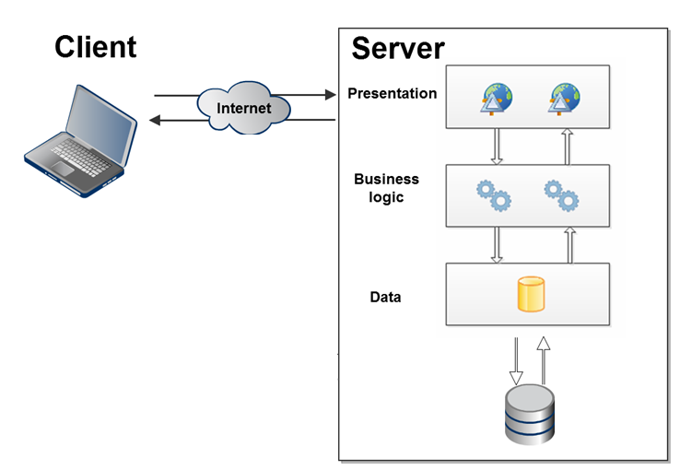
Software Architectural Design
Overall design

Slide 25
Software Architectural Design
Web application Architecture

Slide 26
Software Architectural Design
Component diagram

Slide 27
Software Architectural Design
Component diagramHRBS.Data

Slide 28
Software Architectural Design
HRBS.web componet

Slide 29
Software Architectural Design
Detailed design
  Class diagram
  Class diagram explanation
  Sequence diagram

Slide 30
Software Architectural Design
Class diagram

Slide 31
Software Architectural Design
Sequence diagram view product

Slide 32
Software Architectural Design
Sequence diagram search product

Slide 33
Software Architectural Design
Sequence diagram maintain s.c

Slide 34
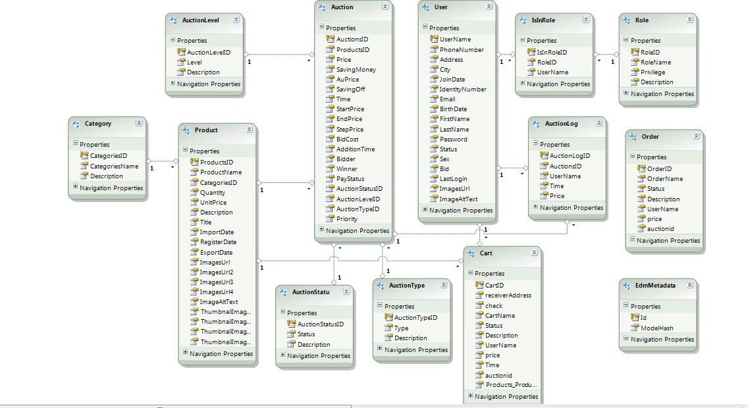
Software Architectural Design
Database Design
Notes:
Gen lại ERD

Slide 35


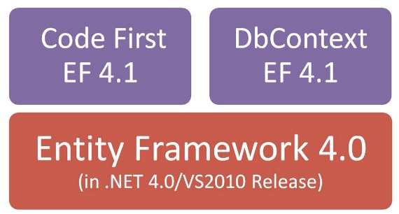

Software Architectural Design
Technology

Slide 36





Software Architectural Design
Tool
Tools
1.9b4
SVN 1.6.16

Slide 37
Testing
Testing Strategy
Developing
Testing
Requirements
Acceptance
System design
System
Architecture design
Integration
Module design
Unit
Coding

Slide 38
Testing
Testing Strategy
Test Process
Create TC template
Write TC (based on SRS)
Review TC
Test Execution
Test Plan

Slide 39
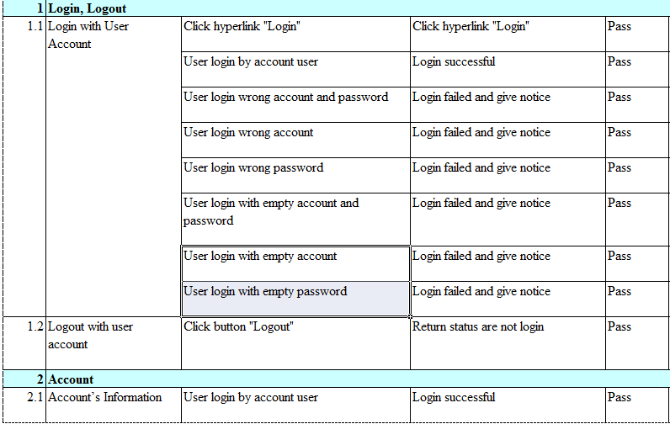
Testing
Testcase

Slide 40
Testing
Test Report
Pass/failed/ % coverage

Slide 41

Result
Lesson learnt
Improve technical skill
Soft Skills
Risk and issues management

Slide 42
Demo
F.U

Slide 43
Thank You !
F.U

