Slide 1
Baokim Mobile
e-Wallet

Slide 2
Supervisor
Mr. Nguyễn Tất Trung
Project Manager
Vũ Hải Nam
Business Analysis Team
Nguyễn Lưu Bách (Leader)
Vũ Hải Nam
Design Team
Nguyễn Ngọc Hưng (Leader)
Vũ Hải Nam
Coding Team
Vũ Hải Nam
(Leader)
Nguyễn Ngọc Hưng
Nguyễn Lưu Bách (support & review)
Test Team
Đỗ Thùy Vân (Leader)
Trần Quang Linh

Slide 3
Contents
1
3
Proposal
5
Software Project Management Plan
2
Background
Baokim introduction
4
Main Objectives
6
Software Requirement Specification
7
Software Design Description
8
Testing
9
Demo

Slide 4
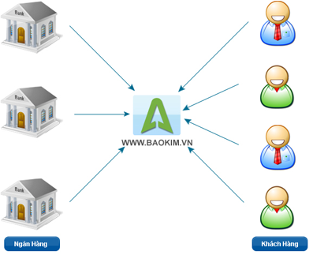
Baokim introduction
Online payment portal.
Was built based on PayPal, Moneybookers models.
Baokim.vn plays the role of payment intermediary.
Provide services: Online payment, transfer funds online.
BMW’s sponsor.

Slide 5
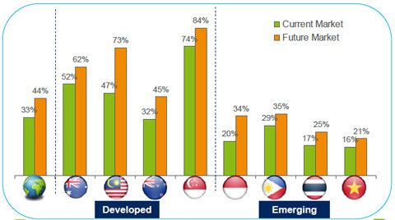
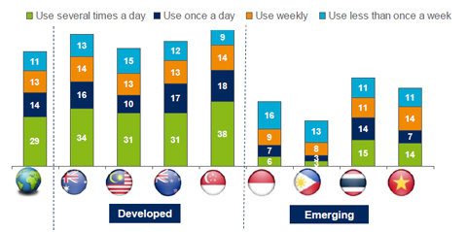
Background - Trend of smartphone in
Vietnam
Figure 1: Rate of people using smartphones
Figure 2: Rate of people using smartphone application daily

Slide 6
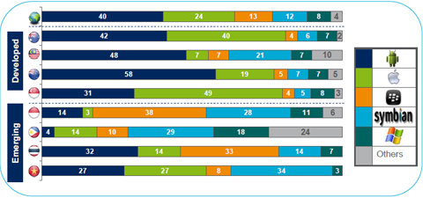
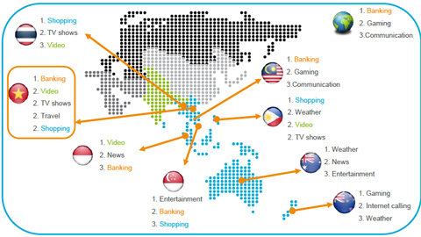
Background - Trend of smartphone in
Vietnam
Figure 3: Rate of people using Android smartphone
Figure 4: Kinds of popular smartphone applications used in Vietnam

Slide 7
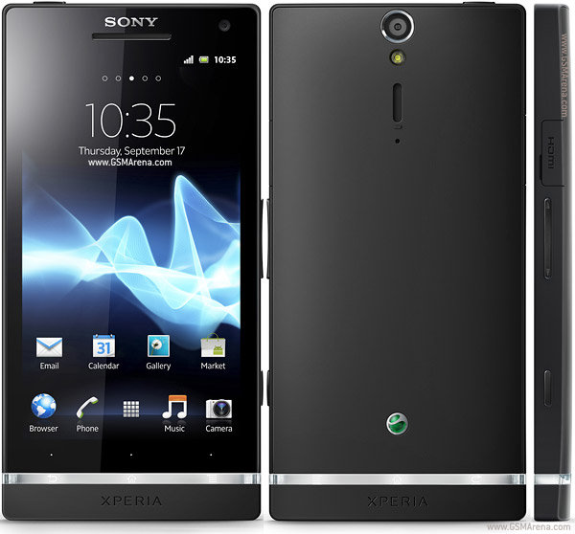
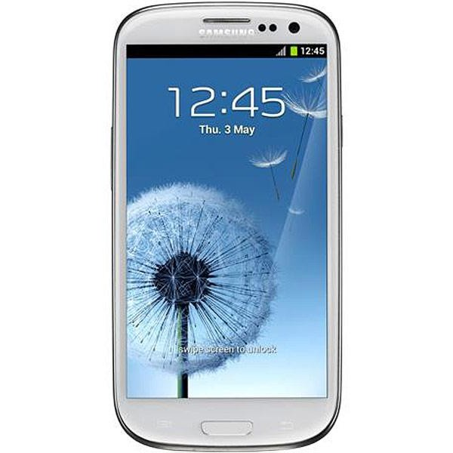
Background - Trend of smartphone in
Vietnam
Android smartphones are becoming hotter and hotter in Vietnam
Android banking and shopping applications are popular used in Vietnam
CHANCE

Slide 8
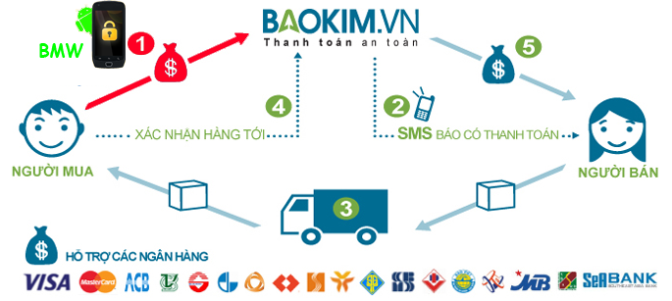
Proposal - Idea
A mobile e-wallet specified for Baokim users

Slide 9
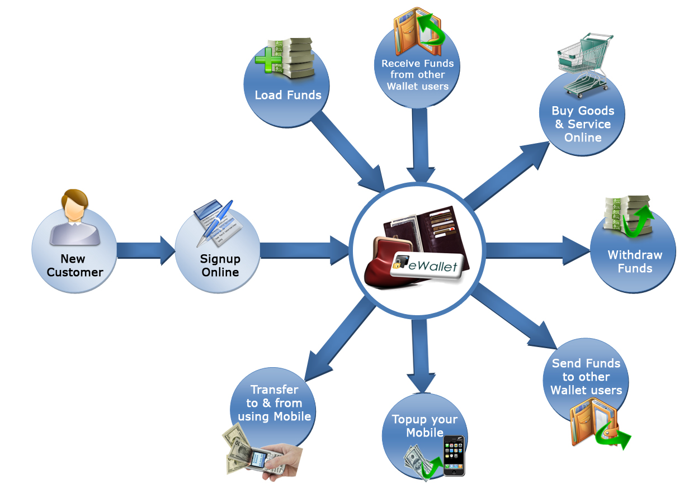
Proposal- E-wallet and mobile e-wallet
e-Wallet:
A virtual wallet that stores your payment cards, offers, and more on your phone and online.
Some e-Wallets in Vietnam: MobiVi, Momo, Payoo, VnMart.
Mobile e-Wallet:
E-wallet is specialized for using on mobile devices.

Slide 10
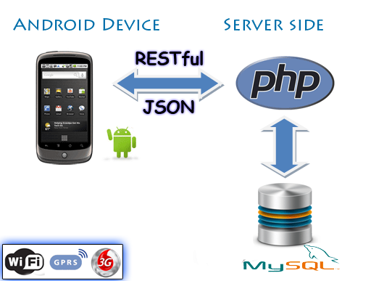
Proposal – Proposed system

Slide 11
Main Objectives
Shopping by scanning QR code
Transfer money to another BMW user
Request money from another BMW user
View transactions history
View account information

Slide 12
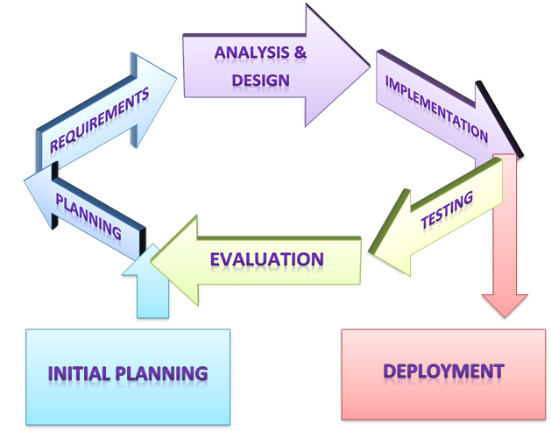
Software project management plan Software process model
Iterative model
Always have a running version of the program
Easily identify the source of last error
Customers are psychologically more satisfying
Less time for corrections

Slide 13
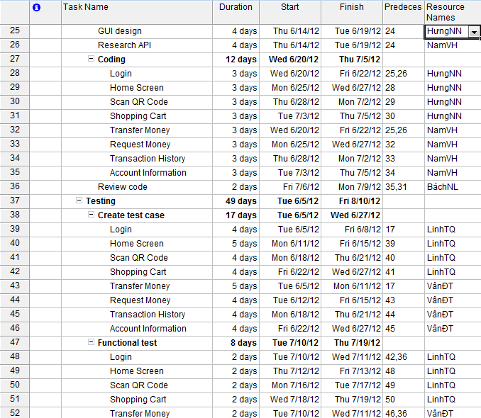
Software project management plan Master plan

Slide 14
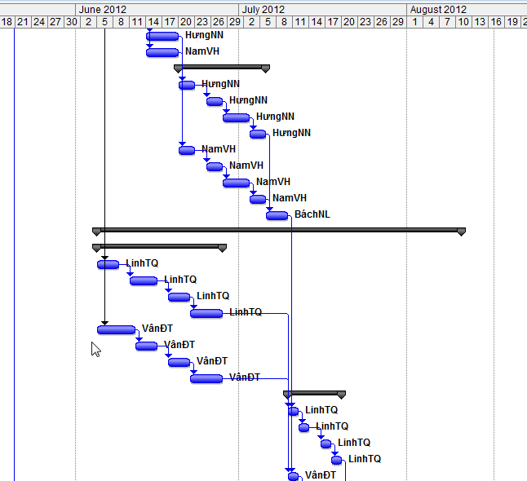
Software project management plan Master plan

Slide 15
Software project management plan Quality plan
Estimated | Quantity
Use cases | 10
Test cases | GUI test cases | 106
 | Functional test cases | 245
Defect density | 5 bugs per kLOC

Slide 16
Software project management plan Risk management
No. | Risk | Avoidance | Contingency Plan | Status
1 | SRS does not cover enough business logic. | Before writing SRS, hold one meeting with customer to make clear everything related to SRS and take note carefully | Hold an internal meeting to review all meeting minutes and notes related to SRS to find out what we have missed | Closed
2 | Unit test is not performed thoroughly. | Developers are responsible for write unit test for their own codes | Re write unit test and every developers are responsible for reviewing. | Closed
3 | Lack of testing tools | Buy a new device named Sony Xperia S for testing and developing | Ask customer to support devices for testing and developing. | Closed
4 | Baokim Rest APIs are not completed on time. | Inform a specific plan for implementing BMW to customer. | Delay implementing methods/use cases related to these APIs. Implementing others methods/use cases. | Closed
5 | Conflicts happen between team members | Hold weekly meeting. On this meeting, everyone has right to express his opinions and feeling about everything related to project | Team leader is responsible for talking with those members to find the solution. | Closed

Slide 17
Software Requirement Specification Functional Requirement
Function
Login
Initialize application
Shopping by scanning QR code
Remove product(s) from cart
Make payment for cart
Transfer money
Receive money
Request money
View transaction history
View account information

Slide 18
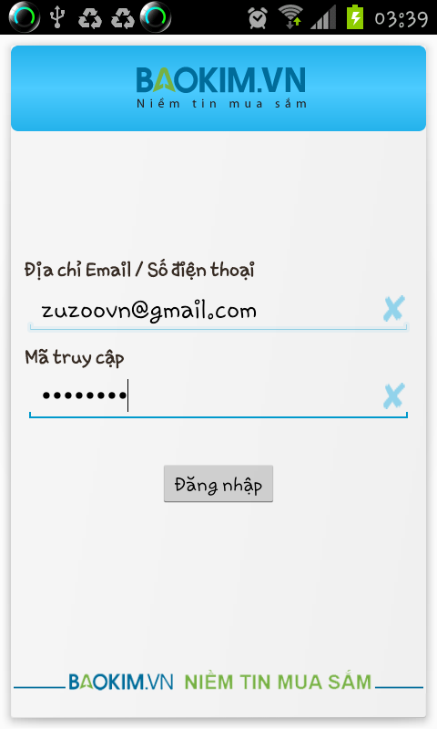
Software Requirement Specification Functional Requirement
Login

Slide 19
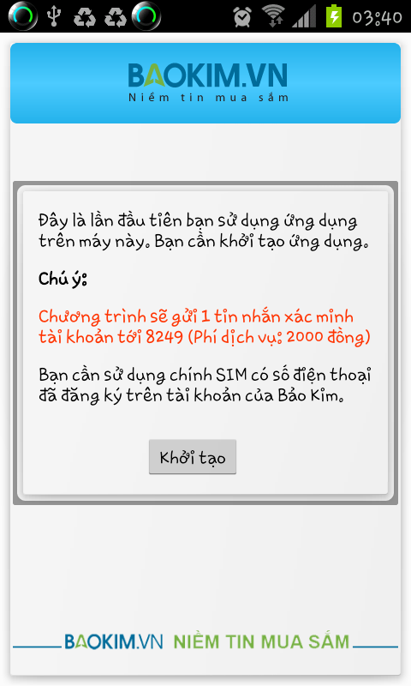
Software Requirement Specification Functional Requirement
Initialize application

Slide 20
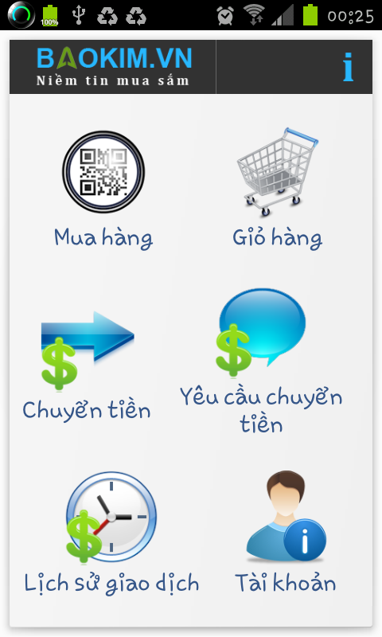
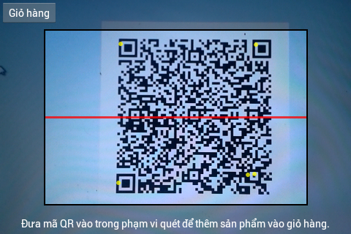
Software Requirement Specification Functional Requirement
Shopping by scanning QR code

Slide 21
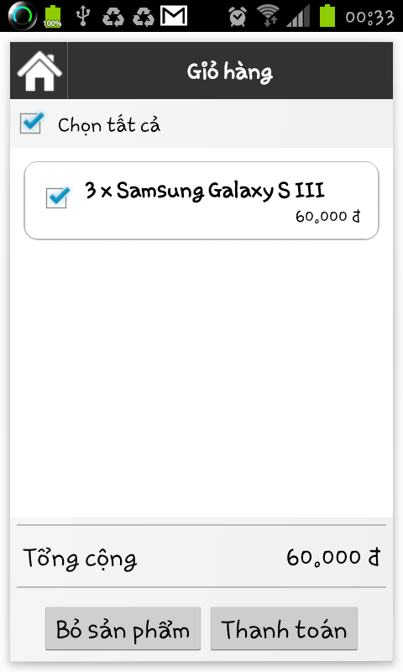
Software Requirement Specification Functional Requirement
Remove products & Make payment

Slide 22
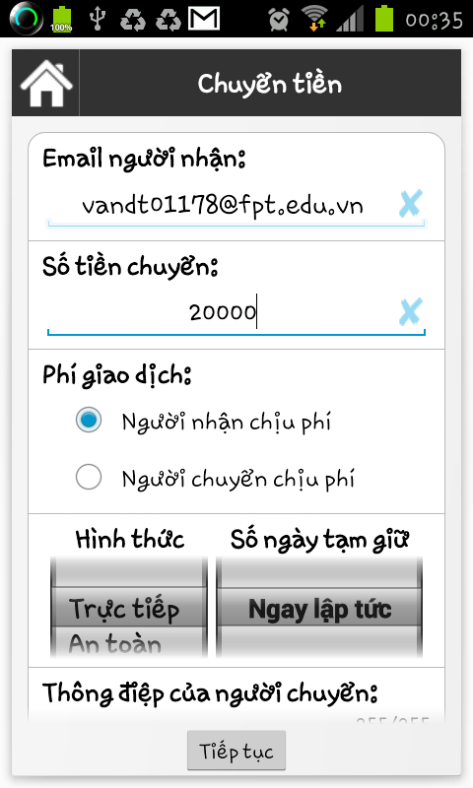
Software Requirement Specification Functional Requirement
Transfer money

Slide 23
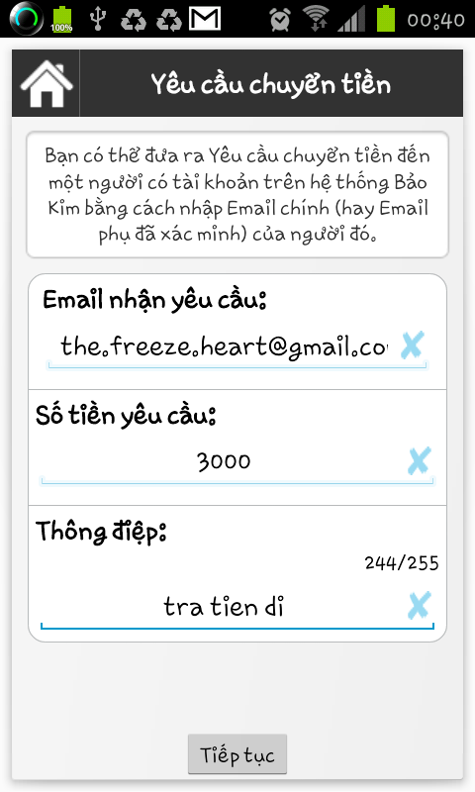
Software Requirement Specification Functional Requirement
Request money

Slide 24
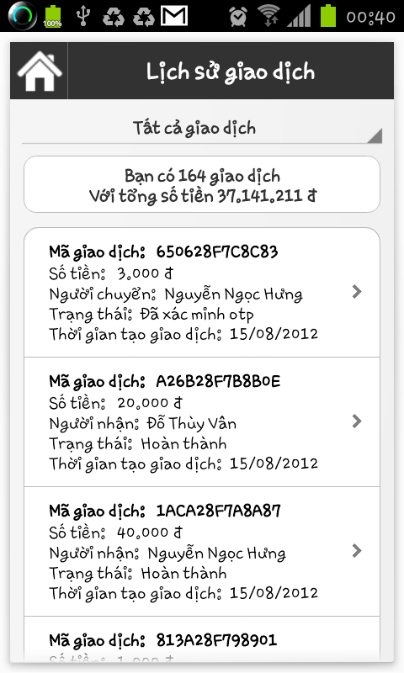
Software Requirement Specification Functional Requirement
View transactions history

Slide 25
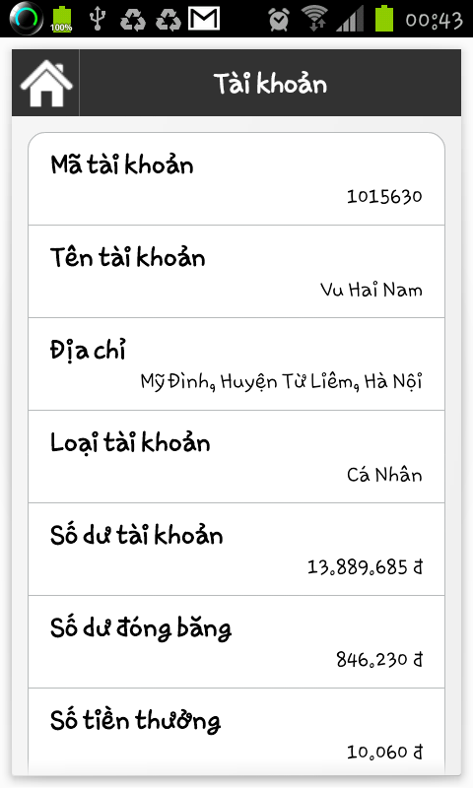
Software Requirement Specification Functional Requirement
View account information

Slide 26
Software Requirement Specification Non-Functional Requirement
Non-Function
Usability
Reliability
Security
Performance

Slide 27
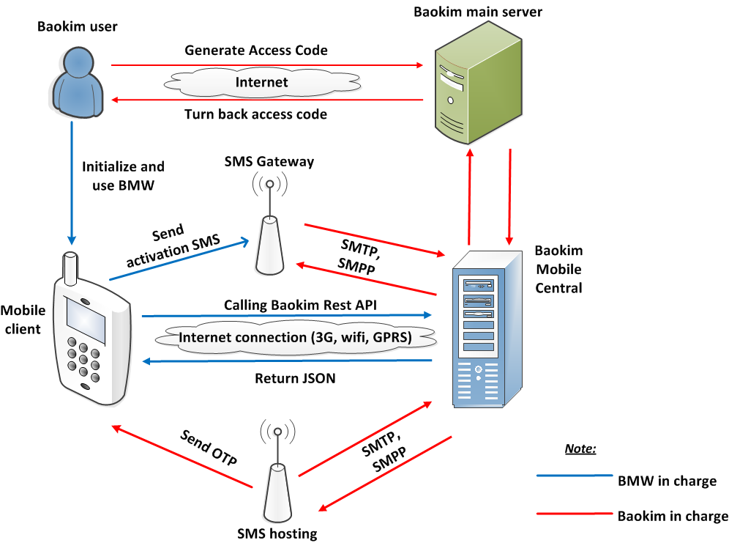
Software Design Description Overall system architecture

Slide 28
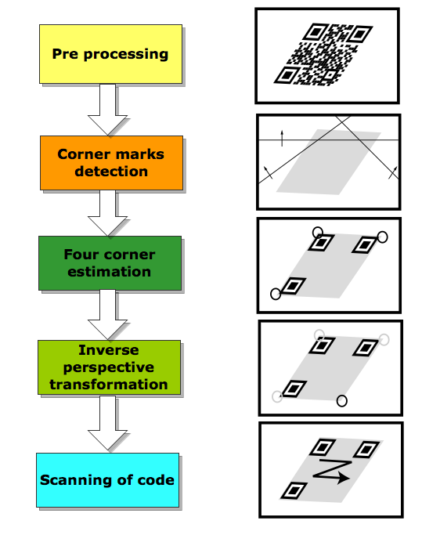
Software Design Description ZXING library

Slide 29
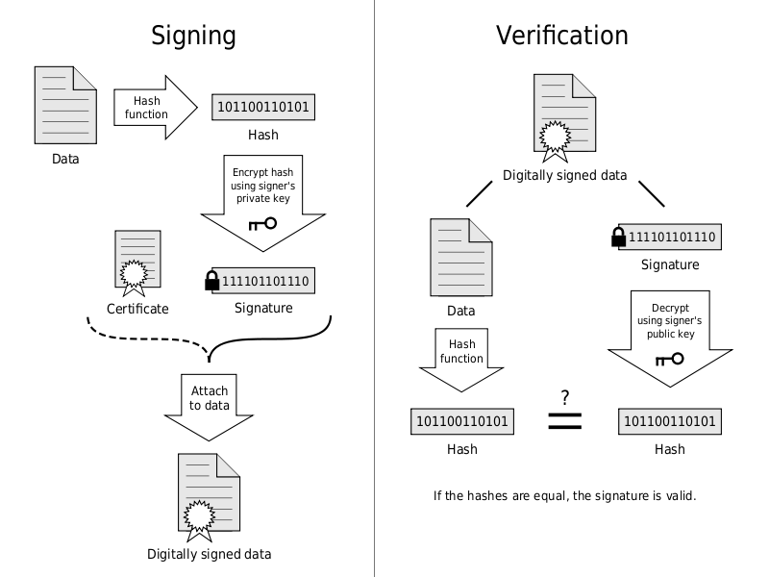
Software Design Description Digital Signature algorithm

Slide 30
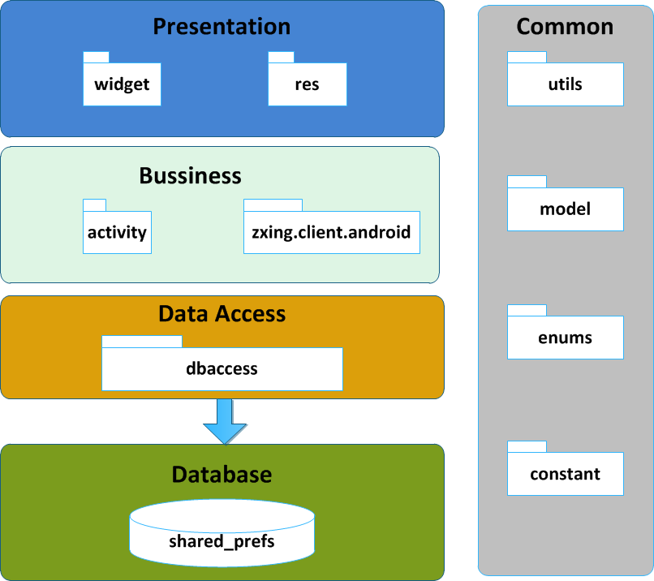
Software Design Description Component diagram

Slide 31
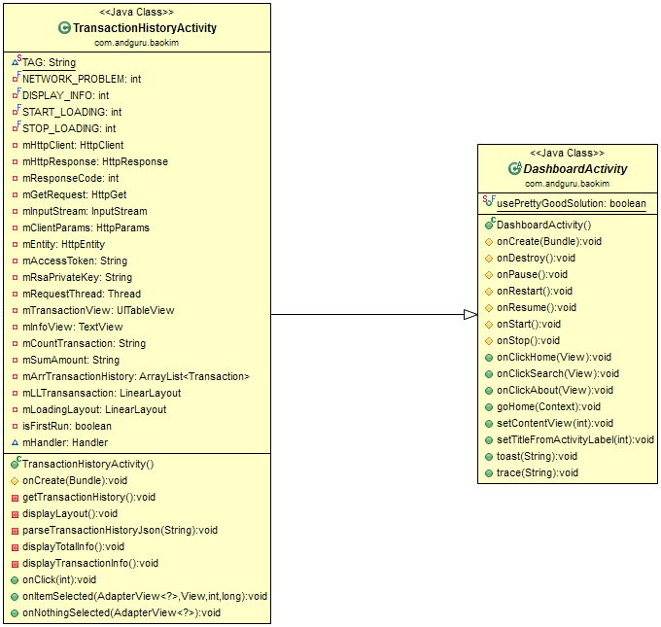
Software Design Description Class diagram

Slide 32
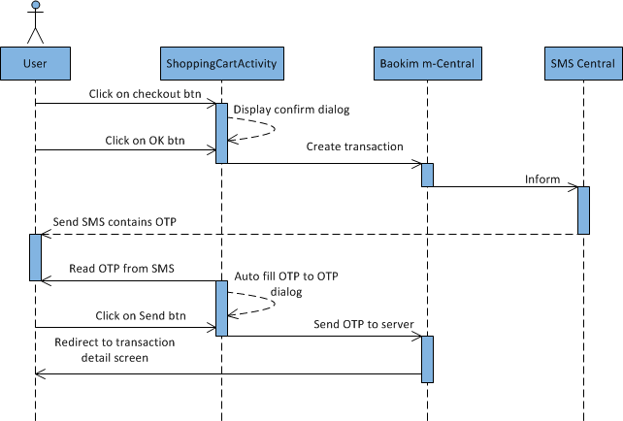
Software Design Description Sequence diagram

Slide 33
Software Design Description Database design
<?xml version='1.0' encoding='utf-8' standalone='yes' ?> <map> <string name="preferences_search_country">-</string> <boolean name="preferences_play_beep" value="true" /> <boolean name="preferences_supplemental" value="true" /> <boolean name="licenseScreenShown" value="true" /> <boolean name="preferences_decode_QR" value="true" /> <boolean name="preferences_copy_to_clipboard" value="true" /> <string name="accessToken">54a6c9f23b90b2cd09ee69bc72d56f09</string> <string name="email">the.freeze.heart@gmail.com</string> <string name="id">1015635</string> <string name="phone_no">84973663054</string> <string name="rsaPrivateKey">MIICXwIBAAKBgQC6AzNJP9I5/Nx6igJnSsKzN096Z9Ot4FMR/q5qhcpxl9ZuNJZv HYWSqoaqHCTyRfGnXslbGwa22USD68bv1nRlw0w90gImnn+3u1DGOBaoNM08T45b XEI4Rr5atJsoluxspvRqjiqDqZwVjo6puiq/mNvSA2um9HpPu6zIOWGd1wIDAQAB AoGBALdmAGLwMe5KiXeoKsZ8x4q7tfkR9Xsx+bV8TatpTjjBZAI0hz329YOt7ig6 p5LXs3M52X2iH/SYMx1+kh5Wa1tY21HoJhCqE7vxUOp9h0mXVpm/QKCQkQYeEqtc QPiiX7ZR94GfGooAsImgEwlIYBn7F96iBKZdFhFfkE3tj/eBAkEA9dw9W8WDbXbJ 0K7cac47KGqv2cZTvBQhPLCBNdKF6CW9gtoCpy9cS5rFl5Mo4/rnE2hZ7CibTvEO HFh8uwRWqQJBAMGvGHDxpN7tdSumt0IvKyj5GGbX+RrNLA58/4ByR3ORj4jWmJ91 958xCSfmpIL7cdlG3hPjpGjKhbZlg+MpoH8CQQDr446fYWcS/JjvdwYVIgCSa6Ij AO1QE8Q79WFTYZSGwscMJ93JyF/2Th3sqw3dhtp0PXehZOh2GkQeoCu0R5pZAkEA sNmxZoeutIN8JpR+5ubs8OeqGVYBNjC7lqsaHW27wlHaDudrysbLiMcchht6gcMY bH3iD6UfnTO3Lhm5eHWs/wJBALaKFFJUIKmKa3M94si7iJTCVXbDby3hV4IZwu90 gIybh1nd/dNoqFYiSROX1I/ayGahMIgt2ix+M33I/E/2u94=</string> <string name="total_amount">12</string> </map>

Slide 34
Testing Testing phases
Software Development Phases
Test Excuse Phases
User Requirement
Acceptation Test
1/8-6/8
Validate
System Requirement Spec
System Test
28/7-31/7
Verify/Validate
Integration Test
21/7-27/7
Architectural
Design Spec
Verify
Detail Design Spec
Verify
Unit Test
15/7-20/7
Coding & Review

Slide 35
Testing Testing process
Test plan
Create test case
Review TC
Execute test

Slide 36
Testing Defect log
Using excel to log defect, includes:
Communicate with developer via SVN or directly

Slide 37
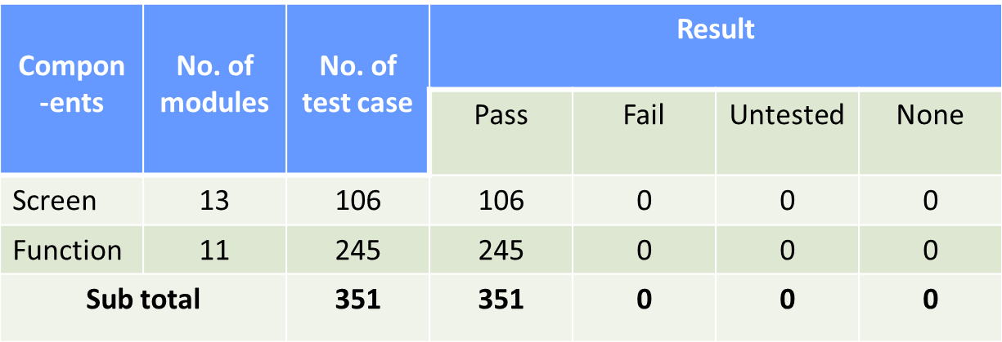
Testing Test result

Slide 38
Testing Acceptance test result

