Slide 1
JKids
CAPSTONE PROJECT
--
Dev Team: BOD Team
Supervisor: Mr. Binh Duong, Tran

Slide 2
Agenda
Introduction
Requirement
Demo
Project Management
Design
Testing
Achievement

Slide 3
Introduction
Introduction
Requirement
Demo
Project Management
Design
Testing
Achievement
Market research
Run on smartphone (Android and iOS)
For kids
Market forecast
Summarize others (similar content)

Slide 4
Introduction (con.)
Introduction
Requirement
Demo
Project Management
Design
Testing
Achievement
JKids
Scenario
Objective
Scope

Slide 5
Requirement
User requirement
play
save
setting
minigame’s requirement
help
System requirement
create, resume, clear journey
database
language, music, sound
pause, resume, replay, quit minigame
guide, confirm, alert
Introduction
Requirement
Demo
Project Management
Design
Testing
Achievement

Slide 6
Requirement (con.)
Introduction
Requirement
Demo
Project Management
Design
Testing
Achievement
Play
Create new journey
Resume current journey
Clear journey

Slide 7
Requirement (con.)
Introduction
Requirement
Demo
Project Management
Design
Testing
Achievement
Quit, Save, Upload high score to Facebook

Slide 8
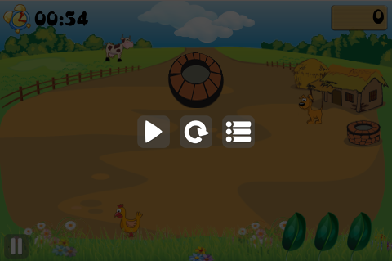
Requirement (con.)
Introduction
Requirement
Demo
Project Management
Design
Testing
Achievement
Minigame’s Requirement
Pause
Resume
Replay
Quit

Slide 9
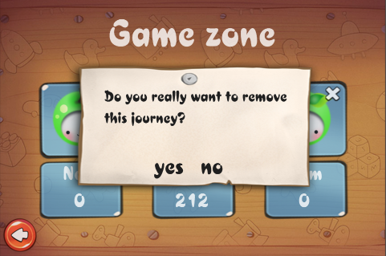
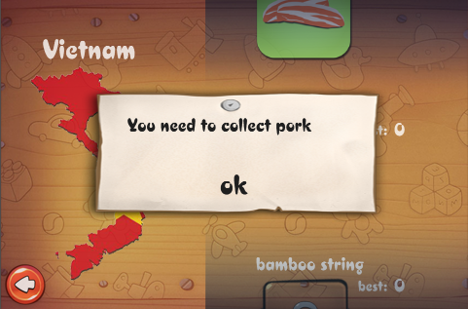
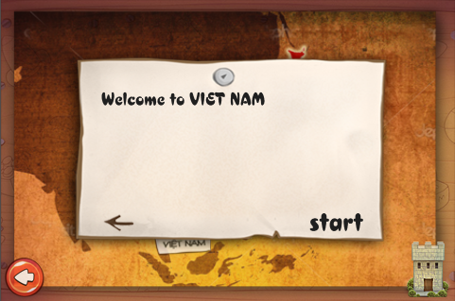
Requirement (con.)
Introduction
Requirement
Demo
Project Management
Design
Testing
Achievement
How to play

Slide 10
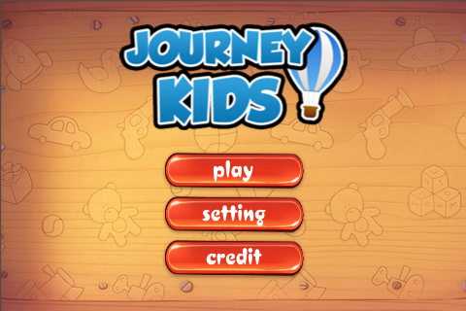
Demo
Introduction
Requirement
Demo
Project Management
Design
Testing
Achievement
Enjoy

Slide 11
Project Management
Introduction
Requirement
Demo
Project Management
Design
Testing
Achievement
Roles and Responsibilities
Software Process Model
Project Management Plan
Risk
Solution
Risk Management
Tools and Techniques

Slide 12
Design
Introduction
Requirement
Demo
Project Management
Design
Testing
Achievement
System Overall
Package Diagram
Database Design

Slide 13
Design (con.)
Introduction
Requirement
Demo
Project Management
Design
Testing
Achievement
System Overall

Slide 14
Design (con.)
Introduction
Requirement
Demo
Project Management
Design
Testing
Achievement
Package Diagram

Slide 15
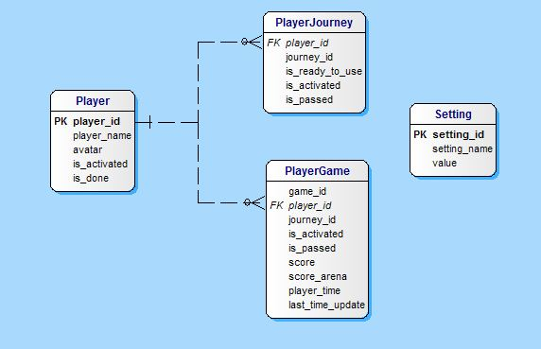
Design (con.)
Introduction
Requirement
Demo
Project Management
Design
Testing
Achievement
Database Design

Slide 16
Testing
Introduction
Requirement
Demo
Project Management
Design
Testing
Achievement
Test Plan
Test Case
Checklist

Slide 17
Achievement
Introduction
Requirement
Demo
Project Management
Design
Testing
Achievement
Capstone project

