Slide 1
CAPSTONE PROJECT
iTest
Group Members | 00164- Dao Van Son
 | 01077- Le Thi Huy Duong
 | 01171- Do Thanh Trung
 | 01330- Nguyen Duc Loc
Supervisor | Nguyen Van Sang

Slide 2
I- Project Overview
II- Project Management
III- Requirements
IV- Architecture & Technology
V- Project Result
VI- Demo

Slide 3
I- Project Overview
Current Situation
Ideas- Project approach
Objectives
Proposal – System Overview, Function Overview

Slide 4
Current Stituation
EOS system is the exam online system which is used as main exam method at FU. FU’s EOS system has been using for the past 5 years to replace completely the traditional examination method
Modules/ Function
Advantages
Disadvantages

Slide 5
Ideas- Project approach
Overcome disadvantages of EOS
The most important thing in exam online is guaranteed that the users cannot cheat or hack while taking exams.
Besides, users result for each exam must be saved precisely.

Slide 6
Objectives
Build a computerized system completely.
Benefits for user Object

Slide 7
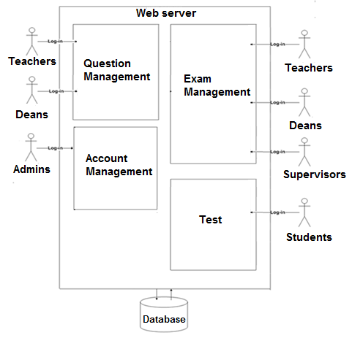
Proposal System Overview

Slide 8
Function Overview
iTest system helps teachers can create exam questions quickly, accurately and abundant.
iTest system helps deans can review/approve/reject all exam file which created by teachers.
iTest system helps supervisor can control and manage the examination process closely and more carefully.
iTest system helps students can take part in the test are fast, convenient and easy.

Slide 9
II- Project Management
Process Model + Project Lifecycle
Organization
Master Schedule
Objectives & Deliverables
Quality Management

Slide 10
Process Model
The Iterative and Incremental model

Slide 11
Project Lifecycle
The Project Life Cycle refers to a collection of phases to accomplish the project’s goals or objectives. The project is divided into four phases :
Initiation
Solution
Construction
Transition

Slide 12
Organization
Initiation
Team decided develop this project follow “Iterative Model”
Prepare development technology, install and configuration C# with Silverlight and SQL server.
Learn more about new technology is Silverlight.
Collect business requirement and processes.
Create draft screen prototypes and create project plan.
In this phase will complete with submit report #1 and report #2.

Slide 13
Organization
Solution
Design database models, use-case model, and develop main function and process.
Create System Requirement Specification; User Interface ;Design first version ERD (Entity Relationship Diagram).
Study the common System Architecture and choice of System Architecture.
Create detail database design.
Create class diagram and UI for: Question Mgt Module, Exam Mgt Module, Admin functions, Do Test Module, Test Report Module.
In this phase will complete with submit report #3 and report #4.

Slide 14
Organization
Construction
Coding and Testing five main modules.
Crate test plan and test cases.
In this phase done submit report #5 and report #6.
Prepare for hardcopy document.

Slide 15
Organization
Transition
Conduct project review-lessons learned
Complete program and documents
Submit the last document and CD source code
In this phase will complete with the final presentations to protect project.

Slide 16
Master Schedule

Slide 17
Objectives & Deliverables
Submit report#1: 21/05/2012
Submit report#2: 28/05/2012
Submit report#3: 12/06/2012
Submit report#4: 28/06/2012
Submit report#5: 27/07/2012
Submit report#6: 15/08/2012
Deliver hardcopy documents : 17/08/2012

Slide 18
Quality Management
Test Approach
How to ensure quality?

Slide 19
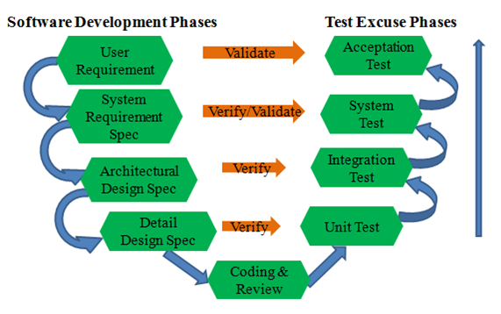
Testing Phase

Slide 20
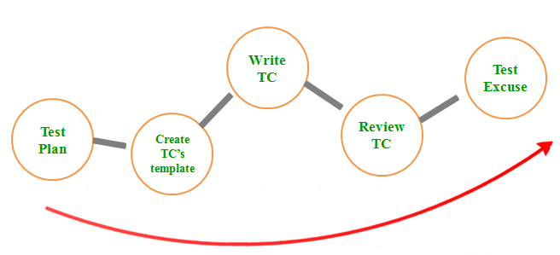
Testing Process

Slide 21
Testing Method and approach

Slide 22
Defect Log
Using excel to log defect, includes:
Communicate with developer via Dropbox or directly.

Slide 23
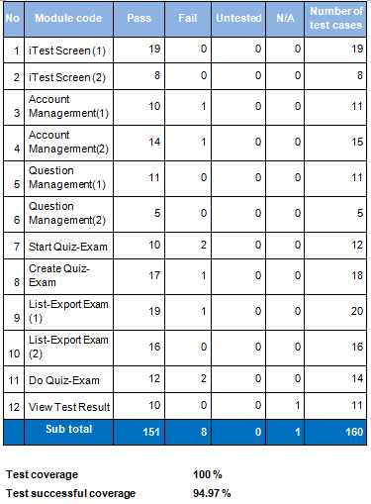
Test Report

Slide 24
III- Requirements
Functionality
Non-functional Requirements Overview

Slide 25
Functionality
Test
Question Management
Exam Management
Report

Slide 26
Non-functional Requirements
Ensure data security capabilities, speed data transmission.
Silverlight security.
Easy to maintain and upgrade .
GUI is clear, friendly and easy to use.
System has clear permission for user and can support for user with multi role.

Slide 27
IV- Architecture & Technology
Architectures Representation
Why choose the technology?
Component View
Database Design Overview

Slide 28
Architectures Representation
RIA Services focuses on the box between the presentation tier and
the data access layer (DAL) to
facilitate n-tier development with a RIA Services client.

Slide 29
Why choose the technology?
Microsoft WCF RIA Services simplifies the traditional n-tier application pattern by bringing together the ASP.NET and Silverlight platforms using the power of WCF for communication.
Silverlight uses technologies that familiar with developers.
Silverlight helps developers and designers work together.

Slide 30
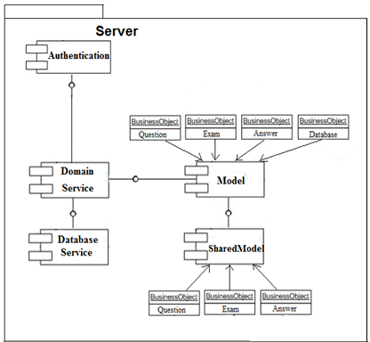
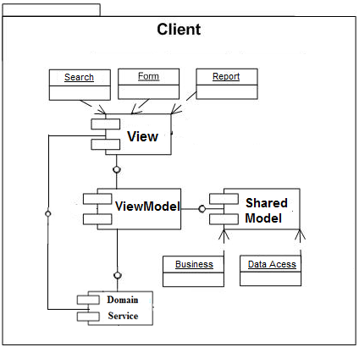
Component View

Slide 31
Database Design Overview

Slide 32
V-Project Result
Objectives compare with result
Lessons learnt

Slide 33
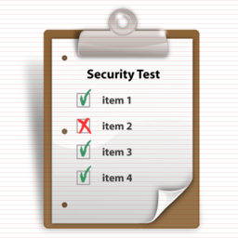
Objectives compare with result
Exceed the initial scope
Objectives: Built system iTest : computerization process, simple use, bringing many functions, saving time,etc.
Overcome disadvantages of EOS system.

Slide 34
Experience gained
Have experience and deeply understand about Silverlight
Understand new technology like WPF, JavaScript, XAML, .NET Framework…
Understand about the general process or work flow of Exam Online Test
Know how to manage project, manage risk, development process
Learn how to develop software projects

Slide 35
Lesson Learn
Understand working in group skill.
Approach with new technology
Good & Bad lesson

Slide 36
Demo

