Slide 1
Wireless Module and Application
Supervisor: Dr. Phan Duy Hùng
Thái Thanh Tùng
Trần Xuân Đạt
Nguyễn Bá Thuận
Bùi Văn Thái
Nguyễn Anh Quân
Trần Hải Linh

Slide 2
Contents
Introduction
Project Management
Implementation
Result & Future Plan
Demonstration & QA

Slide 3
Introduction

Slide 4
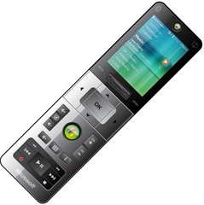
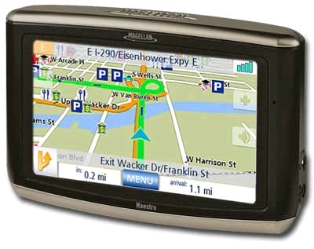
The Idea
The remote Control

Slide 5
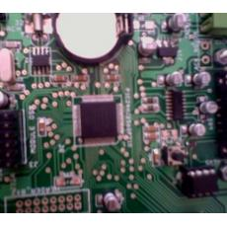
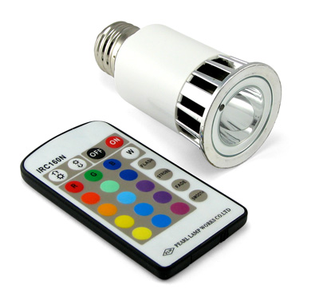
Existing System
Tech Pal LED board controlling over WIFI
LED Lightning Controlling over RF

Slide 6
Proposed System

Slide 7
Project Management

Slide 8
Member Roles
No | Full name | Role | Responsibilities
1 | Thái Thanh Tùng | Project Manager, Developer | Managing, creating documents, coding, testing
2 | Trần Xuân Đạt | Project Technical Leader, Developer | Managing documents, coding, testing
3 | Bùi Văn Thái | Developer, Hardware | Coding, hardware crafting, testing
4 | Nguyễn Bá Thuận | Developer, Quality Assurance | Coding, creating Test Plan, test Case, testing
5 | Nguyễn Anh Quân | Developer, designer | Coding, testing
6 | Trần Hải Linh | Developer, Designer | Coding, testing

Slide 9
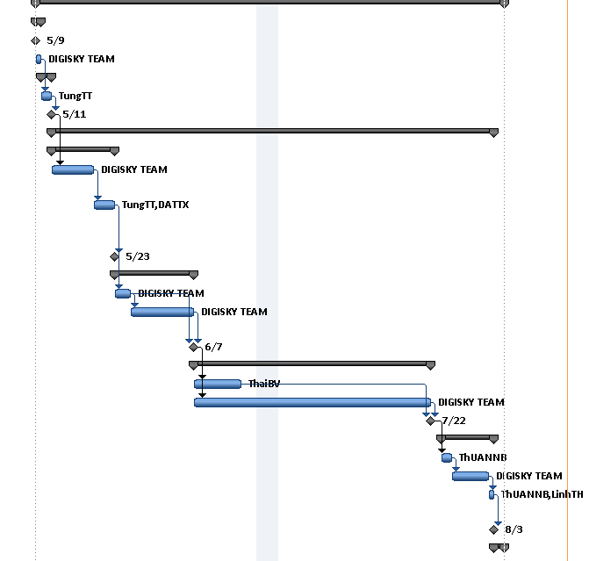
Project Plans
09-May: Register Capstone Project
11-May: Project Plan Approved
23-May: SRS Document completed
07-June: System Design completed
22-July: Implementation completed
03-August: System Test completed

Slide 10
Implementation

Slide 11
WMA Requirements
Functional Requirements
Led Board controlling over GSM Network using software on PC and Mobile.
GPS Locator via GPRS Network.
Non-functional Requirements
Stability, safety, reliability

Slide 12
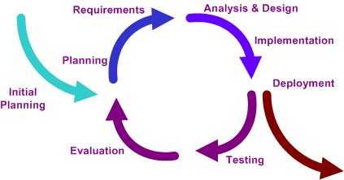
Development Process

Slide 13
WMA System Architecture

Slide 14
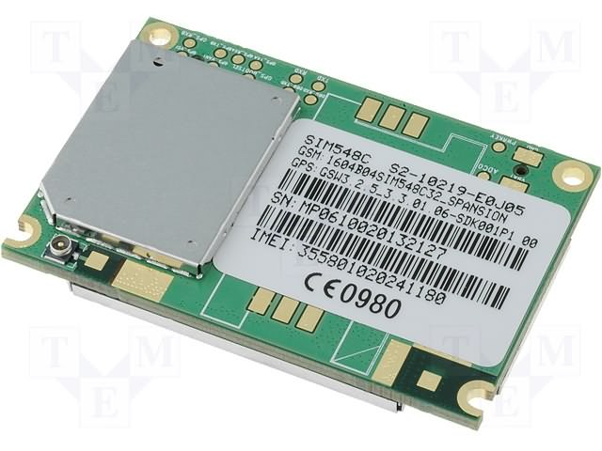
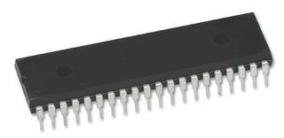
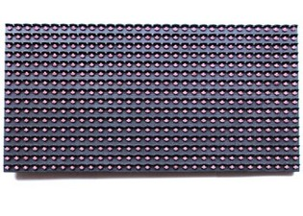
Selection of Devices
SIMCOM SIM548C
MICROCHIP dsPIC30F4013
LED Module 16x32x2

Slide 15
Selection of Tools
Development Tools
Designing & Visualizing Tool
Hardware Designing Tool
Source Code Control Tool
Communicating Toolsd

Slide 16
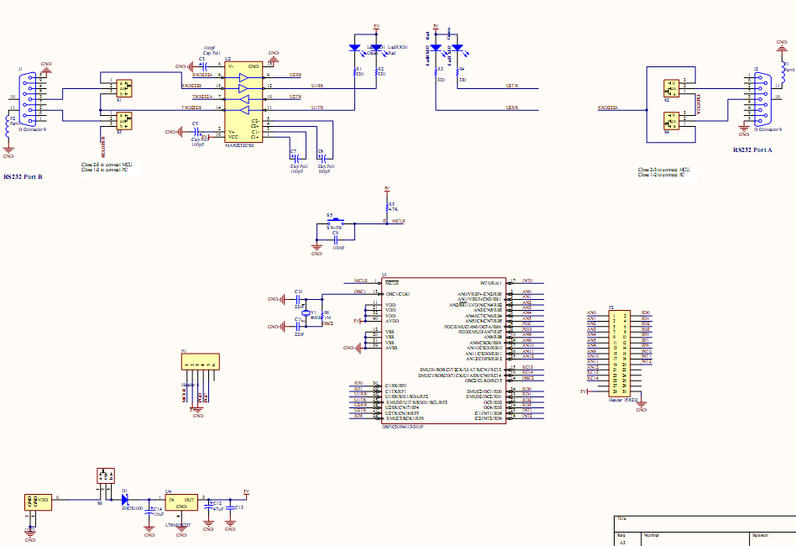
Circuit Design Schematic

Slide 17
Circuit Design Printed Circuit Board

Slide 18
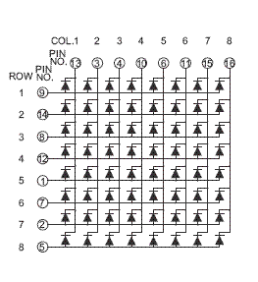
LED board controlling principle

Slide 19
Protocol Design Wireless Module Message Format
1 | 2 | 3 | 4 | 5 | 6 | 7 | 8 | 9 | 10 | 11 | 12 | …
RT | PWD |  |  |  |  |  | DT | EF | SPD | LEN
RT (1 byte): A 8 bits integer that represents the request type. This field must be 0x00.
PWD (6 bytes): A 6 bytes string in ASCII format that represents password.
DT (1 byte): A 8 bits integer that represents data type. This field can be 0x00 for text and 0x01 for image.
EF (1 byte): A 8 bits integer that represents effect ID.
SPD (1 byte): A 8 bits integer that represents effect speed.
LEN (1 byte): A 8 bits integer that represents length of LED data.
Following are number of bytes whose size is defined in LEN field.

Slide 20
Protocol Design(cont’d) Wireless Module Communication Protocol
Pseudo-code of WMADATAHEADER
Struct WMADATAHEADER
{
byte stx; (1 byte)
byte command; (1 byte)
short dataLength; (2 bytes)
}

Slide 21
Protocol Design(cont’d) Wireless Module Communication Protocol

Slide 22
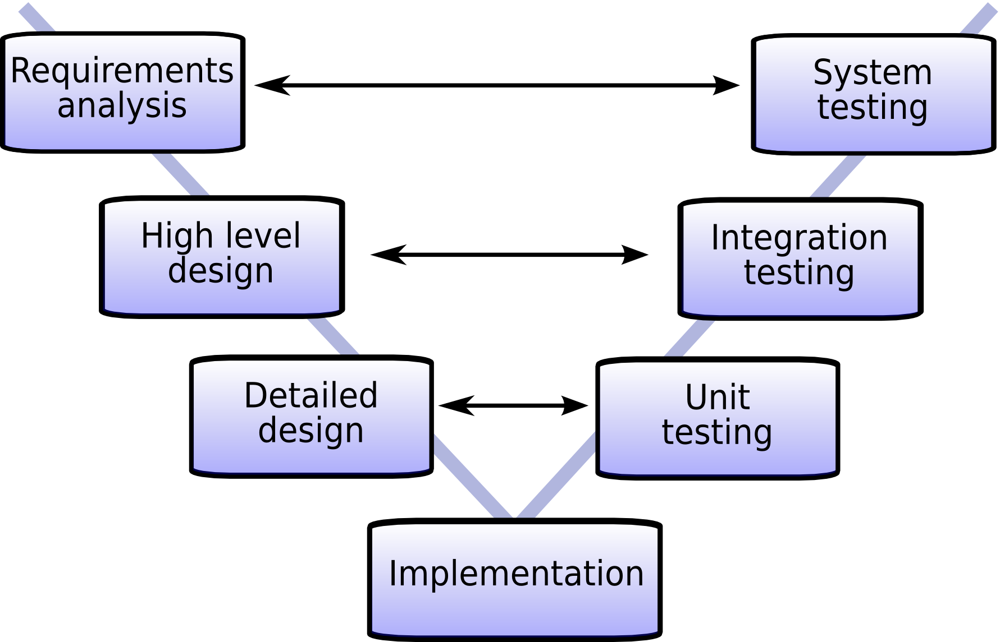
Testing model

Slide 23
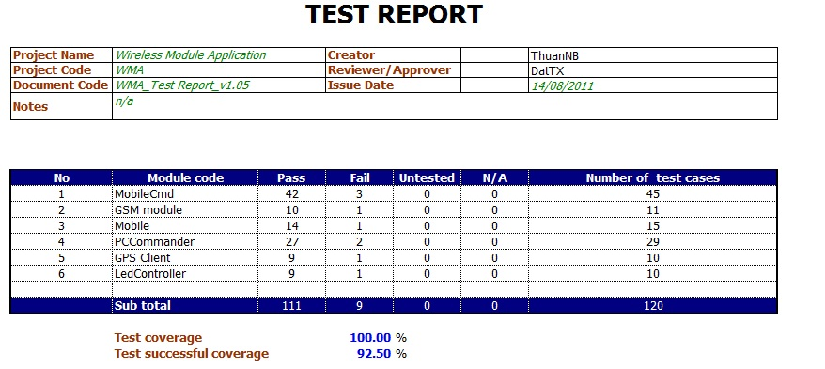
Test Result

Slide 24
Results & Future Plans

Slide 25
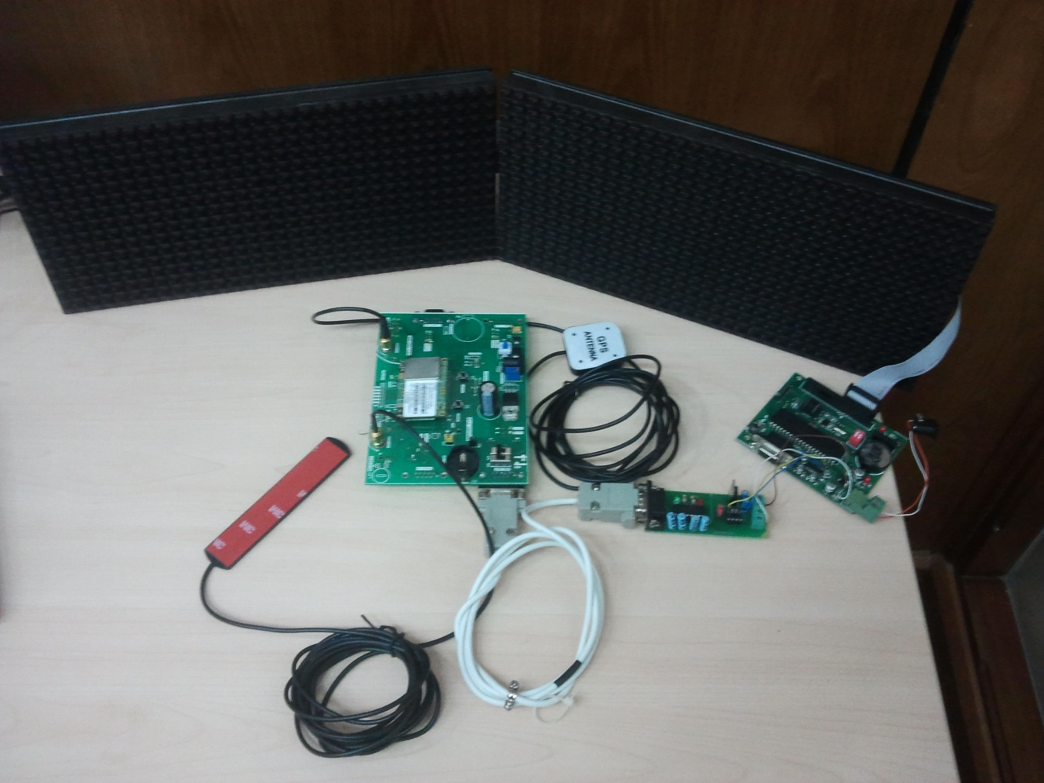
Achievements

Slide 26
Limitations
Depends on GSM Network.
SMS Limitation.
LED Board Effect & Size Limitation
Extremely low GPS signals when put indoor
Low physically security.
Platform-dependant application

Slide 27
Future Plans
Using GPRS instead of GSM
Adapt dsPic30F4013 to the LED controller
Develop commander on Web Application Framework.
Optimize size of printed circuit board.
Box the circuit board into completed packet.

Slide 28
Lessons Learnt
Project management
Working group
Communication

Slide 29
Demonstration & QA

