Slide 1
Vietnamese Education Information Portal
Sapling Group

Slide 2
Members

Slide 3
Contents
Project Introduction
Management Plan
Requirements Specifications Exposure
Selected Solutions and Design Definition
Implementing
Testing and Quality Assurance
Final Judging & Conclusions
Demo
Q&A
2

Slide 4
I. Project Introduction
Initial Idea Introduction
Reasons to choose
Current Systems Comparisons

Slide 5
I. Project Introduction (1/5)
Initial Idea Introduction
Background Information:
The trends in general developing of portals in Vietnam
Before 2005:
Government - Vertical type
2006 to 2008:
Business - Affinity type
2008 to now:
Vertical Information Portal and Horizontal type
Predications in future:
- Web 2.0, Combination type, User focus, Mobile issues

Slide 6
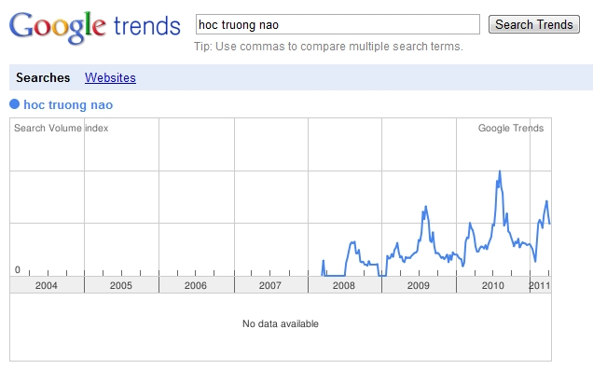
I. Project Introduction (2/5)
Initial Idea Introduction (cont.)
Background Information:
The interests and needs of education information in Vietnam, through Internet

Slide 7
I. Project Introduction (3/5)
Initial Idea Introduction (cont.)
c. Idea Proposal:
Vietnamese Education Information Portal
→ Information providing service
→ Search service
→ Sharing service
→ Content manageableness

Slide 8
I. Project Introduction (4/5)
Reasons to choose
Expected Social Benefits
Team’s Experiences and Ambition

Slide 9
I. Project Introduction (5/5)
Current Systems Comparisons
Education Network of MOET
(http://moet.gov.vn/)
360-Degree Education Portal
(http://giaoduc360.vn)
Educational Enrolment Consulting Website
(http://thongtintuyensinh.com)
Vietnamese Course Supermarket
(http://hieuhoc.com)

Slide 10
II. Management Plan
Project Abstract and Overview
Project Organization
Management Plan

Slide 11
II. Management Plan (1/5)
Project Abstract and Overview
Objectives
Complete and stand-out product
Rich documents
Good marks
Team in High Spirit
Boundaries
Time and Resources
(Require suitable Process Model)
Product Requirements

Slide 12
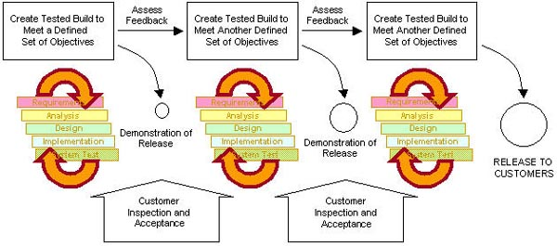
II. Management Plan (2/5)
Project Organization
Software Process Model: Iterative development

Slide 13
II. Management Plan (3/5)
Project Organization (cont.)
Software Process Model: Iterative development
Strong points
Integration and testing is executed continuously
Soon reacting to prevent undetected misunderstanding by feedback in each iteration
There is always something runnable as concrete evidences of the project's status
The team members have the right focus on the issues with high critical impacts to project, leverage lessons learned more effectively

Slide 14
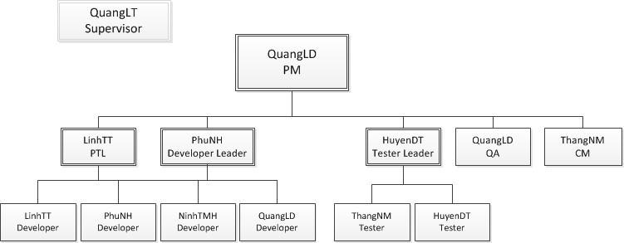
II. Management Plan (4/5)
Project Organization (cont.)
Roles and Responsibilities

Slide 15
II. Management Plan (5/5)
Management Plan
From 03/01/2011 to 02/05/2011
The Plan
Communication Channels
Risk Management

Slide 16
III. Requirements Specifications
Requirements Approaching
User Requirements
System Requirements

Slide 17
III. Requirements Specifications (1/7)
Requirements Approaching
Ways to approach
Surveys and Interviewing
Direct interacting with educators in schools
(Luong The Vinh High School, Nguyen Sieu High School, Hanoi College School of Pedagogy, FPT University)
Direct interacting with E-News administrators (VIT Info)
Steps in summaries and analyzing
Interacting with customers to define requirements
Handling implicit requirements
Handling conflicts in requirements
Creating requirements specification in documents
Having customer review

Slide 18
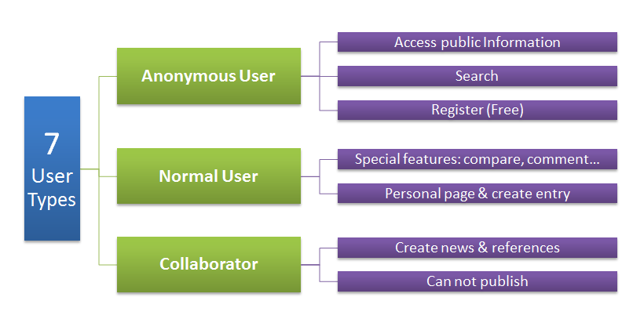
III. Requirements Specifications (2/7)
User Requirements

Slide 19
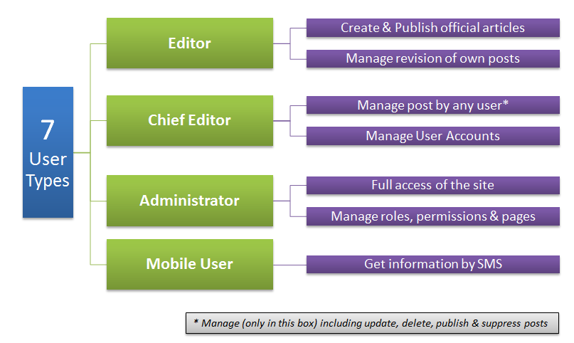
III. Requirements Specifications (3/7)
User Requirements (cont.)

Slide 20
III. Requirements Specifications (4/7)
System Requirements
Features
Front-End

Slide 21
III. Requirements Specifications (5/7)
System Requirements (cont.)
Features
Back-End
View Dashboard | Manage Users | Manage Articles | Manage References
Manage News | Manage Entries | Manage Comments | SMS

Slide 22
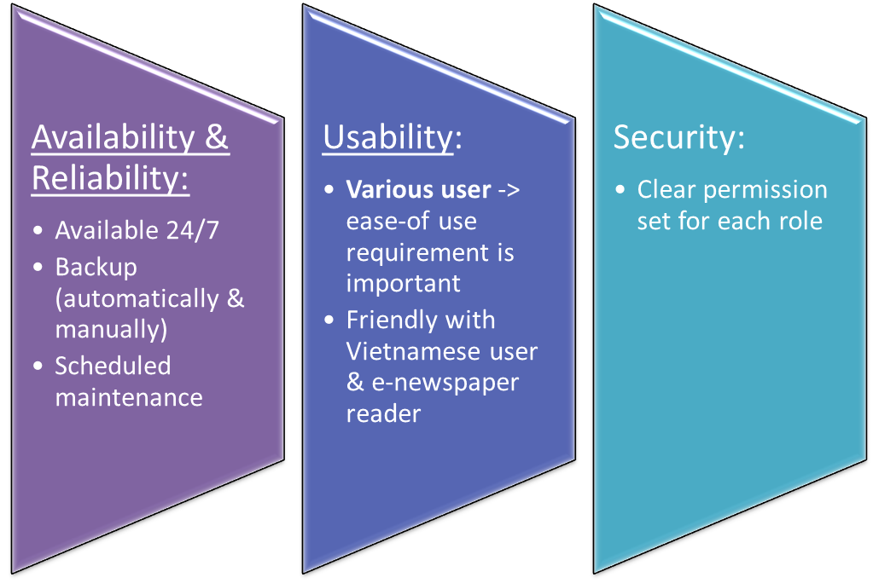
III. Requirements Specifications (6/7)
System Requirements (cont.)
Attributes

Slide 23
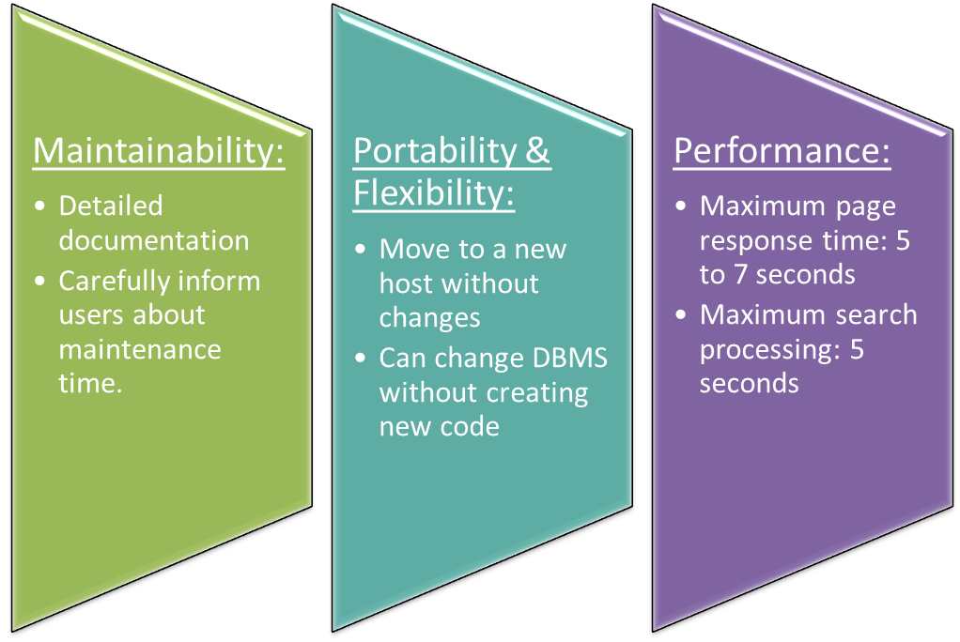
III. Requirements Specifications (7/7)
System Requirements (cont.)
Attributes

Slide 24
IV. Solutions and Design Definition
Posed System’s Problems
Solutions
System Architectural Design
Component Structure
Components
Database Design
User Interface Design

Slide 25
IV. Solutions and Design Definition (1/13)
Posed System’s Problems
Dynamic Web page, UI Management
Data Consistency
Security and Privilege
Performance & Scalability
Web Traffic
Socializing
Mark Forecasting
Searching
SEO

Slide 26
IV. Solutions and Design Definition (2/13)
Solution
N-Tier Architecture
Build an Asp.Net Framework
Dynamic pages , Url Friendly
Dynamic Module, Widgets, Web user controls
Site Security
User & Privilege Management (dynamic Privilege)
Web Traffic reduction solution
Scalability & Flexibility
Searching
SEO Friendly

Slide 27
IV. Solutions and Design Definition (3/13)
Solution (cont.)
Searching
Lucene.Net Search Engine
Database searching using SQL Query
Socializing:
Database and Module must support this feature
Mark Forecasting
Statistic algorithm
Doing research in real life

Slide 28
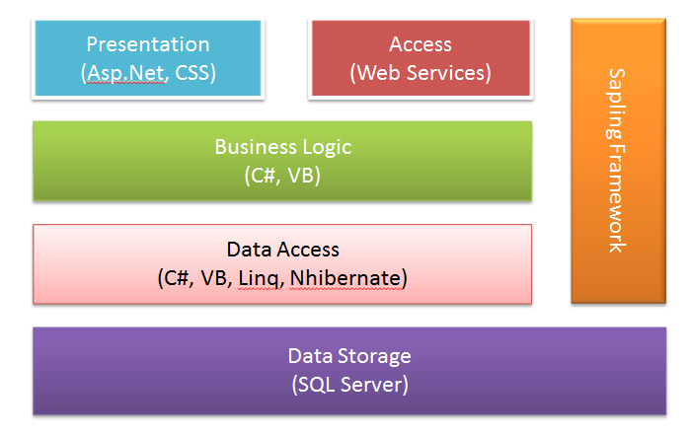
IV. Solutions and Design Definition (4/13)
System Architecture Design

Slide 29
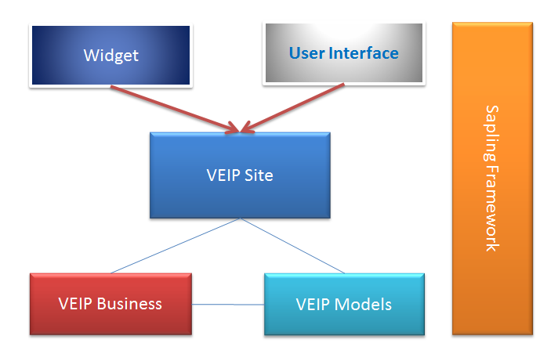
IV. Solutions and Design Definition (5/13)
Component Structure

Slide 30
IV. Solutions and Design Definition (6/13)
Components
VEIP Models
ORM: Each model is mapped with one table in database
Schools Model:
- Int schoolID
- String schoolName
- String schoolCode
Schools
schoolID | schoolName | schoolCode
1 | Đại học FPT | FPT
2 | Đại học Bách khoa | BKA

Slide 31
IV. Solutions and Design Definition (7/13)
Components
VEIP Business
Each Business class related with one main model
Schools Model:
-int schoolID
-String schoolName
-String schoolCode
SchoolBusiness class:
-void Insert(Schools school)
-void Update(Schools school)
-void Delete(Schools school)
-Schools Select(int schoolID)

Slide 32
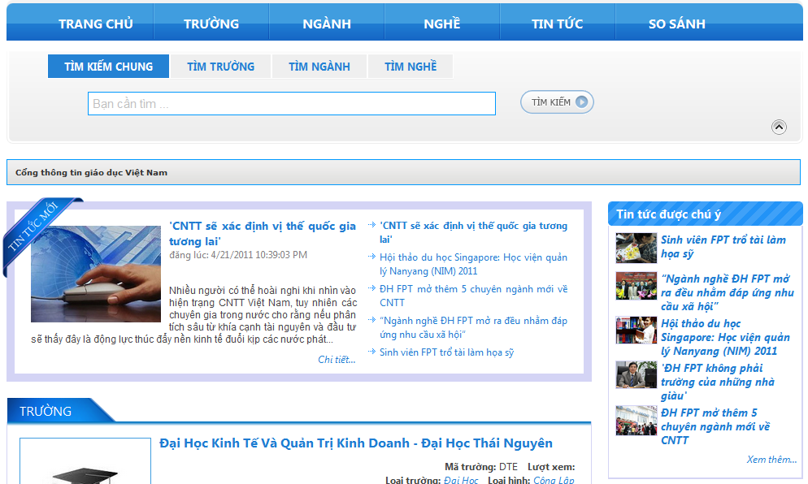
IV. Solutions and Design Definition (8/13)
Components
Widgets/Modules

Slide 33
IV. Solutions and Design Definition (9/13)
5. Database Design
Third Normal Form
Schools
schoolID | schoolName | createdUserID
1 | Đại học FPT | 1
2 | Đại học Bách Khoa | 2
Users
userID | userName | Birthday
1 | Admin | 1989/04/23
2 | Friend_Of_Admin | 1989/12/01

Slide 34
IV. Solutions and Design Definition (10/13)
5. Database Design (cont.)
Revision handling support
SchoolAddInfo
id | schoolID | History | basedId | status
1 | 1 | Thành lập năm 2006 |  | Draft
2 | 2 | Thành lập năm 1956 |  | Published
3 | 1 | Thành lập năm 2005 | 1 | Draft
4 | 1 | Thành lập năm 2007 | 3 | Published

Slide 35
IV. Solutions and Design Definition (11/13)
5. Database Design (cont.)
Support Teamwork and multi-users
Based record
Updating Process
Schools
schoolID | createdDateTime | createUserID | editedDateTime | editedUserID
1 | 2011/04/21 20:11:00 | 1 | 2011/04/21 20:11:00 | 1
User3 | User4
Old editedDateTime: 2011/04/21 20:11:00 | Old editedDateTime: 2011/04/21 20:11:00
Update at 2011/04/21 21:00:00 | Update at 2011/04/21 22:00:00
New editedDateTime: 2011/04/21 21:00:00 | ?
New editedUserID: 3 | ?

Slide 36
IV. Solutions and Design Definition (12/13)
5. Database Design (cont.)
Overflow data avoiding (in revision handling)
Schools
schoolID | schoolName | schoolCode
1 | Đại học FPT | FPT
SchoolAddInfo
id | schoolID | History
1 | 1 | Thành lập năm 2007
SchoolEnrolInfo
id | schoolID | area
1 | 1 | Tuyển sinh toàn quốc

Slide 37
IV. Solutions and Design Definition (13/13)
6. User Interface Design
Based on e-newspaper site design
(vietnamnet.vn, 24h.com.vn)
Based on Testing checklist for Page Design
Code CSS separate from business
Code full UI in FE & customize BE template

Slide 38
V. Implementation (1/3)
CM (Source code, deploy)
Visual Studio 2010, SQL Management Studio 2008
Using SVN and Project Management on Assembla
Differences between local and hosting
Defects (Process)
Test -> Log Defect -> Assign -> Fix -> Re-test
Technical Problems (Process)
Self-investigate
Raise issue if necessary (after 2 hrs.)
Consult Supervisor/Advisor
Notes:
Permission, duong dan, config

Slide 39
V. Implementation (2/3)
Business Problems
Check requirement again
Team discussion
Give solution
Implement solution
Team Problems
Resource exhausted.
Conflicts between members.
Communication.
Notes:
Permission, duong dan, config

Slide 40
V. Implementation (3/3)
Data problems
Collect Data
Data tool
Notes:
Permission, duong dan, config
Đảm bảo nguồn data cho 1 website với chức năng chính là tìm kiếm thông tin
Dữ liệu cho các phần dự đoán điểm thi.
Hỗ trợ nhập liệu data một cách nhanh chóng và hiệu quả nhất

Slide 41
VI. Testing and Quality Assurance (1/7)
Test Policies
Test Plan
3. Running Test
4. Test Result
5. Difficulties

Slide 42
VI. Testing and Quality Assurance (2/7)
Test Policies
“Test without good faith”
“Find bugs as soon as possible and always make sure they have been fixed”
“No outstanding high severity faults”
“Ensuring the product covers key features and attributes requirements”

Slide 43
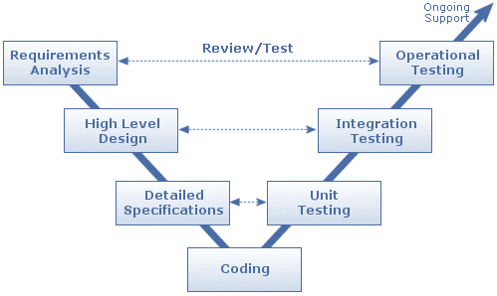
VI. Testing and Quality Assurance (3/7)
Test Planning
Test Model: V-model
Large project scope
Variation among plan, design and implementation
Test Types:
Functional Testing
(Business & GUI)
Compatibility Testing

Slide 44
VI. Testing and Quality Assurance (4/7)
Running Test
Study business, requirements
Develop test cases and test suite
Run all tests after any feature/code is added, updated or removed
Log defects, bugs and inform to developers
Re-run tests and make sure defects are fixed or accepted by team

Slide 45
VI. Testing and Quality Assurance (5/7)
Test Result

Slide 46
VI. Testing and Quality Assurance (6/7)
Test Result (cont.)
Total Test Cases: 261
Pass: 226
Untested: 35
Test coverage: 86.92%
Detected Defects: 80 defects (Apr-22nd)
Resolved Defects: 79 defects (Apr-22nd)

Slide 47
VI. Testing and Quality Assurance (7/7)
Difficulties
Change Management
Lack of defect management tool for higher performance
Large Project Scope
Lack of resource
High pressure

Slide 48
VIII. Final Judging & Conclusions
Product Judging
Project Judging

Slide 49
VIII. Final Judging & Conclusions (1/5)
Product Judging
Overall (to April 22nd)
1 | Group
6 | People
109 | Days
68 | Key User-cases
261 | Test case
80 | Defects
> 550 | Document pages
833 | Revision
Approximately 15k | Lines of code
Notes:
- Những con số nói lên công sức bỏ ra của nhóm chúng em suốt thời gian qua

Slide 50
VIII. Final Judging & Conclusions (1/5)
Product Judging
Advantage of VEIP
http://thongtintuyensinh.com
http://moet.gov.vn/
http://giaoducvietnam.vn/
http://giaoduc360.vn
http://hieuhoc.com
Notes:
thongtints.com: Có hỗ trợ người viết và cộng tác viên tự cập nhật mah không cần phải chờ đến site manager, them co quan ly admin
Moet: Thông tin nhiều và update liên tục.
Giaoducvietnam: Chức năng search
Giaoduc360: Thông tin mới, hữu ích, rất nhiều được cung cấp từ phía nhà trường.
Hieuhoc: chỉ chú trọng vào các cource ngắn hoặc các chtr liên thông, du học tại VN.

Slide 51
VIII. Final Judging & Conclusions (2/5)
Product Judging (cont.)
Current Limitations
+ Some pages are not ready to be published
+ GUI is still in upgrading
Notes:
Có những page trong scope nhưng chưa làm được như: ngành, derparment,…
Giao diện hiện tại đã ổn nhưng chưa phải là tốt nhất

Slide 52
VIII. Final Judging & Conclusions (3/5)
Product Judging (cont.)
Expectation in Future
Multi- language
Mobile Apps
Multi- media

Slide 53
VIII. Final Judging & Conclusions (4/5)
Project Judging
Project Summary

Slide 54
VIII. Final Judging & Conclusions (5/5)
Teamwork.
Project Judging (cont.)
What we found

Slide 55
VIII. Final Judging & Conclusions (5/5)
Teamwork.
Improve skill.
Project Judging (cont.)
What we found

Slide 56
VIII. Final Judging & Conclusions (5/5)
Teamwork.
Improve skill.
Plan management, time management.
Project Judging (cont.)
What we found

Slide 57
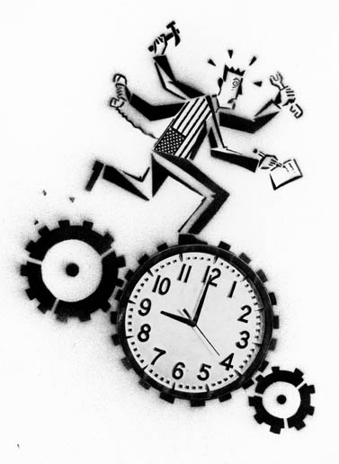
VIII. Final Judging & Conclusions (5/5)
Teamwork.
Improve skill.
Plan management, time management.
Over time.
Project Judging (cont.)
What we found

Slide 58
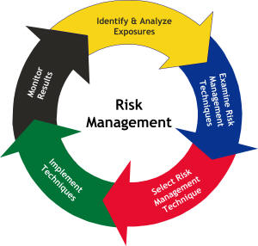
VIII. Final Judging & Conclusions (5/5)
Teamwork.
Improve skill.
Plan management, time management.
Over time.
Risk management.
Project Judging (cont.)
What we found

Slide 59
VIII. Final Judging & Conclusions (5/5)
Teamwork.
Improve skill.
Plan management, time management.
Over time.
Risk management.
Defect and issues.
Project Judging (cont.)
What we found

Slide 60
VII. Demo
Final Local Version
Deployed System

Slide 61
IX. Q & A
We expect and appreciate your questions

Slide 62
Thanks for your Attention!

