Slide 1
Penny Auction Website
Capstone Project
BID
Supervisor
Huỳnh Anh Dũng
Nguyễn Thị Hòa- 00624
Nguyễn Duy Khánh- 00459
Huỳnh Hiếu Nghĩa- 00760
Bùi Sơn Tùng- 00510
Nguyễn Đức Mỹ- 00025
Đào Trọng Linh- 00433
Bid It Team

Slide 2
Contents
Introduction
Project Management
Software Requirement
Architecture
Testing
Demo

Slide 3
Introduction
Online Auction
Participant bids Products over the network
Penny Auction
Is type of Online Auction
Participants must pay a non-refundable fee to place a small incremental bid

Slide 4
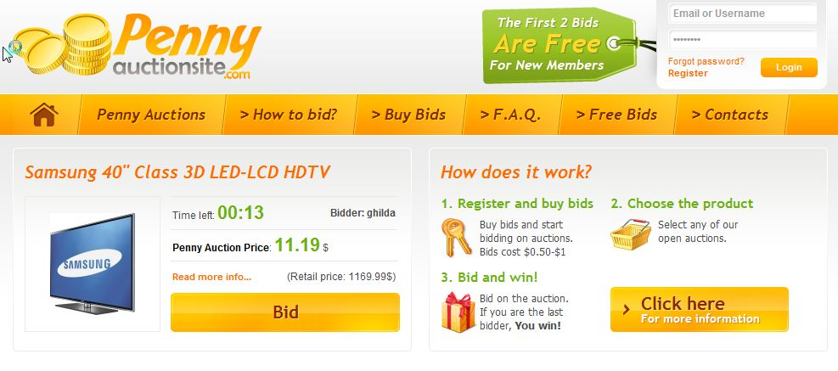
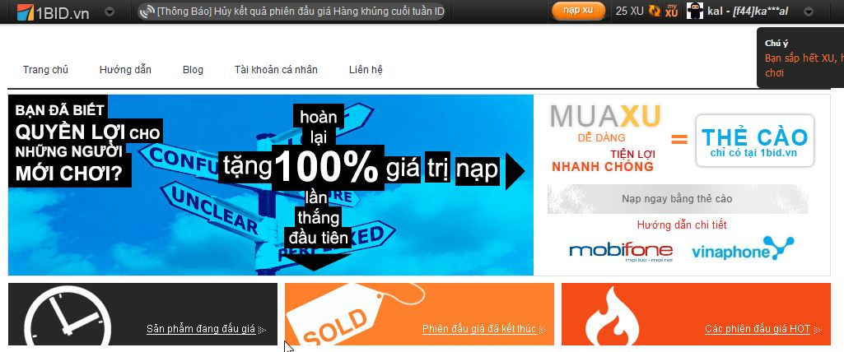
Introduction

Slide 5
Introduction
Penny Auction website – Bid It Team
Participants can bid easily, fast
Participant can pay the won product(s) or buy Penny by internet banking system.
Administration manages auction systems

Slide 6
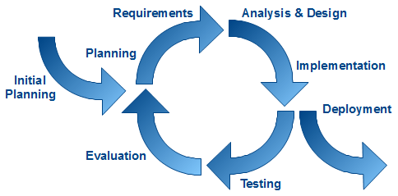
Project Management
Software Process Model
Develop iteratively
Manage requirements
Use components
Model visually
Ensure quality

Slide 7
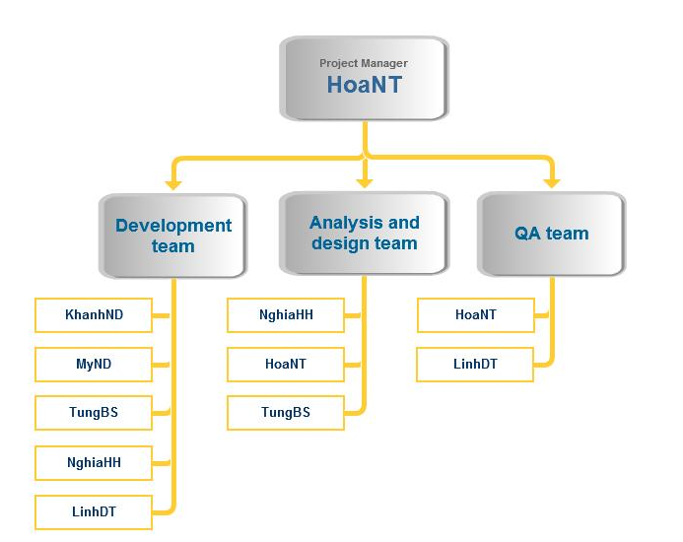
Project Management
Organization Structure

Slide 8
Project Management

Slide 9
Project Management

Slide 10
Project Management

Slide 11
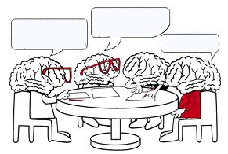
Project Management
Penny Auction website – Bid It Team
Meeting Schedule
With Team Members
With Team Supervisor
Report their tasks in previous week
Issues, knowledge and rules will be shared
PM conduct the discussion about the plan for next week
activities, the issues will be discussed and reported
supervisor will instruct the direction for project team to deal with the problems

Slide 12
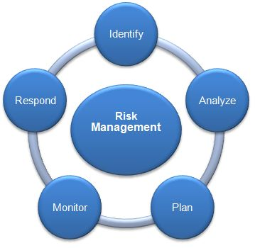
Project Management
Risk Management
Human Resource
Discipline of team members
Lack of team work
Time and Communication
Team members can not spend enough time for project
Technical
In-experience in designing e-commerce project
Hard to connect team member due to the difference place

Slide 13
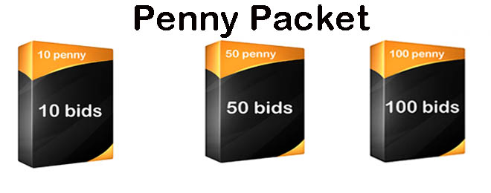
Software Requirement
User Requirement

Slide 14
Software Requirement
Auction
Bid real time
Bid log
Management
Auction management
User management
Internet banking
Statistic

Slide 15
Software Requirement
Non-function Requirement
Availability
Reliability
Security
Maintainability
Portability
Performance

Slide 16
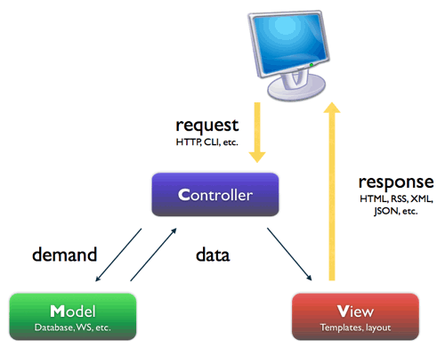
Software Architectural Design
Software Model
MVC3

Slide 17
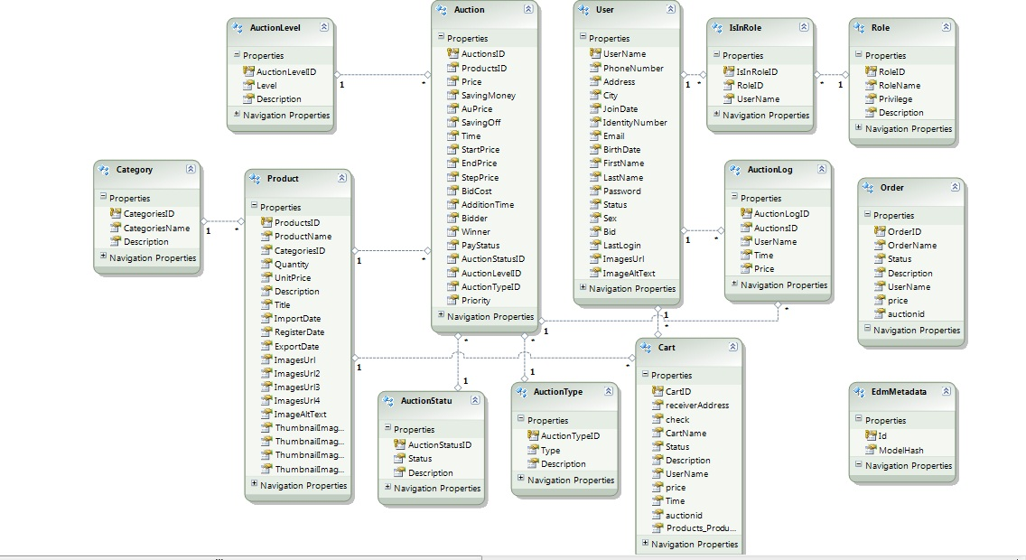
Software Architectural Design
ERD
Notes:
Gen lại ERD

Slide 18
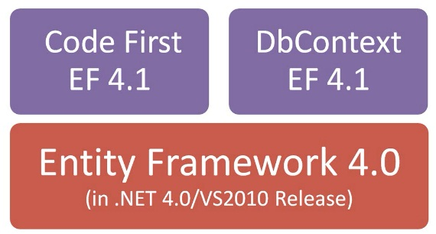
Software Architectural Design
Technology

Slide 19
Software Architectural Design
Tool

Slide 20
Testing
Testing Strategy
Developing
Testing
Requirements
Acceptance
System design
System
Architecture design
Integration
Module design
Unit
Coding

Slide 21
Testing
Testing Strategy
Test Process
Create TC template
Write TC (based on SRS)
Review TC
Test Execution
Test Plan

Slide 22
Testing
Testing Strategy
Test Process
Test Report

Slide 23
Testing

Slide 24
Result
Lesson learnt
Improve technical skill
Soft Skills
Risk and issues management

Slide 25
Demo
BID

Slide 26
Thank You !
BID

