Slide 1

Place Sharing Network
Supervisor: Mr. Huỳnh Anh Dũng
Students:
Võ Thanh Quảng
Lê Minh Quang
Trương Quang Dũng
Nguyễn Minh Quốc
Nguyễn Minh Vượng

Slide 2
Contents
Introduction
Project Management Plan
Requirement Specifications
Design Description
Implementation
Test Documentation
Summary
Demo & Q&A

Slide 3
Part I: Introduction
The People
Background
Literature Review
Our Proposal
Products

Slide 4






The people
Mr. Huỳnh Anh Dũng
Võ Thanh Quảng
Nguyễn Minh Vượng
- Instructor
- Developer
- Tester
- Developer
- Tester
- Project Manager
- Designer
Nguyễn Minh Quốc
- Developer
- Tester
Lê Minh Quang
- Configuration Manager
Trương Quang Dũng
- Developer
- Tester
- Developer
- Tester
- Quality Assurance
- Test Lead

Slide 5
Background
1
20% search queries on the Internet: finding places
Results are not determinable enough
3
Make users confused
4
2
End up going to wrong places!

Slide 6




Literature review

Slide 7

Google Places
1
Focuses on business owners
2
Not fully supported in Vietnam
Many Vietnamese only know Google Search and Gmail!
3
Notes:
Focuses on business owners
Not fully supported in Vietnam
And the fact that many Vietnamese don’t know other (hundreds) products of Google other than Google Search and Gmail

Slide 8
Facebook Places
See where your friends are and share your physical location
1
2
Location-based social network
3
Facebook is banned in Vietnam ☹
Notes:
A Facebook mobile application that allows you to see where your friends are and share your physical location
It’s a location-based social network
And… Facebook is banned in Vietnam

Slide 9


Thodia.vn
A place sharing network of Vietnam
Mainly in HCM city
Not much information
Not many rating factors
Notes:
A place sharing network of Vietnam
Mainly in HCM city
Not much information
Not many rating factors

Slide 10
Infomap.vn
Another place sharing network of Vietnam
No sorting feature when searching
No rating
Too many places with low quality
Notes:
Another place sharing network of Vietnam
No sorting feature when searching
No rating
Too many places with low quality

Slide 11
Our proposal
Vietnamese users
Vietnamese address
Contribution and opinion from all users
Give the best information they need
Vietnamese
Information
Network
User Friendly
More interesting
More spam-free
Make the system user-friendly
Have best performance
Notes:
Specialized for Vietnamese users and Vietnamese addresses
With the contribution and opinion from all users, the places are correctly rated and will give the users the best information they need
Utilize social network model to make the process of contributing information more interesting and more spam-free
Utilized newest technologies to make the system user-friendly and have best performance

Slide 12

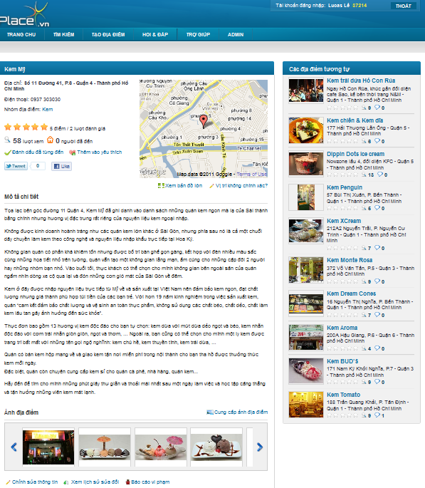
Products
Mobile apps
(out of scope)
Website

Slide 13
Part 2: Software Project Management Plan
The proposed system
Development Environment
Process
Project organization
Project Planning

Slide 14

The proposed system
Front-end:
Anyone : visit, search for places of any kinds
Authenticated users:
  Post places
  Evaluate places
    Rating
    Review
    Comments
    Visiting…
  Edit place’s information
Ask for particular purpose (Q&A)
Integrate well with some other popular networks

Slide 15
The proposed system
Manage Users
Manage Spam Report
Manage Places
Back-end
Manage Address Parts
Manage Categories
Manage Contacts
Manage the most important activities

Slide 16

The proposed system
Commercial ability:
Place owners
  Their places to be the first item in search result or home page
  Post special offers on their places’ page
Service for verifying places
Ad banners on the site
Selling mobile applications

Slide 17


Development Environment
Development Hardware
3 Gb of RAM
100Gb of hard disk
Core 2 Duo 2.0 Ghz
Server Hardware
4 Gb of RAM
100Gb of hard disk
Core 2 Duo 2.0 Ghz

Slide 18







Development Environment

Slide 19
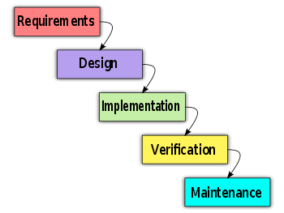
Process
Follow Waterfall model

Slide 20
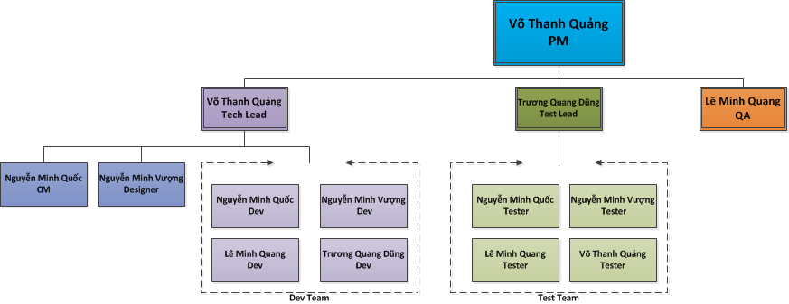
Project Organization

Slide 21

Project Planning
Follow Capstone Project requirements
Buffer: 20% (about 3 weeks)
“Consumed” buffer: 2 weeks
Submit all reports on time

Slide 22
Part 3: System Requirement Specifications
User Requirements
System Requirements
Non-functional requirements*

Slide 23

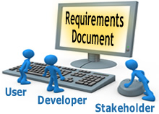
User requirements
User
Administration
Ranking
Comments / Answer
Places
Search

Slide 24
Users
Create a new account & login to the system
Change password & information
Search for places
Create & edit places
View & compare history of places
Write, delete, vote & report comments
View, upload images, rate & share .. places

Slide 25

Administration
Categories
Users
Advertises (out of scope)
Spam reports
Places
Contacts
Address Parts
Use all functions in the system

Slide 26
Ranking
Use User Point
  Starter point : 10
  Create a place: +20
  Spam: - 25
  Can’t earn >100 points a day
  Other activities: future
Normal user: < 1000 Points
Trusted user: >= 1000 Points

Slide 27

Ranking
Only trusted users:
  Edit place without pending
  Approve revision
  Upload images without pending
List :
  20 newest places
  10 hottest places
  20 newest question
  10 most contributors

Slide 28

Comment / Answer
Any authenticated users can comment/answer
Can be voted, reported
Highlight 2 most voted

Slide 29
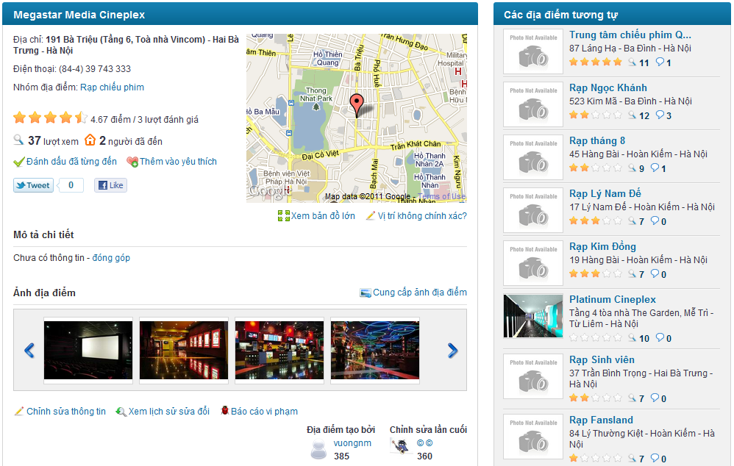
Places
Name
Detail Address
District
City/Province
Description
Phone number
Category
Rating
Visited number
View number
Place Images
Suggestion List: 15 hottest and newest places in the same category and area

Slide 30
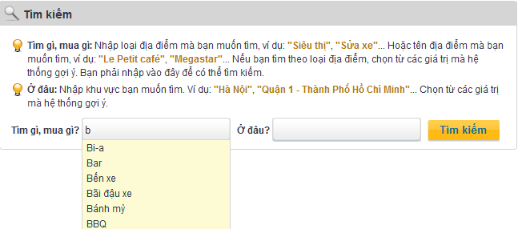
Search
Search
Search by category, place name, and area
Keyword suggestion

Slide 31
System requirements
Document requirements for each use case
Each includes:
  Use case diagram
  Actor
  Summary
  Goals
  Triggers
  Preconditions
  Post conditions
  Success scenarios
  Alternative scenarios
  Exceptions
  Relationship
  Business rules
  Description
  Screen
  Data field definitions
  Button definitions

Slide 32
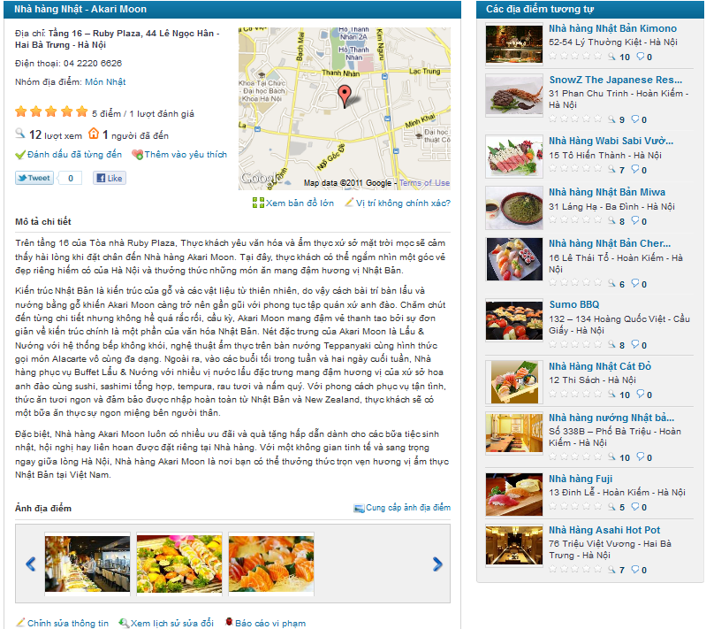
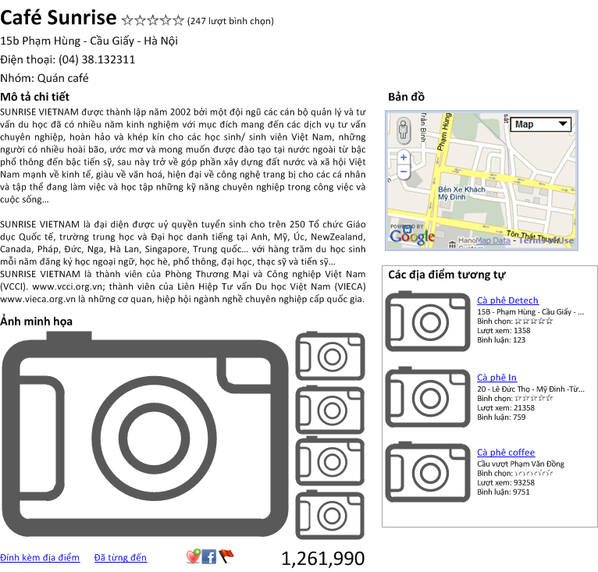
Screen: Before & After

Slide 33
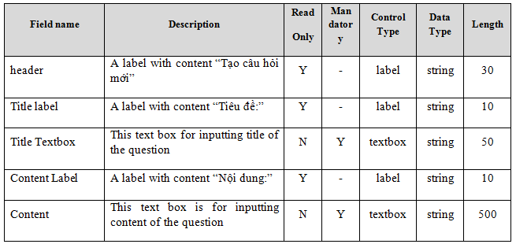
System requirements
Data Fields Definition:
Field name
Description
Read-only
Mandatory
Control type
Data type
Length

Slide 34
Non-functional requirements
Usability
Availability
Reliability
Security
Security
Performance
Maintainability

Slide 35
Non-functional requirements
Usability:
Front-end language: Vietnamese
UI: elegant, simple, out-standing
Searching tool: easy to use
Provide a help page to support novice users
Easy to deploy

Slide 36
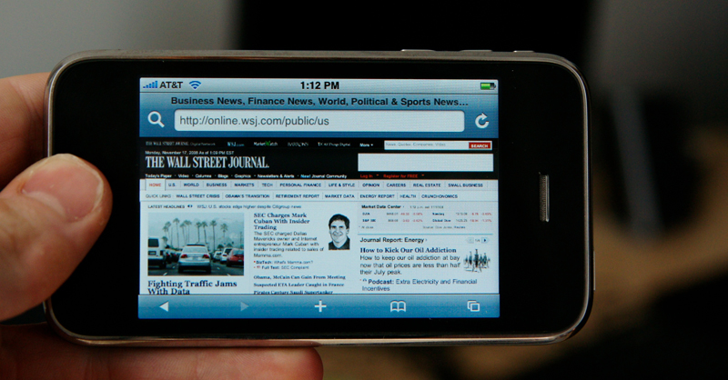

Non-functional requirements
Usability (future):
Mobile view
Support disabled people

Slide 37


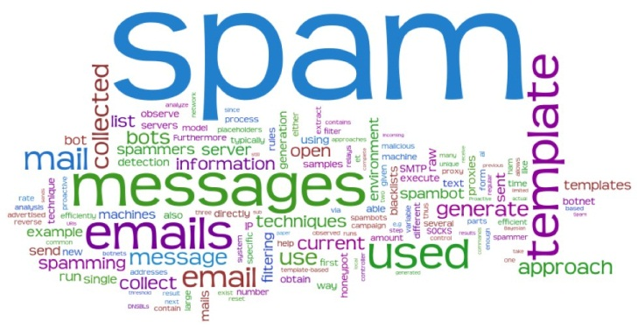
Non-functional requirements
Reliability:
Initial data: collected carefully and correctly
Database and files: backed up regularly
Spam filter
Rating system: must be reliable

Slide 38

Non-functional requirements
Reliability (don’t believe these ☺):
Rate of fault occurrence (ROFO): 0.005
Mean Time Between Failures (MTBF): 1 month
Mean Time To Repair (MTTR): 1 day
Maximum Bugs or Defect Rate: 5 bugs / KLOC

Slide 39
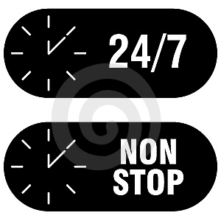
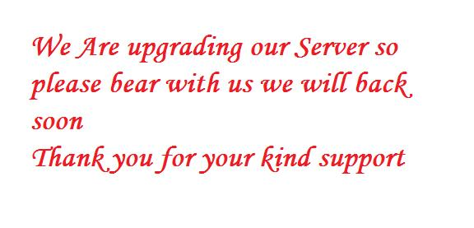
Non-functional requirements
Availability:
Run 24/7
Can be turned off when upgrading

Slide 40

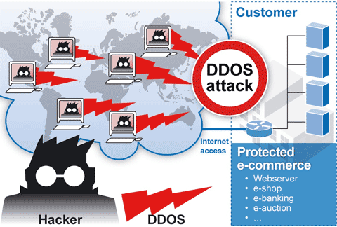
Non-functional requirements
Security:
Privacy: protect user information
User password must be invisible even to admin
Prevent: SQL injection, XSS, DDOS…

Slide 41

Non-functional requirements
Maintainability:
Follow coding standard and naming conventions
Loosely coupled design
Logging functionality
Feedback (contact@place.vn)

Slide 42
Non-functional requirements
Performance:
Load time: average 1.5 second
Comments, rating: no page reloading
Caching
  Frequently accessed data
  Reference data
Mail server: send emails within 1 minute
1000 online users at a moment
100.000 places, 10.000 users without affecting the loading speed

Slide 43
Part 4: Software Design Description
Architectural design
Detailed design
Database design

Slide 44
Architectural design
Overall design
Components
Patterns

Slide 45
Architectural design: Overall Design

Slide 46
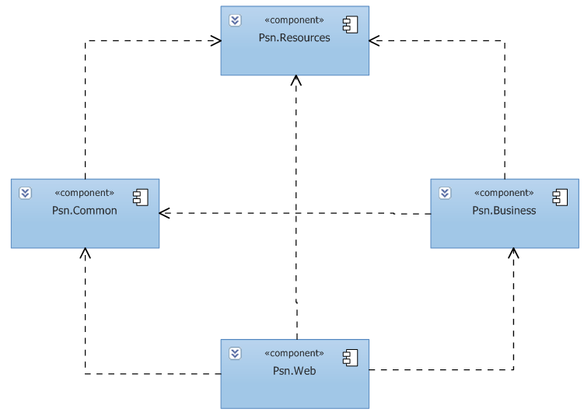
Architectural design
Components:
Business
Common
Resources
Web

Slide 47
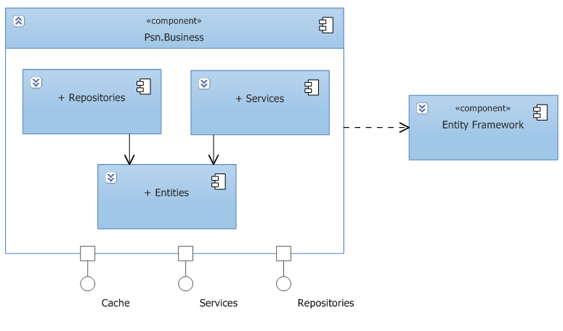
Architectural design
Business Component

Slide 48
Architectural design
Web Component

Slide 49
Architectural design
Common Component

Slide 50
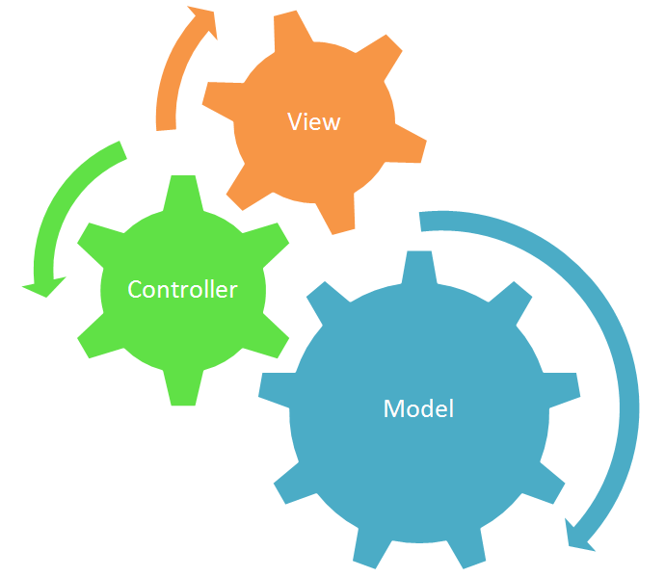
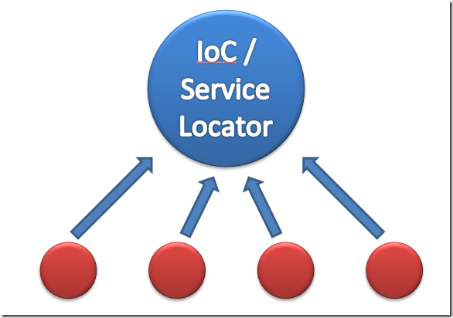
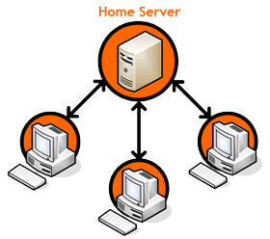
Architectural design
Patterns:
MVC
Client-Server
Dependency Injection
Service Locator
Repository
Singleton

Slide 51
Detailed design
Design for each use case
Class diagram
Class explanation
Sequence diagram

Slide 52
Detailed design: Class Diagram

Slide 53
Detailed design: Sequence Diagram

Slide 54
Database design
Business tables
Support tables: statistics, config…
Every table has a primary key named Id which is of type: INT NOT NULL IDENTITY(1, 1)
Max length and nullability strictly follow field definitions

Slide 55
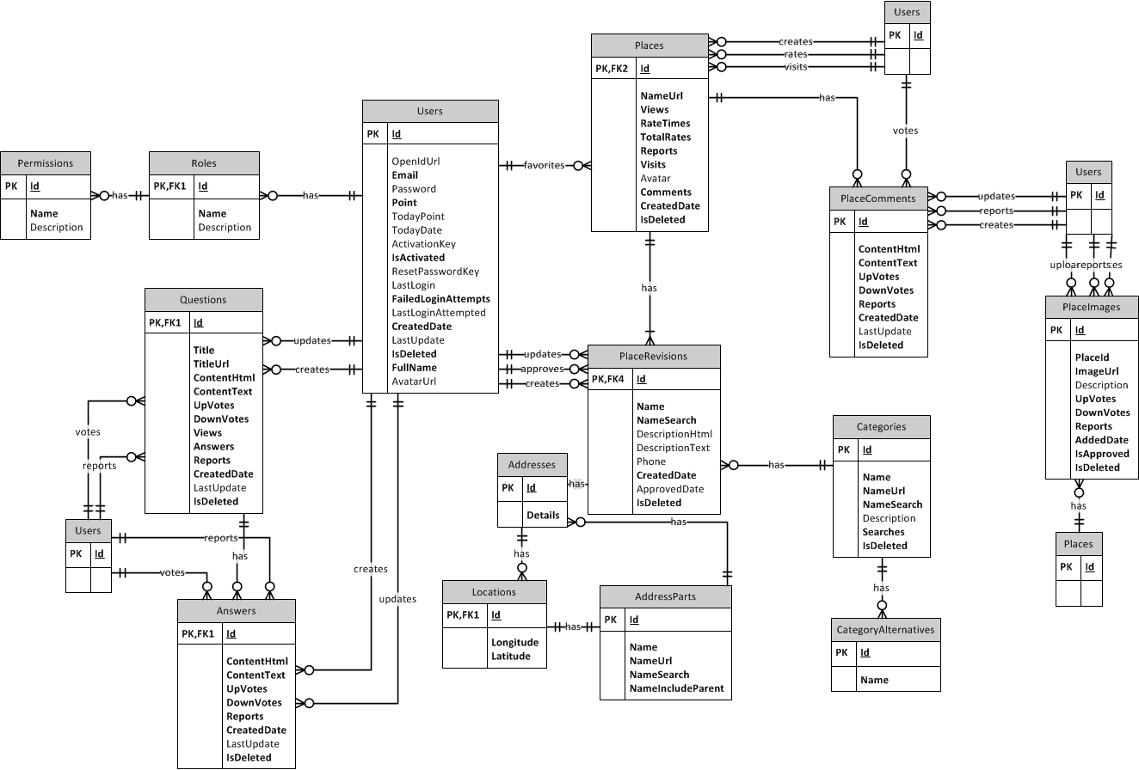
Database design - ERD
Notes:
Crow foot notation

Slide 56
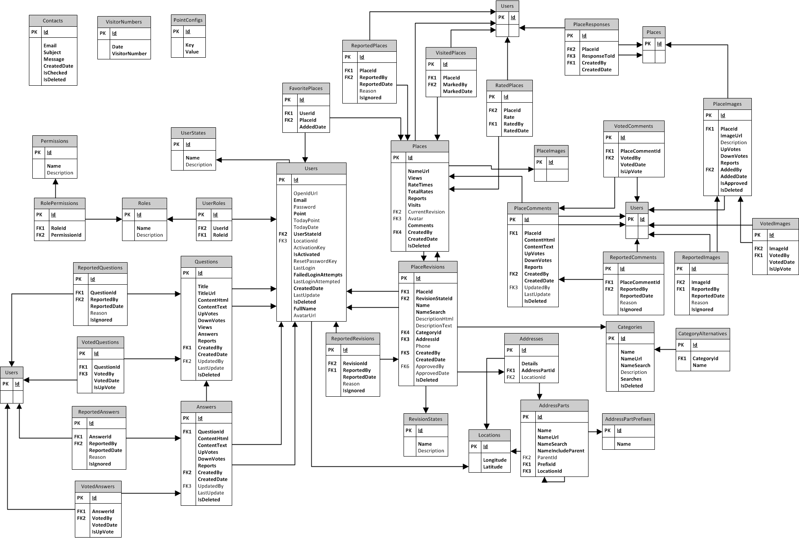
Database design - Tables

Slide 57
Part 5: Implementation
Technologies
Tools
Coding convention
Code review
Unit test
Performance considerations
Security considerations

Slide 58





Technologies

Slide 59




Tools

Slide 60


Coding conventions
Follow general .NET conventions
Follow FxCop rules
Specific conventions for the project
Notes:
Coding conventions:
Follow general .NET coding conventions
e.g. Pascal Casing, Camel Casing…
Follow FxCop rules
e.g. avoid empty interface (FxCop Microsoft.Design CA1040)
Create specific conventions for the project
e.g. all strings must be trimmed before inserting to the database

Slide 61
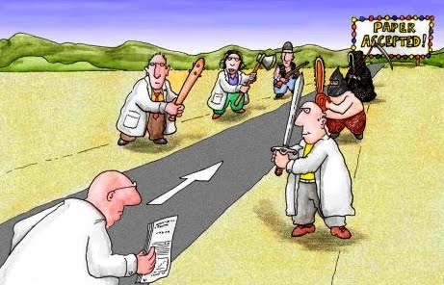
Code review
By technical lead
Peer review
Not done: run FxCop agains defined rules

Slide 62

Unit test
Mainly for data access layer and framework
Follow A/A/A pattern (Arrange/Act/Assert)
Not done: create NUnit report

Slide 63
Performance considerations
Caching in 3 layers: database, memory, output (HTML)
Use SQL Profiler to investigate all data access methods
Minimize requests to the server and database hit
Use JSON with AJAX
Compress and create thumbnail images
…

Slide 64
Security considerations
Client side and server side validation
No SQL injection
No XSS vulnerability
Encrypt sensitive data: password, cookies
Not done:
  Use SSL
  DDOS avoidance

Slide 65
Part 6: Software Test Documentation
Include:
  Features to be tested
  Features not to be tested
  Test case
  Check list

Slide 66
Test result
Number of test cases: 544
Number of passed cases: 544
Number of failed cases: 20
Number of not tested cases: 0

Slide 67


Tested vs not tested
Unit test
Integration test
System test
Performance test
PEN test

Slide 68
Summary
Capstone Project: completed (in next 30’ ☺)
Product: deployed to http://www.place.vn/
Future:
Continue developing
Invest in this product (anyone interested?)

Slide 69
Demo
(try it yourselves: http://www.place.vn/)

Slide 70
Q&A

Slide 71
Thank You !

