Slide 1



POSTER MOBILE SHOPPING
Ha Noi - April 2012

Slide 2
Project Team
Supervisors:
Mr. Phan Duy Hung
PMS Team:
Vu Anh Truong - 00418
Le Hoang Dan - 01367
Nguyen Quoc Tuan - 00406
Le Doan Tien - 00497
Nguyen Ngoc Dung - 00588

Slide 3

Table of content
Introduction
Project Management
Requirements
Design and Implementation
Testing
Result and Future
Demo and Q&A
1
2
3
4
5
6
7

Slide 4
Introduction

Slide 5
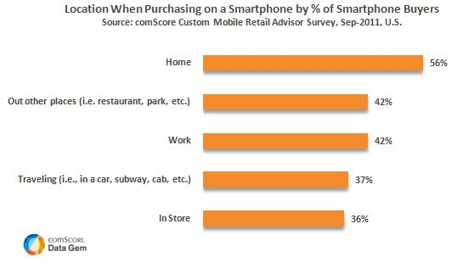
Introduction
Background
Mobile shopping has became familiar
  in Japan, more than 60% experienced mobile shopping

Slide 6
Introduction
Background
  Benefits:
    Fast and flexible
    Time saving
    Convenience
    Money saving
    Fertile area for advertising

Slide 7
Introduction
Background
  In Vietnam:
  - 72,300,000 mobile phones (10/2010 - wikipedia)
  - more than 30% are smart phones (Cimigo VN NetCitizens 2011)
  - some use for Internet browsing, Gaming, Buying ringtones, wallpaper, game...
  - most use for SMSes, Calls, or as a jewelry
  -> not developed to its full potential

Slide 8
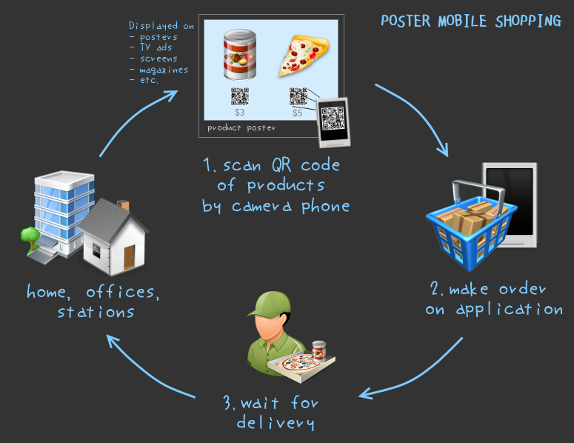
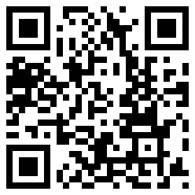

Introduction
Proposed system
  ( + )
  Recent trend has combined QR code and Mobile Commerce

Slide 9
Introduction
Technology choices
  - fast readability
  means
  - large storage capability
  - First created by Toyota subsidiary Denso Wave 1994 to track vehicle
  - Now it is used widely, not only in car industrial

Slide 10
Introduction
Technology choices
  Android OS: has a wide range of phone currently using from various phone manufacturers (Samsung, HTC, Sony ...)
  Android has a market share of 67% of total smart phone in use in Vietnam, while iOS only has 39,3% .
  Android is fast growing and becoming more and more popular with Vietnamese users.

Slide 11
Introduction
Technology choices
Spring MVC with IoC and DI
RESTful Webservice
Java SDK 1.6
Tools:
  Eclipse with Android plug-in
  Spring Source Tool
  Android SDK version 16
  MySQL 5.5
  ApacheTomcat 7.0

Slide 12
Project management

Slide 13
Project management
Project goal
Scope
Success
Time
Cost

Slide 14
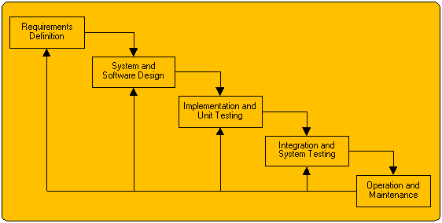
Project management
Process model
Watefall model

Slide 15
Project management
Project organization
Vu Anh Truong
Project Manager
Le Hoang Dan
Tech. Lead/Dev
Nguyen Ngoc Dung
Le Doan Tien
Nguyen Quoc Tuan
QA/Tester
Developer
Developer

Slide 16
Project management
Project organization
Le Hoang Dan
Android division
Web division
Vu Anh Truong
Nguyen Quoc Tuan
Le Doan Tien
QA and Testing
Nguyen Ngoc Dung
QA/Tester

Slide 17
Project management
Milestone
Jan | Feb | Mar | Apr
Intro
R1
Project plan
R2
Requirement
R3
Design
R4
Coding
Unit testing
Testing
R5
User
Manual
R6

Slide 18
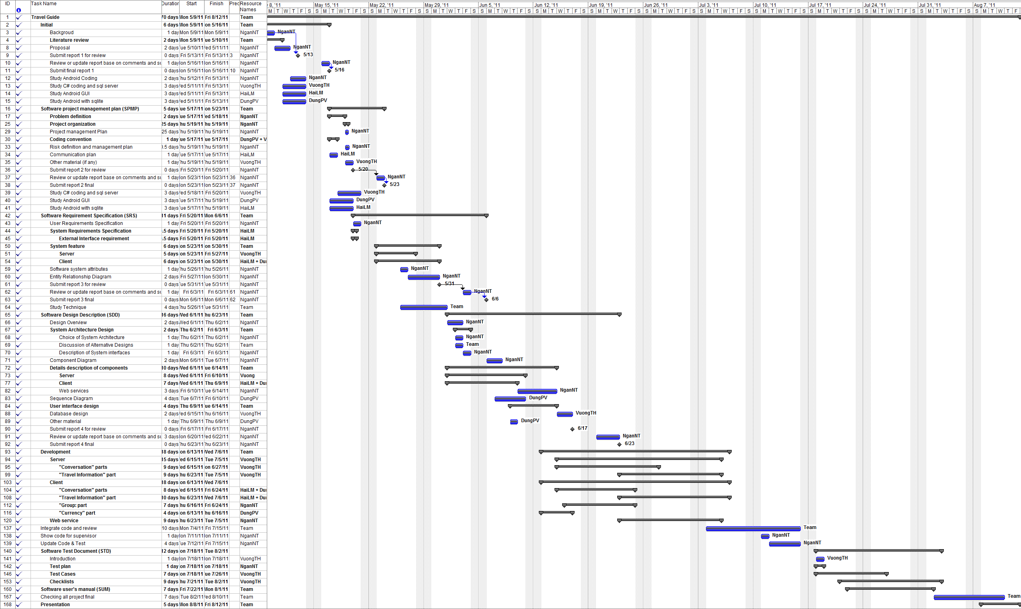
Project management
Project Plan

Slide 19
Project management
Time management
Weekly meeting
Assign Task
Personal working
Individual Report

Slide 20
Project management
Risk Management
1
1
New Technology
Study
2
2
Requirement unclear
Clarify requirement
3
3
Time Management
Team Rules
4
4
Management Experience
Supervisor’s advices

Slide 21



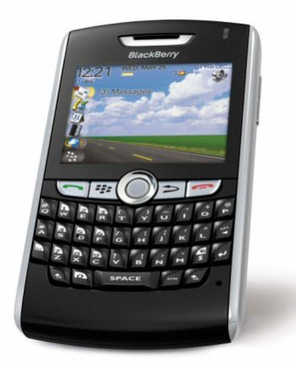
Project management
Communicate tools
2 times per week meeting
keep track with the team’s work everywhere
Daily report, problem sharing , etc.
Emergency case

Slide 22
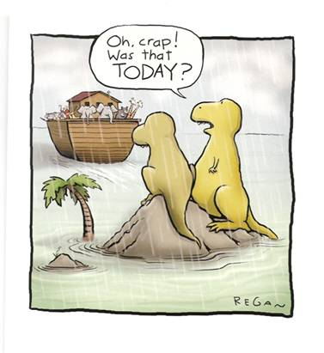

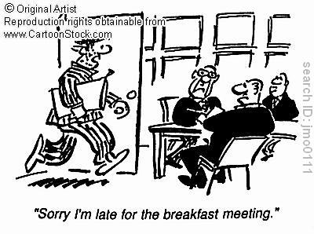
Project management
Team rules
5-10k
5k

Slide 23
Requirement
Specification

Slide 24
Requirement Specification
Web application
  Basic CRUD operation
  Administrator:
    Manage users
  Supplier:
    Manage Products
    Manage Orders status

Slide 25
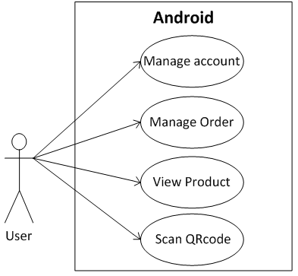
Requirement Specification
Android application

Slide 26
Requirement Specification
Non-Functional requirement
Reliability
Availability
Maintainability
Performance

Slide 27
Design and
Implementation

Slide 28
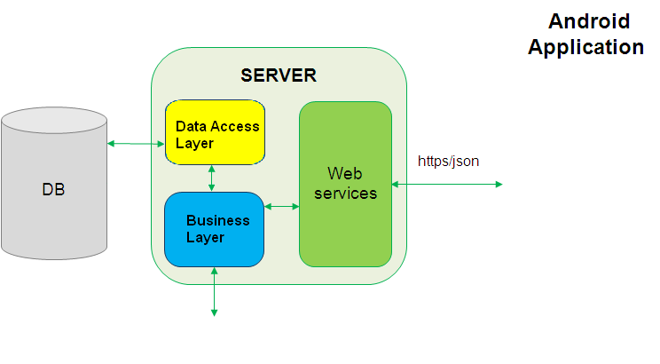
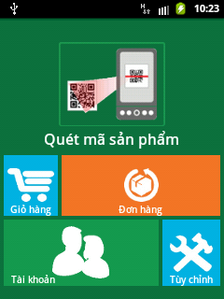
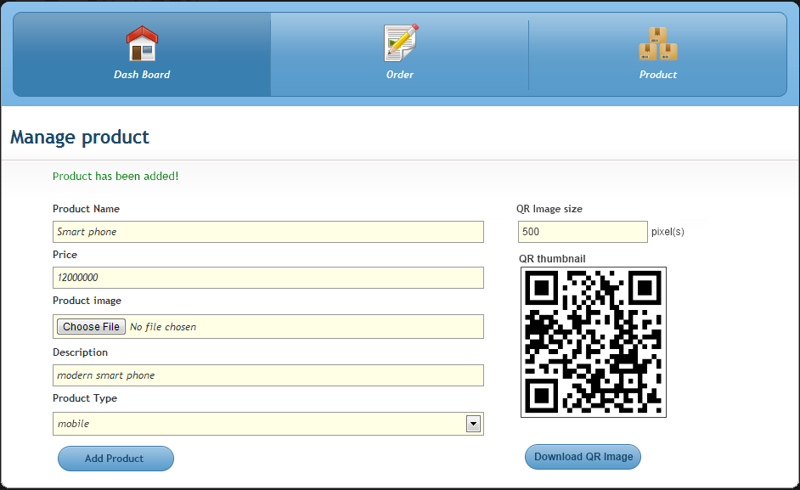
Design and Implementation
System Overview
Web
Application

Slide 29
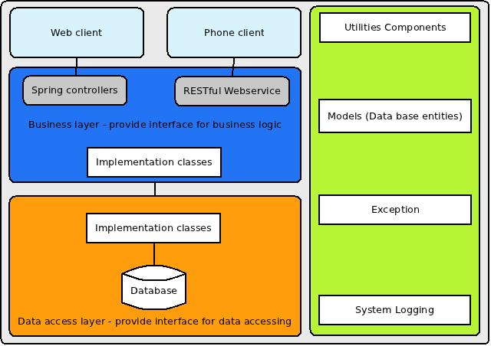
Design and Implementation
Web Application Overview

Slide 30
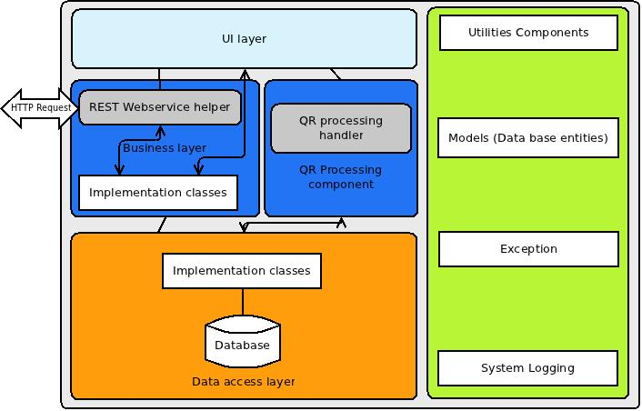
Design and Implementation
Android application

Slide 31
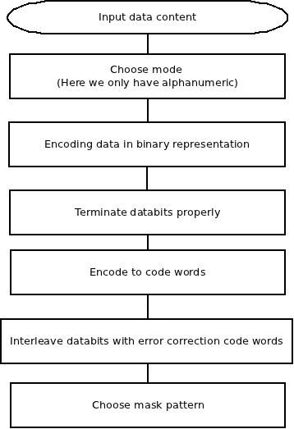
Design and Implementation
QR Encoding algorithm
1|sua vinamilk|big C|Sua rat ngon Length = 33
-> level 10 – 26, 11 bit long: 00000100001
-> 0010 00000100001
-> Split content to 2 characters per unit
-> First value increase 45 times and second value is added to it:
1| su …
1*45 + 45 28*45+30 …
-> 11 bit long binary
0010 00000100001 00001011010 10100001010 …
-> delimited by 8bit
00100000 01000010 00010110 10101000 01010 …
-> if data length < 8, pad 0 to end
-> if count of code words is less than symbol's capacity put "11101100" and "00010001" until full capacity.
-> apply Reed-Solomon error correcting
-> Choose mask pattern
-> Show format information (L in our case)

Slide 32
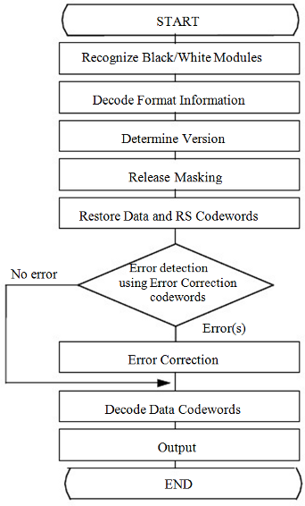
Design and Implementation
QR Encoding algorithm

Slide 33
Testing

Slide 34
Testing
Test stage
Type of Tests | Stage of Test
 | Unit | Integration | System
Functional Tests | x | x | x
User Interface Tests |  |  | x
Data Volume Tests | x | x

Slide 35
Testing
Test schedule
Test Schedule | Start Date | End Date
Unit Testing | 01/03/2012 | 23/03/2012
Integration Testing | 20/03/2012 | 25/03/2012
System Testing | 25/03/2012 | 12/04/2012

Slide 36
Testing
Test plan
Component | Module | Total testcase | Tester | Plan start date | Plan finish date | Actual start date | Actual finish date
Web Application |  | 95
 | Main menu | 6 | DungNN
 | Product management | 25 | DungNN
 | Order management | 15 | DungNN
 | Account management | 25 | DungNN
 | Black list management | 20 | DungNN
 | QR decode | 4 | DungNN
Android Application |  | 37
 | Main menu | 4 | DungNN
 | Account management | 5 | DungNN
 | Order management | 24 | DungNN
 | QR scan | 4 | DungNN

Slide 37
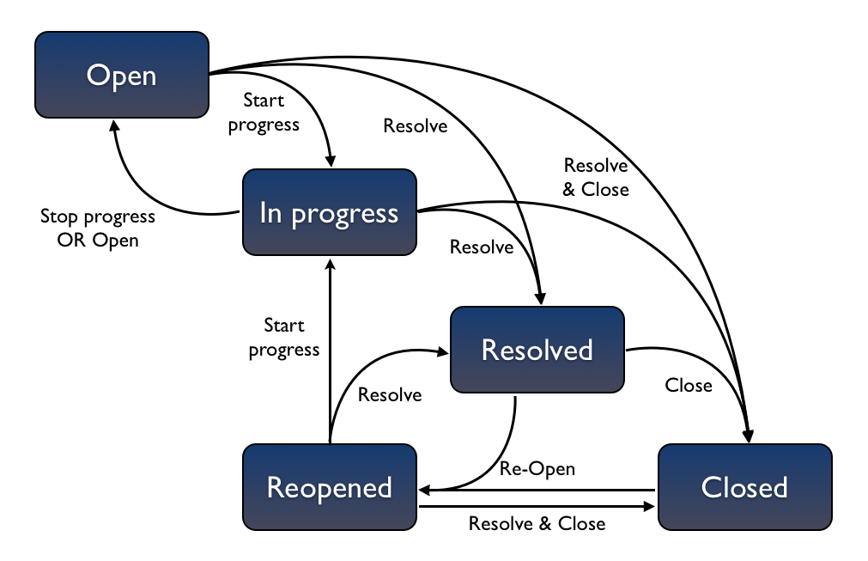
Testing
How to test

Slide 38
Result and Future

Slide 39
Result and Future
Requirement specify
Project management
Team work

Slide 40
Demo

Slide 41
QA

Slide 42

THANK YOU
FOR
LISTENING

