Slide 1


Interactive Shooting Game
ISG Team

Slide 2
ISG Team
Lê Vũ Hải – 00310
Nguyễn Minh Tiến – 00642
Trần Anh Tuấn – 00564
Nguyễn Quốc Tuấn – 00368
Nguyễn Văn Hiệp – 00602
Nguyễn Thị Phương Loan – 00725

Slide 3
Contents
1
A
2
B
3
acc
4
Demo, Q&A

Slide 4
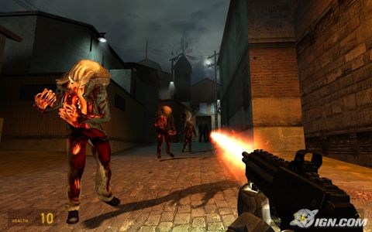
Overview
Three Dimensional Game

Slide 5
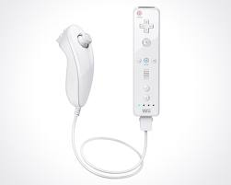
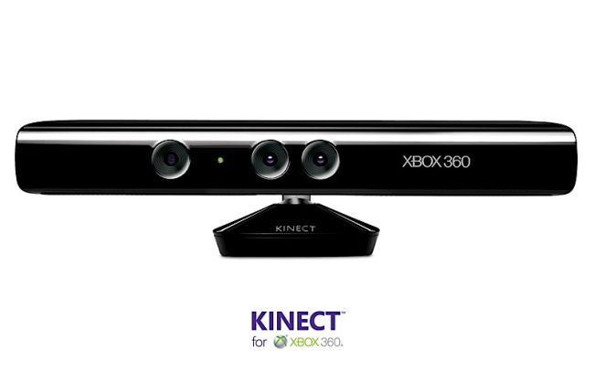
Overview
Another way to approach
Wii Remote
Kinect

Slide 6
Overview
Why is Wii Remote ?
Support PC through Bluetooth
Wii mote provides users a new way of playing game, totally creates a new way of taking part into virtual life in games.
Finance problems.

Slide 7
Idea
Interactive Shooting Game (ISG)
Three dimensional game
Associate with Wii Remote
Shooting Game (best for describing Wii Remote features)

Slide 8
ISG Project

Slide 9
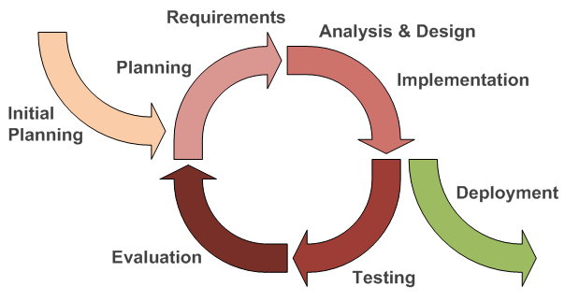
Plan – Software Process Model
Iterative Model

Slide 10
Plan – Game Development
Game Development Process

Slide 11
Plan – Project Organization

Slide 12
Plan - Coding Convention
  Coding Convention Document

Slide 13
Requirement
Functional Requirement
Main Menu Management
Game Play
In-game Menu
Game Options

Slide 14
Requirement
Non-functional Requirement
Reliability
Availability
Security
Maintainability
Portability
Performance

Slide 15
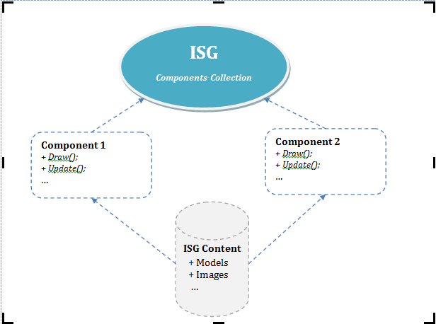
Detailed Design
System Architecture Design
High-level Component-based design pattern for ISG

Slide 16
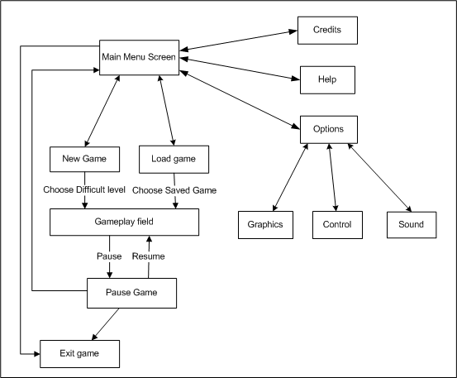
Detailed Design
System Architecture Design
Screen Flow

Slide 17
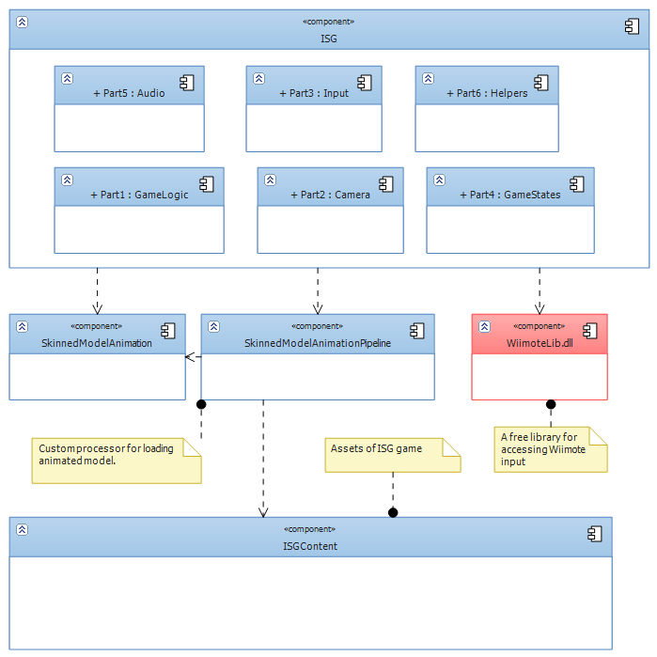
Detailed Design
Component
Diagram

Slide 18
Detailed Design
Game States
Class Diagram

Slide 19
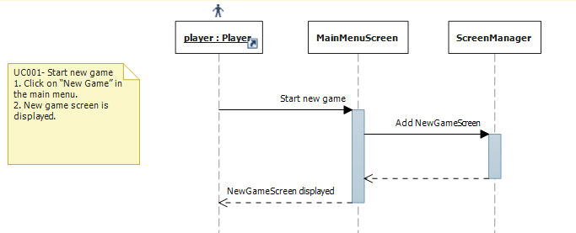
Detailed Design
Game States
Start New Game’s Sequence Diagram

Slide 20
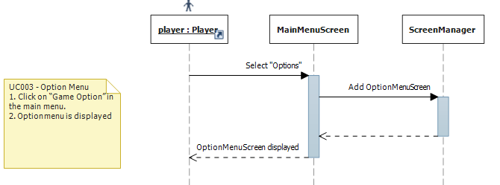
Detailed Design
Game States
Open Option menu’s sequence diagram

Slide 21
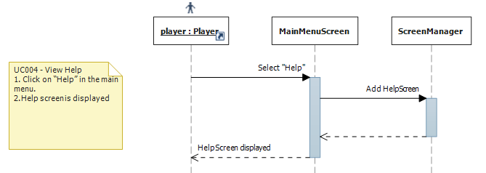
Detailed Design
Game States
View Help’s sequence diagram

Slide 22
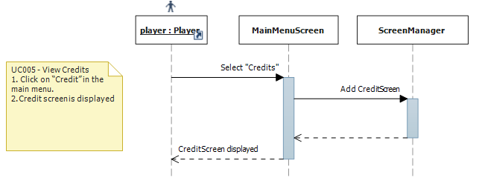
Detailed Design
Game States
View Credits’s sequence diagram

Slide 23
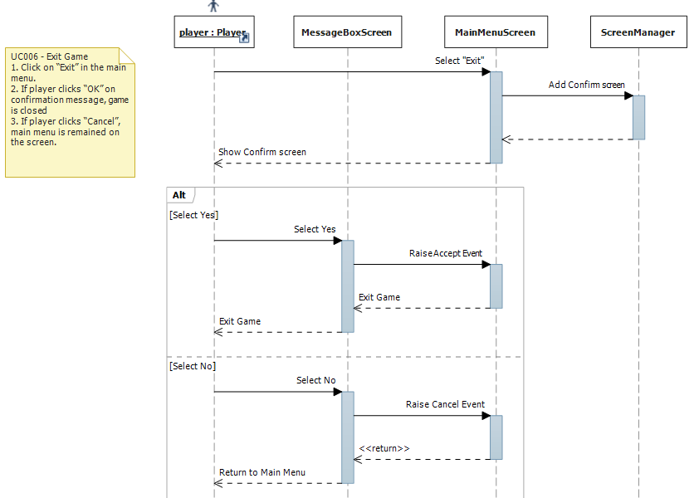
Detailed Design
Game States
Exit game’s sequence diagram

Slide 24
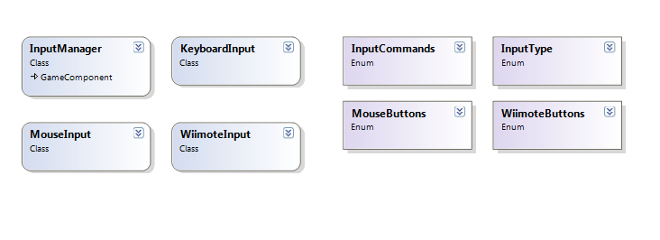
Detailed Design
Input
Class Diagram

Slide 25
V. SOFTWARE TESTING
2. FEATURES TO BE TESTED
3. TEST EXECUTION
4. TEST REPORT
5. BUG REPORT
1. TEST MODEL

Slide 26
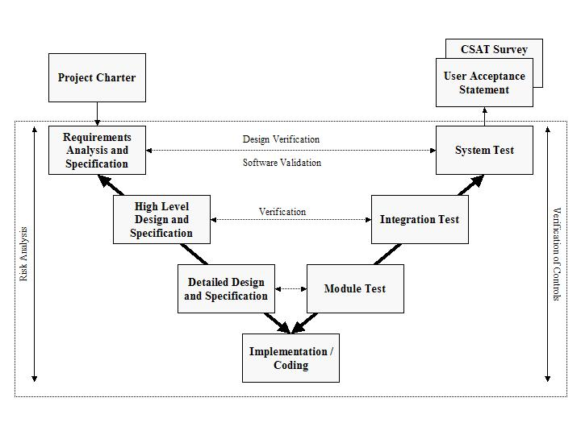
V. SOFTWARE TESTING
1. Test Model
V MODEL

Slide 27
V. SOFTWARE TESTING
2. Features To Be Tested
No | FEATURES | INCLUDE CONTENTS
1 | Game screen | Main menu screen Options screen Sound screen Graphics screen Control setting screen Keyboard settings screen In-game menu
2 | Load & save game | Save game Load game
3 | Game Play | The game Main character Enemy HUD Sound
4 | Input | Keyboard Mouse Wii-mote

Slide 28
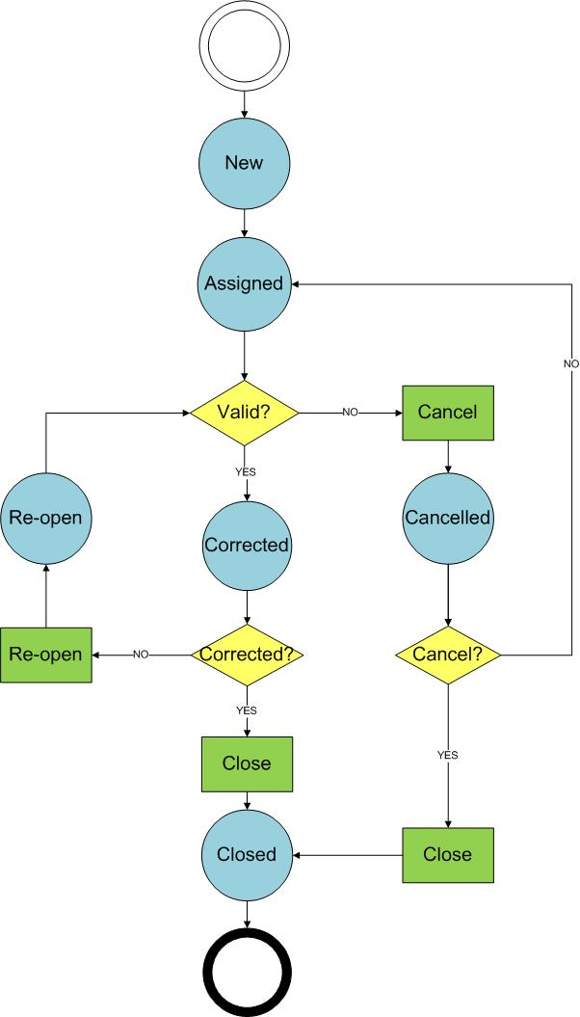
V. SOFTWARE TESTING
3. Test Execution
Bug Management Flow

Slide 29
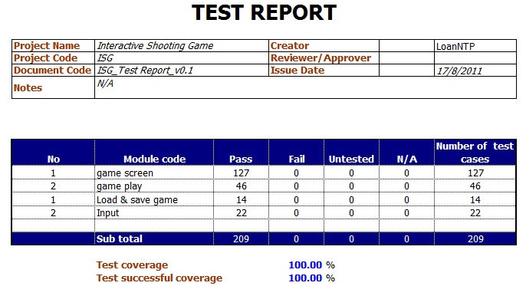
V. SOFTWARE TESTING
4. Test Report

Slide 30
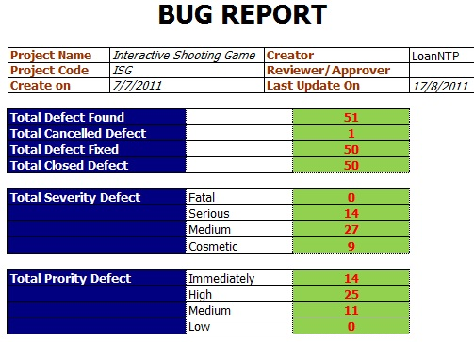
V. SOFTWARE TESTING
5. Bug Report

Slide 31
Thank You !
www.themegallery.com

