Slide 1
KARAOKE ANDROID PLUS
CAPSTONE PROJECT
Hn - summer 2011
KAP

Slide 2
KAP Group
1.PhươngBM (Leader)
2.VinhTD (Vice Leader)
3.ChungBT (Designer)
5. NgọcDB (Test leader)
4. NgọcĐM (Developer)
KAP

Slide 3
Contents
1. Introduction
2. Project Management
3. Requirement Specification
4. Implementation
5.Result and Conclusions
6. Demo
KAP

Slide 4
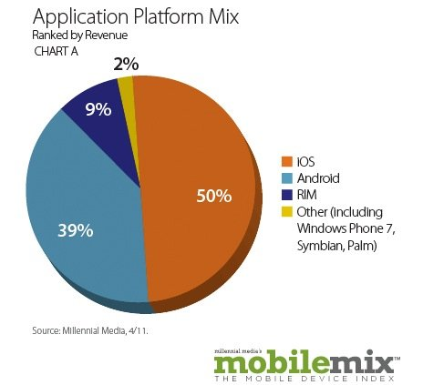
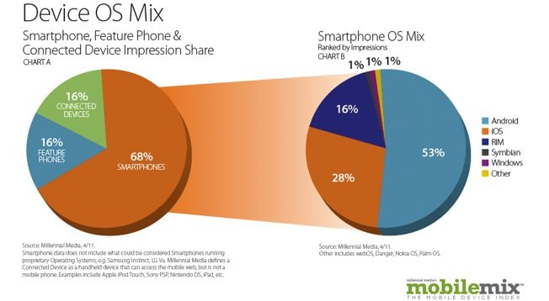
Idea’s Origin
KAP

Slide 5
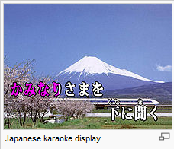
Idea’s Origin
What is “Karaoke”? ( kara is “empty”, and ōkesutora : orchestra )
Classification: Karaoke box and Karaoke family
Karaoke box is the most popular used.
Service :
write name of songs and send request out
Direct remote everything on touch screen monitor
KAP

Slide 6
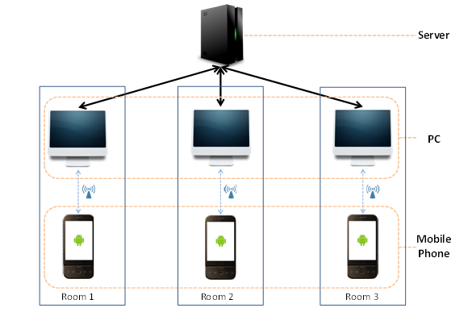
Idea’s Origin
KAP

Slide 7
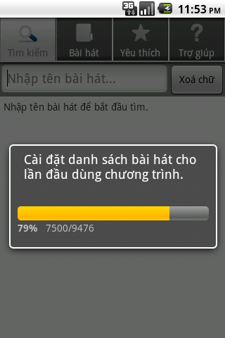
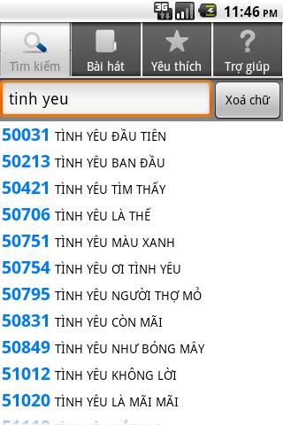
Existing Products

Slide 8
Objective System
A System help user can choose and control karaoke process by Android Mobile

Slide 9
Role and Responsibilities
Role | Member
General manager, Technical leader | PhuongBM
Technical leader, Developer | VinhTD
Test leader | NgocDB
Developer | NgocDM
Analysis, Designer | ChungBT
KAP

Slide 10
Software Process Model
Requirement
Design
Implementation
Verification
Maintain
Waterfall Model
KAP

Slide 11
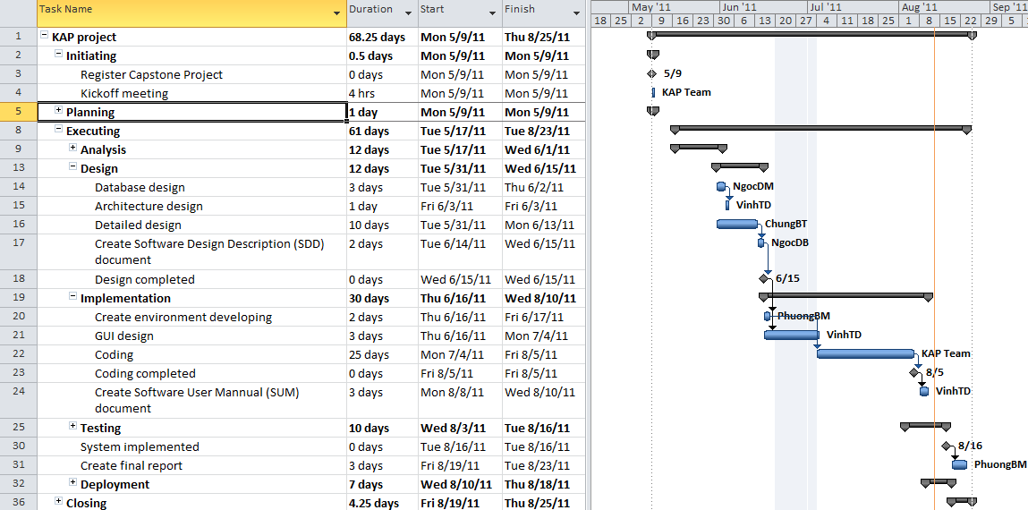
Project Plan

Slide 12
Functional Requirements
Manage connection
Remote Karaoke
Search song
Create favorite songs
Mobile user
Score by user
KAP

Slide 13
Functional Requirements
Collect Karaoke song’s info
Edit Karaoke song’s info
Create all playlist
Create suggest list
Manager
Schedule making playlist
KAP

Slide 14
Non-Functional Requirements
Usability
Maintain and develop
Platform compatibility
Resource constraints (processor speed, memory, disk space, network bandwidth, etc.)

Slide 15
Development Environments
• Hardware
LG, Samsung mobile phone with Android OS
• Software
Server
Software (SQLServer, Visual studio 2010)
.NET Frame 4.0
PC Client
J2EE
Eclipse
Java JDK 6.24
VLC Media Player
Mobile
Android SDK
Java JDK 6.24
Eclipse
KAP

Slide 16
Communication Protocols
Connection : Wi-Fi
Protocol: Http protocol
Data type: video files (mp4,avi,mpg,flv…)
KAP

Slide 17
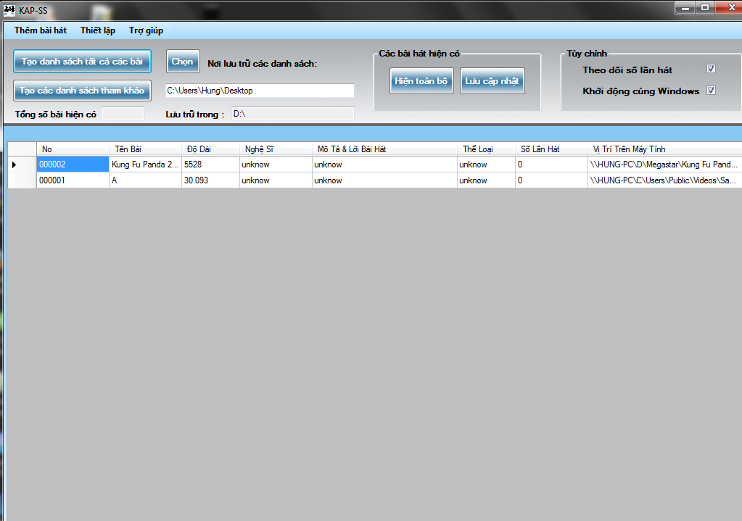
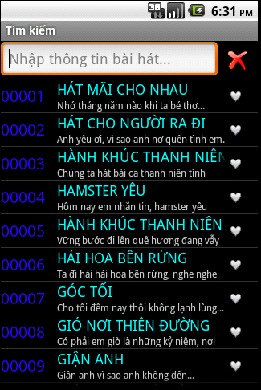
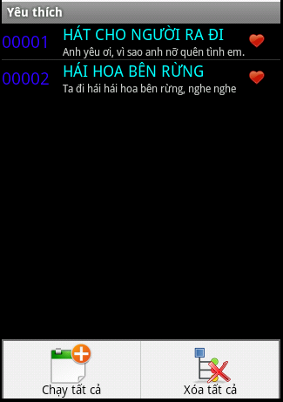
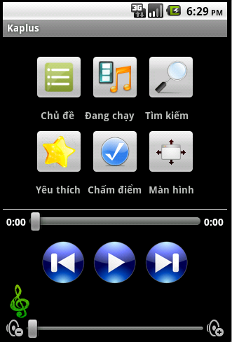
User Interface Design
KAP

Slide 18
Functional Design
Database
Store video file
Create database via XML file
Control
Add, edit , remove
Collect , add song’s information
Update played time
Auto create playlist
KAP

Slide 19
Functional Design
Connection
Find, connect with Access Point
User add server to connect with PC Client by IP Address and Port
Control
User can play, pause, next, previous, fullscreen song in list
Search
View list song is playing
Searching song on Database by song’s name, lyric or singer
Play a song in this list
Play suggest list
Add song into favorite list
Control volume
Seek
KAP

Slide 20
Database Design
PC-Server: OLE DB .NET Data Provider (Microsoft Access)
Mobile phone: SQL Lite
Data table : One main table contains all song’s information
KAP

Slide 21
Database Design
KAP-SS
Name | Video
Description | Main table, Store all songs information
Select Command | SELECT [No], Title, Duration, Artist, Description, Album, PlayedTime, URI FROM Video
Table Adapter | VideoTableAdapter
Column | Data Type | Null Option | Is FK | Is PK | Note
No | Text | No | No | Yes
Title | Memo | No | No | No
Duration | Text | Yes | No | No
Artist | Text | Yes | No | No
Description | Memo | Yes | No | No
Album | Memo | Yes | No | No
PlayedTime | Number | Yes | No | No
URI | Memo | No | No | No
KAPlus
Column | Data Type | Null Option | Is FK | Is PK | Note
id | int | No | No | Yes
location | varchar | No | No | No
title | varchar | No | No | No
title_simple | varchar | No | No | No
favourite | varchar | Yes | No | No
lyric | varchar | Yes | No | No
source | varchar | Yes | No | No
KAP

Slide 22
Technical design
HTTP Request - Response
Client
Mobile
Java
Android
TCP-IP
Server
DB
.NET Framework
KAP

Slide 23
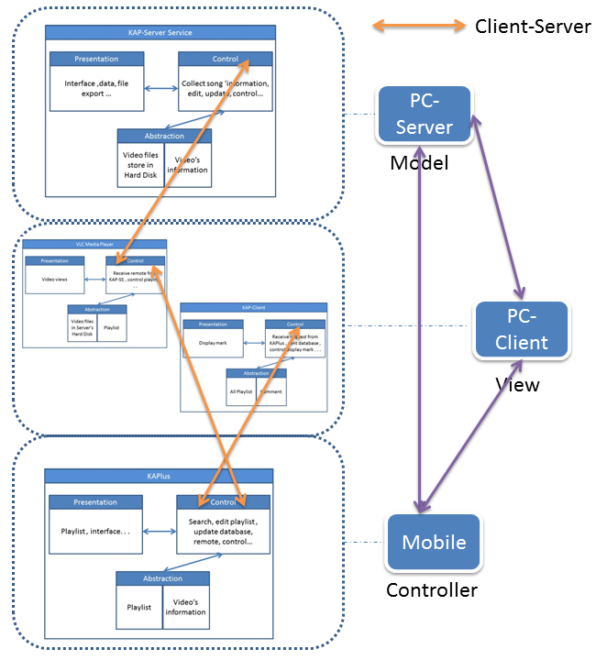
Architecture Model
Client-Server
Interaction-Oriented (MVC and PAC)

Slide 24
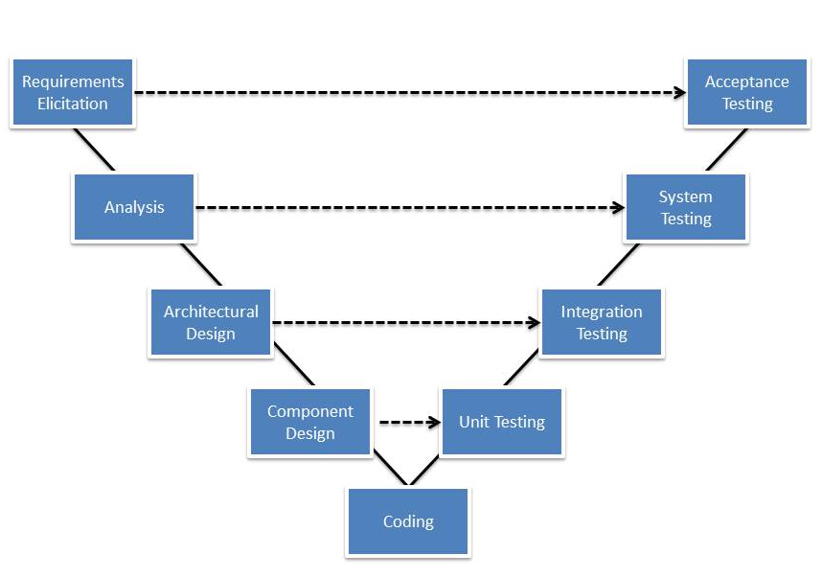
Testing
V – model

Slide 25
Testing Result
Test Report
Sum of TestCase |  | 89
Number of TestCase | 1 | 100
 | 2 | 143
 | 3 | 190
Number of TestCase Failed | 1 | 26
 | 2 | 16
 | 3 | 0
Number of TestCase Pending | 1 | 33
 | 2 | 0
 | 3 | 0
Defect |  | 59
Number of opening defect |  | 0
Number of Closed defect |  | 59

Slide 26
Implemented Technical Problems
Having dependence on VLC media player
New programming language
Some problem with emulator and real devices

Slide 27
Limitations and Future Improvement
Limitations:
Can’t save song’s information with song’s file.
Don’t have portability
Future Improvement:
Save user playlist (mobile or web)
Search unavailable song from internet
Synchrony with social network

Slide 28
Conclusions
Future:
Continue developing
Deployed to Android Market
Make product professional and popular

Slide 29
Demo
KAP

Slide 30
Thanks for Listening
KAP

