Slide 1
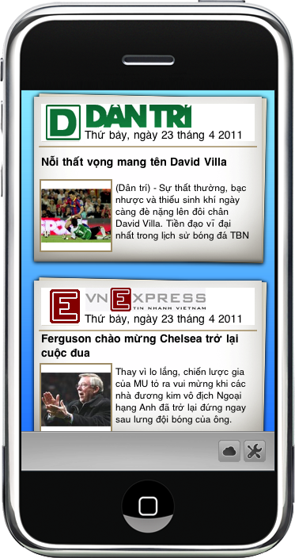
INFORMATION PORTAL
Capstone Project for Information System
Team members:
Pham Minh Ha
Ly Ngoc Anh
Nguyen Duc Viet
Nguyen Thi Huong
Supervisor:
Huynh Anh Dung (Mr.)

Slide 2
Outline
Project Management
Requirement Specification
Software Design
Software Testing
Our Result & Future Plan
Demo and Q&A
Introduction
1
2
3
4
5
7
8

Slide 3
INTRODUCTION

Slide 4

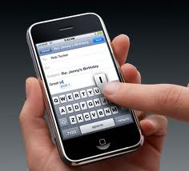
Introduction
Background
The century of internet
The need of updating information, communication and sharing
The development in technology for mobile and smart phone
Good Network infrastructures
We develop an Information Portal for mobile

Slide 5
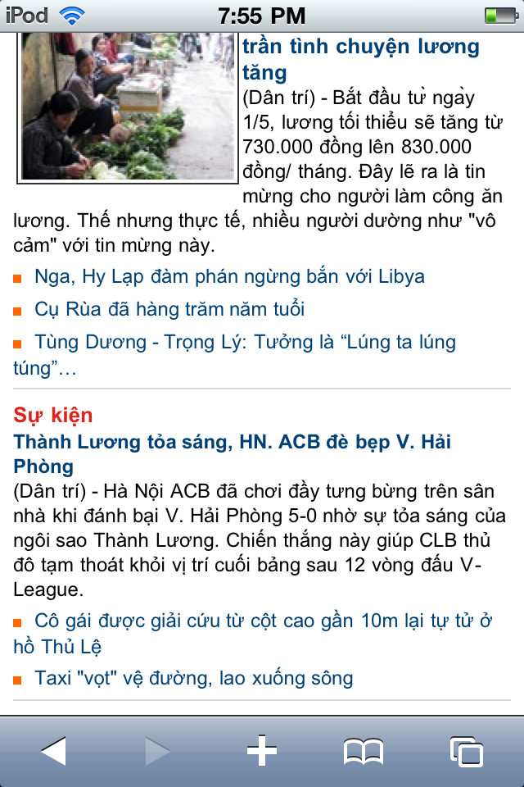
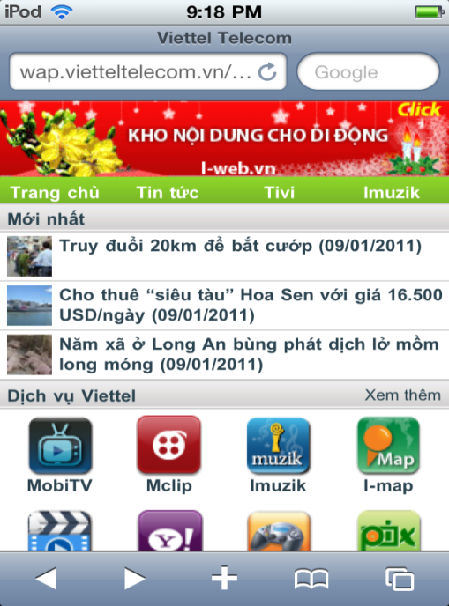
Research
Introduction
Wap
Website’s layout for mobile

Slide 6
Limitations of previous solutions
Introduction
The limitation of mobile browser
Data transferring
Storing data offline
Customize layout
The usability

Slide 7
Proposed System
Introduction
Reading news .
Updating daily information about weather, currency exchange, lottery, television schedule.
Finding information about ATM, bus, taxi, location.
Multi-media service like photos, videos, music.
Customer oriented service.
Reporting and statistic service.

Slide 8
Scope
Introduction
Crawler
Auto collecting news from e-news
Web-application
Client
Reading news
Parse sites by the rules
Viewing weather forecast
Service
Managing server content
Administrator
News service
Weather service
Application run on iOS

Slide 9
Technology Choices
Introduction
Server
Web Application
Web service
SOAP
Windows Service
GZIP
xCode IDE
iPhone SDK
Interface Builder
Client
MVC
XML
GZIP
Visual studio 2010
MS SQL Server 2008
IIS 7

Slide 10
PROJECT MANAGEMENT

Slide 11
Team working
Project Management
Project
HaPM
AnhLN
VietND
HuongNT
Meeting
Working online
Supporting

Slide 12
Milestone
Project Management
10/01/2011
Intro
R1
17/01/2011
Project plan
R2
14/02/2011
Requirement
R3
28/02/2011
Design
R4
04/04/2011
Coding
Unit testing
11/04/2011
Testing
R5
User
Manual
R6

Slide 13
Iterative Waterfall Process Model
Project Management
Requirement
Design
Implementation
Verification
Maintenance
Advantages
1. Clear project visibility
2. Update continuously
3. Easy to implement
4. Effective defect control
Disadvantages
1. Takes time reviewing & analysis
2. Complicated version control

Slide 14
Testing Model
Project Management
Requirements analysis
System testing
High level design
Integration testing
Detailed design
Unit testing
Implementation

Slide 15
Risk Management
Project Management
Minor experience in PM & QA
New to Technologies
Time conflict

Slide 16
REQUIREMENT SPECIFICATION
Server
Automatically collect News and Weather information.
Client
Update latest News from Server.
Manage contents.
Manage user account.
Customize favorites categories or News websites.
Get current weather and forecast information.
Change weather location
Synchronize information with server.

Slide 17
SOFTWARE DESIGN

Slide 18
System Architecture
Software Design

Slide 19
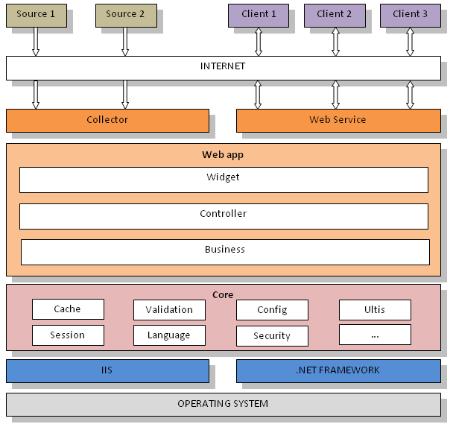
System Interface

Slide 20
News bot
Software Design
RSS
Simple
Quick
DOM Parser
Complex.
Need rules.
Dynamic.
Apply every where.
Not stable
Need rss
  News bot – windows service.
  Rules in XML format
  30 mins interval for parsing section.
  Log.
Notes:
So sánh giữa RSS và DOM Parser (Document Object Model ("Mô hình Đối tượng Tài liệu"))
RSS
Do được các trang báo cung cấp sẵn với cấu trúc giống nhau nên có thể lấy được các nội dung dễ dàng và nhanh
Tính ổn định không cao:
Không có ảnh (laodong.com.vn)
Không được cập nhật theo thời gian thực (vnexpress.net)
Chỉ bao gồm các chuyên mục chính, không bao gồm chuyên mục con
Chỉ sử dụng được khi trang web cung cấp rss
DOM Parser
Xử lý phức tạp hơn và tốn thời gian hơn
Cần phải phân tích và tạo rules cho mỗi trang web
Cấu trúc mềm dẻo có thể thay đổi dễ dàng và áp dụng cho nhiều trang web
Không bị phụ thuộc vào rss
Chọn DOM
Nói về 1 số điểm của News bot

Slide 21
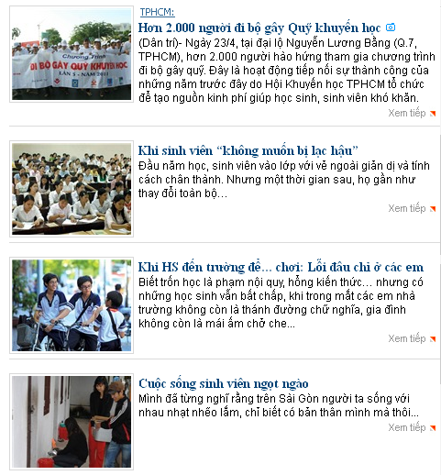
Rules
Software Design

Slide 22
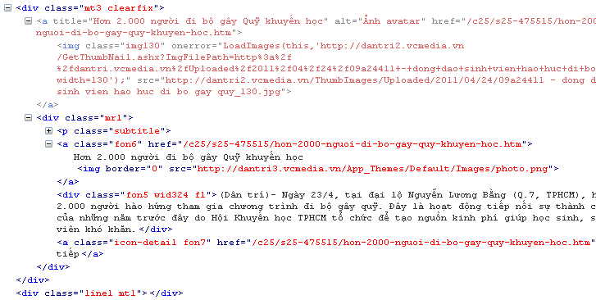
Rules
Software Design
image
detail url
title
description

Slide 23
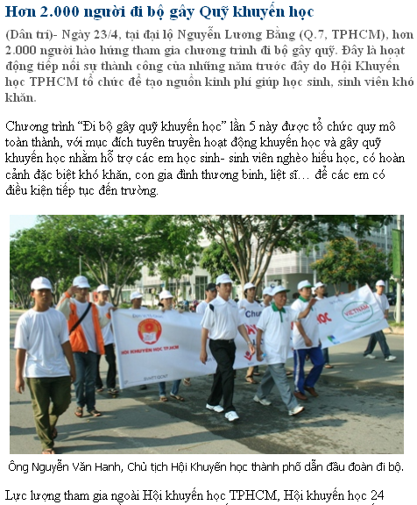
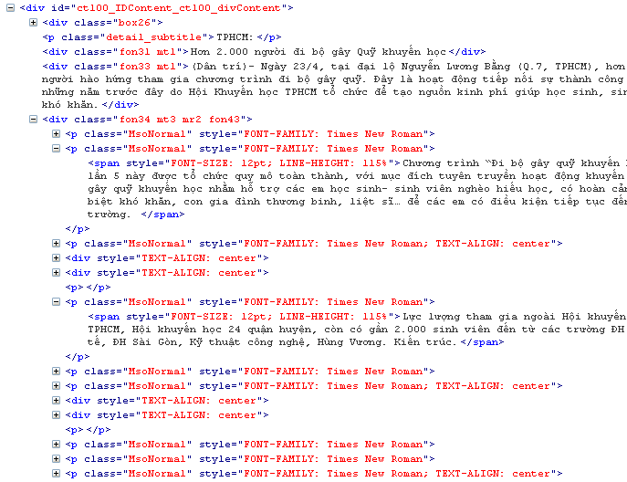
Rules
Software Design

Slide 24
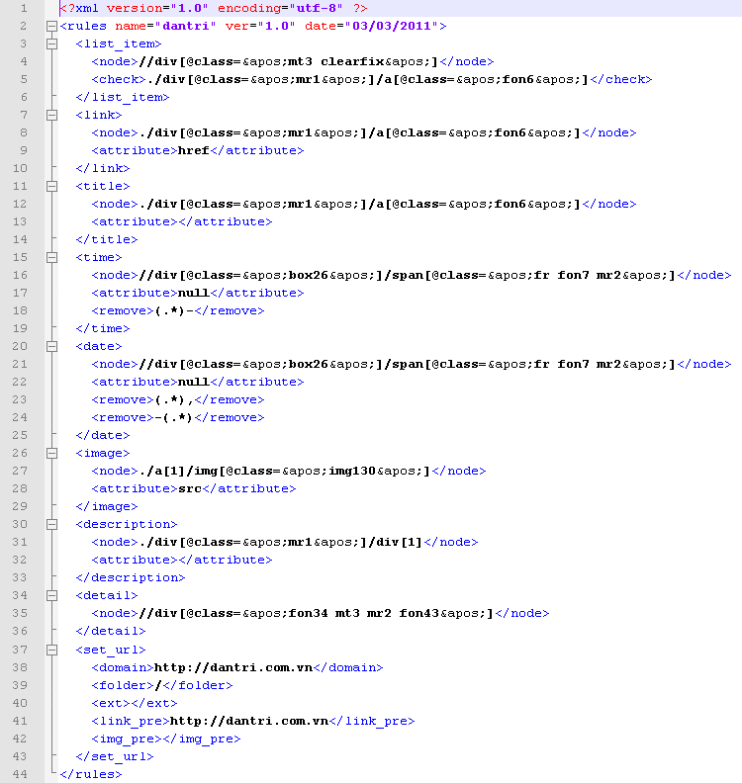
Rules
Software Design

Slide 25
Weather
Software Design
Receive request
Check data in Cache
Get data from Google weather
Store data in Cache
Response data
URL: http://www.google.com/ig/api?weather=hanoi
Notes:
Nếu data thời tiết của địa điểm được yêu cầu chưa quá 30 phút. Service sẽ trả lại ngay data đó cho Client
Nếu data đã quá 30 phút, service sẽ lấy data mới từ google weather về và lưu lại vào cache, sau đó trả lại cho Client
Phương pháp cache này được sử dụng để giảm tải cho server. Server không phải parse data từ google weather mỗi khi client gửi request.

Slide 26
Web services
Software Design
SOAP
HTTP request
XML
GZIP, Base64Encoding

Slide 27
Gzip – Compressed ratio
Software Design
 | Case 1 | Case 2 | Case 3 | Case 4
Normal | 9996 | 9696 | 34336 | 24512
Gzip | 7704 | 6224 | 18264 | 14472
Reduce | 22.9% | 35.8% | 46.8% | 40.9%
45%
20%

Slide 28
Sequence Diagram
Software Design

Slide 29
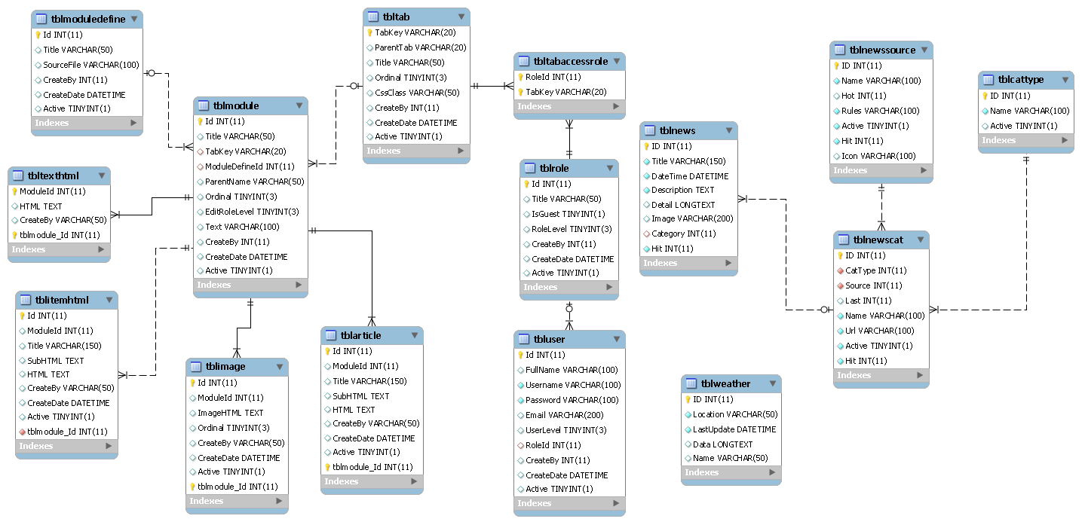
Database Model

Slide 30
SOFTWARE TESTING

Slide 31
Test Plan
Software Testing
Quality Objective
    Testing assures that the system meets all requirements of the customer within trade-off between budget, time and quality
Scope
    Testing focuses on common services is provided by Server for Client which runs on iTouch iOS3

Slide 32
Test Plan
Software Testing
Features to be tested
    All features are defined in Requirement Specification
Features NOT to be tested
    Undocumented features, third party, white box testing and three functions: define module, tab manager, module manager

Slide 33
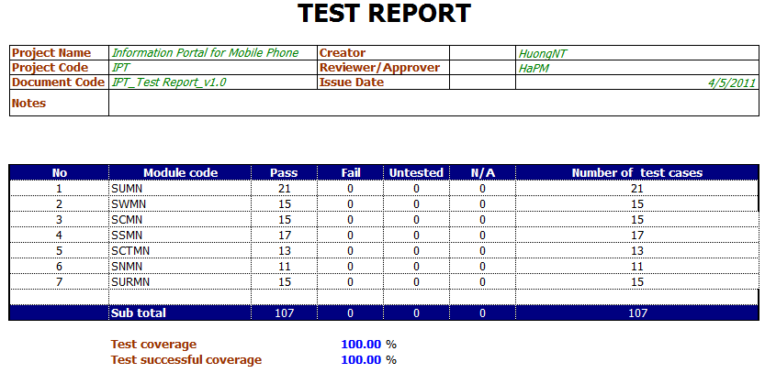
Server
Software Testing
Notes:
Test Report
Kết quả test của Server pass 100%

Slide 34
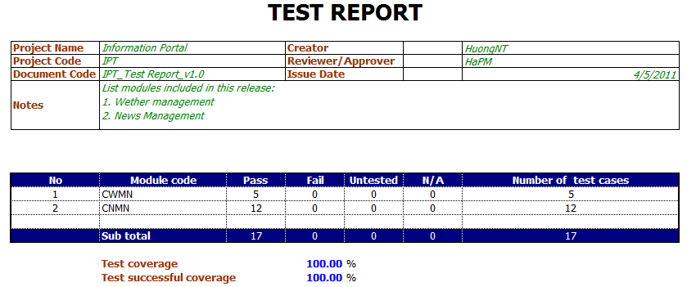
Software Testing
Client
Notes:
Do phần Reminder chưa hoàn thành nên chưa thể tiến hành test, do đó kết quả test Client chỉ conver được 62.96%

Slide 35
OUR RESULT and
FUTURE PLAN

Slide 36
Our Result
Weather
Method
Solving a real problem
Server
Crawler & Web services
News
Client
Process
Software project life cycle
Web-App for administrator
PM, QA, Team-working
Researching in IT
Completed
Lesson Learn

Slide 37
Future Target
Maintenance
- Clear Defects
- Improve
- Performance
New features
- Multimedia
- Streaming
- More services
Business
- App Store
- Other version for different platforms

Slide 38
Product Demo and
Q&A

Slide 39
Thank you!

