Slide 1
e-Citizen

Slide 2
Phan Nhật Minh
00138
Phạm Thị Dinh
00546
Vũ Xuân Đông
00470
Phạm Thị Huyền
00415
Nguyễn Thùy Trang
00525
FiveFingers

Slide 3
Contents
Introduction
1
Implementation
5
Management Plan
2
Test and
Quality Assurance
6
Requirement
Specifications
3
Demo
7
Design
Definition
4
Q&A
8

Slide 4
Introduction
Introduction
Management Plan
Requirement Specifications
Design Definition
Implementation
Test and Quality Assurance
Demo
Q&A
E-Citizen
Checking TimeWork System Using Fingerprint Identification Technique

Slide 5
Introduction
Introduction
Management Plan
Requirement Specifications
Design Definition
Implementation
Test and Quality Assurance
Demo
Q&A
Why fingerprint identification?
High security
No need to keep any kind of additional device along with you.

Slide 6
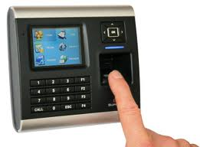
Introduction
Introduction
Management Plan
Requirement Specifications
Design Definition
Implementation
Test and Quality Assurance
Demo
Q&A
Small System

Slide 7
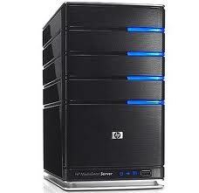
Introduction
Introduction
Management Plan
Requirement Specifications
Design Definition
Implementation
Test and Quality Assurance
Demo
Q&A
Our System
Management
Employee information public provider
Checking Timework

Slide 8
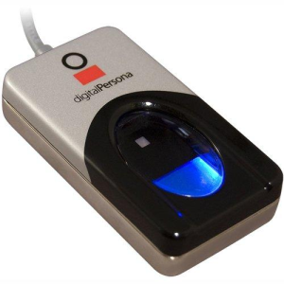
Introduction
Introduction
Management Plan
Requirement Specifications
Design Definition
Implementation
Test and Quality Assurance
Demo
Q&A
FingerPrint Sensor U.R.U 4500 and DigitalPersona OneTouch SDK

Slide 9
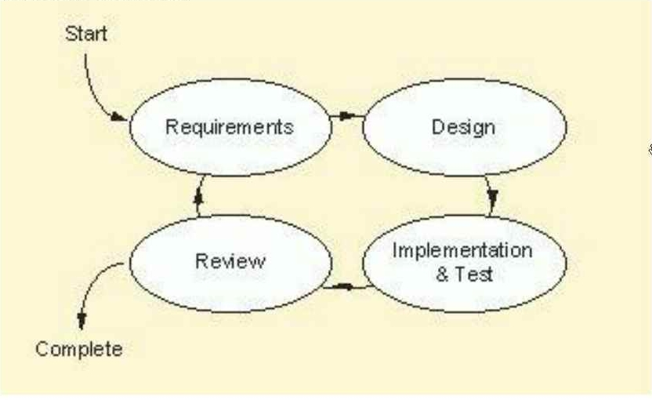
Management Plan
Software Process Model
Introduction
Management Plan
Requirement Specifications
Design Definition
Implementation
Test and Quality Assurance
Demo
Q&A

Slide 10
Management Plan
Software Process Model
Introduction
Management Plan
Requirement Specifications
Design Definition
Implementation
Test and Quality Assurance
Demo
Q&A
Strong points
Integration and testing is executed continuously
Soon reacting to prevent undetected misunderstanding by feedback in each iteration
There is always something runnable as concrete evidences of the project's status

Slide 11
Management Plan
Roles and Responsibilities
Introduction
Management Plan
Requirement Specifications
Design Definition
Implementation
Test and Quality Assurance
Demo
Q&A
Mr Nguyễn Hồng Kỳ
Supervisor
MinhPN
Team Leader
MinhPN
PTL
DinhPT
Dev Leader
TrangNT
Test Leader
HuyenPT
QA
MinhPN
Dev
DinhPT
Dev
DongVX
Dev
TrangNT
Tester
HuyenPT
Tester

Slide 12
Requirement Specifications
User Requirements
Introduction
Management Plan
Requirement Specifications
Design Definition
Implementation
Test and Quality Assurance
Demo
Q&A
Administrator
Admin can manage Account.
Admin can manage Base Information (Country, State, Unit, Position).
Manager
Manager can change Password.
Manager can manage Employee Information.
Manager can manage Timework.
Manager can manage Salary.
Employee
Employee can view and update Employee Information.
Employee can checking Timework.
Employee can view Salary.
Employee can view Timework

Slide 13
Requirement Specifications
System Requirements
Introduction
Management Plan
Requirement Specifications
Design Definition
Implementation
Test and Quality Assurance
Demo
Q&A
Manager Client Service
Client Service
Employee Client Service
Checking Timework Client Service
Create new Account
Manage Manger Account
Functions of Application Server
Reset Password
Delete Account
View Account
Manage Country (Create, Update, Delete, View)
Manage Base Information
Manage State (Create, Update, Delete, View)
Manage Unit (Create, Update, Delete, View)
Manage Position (Create, Update, Delete, View)

Slide 14
Requirement Specifications
System Requirements
Introduction
Management Plan
Requirement Specifications
Design Definition
Implementation
Test and Quality Assurance
Demo
Q&A
Create new Employee Information
Manage Employee Information
Update Employee Information
Delete Employee Information
View Employee Information
Functions of Manager Client
Calculate Timework
Manage Timework
View Timework
Export Timework to Excel Format
Timework Statistic Report
Manage Salary
View Salary
Send Salary Information to Employee

Slide 15
Requirement Specifications
System Requirements
Introduction
Management Plan
Requirement Specifications
Design Definition
Implementation
Test and Quality Assurance
Demo
Q&A
View and Update Employee Information
Update Employee Information
View Employee Information
Functions of Employee Client
View Timework
View Timework
View Salary
View Salary

Slide 16
Requirement Specifications
System Requirements
Introduction
Management Plan
Requirement Specifications
Design Definition
Implementation
Test and Quality Assurance
Demo
Q&A
Functions of Checking Timework Client
View Timework

Slide 17
Requirement Specifications
Non-Functions Requirements
Introduction
Management Plan
Requirement Specifications
Design Definition
Implementation
Test and Quality Assurance
Demo
Q&A
Availability
Usability
Security
The system is built on Windows.
Friendly with Vietnam users
System have to run 24/7
Backup (Automatic and manually)
All people can Login to by their fingerprint only.

Slide 18
Requirement Specifications
Non-Functions Requirements
Introduction
Management Plan
Requirement Specifications
Design Definition
Implementation
Test and Quality Assurance
Demo
Q&A
Maintainability
Portability
.Net Framework 4.0 and SQL server 2008 programs are practically independent of the OS-system which they communicate with
Carefully inform users about maintainability time

Slide 19
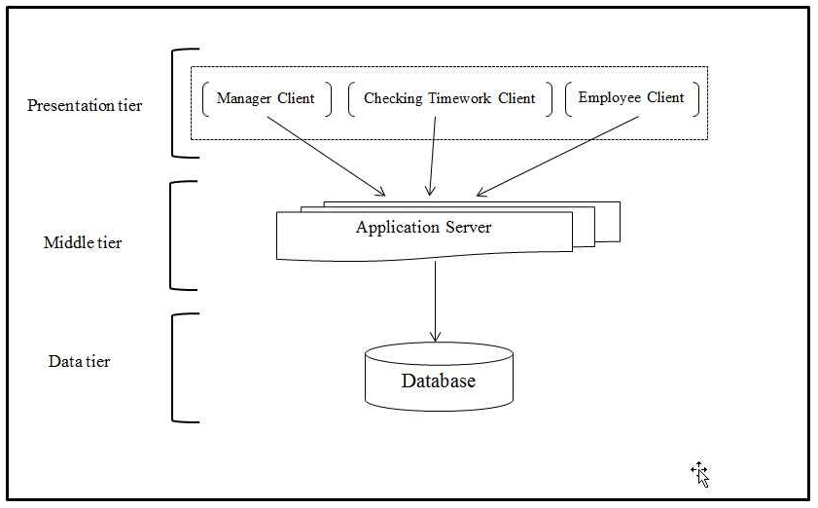
Design Definition
Architecture Design
Introduction
Management Plan
Requirement Specifications
Design Definition
Implementation
Test and Quality Assurance
Demo
Q&A
Multi-tier Architecture Design

Slide 20
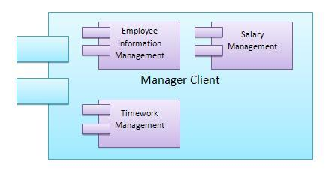
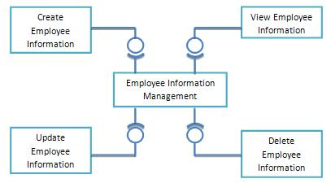
Design Definition
Component Diagram
Introduction
Management Plan
Requirement Specifications
Design Definition
Implementation
Test and Quality Assurance
Demo
Q&A

Slide 21
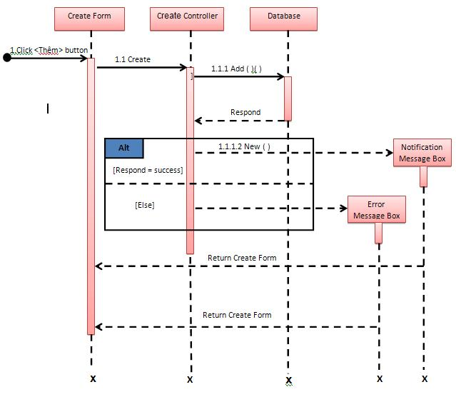
Design Definition
Sequence Diagram
Introduction
Management Plan
Requirement Specifications
Design Definition
Implementation
Test and Quality Assurance
Demo
Q&A

Slide 22
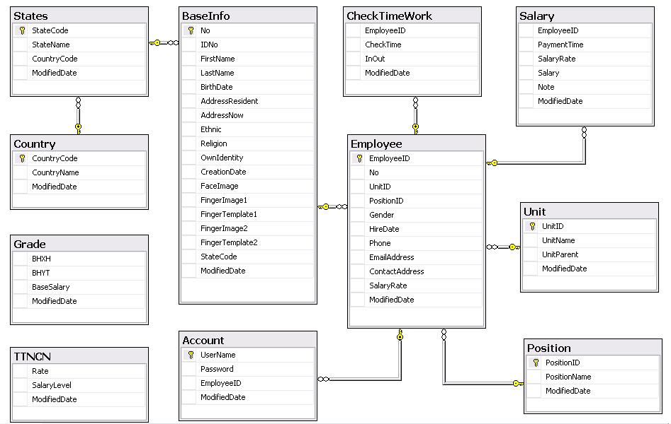
Design Definition
Database Structure
Introduction
Management Plan
Requirement Specifications
Design Definition
Implementation
Test and Quality Assurance
Demo
Q&A

Slide 23
Implementation
Tools and Technologies
Introduction
Management Plan
Requirement Specifications
Design Definition
Implementation
Test and Quality Assurance
Demo
Q&A
.NET Framework 4
SQL Server 2008
Visual Studio 2010
Tortoise SVN

Slide 24
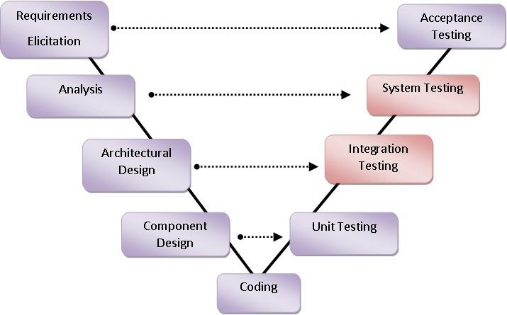
Test and Quality Assurance
Test Process
Introduction
Management Plan
Requirement Specifications
Design Definition
Implementation
Test and Quality Assurance
Demo
Q&A

Slide 25
Test and Quality Assurance
Coding Conventions
Introduction
Management Plan
Requirement Specifications
Design Definition
Implementation
Test and Quality Assurance
Demo
Q&A
Include
Test Plan
Test Cases
Checklists
DefectTrackingLog
Test Plan
Test Cases
Checklists
DefectTrackingLog

Slide 26
Test and Quality Assurance
Running Test
Introduction
Management Plan
Requirement Specifications
Design Definition
Implementation
Test and Quality Assurance
Demo
Q&A
Step1: Study business, requirements
Step 2: Develop test cases and test suite
Step 3: Run all tests after any feature/code is added, updated or removed
Step 4: Log defects, bugs and inform to developers
Step 5: Re-run tests and make sure defects are fixed or accepted by team

Slide 27
Test and Quality Assurance
How to Test
Introduction
Management Plan
Requirement Specifications
Design Definition
Implementation
Test and Quality Assurance
Demo
Q&A
Assign to dev but Defects are not bugs
Cancel
Corrected
Assign To Dev
Bugs are fixed
Defects
are
not
fixed
Re-Assign to Dev
Start
Open
Closed
End
Re-Open
Accepted
Assign to dev but Defects are accepted by PM

Slide 28
Test and Quality Assurance
Test Report
Introduction
Management Plan
Requirement Specifications
Design Definition
Implementation
Test and Quality Assurance
Demo
Q&A
Detected Defects:
Resolved Defects:
 | Pass | Fail | Untested | Accepted | N/A | Number of Test cases
Test Round 1
Function | 111 | 2 | 0 | 0 | 0 | 113
Screen Element | 48 | 0 | 0 | 0 | 0 | 48
View Information | 47 | 0 | 11 | 0 | 0 | 58
Security Matrix | 42 | 0 | 0 | 0 | 0 | 42
Common Cases | 144 | 0 | 0 | 0 | 121 | 265
Number of Test Cases | 392 | 2 | 11 | 0 | 121 | 526
Test coverage
Test coverage |  | 100.00%
Test successful coverage |  | 96.79%
Detected Defects : 35 defects

Slide 29
Demo
Introduction
Management Plan
Requirement Specifications
Design Definition
Implementation
Test and Quality Assurance
Demo
Q&A
Detected Defects:
Resolved Defects:
Demo

Slide 30
Demo
Introduction
Management Plan
Requirement Specifications
Design Definition
Implementation
Test and Quality Assurance
Demo
Q&A
Detected Defects:
Resolved Defects:
Q&A

Slide 31
Thanks for Listening.

