Slide 1

Credit Ranking System

Slide 2
Contents
1
Introduction
2
Plan
3
Development process
4
Demo
5
Q&A

Slide 3
Project management
Quality Assurance
Result
Introduction
Group
GROUP INTRODUCTION
Project name: Credit Ranking System
Supervisor: Mr. Quang LT
Students:
- Đào Mai Ly
- Trần Thị Hương Giang
- Phạm Thị Phương Thảo
- Phan Lê Quang Chính
- Nguyễn Thanh Long
Presentation view-point
Business context
Plan
Development process
SRS
Design
Implement
Testing
Demo
Q&A

Slide 4
Project management
Quality Assurance
Result
Introduction
Group
PRESENTATION VIEW-POINT
Follow process groups: Requirements => Integration Testing
Each process contains 2 two parts: group working method and result
Quality assurance follows all the processes
Presentation view-point
Business context
Plan
Development process
SRS
Design
Implement
Testing
Demo
Q&A
Banking Credit System

Slide 5
Project management
Quality Assurance
Result
Introduction
Group
BUSINESS CONTEXT
Presentation view-point
Business context
BASIC CONCEPTS
  What is Bank Credit Ranking?
  Purpose of the business?
  Who will be ranked or evaluated by the business process?
  Which criteria are used to rank a customer?
Plan
Development process
SRS
Design
Implement
Testing
Demo
Q&A
Banking Credit System

Slide 6
Project management
Quality Assurance
Result
BUSINESS CONTEXT
CREDIT RANKING PROCESS FOR BUSINESS CUSTOMERS
Credit dept
manager
Risk managing
staff
Risk dept
manager
Branch
Director
Credit staff
Receive request ranking
Request for updating
Collect customer information
Identify customer’s industry operation
Marking for Financial Indexes
Marking for Non-Financial Indexes
Calculate total score
Summary Evaluation
Validation
Evaluation
Verified
Accepted
Committing Result
Banking Credit System

Slide 7
Project management
Quality Assurance
Result
BUSINESS CONTEXT
CREDIT RANKING PROCESS FOR INDIVIDUAL CUSTOMERS
Credit dept
manager
Risk managing
staff
Risk dept
manager
Branch
Director
Credit staff
Receive request ranking
Request for updating
Collect customer information
Marking for Basic information
Marking for Other information
Calculate total score
Summary Evaluation
Validation
Evaluation
Verified
Accepted
Committing Result
Banking Credit System

Slide 8
Project management
Quality Assurance
Result
BUSINESS CONTEXT
THE TWO APPROACH OF RANKING CREDIT
OLD SOLUTION
NEW SOLUTION
Simple technique
Clustering technique
AAA
BBB
Customer
AAA
BBB
CC
CC
Banking Credit System

Slide 9
Project management
Quality Assurance
Result
Introduction
Role
Group
Presentation view-point
Role | Tasks in charge
Project manager Nguyen Thanh Long | Work out the plan and time table Team contact point General manage project Design, code, review, create reports
Developer, designer Phan Le Quang Chinh | Support technique Design, code, review, create reports In charge of building Mining module
Developer, designer Dao Mai Ly | Support technique Design, code, review, create reports In charge of building Ranking module
Developer, tester and QA Tran Thi Huong Giang | Design, code, review, create reports In charge of Testing and QA tasks Create test case, test data, operate IT
Developer, tester and QA Pham Thi Phuong Thao | Code, review, create reports In charge of Testing and QA tasks Create test case, operate IT Manage meeting minutes
Business context
Plan
Development process
SRS
Design
Implement
Testing
Demo
Q&A

Slide 10
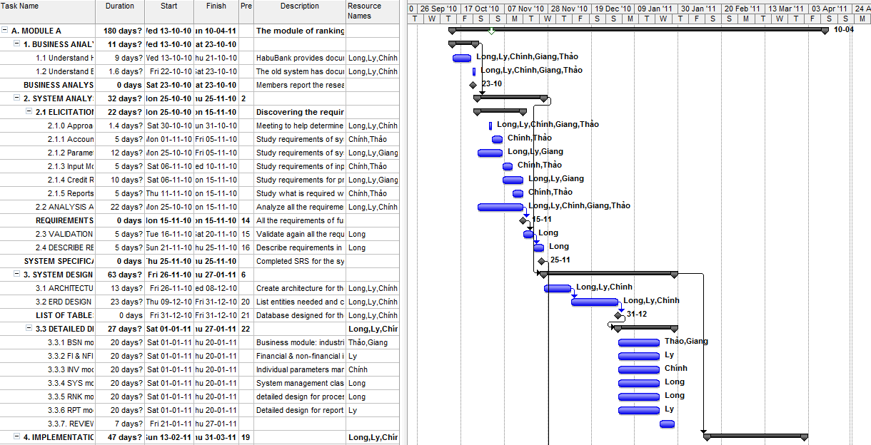
Project management
Quality Assurance
Result
Project Plan

Slide 11
Project management
Quality Assurance
Result
Introduction
Time table
Group
Presentation view-point
Project management
Business context
Quality Assurance
Review
Plan
Feasibility study
Require
ment
Create TC
Integration test
Deploy
Development process
DB & AD
Implement
DD
SRS
Design
Oct
Nov
Dec
Jan
Feb
Mar
Apr
Implement
Testing
Demo
Q&A

Slide 12
Project management
Quality Assurance
Result
Introduction
Contact method
Group
Presentation view-point
Business context
Weekly
meetings
Issue and
bug list
Plan
Development process
SRS
Design
E-mail, Phone,
Skype
SVN server
Implement
Testing
Demo
Q&A

Slide 13
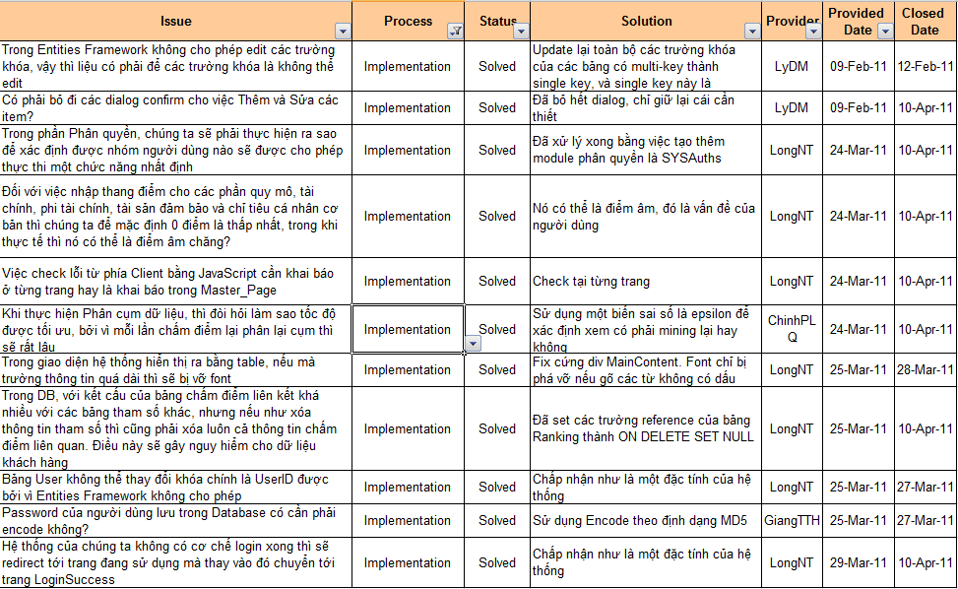
Project management
Quality Assurance
Result
Introduction
Working process – Issue management
Group
Presentation view-point
Business context
Plan
Development process
SRS
Design
Implement
Testing
Demo
Q&A

Slide 14
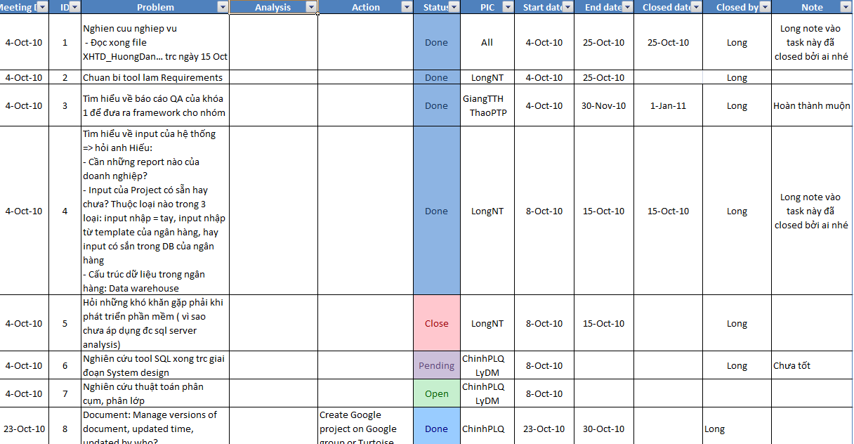
Project management
Quality Assurance
Result
Working process – Task management

Slide 15
Project management
Quality Assurance
Result
Introduction
Working process
Group
Plan
Code
Review
Log bugs
Presentation view-point
Business context
Plan
Development process
SRS
Design
Implement
Testing
Demo
Q&A

Slide 16
Project management
Quality Assurance
Result
Introduction
Cross-Review method
Group
Presentation view-point
- SRS and DD review: cross-review between 2 teams
Business context
- Code review: Person who design the module will review code for this module. This process will form a review circle
Plan
Long
Giang
Thảo
Ly
Chính
Development process
SRS
Design
Implement
Testing
Demo
Q&A

Slide 17
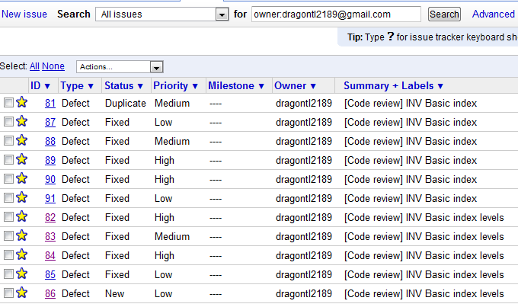
Project management
Quality Assurance
Result
Introduction
Working process – Bug management
Group
Presentation view-point
Business context
Plan
Development process
SRS
Design
Implement
Testing
Demo
Q&A

Slide 18
Project management
Quality Assurance
Result
Introduction
Group
BSN | FI NFI | INV | SYS |RNK |RPT
Presentation view-point
Business context
Plan
Elicitation
Analysis &
Negotiation
Development process
SRS
Documenting
Validation
Design
Implement
Testing
Demo
Q&A

Slide 19
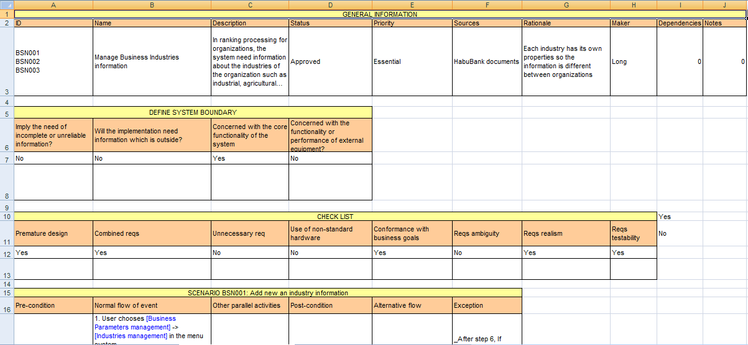
Project management
Quality Assurance
Result
Introduction
SRS Template
Group
Presentation view-point
Business context
Plan
Development process
SRS
Design
Implement
Testing
Demo
Q&A

Slide 20
Project management
Quality Assurance
Result
Introduction
Review action:
  Review within sub-team.
  Cross-review of two sub-team
  Customers clarification.
Group
Presentation view-point
Business context
Plan
Development process
SRS
Design
Implement
Testing
Demo
Q&A

Slide 21
Project management
Quality Assurance
Result
Introduction
Result:
FUNCTIONAL REQUIREMENT
  Use cases:
    22 BSN use cases
    33 INV use cases
    14 NFI use cases
    9 FI use cases
    24 SYS use cases
    17 RNK Use cases
    2 RPT use cases
Group
Presentation view-point
Business context
Plan
Development process
SRS
Design
Implement
Testing
Demo
Q&A

Slide 22
Project management
Quality Assurance
Result
Introduction
NON FUNCTIONAL
  Reliability
  Security
  Portability
  Performance
Group
Presentation view-point
Business context
Plan
Development process
SRS
Design
Implement
Testing
Demo
Q&A

Slide 23
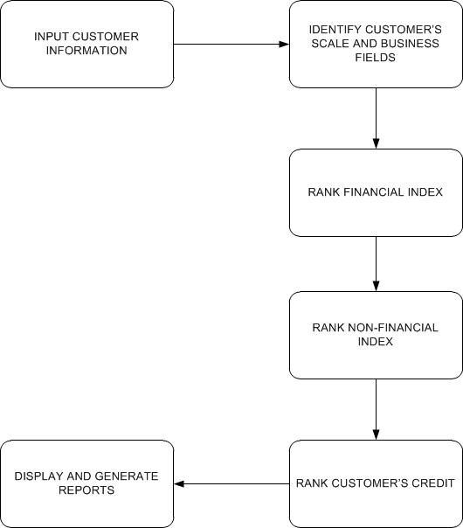
Project management
Quality Assurance
Result
Introduction
DOMAIN REQUIREMENT
Group
Presentation view-point
Business context
Plan
Development process
SRS
Design
Implement
Testing
Demo
Q&A

Slide 24
Project management
Quality Assurance
Result
Introduction
DOMAIN REQUIREMENT
Group
Presentation view-point
Identify customer Information
Business context
Plan
Rank Basic Index
Development process
SRS
Design
Rank Collateral
Index
Implement
Testing
Demo
Q&A

Slide 25
Project management
Quality Assurance
Result
Introduction
DB design
  Goal:
  - Solve business requirement.
  Following 3 Normal Form
  Inherit customer data
  Approach:
  Bottom up
  Design and edit, review, mere in Visio then create DB
  Result:
  Picture design in Visio
Group
Presentation view-point
Business context
Plan
Development process
SRS
Design
Implement
Testing
Demo
Q&A

Slide 26
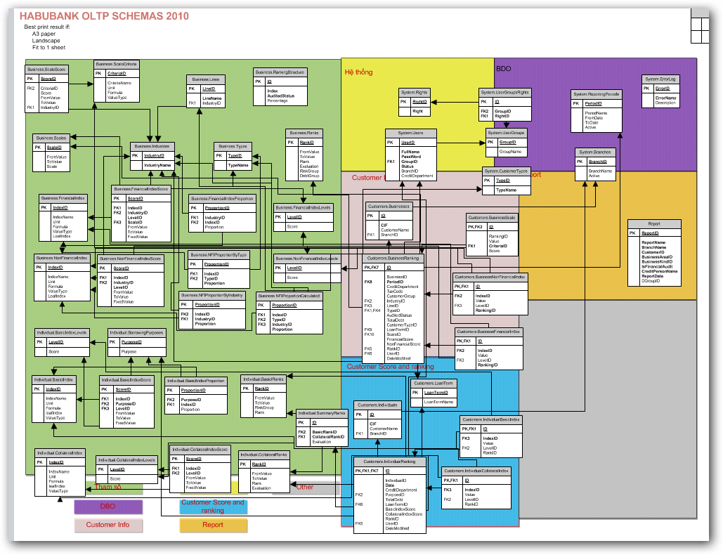
Project management
Quality Assurance
Result
Introduction
DB design
Group
Presentation view-point
Business context
Plan
Development process
SRS
Design
Implement
Testing
Demo
Q&A

Slide 27
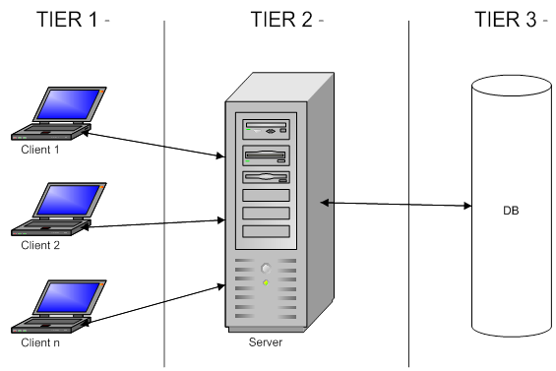
Project management
Quality Assurance
Result
Introduction
High Level design
Base on non-Functional requirement:
  Need a lot of user using common DB
  We develop a three layer architecture
Group
Presentation view-point
Business context
Plan
Development process
SRS
Design
Implement
Testing
Demo
Q&A

Slide 28
Project management
Quality Assurance
Result
Introduction
Group
Create a extranet web to implement our solution
Framework : Using MVC( Microsoft MVC .Net 2.0)
Advance :
  beside common advance, it save our time
Presentation view-point
Business context
Plan
Development process
SRS
Design
Implement
Testing
Demo
Q&A

Slide 29
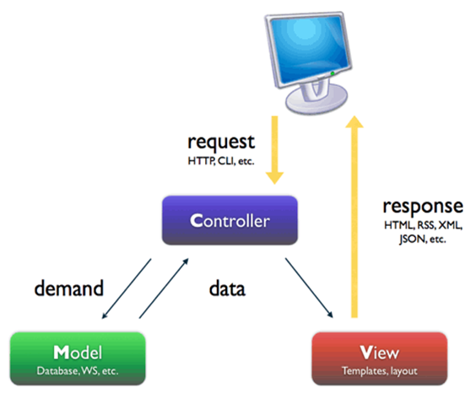
Project management
Quality Assurance
Result
Introduction
Detail Design
Group
Presentation view-point
Business context
Plan
Development process
SRS
Design
Implement
Testing
Demo
Q&A

Slide 30
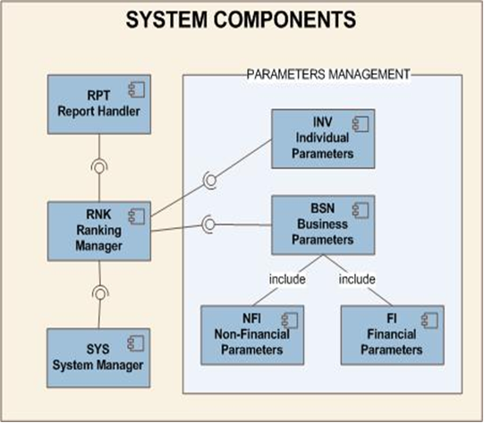
Project management
Quality Assurance
Result
Introduction
  Component in our program:
Group
Presentation view-point
Business context
Plan
Development process
SRS
Design
Implement
Testing
Demo
Q&A

Slide 31
Project management
Quality Assurance
Result
Introduction
Detail Design
Approach: bottom up: each person design a function, using our excel template and MS Visio.
Group
Presentation view-point
Business context
Plan
Development process
SRS
Design
Implement
Testing
Demo
Q&A

Slide 32
Project management
Quality Assurance
Result
Introduction
Implement
Definite:
k-means clustering is a method of cluster analysis which aims to partition n observations into k clusters in which each observation belongs to the cluster with the nearest mean.
Group
Presentation view-point
Business context
Plan
Development process
SRS
Design
Implement
Testing
Demo
Q&A

Slide 33
Project management
Quality Assurance
Result
Introduction
Kean algorithm
Definite:
k-means clustering is a method of cluster analysis which aims to partition n observations into k clusters in which each observation belongs to the cluster with the nearest mean.
Group
Presentation view-point
Business context
Plan
Development process
SRS
Design
Implement
Testing
Demo
Q&A

Slide 34
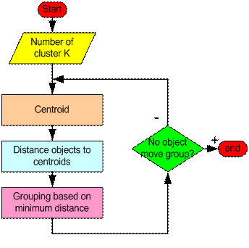
Project management
Quality Assurance
Result
Introduction
Algorithm flow char
Group
Presentation view-point
Business context
Plan
Development process
SRS
Design
Implement
Testing
Demo
Q&A

Slide 35
Project management
Quality Assurance
Result
Introduction
Implemented modules
Group
Presentation view-point
Business context
Administration
Plan
Parameters
Development process
Ranking
SRS
Design
Data Mining
Implement
Testing
Demo
Report
Q&A

Slide 36
Project management
Quality Assurance
Result
Introduction
Test strategy follows V-model
Group
Presentation view-point
Developing
Testing
Business context
Coding
Acceptance
System
Integration
Unit
Requirements
High-level design
Detailed design
Plan for
Plan
Development process
SRS
Design
Implement
Testing
Demo
Q&A

Slide 37
Project management
Quality Assurance
Result
Introduction
Testing process
Group
Presentation view-point
Create TC template
Write TC (based on SRS)
Review TC
Create test data
IT
Business context
Plan
Development process
SRS
Design
Implement
Testing
Demo
Q&A

Slide 38
Project management
Quality Assurance
Result
Introduction
Testing process
Group
Presentation view-point
Test case
Test data
Integration test
Business context
Plan
Development process
SRS
Design
Implement
Testing
Demo
Q&A

Slide 39
Project management
Quality Assurance
Result
Introduction
Testing activities
Code
Unit test
Review code
Integration test
Log bug
Group
Presentation view-point
Business context
Plan
Development process
SRS
Design
Implement
Testing
Demo
Q&A

Slide 40
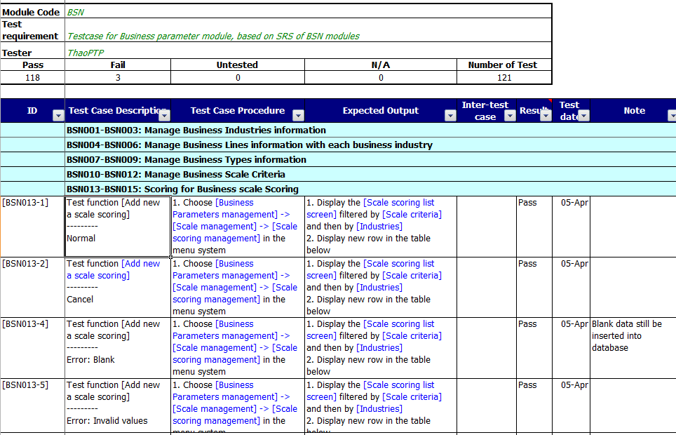
Project management
Quality Assurance
Result
Introduction
Test case
Group
Presentation view-point
Business context
Plan
Development process
SRS
Design
Implement
Testing
Demo
Q&A
Test case

Slide 41
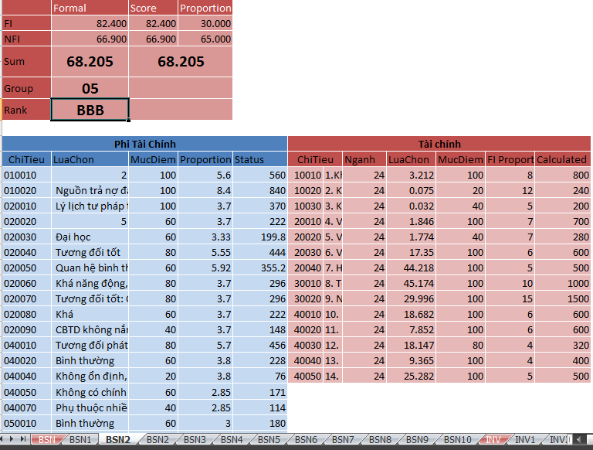
Project management
Quality Assurance
Result
Introduction
Test data
Group
Presentation view-point
Business context
Plan
Development process
SRS
Design
Implement
Testing
Demo
Q&A

Slide 42
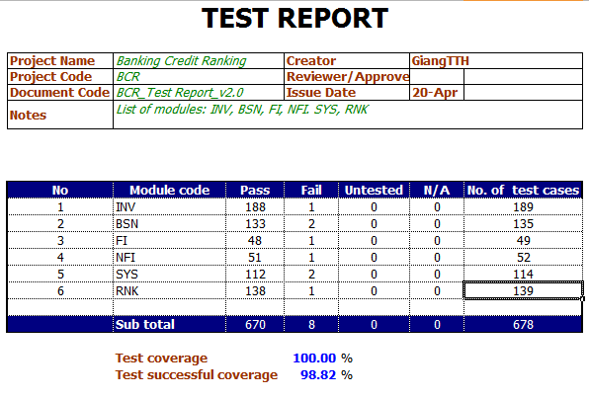
Project management
Quality Assurance
Result
Introduction
Test report
Group
Presentation view-point
Business context
Plan
Development process
SRS
Design
Implement
Testing
Demo
Q&A

Slide 43
DEMO

Slide 44
Q&A

Slide 45
Thanks for listening!

