Slide 1
e-Restaurant System
Supervisor: Nguyễn Hồng Kỳ

Slide 2
Contents
1
Introduction add Title
2
Project management plan lick to add Title
3
Requirement Specifications
4
Design Description to add Title
5
Implementation Title
6
Testing
7
Demo & Q&A

Slide 3
1. Introduction
Background add Title
Literature Review
Our Proposal

Slide 4
2. Project management plan
Development Environment
Process Model
Project organization
Project Planning

Slide 5
2. Project management plan
Development Environment
Hardware
Operating system: Windows 7
Personal computers for developing with the minimum configuration: 2 Gb of RAM, 50Gb of hard disk, Core 2 Duo 2.0 Ghz
Software
Visual Studio 2010
SQL Server 2008
Web Server: IIS 7
Framework: .NET Framework 4.0

Slide 6
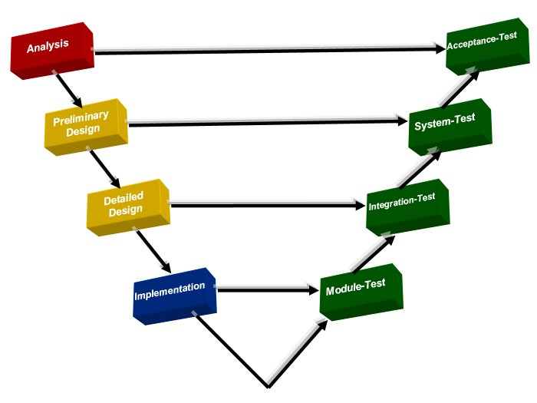
2. Project management plan
Process Model
V-Model

Slide 7
2. Project management plan
Project organization

Slide 8
2. Project management plan
Project Planning
Schedule Management
Resource Management
Communications management
Risk management

Slide 9
3. Requirement Specifications
User Requirements
System Requirements
Non-functional requirements

Slide 10
3. Requirement Specifications
User Requirements
Make the reservation on the website or phone
Add edit delete information table
Add edit delete customer information
Statistics menu lists dishes in a restaurant
Statistics monthly bills
Statistics client list has reservation
Send SMS, Email for customers

Slide 11
3. Requirement Specifications
System Requirements

Slide 12
3. Requirement Specifications
Non-functional requirements
Usability
Reliability
Availability
Security
Maintainability
Performance

Slide 13
4. Software Design Description
Architectural design
Detailed design
Database design

Slide 14
5. Implementation
Technologies
Tools
Coding convention

Slide 15
5. Implementation
Technologies
.NET Framework 4
SQL Server 2008
DotNetBar for Windows forms (Devcomponent)
GSM Communication Library (GSMComm)

Slide 16
5. Implementation
Tools
Visual Studio 2010
ReSharper
TortoiseSVN

Slide 17
5. Implementation
Coding convention
Follow general .NET coding conventions
(e.g. Pascal Casing, Camel Casing…)
Create specific conventions for our project

Slide 18
6. Testing
Test plan
Bug control
Test report

Slide 19
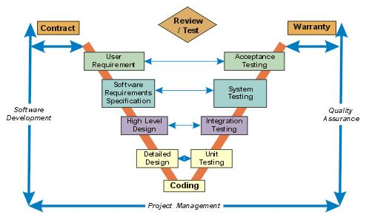
Testing
Process Testing

Slide 20
Testing
Unit
Testing
Unit Testing will be done by developers (ThuongTH, CuongTM, TienND), is integrated and approved by ThuDA, ThuongTH
Integration Test will be done by ThuDA
Integration
Test
System
Test
System Test will be done by ThuDA and ThuongTH
Acceptent Test will be done by people who use product with supported of team member
Acceptant
Test

Slide 21
Demo

Slide 22
Thank You !
e-Restaurant

