Slide 1


DRAWING OBJECTS RECOGNITION
ON MOBILTE
Supervisor: Mr. Trần Bình Dương

Slide 2
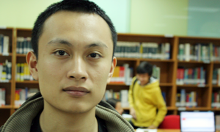
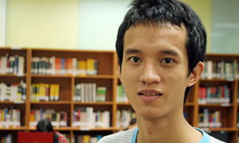
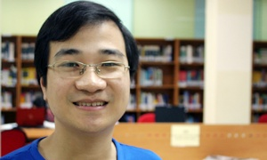
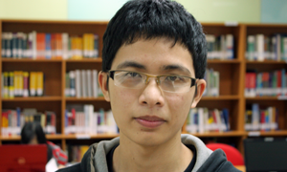
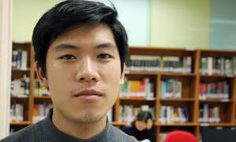
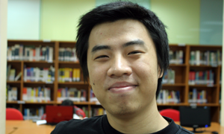
PROJECT MEMBERS
Đỗ Đức Cường
Hoàng Hùng Cường
Nguyễn Minh Công
Nguyễn Đức Giang
Chử Xuân Trường
Lê Thanh Tùng

Slide 3
AGENDA
Introduction
Project Management
Requirements
Design and Implementation
Project Result
Testing
Demo and Q&A
1
2
3
4
5
6
7

Slide 4

1. Introduction

Slide 5










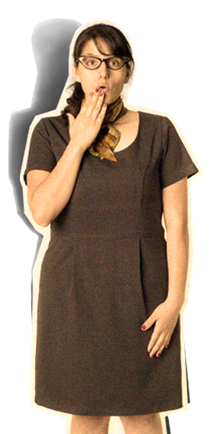






Slide 6



Slide 7

Note and Diagram Creation

Slide 8

Drawing Objects Recognition

Slide 9

Drawing Objects Recognition

Slide 10

Creation
Recognition
Management
Sharing
Internet Sharing

Slide 11

Creation
Recognition
Management
Sharing
DORM NOTE

Slide 12
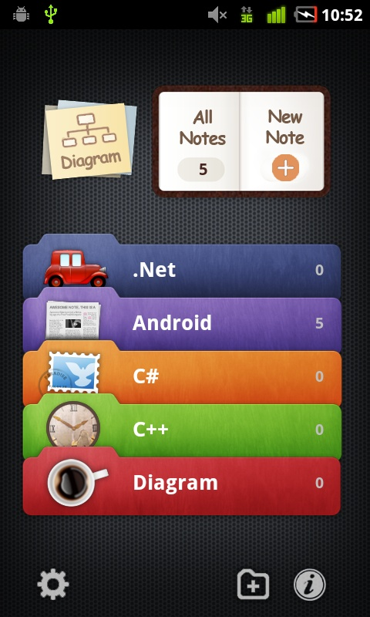
Friendly interface, easy to use.
Note all of information in a convenient
File management, sharing
DORM NOTE

Slide 13
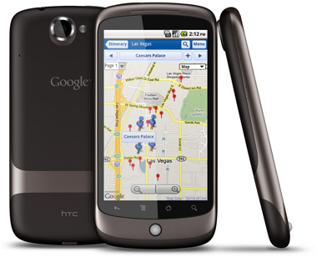


1. Introduction
Applicability

Slide 14
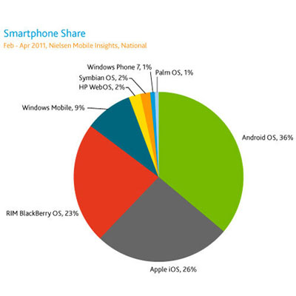


1. Introduction
Technology choices
  Android grow up rapidly
  Easy to develop
  Android 2.2 Froyo
  Java Development Toolkit (JDK)
  Eclipse
  Google SDK
  Facebook SDK

Slide 15
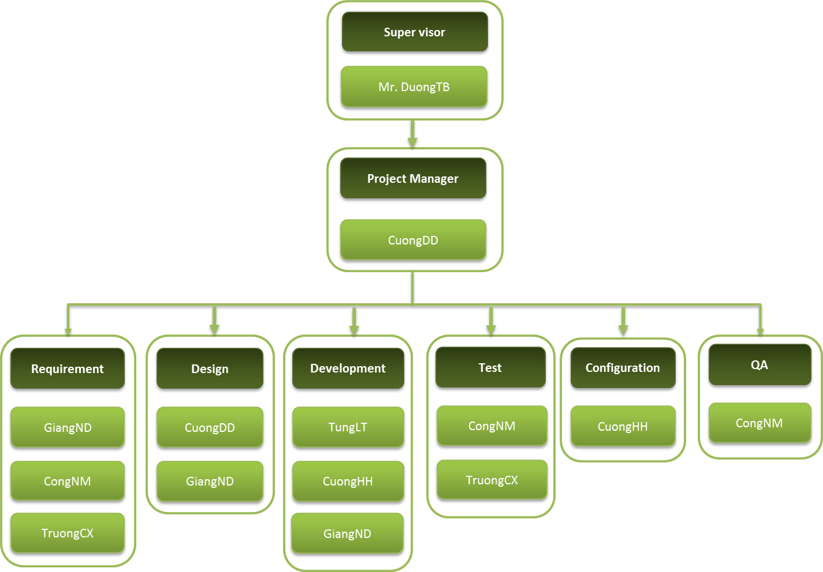
2. Project Management
Organization Structure

Slide 16
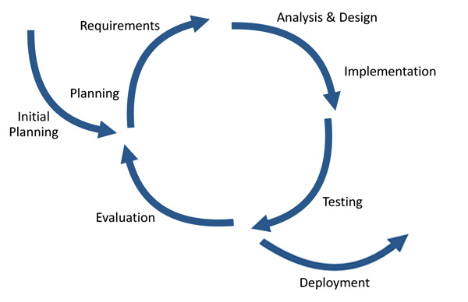
2. Project Management
Process Model
Always have a running version of the program
Difficult in specify all requirement
Support change requirement
Limit time and experience
Iterative model

Slide 17
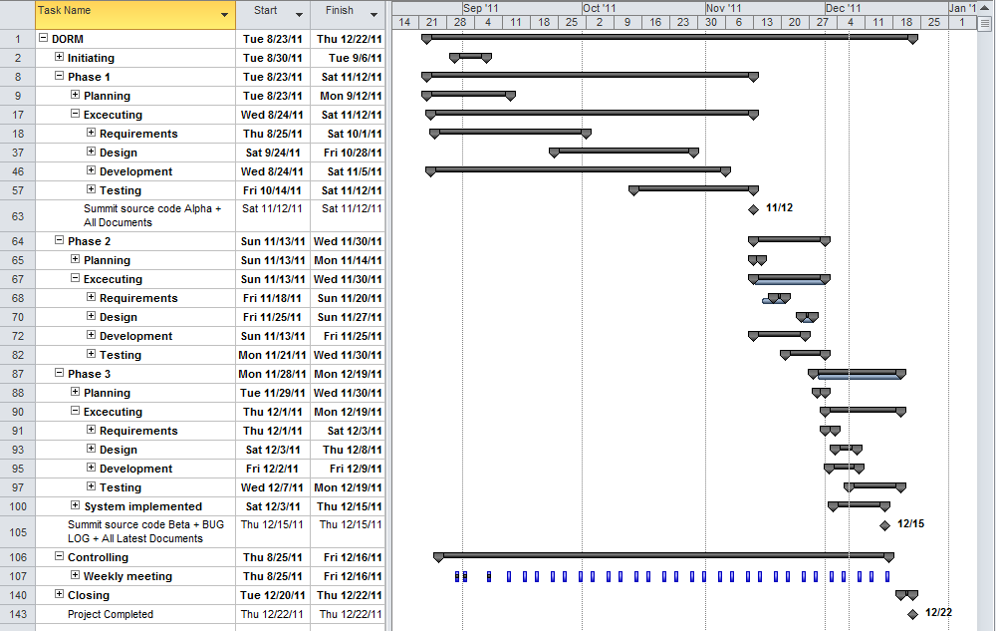

Slide 18
2. Project Management
Progress management
Weekly meeting
Assign Task
Assigned working
Individual Report
Teamwork

Slide 19
2. Project Management
Approach Methodology
Brainstorming
Individual working
Raise issue if any
Summary

Slide 20
2. Project Management
Risk Management
1
1
New Technology
Study & Training
2
2
Requirement Change
Priority & Separate Requirement
3
3
Shortage Time
Team Rules & Teamwork & Critical path
4
4
Management Experience
Supervisor’s Advices

Slide 21






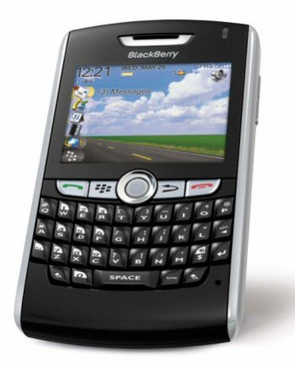
2. Project Management
Communication

Slide 22
2. Project Management
Configuration

Slide 23
3. Requirement
Application Function
1
System Features
2
Command Functions
3
Mini-command Functions
4
File & Folder Operation
5
Map & Sharing

Slide 24
3. Requirement
System Features
Create new Note/Diagram
Open/Save file from internal or SD Card
List all notes and diagrams
Sharing

Slide 25
Create new Note

Slide 26
Input Drawing

Slide 27
3. Requirement
Command Functions
Include the commands on the bottom menu such as undo/redo, insert, save …

Slide 29
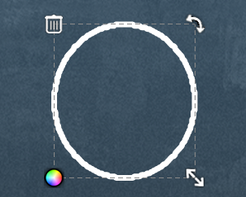
3. Requirement
Mini-command Functions
Move
Resize
Delete
Change color

Slide 31
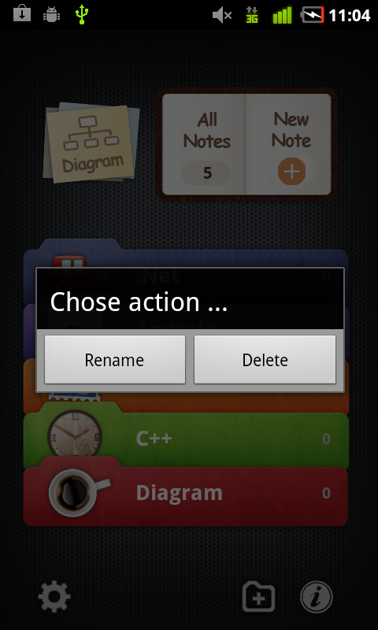
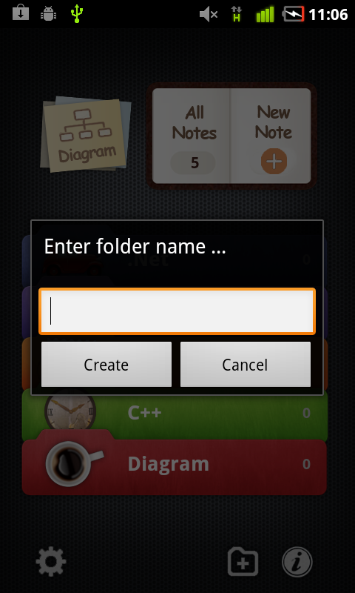
3. Requirement
File & Folder Operation
Create
Rename
Delete
Move file between the folders

Slide 32
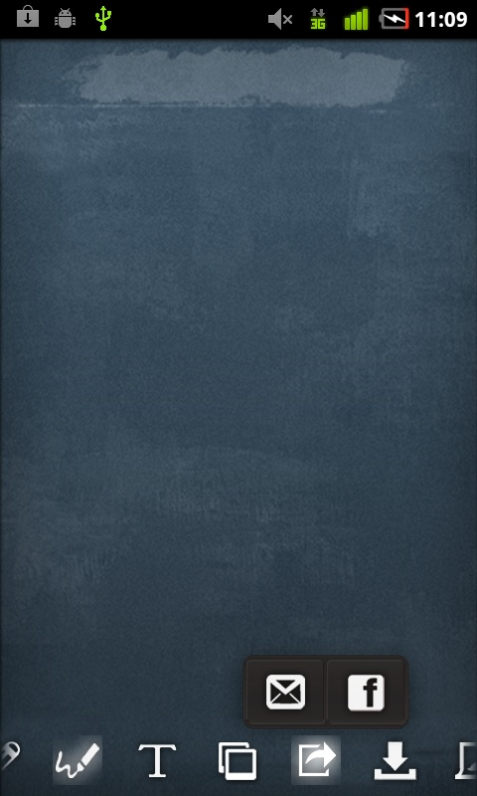
3. Requirement
Sharing
Email
Facebook
Picasa

Slide 33
3. Requirement
Non-functional Requirement
Reliability
Maintainability
Performance

Slide 34




4. Design & Implementation
System overview
Android OS
DORM Application
DORM Application
GUI
Service Providers
Note
Diagram
Network
Internet
Recognition
IO
IO
Data Storage

Slide 35
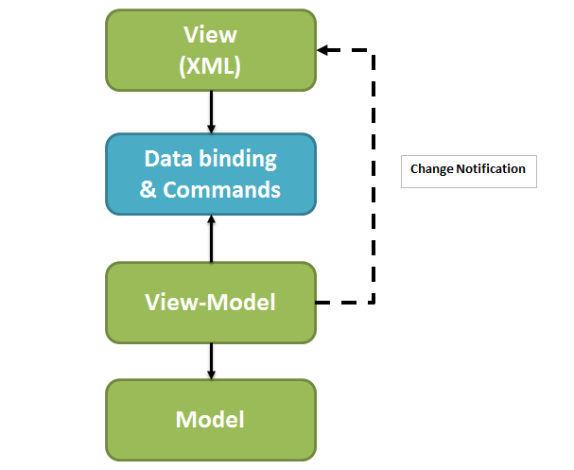
4. Design & Implementation
Model View View-Model model

Slide 36
4. Design & Implementation
Logical View
Main - GUI
Note
Diagram
Recognition
IO
Exemplars
Data Storage

Slide 37
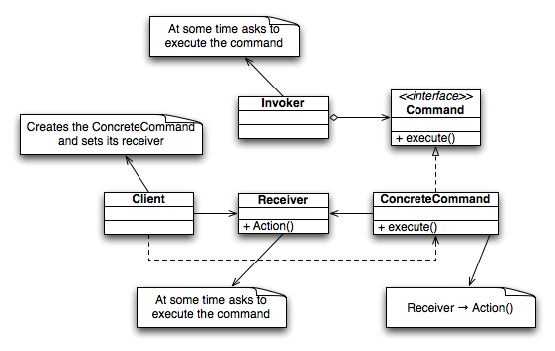
4. Design & Implementation
Command Pattern

Slide 38
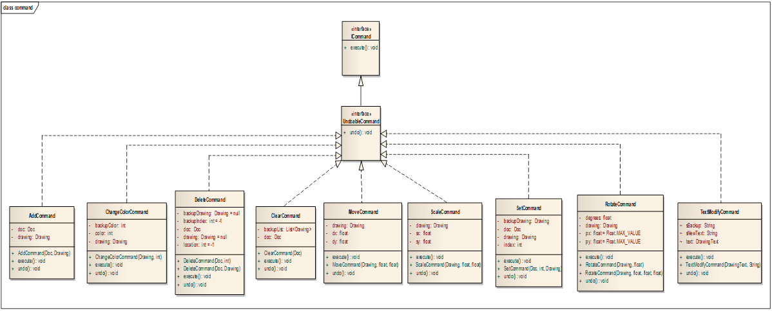
4. Design & Implementation
Command – Class Diagram

Slide 39
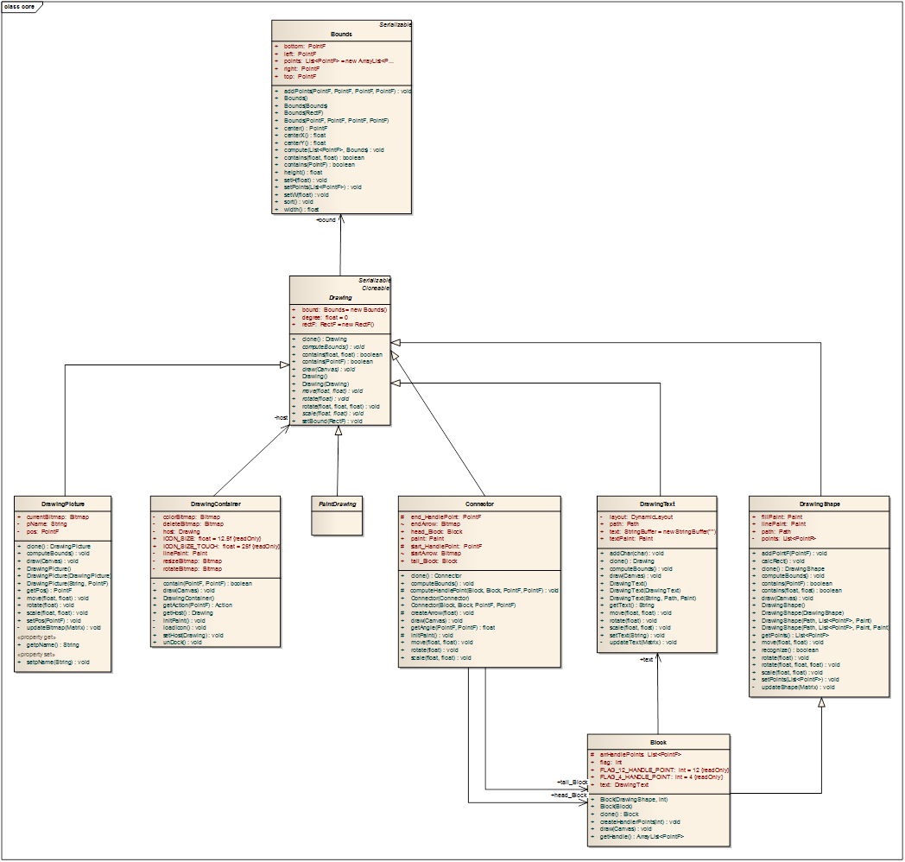
4. Design & Implementation
Model – Class Diagram

Slide 40
4. Design & Implementation
View – Class Diagram

Slide 41
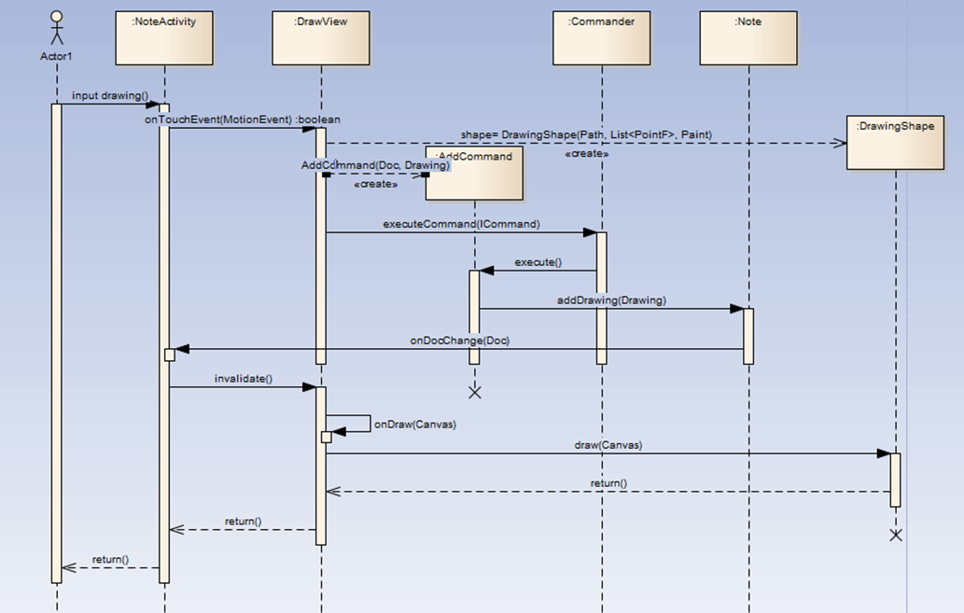
4. Design & Implementation
Sequence Diagram

Slide 42
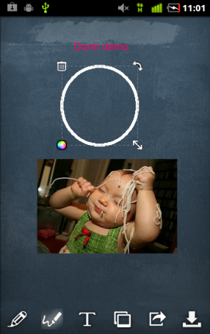




4. Design & Implementation
Data Structure
XML Util
XML Writer
XML Parser
ZIP Util
Data compression
File.drm
File.drm
Data Decompression

Slide 43
4. Design & Implementation
File Structure
The DORM file includes sub files:
  - Dorm.xml
  Images
  (Ex: image1.jpg, image2.png, etc.)

Slide 44
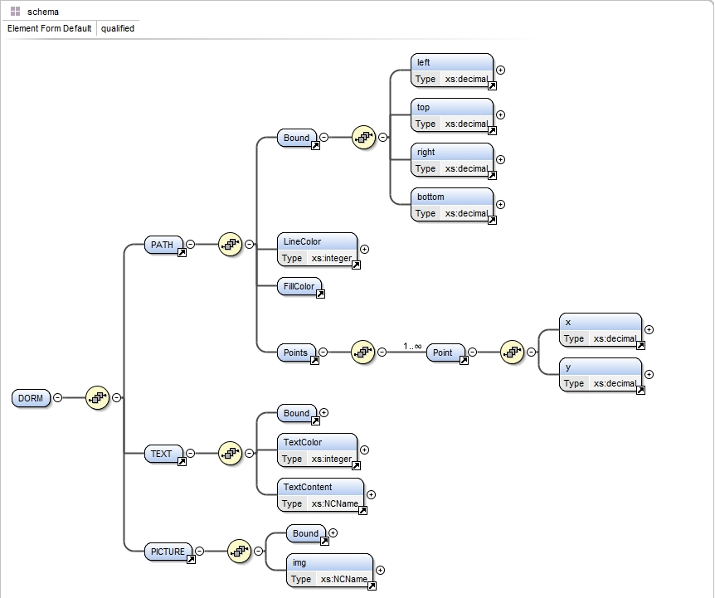
4. Design & Implementation
File Schema

Slide 45
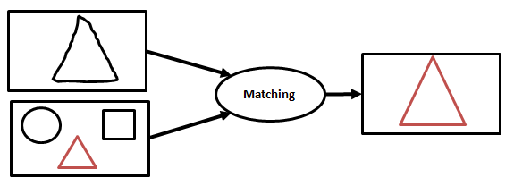
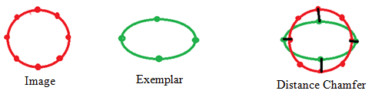
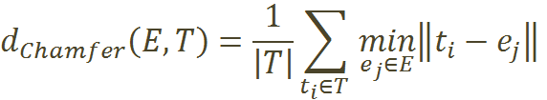
5. Algorithm
Exemplar – Based Approach to Shape Matching using Distance Chamfer

Slide 46
5. Algorithm
Exemplar – Based Approach to Shape Matching using Distance Chamfer
4
2
3

Slide 47



5. Algorithm
Distance Chamfer
Exemplar | 10 | 20 | 40 | 60 | 80 | 100 | 120
 | 85 | 132 | 393 | 667 | 764 | 983 | 1276
 | 106 | 212 | 453 | 752 | 1123 | 1534 | 1645
 | 194 | 612 | 951 | 1691 | 2566 | 3345 | 3452
Enviroment :
  Emulator in Vaio CS16G
  Core 2Duo 2.28Ghz / Memory 2GB / Window 7 Professional

Slide 48
5. Algorithm
Distance Chamfer

Slide 49
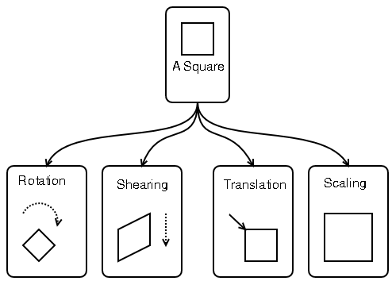

5. Algorithm
Transformation
Affine Transformation

Slide 50
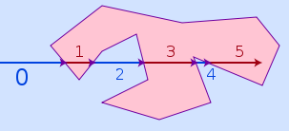
5. Algorithm
Find Point –in-Polygon
Ray casting - Stuart MacMartin

Slide 51
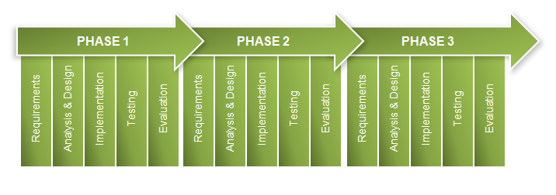
6. Testing
Defect Control

Slide 52
6. Testing
Test Schedule
Test Schedule | Start Date | End Date
Phase 1 | 14/10/2011 | 12/11/2011
Phase 2 | 21/11/2011 | 30/11/2011
Phase 3 | 7/12/2011 | 15/12/2011

Slide 53
6. Testing
Test Strategy
Test types:
  System test
  Integration test
  Unit testing

Slide 54
6. Testing
Test Plan
Features to be tested:
Module | Total testcase | Tester
Draw | 49 | CongNM
Input text | 33 | CongNM
Insert picture | 4 | CongNM
Diagram | 64 | CongNM
Move | 15 | CongNM
Minicomand: delete, rotate, resize, change color | 69 | CongNM

Slide 55
6. Testing
Test Plan
Features to be tested:
Module | Total testcase | Tester
Undo, redo | 33 | TruongCX
Clear | 12 | TruongCX
Change background | 9 | TruongCX
Save file | 12 | TruongCX
Open file | 15 | TruongCX
Send mail, facebook | 18 | TruongCX
Google map | 3 | TruongCX
Operate folder | 4 | TruongCX

Slide 56
6. Testing
Test Report Phase 1
No | Module code | Pass | Fail | Untested | N/A | Number of test cases
1 | Draw | 20 | 2 | 0 | 27 | 49
2 | Input Text | 9 | 1 | 0 | 23 | 33
3 | Insert Picture | 1 | 3 | 0 | 0 | 4
4 | Move | 6 | 6 | 0 | 3 | 15
5 | Mini command | 27 | 9 | 0 | 33 | 69
6 | Undo-Redo | 27 | 6 | 0 | 0 | 33
7 | Clear | 6 | 6 | 0 | 0 | 12
8 | Change Background | 9 | 0 | 0 | 0 | 9
9 | Open File | 15 | 0 | 0 | 0 | 15
10 | Save File | 9 | 3 | 0 | 0 | 12
11 | Send e-mail | 0 | 0 | 0 | 18 | 18
12 | Operate Folder | 0 | 0 | 0 | 4 | 4
 | Sub total | 129 | 36 | 0 | 108 | 273

Slide 57
6. Testing
Test Report Phase 2
No | Module code | Pass | Fail | Untested | N/A | Number of test cases
1 | Draw | 49 | 0 | 0 | 0 | 49
2 | Input Text | 31 | 2 | 0 | 0 | 33
3 | Insert Picture | 2 | 2 | 0 | 0 | 4
4 | Diagram | 0 | 0 | 0 | 64 | 64
5 | Move | 12 | 3 | 0 | 0 | 15
6 | Mini command | 42 | 0 | 0 | 27 | 69
7 | Undo-Redo | 27 | 6 | 0 | 0 | 33
8 | Clear | 10 | 2 | 0 | 0 | 12
9 | Change Background | 9 | 0 | 0 | 0 | 9
10 | Open File | 15 | 0 | 0 | 0 | 15
11 | Save File | 9 | 3 | 0 | 0 | 12
12 | Send e-mail | 18 | 0 | 0 | 0 | 18
13 | Google maps | 3 | 0 | 0 | 0 | 3
14 | Operate Folder | 4 | 0 | 0 | 0 | 4
 | Sub total | 231 | 18 | 0 | 91 | 340

Slide 58
7. Project Result
Project result
Plan
Actual
Technique
Smart
Pretty
Useful
Work with Android graphic package.
Fantastic and friendly GUI design.
Successful installation drawing object recognition algorithm.
Build a bulk of useful utility.

Slide 59
7. Project Result
Project result
Plan
Actual
Report
Complete, compact , easy to understand
Meet deadline
Complete Clear but not compact enough.
Meet deadline.
Easy to understand.

Slide 60
7. Project Result
Project result
Plan
Actual
Teamwork
Not conflict time.
Support each other.
Clear division of work according to the ability of each person.
Reasonable time management.
Offset the disadvantages of the members.
Good in resolve problem.
Good task control.

Slide 61
7. Project Result
Project result
Good points
Almost complete all functions of Requirement.
Limits
Missing some type of diagram.
Recognition algorithm is not optimal.
Nice and sparkling interface.
Particularly effective in sharing.
The improvement using in the limited space not yet done.
Synchronization not complete yet.
Good file and folder management.
Easy to modify and maintenance.
Easy to install and use.

Slide 62
7. Project Result
Future Development
Overcome limit
Resolve remaining problem.
Complete product
Complete functions related to copyright and license.
Publish on Android Market.
Get revenue.

Slide 63
7. Project Result
Future Development
Technical study Skills
Study along with use demand
Team work
Management Project
Time management
Risk detect and response
Information sharing
communicate
Refer experienced people

Slide 64
DEMO

Slide 65
QUESTIONS
&
ANSWERS

Slide 66
THANKS FOR
YOUR ATTENDENT

