Slide 1

CAPSTONE PROJECT
House Finding Website
by GG-Team
Hanoi, 24th May, 2012

Slide 2
Contents:
1
Group Introduction
2
Idea
3
Existing solutions
4
Purposed solution
5
Project management

Slide 3





1. Group Introduction
Hoàng Mạnh Tùng
Leader
Phạm Hoài Nam
Developer
Nguyễn Tiến Bình
Developer
Tạ Thị Bích Hằng
Tester
Lê Thiện Tài
Designer

Slide 4
Project Overview
Project name: House Finding Website
Project code: HF1102
Project type: Web application
Duration: May 2012 to August 2012

Slide 5
2. Idea
Situation:
- Demand to find house
- Need to announce house or other properties
Problems:
- Complicated information
- Difficult to find desired apartment

Slide 6
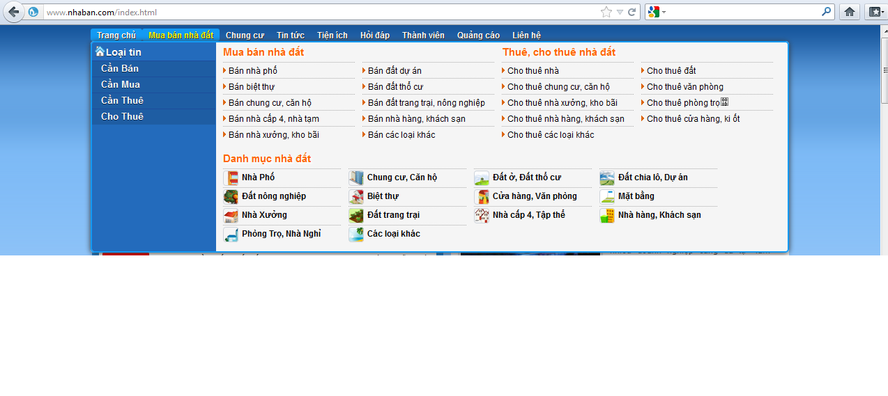
3. Existing solutions: (1)
  http://www.nhaban.com
  Disadvantage:
  Confused with many types of property

Slide 7
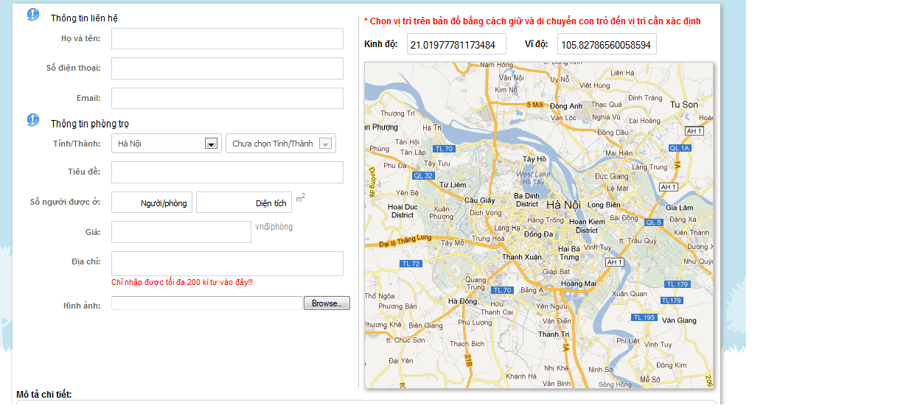
3. Existing solutions: (2)
http://xomtrosv.com
  Advantage:
  Added map into property information

Slide 8
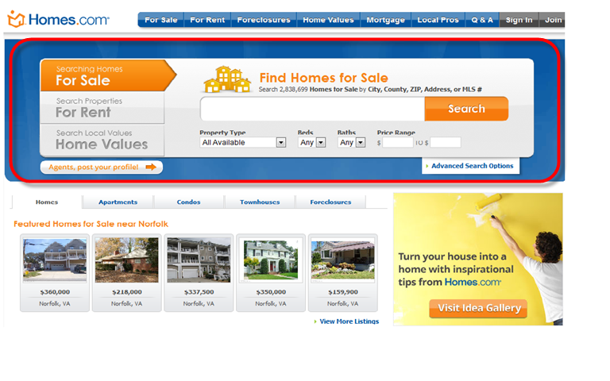
3. Existing solutions: (3)
http://www.homes.com
  Advantage:
  Use tab to divide information

Slide 9
4. Purposed Solution: (1)
Solve problems of existing solutions
More functions to help user finds information easily

Slide 10
4. Purposed Solution: (2)
Main functions:
User:
- Ability to upload content about for sale and for rent department.
- Search content by RELATED places
- Easily view content with map in ONE page
  → Friendly UI

Slide 11
4. Purposed Solution: (3)
Main functions:
Administrators:
- Easily to manage topics/users in ONE page.
- Add more information into content of topic
(Map, Project …)

Slide 12
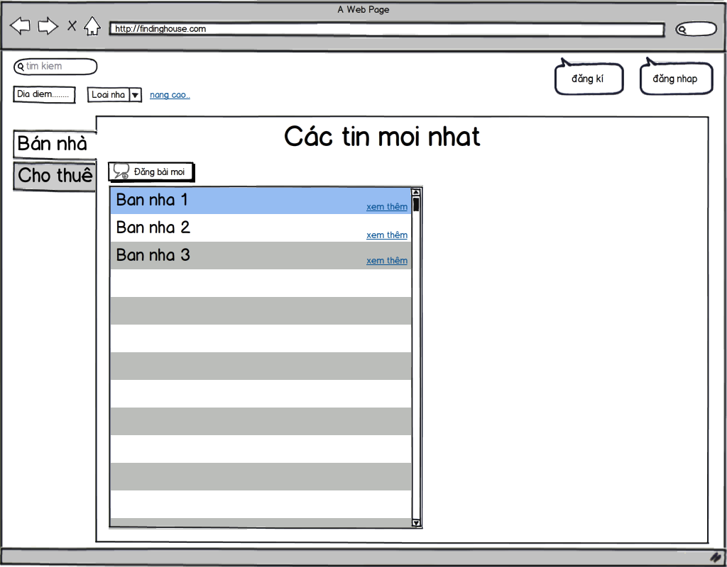
Main Screen:

Slide 13
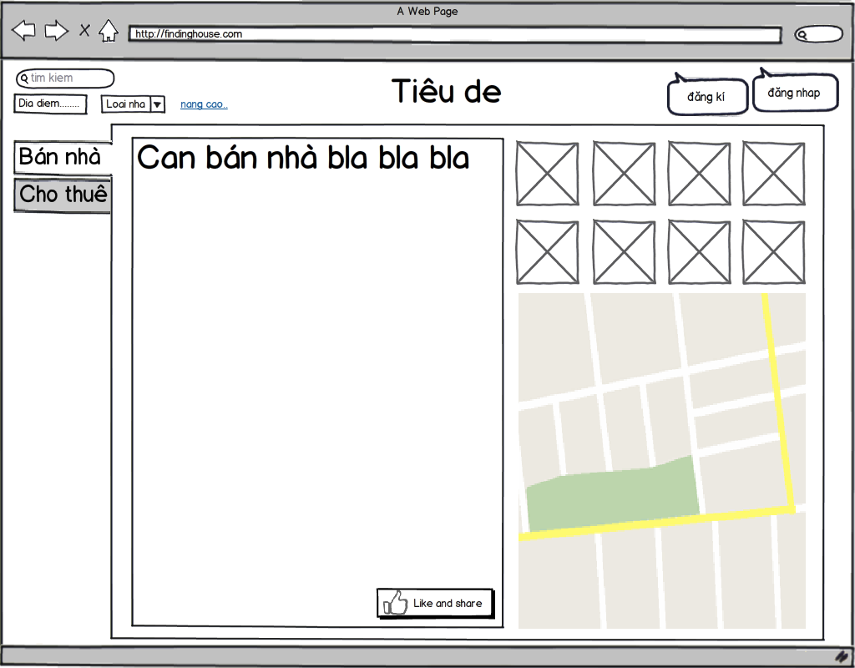
View topic:

Slide 14
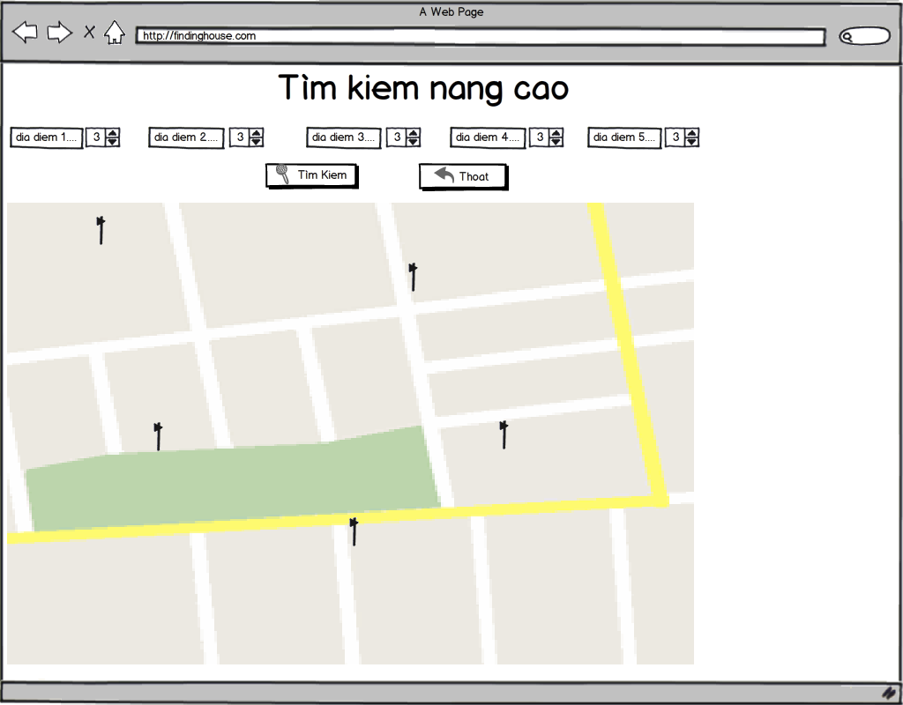
Advance search tool

Slide 15
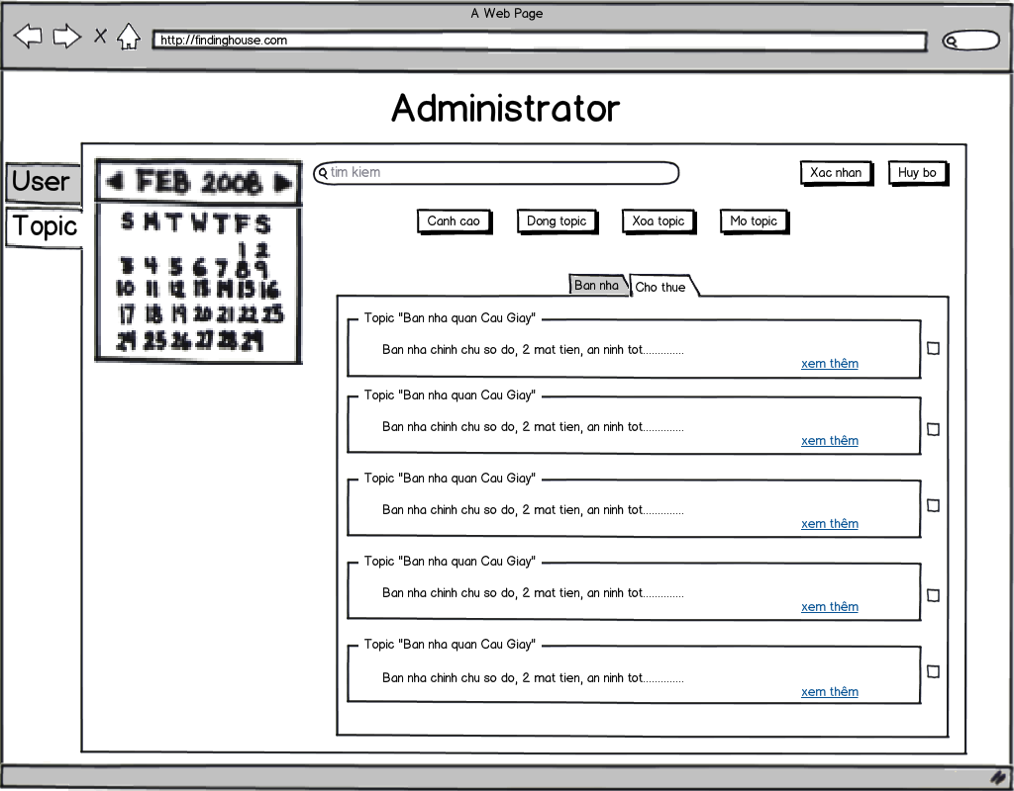
Admin

Slide 16
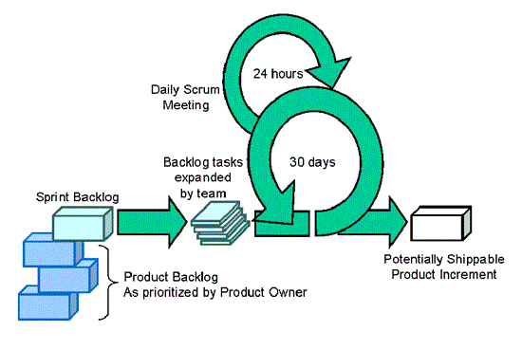
Project management:
Methodology: Scrum

Slide 17
Project management:
Project plan:

Slide 18
Thank You !

