Slide 1
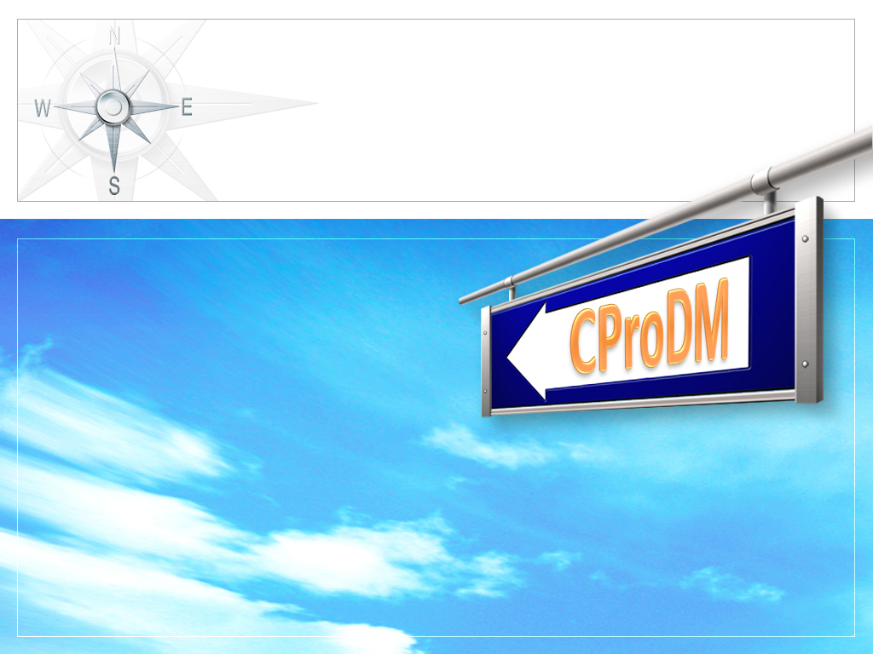


Capstone Project Document Management
Supervisor:
Mr. Phan Trường Lâm
Student: Vũ Nhật Linh
Lê Quang Hoàn
Nguyễn Duy Quyền
Hoàng Nam
Nguyễn Thế Anh

Slide 2
Outline
Introduction
Project plan
System Requirement Specifications
System Analysis and Design
Test Documentation
Deploy and User guide
Summary
Demo & Q&A

Slide 3
Introduction
1
2
3
4
5
6
7
8
Team Information
Initial Idea
Literature Review
Proposal & Product

Slide 4

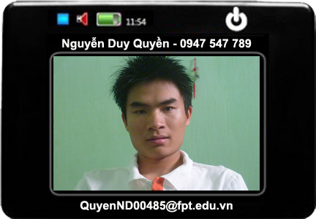
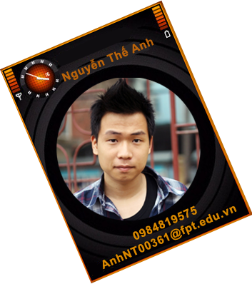

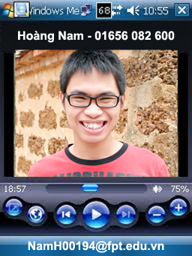
Team information
1
2
3
4
5
6
7
8

Slide 5
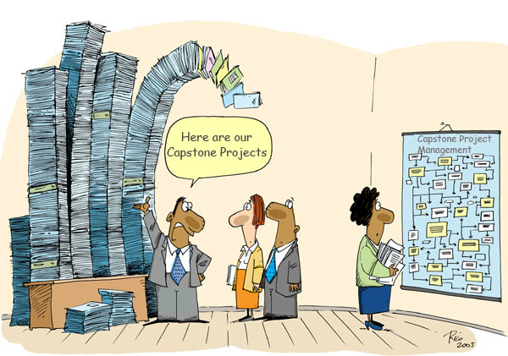
Initial Idea
1
2
3
4
5
6
7
8

Slide 6


Initial Idea (Cont)
1
2
3
4
5
6
7
8
We decide to develop a new system that integrated:
  Collect documents
  Organize these documents
  Searching

Slide 7


Literature Review
1
2
3
4
5
6
7
8
Methods that these websites use
to build their systems:
  Big database
  Search
  Ranking and presentation of return results
  Turnitin’s solution - OriginalityCheck™
  Plagiarism Prevention

Slide 8


Literature Review (Cont)
1
2
3
4
5
6
7
8
Achievements of the existing systems
  Attractive
    Easy to Read
    Speed & Reliability
    Quality Results
    Ensuring Privacy
  Awareness
Limitations of the existing systems
  Costs
  Privacy
  Relationship between Students – Teachers

Slide 9



Proposal
1
2
3
4
5
6
7
8
Collect and manage Capstone projects
Support looking up Capstone projects
Avoid repeating and copying idea
Detect cheating
Ranking results
Refer to other materials
Friendly interface like google
Public for everyone
Inside and outside University
Chipper to build
Free to use

Slide 10
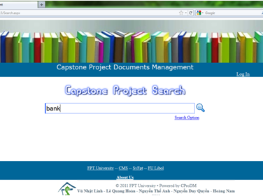
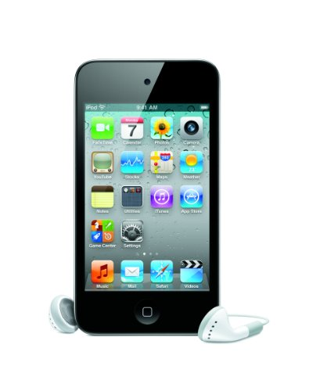
Product
1
2
3
4
5
6
7
8
Mobile apps
(in future)
Website

Slide 11

Project Plan
1
2
3
4
5
6
7
8
Development environment
Process
Project organization
Project schedule
Coding conventions
Risk management

Slide 12









Development Environment
1
2
3
4
5
6
7
8
HARD WARE
2 Gb of RAM
100Gb of hard disk
Core 2 Duo 2.0 Ghz
4 Gb of RAM
100Gb of hard disk
Core 2 Duo 2.0 Ghz
SOFT WARE

Slide 13
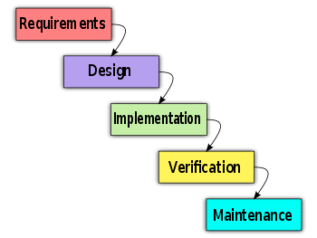
Process
1
2
3
4
5
6
7
8
Follow Waterfall model

Slide 14
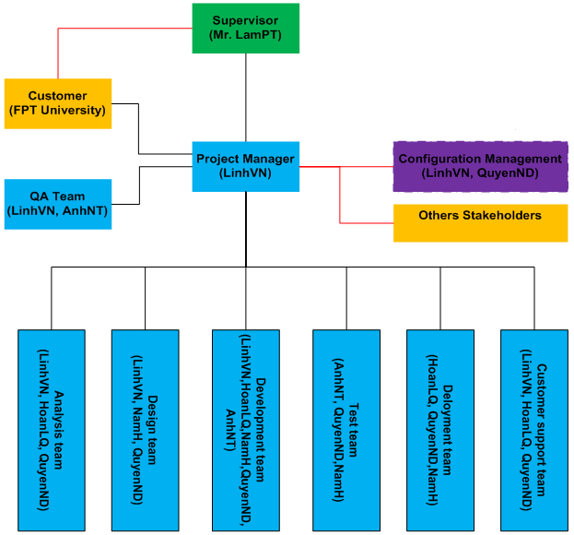
Project organization
1
2
3
4
5
6
7
8

Slide 15
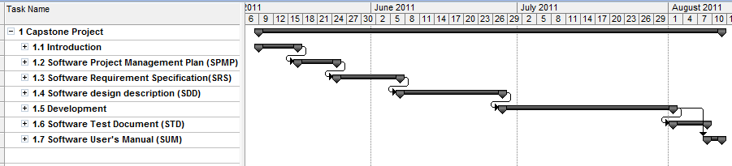
Project Schedule
1
2
3
4
5
6
7
8
Overall plan

Slide 16


Coding conventions
1
2
3
4
5
6
7
8
Follow .NET Naming Guidelines
Follow FxCop rules

Slide 17
Risk Management
1
2
3
4
5
6
7
8
Risk
Management
People risk
Estimation risk
Technology risk
Requirement risk
Schedule risk

Slide 18

System Requirement Specifications
1
2
3
4
5
6
7
8
User Requirements
System Requirements
Non-functional requirements

Slide 19
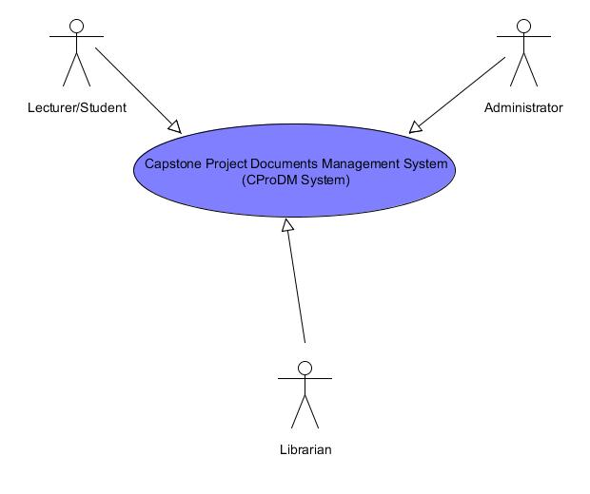
User Requirements
1
2
3
4
5
6
7
8
Lecturers and Students:
  Search project documents.
  Download documents.
Librarians:
  Edit profile.
  Change/Reset password.
  Edit documents information.
  Categorize documents.
Administrator
  Create/Edit/Delete account.

Slide 20

User Requirements (Cont)
1
2
3
4
5
6
7
8
Other requirement
  Searched Results will be ranked.
  Have advance search.
  Document has following information:
          name
          author name
          supervisor name
          created date
          description
          and category
  System input included:
          keyword file
          abstract file
          full document file
          other materials

Slide 21
System Requirements
1
2
3
4
5
6
7
8
Document requirements for each use case
Each includes:
  Use case diagram
  Actor
  Summary
  Goals
  Triggers
  Preconditions
  Post conditions
  Success scenarios
  Alternative scenarios
  Exceptions
  Relationship
  Business rules
  Description
  Screen
  Data field definitions
  Button definitions

Slide 22
Non-functional Requirements
1
2
3
4
5
6
7
8
Usability
Availability
Reliability
Non-functional Requirement
Security
Security
Performance
Maintainability

Slide 23

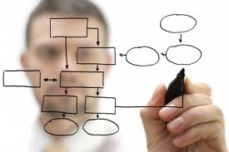
System Analysis and Design
1
2
3
4
5
6
7
8
Architectural design
Detailed design
Database design

Slide 24
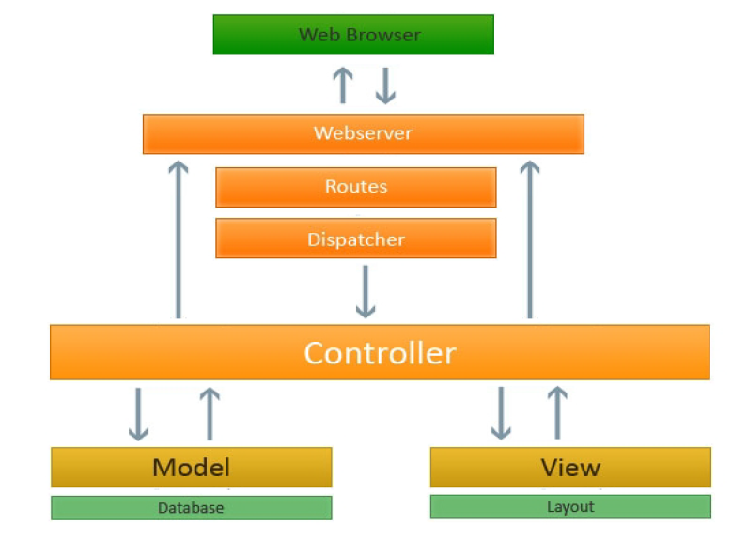
Architectural design
1
2
3
4
5
6
7
8
“CProDM” web application built with MVC in detail view.

Slide 25
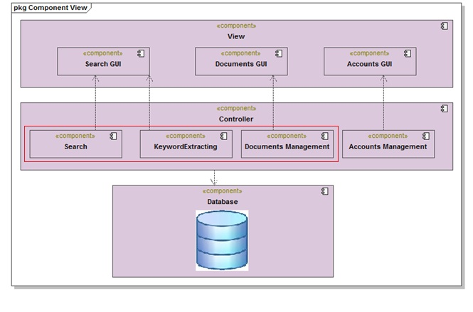
Detailed design
1
2
3
4
5
6
7
8
“CProDM” Component Diagram

Slide 26
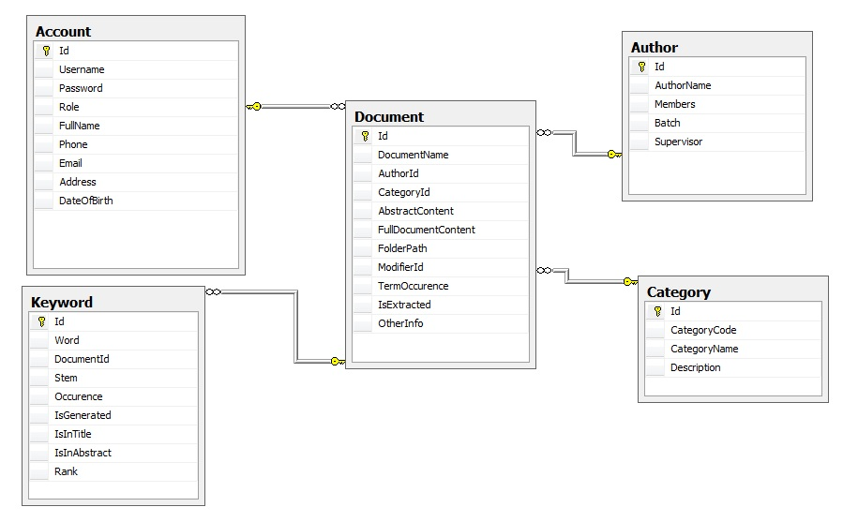
Database design
1
2
3
4
5
6
7
8
Entity diagram

Slide 27
Algorithm
1
2
3
4
5
6
7
8
Keyword Extraction from a Single Document using Word Co-occurrence Statistical Information
(YUTAKA MATSUO and MITSURU ISHIZUKA)
Introduction
Study Algorithm
Evaluation
Improve Algorithm

Slide 28

Algorithm – Introduction
1
2
3
4
5
6
7
8
Meaning
Position
Frequency

Slide 29
Algorithm – Introduction (Cont)
1
2
3
4
5
6
7
8
Discard stop words
Stem
Extract frequency
Preprocessing
Calculate
X’² value
Expected probability
Select frequent term
Processing
Output

Slide 30
Algorithm – Study Algorithm
1
2
3
4
5
6
7
8
Preprocessing
Goal:
Remove Stop words in document.
Stem words.
Get terms which are candidate keywords and their frequency.

Slide 31
Algorithm – Study Algorithm (Cont)
1
2
3
4
5
6
7
8
Step2
Example:
Step1
Stemmed Words
Information powerful
weapon modern society
day overflowed
huge amount data
electronic newspaper
articles emails web pages
search results Often
information receive
incomplete such further
search activities required
enable correct interpretation
usage information
Discarded Stop Words
Informat power
weapon modern societi
day overflow
huge amoun data
electronic newspaper
articl email web page
search result Often
informat receive
incomplet such further
search activ requir
enable correct interpret
usag informat
Original Text
Information is the most powerful weapon in the modern society. Every day we are overflowed with a huge amount of data in form of electronic newspaper articles, emails, web pages and search results. Often, information we receive is incomplete, such that further search activities are required to enable correct interpretation and usage of this information.
Information powerful
weapon modern society
day overflowed
huge amount data
electronic newspaper
articles emails web pages
search results Often
information receive
incomplete such further
search activities required
enable correct interpretation
usage information
Information is the most powerful weapon in the modern society. Every day we are overflowed with a huge amount of data in form of electronic newspaper articles, emails, web pages and search results. Often, information we receive is incomplete, such that further search activities are required to enable correct interpretation and usage of this information.

Slide 32
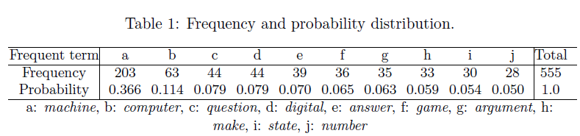
Algorithm – Study Algorithm (Cont)
1
2
3
4
5
6
7
8
Processing
Select frequent Term
The top ten frequent terms (denoted as G) and the probability of occurrence, normalized so that the sum is to be 1.

Slide 33
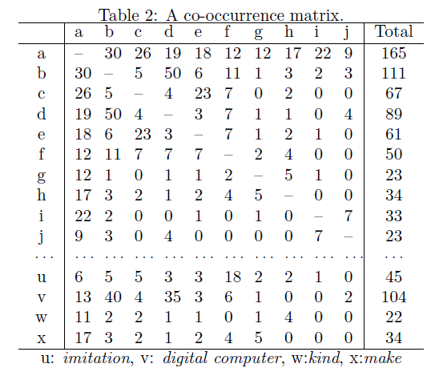
Algorithm – Study Algorithm (Cont)
1
2
3
4
5
6
7
8
Co-occurrence and Importance
Two terms in a sentence are considered to co-occur once.

Slide 34
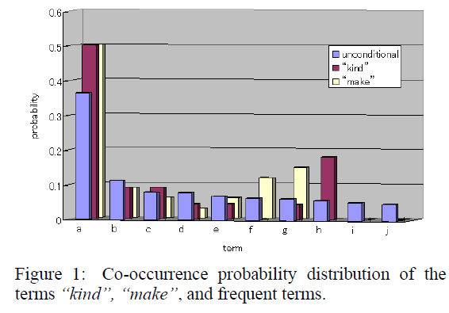
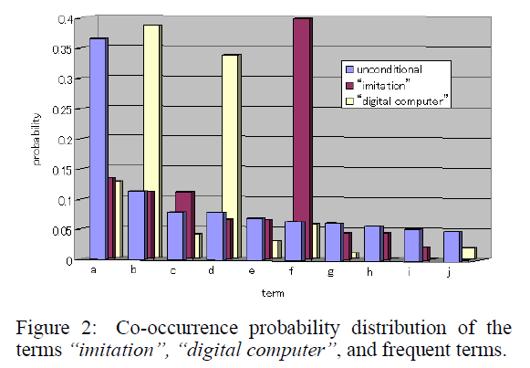
Algorithm – Study Algorithm (Cont)
1
2
3
4
5
6
7
8
If X²(w) > X²α , the null hypothesis is rejected with signiﬁcance level α.

Slide 35

Algorithm – Study Algorithm (Cont)
1
2
3
4
5
6
7
8
The statistical value of χ² is deﬁned as
P_{g} Unconditional probability of a frequent term g ∈ G
(the expected probability)
N_{w} The total number of co-occurrence of term w and frequent terms G
freq (w, g) Frequency of co-occurrence of term w and term g

Slide 36
Algorithm – Study Algorithm (Cont)
1
2
3
4
5
6
7
8
If a term appears in a long sentence, it is likely to co-occur with many terms;
if a term appears in a short sentence, it is less likely to co-occur with other terms.
We consider the length of each sentence and revise our deﬁnitions
P_{g} (the sum of the total number of terms in sentences where g appears) divided by (the total number of terms in the document)
N_{w} The total number of terms in the sentences where w appears including w

Slide 37

Algorithm – Study Algorithm (Cont)
1
2
3
4
5
6
7
8
the following function to measure robustness of bias values

Slide 38
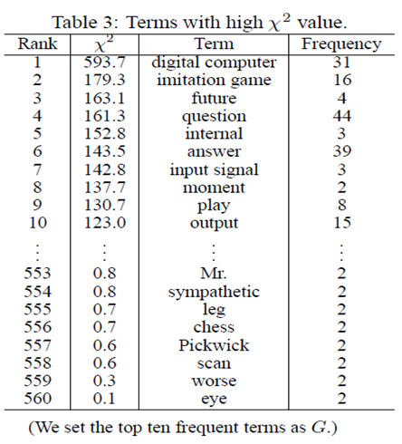
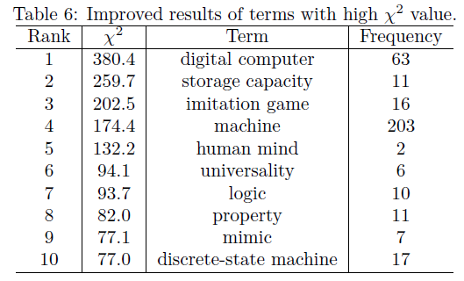
Algorithm – Evaluation
1
2
3
4
5
6
7
8

Slide 39
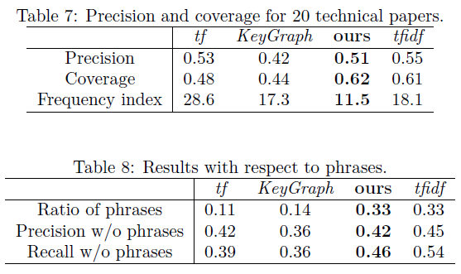
Algorithm – Evaluation (Cont)
1
2
3
4
5
6
7
8

Slide 40
Algorithm – Improve Algorithm
1
2
3
4
5
6
7
8
To improve extracted keyword quality, we will cluster terms
Two major approaches (Hofmann & Puzicha 1998) are:
Similarity-based clustering
If terms w1 and w2 have similar distribution of co-occurrence with other terms, w1 and w2 are considered to be the same cluster.
Pairwise clustering
If terms w1 and w2 co-occur frequently, w1 and w2 are considered to be the same cluster.

Slide 41
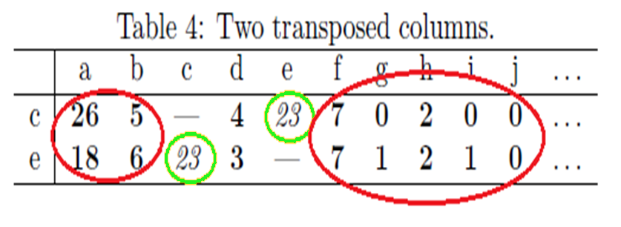
Algorithm – Improve Algorithm (Cont)
1
2
3
4
5
6
7
8
Similarity-based clustering centers upon Red Circles
Pairwise clustering focuses on Green Circles

Slide 42
Algorithm – Improve Algorithm (Cont)
1
2
3
4
5
6
7
8
Similarity-based clustering
Cluster a pair of terms whose Jensen-Shannon divergence is
Where:
and:

Slide 43


Algorithm – Improve Algorithm (Cont)
1
2
3
4
5
6
7
8
Pairwise clustering
Cluster a pair of terms whose mutual information is
Where:

Slide 44
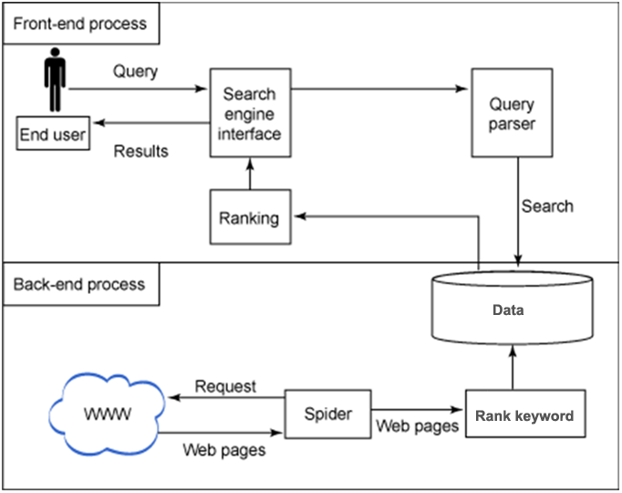
Ranking
1
2
3
4
5
6
7
8

Slide 45
Ranking (Cont)
1
2
3
4
5
6
7
8
Use rank calculate formula Term in a collection documents:
( Automatic Keyword Extraction for Database Search
First examiner : Prof. Dr. techn. Dipl.-Ing. Wolfgang Nejdl
Second examiner : Prof. Dr. Heribert Vollmer
Supervisor : MSc. Dipl.-Inf. Elena Demidova )
R(t) = Fd(t)*log(1 + N/N(t))
Finally formula :
Rank = d * Rd(t) / R(t)
Rank = d * Rd(t) / (Fd(t)*log(1 + N/N(t)))

Slide 46
Test Documentation
1
2
3
4
5
6
7
8
Test result
No | Tester | Module code | Pass | Fail | Untested | N/A | Number of test cases
1 | AnhNT | Master Page | 18 | 0 | 0 | 0 | 18
2 | AnhNT | Home Page | 12 | 0 | 0 | 0 | 12
3 | AnhNT | Search Result | 5 | 0 | 0 | 0 | 5
4 | AnhNT | User Account | 69 | 0 | 0 | 0 | 69
5 | AnhNT | Error Page | 8 | 0 | 0 | 0 | 8
6 | NamH | Category | 36 | 0 | 0 | 0 | 36
7 | NamH | Document | 47 | 0 | 0 | 0 | 47
8 | NamH | Authenticated | 81 | 0 | 0 | 0 | 81
9 | NamH | User Document Detail | 9 | 0 | 0 | 0 | 9
 |  | Sub total | 285 | 0 | 0 | 0 | 285
 |  | Test coverage |  | 100.00 | %
 |  | Test successful coverage |  | 100.00 | %

Slide 47
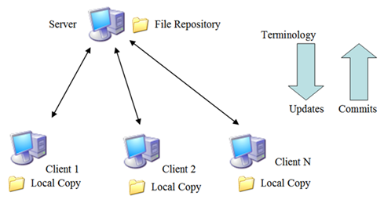
Deploy and User guide
1
2
3
4
5
6
7
8
Controlling and Monitoring
  Source code
    Code repository
    Subversion
  Team member
    Meeting
    Assign task
    Tracking task
    Issue resolve
    Review task
    Report

Slide 48
Deploy and User guide (Cont)
1
2
3
4
5
6
7
8
Communication control
  Online activity
    Email
    Google group
    Chat
    Phone
  Offline activity
    Kick-Off project
    Daily and weekly meeting
    Working together from Mon to Sat
    Team building

Slide 49
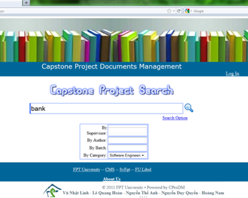
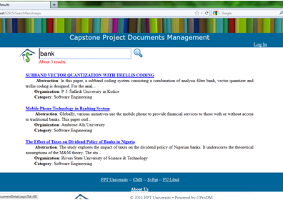
Deploy and User guide (Cont)
1
2
3
4
5
6
7
8

Slide 50
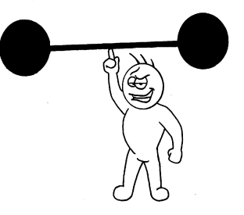


Summary
1
2
3
4
5
6
7
8
Strong point
  Creative
  Active
  Cope with change
              Weak point
                Lack of technical skill
                Lack of management skills
Lessons learned
  Improve technical & management skills
  Release on-time product with the restriction of time and resource
  Improve communication skills & problem solving

Slide 51

Demo & Q&A
1
2
3
4
5
6
7
8

Slide 52

THANK YOU!

