Slide 1

Supervisor: Mr.Huỳnh Anh Dũng
Students:
Nguyễn Công Tuyến
Nguyễn Cảnh Phương
Phạm Thị Hằng
Bùi Thị Huệ
Trần Đức Bình
Nguyễn Ngọc Long
Direction Hunter

Slide 2

Contents
1. Introduction
2. Project Management Plan
3. Requirement Specifications
4. Design Description
5. Implementation
6. Test Documentation
7. Demo & Q&A
Add Your Text in here

Slide 3
Part 1: Introduction
Development Team
Background
Literature Review
Ideal
Product

Slide 4
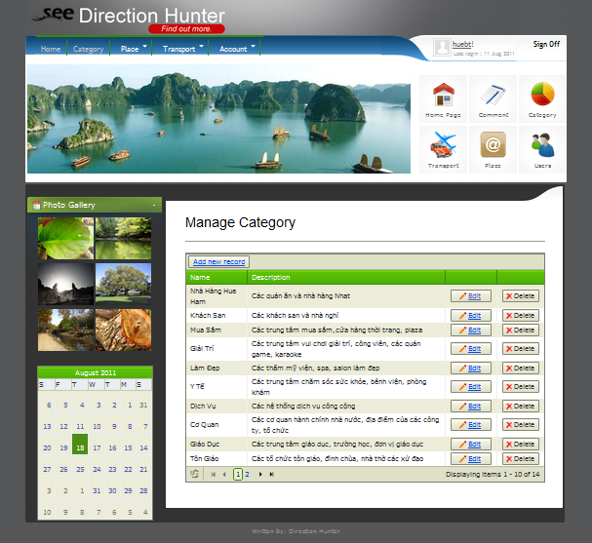

Development Team

Slide 5
Background
Android: New generation of smart mobile phone
The need of searching location
Reliability and complement of information sources
Vital demand of mobile search engine

Slide 6





Literature Review

Slide 7





Slide 8

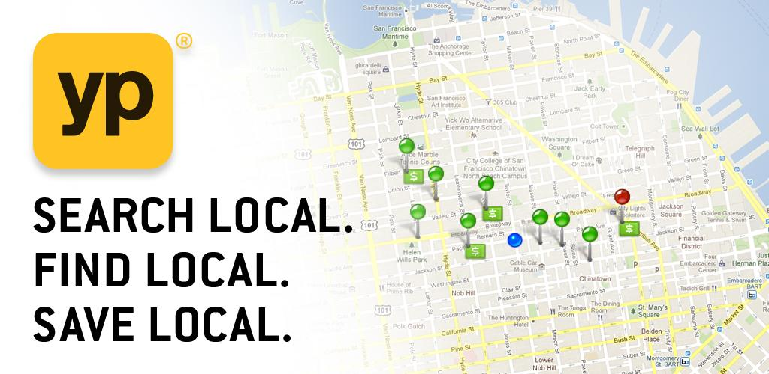


Slide 9

Ideal
Vietnamese
Small & Enough
Vietnamese User
Vietnamese Place
- Vietnamese Language
- Support useful functions
- Best performance with resource
Android Platform
- Real huge data
- Contribution from million users
Nice user interface
Easy to use
Reliability
User Friendly

Slide 10
Our Product

Slide 11


Part 2: Software Project Management Plan
1. Project Overview
- Front-end
- Back-end
1
2. Project Organization
- Process Model
- Role and responsibilities
2
3
3. Tool and techniques
- Hardware
- Software
4
4. Project Planning
- Tasks
- Risk management

Slide 12

Project overview : Front-end
Place:
  View place directory, place detail
  Add new place
  Search place
  Call place
  View place on map
  Get direction to place
  Evaluate place: Rating, review, comment, visiting…
  Add place picture…
  Inform incorrect information
Favorite: view Favorite list, delete, view on map…
Map: view place by category, view place Nearby, Get Direction
Transportation
Group: create group, device member, view GPS of other member, manage schedule, auto remind…
Setting

Slide 13
The proposed system – Back-end
Manage Users
Manage Spam Report
Manage Places
Manage Address Parts
Back-end
Manage Categories
Manage Comments
Manage Transportation

Slide 14
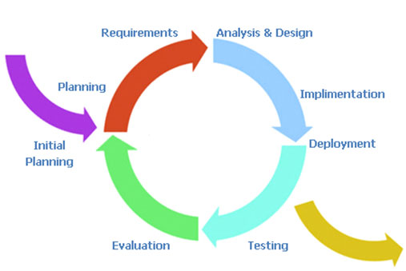
Process
Follow Iterative model

Slide 15
Role and responsibilities

Slide 16
Environment - Hardware
Development Hardware
2 Gb of RAM
300Gb of hard disk
Core 2 Duo 2.0 Ghz
Two Android smartphone with GPS and Wi-Fi powered
Server Hardware
4 Gb of RAM
300Gb of hard disk
Core 2 Duo 2.0 Ghz

Slide 17








Environment -Software

Slide 18
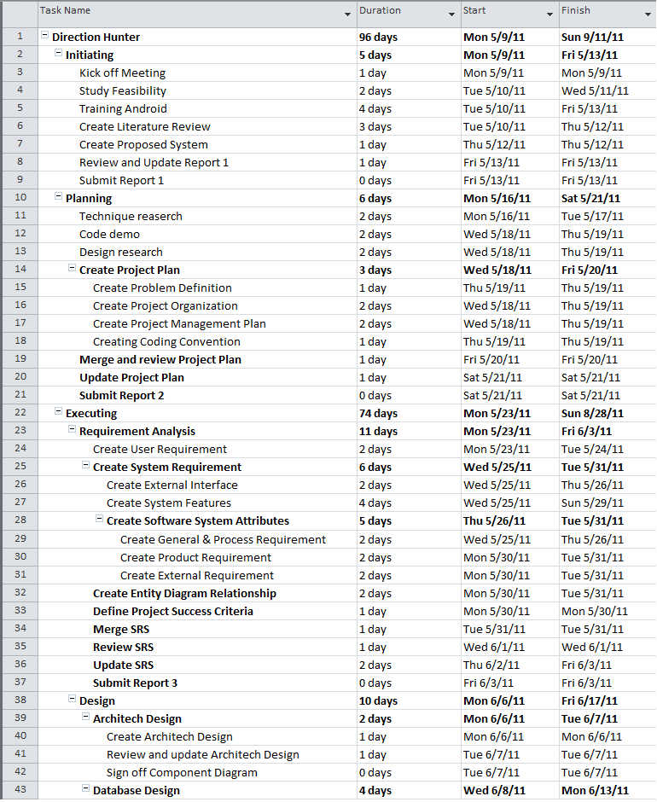
Project Plan

Slide 19

Part 3: System Requirement Specifications
Direction Hunter- The art of mobile search
1. User Requirement
2. System Requirement
3. Nonfunctional Requirement

Slide 20
User Requirement
Place
Map
Group
URD
Admin
Setting
Transportation

Slide 21
System requirements
Document requirements for each use case
Each includes:
  Use case diagram
  Actor
  Summary
  Goals
  Triggers
  Preconditions
  Post conditions
  Success scenarios
  Alternative scenarios
  Exceptions
  Relationship
  Business rules
  Description
  Screen
  Data field definitions
  Button definitions

Slide 22
Non-functional requirements
Usability
Availability
Reliability
Security
Security
Performance
Portability

Slide 23
Part 4: Software Design Description
Architectural Design
Component Diagram
Detail Design
Database Design

Slide 24
Architectural Design

Slide 25
Component Diagram

Slide 26
Detailed design
Design for each use case
Class diagram
Class explanation
Sequence diagram

Slide 27
Detail Design

Slide 30
Part 5: Implementation
Tool & Technologies
Android training
Coding convention & coding checklist
Unit test
Code review
Deployment consideration
Performance consideration

Slide 31







Tool
Robotium

Slide 32


Coding convention
General .NET and Java coding conventions
Follow FxCop, JTest rules
Define specific convention for Android platform

Slide 33
Demo

Slide 34
Q&A

Slide 35
Thank You !

