Slide 1

Capstone Project
E- Office
Group name: FOG
Group Member: Nguyen Tuan Linh
Pham Hoang Giang
Nguyen Trung Hieu
Duong Thanh Dat
Dao Quang Huy
Nguyen Duy Tiep
Instructor: Mr. Nguyen Tat Trung

Slide 2
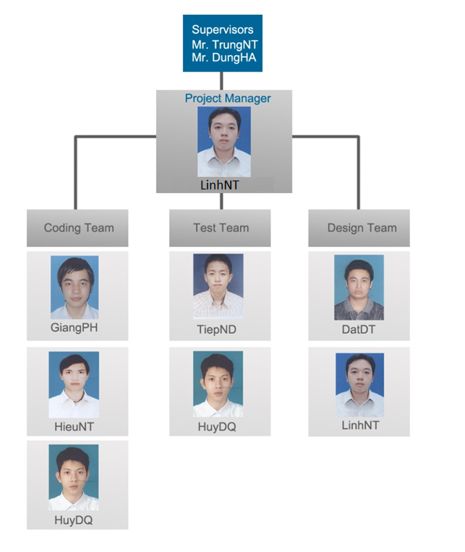
Team Introduction

Slide 3
Table Of Contents
Existing Systems
Idea
Software Process Model
Project Plan
Requirement
Architecture
Test Plan
Demo
Notes:
Access via internet: nhan vien
3 cai dau len wiki doc.
SaaS: wiki, moi truong lam viec nang dong hon cac kieu, lam viec tu xa
Multi:
Business Process Integration:

Slide 4
Existing Systems
BKIS EOffice
E-Office
Desktop Application
Rich Functionality
Maturity
Collaborative
ECM
Workflow
Realtime
Productivity Tools
Platform
Web Application
Software As A Service
Build from Scratch
Notes:
Lam theo bieu do` Vent

Slide 5

Idea
Computerization
  Paperless office
New working trends
  Flexible hours
  Comfortable working style
Process is still important
Notes:
Them vao` muc. con, gach dau dong`, in dam lai cai diem chinh, dua slide overview len sau abstract

Slide 6
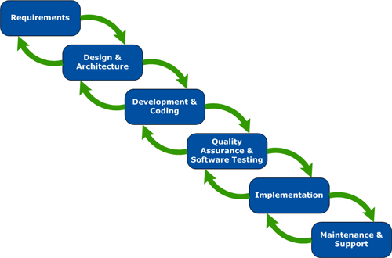
Software Process Model
Notes:
Access via internet: nhan vien
3 cai dau len wiki doc.
SaaS: wiki, moi truong lam viec nang dong hon cac kieu, lam viec tu xa
Multi:
Business Process Integration:

Slide 7
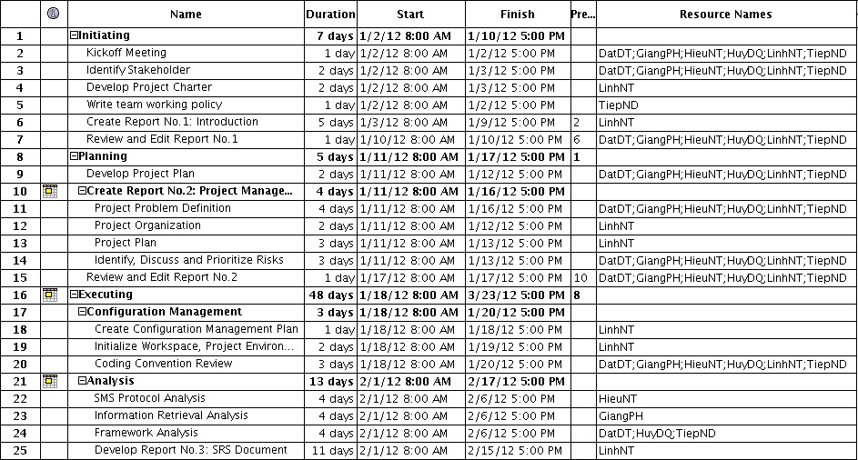
Project Plan
Notes:
Access via internet: nhan vien
3 cai dau len wiki doc.
SaaS: wiki, moi truong lam viec nang dong hon cac kieu, lam viec tu xa
Multi:
Business Process Integration:

Slide 8
Risk Management
Risk Name | Avoid Plan | Contingency Plan | Status
Inexperience with Project Technology | Create buffer time for researching and training | Change to familiar technology, but having lower effective | Closed
Insufficient business knowledge | Training team members to be familiar with domain knowledge | Reduce scope | Closed
Poor design | Spend time to produce a good design | Spend time to fix design | Closed
Team Spirit and Attitude | Set common goal close to members’ personal goal | Meeting to communicate and team building | Closed
Running behind schedule | Set loose schedule | Work over time | Closed
Notes:
Access via internet: nhan vien
3 cai dau len wiki doc.
SaaS: wiki, moi truong lam viec nang dong hon cac kieu, lam viec tu xa
Multi:
Business Process Integration:

Slide 9
Functional Requirement
 | Administrator | Tenant Manager | User Group Manager | User
Deploy Module | x
Manage Tenant | x
Manage User Group | x | x
Manage User | x | x
Manage Calendar | x | x | x | x
Broadcast Group Event |  |  | x
Assign Task |  |  | x
Manage Document |  | x
Notes:
Access via internet: nhan vien
3 cai dau len wiki doc.
SaaS: wiki, moi truong lam viec nang dong hon cac kieu, lam viec tu xa
Multi:
Business Process Integration:

Slide 10
Non-Functional Requirement
Availability
  The server can run with availability of 99% by using failover mechanism and multi mirror system
Maintainability
  Use module system to make future maintenance and change to new requirements easier
Scalability
  The system is designed to be able to scale horizontally to serve a large number of users
Notes:
Access via internet: nhan vien
3 cai dau len wiki doc.
SaaS: wiki, moi truong lam viec nang dong hon cac kieu, lam viec tu xa
Multi:
Business Process Integration:

Slide 11
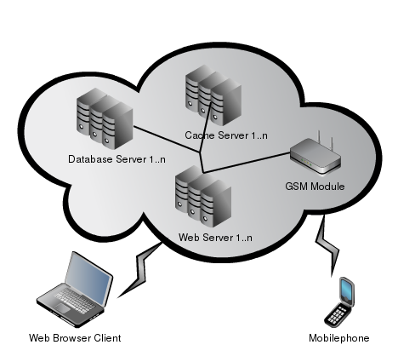
Overall Architecture
Collaborative Software
Enterprise Content Management
Productivity tools
Software-as-a-Service
Multi-tenancy
Business Process Integration
Realtime Communication
Notes:
Access via internet: nhan vien
3 cai dau len wiki doc.
SaaS: wiki, moi truong lam viec nang dong hon cac kieu, lam viec tu xa
Multi:
Business Process Integration:

Slide 12
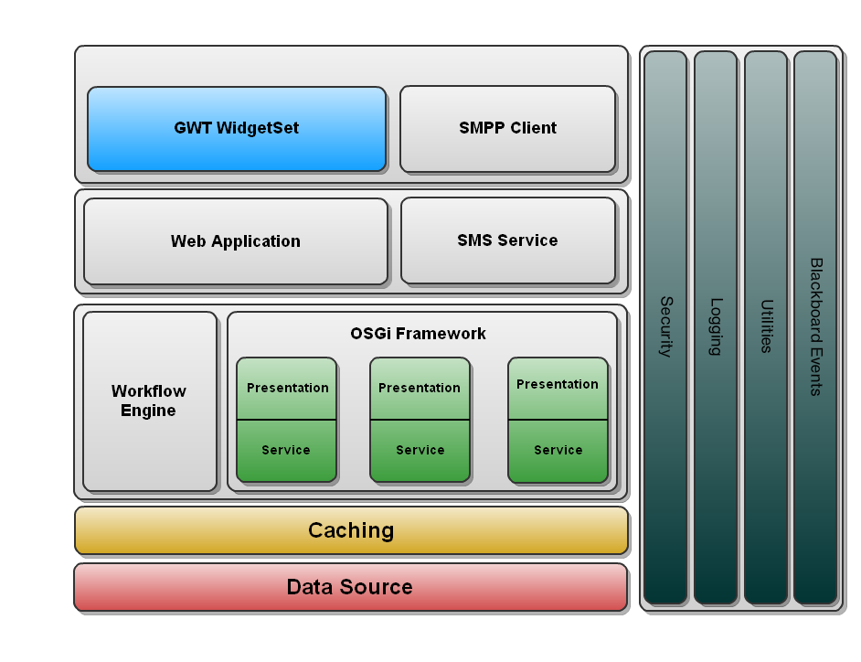
Overall Architecture
Notes:
Access via internet: nhan vien
3 cai dau len wiki doc.
SaaS: wiki, moi truong lam viec nang dong hon cac kieu, lam viec tu xa
Multi:
Business Process Integration:

Slide 13
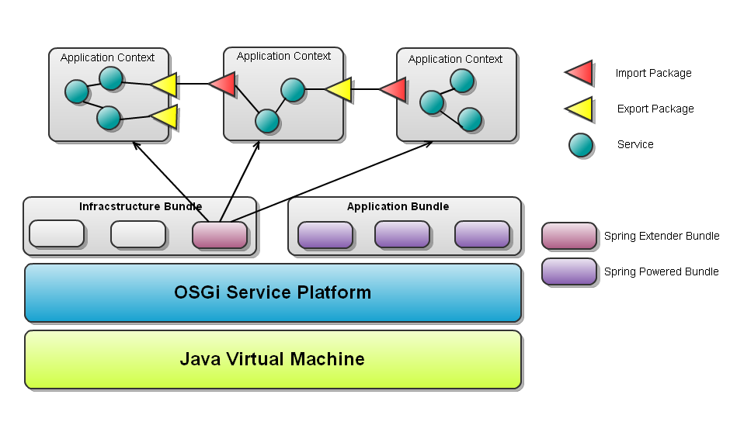
Module Architecture
Notes:
Them vao` muc. con, gach dau dong`, in dam lai cai diem chinh, dua slide overview len sau abstract

Slide 14
Package
No | Package Name | Description | Naming Convention
01 | com.cloffice.util | Contains Ultility Class | xxxUtil
02 | com.cloffice.ui | Contains UI Class | Take name of UI component
03 | com.cloffice.blackboard | Contain Event and Listener | xxxEvent and xxxListener
04 | com.cloffice.tenant | Contain Service and Entity of User and Tenant | xxxService, xxxDao
05 | com.cloffice.common | Contains Common Interface | Genericxxx, xxxComponent
06 | com.cloffice.module | Contains Module related Class | Modulexxx
Notes:
Them vao` muc. con, gach dau dong`, in dam lai cai diem chinh, dua slide overview len sau abstract

Slide 15
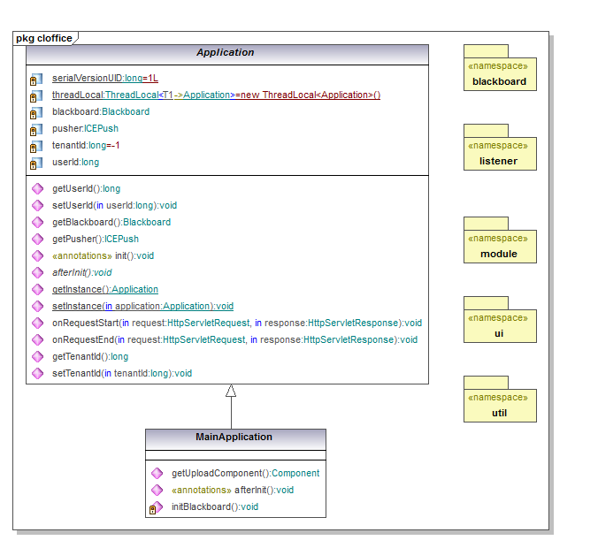

Slide 16
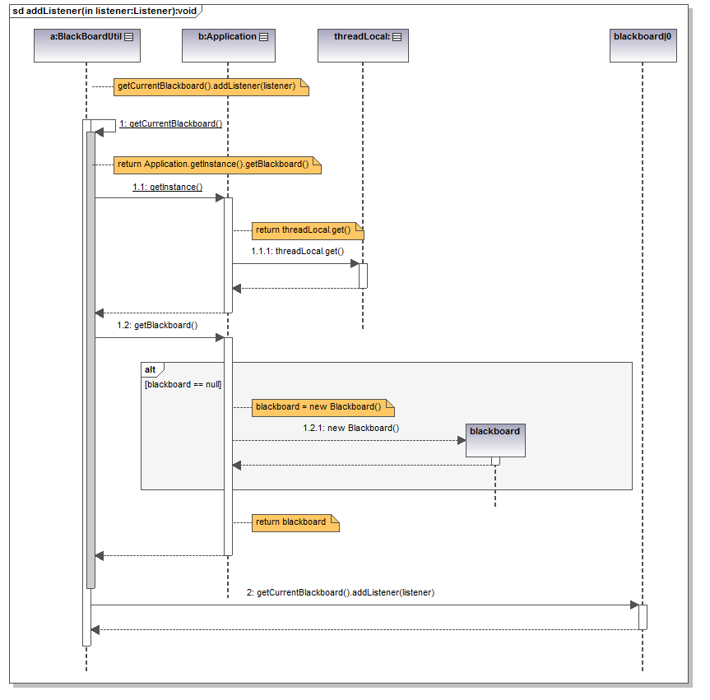

Slide 17
Test Plan / Schedule
Type of Tests | Stage of Test
 | Unit | Integration | System
Functional Tests | x | x | x
User Interface Tests |  |  | x
Data Volume Tests | x | x
Test Schedule | Start Date | End Date
Unit/Functional Testing | 15/03/2012 | 01/04/2012
User Interface Testing | 02/04/2012 | 10/04/2012
Notes:
Access via internet: nhan vien
3 cai dau len wiki doc.
SaaS: wiki, moi truong lam viec nang dong hon cac kieu, lam viec tu xa
Multi:
Business Process Integration:

Slide 18

Demo
Notes:
Access via internet: nhan vien
3 cai dau len wiki doc.
SaaS: wiki, moi truong lam viec nang dong hon cac kieu, lam viec tu xa
Multi:
Business Process Integration:

Slide 19


