Slide 1
FPT ONLINE ENROLLMENT SYSTEM
Capstone Project

Slide 2
Outline
Initial idea
Existing Problems
Functionalities
Technology
Planning
Difficulties

Slide 3
Initial Idea
Web Application for FPT University, support subject registration online
Improve some AP functions
Develop new useful functions

Slide 4
Existing Problems
Outline:
  Current subject register business
  Student
  Staff

Slide 5
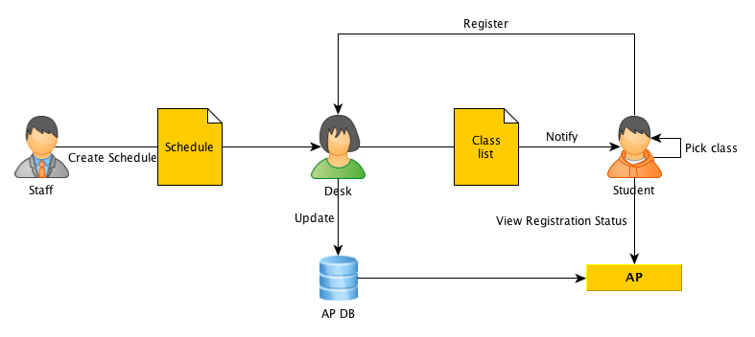
Register Business

Slide 6
Existing Problems - Student
Problem
Consequence
Register at desk
Study result
Manually pick class
Curriculum versions, subject code
Crowded, waiting time
Progress, personal goal
Inefficient
Study progress

Slide 7
Existing Problems - Staff
Problem
Consequence
Manage hard-copy registration
Manually check for changes and notify student
Error-prone, hard searching
Error-prone, miss notifications

Slide 8
Functionalities
Outline:
  AP functions as basis
  AP functions improvement
  APX new functions
  Summary of APX functions - functions and problems matching

Slide 9
Functionalities - Basic
User authentication & User profile:
  Authenticate using Google Authentication service
  View user profile
Learning State:
  View result of learned subject
  View personal time-table
Schedule Management:
  Import schedule from Excel files
  View schedule
  Modify schedule

Slide 10
Functionalities - Improvement
Learning State:
  Alternative representation of learned subject and personal time-table

Slide 11
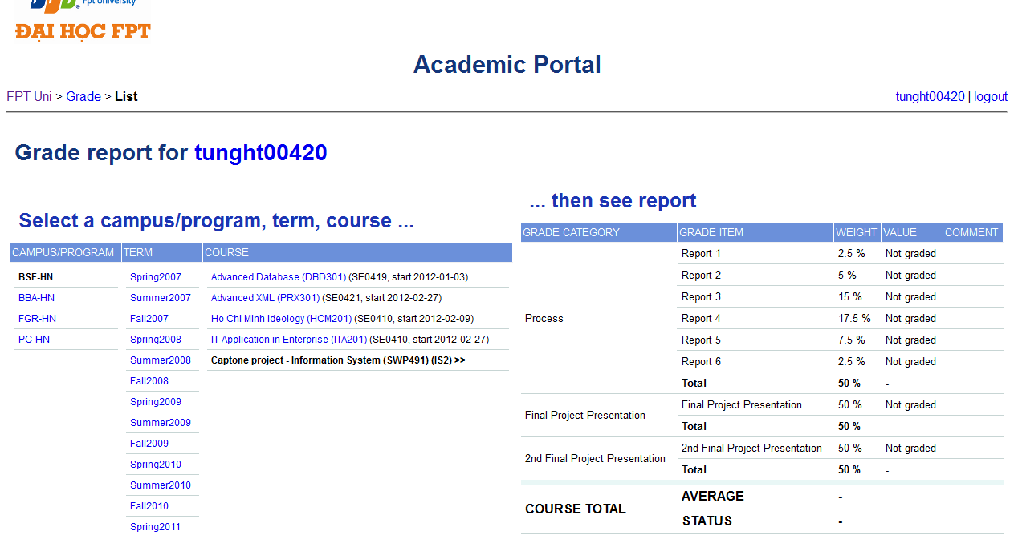
Functionalities - Improvement

Slide 12
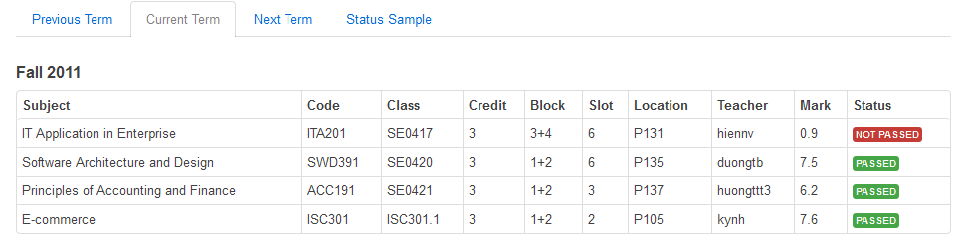
Functionalities - Improvement

Slide 13
Functionalities - Improvement
Schedule Management:
  Alternative perspective of viewing schedule

Slide 14
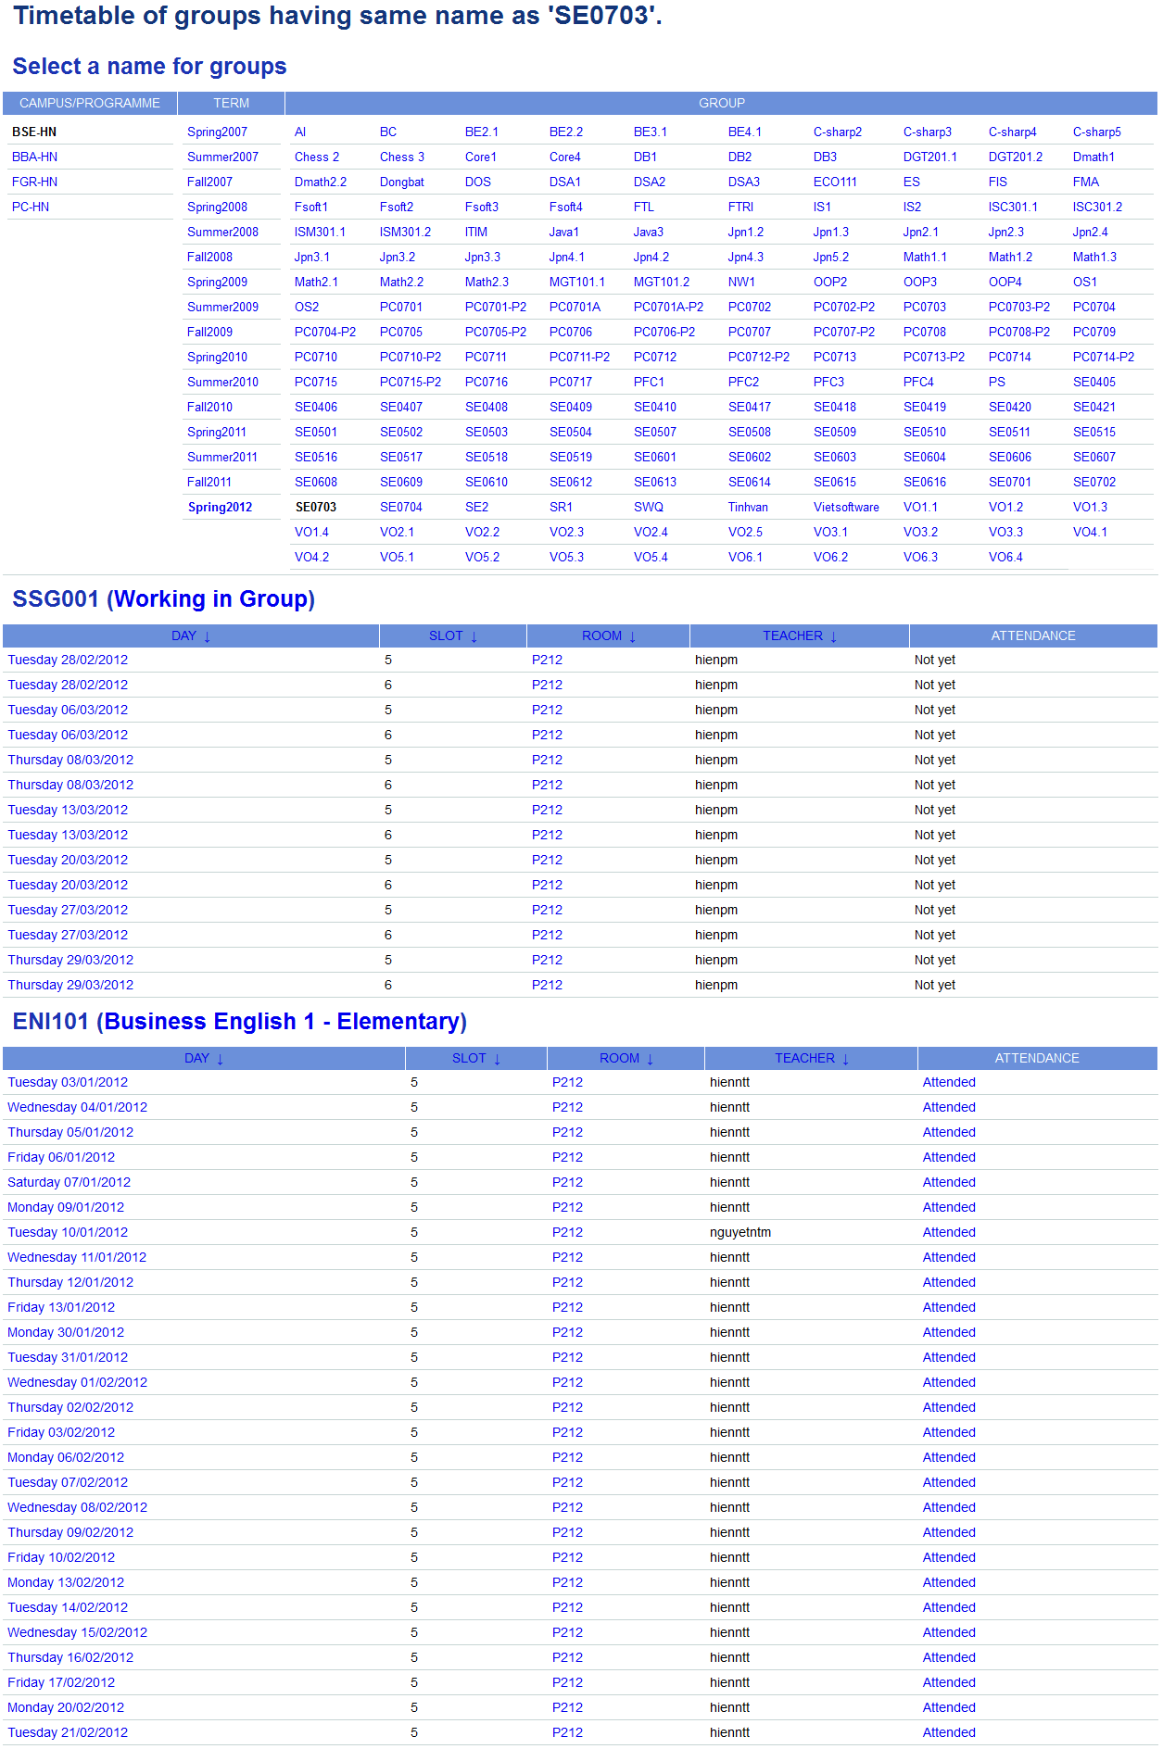
Functionalities - Improvement

Slide 15
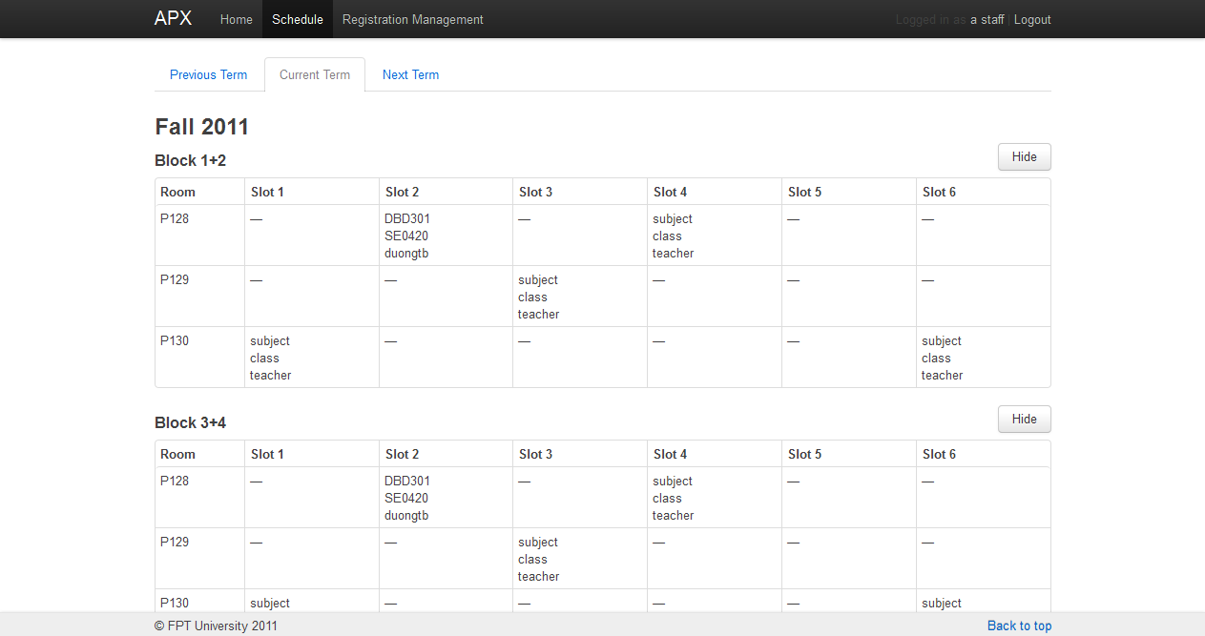
Functionalities - Improvement

Slide 16
Functionalities - New Features
Learning State:
  Student can view summary of study result such as: accumulated credit, accumulated average grade, detail credit and grade for each learned subject.
Registration Management:
  Student can register for subject online
  Student can use suggestions to pick classes appropriately such as: pick morning classes, pick afternoon classes, pick as many classes as possible
  Staff can manage student registration: filter, create, modify, approve and cancel

Slide 17
Functionalities - New Features
Learning Tree:
  Use curriculum simulator to view study progress, calculate the final accumulated average grade.
Report:
  Provide useful report for management purposes

Slide 18
Functionalities - Summary
User Management
Schedule Management
Registration Management
  Student can register online
  Student can use suggestions to pick classes
  Staff can manage registration online
  Automatically notify involved students and staff about changes
Learning State
  Student can view study result
Learning Tree
  Student can view various curriculums, simulate studying progress
Report

Slide 19
Planning
Duration: 91 working days, from 20/12/2011 to 19/04/2012
Development model: Iterative Model

Slide 20
Technologies
Programming language: PHP
Framework: CodeIgniter
DBMS: MySQL
Web Server: Apache
IDE: Sublime Text 2, Notepad++

Slide 21
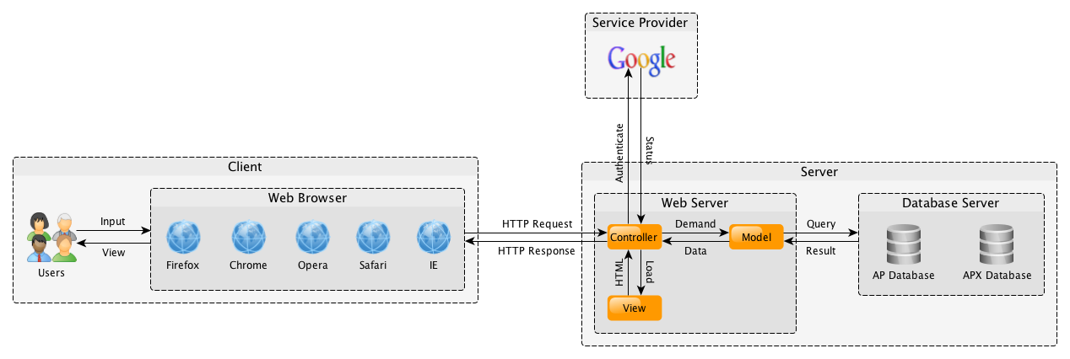
Design
Architecture Design (MVC)

Slide 22
Design
Class Diagram for User authentication & User profile

Slide 23
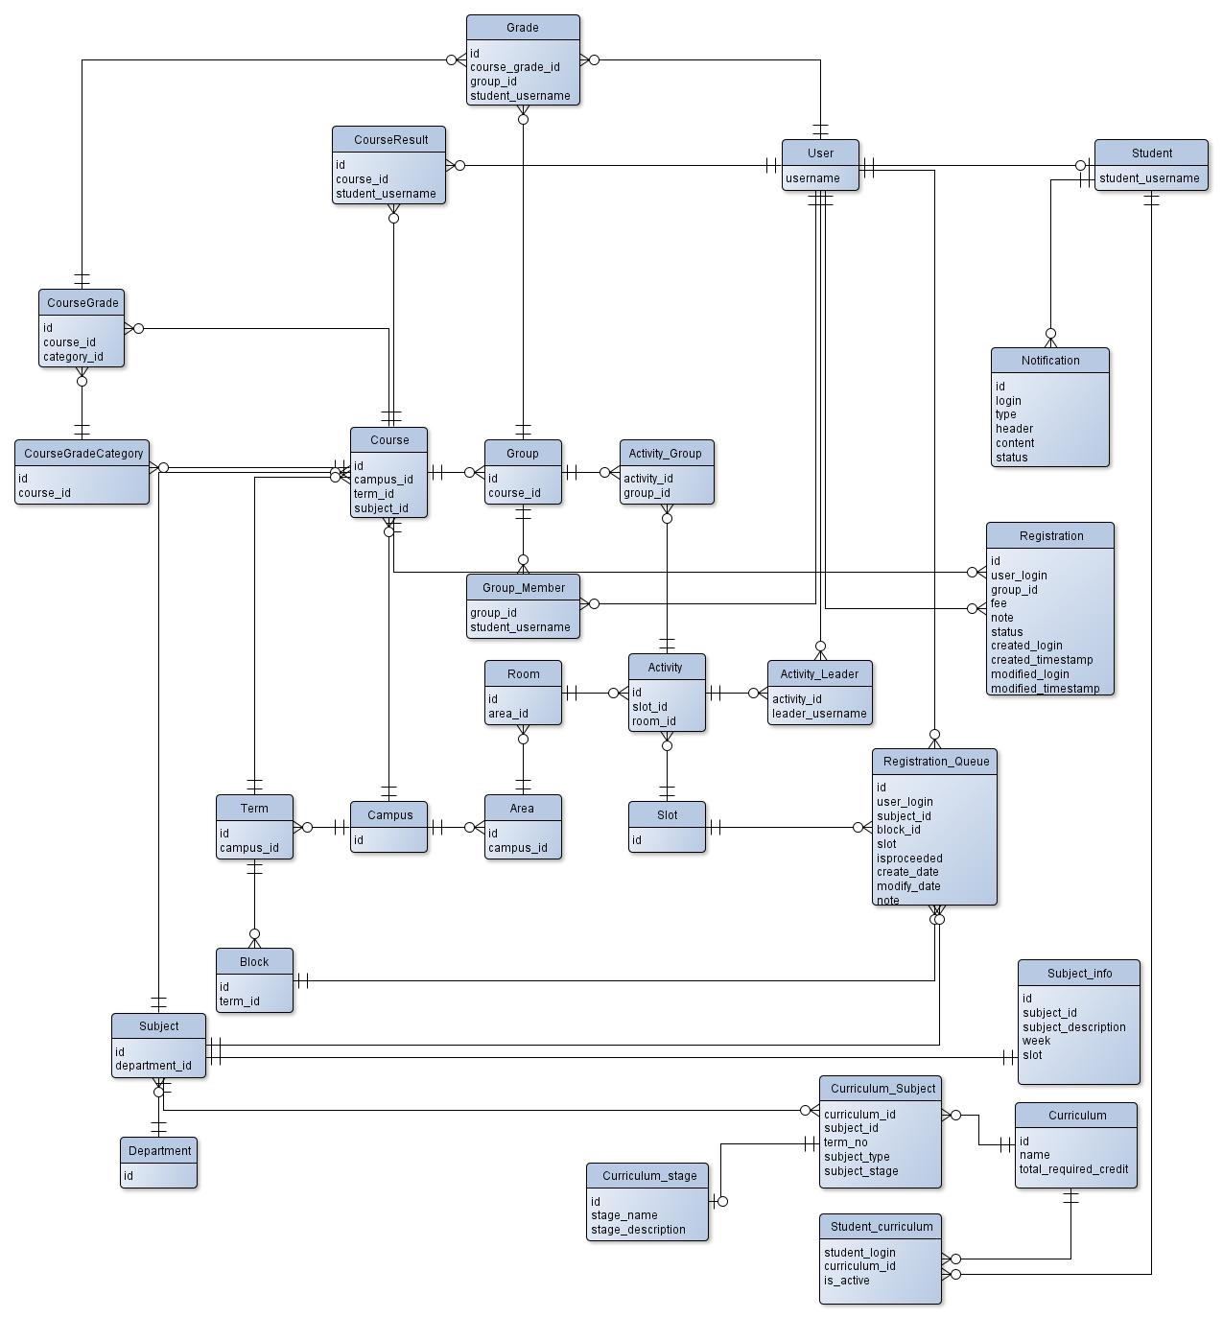
Design
ERD

Slide 24
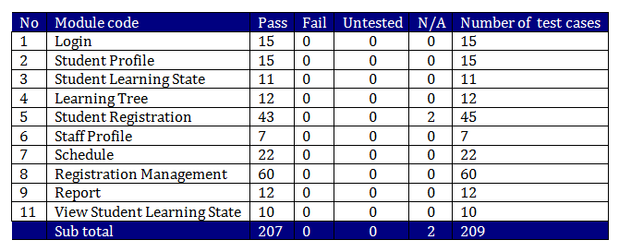
Testing
Testing result

Slide 25
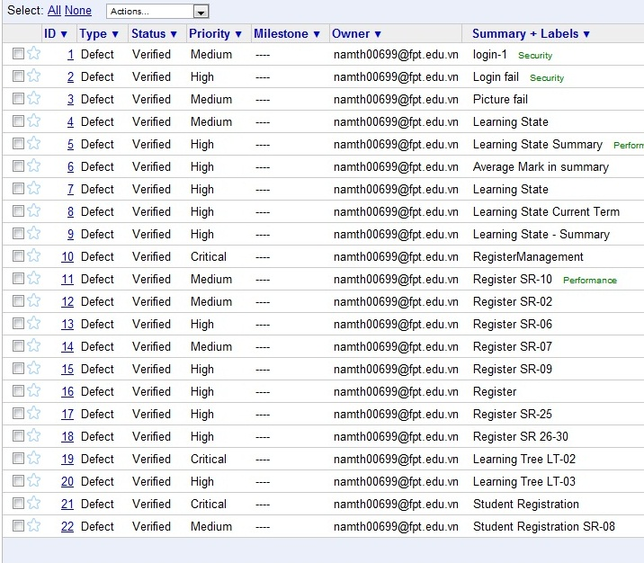
Testing
Defect Log

Slide 26
Demo

Slide 27
Questions & Answers

