Slide 1


Funny Contents Sharing Community
Supervisor: Mr. Tran Binh Duong
Students:
1. Nguyen Anh Quan
2. Tran Minh Duc
3. Dang Tuan Linh
4. Nguyen Huong Thanh
5. Pham Thi Bich Thuy
6. Nguyen Thi Thu Huyen

Slide 2
Contents
1
Introduction
2
Process Management Plan
3
Requirements Specification
4
Software Design Description
5
Implementation
4
6
Testing
5
Demo & Q/A
7

Slide 3
Part 1: Introduction
The People
Background
Literature Review
Our Proposal
Products

Slide 4







The People
Mr. Trần Bình Dương
Phạm Thị Bích Thủy
Nguyễn Hương Thanh
Nguyễn Anh Quân
Nguyễn Thị Thu Huyền
Trần Minh Đức
Đặng Tuấn Linh

Slide 5
Background
Smile is indeed important in our everyday life
The most effective and easiest way to have fun is read, view or listen funny contents.
The necessary of sharing funny contents were not evaluated seriously.

Slide 6




Literature review

Slide 7


Literature review - Facebook fan page
Created easily by Facebook users
Has effective support from Facebook
Owner can’t fully control their page
Facebook is banned in Vietnam

Slide 8
Literature review – teghe.com
Content’s posted by website’s admin
User can’t post, comment or rate content

Slide 9
Literature review – funnyordie.com
Content’s posted by website’s admin
User can’t post, comment or rate content
Has effective support from Facebook

Slide 10
Literature review – 9gag.com
Very famous at funny photo sharing network
User can post, comment, rate content
Inappropriate with Vietnamese

Slide 11
Our Proposal
Specialized for Vietnamese users.
Contribute from users.
Give more interesting.
Make the system user-friendly.
Have best performance

Slide 12
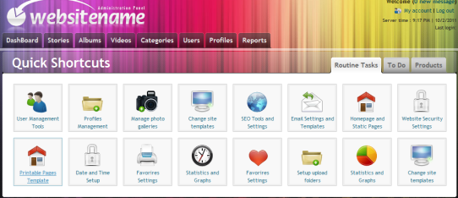
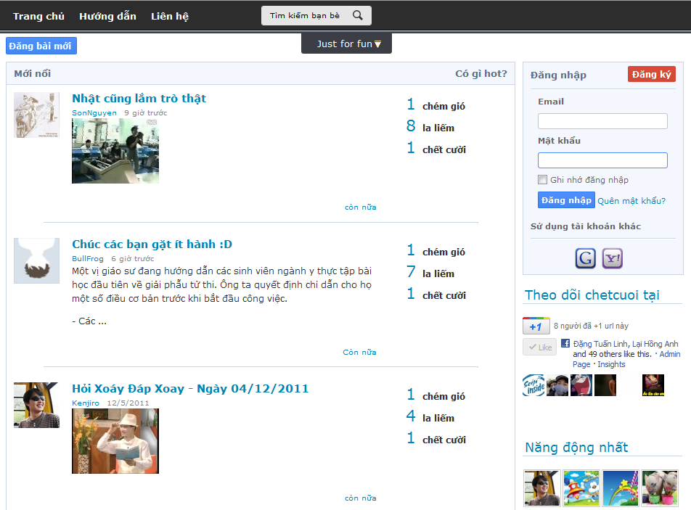
Products
The main product of this project is a website:

Slide 13
Part 2: Process Management Plan
The proposed system
Environment
Process
Process Organization
Team work
Project planning

Slide 14
The proposed system - Front-end
Front-end:
Guest : view all contents of any kind
User:
  Share contents
  Community functions
Integrate well with some other popular networks(Google,
Yahoo)

Slide 15
The proposed system - Back-end
Manage users
Manage categories
Manage roles
Manage contents(stories, albums, videos)
Manage reports

Slide 16


The proposed system - Commerce
Advertisement Banner
Souvenirs(glass, T-shirt…)

Slide 17
Environment - Hardware
Development Hardware
  Core 2 Duo 2.0 Ghz
  2 GB RAM
  120 GB of hard disk
Server
  Core 2 Duo 2.0 Ghz
  3 GB RAM
  120 GB of hard disk

Slide 18






Environment - Software

Slide 19
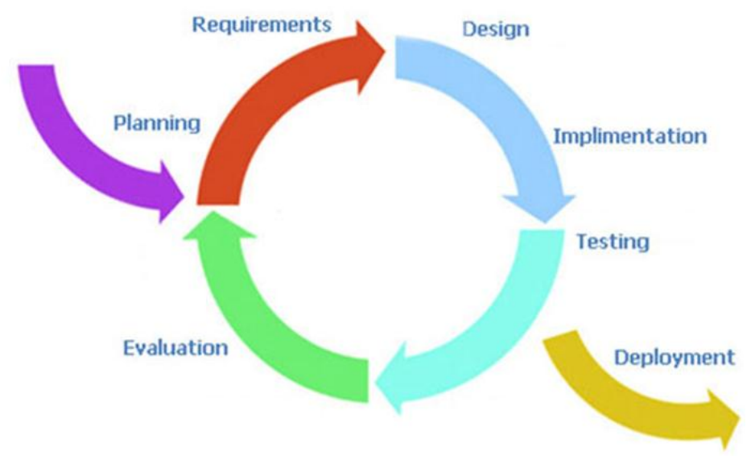
Process
Iterative Model

Slide 20
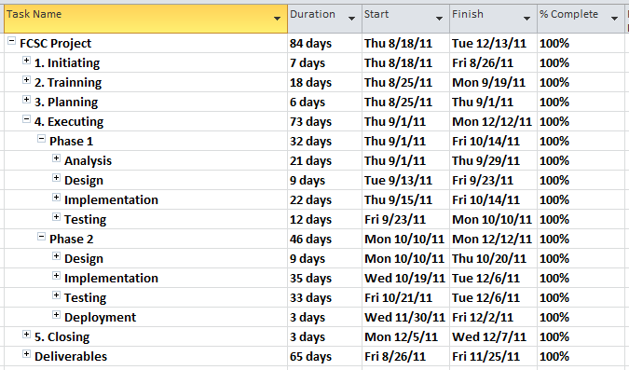
Diagram
2 Circles in project plan

Slide 21
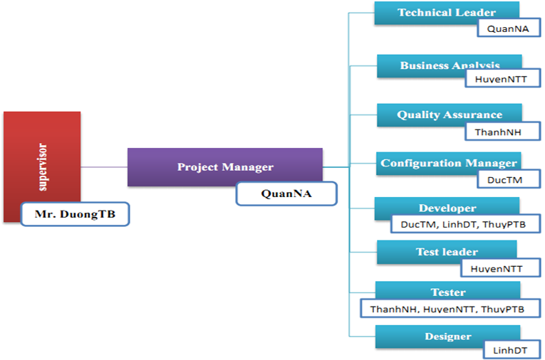
Project Organization

Slide 22
Team work
Working 6h/day and 5d/week
Meeting with supervisor 1-2 times a week.
21 meeting minutes.

Slide 23
Project Planning
Follow Capstone Project requirements
Buffer: 3 weeks
Using buffer: 2 weeks
Submit all reports before dead-line at least 1 week
Master plan
Details plan.

Slide 24
Part 3: Software Requirement Specifications
Functional requirements
Non-functional requirement

Slide 25
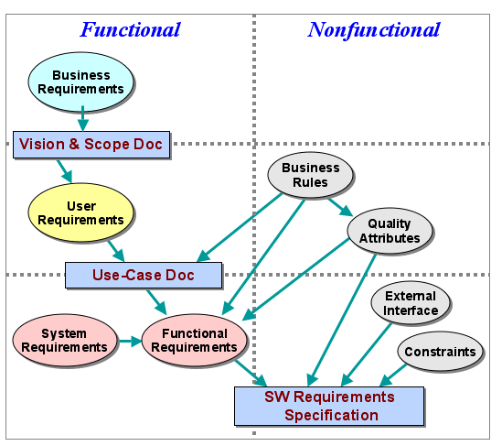
Functional & Nonfunctional

Slide 26
User Requirement
Users
Admin
Approve
Report
Follow
Search

Slide 27
Users
User
Power user
Guest

Slide 28
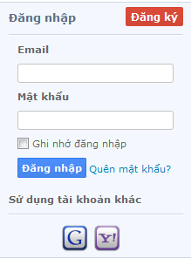
Guest
Users
User
Power User
Read contents at the website
View other user’s profile
Register account and login into the system
- Approve contents
Add categories for contents
Delete contents, comments

Slide 29
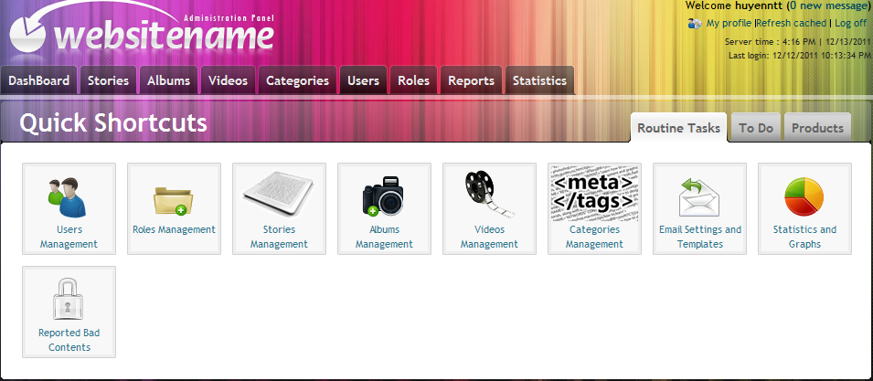
Admin
Reports management
Users management
Roles management
Categories management
Contents management
Statistic

Slide 30
Approve
The contents displayed in home page are approved contents
By power user
By users

Slide 31
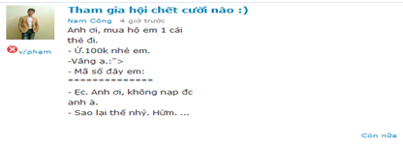
Report
Bad comments
Bad user
Bad contents

Slide 32
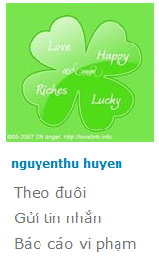
Follow
Follow users :
  The followers' contents will be updated in user’s page.

Slide 33
Search
Other users : search user

Slide 34
System Requirement
Document requirements for each use case
Each includes:
  Use case diagram
  Actor
  Summary
  Goals
  Triggers
  Preconditions
  Post conditions
  Success scenarios
  Alternative scenarios
  Exceptions
  Relationship
  Business rules
  Description
  Screen
  Data field definitions
  Button definitions

Slide 35
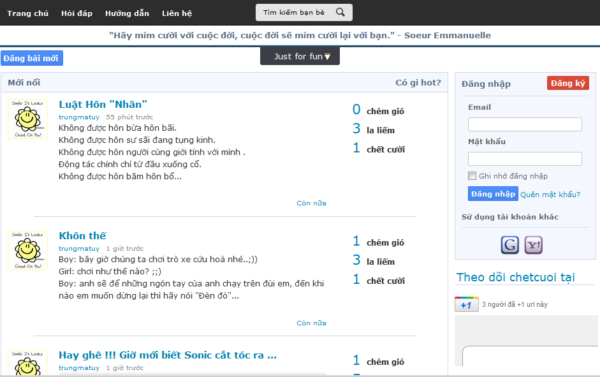
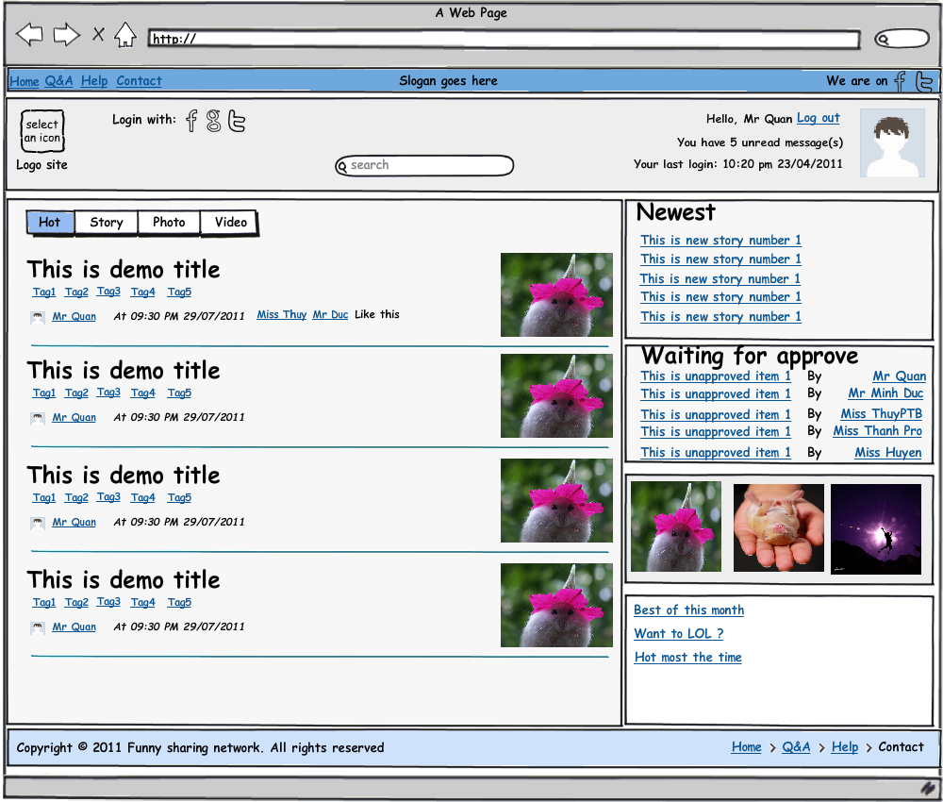
Screen

Slide 36
Non-functional Requirements
Usability
Reliability
Availability
Security
Maintainability
Performance

Slide 37
Part 4: Software Design Description
Architecture design
Detailed design
Database design

Slide 38
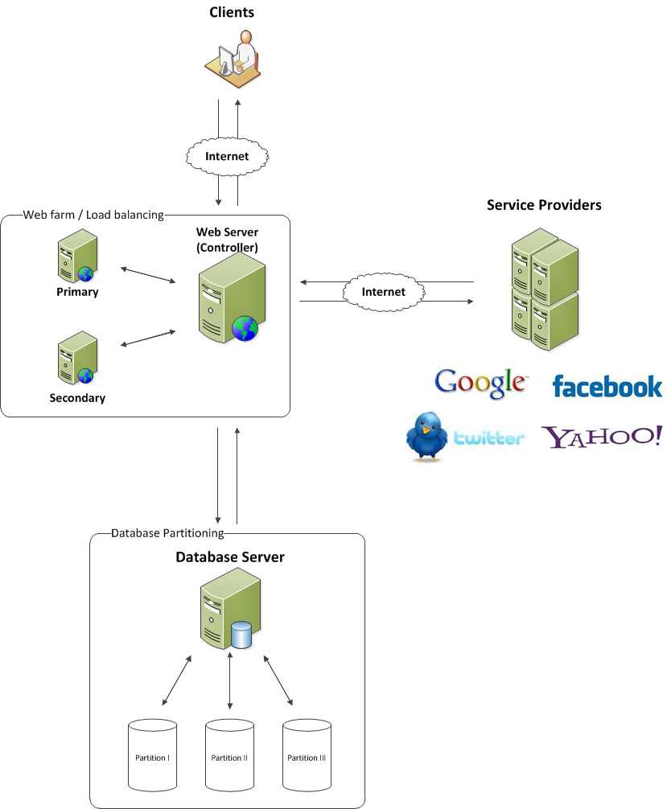
Architecture Design
Overall design

Slide 39
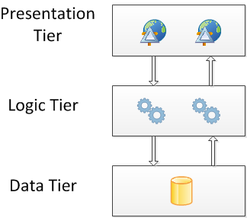
Architecture Design
Multitier architecture

Slide 40
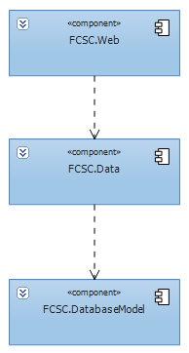
Architecture Design
Components

Slide 41
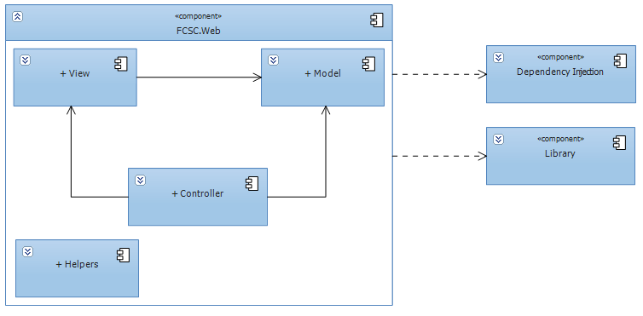
Architecture Design
Web components

Slide 42
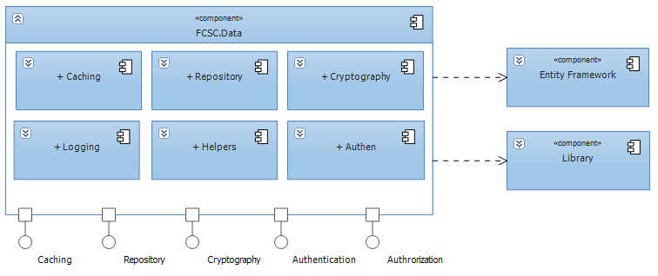
Architecture Design
Data components

Slide 43
Detailed Design
Design for each use case:
  Class diagram
  Class explanation
  Sequence diagram

Slide 44
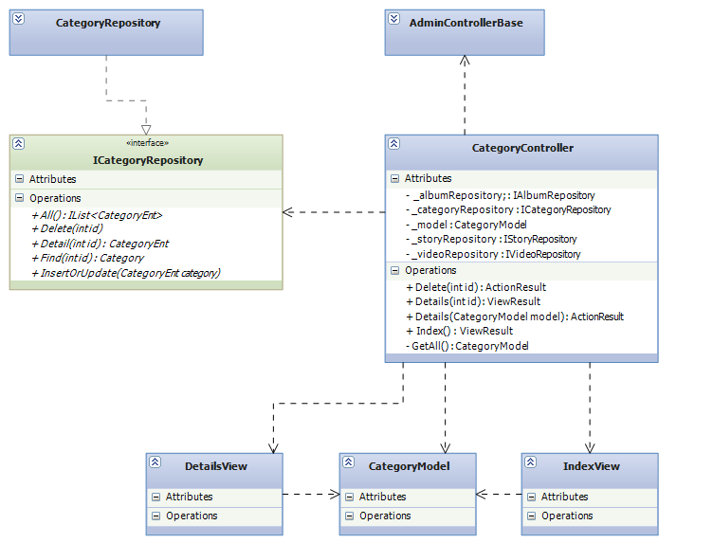
Detailed Design
Class diagram example

Slide 45
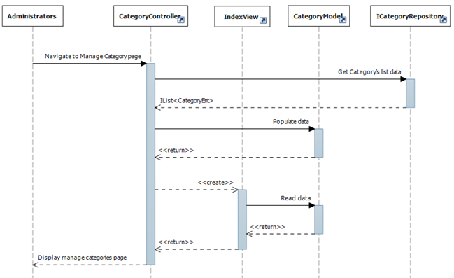
Detailed Design
Sequence diagram example

Slide 46
Database Design
Business tables
Every table has a primary key named Id which is of type: INT NOT NULL IDENTITY(1, 1)
Max length and nullability strictly follow field definitions

Slide 47
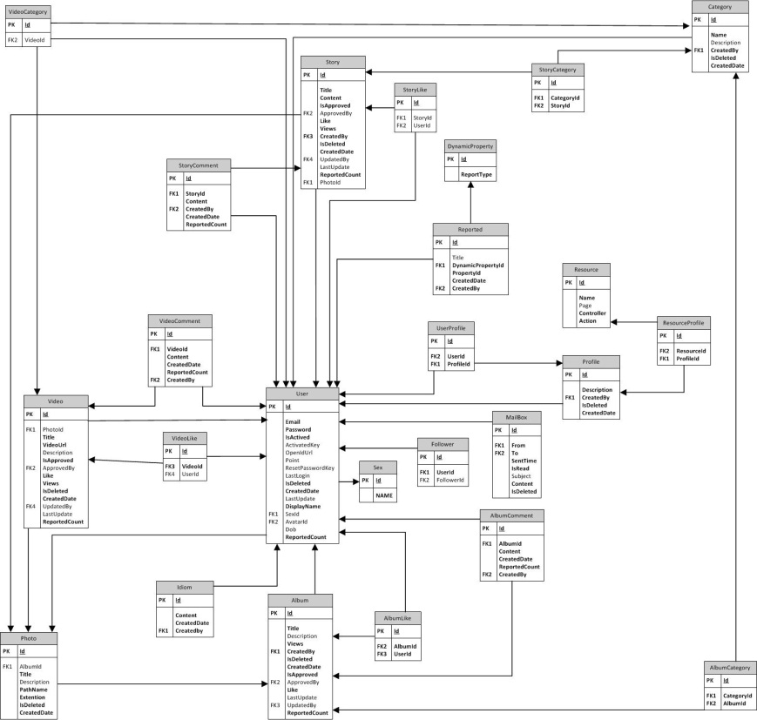
Database Design

Slide 48
Part 5: Implementation
Technologies
Tools
Coding convention
Code review
Unit test
Performance consideration
Security consideration

Slide 49
Technologies

Slide 50







Tools

Slide 51


Coding convention
Follow the general .NET naming convention
FxCop Microsoft naming
Coding style

Slide 52
Code review
Reviewed by Technical leader
Peer review

Slide 53

Unit test
Mainly for data layer and framework
Unfinished: create NUnit report

Slide 54
Performance consideration
Caching in 3 layers: database, memory, and output (HTML)
Use SQL Profiler to investigate all data access methods
Minimize requests to the server and database hit
Use AJAX
Compress javascript and css files
…

Slide 55
Security consideration
Client side and server side validation
No SQL injection
Encrypt sensitive data: password, cookies

Slide 56
Part 5: Testing
Testing Activities
Testing Strategy
Testing Process
Test Execution
Bugs Report
Test Report
Performance Testing

Slide 57
Test Activities
Code
Unit
test
Log
bug
Review
code
Testing

Slide 58
Test Strategy follows V-model
Developing
Testing
Module design
Acceptance
System
Integration
Unit
Requirements
System design
Architecture design
Coding
Plan for

Slide 59
Testing process
Test Plan
Create TC template
Review TC
Write TC (based on SRS)
Test Execution

Slide 60
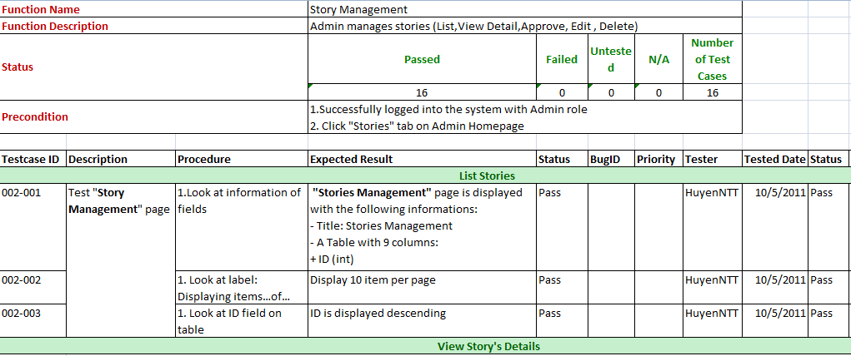
Test Case

Slide 61

Test Execution
Unit test
Function test
System test
Acceptance test
Performance test

Slide 62
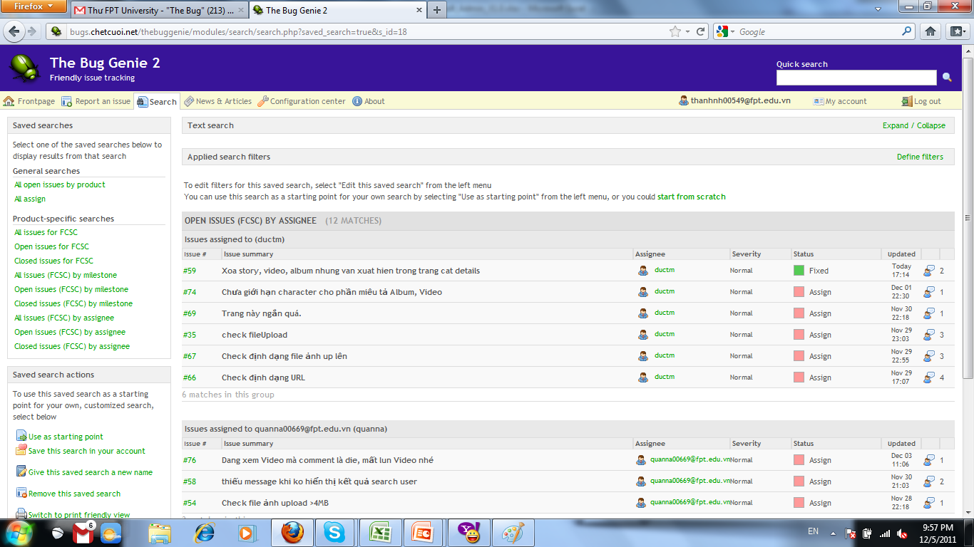
Bugs Reporting

Slide 63
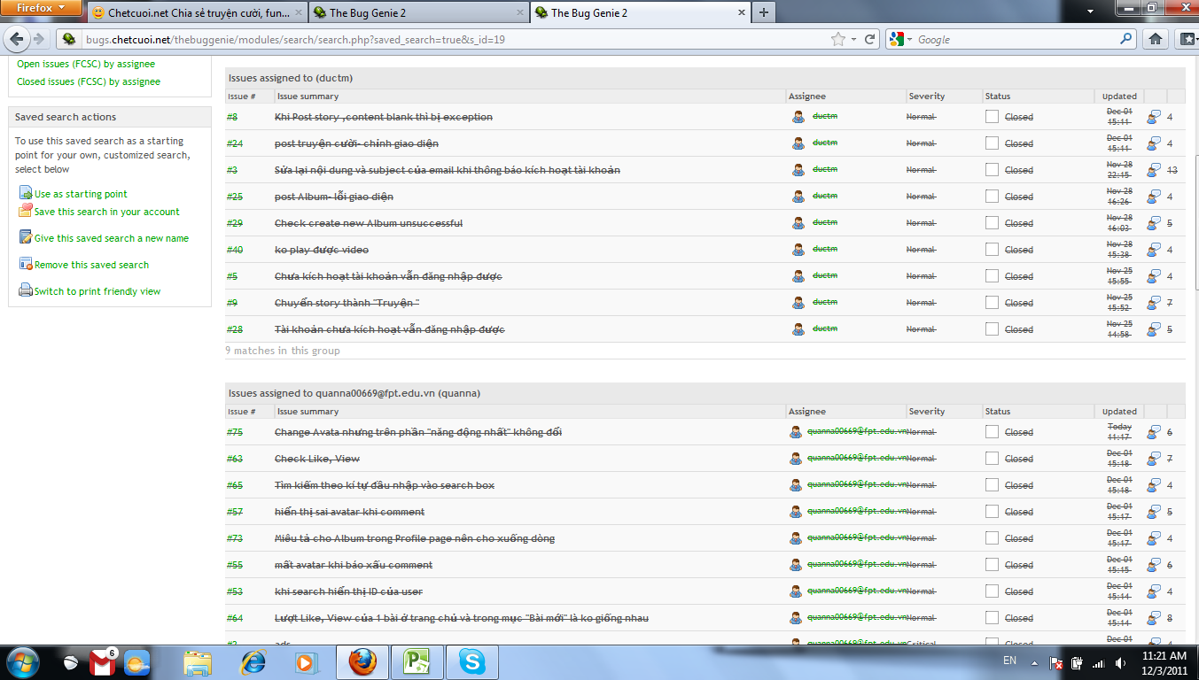
Bugs Reporting

Slide 64
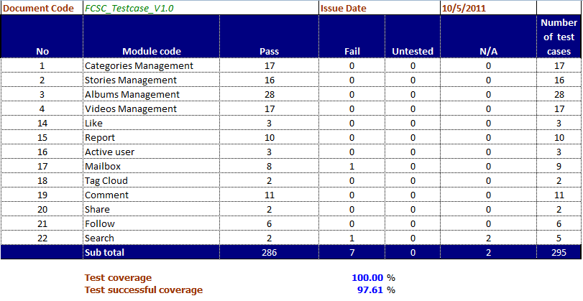
Test Report

Slide 65
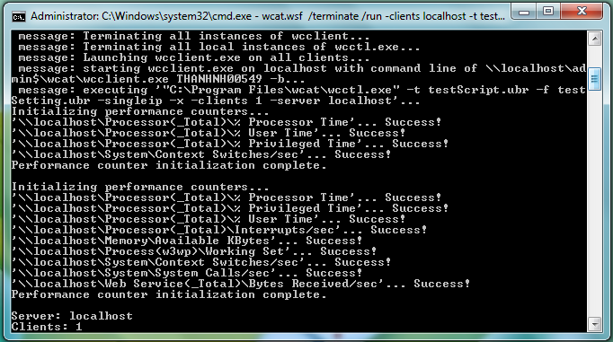
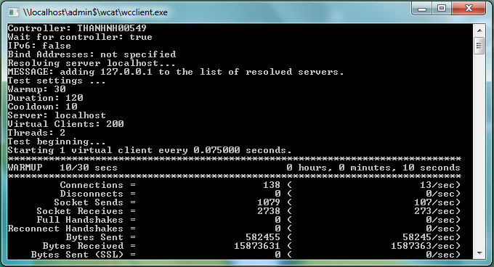
Test Performance

Slide 66
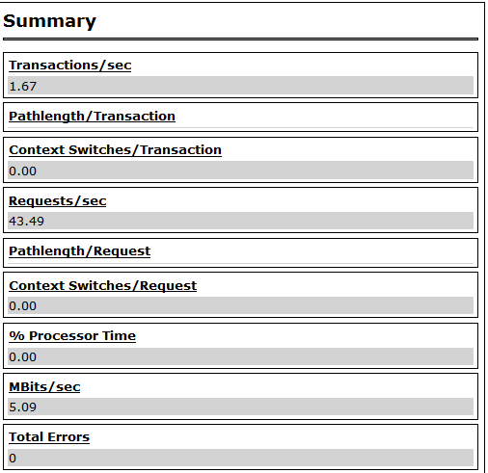
Test Performance Result

Slide 67

Demo & Q/A

Slide 68
Thank You !

