Slide 1
FAP PROJECT
Top.Not.59 Group:
Trần Hùng Team Leader
Mai Thị Thu Hà
Vũ Hồng Quân
Lê Thị Hoài Thu
Vũ Đình Thắng
Supervisor: Mr. NguyỄn TẤt Trung

Slide 2
Contents
I. Introduction
II. Project Management Plan
III. Requirement Specifications
IV. Design description
V. Implementation
VI. Testing

Slide 3
I. INTRODUCTION
1. The people
2. Background information
3. Proposal system

Slide 4
1. The people

Slide 5
2. Background information
AP system was developed based on the need of FPT University
There is an existed system but having limitations:
Privacy issues
Navigation issues
Filter issues
Not support create a timetable for new terms.

Slide 6
3. Proposal
Keep good points of current system
Improve current system’s limitations
New features: new design with menu bar, report function, filter function

Slide 7
II. PROJECT MANAGEMENT PLAN
1. Process
2. Project organization
3. Project planning

Slide 8
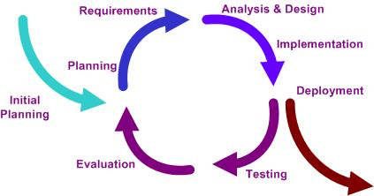
1. Process

Slide 9
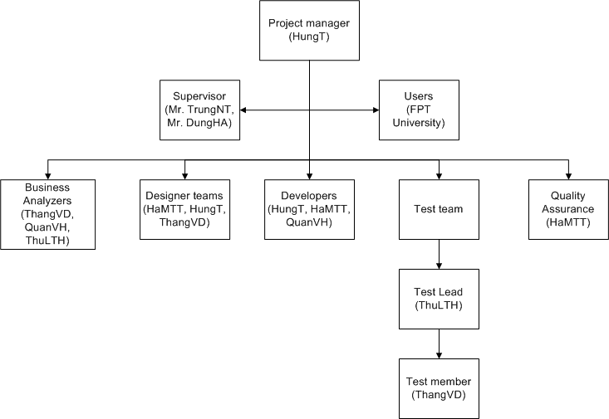
2. Project organization

Slide 10
3. Project planning
Follow Capstone Project requirements
Submit all reports on time
Boundaries of the system
Administration module
Attendance module
Grade module
Timetable module
Feedback module

Slide 11
III. REQUIREMENT SPECIFICATIONS
1. User requirements
2. Non-functional requirements

Slide 12
1. User requirements
Site:
Teacher: View/ Take/ Edit attendance
View grade
View student details
Student: View grade
View attendance
Application:
Admin: Manage user accounts
Staff: Manage data in database about grades, schedules

Slide 13
2. Non-functional requirements
Usability
Availability
Reliability
Security
Security
Performance
Maintainability

Slide 14
IV. DESIGN DESCRIPTION
1. System architecture
2. Detail design
3. Database design

Slide 15
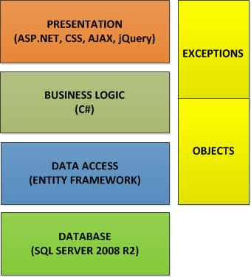
1. System architecture
N-tier architecture

Slide 16
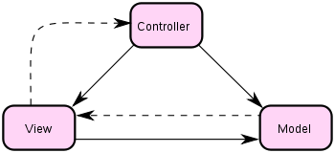
1. System architecture
MVC design pattern

Slide 17
2. Detail design
Design for each component includes:
Class diagram
Class explanation
Sequence diagrams (for all use case)

Slide 18
2. Detail design
Class diagram example

Slide 19
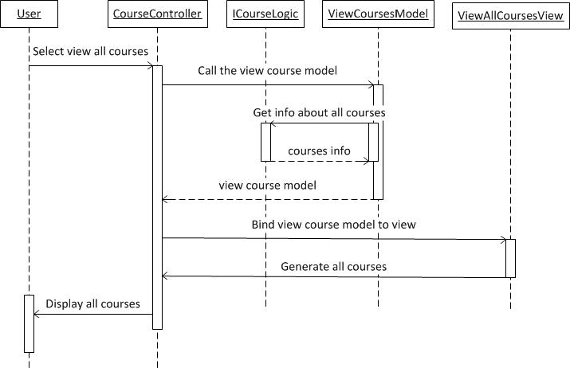
2. Detail design
Sequence diagram example

Slide 20
3. Database design
Every table has a primary key type IDENTIFIER
Max length and nullability strictly followed field definitions
There have 22 tables

Slide 21
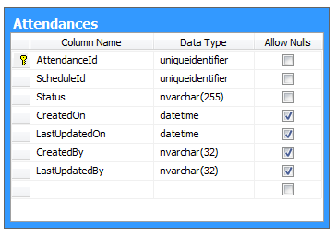
3. Database design
Database table example

Slide 22
V. Implementation
1. Tools
2. Technologies

Slide 23
1. Tools

Slide 24
2. Technologies

Slide 25
VI. Testing
1. Test Approach
2. Test result

Slide 26
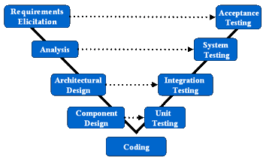
1. Test Approach

Slide 27
2. Test Result
Number of test cases: 182
Number of passed cases: 182
Number of failed cases: 0
Number of not testes cases: 0

Slide 28
DEMO

Slide 29
Thank you for your attention!
Q&A

