Slide 1
Vietnam Location
Capstone Project

Slide 2
Supervisor : Nguyễn Văn Hiển
Students :
Nguyễn Thế Vũ
Nguyễn Quang Trung
Nguyễn Thị Thùy Linh
Nguyễn Xuân Thời
Trần Thế Công

Slide 3
Contents
Introduction
Project Management Plan
Requirement Specifications
Design Description
Test Documentation
Summary

Slide 4
Introduction
Background
Literature Review
Our Proposal
Products

Slide 5
Background
1
40% search queries in web : finding places
Number of people using smart phone growing
3
Don’t know where to go ?
4
2
No social place network in Mobile
Smartphones spark mobile Internet boom in Vietnam

Slide 6
Literature review

Slide 7
ICOMPANION
DU LỊCH ViỆT
User can’t share the places .
User can’t create favorite place list.
Just share only entertainment places.
Can’t search and scan base interests, distance

Slide 8
Our Proposal
Vietnam user
Vietnam Address
User Friendly
New way to share place

Slide 9
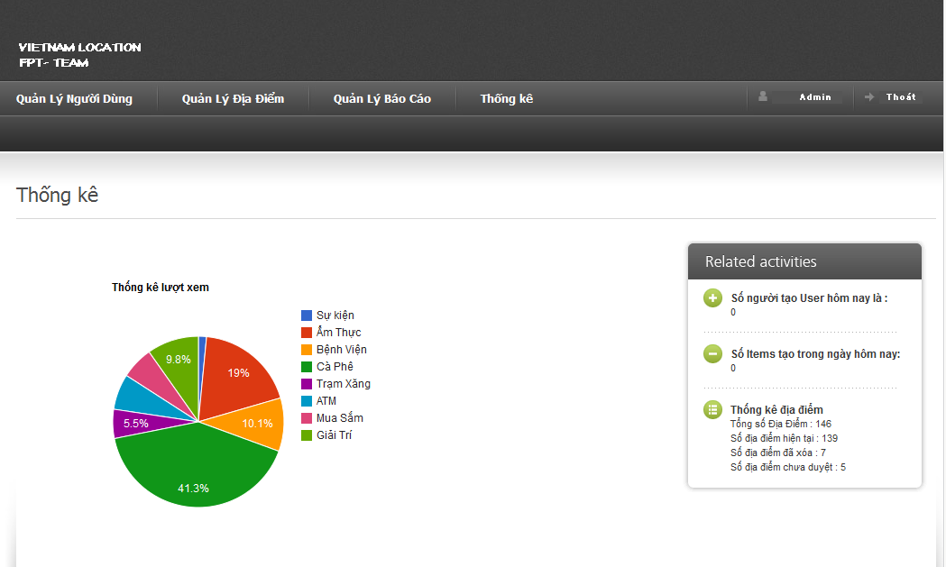
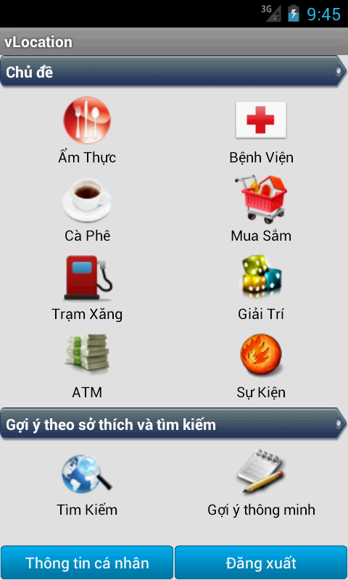
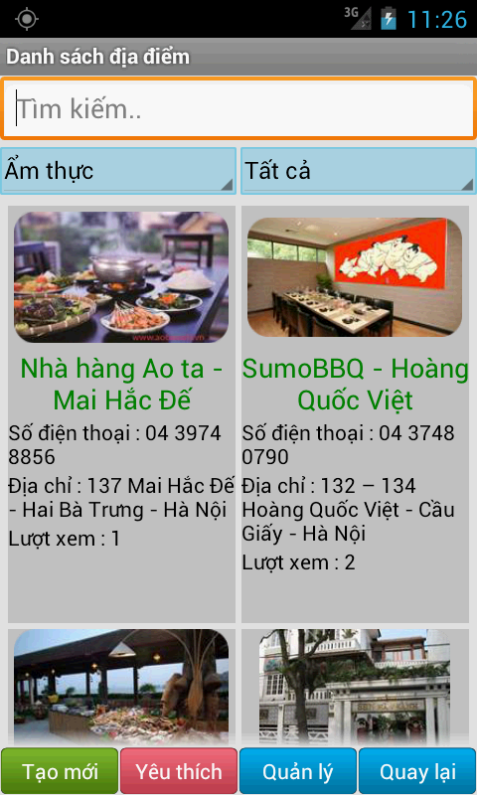
Products
Admin page
Application

Slide 10
Project Management Plan
The proposed system
Development Environment
Process
Project organization
Project Planning

Slide 11
The proposed system
Social place network.
User can create / share the place onto network
User can search place by categories and scan place by distance.
Users can contribution by comment, like, report other places onto network

Slide 12
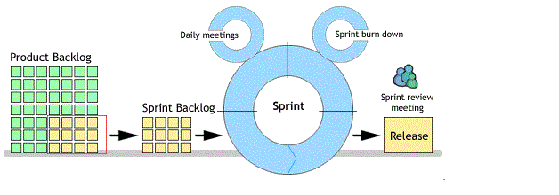
Process
For the development process, we will use our self process. It based on Scum model with some modifies.

Slide 13
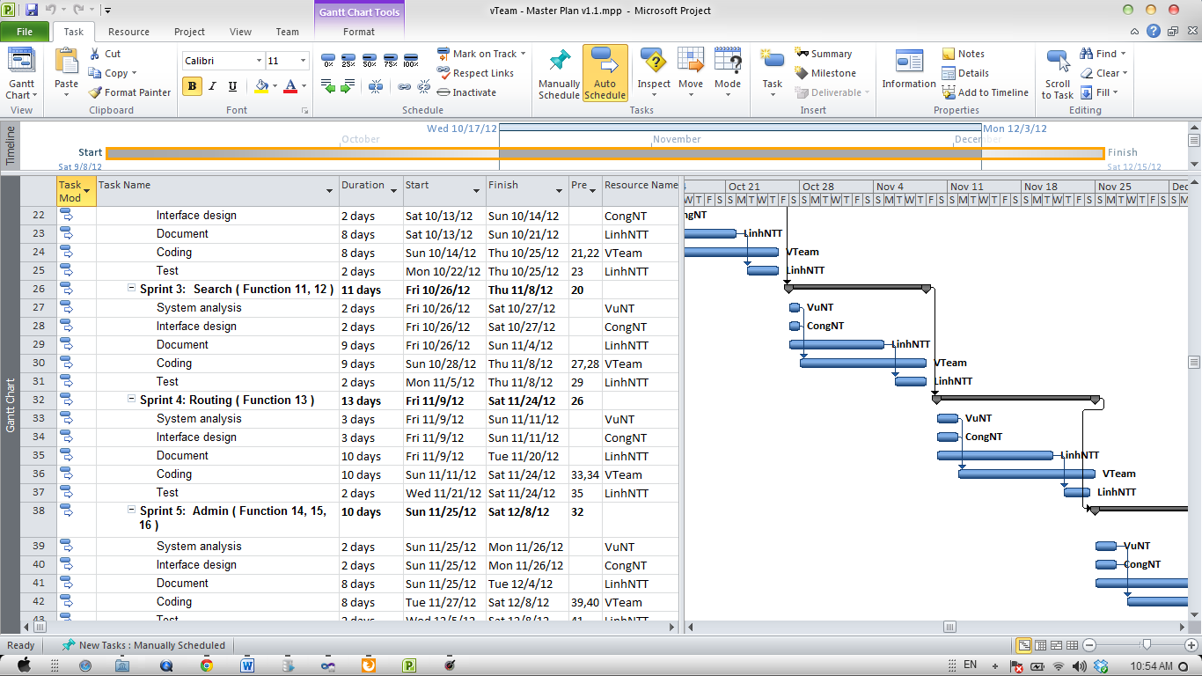

Slide 14
Project Planning
PFM
Communication
Meeting, Email, Skype, Hangout…
Time
Follow Capstone Project Requirements
Buffer: 10 days
Weekly Meeting
Checking progress
Require: Instructor and all team members.
Data
Upload and download all project document from SVN:http://code.google.com/p/vlocation/

Slide 15
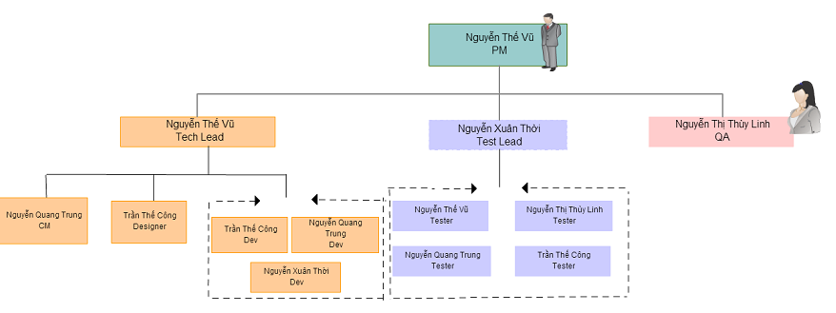
Project organization

Slide 16
Requirement Specifications
User Requirements
System Requirements
Non-functional requirements*

Slide 17
User requirements
User
Administration
Roles
Comments
Places
Search

Slide 18
FUNCTION REQUIREMENTS
SHARING PLACE
MANAGER PLACE BY CATEGORY
VIEW DETAIL PLACE
SHOW MAPVIEW PLACE
SEARCH AND SCAN PLACE
ROUTING

Slide 19
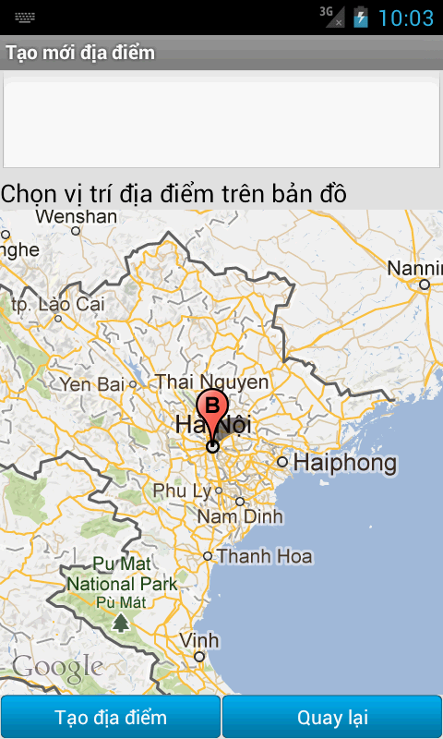
SHARING PLACE AND MANAGE PLACE

Slide 20
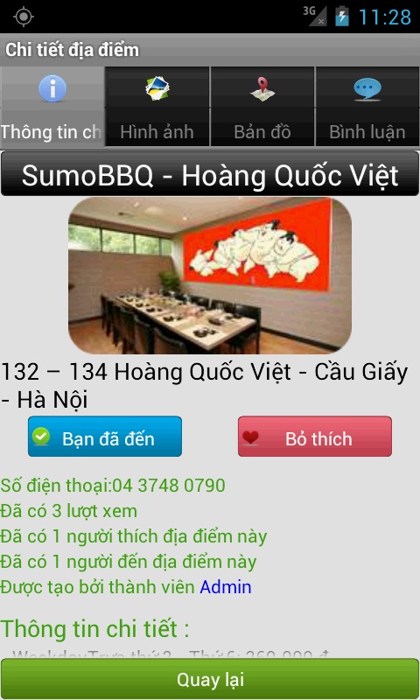
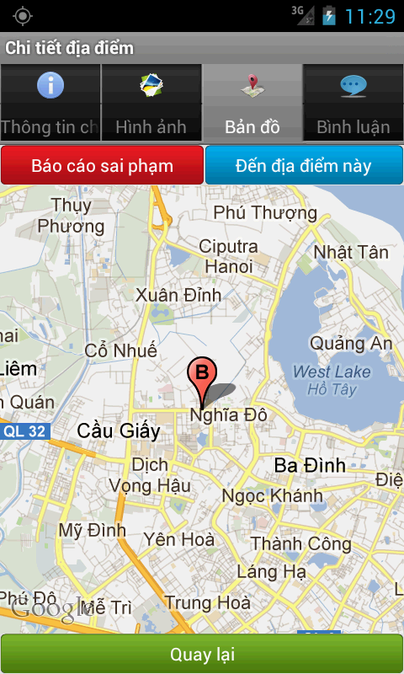
VIEW DETAIL PLACE SHOW MAPVIEW PLACE

Slide 21
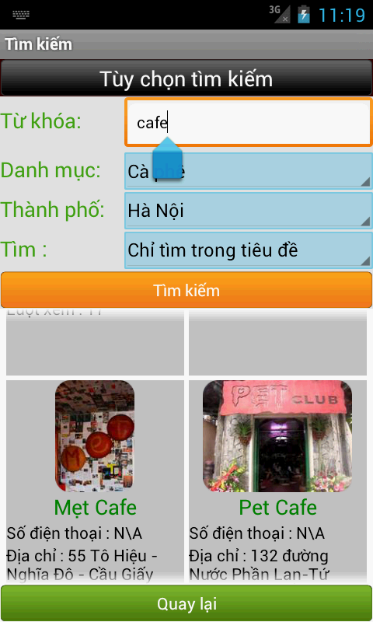
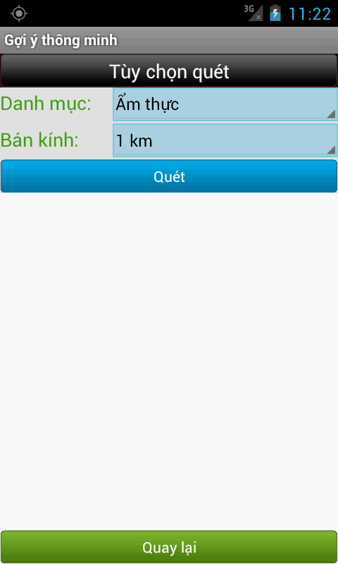
SCAN AND SEARCH PLACE

Slide 22
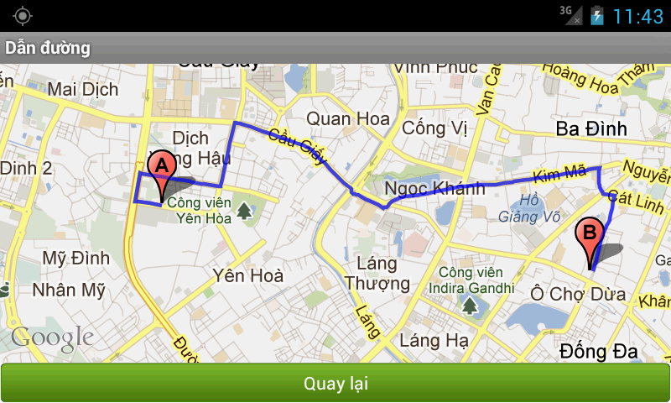
ROUTING

Slide 23
Nonfunctional Requirement
Reliability
Availability
Usability
Performance
Maintainability
Security

Slide 24
Software Design Description
Architectural design
Detailed design
Database design

Slide 25
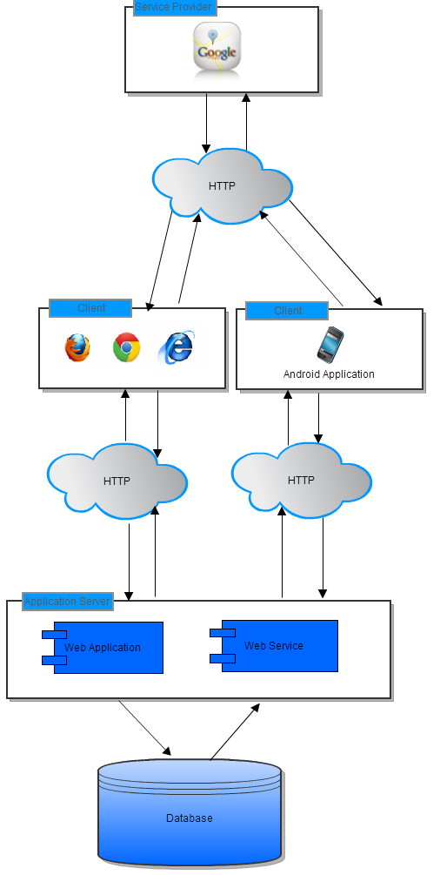
Architectural design: Overall Design

Slide 26
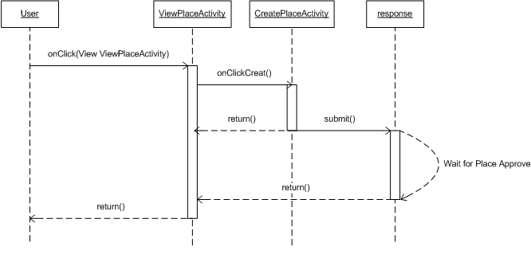
Detailed design

Slide 27
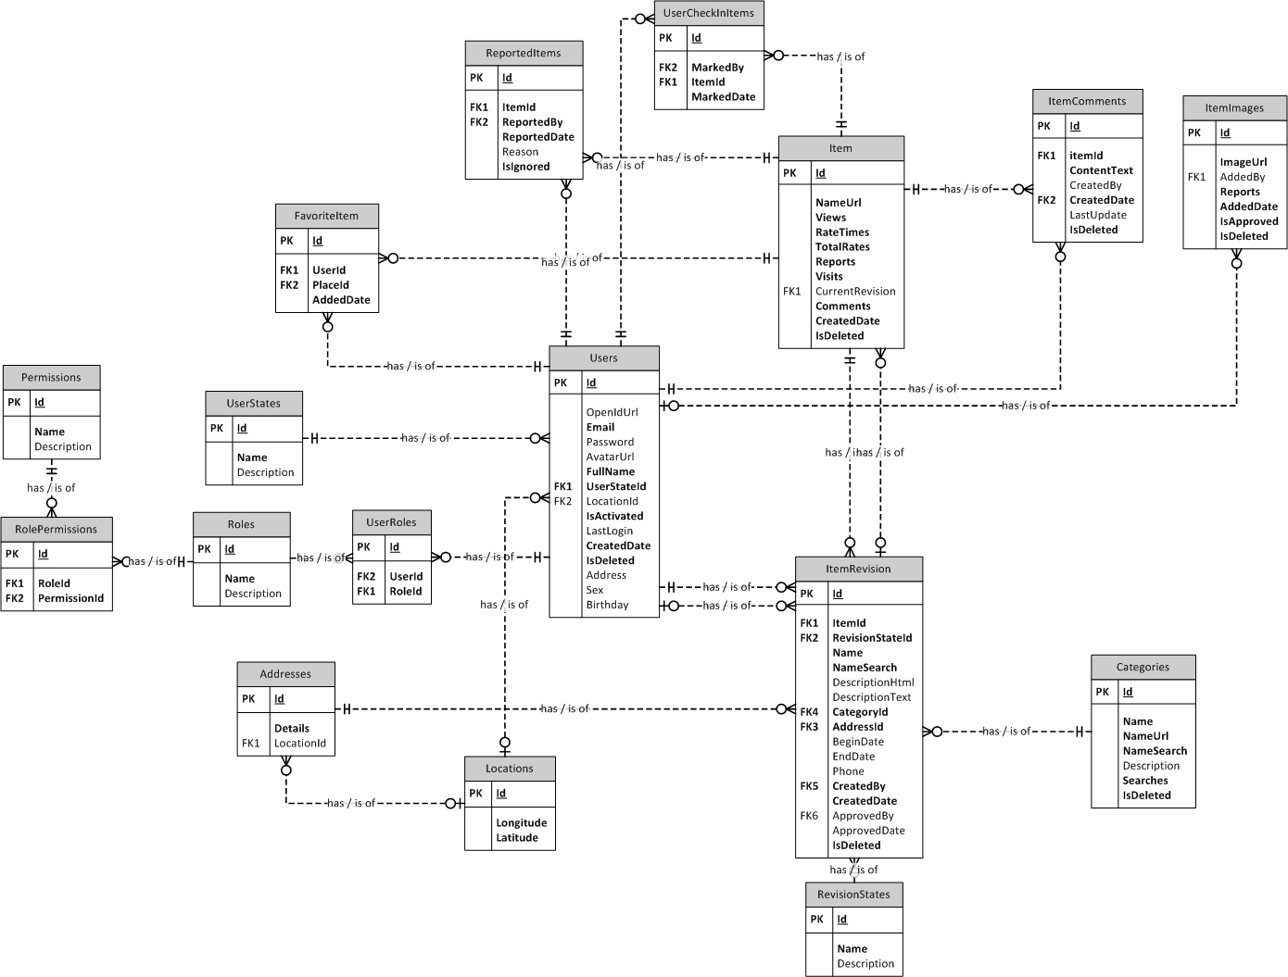
Database design

Slide 28
Software Test Documentation
Include:
Features to be tested
Features not to be tested
Test case
Check list

Slide 29
Test result
Number of test cases: 295
Number of passed cases: 295
Number of failed cases: 0
Number of not tested cases: 0

Slide 30
Summary
Capstone Project: completed (in next 30’ ☺)
Product: deployed to
Future:
Continue developing
Invest in this product (anyone interested?)

Slide 31
Demo

Slide 32
Q&A

Slide 33
Thank You!!!

