Slide 1


Thanh Long Company Business Management System
Supervisor: Mr Phan Trường Lâm
Students:
Nguyễn Minh Đức
Nguyễn Tiến Khiêm
Nguyễn Minh Sơn
Nguyễn Mạnh Linh
Ngô Văn Thắng

Slide 2
Contents
1. Introduction
2. Project Management Plan
3. Requirement Specifications
4. Design Description
5. Test Documentation
6. Demo, Q&A

Slide 3
Part 1: Introduction
The People
Background
Literature Review
Google cloud benefits
Our Proposal

Slide 4
The people
Nguyễn Minh Đức
Nguyễn Minh Sơn
- Project Manager
- Developer
- Tester
- Developer
- Designer
Nguyễn Tiến Khiêm
Nguyễn Mạnh Linh
- Developer
- Designer
- Developer
- Technical
- Configuration Manager
Ngô Văn Thắng
Test Lead -Tester

Slide 5
Background
1
Using traditional methods to manage projects
Difficulty to manage projects
3
Inconvenient and inefficient
4
2
Behind schedule and over budget

Slide 6

Literature review
1
Expensive cost
2
No portable and Inconvenient
3
No support Vietnamese

Slide 7

Literature review
1
Expensive cost
2
Inconvenient
3
Only supported Project manager

Slide 8


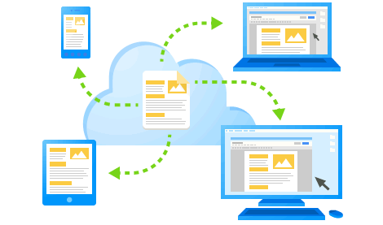

Google Cloud Benefits
1
Security
Work better together
2
3
Everywhere connected
4
Low cost

Slide 9
Our proposals
Thanh Long construction company
Small construction companies
Reduce management cost
Increase economic efficiency
Company
Economic
Network
User Friendly
Make the system user-friendly, Vietnamese and convenient.
Have best performance
Using cloud computing
More faster and safe

Slide 10
Part 2: Software Project
Management Plan
The proposed system and scope
Development Environment
Process
Project organization
Project Planning

Slide 11
Proposed system & scope
Propose
  Providing tool to manage projects in individual construction company
Scope
  Manage project staffs
  Manage project tasks
  Manage reports
  Manage message system

Slide 12

Dev Environment Hardware
CPU: Intel(R) Pentium3 2.0 GHz or better supported
RAM: 512MB RAM for Windows XP/Win7
Hard Drive: 2Gb of free space
Connect internet or USB 3G
Server Hardware

Slide 13



Dev Environment Software

Slide 14
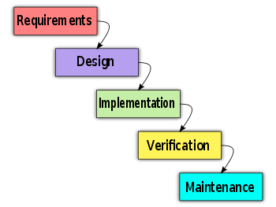
Process
Follow Waterfall model

Slide 15
Project Organization
Project Manager
DucNM
Analysis and design team
Developer
QA & Tester
DucNM
KhiemNT
SonNM
KhiemNT
DucNM
ThangNV
SonNM
LinhNM

Slide 16

Project Planning
Follow Capstone Project requirements
Buffer: 20% (about 3 weeks)
“Consumed” buffer: 1.5 weeks
Submit all reports on time

Slide 17
Part 3: System Requirement Specifications
User Requirements
System Requirements
Non-functional requirements*

Slide 18
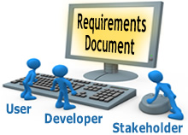
User requirements
Administrator
Director
Human Resource Manager
Operator
Project Manager

Slide 19
User Requirements
Admin
Log in – log out, view general information
Create, search, update, delete projects.
View, create, update and search accounts’ information
View, add and search messages

Slide 20
User Requirements
Director
Log in – log out, View general information
View project list, search projects, view tasks of the project
View, search projects’ reports
View Human Resource (HR) information, decide HR requirement
View, add and search message

Slide 21
User Requirements
Human Resource Manager
Log in – log out, View general information
View list, delete, add, update, search staffs
View list, delete, add, update, specialty
View list of project, search projects, view projects’ detail
Search staffs and add resources to project
View HR information, provide HR requirement
View list, view detail, add and search messages

Slide 22
User Requirements
Operator
Log in – log out, View general information
View task list & project information, view task detail
View list, view detail, create and search daily report
View list, view detail, add and search message

Slide 23
User Requirements
Project Manager
Log in – log out, View general information
view list, add, update, delete, staff requirement and search tasks
View list, search, assign tasks, confirm human resource, remove staffs
View list, add, update, delete operator
View require human resource information
View task information, change task status, manage task constraint, Create line chart, manage document task

Slide 24
User Requirements
Project Manager
View project information & task list, change project status, view projects’ documentations, Gantt-chart, update project's information
View project list, search project
View list, view detail, update and search daily report
View list, search, create, view detail
View list, view detail, add and search message

Slide 25
System requirements
Document requirements for each use case
Each includes:
  Use case diagram
  Actor
  Summary
  Triggers
  Preconditions
  Post conditions
  Success scenarios
  Alternative scenarios
  Exceptions
  Relationship
  Business rules

Slide 26
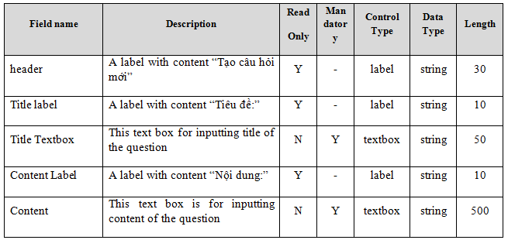
System requirements
Data Fields Definition:
Field name
Description
Read-only
Mandatory
Control type
Data type
Length

Slide 27
Non-functional requirements
1
Usability
2
Availability
3
Security
4
Maintainability
5
Performance

Slide 28
Usability
Front-end language: Vietnamese
Easy to use.
Clear and convenient user interface

Slide 29

Availability
Run 24/7

Slide 30

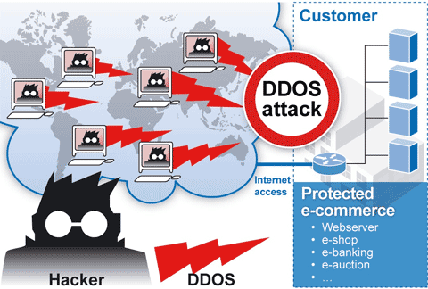
Security
Privacy: protect user information
User password must be encryption by MD5
These pages are secured by SSL.
All sensitive information is encrypted using DES

Slide 31

Maintainability
Follow coding standard and naming conventions
Loosely coupled design
Logging functionality

Slide 32
Performance
Caching
  Frequently accessed data
  Reference data

Slide 33
Part 4: Software Design Description
Architectural design
Detailed design
Database design

Slide 34
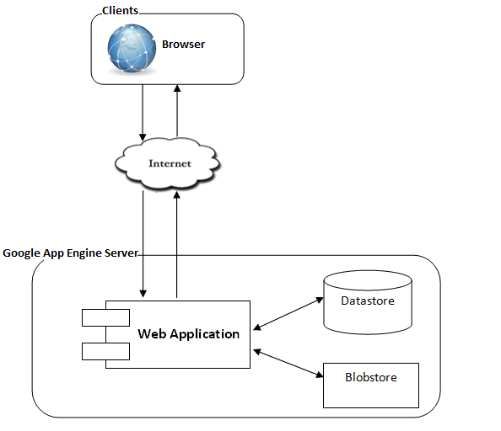
Overall Design

Slide 35
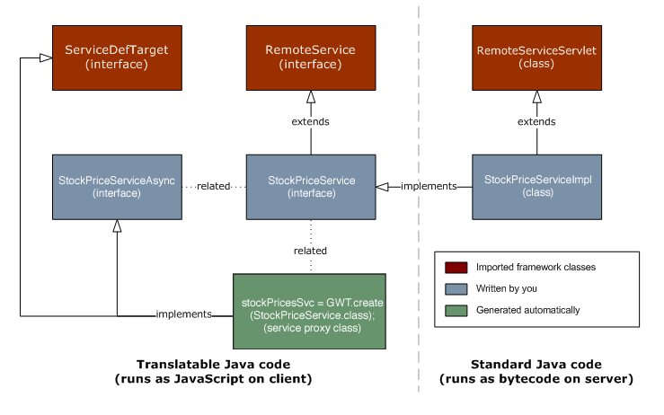
Client – server communication
Remote procedure call

Slide 36
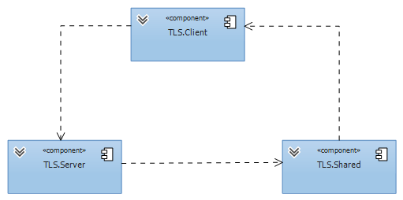
Components

Slide 37
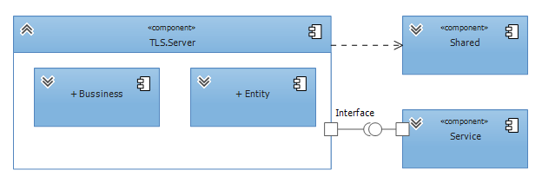
Server component
Server Component

Slide 38
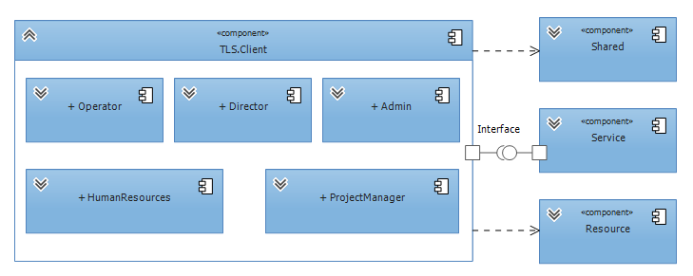
Client component
Client Component

Slide 39
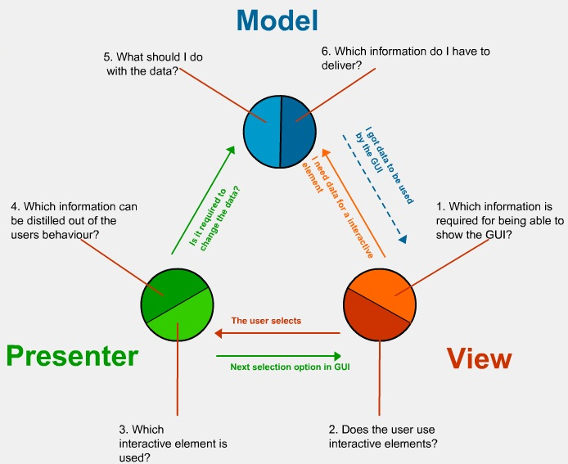
Architectural
Design patterns
MVP

Slide 40
Detailed design
Design for each use case
Class diagram
Class explanation
Sequence diagram

Slide 41
Class Diagram
Staff management class diagram
Class diagram example

Slide 42
Class Diagram
View staff list sequence diagram
Sequence diagram example

Slide 43
Database design
Using App Engine Datastore via JDO (Java Data Objects).
Business entities.
Every entity has a primary key named Id.

Slide 44
ER Diagram
Notes:
Crow foot notation

Slide 45
Part 5: Software Test
Documentation
Include:
  Features to be tested
  Features not to be tested
  Test case
  Check list

Slide 46
Test Model
Requirement Analysis
Acceptance Testing
Specifications
System Test
Detail Design
Integration Test
Code & Unit Test
V Lifecycle Model
46

Slide 47
Test Plan
  Admin
  Director
  Human Resource Manager
  Operator
  Project Manager

Slide 48
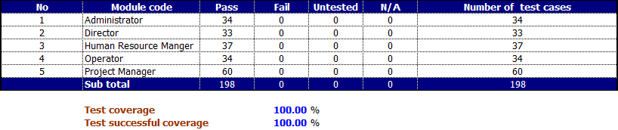
Test result

Slide 49
Demo

Slide 50
Q&A

Slide 51
Thank You !

