Slide 1
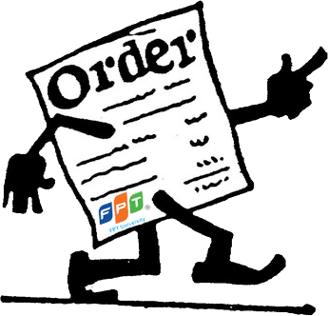
Capstone Project Smart Menu Solution
Students: Lê Cao Minh Thành 60082
Hồ Anh Đức 60015
Trần Minh Trung 60025
Mạc Nguyên Khôi 60117
Nghiêm Tuấn Cường 60100
Supervisor: Dr. Phan Duy Hùng
1/41

Slide 2
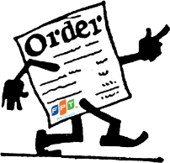
Content
Introduction
Hardware and Software
Yakindu
Conclusion
Why we do this project?
Idea’s Origin
Existing System
Idea’s Evaluating
Scope
Product Overview
Principle
Feature
Risk
2/41

Slide 3
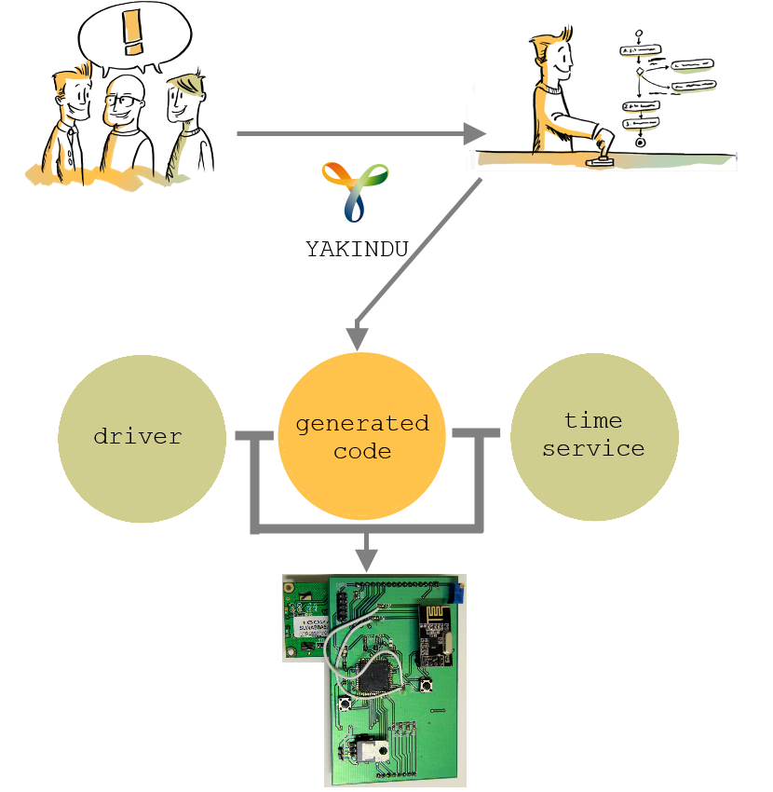
Introduction
Why do we do this project?
3/41

Slide 4
Introduction
Idea’s Origin
Waste time
4/41

Slide 5
Introduction
Idea’s Origin
Costly
Redundancy
5/41

Slide 6
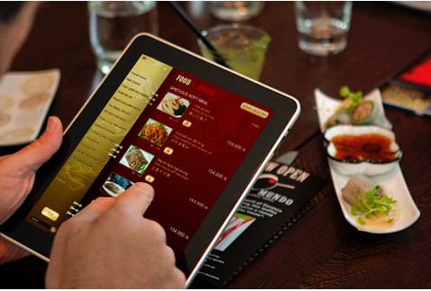
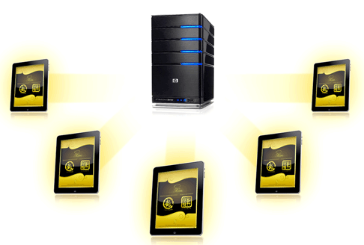
Introduction
Existing Systems
A system is installed on server
Application runs on Ipad/Tablet (Client) thought server
iMENU
Bach Hop Company (BICWeb.VN)
Choosing dishes thought IPAD, tablet
http://www.bicweb.vn

Slide 7
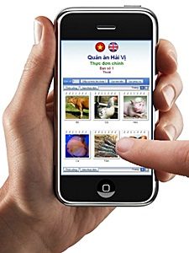
Introduction
Existing Systems
ezMenu
http://vienphuc.com/ezmproduct.htm

Slide 8
Introduction
Idea’s Evaluating
Actual needs:
- Lost time for waiting to note orders.
- Have errors and lead to debate later when notes by papers.
- High expense and hard to control a lots waiter.
None of the existing system is widely applied in Viet Nam because:
- Price,
- Functionality,
- Usability, etc.
→ The market is still available for our product.
8/41

Slide 9
Introduction
Scope
Provide the basic functions:
- Ordering: Provide a new electric device replace a traditional ways in ordering dishes.
- Management: Provide a window management software to manage orders, billing, statistic and automatically distribute dishes to chef.
Research & apply formal methods development (Yakindu) into executable embedded system.
Provide a long-term stable system.
Have acceptable price.
9/41

Slide 10
Introduction
Product Overview
Cashier
SMO Device
SMR Device
SMC
Device
SMO Device
Kitchen
…
PC Server
SMO: Smart Menu Ordering
SMR: Smart Menu Receiver
SMC: Smart Menu Chef
Printer
10/41

Slide 11
Introduction
Product Overview (cont)
SMO
SMR
LCD Display
Microprocessor
Microprocessor
RF module
Radio signal
RF module
USB module
Keypad
Radio signal
SMC
Bus
RF module
Keypad
Microprocessor
11/41

Slide 12
Introduction
Priciple
12/41

Slide 13
Introduction
Feature
Using SMO to select menu.
Support two languages: English or Vietnam
View dishes' status: not done, doing or done.
May cancel dishes if it haven’t been done yet.
Call waiter for additional or unusual request.
Automatic distribute orders to kitchen.
Quick billing.
Develop using “Yakindu” for easy maintain and update.
13/41

Slide 14
Introduction
Risk
Half of project team members do not have experiences working in real project.
The team leader lack of project management skill, experiences.
None of the project team members has been work as tester position.
The facilitation for developing the project maybe the risk (like places, equipment , etc…)
Lack of experiences of estimating time and budget for developing project.
14/41

Slide 15
Content
Introduction
Hardware and Software
Yakindu
Conclusion
Hardware
List
Device
Software
Model
Entity Framework
Demo
15/41

Slide 16
Hardware
List
Equipment’s Name | Quantity
Atmega128A | 3
nRF24L01 | 3
USB to RS232 Converter Cable | 1
LM7805 | 3
74HC245D | 3
MAX232 | 3
PL2303-HX SSOP28 USB to UART | 5
AVR STK500 - Programing Kit | 2
9V/1A Power Adaptor | 3
8 MHz HC-49S Crystal | 5
16/41

Slide 17
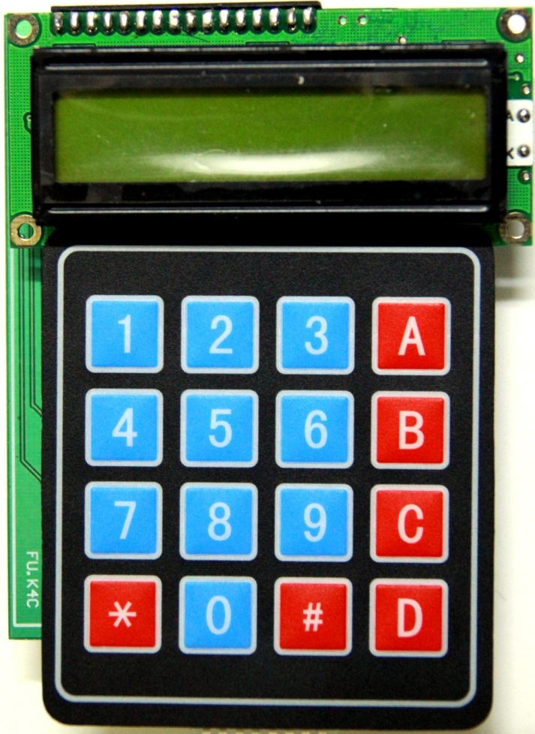
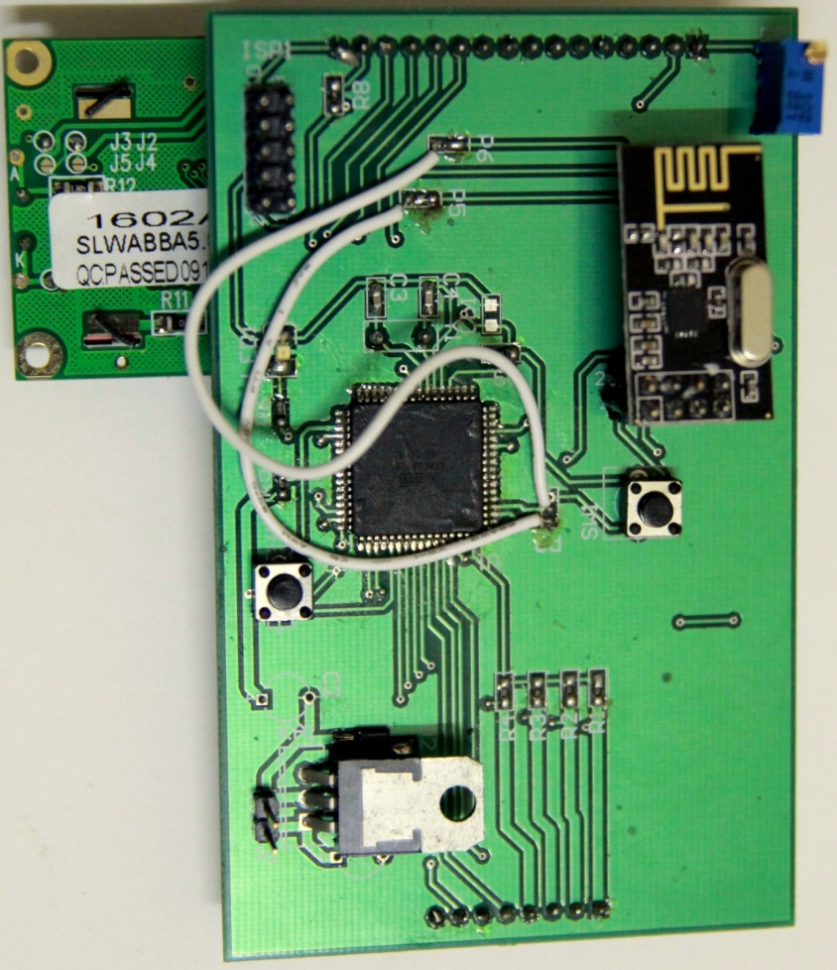
Hardware
Device
Main Device (Front)
Main Device (Back)
17/41

Slide 18
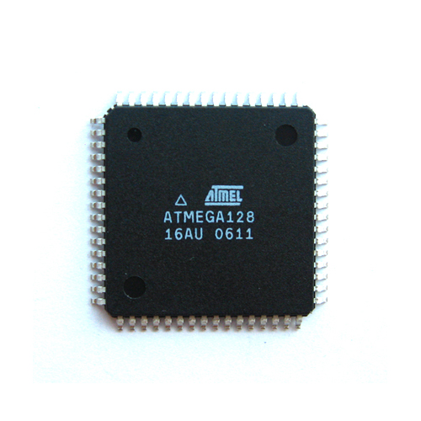
Hardware
Device (cont)
High-performance, Low-power AVR® 8-bit Microcontroller
High Endurance Non-volatile Memory segments
JTAG (IEEE std. 1149.1 Compliant) Interface
Peripheral Features
Special Microcontroller Features
I/O and Packages
Operating Voltages: 4.5 - 5.5V
Speed Grades: 0 - 16 MHz
Atmega128A
18/41

Slide 19
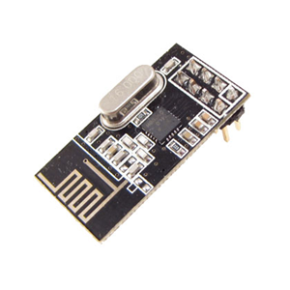
Hardware
Device (cont)
Low cost single-chip 2.4GHz GFSK RF transceiver IC
Worldwide license-free 2.4GHz ISM band operation
1Mbps and 2Mbps on-air data-rate
Enhanced ShockBurst™ hardware protocol accelerator
Ultra low power consumption – months to years of battery lifetime
nRF24L01
19/41

Slide 20
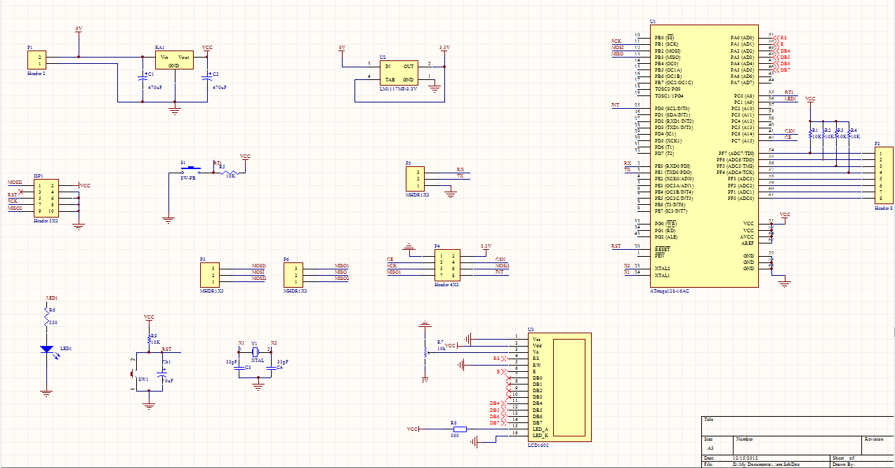

Slide 21
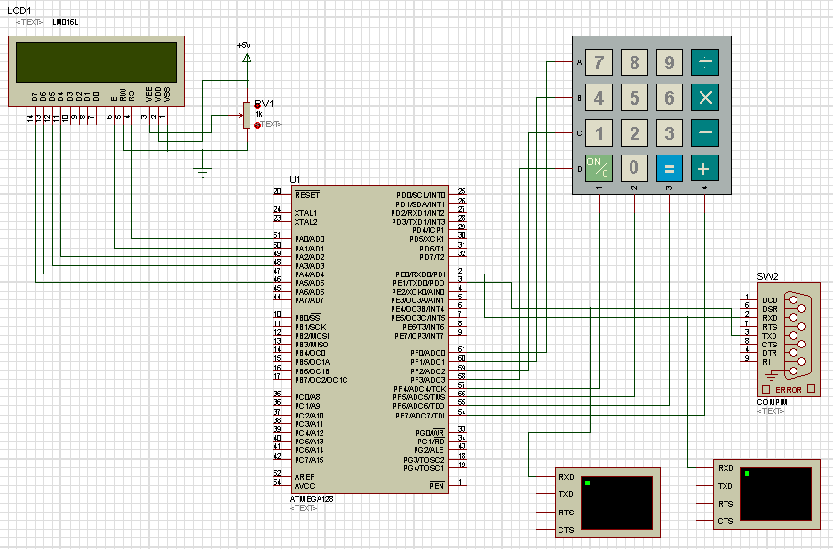

Slide 22
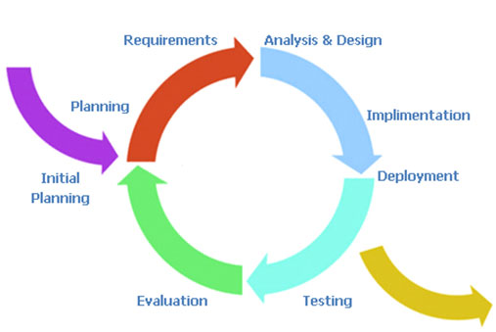
Sofware
Model
Iterative development model
22/41
Notes:
Planning phase, in which the plane for this project is created
Requirement phase, in which the requirements for the software are gathered and analyzed.
Design phase, in which software solution to meet the requirements is designed.
Implementation phase, when the software is code and integrated.
Test phase, when the software is tested.
Evaluation phase, in which the software is evaluated.
Deployment phase, in which the system is deployed.

Slide 23
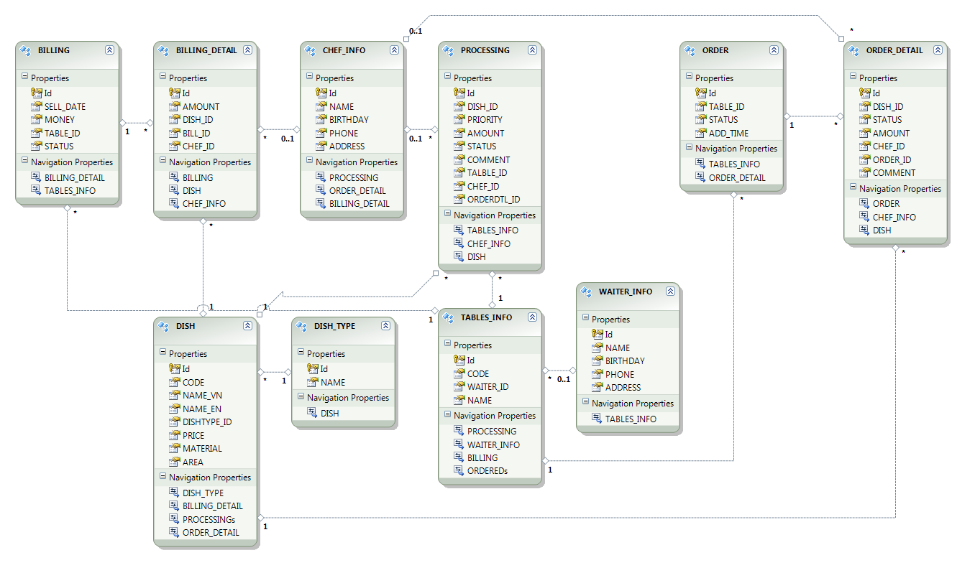
Sofware
Entity Framework
23/41

Slide 24
Hard&Soft
Demo
DEMO
24/41

Slide 25
Content
Introduction
Hardware and Software
Yakindu
Conclusion
Introduction
State chart Tools
Editing
Simulation
Code generation
Demo
25/41

Slide 26
Yakindu
Introduction
YAKINDU
is an open-source-toolkit
for the model-driven development
of embedded systems
built on Eclipse
open source
available at Eclipse Labs
http://statecharts.org
26/41

Slide 27
Yakindu
Statechart Tools (SCT)
27/41

Slide 28
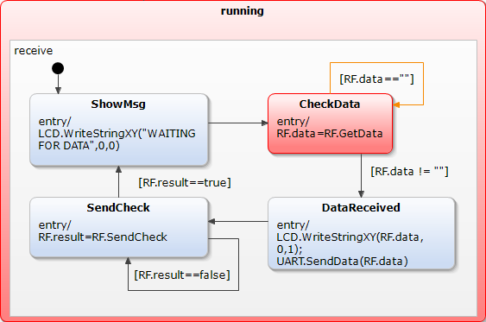
Yakindu
Statechart Tools (SCT)
Formalism similar to state machines as defined by David Harel, but:
self-contained with a well defined interface
with a cycle-based execution semantics
allows processing concurrent events
event-driven behavior can be defined on top
time control is delegated to the environment
28/41

Slide 29
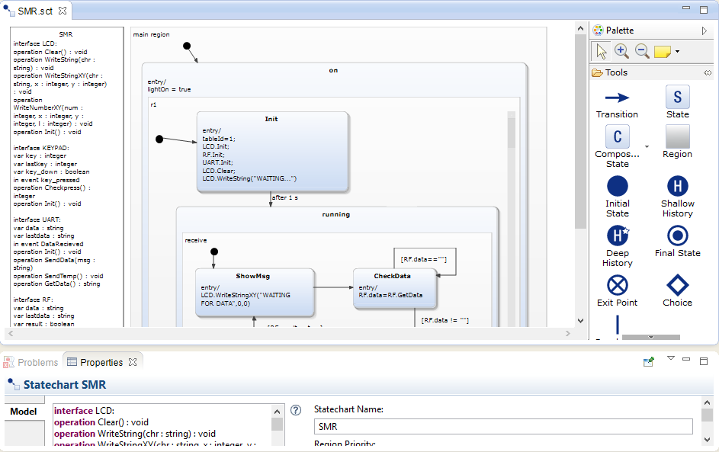
Yakindu
Editing
29/41

Slide 30
Yakindu
Editing
30/41

Slide 31
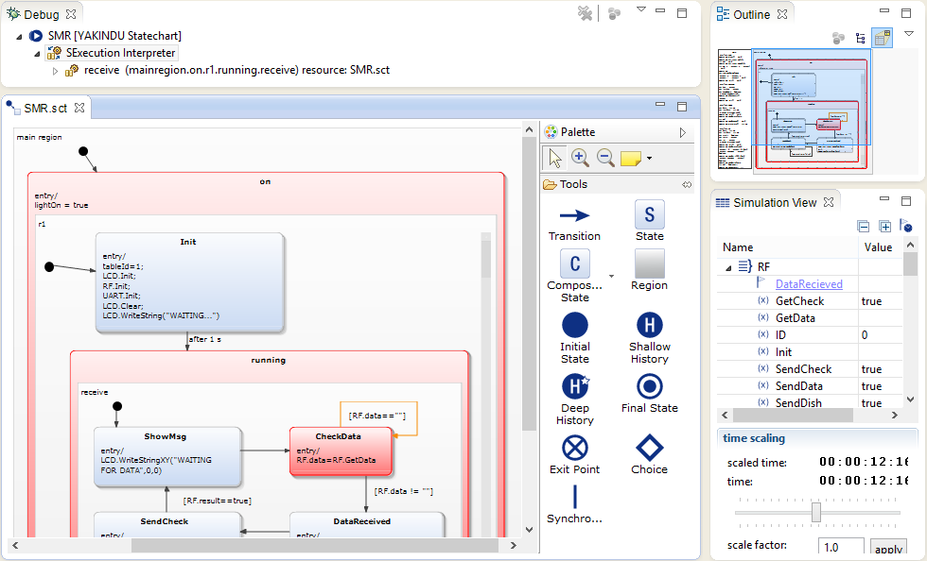
Yakindu
Simulation
31/41

Slide 32
Yakindu
Simulation
32/41

Slide 33
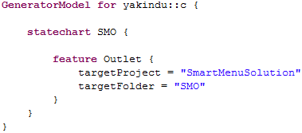
Yakindu
Code generation
Yakindu comprises code generators for Java, C, C++
All generators can be customized by a generator model
Custom generators based on Xpand & Xtend2/Java can be easily integrated
33/41

Slide 34
Yakindu
Code generation
34/41

Slide 35
Yakindu
Demo
35/41

Slide 36
Content
Introduction
Hardware and Software
Yakindu
Conclusion
Testing
Limitation
Future Improvement
36/41

Slide 37
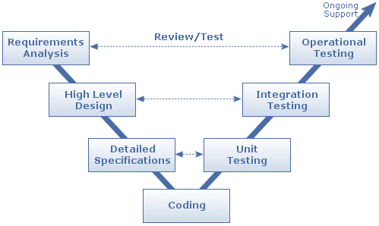
Conclusion
Testing
V – Model Test Strategy
37/41

Slide 38
Conclusion
Testing (cont)
Embedded System Testing
RS232 testing
Atmega128A testing
nRFL2401 testing
LCD display testing
Keyboard testing
Data transferring testing
Information System Testing
GUI testing
Functions testing
Insert database testing
Connect COM port testing
38/41

Slide 39
Conclusion
Limitation
Control software
Control software design is monotonous
Software didn’t have many functions
Do not display all system operations
Database design is not in standard
Sometimes not operate reliability
Source code is quite complicated
Counter printed board
Operate in 9V power only
Still cannot transfer data in a long distance (desire possible)
Design is not complete
Connection sometimes not reliability
39/41

Slide 40
Conclusion
Future Improvement
Large restaurant
Expensive price
Provide software in tablet
Have all basic function
Can custom comment dishes
No need paper menu
40/41

Slide 41
THANK YOU!

