Slide 1

WSM TEAM
Capstone Project
Wood Super Market
Instructor:
Trần Đình Trí
Members:
Hoàng Văn Minh Đức
Nguyễn Việt Hưng
Lê Đức Minh
Nguyễn Minh Hải
Trần Đăng Khoa

Slide 2
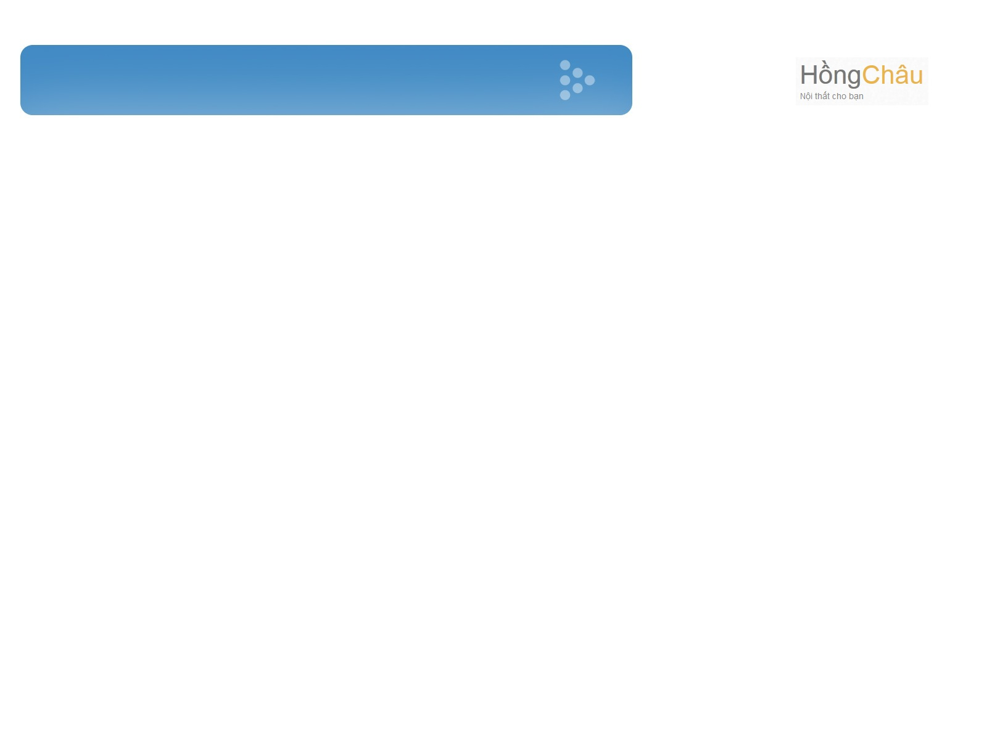
Table of Content
Project Introduction
Project Management Plan
Requirement Specification
Software Design
Demo
Q&A
Testing
Lesson Learned

Slide 3

1.Project Introduction

Slide 4
Common Information
Project Name: Wood Super Market.
Project Code: WSM.
Project Type: Web-based app
Project lifetime: 5/5/2014 – 16/08/2014.

Slide 5
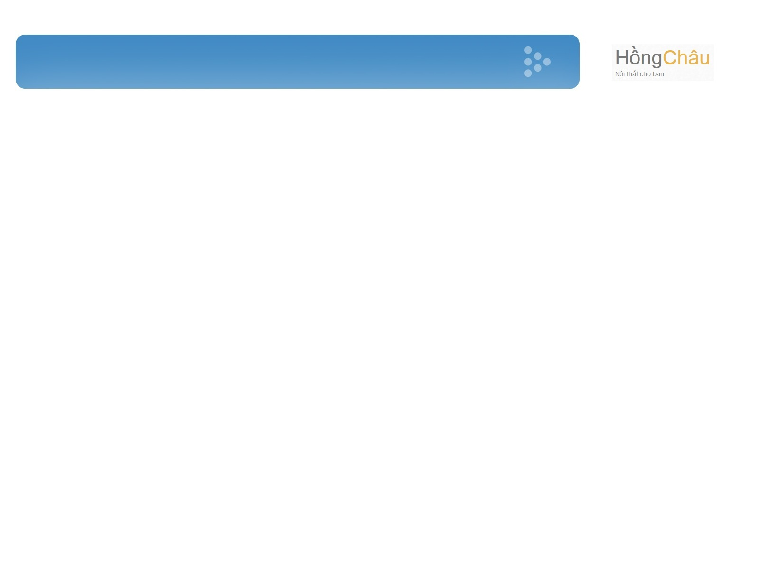
Advantage of e-commerce
Cost of building an e-commerce website will save investment costs many times cheaper than building a referral system booth and product distribution.
Cost of building an e-commerce website will save investment costs many times cheaper than building a referral system booth and product distribution.
Save the cost of construction, renting ground.
Save human resources.
Cost savings to maintain function, operation of enterprises.
Save advertising costs.
Increase the speed of introduction of new products.

Slide 6
Advantage of e-commerce
E-commerce helps businesses reach customers with diversified subjects, not limited in terms of space and time or geographical distance. E-commerce helps businesses expand markets and sales.
E-commerce does not only bring benefits to suppliers and manufacturers, it also helps customers easily search products. Information about product details, together with the rich multimedia information such as audio, image, etc.
Besides, E-commerce's bring benefits to society and the community: online activities will minimize unnecessary travel, environmental pollution, reduce risk of traffic accidents. It also helps to improve people's life, and provide them with more information…
So, e-commerce is an effective communication channel, a bridge between suppliers, manufacturers and customers.

Slide 7
2.Project Management Plan

Slide 8
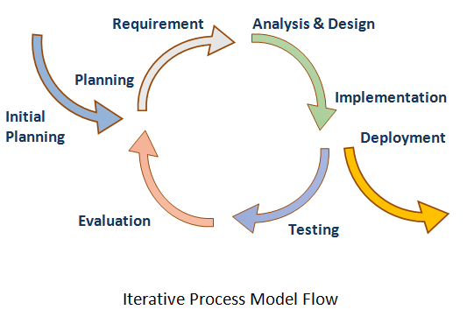
Soft ware Process Model

Slide 9
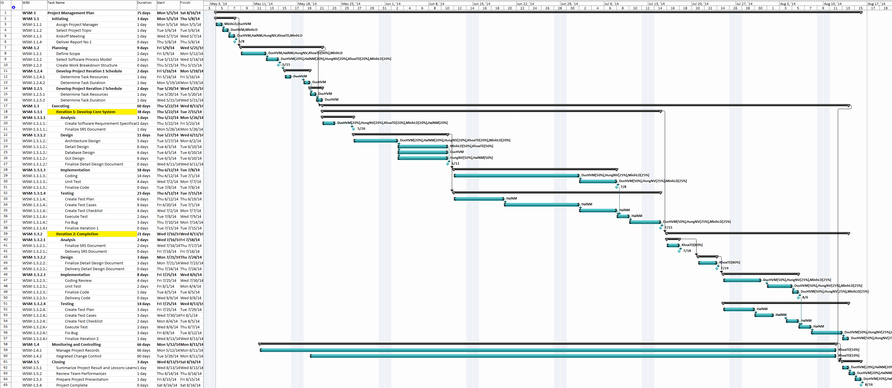
WBS and Gantt Chart
Task Sheet- Assignments and Timetable

Slide 10
Tools – Techniques
Tools:
  Microsoft® Office, Microsoft® Project (2010, 2013)
  Operating System: Microsoft® Windows 7, 8, 8.1
  Visual Studio 2012
  TortoiseSVN 1.8.3
  Notepad ++
  Microsoft SQL Server 2008 and IIS7.5
  Browser: Chrome 31, Firefox 20, IE 10 or higher
Techniques:
  Server: .Net, framework .Net 4.0, IIS 7.5
  Client: Html, CSS, Java script, JQUERY, AJAX.

Slide 11
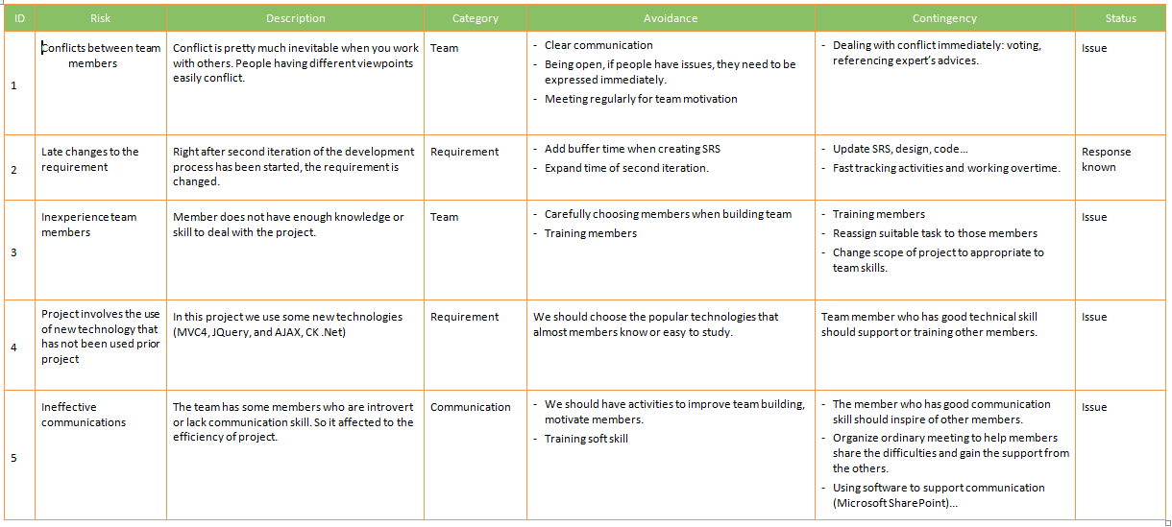
Project Risk Management

Slide 12
3.SoftWare Requirement Specification

Slide 13
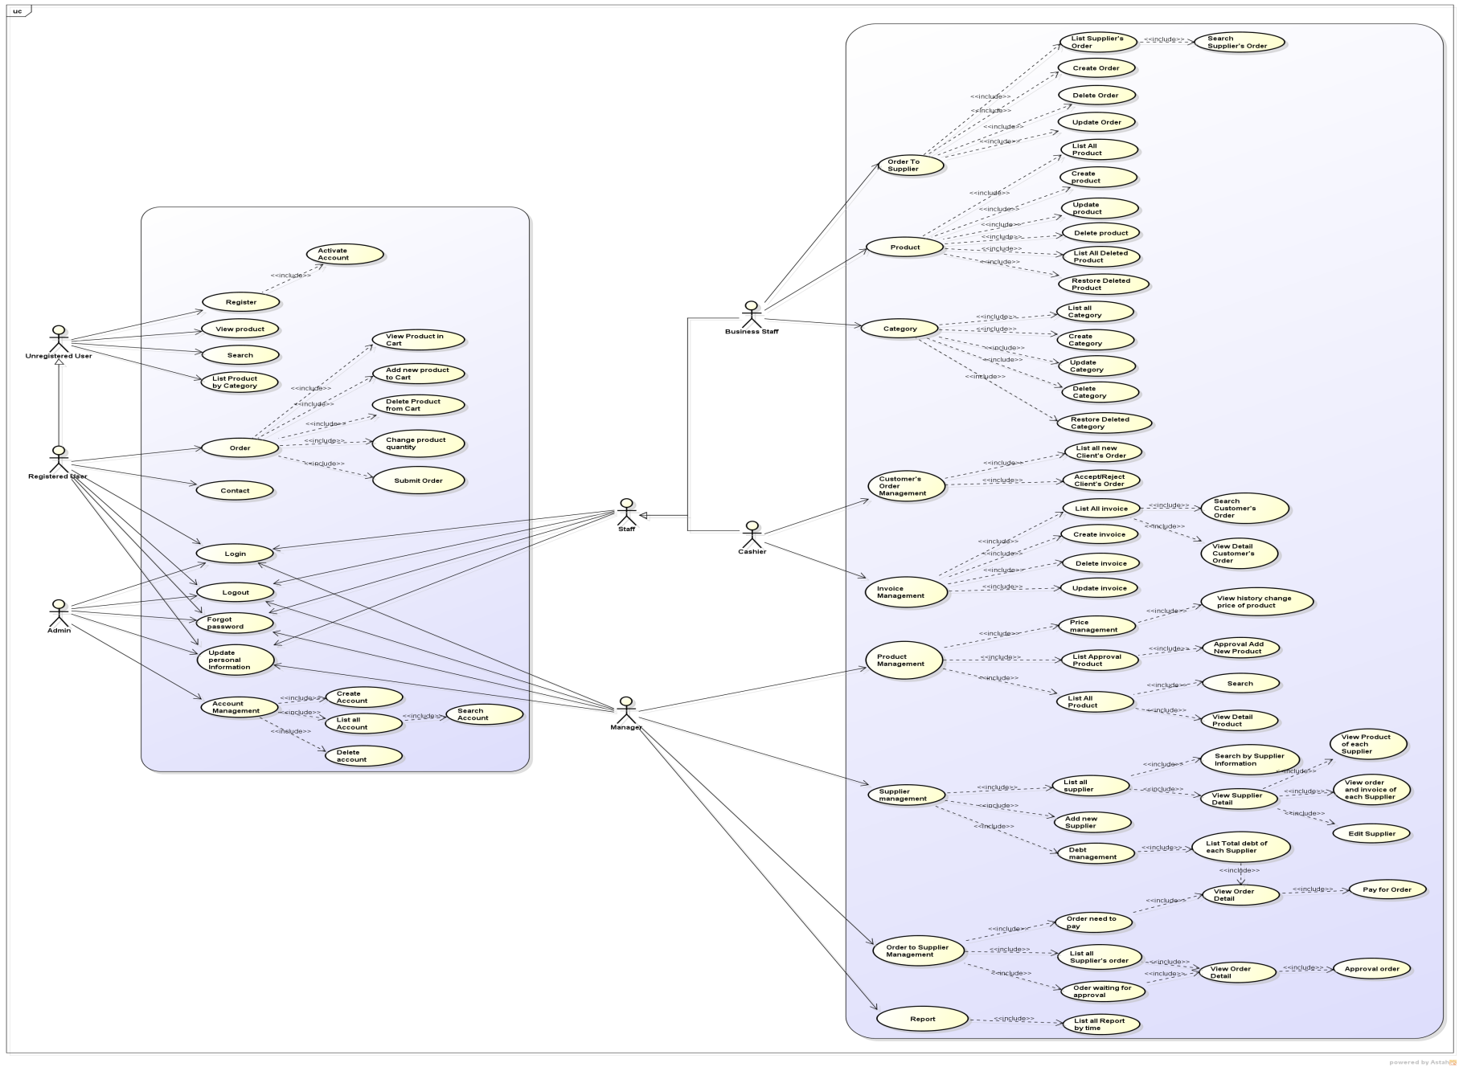
Use-Case Diagram

Slide 14
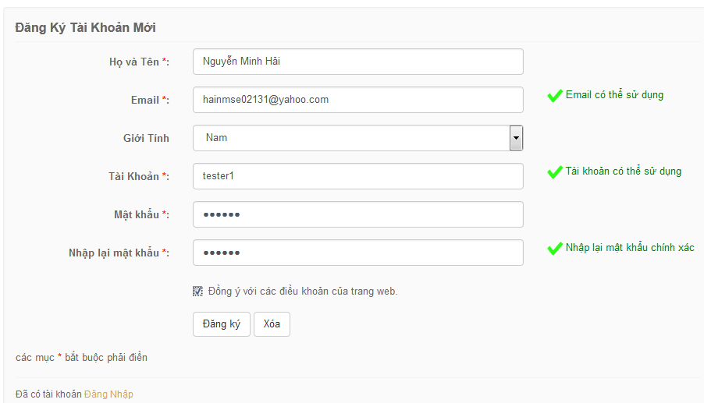
Actor Unregistered User
Register
View Product
Search
List Product by Category
Contact

Slide 15
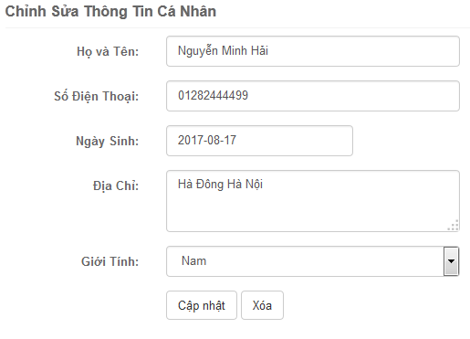
Actor Registered User
Register
View Product
Search
List Product by Category
Login
Order
Logout
Forgot Password
Update Personal Information

Slide 16
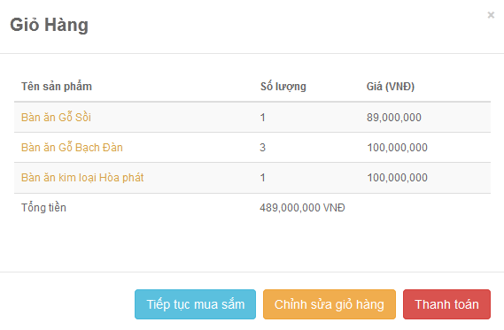
Actor Registered User
Order
View Product in Cart
Submit Order
Change Product Quantity
Delete Product from Cart
Add New Product To Cart

Slide 17
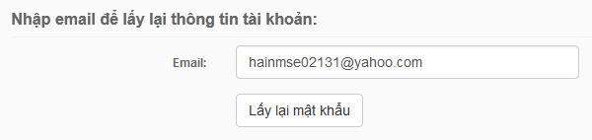
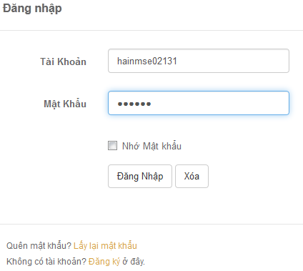
Actor Admin
Login
Logout
Forgot Password
Update Personal Information
Account Management

Slide 18
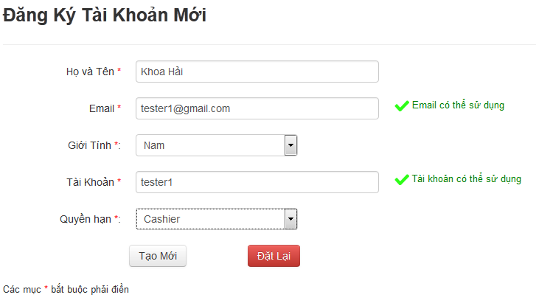
Actor Admin
Account Management
Create Account
List all Account
Search Account
Delete Account

Slide 19
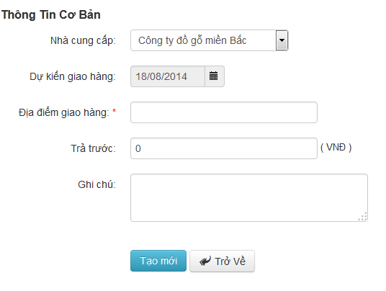
Actor Business Staff
Order to Supplier
Create Order
Update Order
List all Order
Search Order
Delete Order

Slide 20
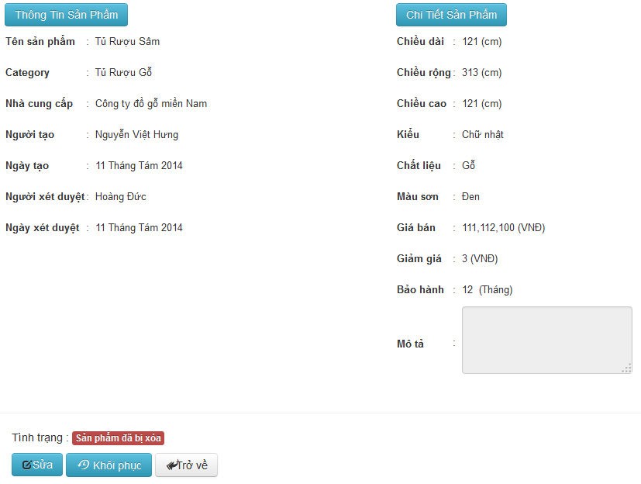
Actor Business Staff
Product
Create Product
Update Product
List All Product
Delete Product
List All Deleted Product
Restore Deleted Product

Slide 21
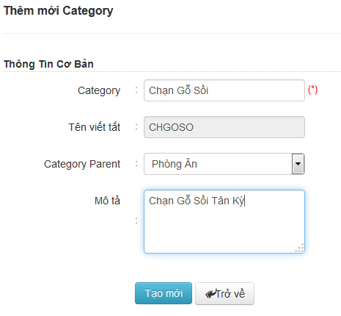
Actor Business Staff
Category
Create Category
Update Category
List All Category
Delete Category
Restore Deleted Category

Slide 22
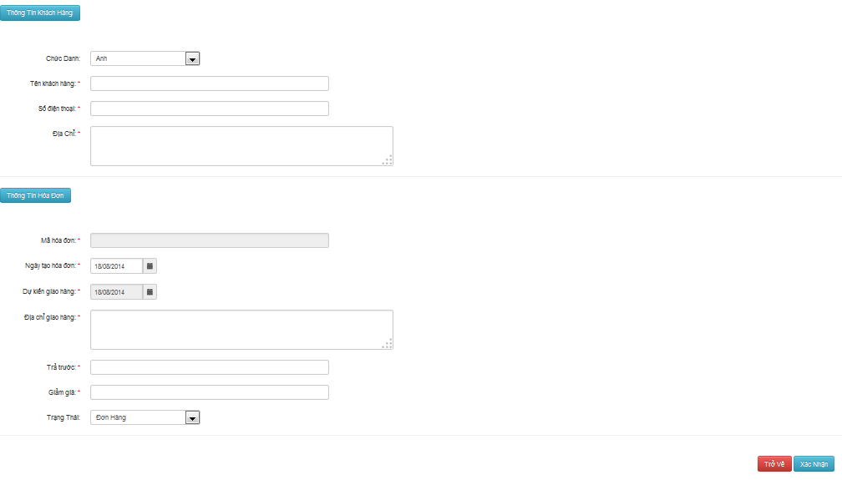
Actor Cashier
Customer’s Order Management
Accept/ Reject Customer’s Order
List All New Customer’s Order
Search Customer’s Order
Create Order
View Detail Customer’s Order
Update Order
Delete Order

Slide 23
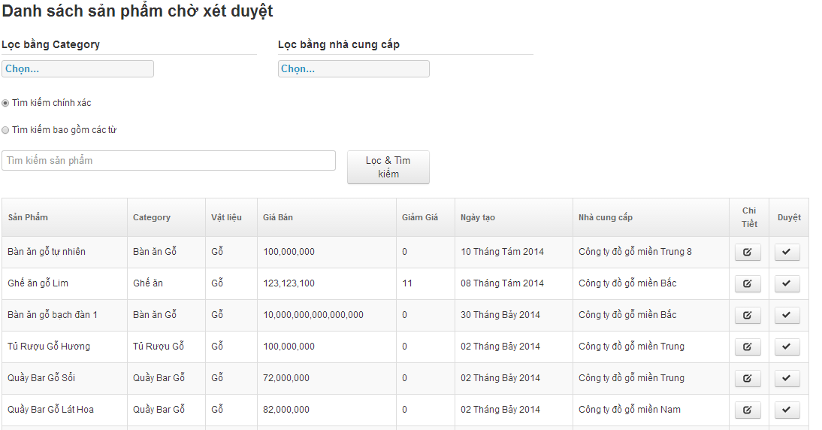
Actor Manager
Product Management
Price Management
Search
View Detail Product
List All Approval Product
List All Product
View History Change Price Of Product
Approval Add New Product

Slide 24
Actor Manager
Supplier Management
List All Supplier
Debt management
Search By Supplier Information
View Supplier Detail
View Product Of Each Supplier
View order and invoice of each Supplier
Edit Supplier
Add new Supplier
List Total debt of each Supplier
View Order Detail
Pay For Order

Slide 25
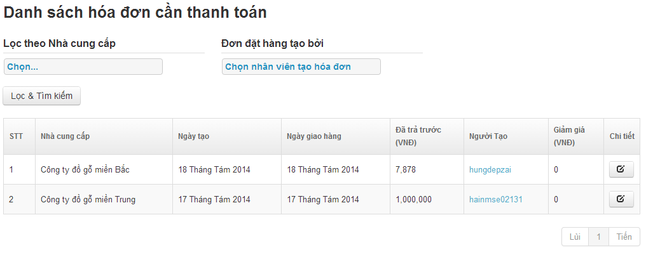
Actor Manager
Order To Supplier’s Management
Order Need To Pay
Approval Order
Pay For Order
View Order Detail
View Order Detail
List All Supplier’s Order
Order Waiting For Approval

Slide 26
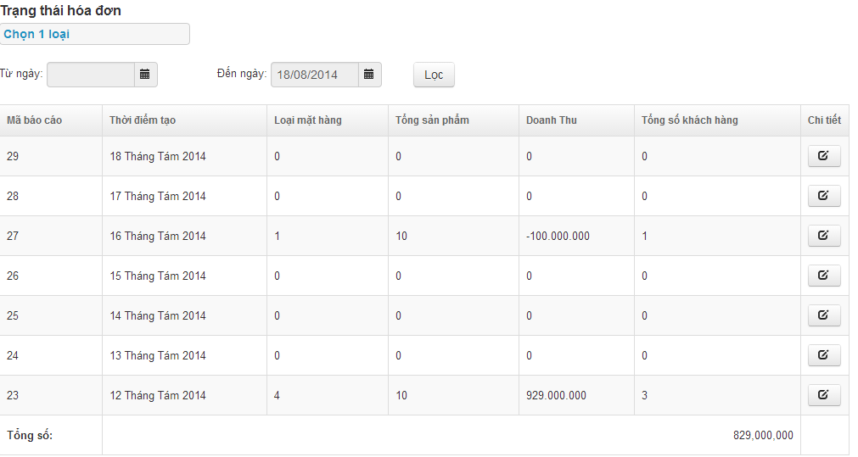
Actor Manager
Report
List All Report By Time
View Detail Of Report

Slide 27
Non-Function Requirements
Security
Password: SHA1
Maintainability
Follow C# Coding convention
Performance
Database indexing, review code
Usability
Support Vietnamese
Interface should be elegant, simple

Slide 28
4.SoftWare Design

Slide 29
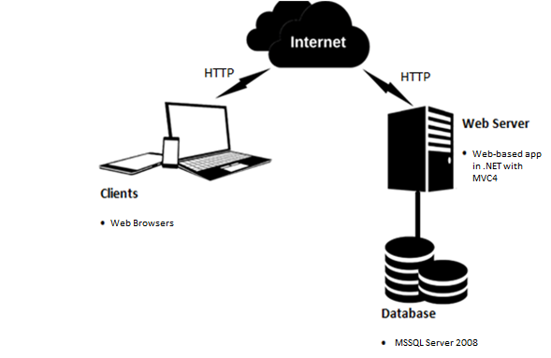
Architecture Overview

Slide 30
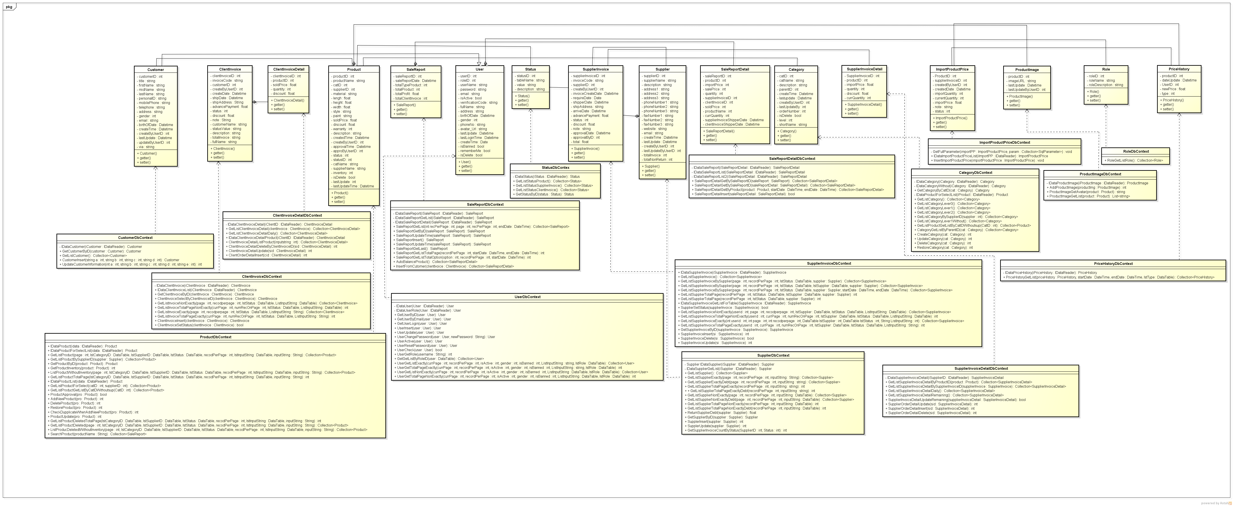
Class Diagram

Slide 31
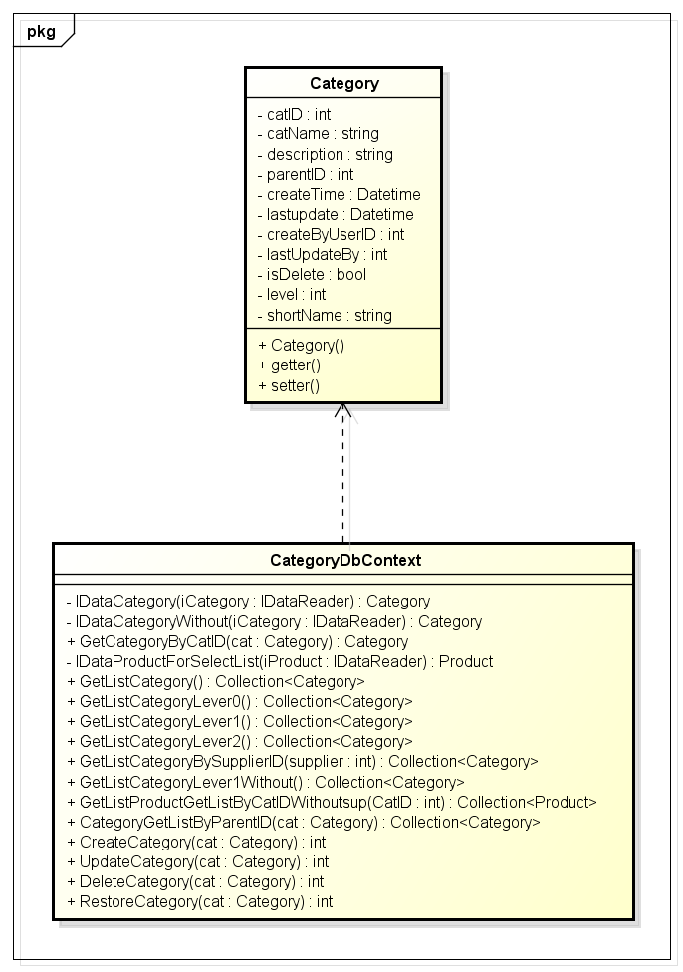
Class Diagram

Slide 32
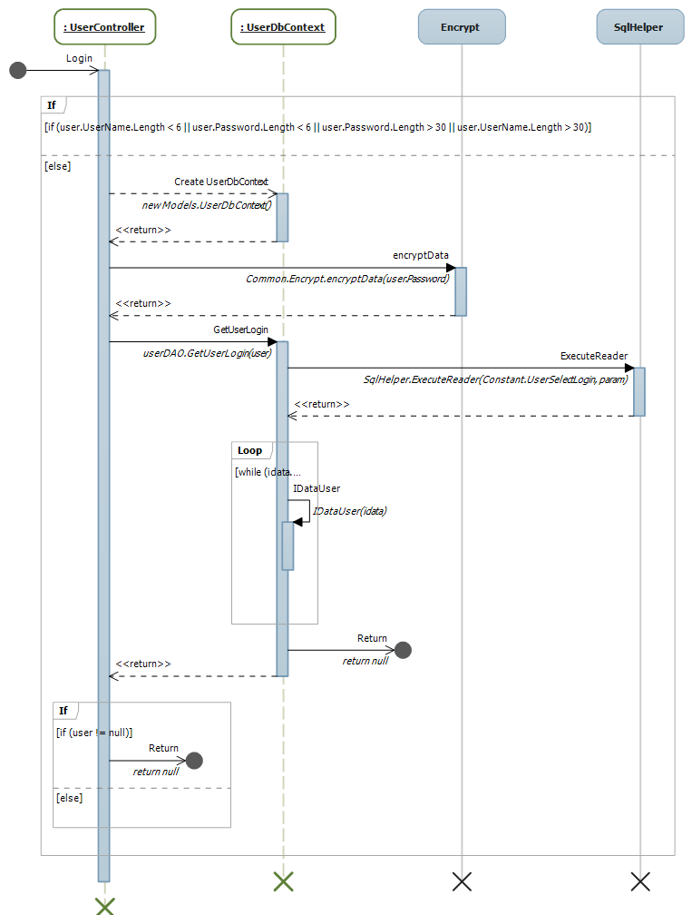
Sequence Diagram
Sequence Diagram for Login Use Case

Slide 33
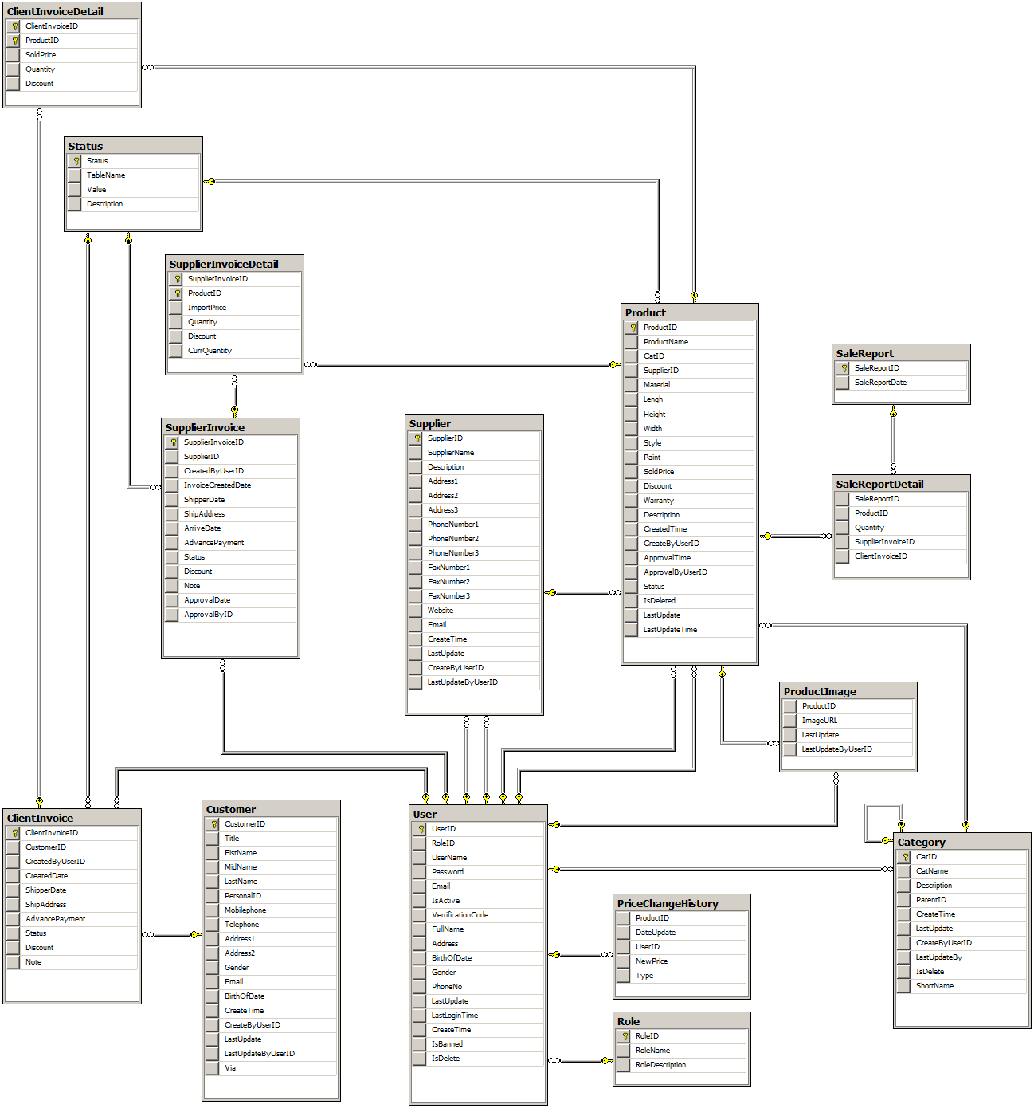
Database Diagram

Slide 34
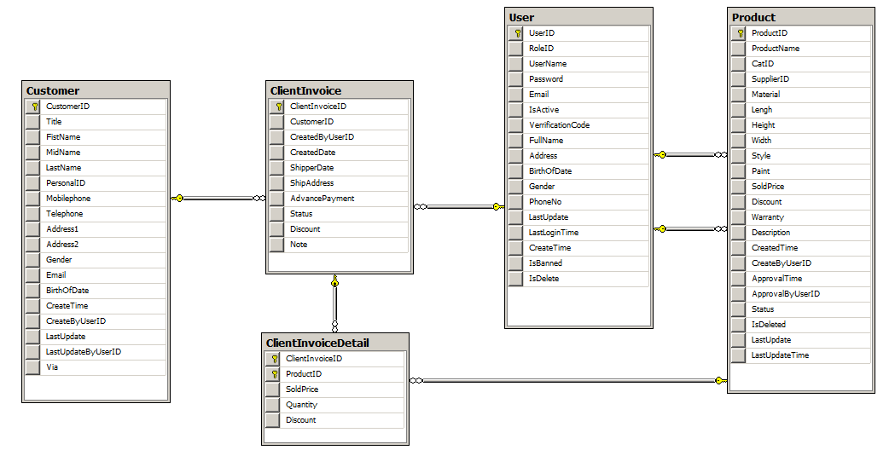
Database Diagram

Slide 35
5. TESTING

Slide 36
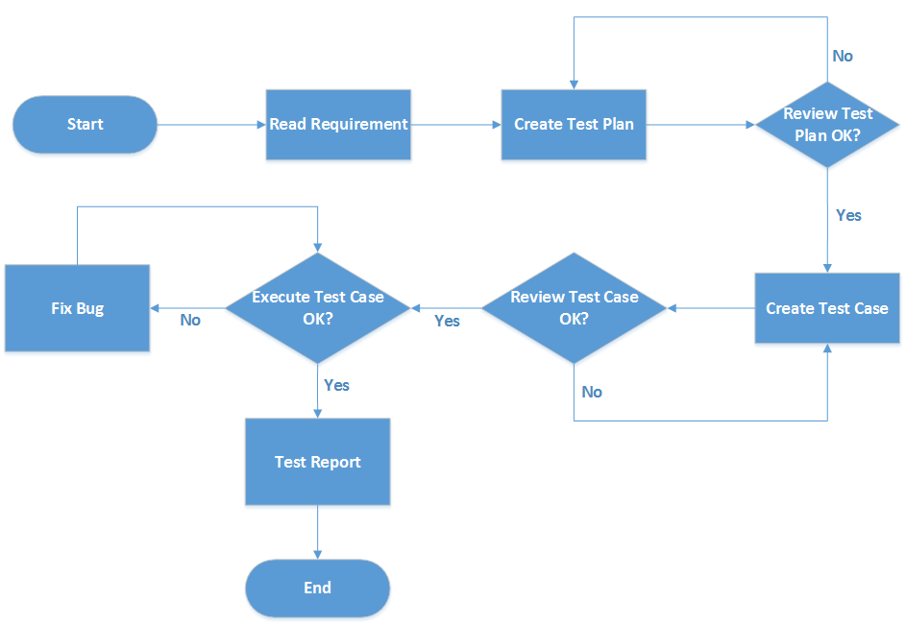
Testing Process

Slide 37
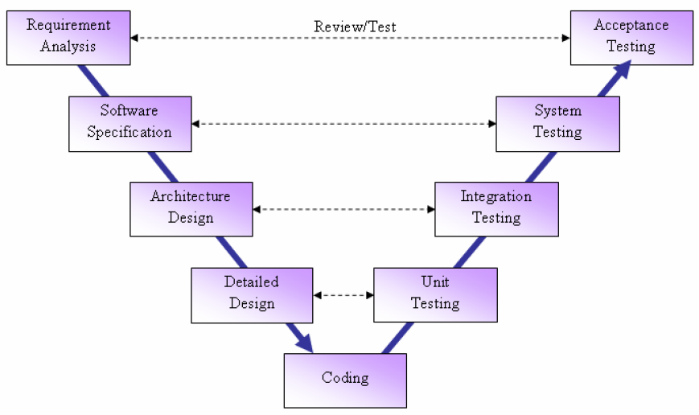
Stages of Testing
V-Model

Slide 38
Testing Types
GUI Testing
Function Testing

Slide 39
Testing Schedule
MileStone Task | Start Date | End Date
Iteration 1
Unit Testing | 02/07/2014 | 07/07/2014
Integration Testing | 08/07/2014 | 09/07/2014
Iteration 2
Unit Testing | 01/08/2014 | 04/08/2014
Integration Testing | 04/08/2014 | 06/08/2014
System Testing | 08/08/2014 | 12/08/2014
Acceptance Testing | 12/08/2014 | 13/08/2014

Slide 40
Testing Environment
Client
Google Chrome 36.0.1985.143 m
Fire Fox 31.0
Server
Windows Sever 2008
Ram: 4GB
CPU: Intel Core i3 2.3Ghz
HDD: 250 GB

Slide 41
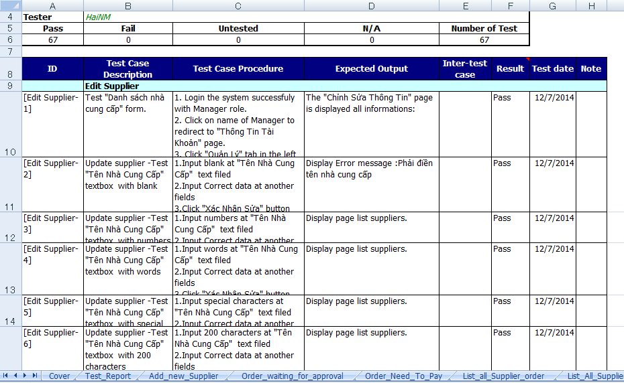
Test Case

Slide 42
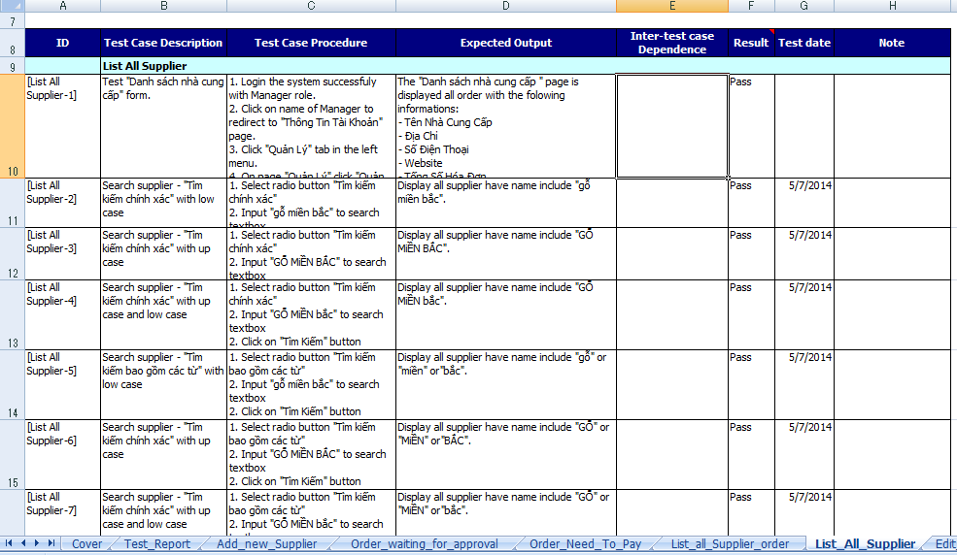
Test Case

Slide 43
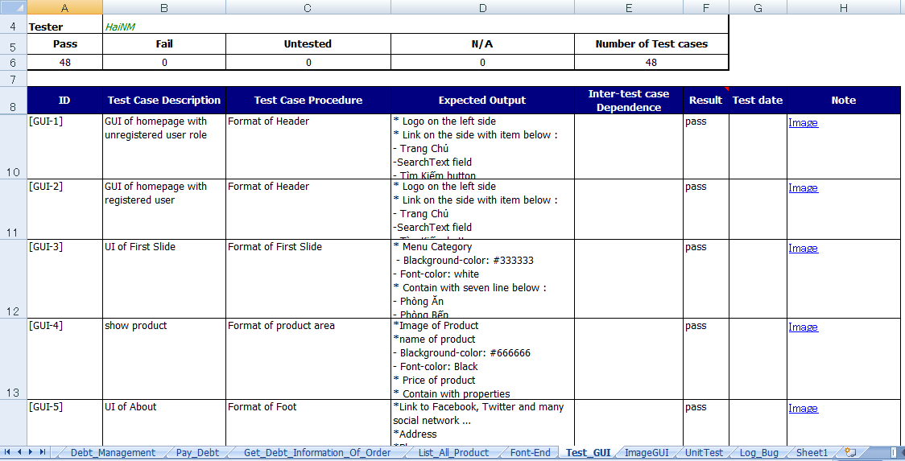
Test Case

Slide 44
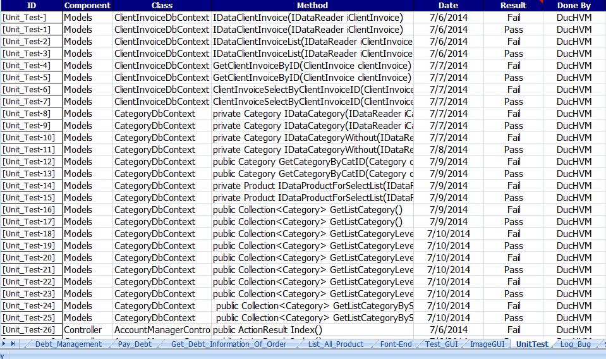
Test Case

Slide 45
Test Report

Slide 46
6. Lesson Learned
Working In Group
Management Skills
Technologies
Communication
Resolve Conflicts
Organize
Planning
Work with MVC4, html5
Store Procedure

