Slide 1
Smart Home
Capstone project introduction
Capstone project _Star team. Dec-12

Slide 2
Contents
Introduction
Project management
Requirement specification
Design description
Implementation
test
demo
Q&A

Slide 3
I - Introduction
Team member
Background, Ideal
Our proposal

Slide 4
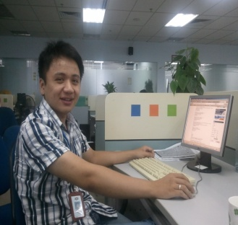
I - Introduction
Star team:
SonNH - PM
QuyenPN – DEV
(IS/ES)
PhuND – DEV
(IS)
DucNA – DEV
(ES)
MinhDA – Doc/DEV
(IS)

Slide 5
I – Introduction (cont)
Back ground:
Remote Control
Safe
More Use full
Time
Home

Slide 6
I – Introduction (cont)
Resolving:
Can monitoring every where, every time
Remote Control
Warning Gas

Slide 7
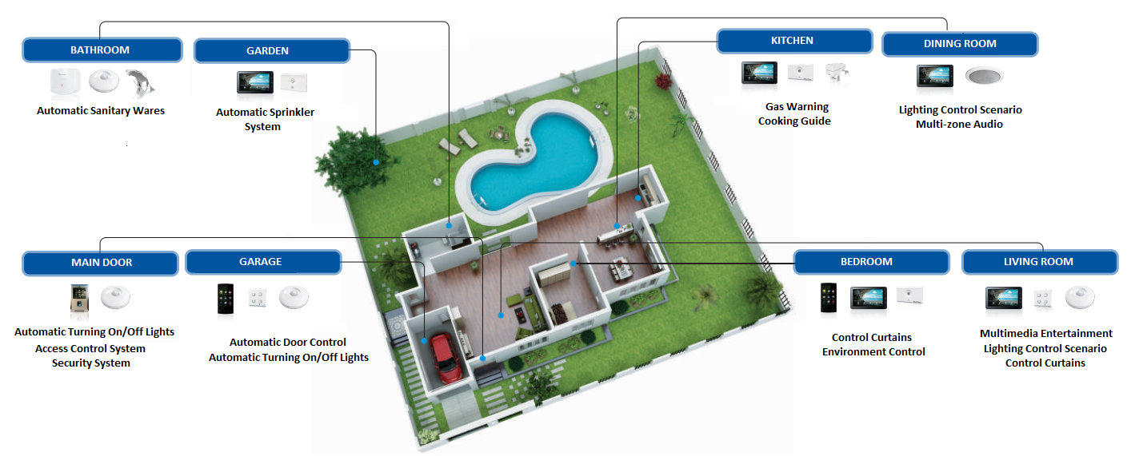
I – Introduction (cont)
Smart home System of BKAV

Slide 8
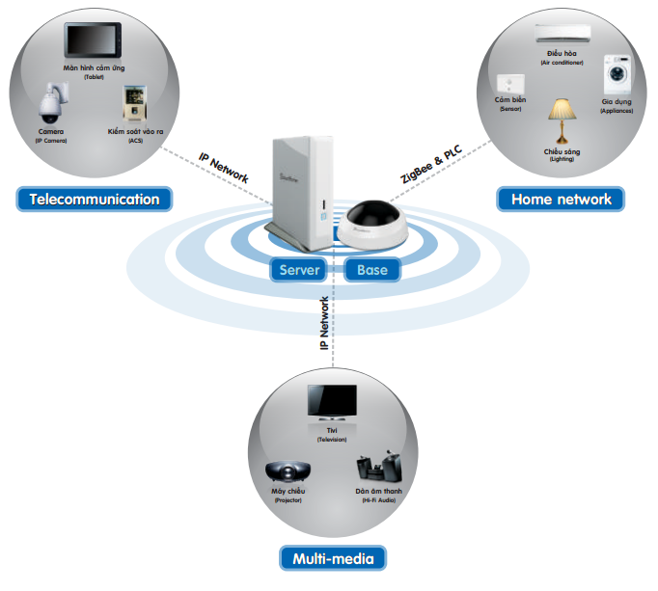
I – Introduction (cont)
Expensive
Long time to develop
ZigBee

Slide 9
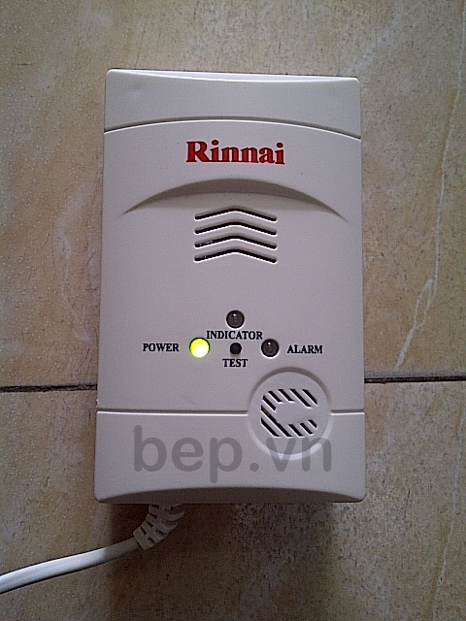
I – Introduction (cont)
Not too complex
Simple alert function
Warning GAS

Slide 10
I – Introduction (cont)
Our proposal:
Controlling
On/Off
PID
Warning
Gas
Theft

Slide 11
II – Project management
Development Environment
Development Process
Project Organization
Planning & Management

Slide 12
II – Project management
Development Hardware
4 Gb of RAM
100Gb of hard disk
Core 2 Duo 2.0 Ghz
3 Gb of RAM
100Gb of hard disk
Core 2 Duo 2.0 Ghz

Slide 13
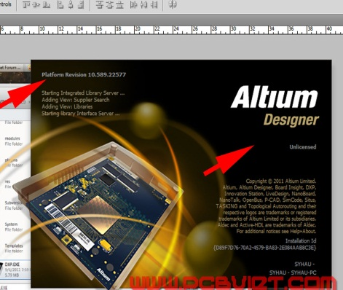
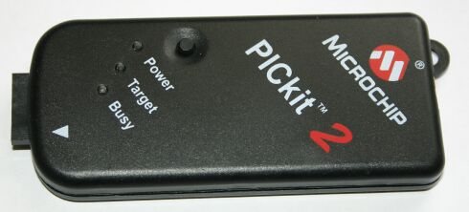
II – Project management
Development Software

Slide 14
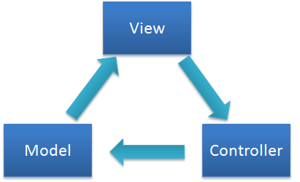
II – Project management
Development Technology

Slide 15
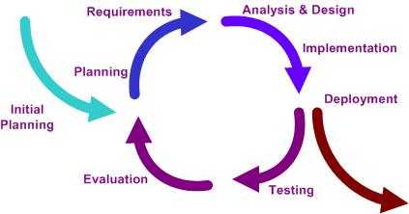
II – Project management (cont)
Process

Slide 16
II – Project management (cont)
Project organization
SonNH
(PM)
QuyenPN
(Service)
QuyenPN (Dev)
SonNH
(Dev/CM)
DucNA
(Embedded)
SonNH
(Dev/CM)
DucNA
(Dev)
PhuND
(Website)
PhuND
(Dev/CM)
MinhDA
(DEV)
MinhDA
(Doc, Test)
MinhDA
(Doc/Test)
SonNH
(CM)

Slide 17
II – Project management (cont)
All Meeting Minutes:
3h/3day/1week
1Teambuilding/month
Team rules:
Late 5 minutes penalty 50.000 VNĐ.
Late Deadline penalty 50.000 VNĐ.
If you estimate wrong deadline must notify reasons before 24h.
Repeat with one error in one month, the penalty doubles.
Communication:
Yahoo, Mail, Phone

Slide 18
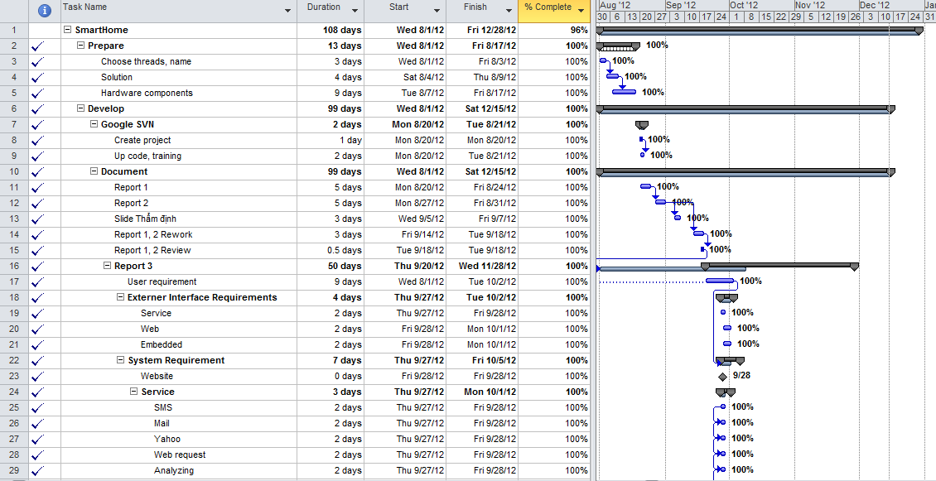
II – Project management (cont)
Plan
Capstone project _Star team. Sep-12

Slide 19
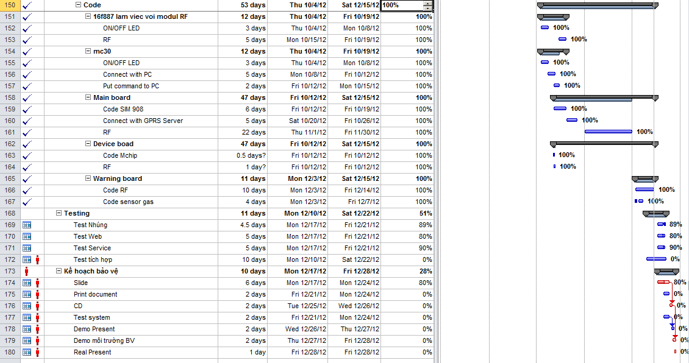
II – Project management (cont)
Plan
(cont)
Capstone project _Star team. Sep-12

Slide 20
III - Requirement
Function Requirements
Non-functional Requirements
Capstone project _Star team. Sep-12

Slide 21
III - Requirement
System Functional Requirements:
Remote control device: On / Off via SMS, Yahoo messenger, Web, Mail
Warning Gas: Send messenger to customer’ s phone when have gas leak

Slide 22
III - Requirement (cont)
Service requirements:
Receive SMS
Receive Yahoo Messenger
Receive Mail
Receive Web Request
Process request
Return result to
Save information of requests to database

Slide 23
III - Requirement (cont)
Web site requirements:
- User / Log in/ Log out / admin
- Can view history
- Remote control device/ Remote Control with schedule

Slide 24
III - Requirement (cont)
Non-functional requirement
Field name | Control Type | Maximum | Minimum
Requests per second | Number | 50 | ~
Delay timing for Yahoo, SMS, Website | Second | 10 | ~
Delay timing for Mail | Second | 20 | ~

Slide 25
III - Requirement (cont)
Inexpensive
Compact
Safe, stable
Easy to use

Slide 26
IV – Design Description
Architectural design
Database design
Problem overview

Slide 27
IV – Design Description
Problem overview:
Service:
Yahoo API, SMS (USB3G), Mail API
Connect with SIM908
Web application
MVC
Database
Embedded
SIM908
RF

Slide 28
IV – Design Description (cont)
Architecture:
Many Tier
MVC
Client - Server

Slide 29
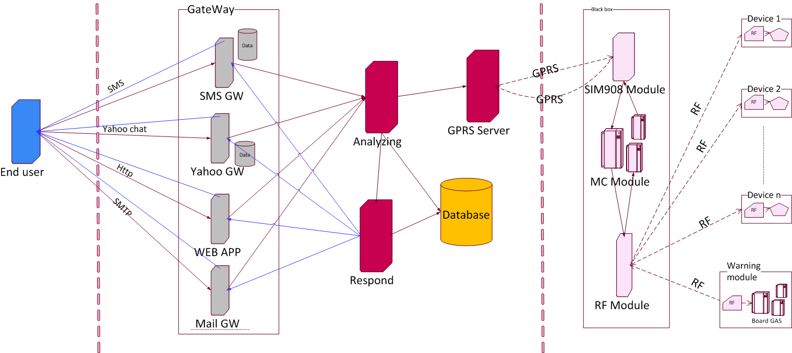
IV – Design Description (cont)

Slide 30
V – Implementation (Web)
Service
Embedded
Web

Slide 31
V – Implementation (Web)

Slide 32
V – Implementation (Web)
Using ASP.NET Webforms and ASP.NET MVC side by side
Administrator - Webform:
Manage User accounts, devices, services packages provider.
Working with database
Each webform have certain function, not change when deployed.
User - MVC:
Control device
Edit account information
Attach more user reicive system notification

Slide 33
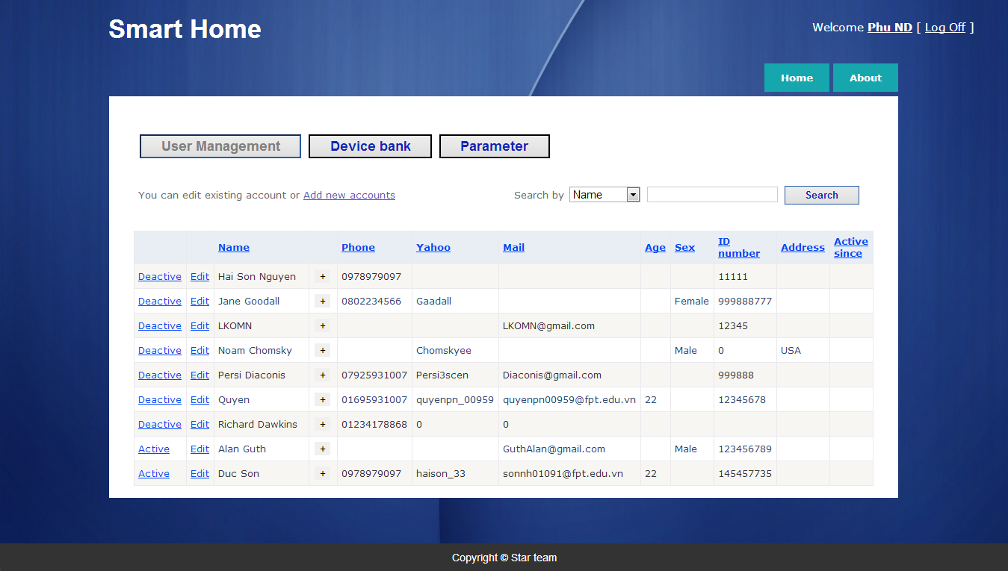
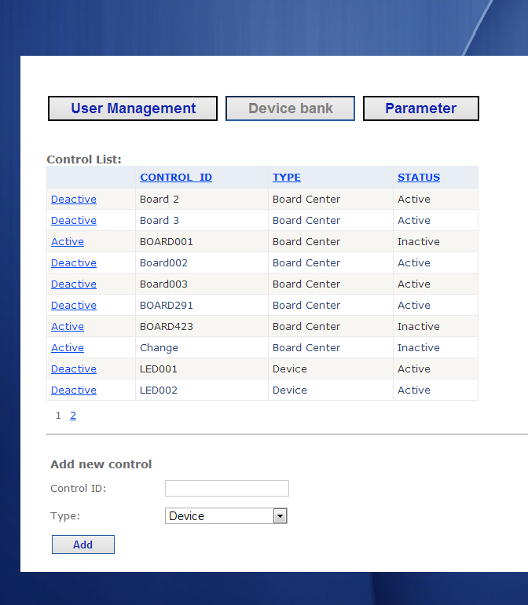
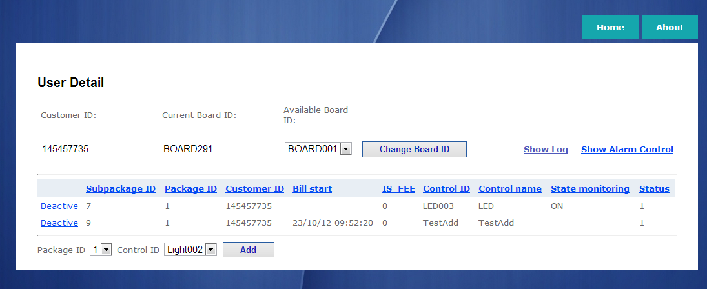
V – Implementation (Web)
Administrator
Capstone project _Star team. Sep-12

Slide 34
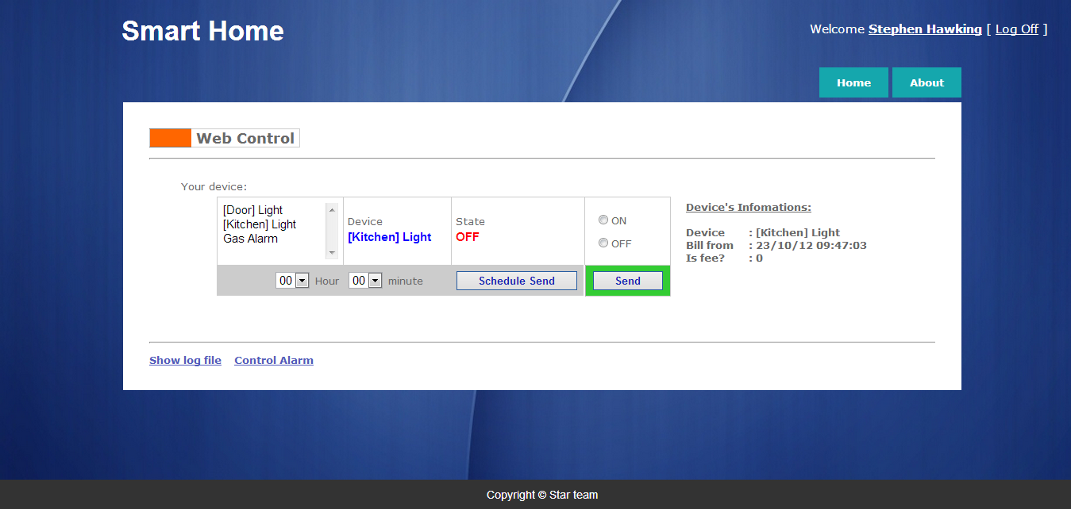
V – Implementation (Web)
User
Capstone project _Star team. Sep-12

Slide 35
V – Implementation (Web)
Preprocessing
Log On
Controller
Querry User’s Devices
Database
Web Control
Update View
User’s device and control
Submit request
Controller
Command Create
Capstone project _Star team. Sep-12

Slide 36
V – Implementation (Service)
Processing
SMS
Yahoo
Analysis Data
GPRS Server
Mail
Web
Database
Response to Customer

Slide 37
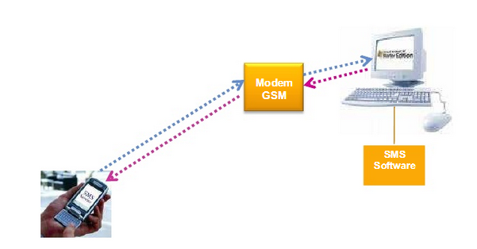
V – Implementation (Service)
SMS
AT Commands to control GSM modem (USB 3G)
Connect Model GMS with Computer via COM port

Slide 38
V – Implementation (Service)
YAHOO
Use Yahoo API
YMSG (Yahoo! Messenger Protocol)

Slide 39
V – Implementation (Service)
MAIL
POP3 (Post Office Protocol)
SMTP (Simple Mail Transfer Protocol)

Slide 40
V – Implementation (Service)
Analysis Data
Receive Request from Client
Send commands correct to GRPS Server
Send Response commands incorrect to Client

Slide 41
V – Implementation (Service)
Response To Customer
Send SMS
Send Mail
Send Yahoo Message

Slide 42
V – Implementation (Service)
GPRS Server
Send command to Board
Receive result to response to Client

Slide 43
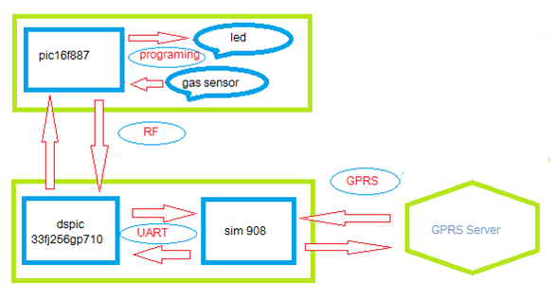
V – Implementation (ES)
Processing

Slide 44
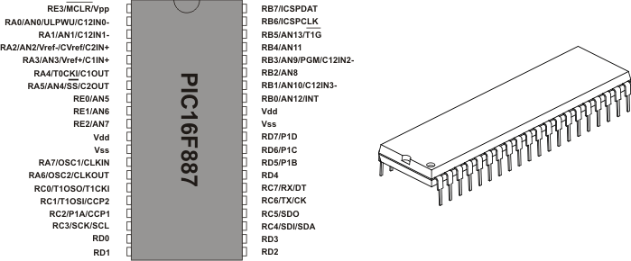
V – Implementation (ES)
Pic16F887

Slide 45
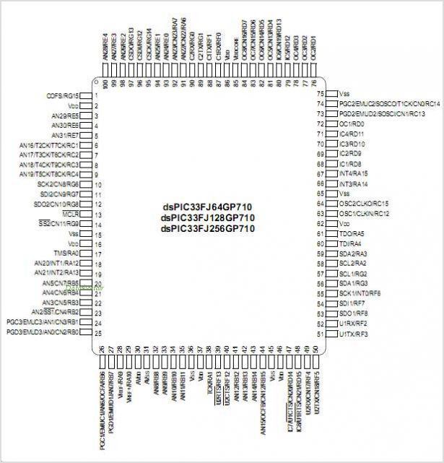
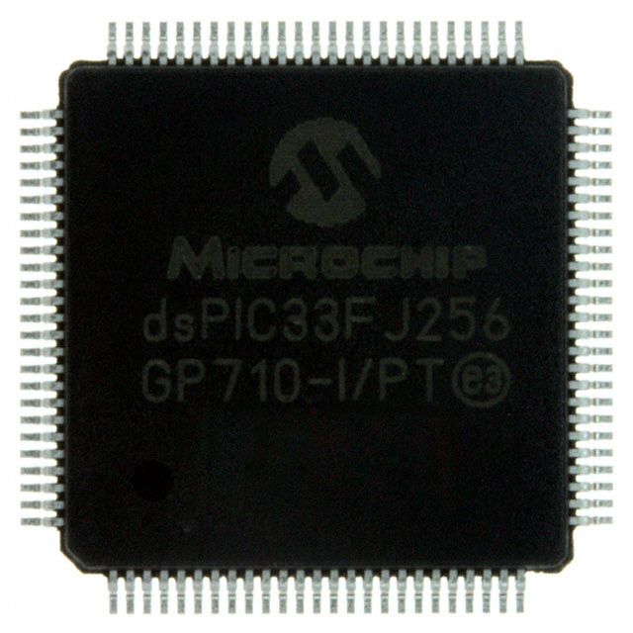
V – Implementation (ES)
Dspic33fj256gp710

Slide 46
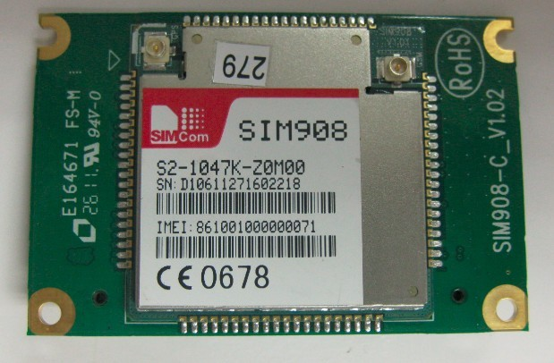
V – Implementation (ES)
Module sim908
Capstone project _Star team. Sep-12

Slide 47
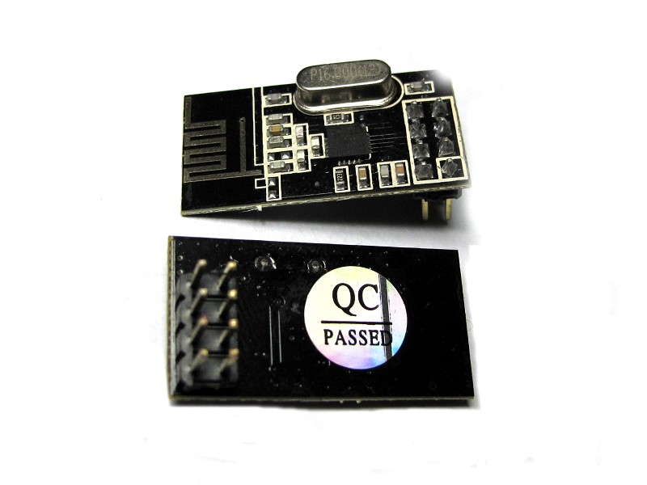
V – Implementation (ES)
Module nRF24L01: Radio frequency (RF)
2.4GHz Antenna
100m Range at 250kbps
250kbps to 2Mbit Data Rate
Auto Acknowledge
Auto Re-Transmit

Slide 48
V – Implementation (ES)
Gas sensor:

Slide 49
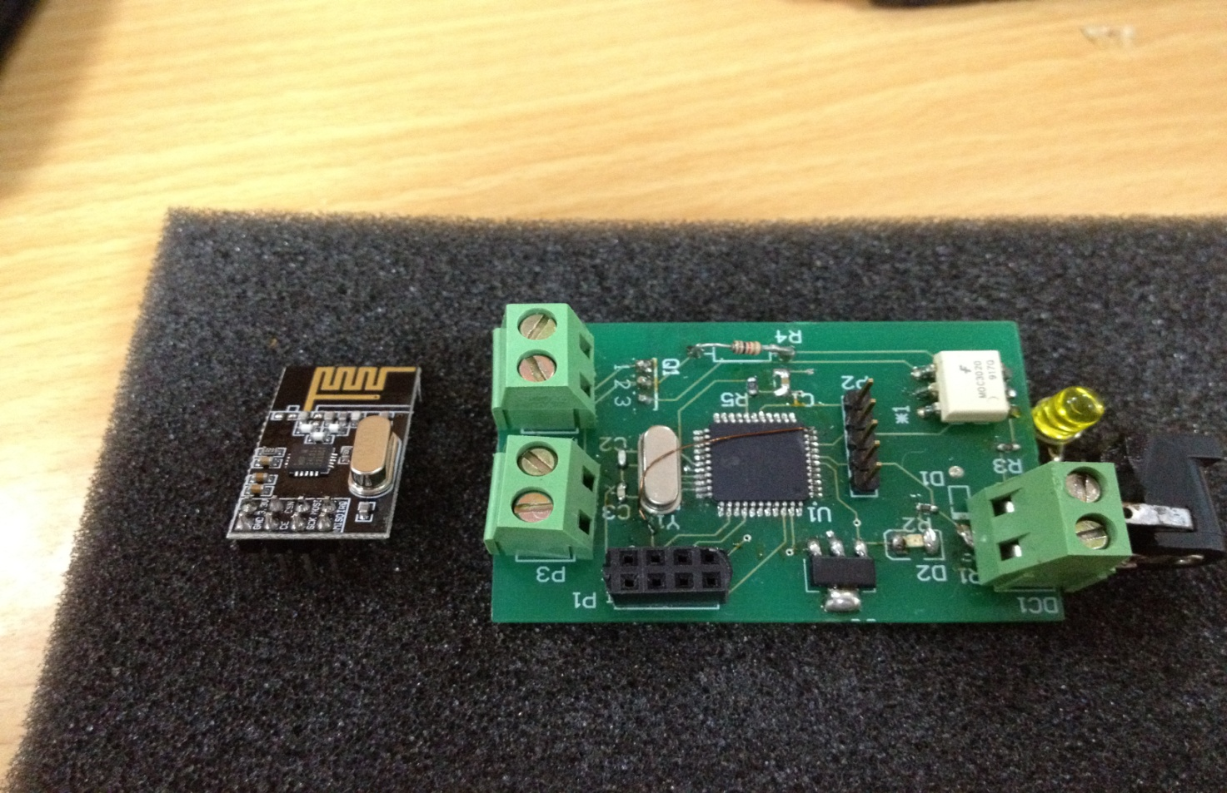
V – Implementation (ES)
Board Device:

Slide 50
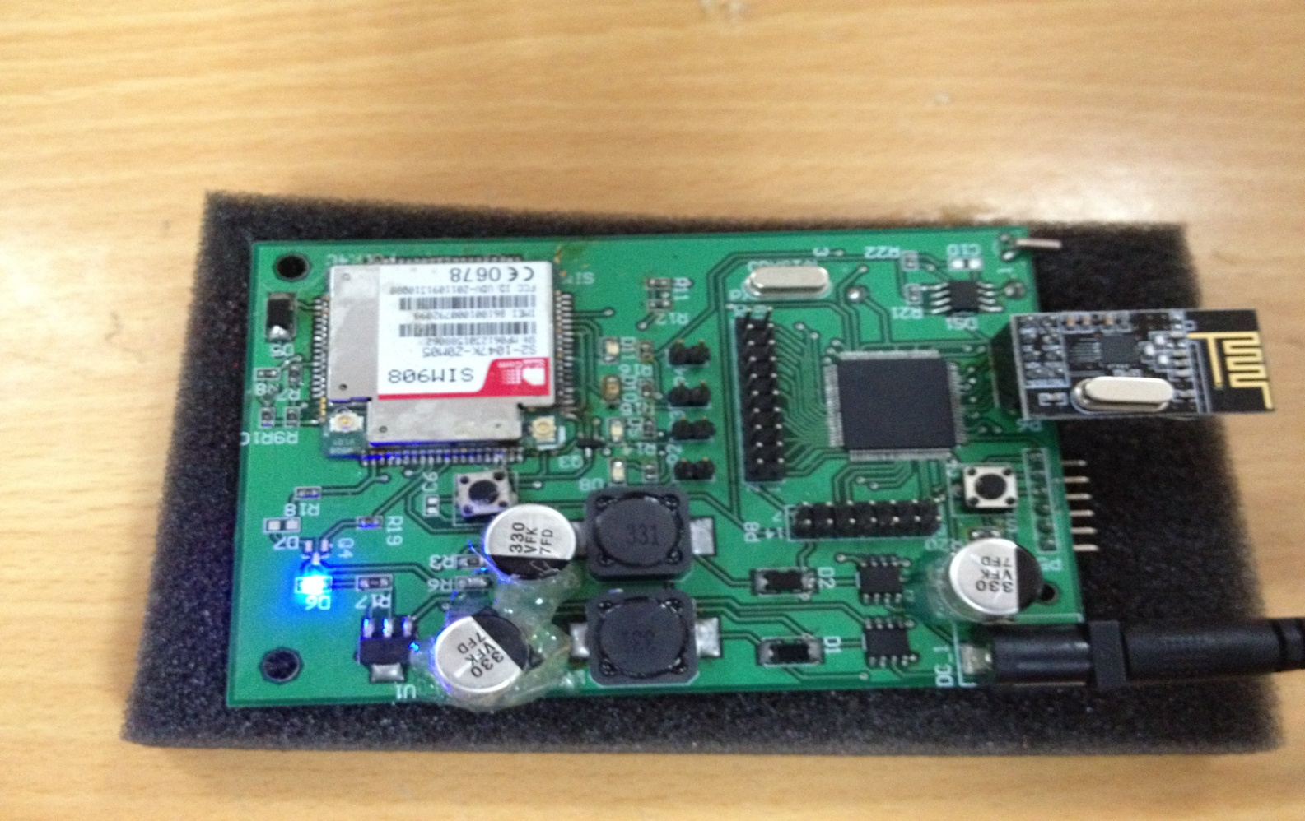
V – Implementation (ES)
Board Center:

Slide 51
VI – Test
Test case
Check list
Features to be tested

Slide 52
VI – Test
Test Model
Requirement Analysis
Acceptance Testing
Specifications
System Test
Detail Design
Integration Test
Code & Unit Test
V Lifecycle Model

Slide 53
VI – Test (cont)
Features to be tested of Service Application

Slide 54
VI – Test (cont)
Features to be tested of Website Control

Slide 55
VI – Test (cont)
Features to be tested of Hardware

Slide 56
VI – Test (cont)
Results

Slide 57
VII – Demo & QA
Server in Home (Web and service)
Remote desktop Server
Demo Remote control in Detech
Demo Gas warning in Detech

