Slide 1
SFC
School for children
Capstone Project

Slide 2
Contents
Introduction
Software Project Management
Software Requirement
Software Design Description
Implementation
Testing
Summary & Lesson Learned
Demo – Q&A

Slide 3
Introduction
The People
Background
Literature Review
Our Proposal
Products

Slide 4
The People
Instructor : Trần Bình Dương
Member:
  Nguyễn Trọng Thanh Tùng
  Nguyễn Thị Lệ Thu
  Trần Thị Hồng Nhung
  Doãn trường Ninh
  Đặng Xuân Linh

Slide 5
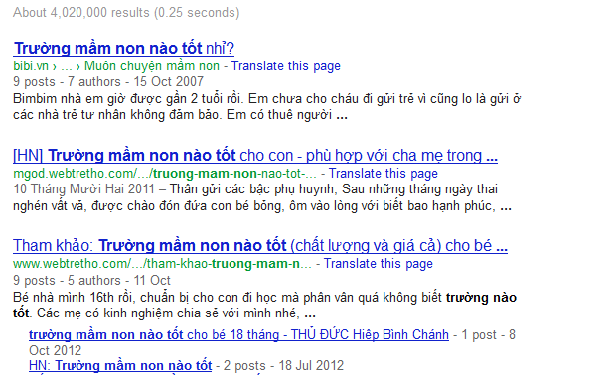


Background
Kindergartens
Finding the kindergartens?
Developing a website
provide information about
kindergartens

Slide 6



Literature Review
Dihoc.vn
Mamnon.com
Bedihoc.com

Slide 7
Literature Review
Dihoc.vn
Provide information about kindergartens but not fully
Searching function is not good
Search results are not correct and not make users satisfy

Slide 8
Literature Review
Mamnon.com
Just focus on news and articles about pre-school education and caring for children
Information about kindergartens are sketchy
Not has searching function to find schools

Slide 9
Literature Review
Bedihoc.org
The most completed information of school from pre-primary to secondary schools
Provide school searching function
Search functions are not complete
Not support for choosing schools easily

Slide 10

Our proposal and product
Tìm trường cho bé
  Kindergarten information in Hanoi
  Provide ranking of each school
  Provide 3 search functions and school suggestion
  Provide compare school function
  Provide article about children and education

Slide 11
Software Project Management
Development Environment
Process
Project Organization
Project Planning

Slide 12
Development Environment
Hardware
Developer
Server
Core 2 Duo 2.0Ghz
2 GB RAM
4 GB of HDD
Core 2 Duo 2.0Ghz
4 GB RAM
5 GB of HDD

Slide 13





Development Environment
Software:
Operation System
Tools

Slide 14
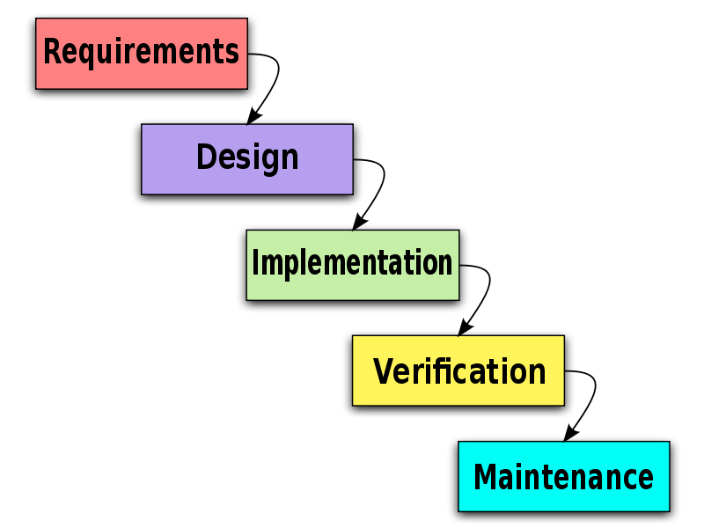
Process

Slide 15
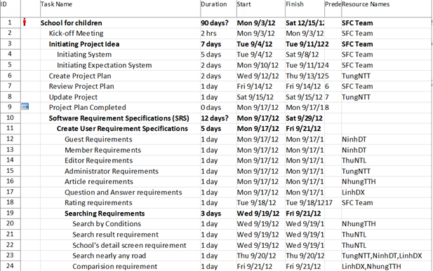
Project Plan

Slide 16


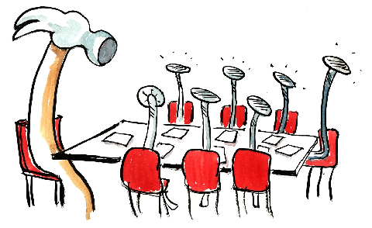
Teamwork
Work at same place 8 hrs./day, 5 days/ week
Communicate by phone, Facebook on Saturday and Sunday
Meeting: once per week

Slide 17
Project Organization
Nguyễn Trọng
Thanh Tùng
PM
Nguyễn Trọng
Thanh Tùng
Tech Lead
Trần Thị Hồng Nhung
BA/Test Lead
Nguyễn Thị Lệ Thu
BA/QA
Doãn Trường Ninh
CM
Đặng Xuân Linh
Designer
Doãn Trường Ninh
Coder
Nguyễn Thị Lệ Thu
Tester
Trần Thị
Hồng Nhung
Tester
Nguyễn Trọng
Thanh Tùng
Coder
Đặng Xuân Linh
Coder

Slide 18
Software Requirements
Functional Requirement
Non-function Requirement

Slide 19
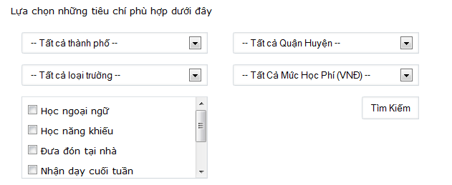

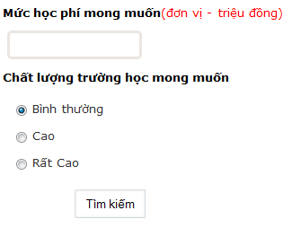
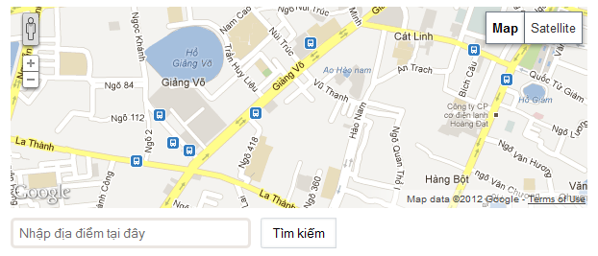
Functional Requirement
Guest
  Searching function
View detail , compare and report school
View public information

Slide 20
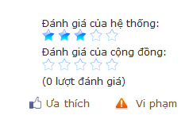
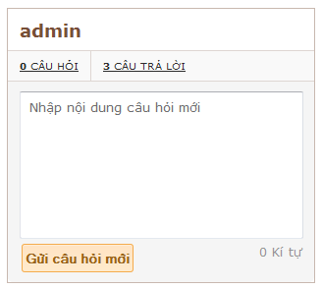
Functional Requirement
Member
  Add school to favorite list, comment school and rank school
  Question and Answer

Slide 21
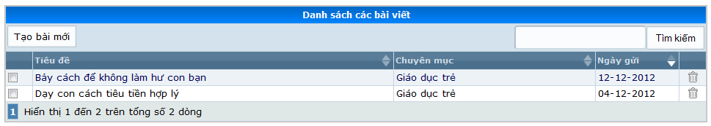
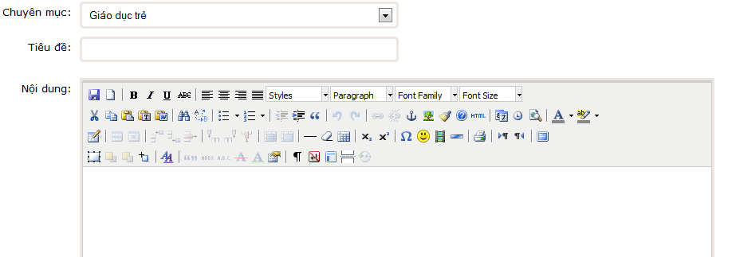
Functional Requirement
Editor
  Create, Update and Delete Article

Slide 22
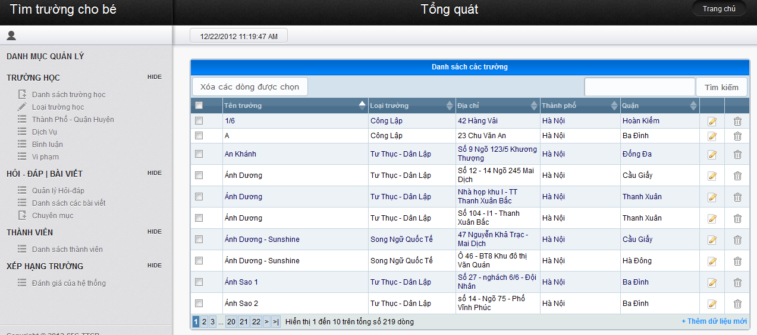
Functional Requirement
Administrator
  Manage system
  Manage information of school, article, category, member,
  References standard

Slide 23
Non-functional requirement
Maintainability:
  System can be maintained each part
Security
  System has 4 kind of users
  User’s password be encoded by MD5
Reliability
Interoperability
Performance
Availability

Slide 24
Software Design Description
Architecture design
Detailed Design
Database Design

Slide 25
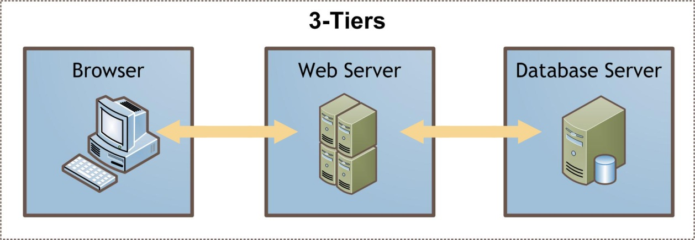
Architecture Design
System architecture design

Slide 26
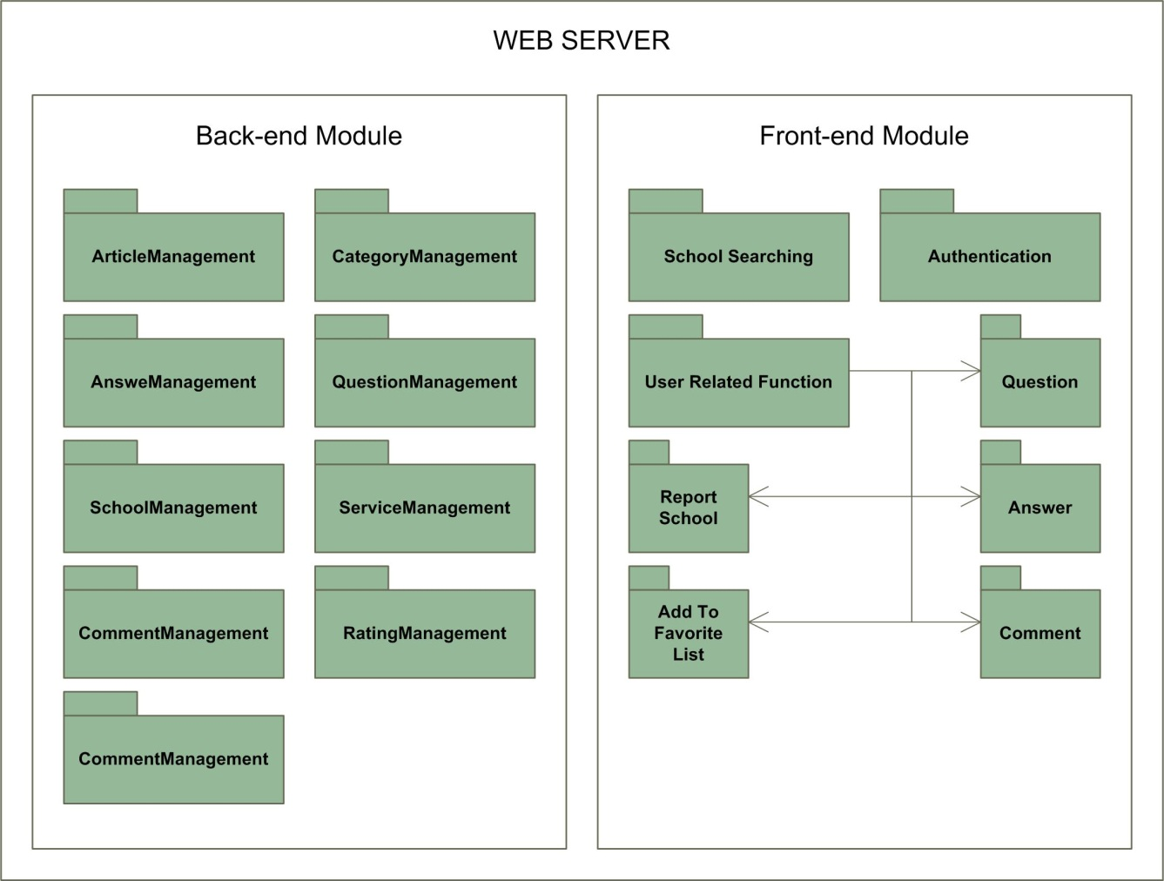
Architecture Design
Module decomposition view

Slide 27
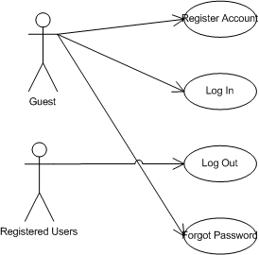
Detailed Design
USE CASE- Log In

Slide 28
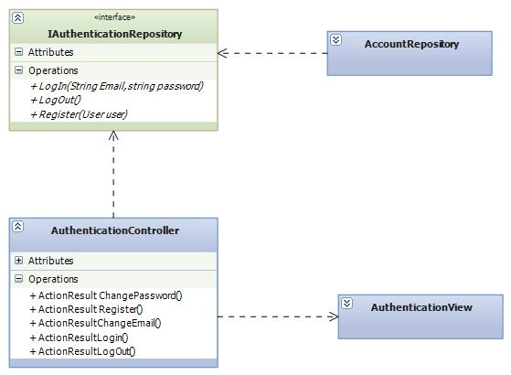
Detailed Design
Authentication Class Diagram

Slide 29
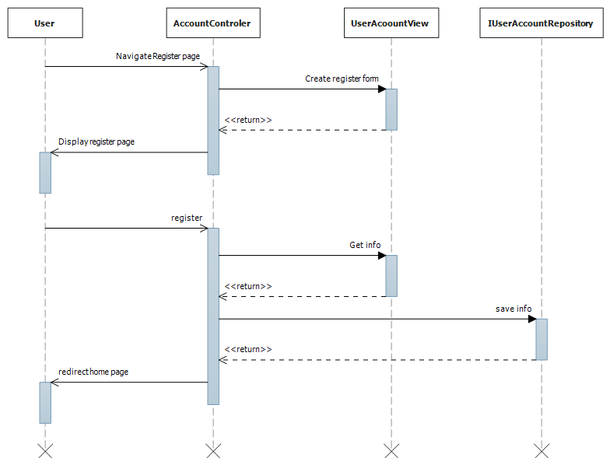
Detailed Design
Register Sequence Diagram

Slide 30
Database Design
Miêu tả Database Design

Slide 31
Implement
Technologies
Implementations
Coding convention

Slide 32




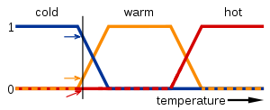
Technologies
ASP.NET
AJAX & JQUERY
ENTITY FRAMEWORK
Fuzzy Logic

Slide 33
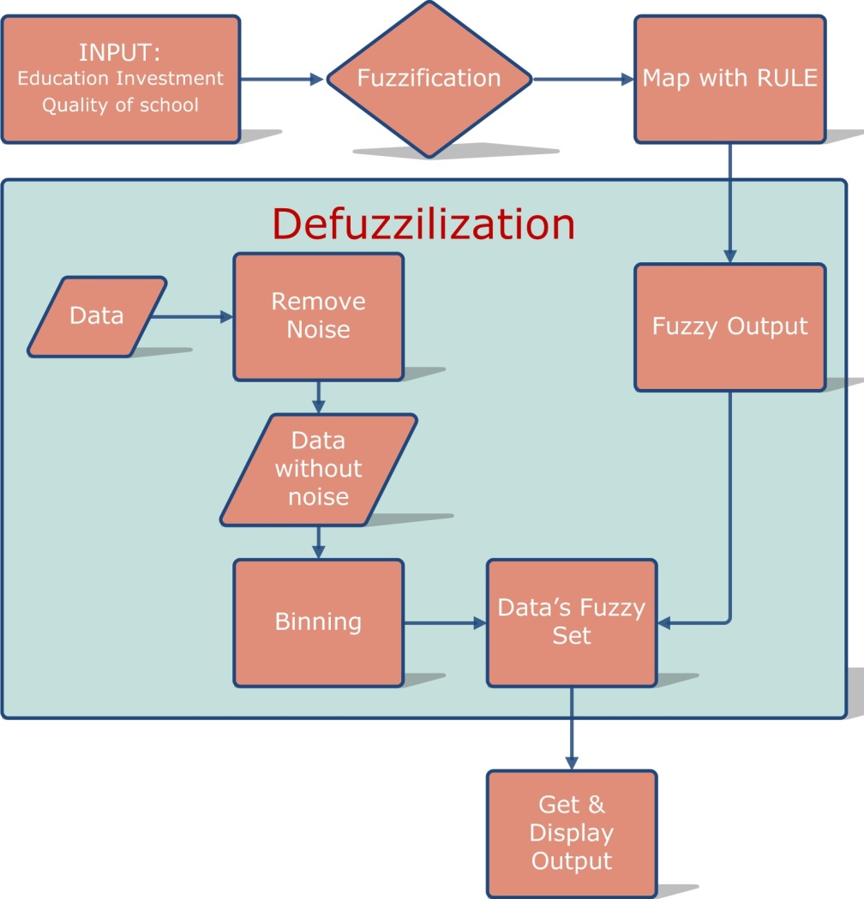
Fuzzy Logic in SFC
DBSCAN
Bin by means

Slide 34
Testing
Testing Strategy
Testing Process
Test Case Sample
Test Report

Slide 35
Test Strategy
Requirements
Acceptance test
System design
System test
Architecture design
Integration test
Module design
Unit test
Coding

Slide 36
Test Process
Test Plan
Test Case Writing
Test Case Review
Test Execution

Slide 37
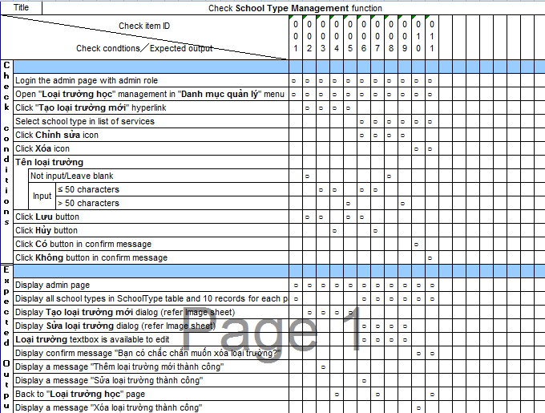
Test case

Slide 38
Test Report
Number of test cases: | 361
Number of passed cases: | 336
Number of failed cases: | 25
Fixed | 25
Number of untested cases: | 0

Slide 39
Summary & Lesson Learned
Summary
  Finish project on time
  Develop the website to perfect the website in the feature
Lesson learned
Improve member skill and knowledge when working in group.
Improve technical skill

Slide 40
DEMO – Q&A

