Slide 1

Project Management Simulation Game

Slide 2

Instructor: Mr. Bui Dinh Chien
Students:
To Viet Anh – 00854
Nguyen Dang Quang – 00944
Dao Duy Thanh – 00998
Le Gia Cuong - 01088
Nguyen Bao Ngoc - 00977

Slide 3
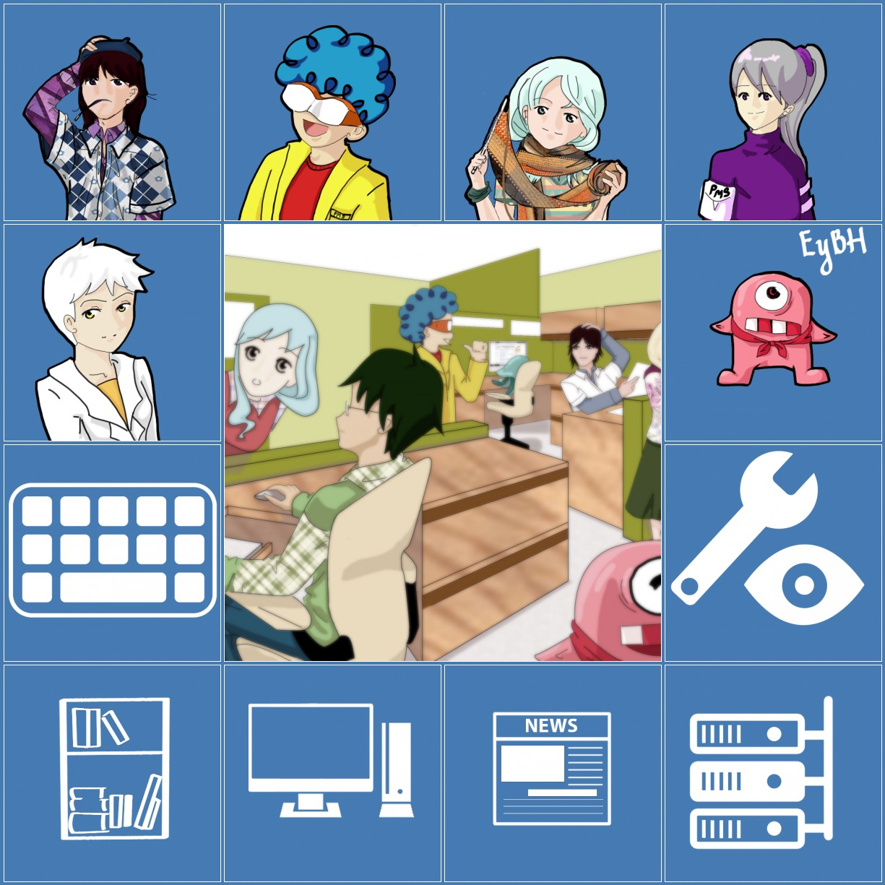
Content
Game Idea
Architecture Design
Database Design
Algorithm
Characters
Skills
Jobs System
Items
Product And Project
Mystery
Achievement
Demonstration

Slide 4
Game Idea
Project management simulation game is a game simulating the process of software company making product
Player can:
  Do project or create new product
  Hire/fire/train employees
  Buy services for company
  ...

Slide 5
Technologies
C#.NET
Asp.NET MVC 4
Entity Framework 5
HTLM, CSS, JavaScript(for both web version and Windows 8 version)
Photoshop, Illustrator

Slide 6
Architecture Design

Slide 7


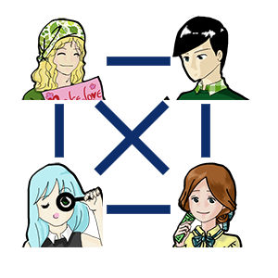
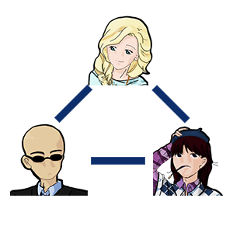
Algorithm – teamwork point
n = 2
n = 5
n = 4
n = 3

Slide 8
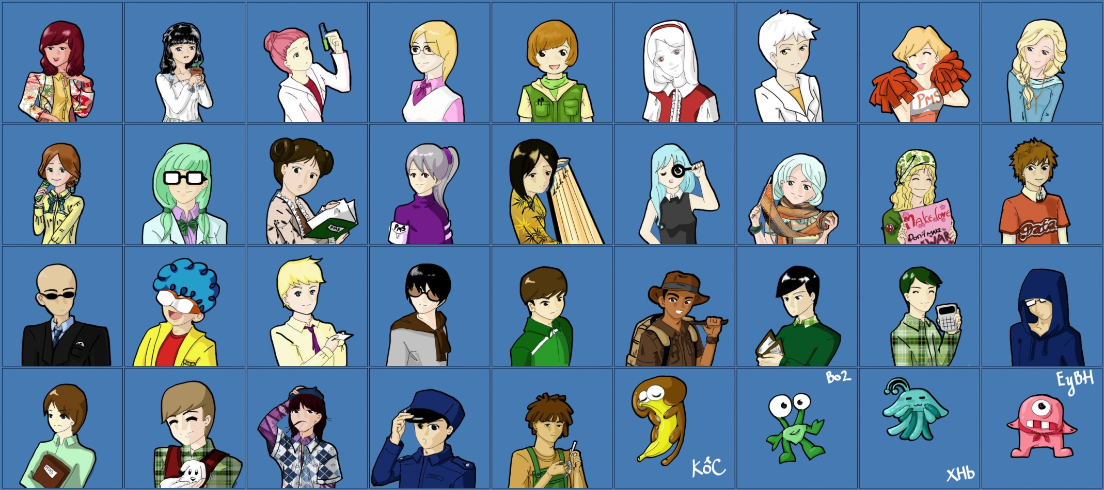
Characters

Slide 9
Skills
50 skills
Java core, php, c++, c#, python, javascript,…
Unit test, Integration test, Stress test,…
Photoshop, auto cad, hci…
…

Slide 10

Jobs system

Slide 11

Items

Slide 12
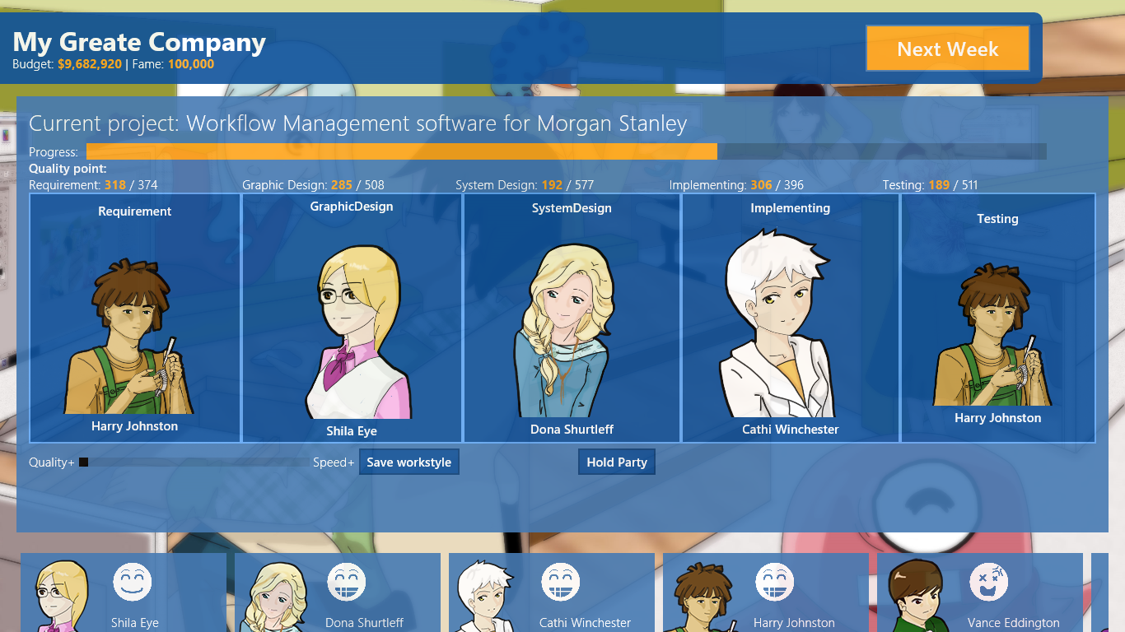
Product and Project

Slide 13
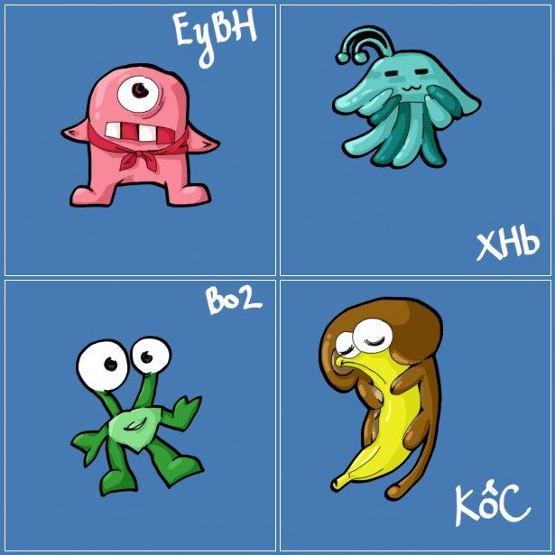

Mystery
Prizes and special employees(aliens)

Slide 14
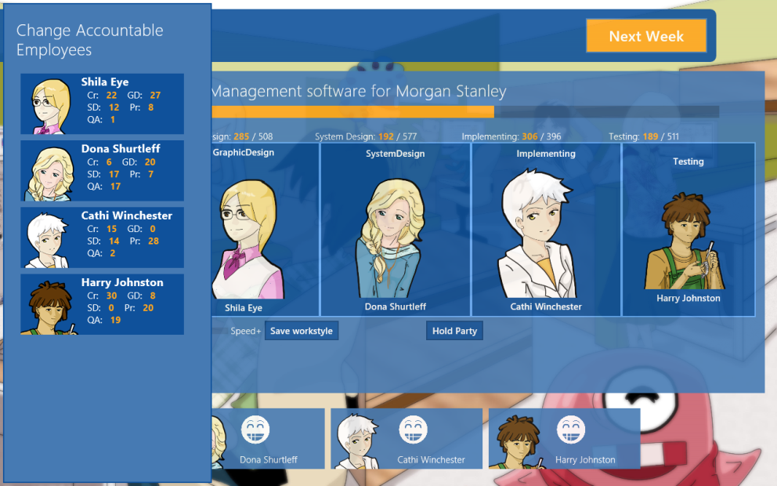
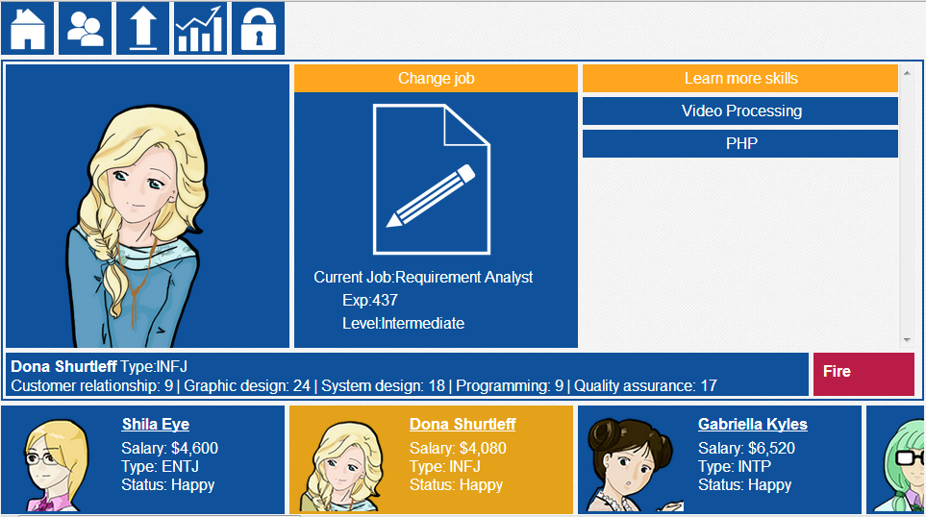
Achievement
After 4 months, we have created two versions of PMS game
  Web version
  Windows 8 version

Slide 15
Problems
Requirement changes
Difficult to create a simple but academic software

Slide 16
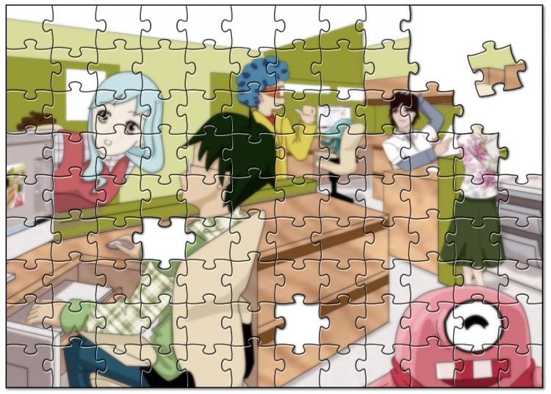
Demonstration

Slide 17
Question and Answer

