Slide 1
THE BOOKS SHARING WEBSITE

Slide 2
AGENDA

Slide 3
AGENDA

Slide 4
AGENDA

Slide 5
AGENDA

Slide 6
AGENDA

Slide 7
AGENDA

Slide 8
AGENDA

Slide 9
AGENDA

Slide 10
The TEAM

Slide 11
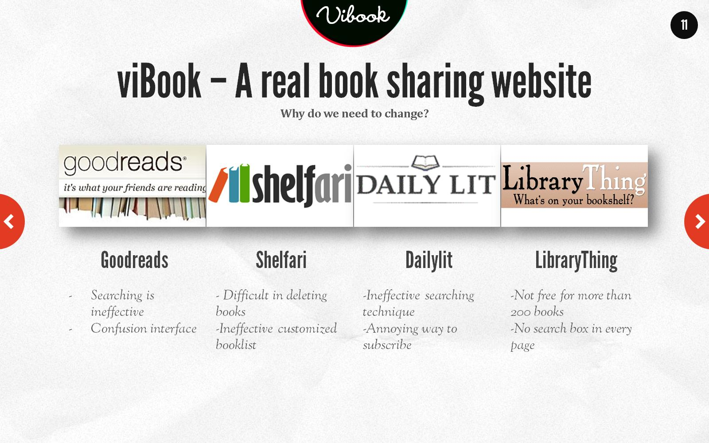
viBook – A real book sharing website

Slide 12
Why viBook is change to this era?

Slide 13
Why viBook is change to this era?

Slide 14
Why viBook is change to this era?

Slide 15
Why viBook is change to this era?

Slide 16
Project management

Slide 17
Project management

Slide 18
Software Process model

Slide 19
Software Process model

Slide 20
Underlying tool and process

Slide 21
Process

Slide 22
Framework

Slide 23
Design pattern – Server side

Slide 24
Design pattern – Client side

Slide 25
Coding supporting Tool

Slide 26
Profiling and Monitoring Tool

Slide 27
Coding conversion and rules

Slide 28
Unit test

Slide 29
Security and Performance

Slide 30
Testing

Slide 31
Demo

Slide 32
THANKS FOR COMING

