Slide 1
IBG3d.Pro Froject
Final Report

Slide 2
Member

Slide 3
Contents
1
Idea and Overview
2
Scope
3
Hardware and software
4
Algorithm
5
Experiments & Results
6
Conclusion

Slide 4
The purpose
Idea and Overview
Develop a visual entertainment where they can interactive with computer in a boxing game using portable device.
Bring to user some action :
Punch
Block
Dodge

Slide 5
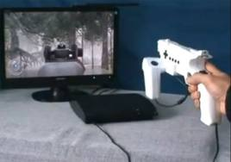
Some example Interactive games 3d
Idea and Overview
Idea
1.Light Gun
A light gun is a pointing device for computers and a control device for arcade and video games.
The video game light gun is typically modeled on a ballistic weapon (usually a pistol) and is used for targeting objects on a video screen.
It uses light as its method of detecting where on screen the user is targeting

Slide 6
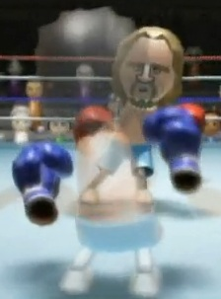
Idea and Overview
Idea
Some example Interactive games 3d
2. Wii Sports – Boxing
This game is the only game on Wii Sports to use the nunchuk attachment.
You can punch, block, and dodge in the game by moving Wiimote
To control your player you basically need to imagine that the 2 controllers are your players fists.

Slide 7
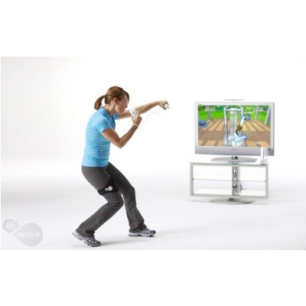
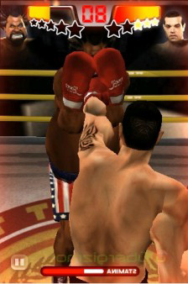
IBG3d.Pro Overview
Idea and Overview

Slide 8
System overview
Scope
PC
Game
Camera
(Option)
Bluetooth sensor
Transmit sensor
data via bluetooth
Microcontroller
Power
(Battery)
Gyro IMU
Accelerometer
Bluetooth
Portable device

Slide 9
System detail
Scope
Portable device: Send Sensor’s output to computer at a real-time rate.
Microcontroller : control accelerometer, gyro IMU, bluetooth sensor
Acelerometer : Calculate acelerometer rate
Gyro IMU : Calculate angle rate
Bluetooth sensor : Connect and send Sensor data to computer
Power (Pin) : Provide power to Portable device

Slide 10
System detail
Scope
Computer: Receive Sensor’s statues from portable device to make action in game.
Game: A boxing game 3d which user can play with AI
Camera (option) : detech the movement, calculate the moving distance to make action in game
Bluetooth : Make a communication with portable device

Slide 11
System detail
Scope
Main action in game
Punch : It happen when the accelerate increase with the calculated angle received by gyro IMU.
Block : It happen when the accelerate decrease and stop.
Dodge :It happen when the accelerate increase but with design angle.

Slide 12
System detail
Scope
Communication system
Communicate portable device via Bluetooth:
Portable device sends Sensor data (angle rate, acceleration rate…) to computer.
Communicate via Camera:
PC get action from camera to detect the movement of the portable device.

Slide 13
Hard & Soft
No. | Components | Quantity | Description
1 | dsPIC30f4012 | 1 | Microcontroller
2 | HC-06 | 1 | Bluetooth module
3 | ADXL345 | 1 | Accelerometer
4 | ITG3205 | 1 | Gyroscope
5 | Lipo Pack 7.4v | 1 | Battery

Slide 14
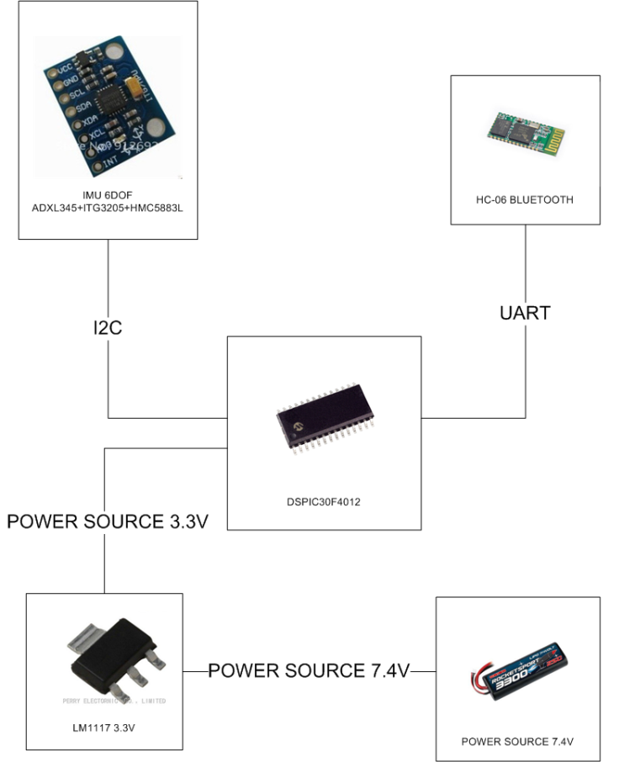
Hard & Soft
Hardware context design

Slide 15
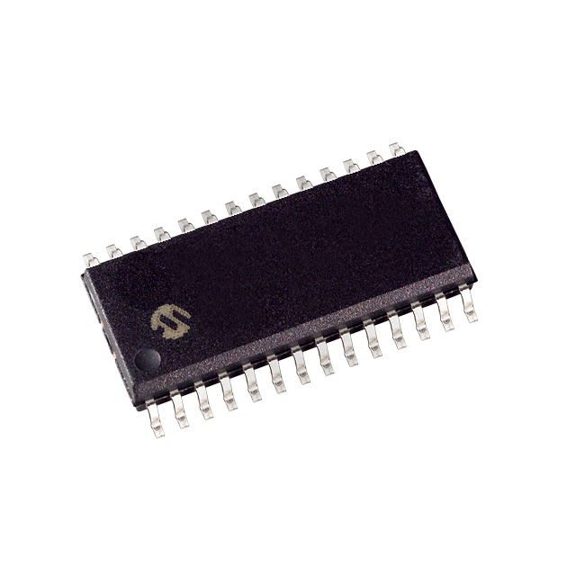
Hardware study
Hard & Soft
dsPIC30f4012 Microcontroller
Max speed: 30 MIPS
16x16 bit working arrays
5 timers
Programmable by C30.

Slide 16
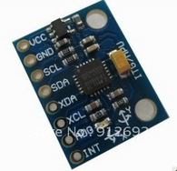
Hardware study
Hard & Soft
HMC5883N + ADX345 + ITG3205
All-in-one module:
3-axis accelerometer.
3-axis gyroscope.
-300m to 9000m altimeter.

Slide 17
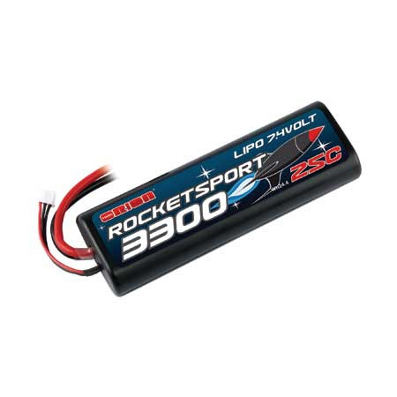
Hardware study
Hard & Soft
Orion Rocket Sport Lipo Battery
7.4v 3300mAh LiPo
25C nominal discharge
Stick pack shaped hard plastic case
Factory fitted Traxxas TRX power plug
JST-XH balance connector

Slide 18
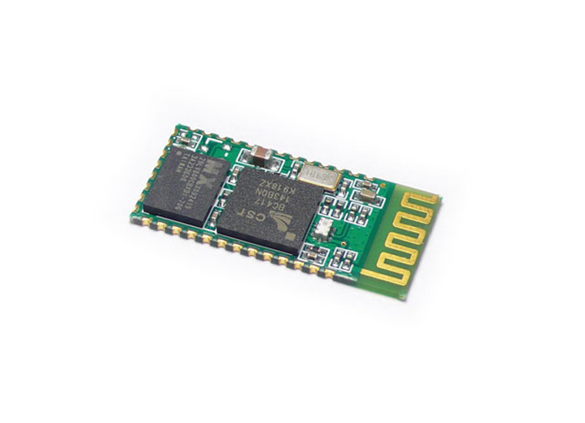
Hardware study
Hard & Soft
HC-06 Bluetooth Module
Slave Bluetooth to serial adapter
Measures only 28mm x 15 mm x 2.35mm
Possible baud rates: 1200, 2400, 4800, 9600, 19200, 38400, 57600, 115200

Slide 19
Hardware design
Hard & Soft

Slide 20
Hardware design
Hard & Soft

Slide 21
Hardware design
Hard & Soft

Slide 22
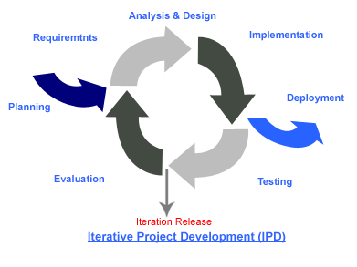
Software study
Hard & Soft
Iterative model:

Slide 23
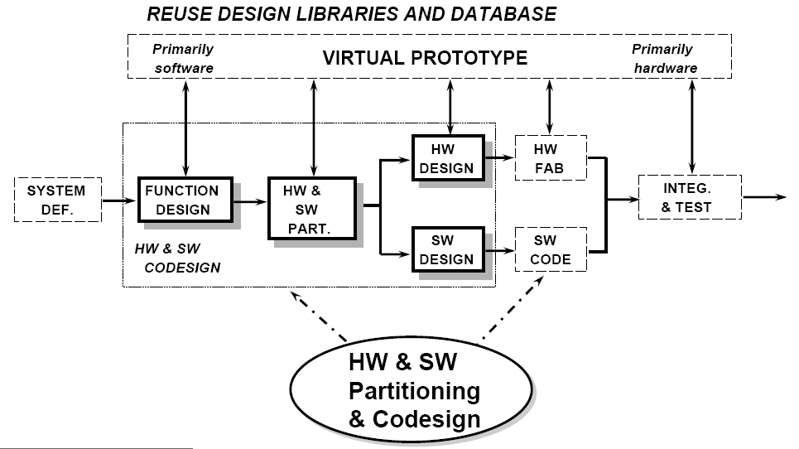
Software study
Hard & Soft
Embedded system development:

Slide 24
Software study
Hard & Soft
Two main software
Software on PC : 3 Application
Test application 1: Test communicate with Portable device via Bluetooth, received and show data, draw chart
Test application 2: Test communicate with other Computer via Bluetooth, send virtual distance and angle data
3d Boxing game
Firmware : Control action inside Portable Device

Slide 25
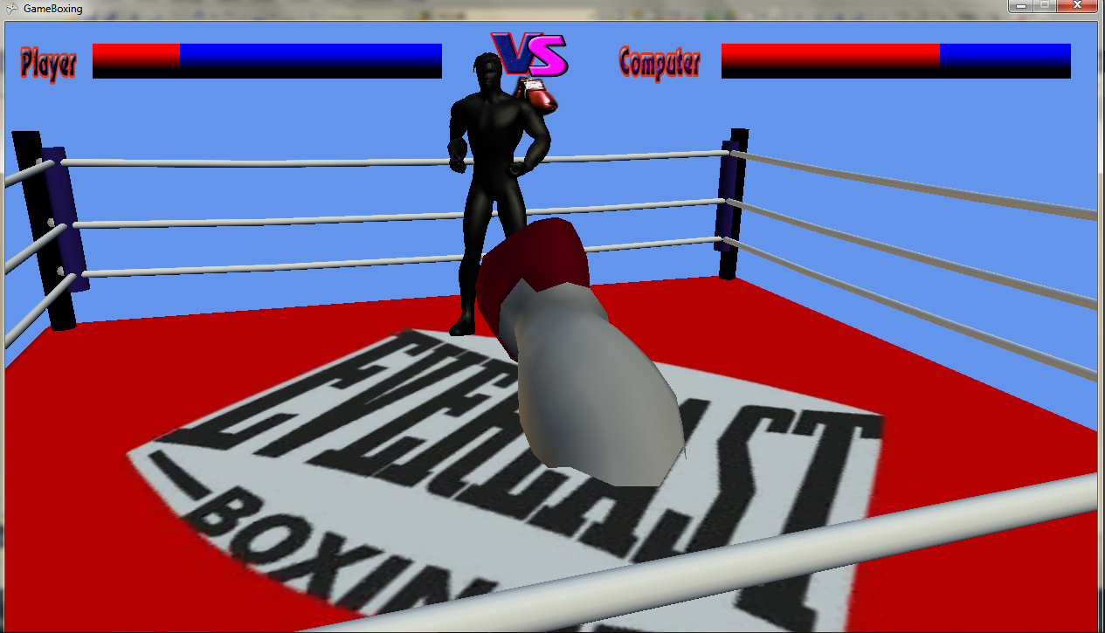
Software study
Hard & Soft
<Image>

Slide 26
Software study
Hard & Soft
FSM:
Power on
System initiated
WaitingForConnection
Start
Any Error
System connected
with AOC
Error
Any Error
SendSensorData
System are stopped

Slide 27
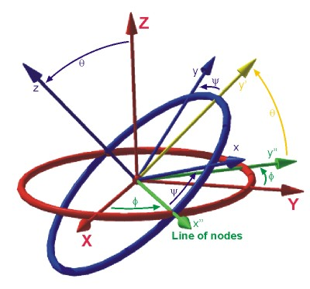
Portable Device Dynamic
Algorithms
Euler Angle:

Slide 28
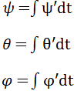
Signal Processing
Algorithms
Euler angles calculation:
Gyroscope: Integration of angular velocity over time.
Accelerometer: Multiplication with a (x,y,z) Direction Cosine Transformation Matrix.

Slide 29
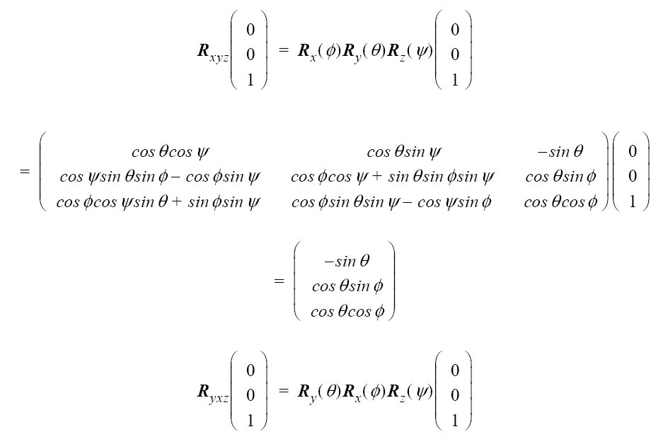
Signal Processing
Algorithms

Slide 30
Signal Processing
Algorithms
Moving distance measure :
Accelerometer : Bring out acceleration of each axe when the sensor move.In case of moving straight in one line we can calculate the velocity and finally calculate distance.

Slide 31
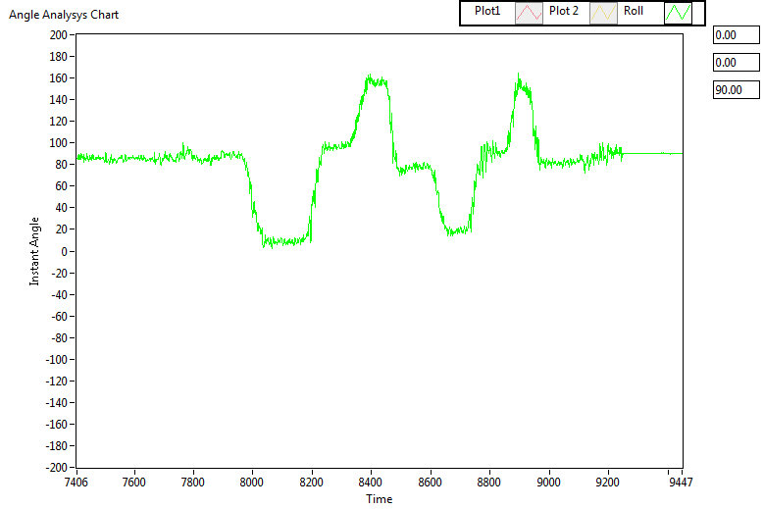
Signal Processing
Algorithms
Theta angle by Accelerometer
BEFORE FILTER

Slide 32
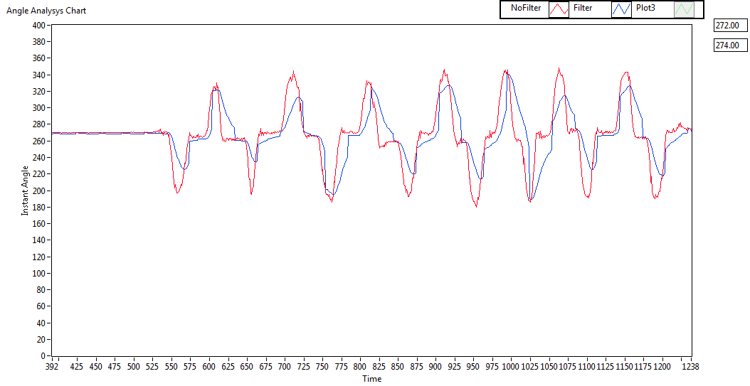
Signal Processing
Algorithms
Theta angle by Accelerometer and Gyroscope:
AFTER HIGH-PASS AND LOW-PASS FILTER

Slide 33
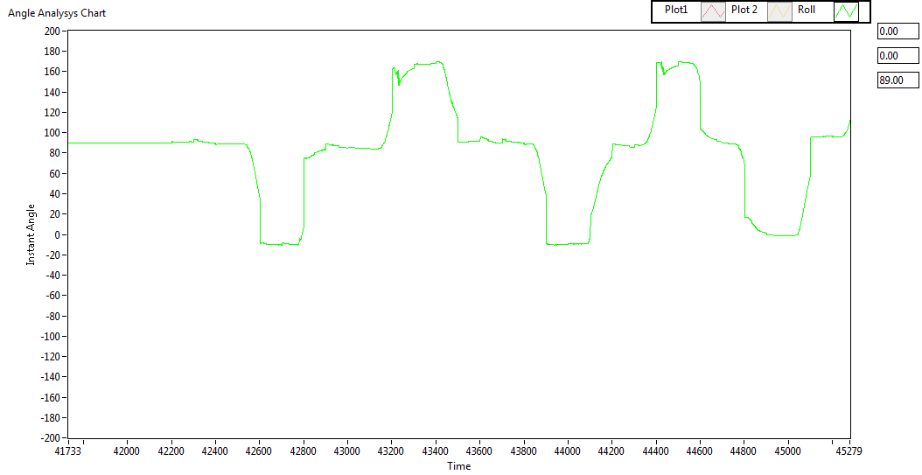
Signal Processing
Algorithms
Theta angle by Accelerometer and Gyroscope:
AFTER COMPLEMENTARY FILTER

Slide 34
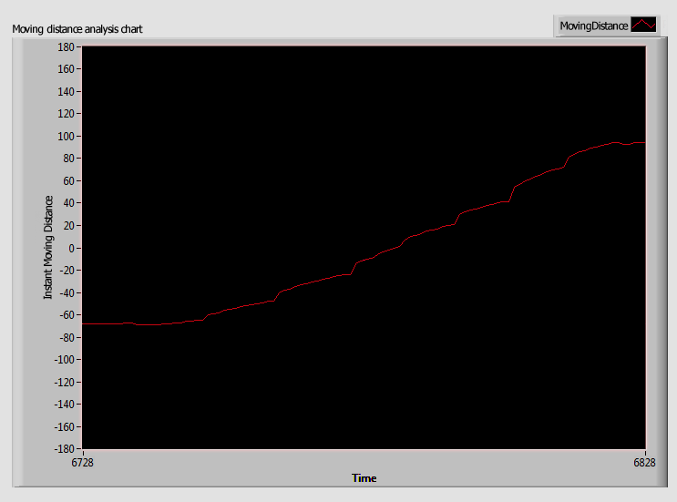
Signal Processing
Algorithms
Measure moving distance :

Slide 35
Demo
Experiments & Results
<Demo>

Slide 36
Achievement
Conclusion
1
2
Understand more about IMU sensor to apply in real device
Improve working in group ability and skill for each member
3
Successful proved the correctness of the aforementional algorithms.

Slide 37
Future Improvement
Conclusion
Develop an Interactive 3d game system with more action.
Use more flexible but useful algorithm to make more smooth data.
Change the component to reduce price and size of Portable device,improve ability of calculate angle and moving distance.

Slide 38
Reference
http://www.techterms.com/definition/esports
http://en.wikipedia.org/wiki/Light_gun
http://strategywiki.org/wiki/Wii_Sports/Boxing
“Gravity Force” http://www.universetoday.com/34824/force-of-gravity
“Blender version 2.7”http://www.blender.org
"High-pass Filter"- http://en.wikipedia.org/wiki/High-pass_filter
"Low-pass Filter"- http://en.wikipedia.org/wiki/Low-pass_filter
"Kalman Filter Vs Complementary Filter" - http://robottini.altervista.org/kalman-filter-vs-complementary-filter
Shane Colton, MIT (2007) - "The Balance Filter"
"Inertial Measurement Unit" - http://en.wikipedia.org/wiki/Inertial_Measurement_Unit
Laura Salhuana , AN (2012), Frescale Semiconductor - "Tilt Sensing using linear accelerometer"

Slide 39
Thank You !
From IBG3d.Pro team with love

