Slide 1

FSH_Presentation

Slide 2


Finding and sharing house for lease
Supervisor: Mr. Tran Binh Duong
Students:
  Nguyen Duc Thuong
  Duong Hong Loc
  Chu Minh Tung
  Pham Van Khanh
  Pham Tuan Anh

Slide 3



Contents
    1. Introduction
    2. Project Management
    3. Requirement Specifications
    4. Design Description
    5. Test Documentation
    6. Summary
    7. Demo & Q&A
FSH

Slide 4
Part 1: Introduction
1
The People
2
Background
3
Literature Review
3
4
Our Proposal &Products
4
FSH

Slide 5
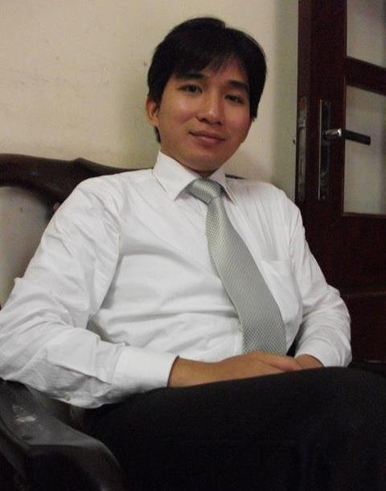
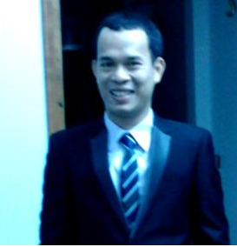
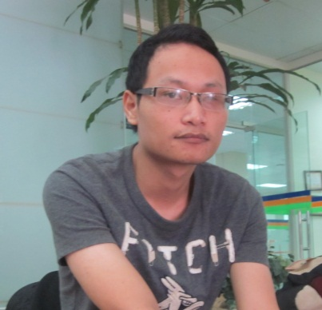
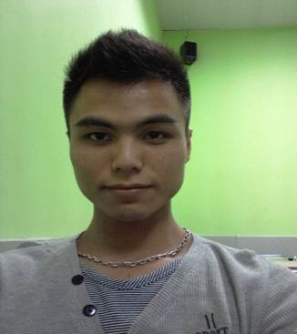

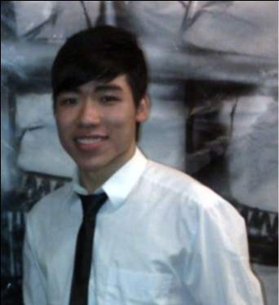
Part 1: Introduction
1
The People
Mr. Tran Binh Duong
Supervisor
Chu Minh Tung
Technical Leader
Nguyen Duc Thuong
Project Manager
Pham Van Khanh
Tester Leader
Duong Hong Loc
Quality Assurance
Pham Tuan Anh
Designer
FSH

Slide 6
Part 1: Introduction
2
Background
Student in Ha Noi : 690,276 (2011)
http://www.gso.gov.vn
The need of finding and sharing house for lease is very popular.
Students spend lots of time for asking friends or going to somewhere to find a suitable house for lease.
Sometime, you want to share your house, or introduce for someone about house for lease, but you do not know how to share
FSH

Slide 7

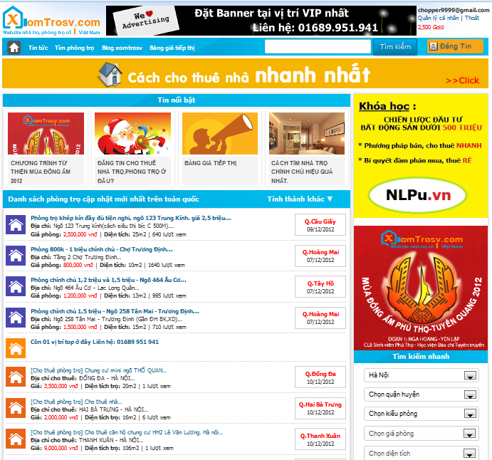
Part 1: Introduction
Literature Review
3
This site supports good find house for lease. But there are some functions do not support users as:
The website has not function compare between many topics together.
This site have support Google map but does not support the display of the surrounding services such as bus stations, universities, markets, parks.
Not support user can rate others the topics, favorite list.
FSH

Slide 8

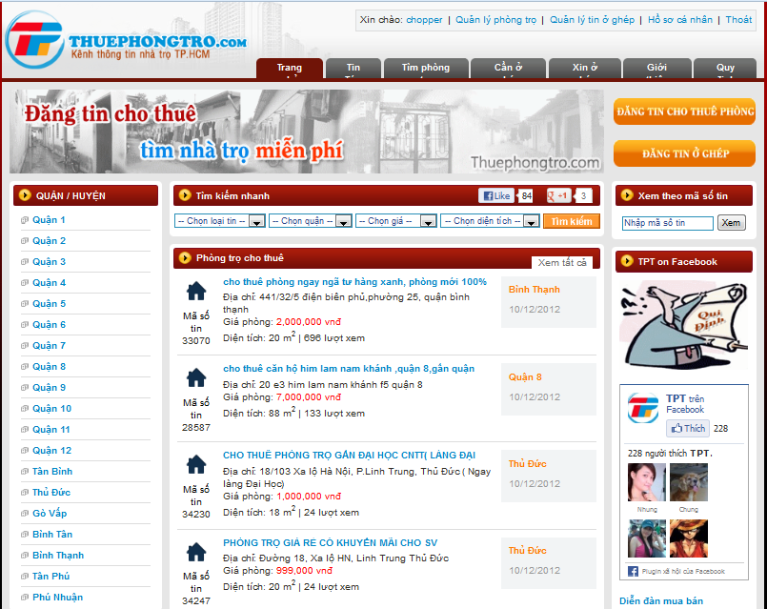
Part 1: Introduction
Literature Review
3
This site is only supported in Ho Chi Minh City.
This website does not support location in Google map.
The website has not function compare between many topics together.
Not support user can rate others the topics, favorite list.
FSH

Slide 9
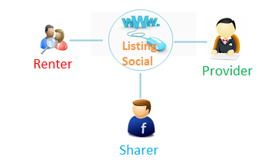
Part 1: Introduction
Our Proposal & Products
4
Web application for finding and sharing house for lease.
Our website will help people to find and share house for lease easily and efficiently.
FSH

Slide 10
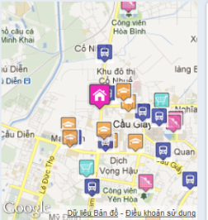



Part 1: Introduction
Our Proposal & Products
4
Advantages
Only information about house for lease
Rate
Compare
Favorite
Fan Pages
Support Google map
FSH

Slide 11
Part 2: Software Project Management
1
Development Environment
2
Process
3
Project Planning
3
FSH

Slide 12


Part 2: Software Project Management
1
Development Environment
Development Hardware
2 Gb of RAM,
50 Gb of hard disk
Pentium dual core 2.0 GHz.
Server Hardware
2 Gb of RAM
50Gb of hard disk
Core 2 Duo 2.0 GHz
FSH

Slide 13










Part 2: Software Project Management
1
Development Environment
Framework :
Environment :
Web Server:
Source Control:
Operating system:
DBMS:
API:
FSH

Slide 14




Part 2: Software Project Management
1
Development Environment
FSH

Slide 15
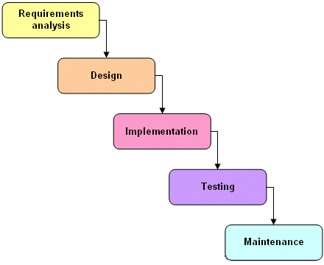
Part 2: Software Project Management
2
Process
Follow Waterfall model
FSH

Slide 16
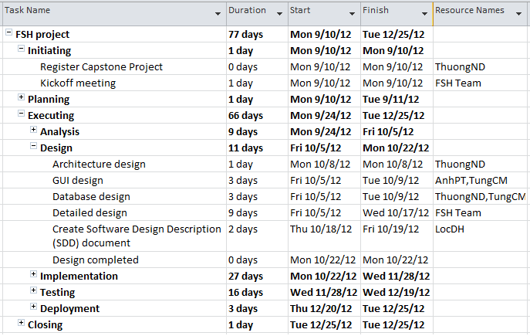
Part 2: Software Project Management
3
Project Planning
3
FSH

Slide 17
Part 3: System Requirement Specifications
Functional Requirements
Non-functional requirements
FSH

Slide 18
Part 3: System Requirement Specifications
Functional Requirements
Visitor
View information of house for lease
Compare two or three topics
Use account Facebook , Gmail , Yahoo mail to comment
View 5 topics which him/her had view before
View other user’s profiles
FSH

Slide 19
Part 3: System Requirement Specifications
Functional Requirements
Visitor
Search
Quick search
Full text search
Advance search (Use Fuzzy logic)
FSH

Slide 20
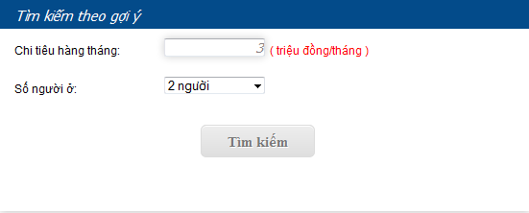
Part 3: System Requirement Specifications
Fuzzy logic
Input
FSH

Slide 21
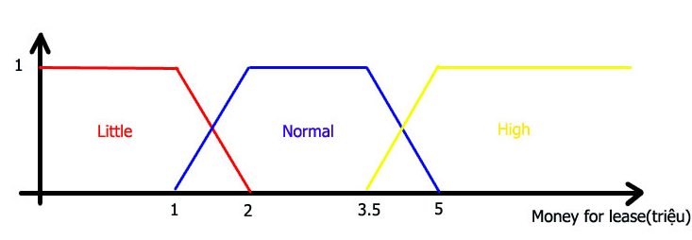
Part 3: System Requirement Specifications
Fuzzy logic
Fuzzification
Number person
1,2-> little
3 -> normal
4,5-> many
1 if money <=1
F(little)=
0 if money >2
2-money if 1<money<2
FSH

Slide 22
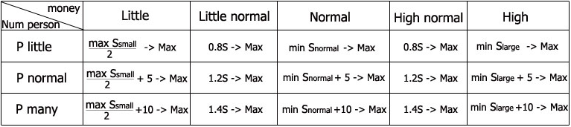
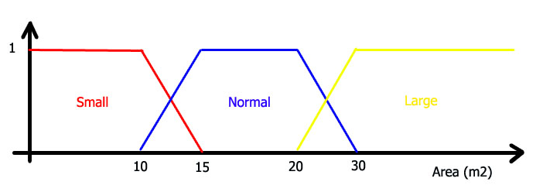
Part 3: System Requirement Specifications
Fuzzy logic
Rules & defuzzification
FSH

Slide 23
Part 3: System Requirement Specifications
Functional Requirements
User
Login to website by account Facebook
Post topic with form of Website
Can post topic in the wall on Facebook
Refresh their topic when their topic had hidden
Edit information , hide, delete topic which posted by his-self
FSH

Slide 24
Part 3: System Requirement Specifications
Functional Requirements
User
Rate others the topics in website.
Edit individual information: display name and avatar
Add favorite topic, view ,remove topics
from the list at his/her profile page.
User can report about topic
FSH

Slide 25
Part 3: System Requirement Specifications
Functional Requirements
Administration
Manager locations
Manager users
Manager topics
Manage report topics
View activity of user in the system
FSH

Slide 26
Part 3: System Requirement Specifications
Functional Requirements
System
Auto hide the topic post after 30 days posted
Auto send mail to user to notification
about the topic had hidden
FSH

Slide 27
Part 3: System Requirement Specifications
Non-functional requirements
Reliability
Availability
Security
Maintainability
Portability
Performance
FSH

Slide 28
Part 4: Software Design Description
1
Architectural design
2
Detailed design
3
Database design
3
FSH

Slide 29
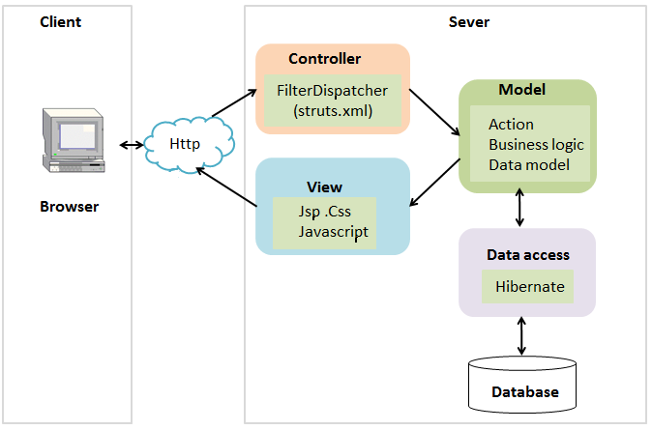
Part 4: Software Design Description
1
Architectural design
FSH

Slide 30
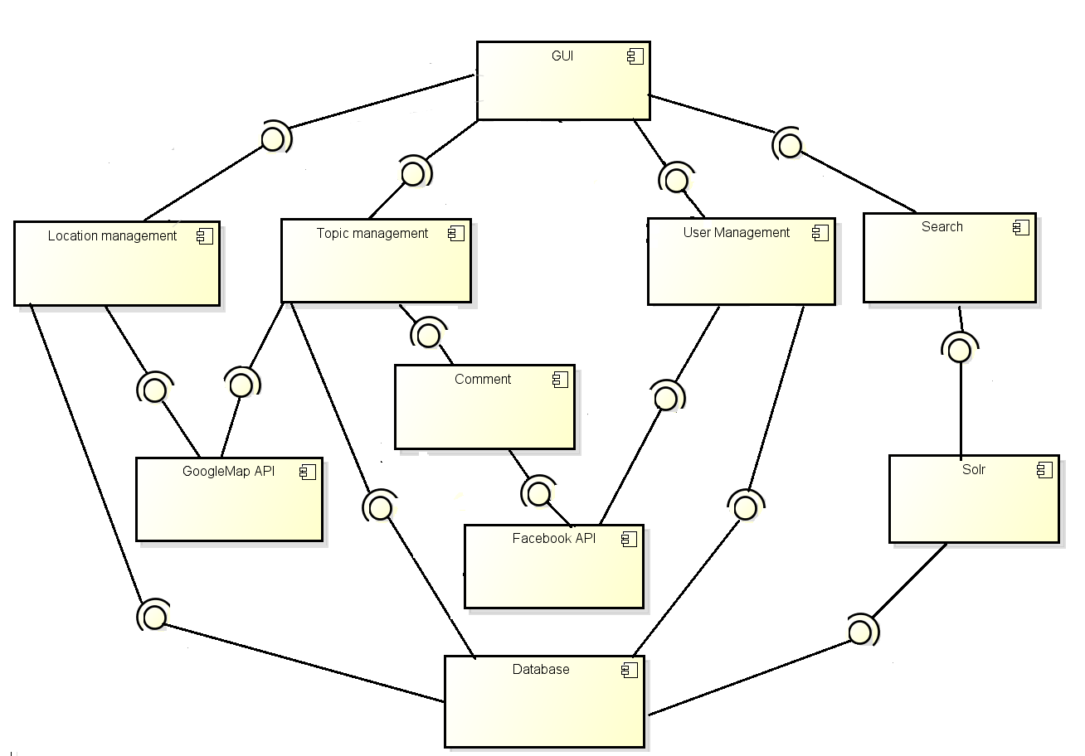
Part 4: Software Design Description
2
Detailed design
Component diagram
FSH

Slide 31
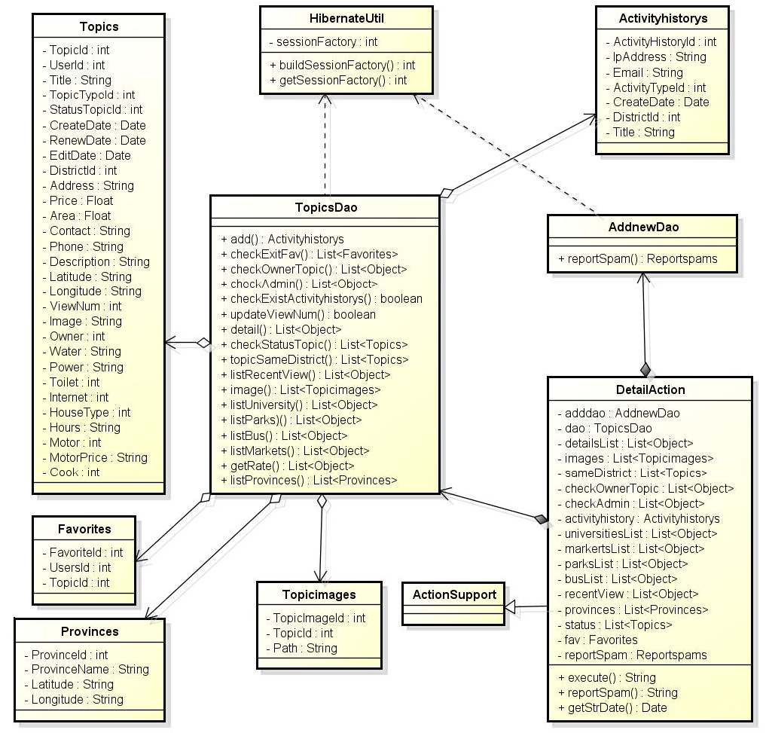
Part 4: Software Design Description
2
Detailed design
Topic Detail-Class diagram
FSH

Slide 32
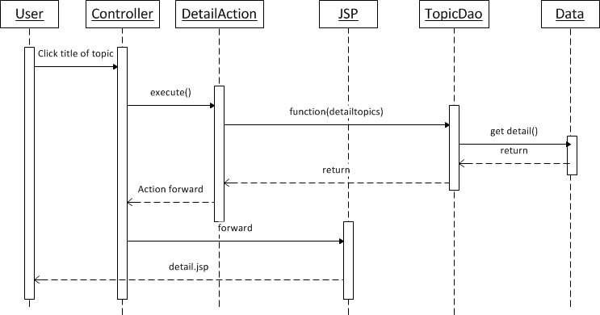
Part 4: Software Design Description
2
Detailed design
Topic detail-Sequence diagram
FSH

Slide 33
Part 4: Software Design Description
3
Database design
3
FSH

Slide 34
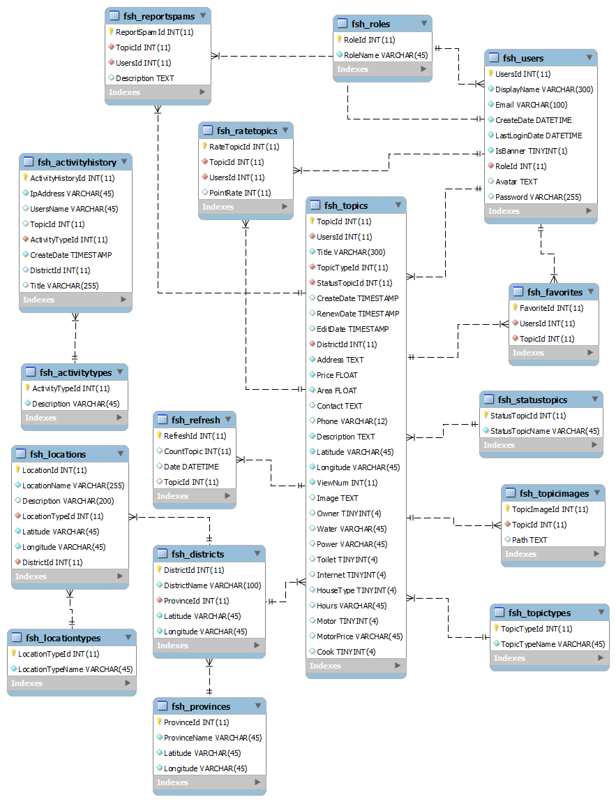

Slide 35
Part 5: Software Test Documentation
1
Unit Testing
2
Integration Testing
3
System Testing
FSH

Slide 36
Test result:
Part 5: Software Test Documentation
Module | Pass | Fail | Untested | Number of Test case
Login-Logout | 12 | 0 | 0 | 12
User manage Owner profile | 8 | 0 | 0 | 8
User manage favorite | 5 | 0 | 0 | 5
View list created topics | 3 | 0 | 0 | 3
View topics detail | 50 | 0 | 0 | 50
Edit topics | 36 | 0 | 0 | 36
Hide topics | 14 | 0 | 0 | 14
Refresh topics | 20 | 0 | 0 | 20
Delete topic | 7 | 0 | 0 | 7
Rate topic | 12 | 0 | 0 | 12
Report topic | 10 | 0 | 0 | 10
Compare topics | 11 | 0 | 0 | 11
Add topic to favorite list | 4 | 0 | 0 | 4
Manage recent topics | 4 | 0 | 0 | 4
Create new/share topic | 44 | 0 | 0 | 44
Search | 16 | 0 | 0 | 16
<Admin> Manage user | 41 | 0 | 0 | 41
<Admin> Manage locations | 12 | 0 | 0 | 12
<Admin> Manage topics | 10 | 0 | 0 | 10
<Admin> Manage report topics | 12 | 0 | 0 | 12
Total | 331 | 0 | 0 | 331
FSH

Slide 37
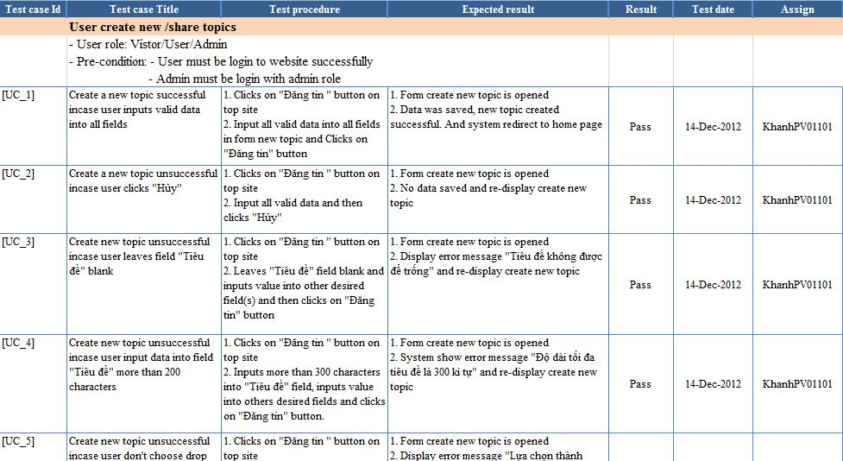
Test Logs
Part 5: Software Test Documentation
FSH

Slide 38
Part 6: Summary
Capstone Project: completed
Future:
Continue developing
Deploy to http://www.khutro.net/
FSH

Slide 39
Part 6: Summary
Lesson learnt
Software development process
Team communication
Project management skills
Time management
FSH

Slide 40


Part 7: Demo & Q&A
FSH

Slide 41

FSH

