Slide 1

Exam Online
Supervisor:
Lecturer Phan Trường Lâm
Students:
Nguyễn Văn Hải
Bùi Thị Mai
Bùi Thế Mạnh
Trần Văn Hòa
Nguyễn Trọng Dương

Slide 2
AGENDA
Introduction
Plan
Requirement
Software design
Implementation
Testing
Demo & QA

Slide 3
I. INTRODUCTION
Background
Literature review
Proposal
Products

Slide 4
Background
IT Application in education.
Organizing and grading exam take time , human effort.
Essay exam still do on paper.

Slide 5
Literature review
EOS software executed well the basic functional organization for the multiple choice exam with one of the main functions:
+ Management questions bank
+ Do exam
+ Submit answers
+ Automate mark….
Moodle: CMS

Slide 6
Proposal
Question’s bank is secured.
Create exam, do exam , grading exam on PC.
Simple interface
Easy to use

Slide 7
Proposal(cont)
Some new features the system support:
+ Essay question
+ The formulas
+ Financial function
+ Graphing
+ Input Chinese on essay question

Slide 8
Products
Question bank management.
Exam Server.
Exam Client.
Essay grading tool.

Slide 9
Products(cont)
Question bank management :Tool for organize, manage subject, chapter, question, exam.
Exam server: start exam, stop exam, reassign, view submit page, automate mark.
Exam Client: Do exam, submit exam.
Essay grading tool: grading essay answer sheet.

Slide 10
II. PLAN
Environment
Process
Organization
Planning

Slide 11





Environment

Slide 12
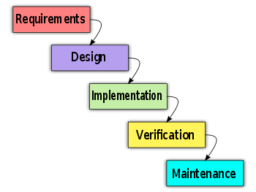
Process
Follow Waterfall model
  Make clear ideas
  Analysis requirements
  Clearly Design

Slide 13
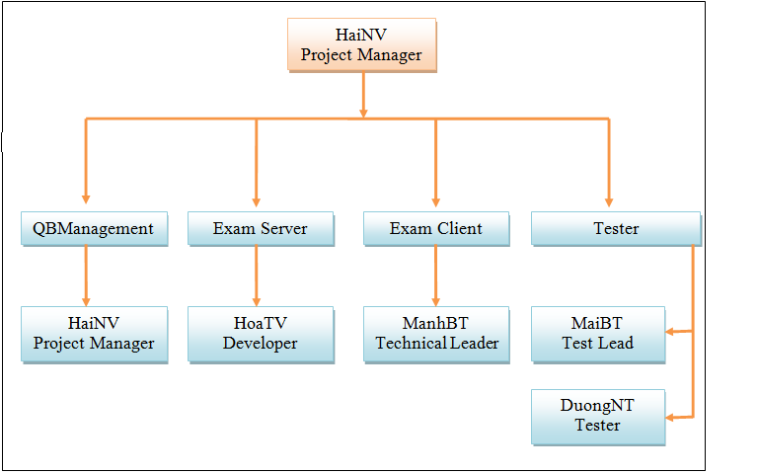
Organization

Slide 14
Project planning
Follow Capstone Project requirements
Buffer: 1 weeks
Submit all reports on time
No overtime

Slide 15
III. REQUIREMENT
Functional requirement
Non-functional requirement

Slide 16
Functional requirement
Question bank management
Exam client
Exam server
Essay grading

Slide 17




Question bank management
Manage subject
Manage chapter
Manage question
Manage exam

Slide 18




Question bank management
Add, Edit, Delete, Search.
Create Exam:
  Random question
  Make exam code , test code
  Export to file

Slide 19
Question bank management
Doc format file
  Include content of question
  Print hard copy
Exam information file
  Include following information
    Exam code, subject, duration, number questions, total mark
  Encryption

Slide 20






Question bank management
Server
Process Create Exam
Encrypt
Exam information
Database
Doc file
Printer

Slide 21




Exam server
Manage the exam
  Start exam
  Stop exam
  Show exams information
  Store student’s answer sheet

Slide 22

Exam server
Manage student:
  Add
  Remove
  Re-assign

Slide 23
Exam server
Automatic grade solutions
View result of the exam
View answer sheet of each student

Slide 24


Exam client
Authentication
Do exam
Submit exam

Slide 25
Non functional
Usability
Reliability
Performance
Maintainability
Security

Slide 26

IV. SOFTWARE DESIGN
Architectural design
Detailed design
Database design

Slide 27
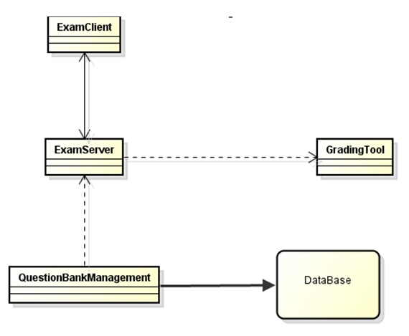
Architecture design

Slide 28
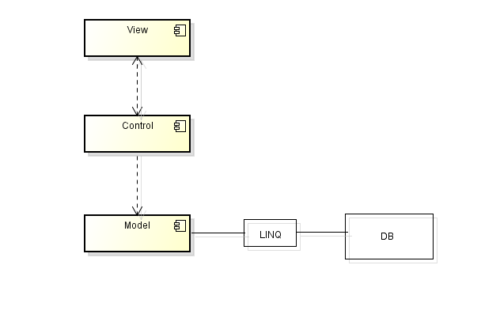
Detailed design- QEB

Slide 29
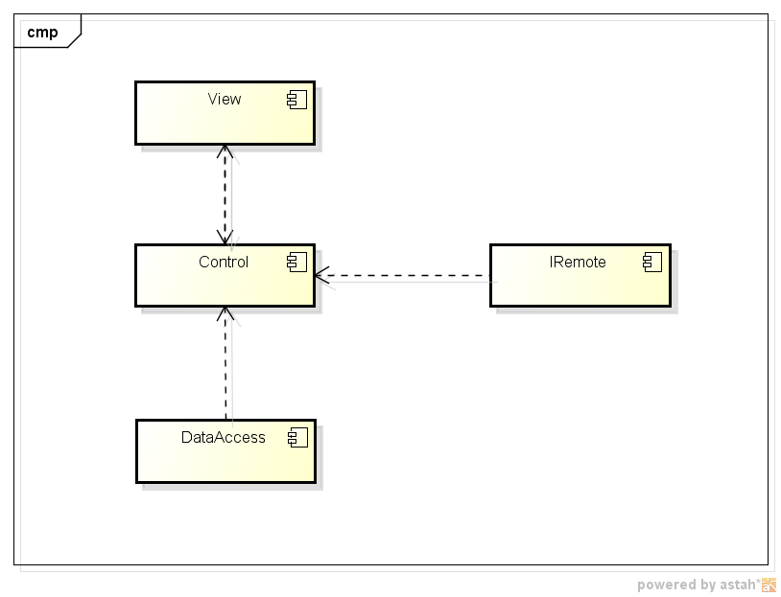
Detailed design-Server

Slide 30
Detailed design-Client

Slide 31
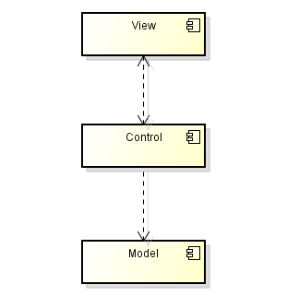
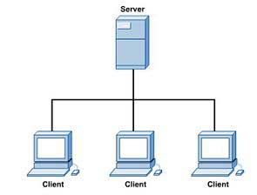
Architectural & design patterns
3-layer
Client - Server
.NET Remote Single call

Slide 32
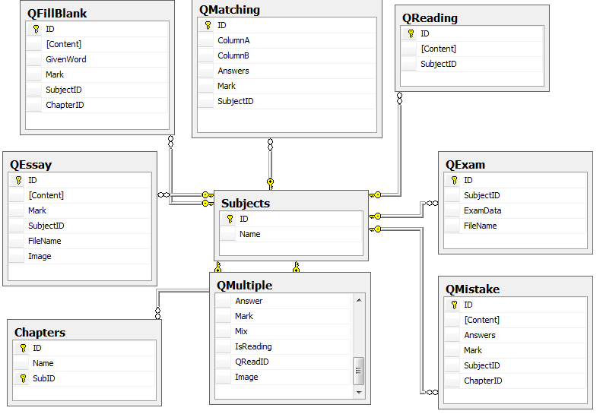
Database design

Slide 33
Design-Detailed design
Class diagram
Sequence diagram

Slide 34
QEB-Class diagram

Slide 35
QEB-Sequence diagram(sample)

Slide 36
V. IMPLEMENTATION
Technologies
Tools
Coding convention
Code review
Performance
Security

Slide 37


Technologies
SQL Server
C#
.NET Framework 3.5

Slide 38

Tools
Microsoft Visual Studio 2008
Microsoft SQL Server 2005
Tortoise SVN

Slide 39
Coding conventions
Follow general .NET conventions
Specific conventions for the project

Slide 40

Code review
Self-review
Peer-review
Review following checklist

Slide 41

Performance
Compress file to reduce data storage
Avoid multiple loop
Use Linq to optimize processing time

Slide 42
Security
Risks | Solution
Student submit exam for other students | Generate md5 by: Username, Password, IP address, Mac address. Compare md5 code when students submit exam.
Student edit submit files | Encrypt files: paper, file submit …
Student modify Client to do exam | Create session key for each account logged in
Student decompile client | Store code on server. Client has interface to call function on server
Use team viewer to do exam outside | Interrupt internet while doing exam
Add key to some dictionary software: LacViet, Lingoes, StarDict … | Disable selection text in client

Slide 43
VI. TESTING
Understand requirement clearly
Plan test for each module
Create test case
Executed test system

Slide 44
Test results
Modules | Total of test cases | OK | NG | NA
Question bank management | 171 | 160 | 7 | 4
Exam server, client, grading tool | 40 | 39 | 1 | 0
- Number of not tested cases:

Slide 45
Demo & QA

