Slide 1
Project Presentation V-creatures
www.vncreatures.net

Slide 2
Group members
Nguyễn Quang Lân
Trần Ngọc Việt
Nguyễn Thiện Chính
Hồ Thiện Minh
Võ Ngọc Lưu

Slide 3
Project organization
Designer:
ViệtTN
Project Manager:
ChinhNT
Team lead:
LânNQ
Test Lead:
ChinhNT
Tester:
MinhHT
Developer:
MinhHT
Tech Lead:
LânNQ
Tester:
ViệtTN
Developer:
LưuVN
Developer:
ChínhNT

Slide 4
Contents
1
Introduction
2
Project management plan
3
Requirement specifications
4
Design specifications
5
Test documentation
6
Q&A & Demo

Slide 5
Part I: Introduction
www.vncreatures.net

Slide 6
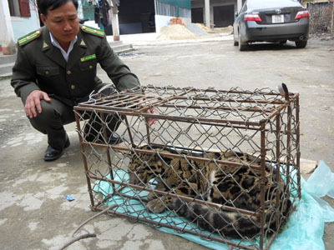
Initial Idea
How can we find information about native Vietnamese creatures?
How can we know and understand more about creatures in Vietnam that are in danger or going to extinct ?

Slide 7
Literature review
Huge database.
Suited for searching American national parks information.
English language.

Slide 8
Our proposal
Users can keep connect and discuss with each other
Informative
Very userful and truthful information
Connectivity
VNCreatures
Friendly
All in Vietnamese language
Viet Nam creatures
For Vietnamese users
Simple and nice layout.
Good performance.
Easy to use
Vietnamese

Slide 9
Part II: Software project management plan
www.vncreatures.net

Slide 10
Scope
 | Use case name | Use case description
Back-end website | Create | Create creatures information, news and national parks
 | Update | Update creatures information, news and national parks
 | Detele | Delete creatures information, news and national parks
 | View | View creatures information, news and national parks
Front-end website | View | View creatures information, news, discussion and national parks
 | Search | Search creatures information, news and national parks
Android application | View | View creatures information, news, discussion and national parks
 | Search | Search creatures information, news and national parks

Slide 11
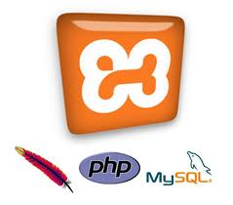
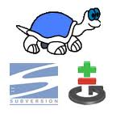
Development enviroment

Slide 12
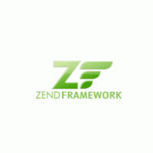
Development Technologies
Notes:
Hãy dùng Yii Một tên tuổi PHP Framework mới nhưng Yii chính là hậu sinh của Prado. Yii đang nổi lên là 1 framework tốt bởi hiếm có nhóm phát triển framework nào bỏ đi 1 framework để làm cái thứ hai với những kn đã có từ cái framework (mà số fan sử dụng không hề nhỏ nhé) như nhóm làm Yii. Ưu điểm của Yii là tính đơn giản trong cách viết kết hợp với thế mạnh "scripting" của PHP và cơ chế mảng index (associative array). Yii cũng được viết bởi những người viết "thực tế" hơn Zend nên có sẵn những công cụ "hợp thời trang" nhất cho người viết ứng dụng. Yii là framework MVC nhưng có kiến trúc OOP rất tốt và lại hướng component nên mức độ tái sử dụng giữa các project rất cao. Yii đặc biệt chạy nhanh hơn Zend và Symfony. Hãy lợi dụng Zend Được tạo ra bởi tổ chức support lớn nhất cho PHP, giống như Microsoft tạo ra .NET hay Sun viết ra Java, Zend Framework có nhiều tính năng nhất và công cụ nhất cho người lập trình. Zend có các component như indexing hay API cho Yahoo, Google theo kiểu độc nhất vô nhị mà các framework khác không có. Khi các framework khác không có cái bạn cần, có thể "mượn" các component của Zend để dùng. Điểm yếu của Zend là tốc độ chậm và sự cồng kềnh. Mọi thứ trong Zend đều đẹp nhưng với 1 ứng dụng trung bình, viết bằng Zend sẽ không hề nhanh hơn dùng Yii nhưng kết quả thì chắc chắn rùa chạy với thỏ.

Slide 13
Process model
Iterative development model
Notes:
The software will be implemented using iterative process model. This model is deemed to be the most appropriate for us with its original advantages as well as positive psychological factors
Iterative model also fit perfectly with the team skill sets, being inexperience in developing an entire system, managing projects, creating documents and working with customer

Slide 14
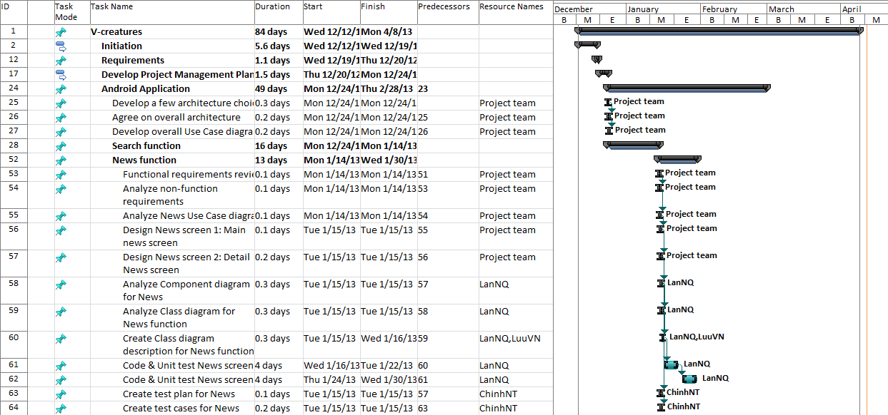
Process planning

Slide 15
Team management
Work 8 hours per day and 5 days per week.
Meeting: Every Tuesday, from 18:00 to 19:00.
Meeting place: FPT University.
Team management tool:

Slide 16
Risk management
Risk type | Risk description | Resolution
People | -Team members get personal matters to attend -Conflict between members | -Have each member to know what others are doing so they can support if required -Setup open mined environments
Technical | -Google Map technology will release a new version -Due to client request, all databases must remain unchanged. | -Follow its implementation closely to get newest update and information -Try to create work-around
Business | -Clients are unfamiliar with our working process -The study of creatures in Vietnam is complex | -Give client informative update of the project -Work closely with the client to get the logic
Process | -Wrong estimation about project plan | -Consult with instructor
Notes:
ID
Risk description
Probability
Effect
Solutions
# People risks
1
Team members get personal matters to attend (sickness, vacations, emergency work ,etc.) thus affect the plan
Normal
High
Have each member to know what others are doing so they can support if required
2
Conflict between members
High
High
Work in professional manner
Setup open mined environments
Project manager involvement
3
Members lack of technical skill, knowledge
Very High
Normal
Technical lead involvement and support
Have time to train new technology
Support from instructor
# Technical risk
4
Not enough Android device for team to use
High
Normal
Members take turn to use available devices
Borrow from others people
5
Intended Google Map technology will release a new version in the February 2013, so unknown and unfixable bugs may surface
Very High
Normal
Follow its implementation closely to get newest update and information
Pay extra attention and testing into that fields and related components
6
Due to client request, all databases must remain unchanged. The former poor database design and such restriction might affect our design and technology choices
Very High
Very High
Try to create work-around
# Business risk
7
Clients are unfamiliar with our working process, and thus unwilling to get involved
High
Normal
Contact point must be established
Explain calmly and give client informative update of the project
8
The user requirements might get dramatically
changed
High
Very High
Follow its implementation closely to get newest update and information
Pay extra attention and testing into that fields and related components
9
The study of creatures in Viet Nam is a large, complex and academic field that no members have expertise in. It can seriously affect impact the coding logic or the correctness of the system
Very High
High
Work closely with the client to get the logic
Pay extra attention in user requirement to get out correct software specification requirement
# Process Risk
10
Wrong estimation about project plan, efforts, problem difficulty, and risk impacts, etc…
High
Very High
Consult instructor with our estimations
Re-evaluate in milestone

Slide 17
Part III : Software Requirement Specification
www.vncreatures.net

Slide 18
Software Requirements
Functional requirements.
Non-functional requirements.

Slide 19
Android and Web frontend
Filter by types
Display: Content, Images, Map
Create threads, post
Track using notification
Report inappropriate behaviors
Read news and articles
View national parks locations
View detail content of a national park
Search creatures
News reading
Discussion
National Park Map
Android and Website front end

Slide 20
Website backend
CRUD creatures
CRUD elements related to creatures for example: “Ho”, “Bo”, “Loai”, etc…
RUD posts, threads, reports
Ban and unban users
CRUD news and categories
CRUD national parks
Manage creatures
Manage news
Manage discussion
Manage national parks
Website backend

Slide 21
Use case for Android

Slide 22
Use case Website backend

Slide 23
Non-functional requirements
The highest number of steps need to find a creatures : 5
The lowest number of steps to find any creatures : 2
Waiting time for all screen is at most 10 seconds in 3G standard network condition.
Use meaningful icons instead of text buttons.
Simple, lighten colors design.
The data is secured and encoded in database.

Slide 24
Non-functional requirements
Reliability
Data must be inputted through Web-based administrator site so that the consistency and correctness are preserved.
Availability
Application on Android can run successfully every time.
Security
The Facebook account information of the users cannot be seen, or download through Android application.
Android application has no conflict with other applications.
Database is back-up regularly (one per 2 days).
Website is available 24/7 (98%).

Slide 25
Non-functional requirements
Maintainability
The MVC approach must be kept in order to have a clean code, easy to maintain, to fix or upgrade.
Usability
All the text, images, buttons should be in Vietnamese.
Notify the user if there are any new upgrades from Google Play.
Android interface should be simple, lighten colored.
Opening screen should be high definition picture, native to Viet Nam wildlife.

Slide 26
Part IV: Design Specification
www.vncreatures.net

Slide 27
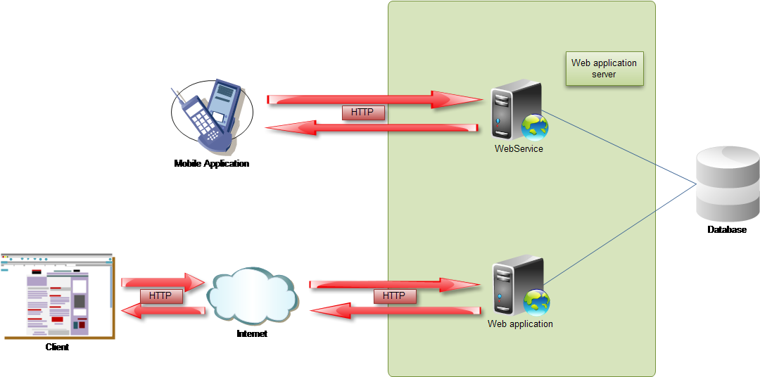
Overall Design
Overview of the whole system.

Slide 28
Design Pattern
MVC Model Pattern Design

Slide 29
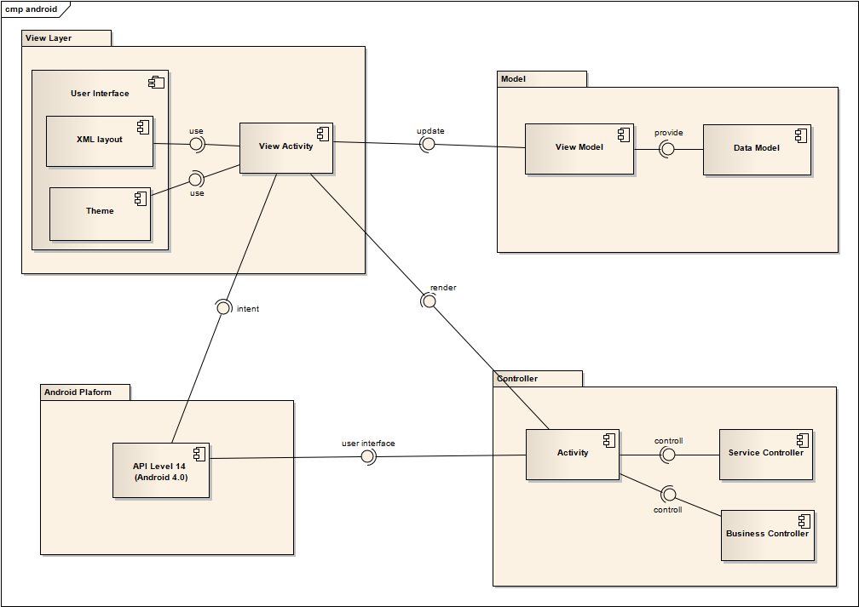
Component Diagram
Android Component Diagram

Slide 30
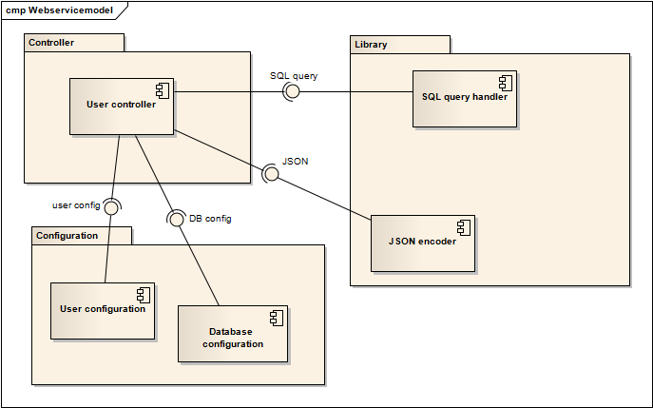
Component Diagram
Webservice Component Diagram

Slide 31
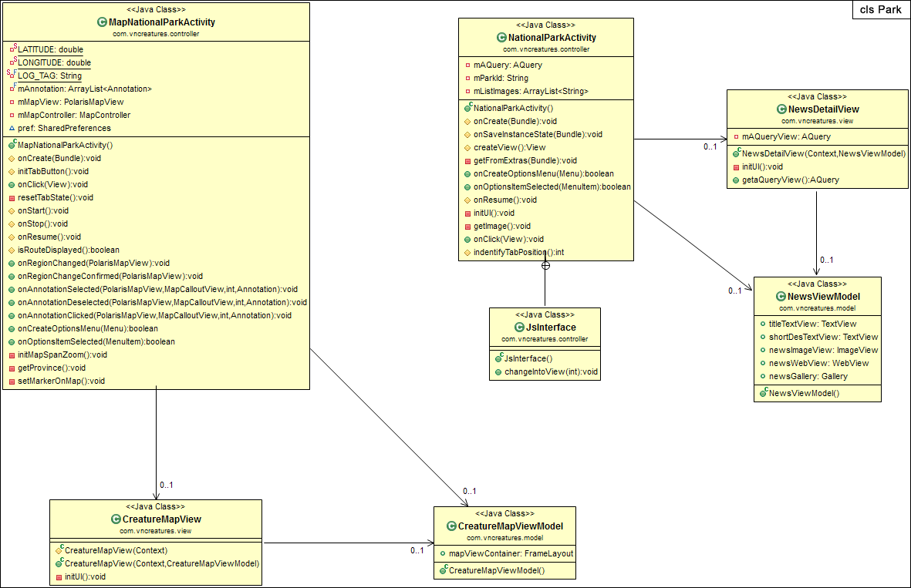
Class Diagram
Map National Parks Class Diagram

Slide 32
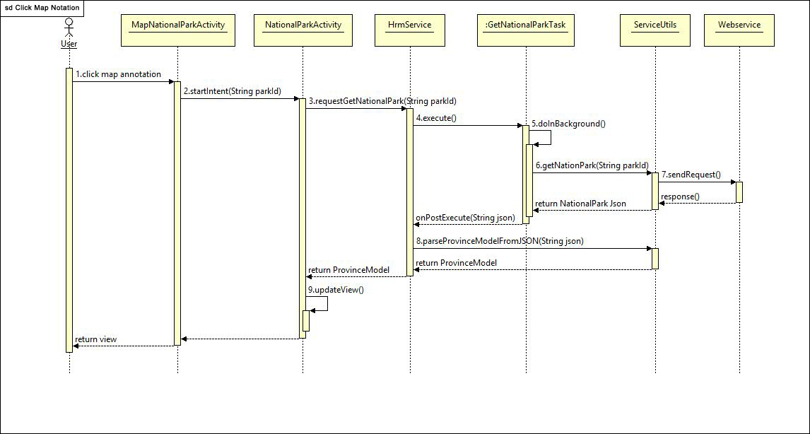
Sequence Diagram
View Map Detail Sequence Diagram

Slide 33
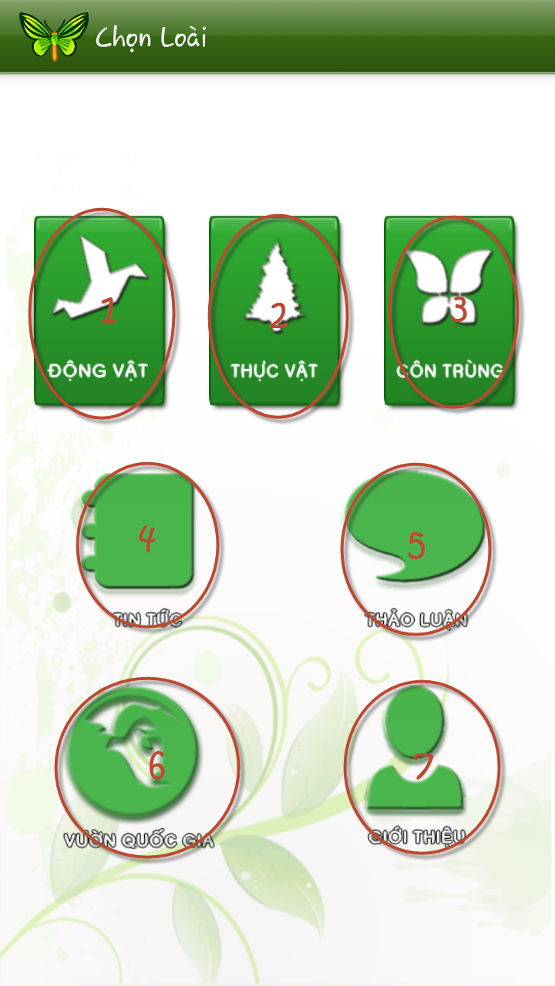
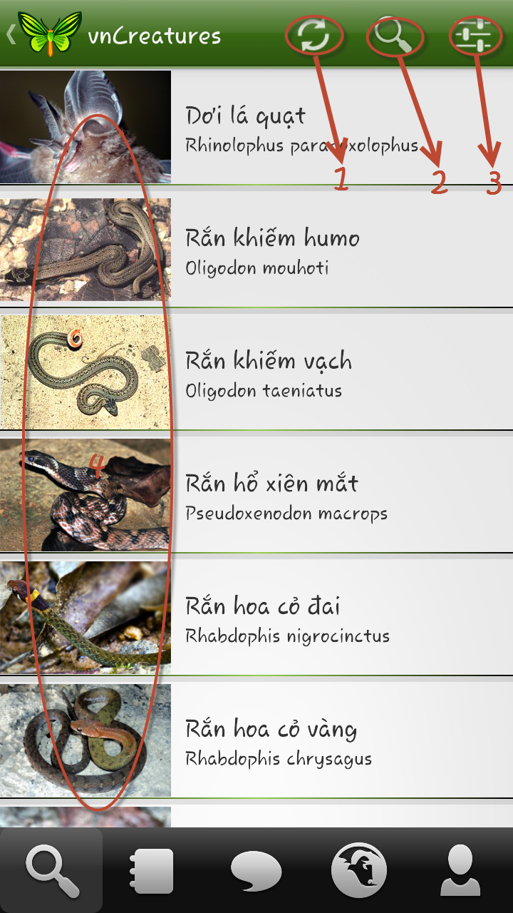
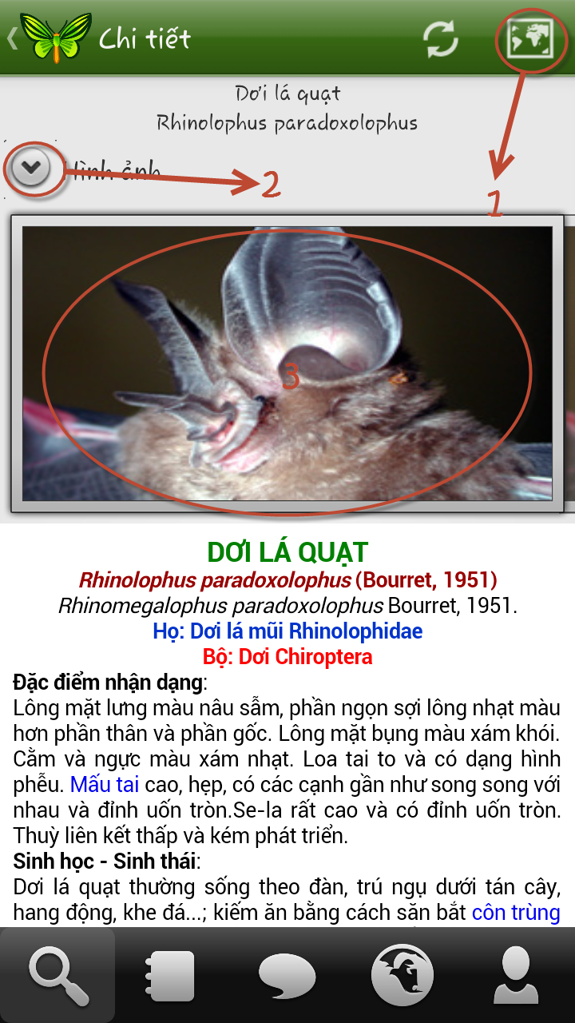
Screen Design
Android screen

Slide 34
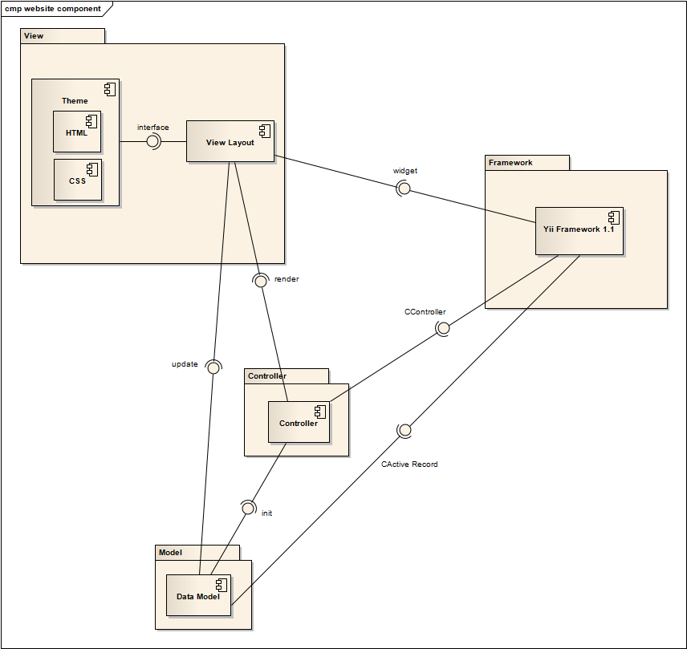
Website component diagram
Website component diagram

Slide 35
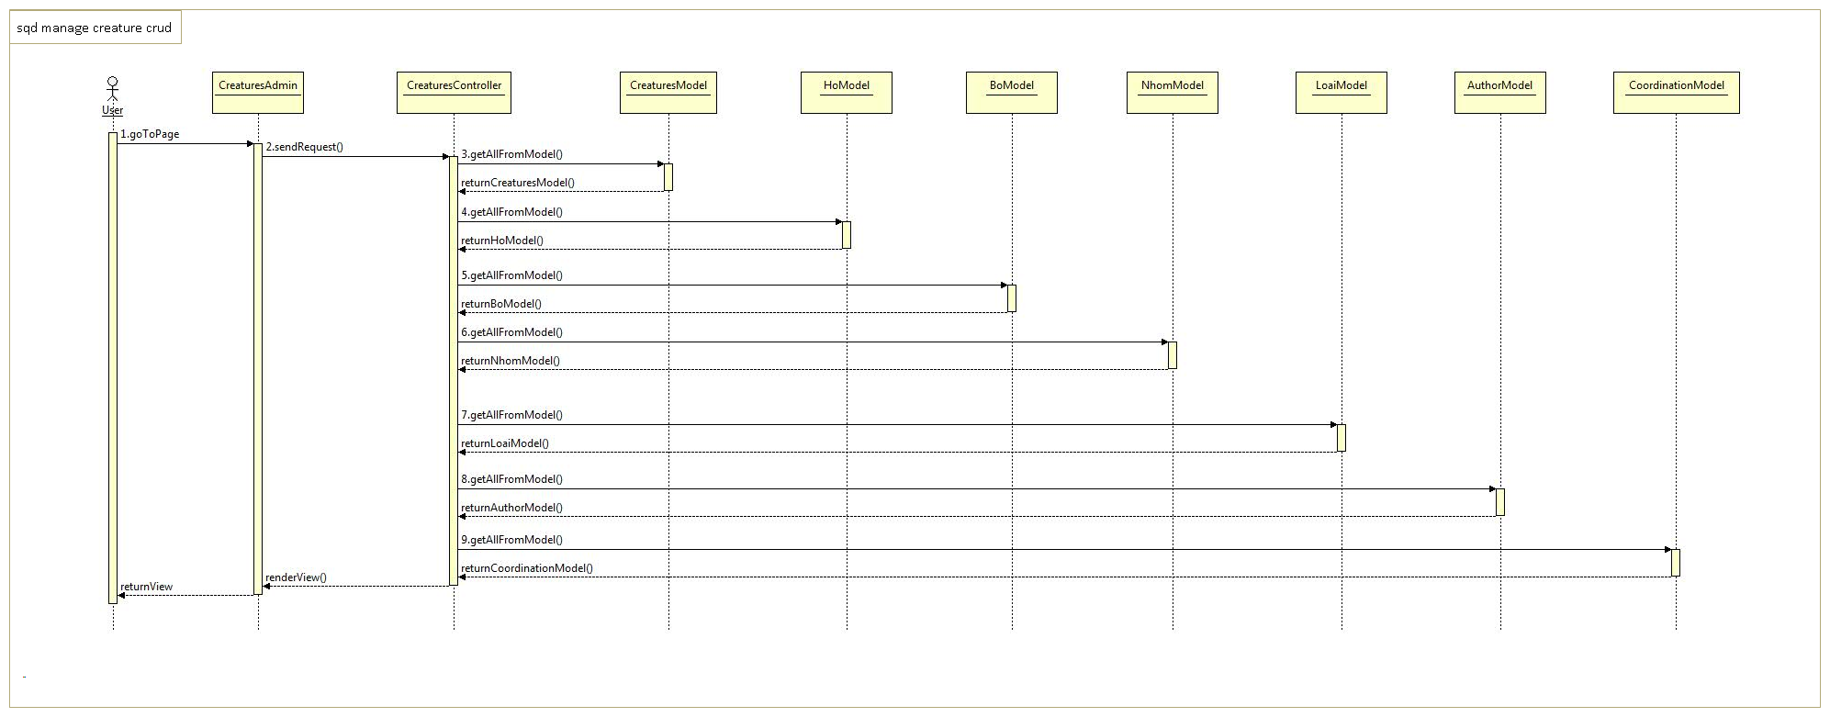
Website backend
Manage creatures sequence diagram

Slide 36
Website backend

Slide 37
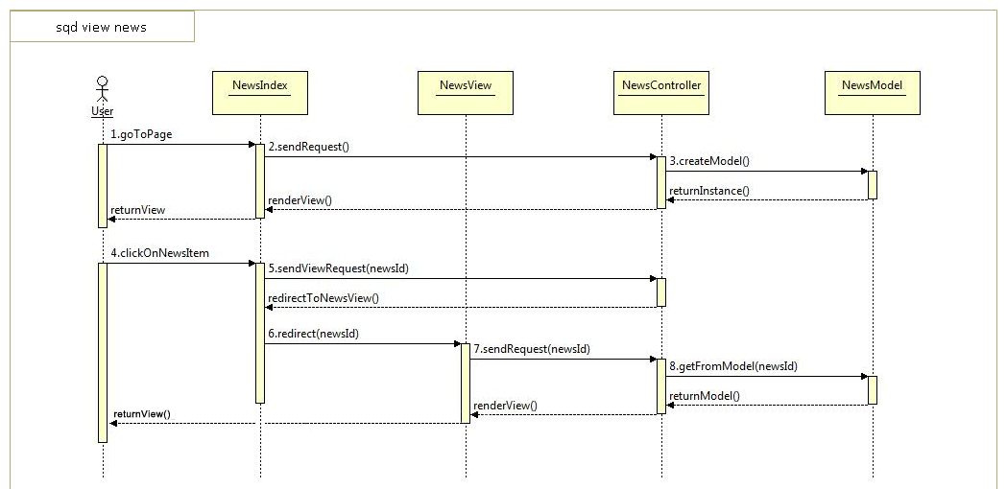
Website frontend
View news sequence diagram

Slide 38
Website frontend

Slide 39
Entity relationship diagram

Slide 40
Database Design

Slide 41
Part V: Software testing
www.vncreatures.net

Slide 42
Test model

Slide 43
Test plan
Type of test | Target of testing | Brief description
Unit testing | Android and Web | Developers will be the one in charged. Testers collect test result and test driver module
Functional testing | Android and Web | Black box testing type, verify the functionality’s correctness
Integration testing | Android and Web | Testing of integrated modules to verify combined functionality after integration.
System testing | Android and Web | Entire system is tested as per the requirements.
Usability testing | Android and Web | Heavily focus on UI and user-friendly factors
Performance testing | Web | Due to limited technology and knowledge, performance testing will be tested using Yslow, a Firefox add-on

Slide 44
Test report
TEST REPORT
Project Name | V-creatures |  | Creator |  |  | ChinhNT
Project Code |  |  | Reviewer/Approver
Document Code | Test report |  | Issue Date |  |  | 8/4/2013
Notes
No | Module code | Pass | Fail | Untested | N/A | Number of test cases
1 | Search | 32 | 1 | 0 | 0 | 33
2 | News | 8 | 0 | 0 | 0 | 8
3 | National Park Map | 12 | 0 | 0 | 0 | 12
4 | Discussion | 40 | 3 | 0 | 0 | 43
5 | Website front-end | 55 | 2 | 0 | 0 | 57
6 | Website back-end | 70 | 3 | 0 | 0 | 73
 | Sub total | 217 | 9 | 0 | 0 | 226
 | Number of defect |  |  |  |  | 24
 | Test coverage |  | 100.00 | %
 | Test successful coverage |  | 96.02 | %

Slide 45
Test unit sample
public void testGetCreatureById() {
CreatureModel creatureModel = new CreatureModel();
Creature creature = new Creature("1", "Ong baryconus diversus",
"Baryconus diversus", "1", "3", null,
"L\u00ea xu\u00e2n Hu\u1ec7", null);
creatureModel = ServiceUtils.parseCreatureModelFromJSON(ServiceUtils
.getCreaturesById("1"));
assertEquals(creature.getId(), creatureModel.get(0).getId());
assertEquals(creature.getVName(), creatureModel.get(0).getVName());
assertEquals(creature.getLatin(), creatureModel.get(0).getLatin());
assertEquals(creature.getImageId(), creatureModel.get(0).getImageId());
}

Slide 46
Defect log sample
Defect ID | Created | Summary | Detail Description | Test case ID | Type | Assign to | Severity | Status | Product
1 | ChinhNT | Searching returns result without order | The result of all searching is not in alphabet order. See the test case for reproduce steps Expected result: Result are back in alphabet order | 1.3 | Functional | LanNQ | Medium | Done | Android
2 | ChinhNT | Creatures details are rigid when scrolling | When you get into creatures detail screen, scrolling down for the first time will result in uncomfortable twitching and flashing Expected result: Smooth scrolling without twitching and flashing | Adhoc | Cosmetic | LanNQ | Low | Done | Android
3 | VietTN | Database for creatures are illogical | The data in the database shows inconsistency and proved to be illogical: Expected result: A Order belongs to only one Family A Family belongs to only one Class | Adhoc | Data | VietTN | High | Pending | Android

Slide 47
Summary
Further development after working with clients
Evaluating and solve pending defects.
Provide trainning for clients in order to fully administrate and use V-creature effectively

Slide 48
Thank You!
www.themegallery.com

