Slide 1

VietNam Travel Sharing NetWork
Capstone Project
FPT University
Supervisor: Mr. Nguyen Van Hien
Team member: Dao Dang Dan
Tran Van Su
Nguyen Van Nam
Nguyen Duc Cuong
Nguyen Vu Binh

Slide 2
INTRODUCTION
SOFTWARE PROJECT MANAGEMENT
SOFTWARE REQUIREMENT SPECIFICATION
SOFTWARE DESIGN DESCRIPTION
TEST DOCUMENTATION
DEMO & QA

Slide 3
Part I : Introduction

Slide 4


Initial Idea
Social Network
Journey Diary

Slide 5
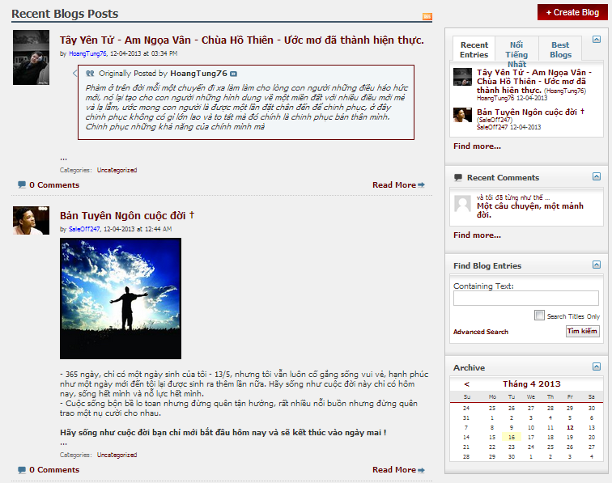
Literature review
Banchanviet.vn
Phuot.vn

Slide 6
Our proposal
Vnspot.net
friendly
information
social

Slide 7
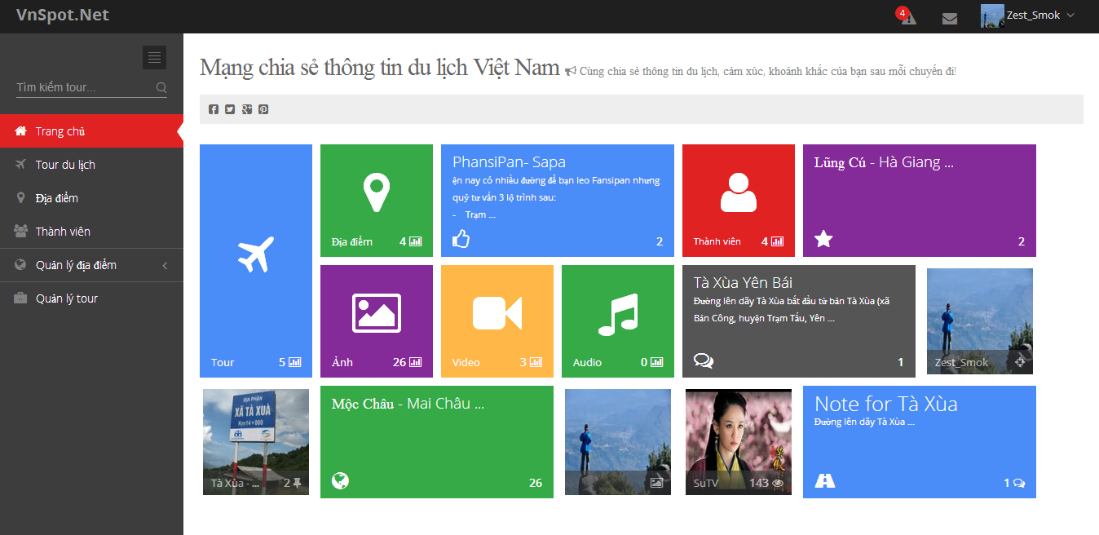
Our Product

Slide 8
Part II : Software project management plan

Slide 9
Roles in Team
Project Manager
SuTV
SRS Analysis Team
Design Team
Coding Team
Test Team
BinhNV
NamNV
CuongND
NamNV
CuongND
SuTV
DanDD
BinhNV

Slide 10
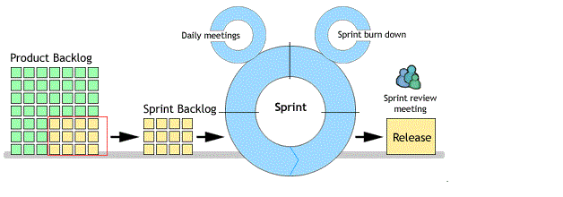
Software Process model
Software process model
For the development process, we will use our self process. It based on Agile framework with some modifies.
http://www.testertroubles.com/2009/03/agile-scrum-process-model.html

Slide 11
Software project management
Communication
Meeting, Email, Skype, Facebook…
Time
Work 6h per day and 5 days per week
Weekly Meeting
Every Thursday, from 18:00 to 19:00 .
Data
Upload and download all project document from Dropbox

Slide 12
Risk management
Risk type | Risk description | Resolution
People | Team members get personal matters to attend Conflict between members | Have each member to know what others are doing so they can support if required Setup open mined environments
Technical | Google Map technology will release a new version | Follow its implementation closely to get newest update and information
Process | Wrong estimation about project plan | Consult with instructor

Slide 13

Technologies

Slide 14





Tools

Slide 15
Part III : Software Requirement Specification

Slide 16
SOFTWARE REQUIREMENT SPECIFICATION
Functional Requirement
Non-functional Requirement

Slide 17
Functional requirements - User
Register account, login, logout
Edit profile, change password, user setting
Create new place, edit place information
Create new trip, edit trip information
Check in place in trip
Add media(photo, video, audio) into trip
Add, edit note into trip
Create, edit album
Like, comment items in trip
Like, rate trip
View trip in timeline

Slide 18
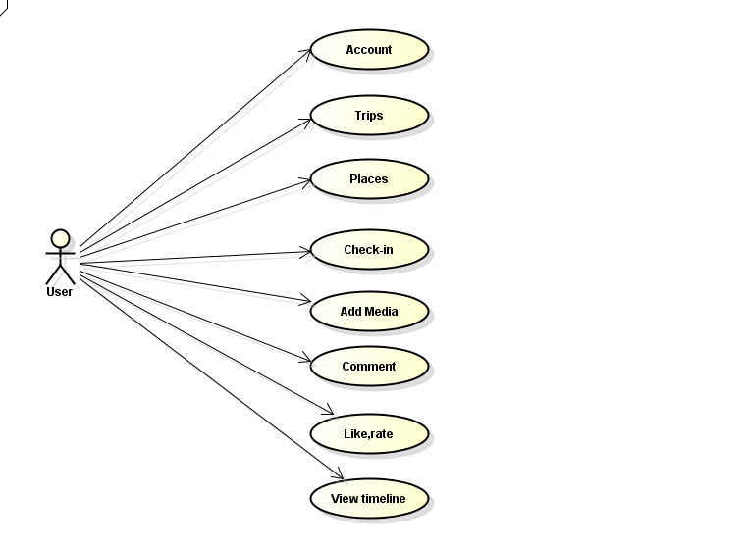
User Use case

Slide 19
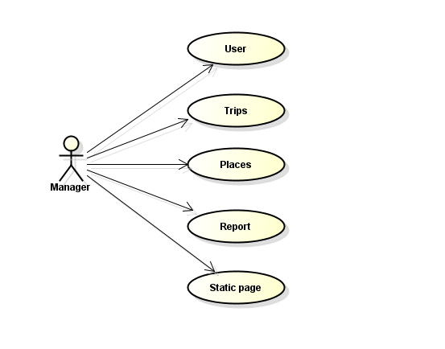
Functional requirement - admin
Manage user
Manage place
Manage place category
Manage tour
Manage report
Manage static page

Slide 20
Non-functional requirement
Reliability
Reliable information about place
Reliable rating and other statistics
Maintainability
Follow standard coding style and naming conventions
Code is clearly commented
Availability
System is available 24/7 ( 98%)
System is monthly maintained
Portability
Easy to use by all PCs with a browser and internet connection
Security
User’s password is encrypted by MD5 standard.
User’s password is invisible to admin

Slide 21
Part IV :Software design

Slide 22
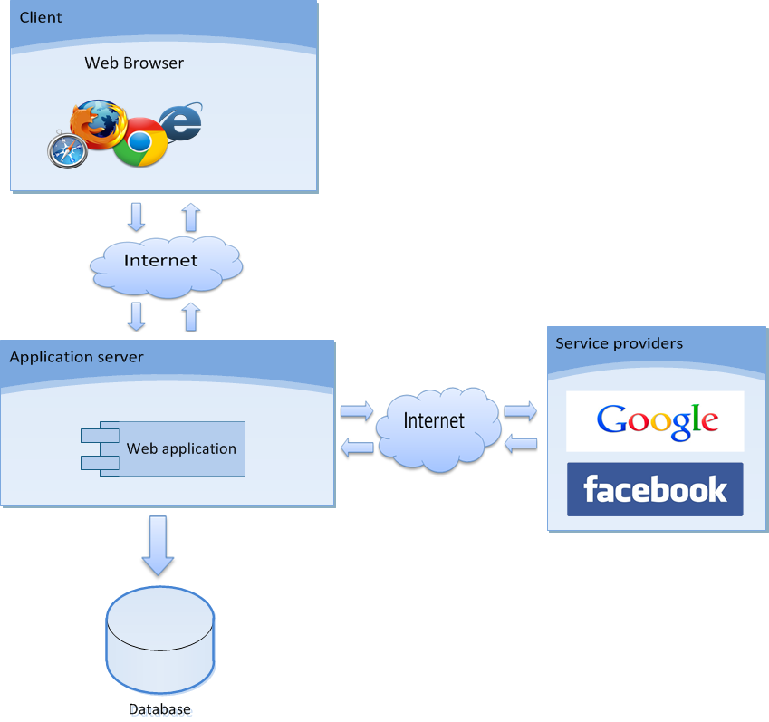
4.1 Overall Design

Slide 23
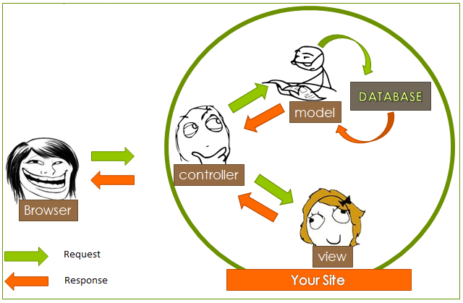
4.1 Design Pattern
MVC model

Slide 24
Flow
Activity

Slide 25
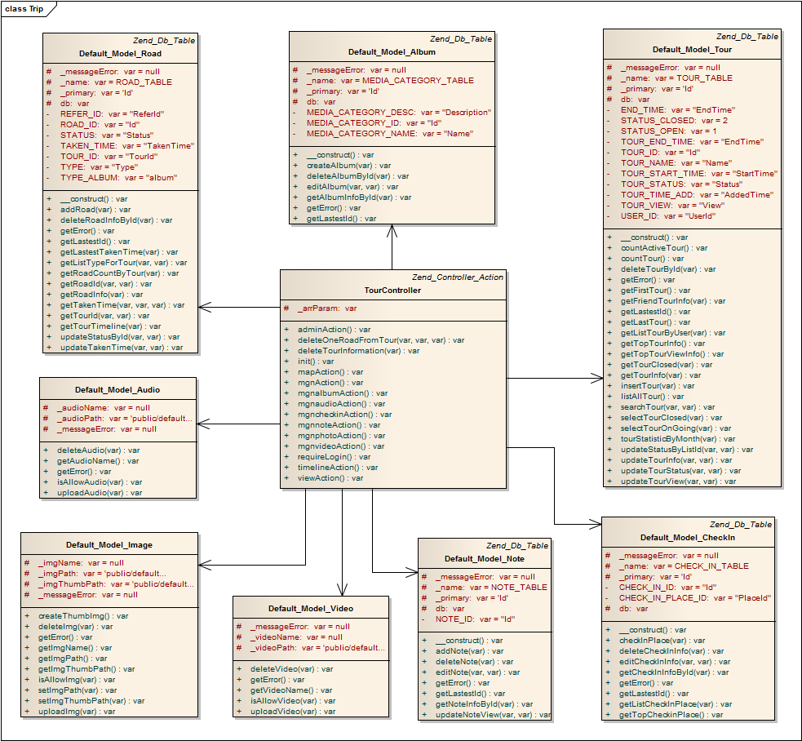
4.3 Class Diagram
Example: Trip class diagram

Slide 26
4.4 Sequence diagram
Example: add trip sequence diagram

Slide 27
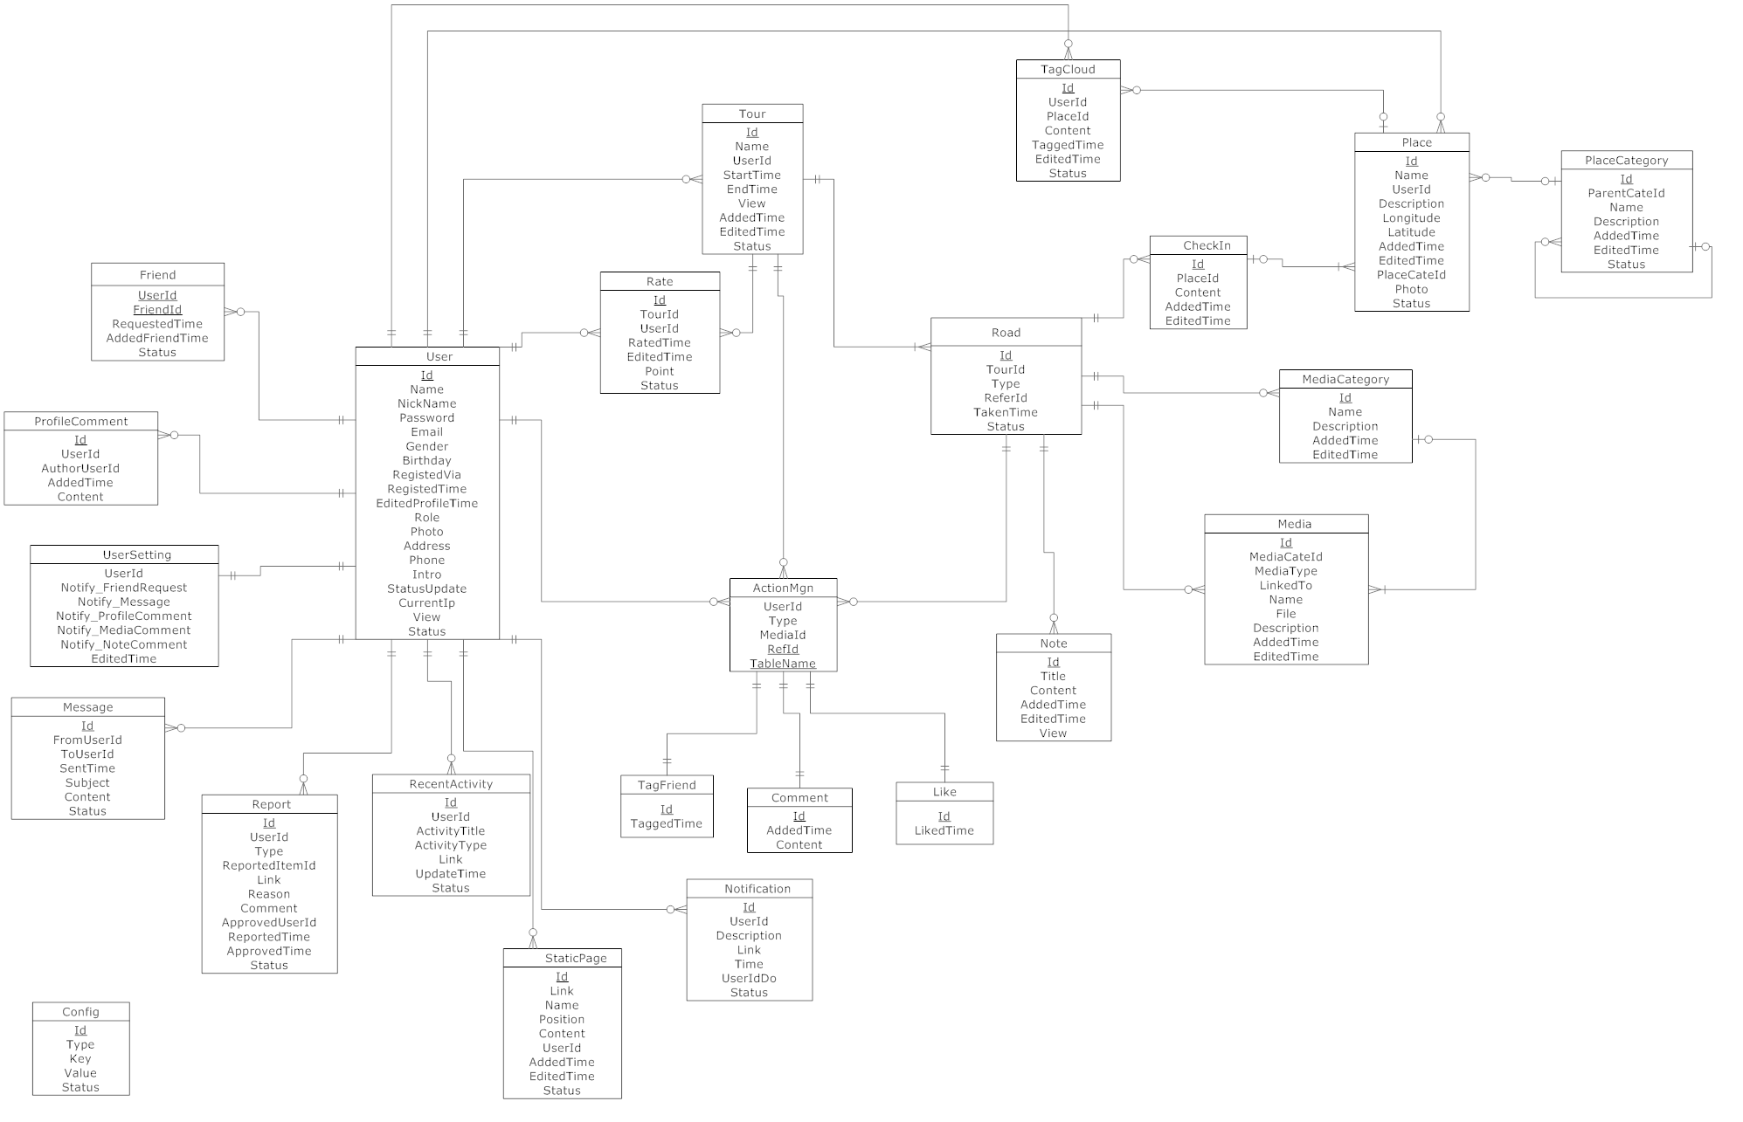
4.5 Database Design

Slide 28
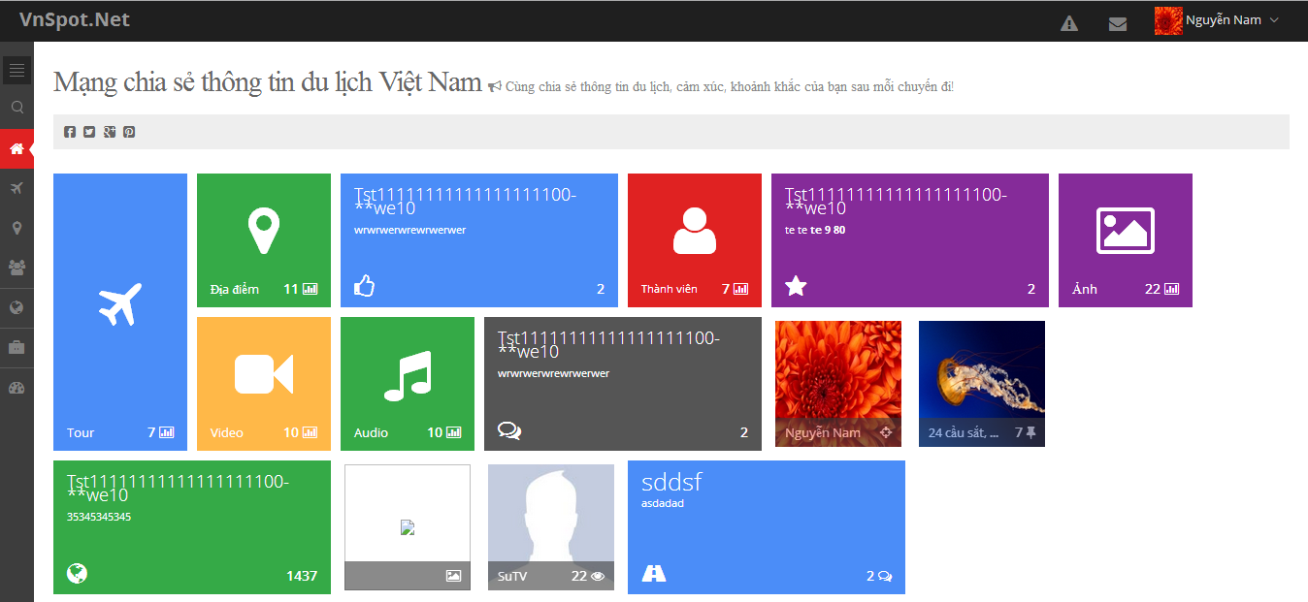
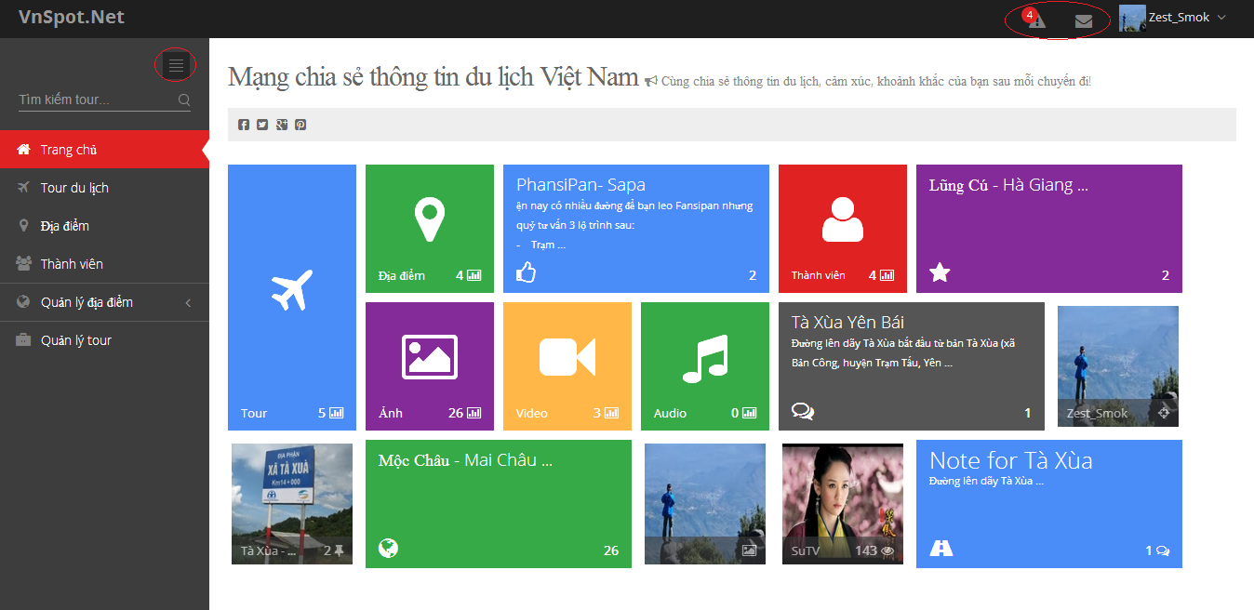
4.6 Screen Design

Slide 29
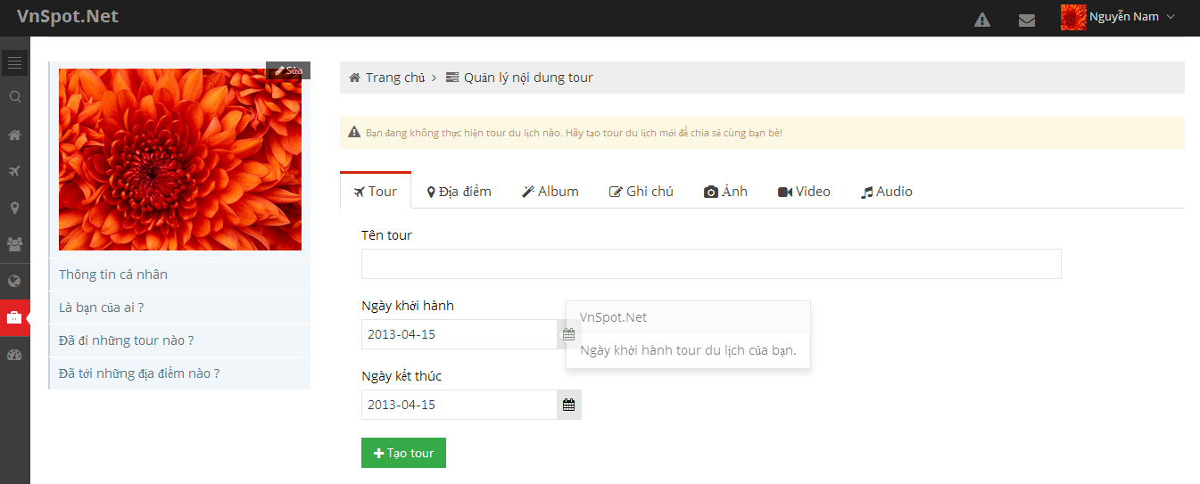
4.6 Screen Design

Slide 30
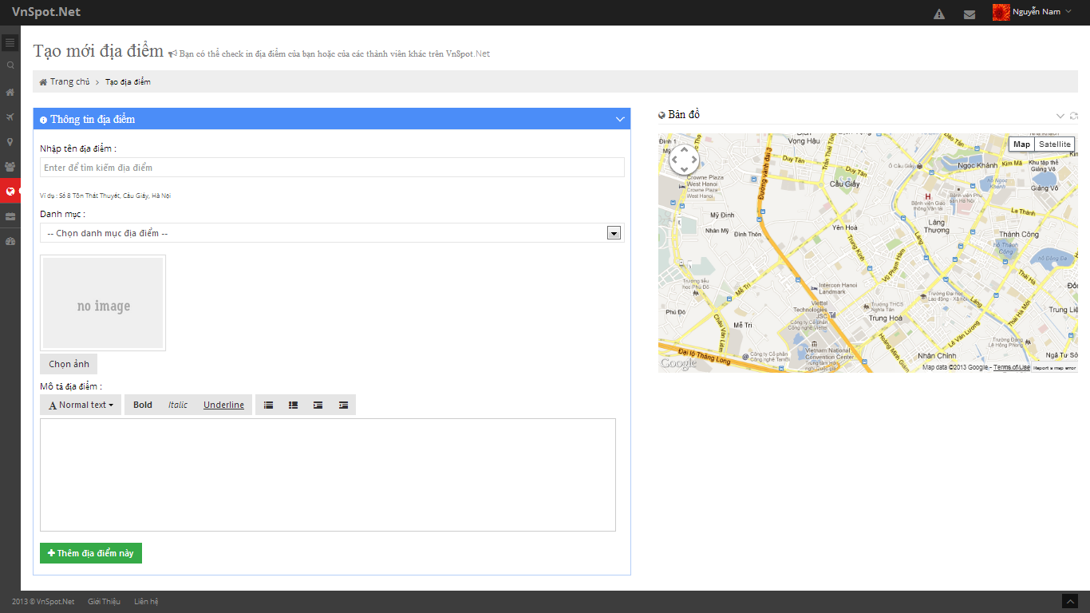
4.6 Screen Design

Slide 31
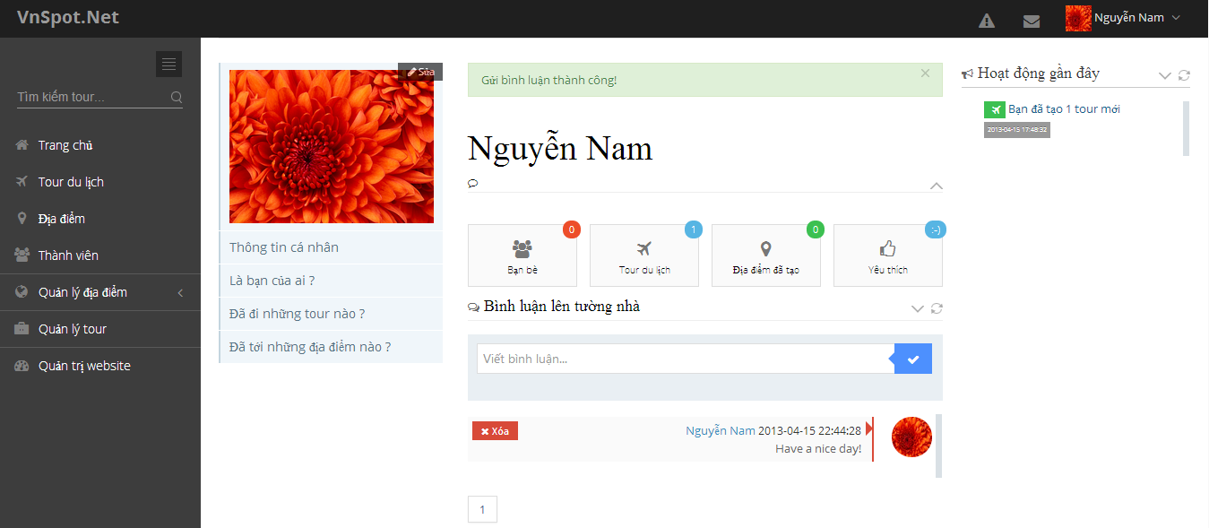
4.6 Screen Design

Slide 32
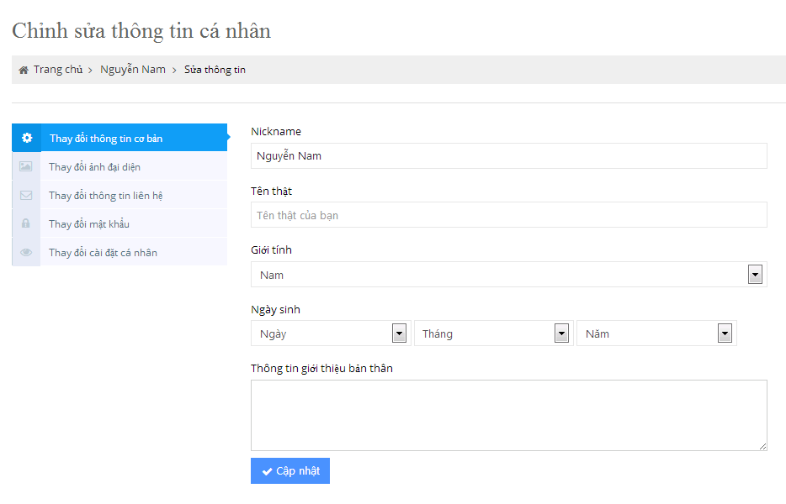
4.6 Screen Design

Slide 33
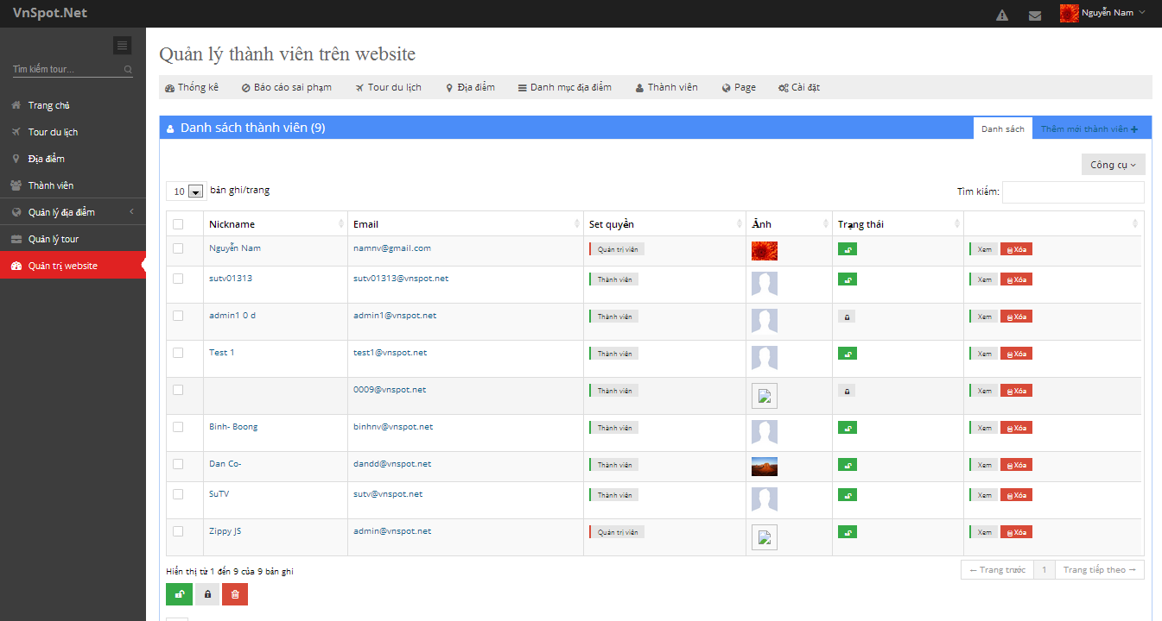
4.6 Screen Design

Slide 34
Part V : Software Testing

Slide 35
Software TEST description
TEST STRAGERY
TEST CASE
TEST RESULT

Slide 36
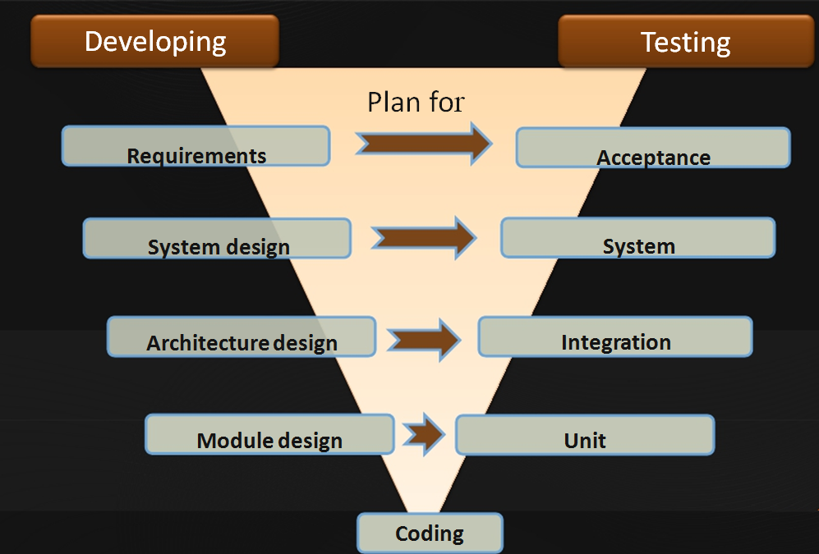
test Model

Slide 37
Test Plan

Slide 38
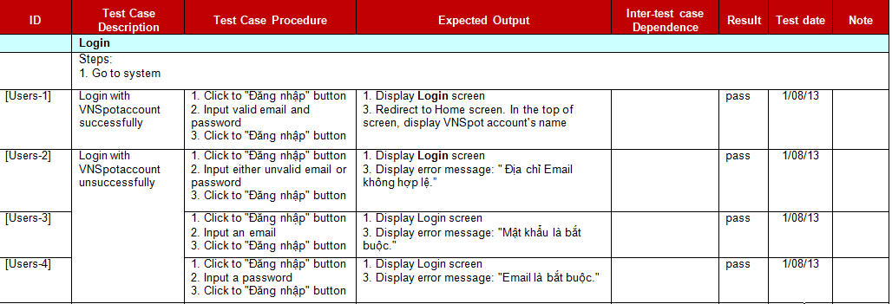
Test Case
Example: User test case

Slide 39
Test Result
No | Function | Pass | Fail | Untested | N/A | Number of test case
1 | User | 40 |  |  |  | 40
2 | Place | 58 |  |  |  | 58
3 | Trip | 68 |  |  |  | 68
4 | Friend | 15 |  |  |  | 15
5 | Search | 4 |  |  |  | 4
6 | Social | 9 |  |  |  | 9
7 | Admin | 54 |  |  |  | 54
 | Sub Total | 249 |  |  |  | 249

Slide 40
Lesson learned
Technique
Soft-skill
Software Requirement
Management

Slide 41
Summary
Capstone project: Completed
Product: deployed on http://vnspot.net
Future:
  Supported multiple language
  Develop mobile apps
  Supported travel destinations around the world

Slide 42
DEMO
Q&A

Slide 43
Thank you!

