Slide 1
Food Advisor Application
Capstone Project
FPT University
Supervisor: Mr Nguyen Van Sang
Team member: Doan Thi Hai Yen
Hoang Anh Tuan
Nguyen Minh Tu
Tan Van Manh
Duong Anh Dung

Slide 2
INTRODUCTION AND BACKGROUND
SOFTWARE PROJECT MANAGEMENT
SOFTWARE REQUIREMENT SPECIFICATION
SOFTWARE DESIGN
TEST PLAN AND RESULT
DEMO

Slide 3

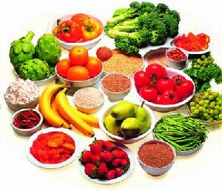
INTRODUCTION and BACKGROUND
Health for people
Impact food?

Slide 4
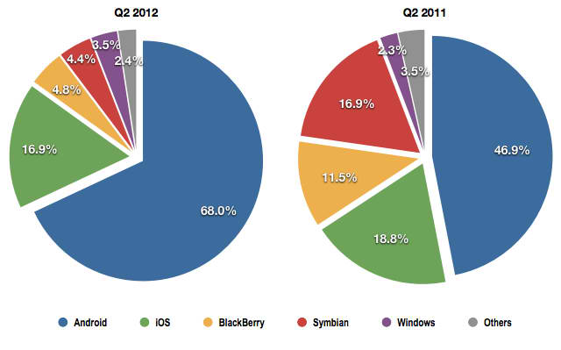
Mobile Markets
INTRODUCTION and BACKGROUND

Slide 5
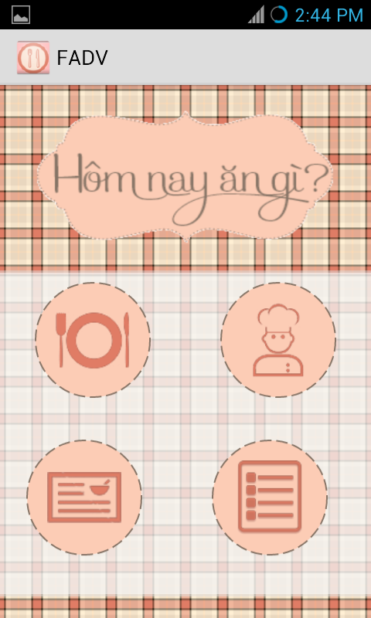
INTRODUCTION and BACKGROUND
FOOD
ADVISOR
APPLICATION

Slide 6
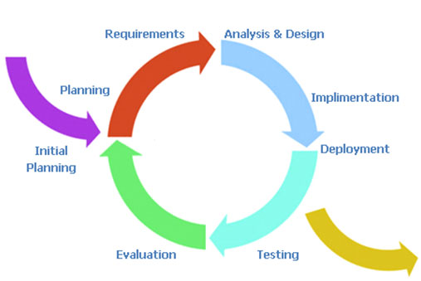
Software Project Management
Software process model

Slide 7
Software Project Management
Roles in Team
Project Manager
YENDTH
SRS Analysis Team
Design Team
Coding Team
Test Team
TuanHA
ManhTV
YenDTH
DungDA
TuNM
TuanHA
ManhTV
YenDTH
DungDA

Slide 8
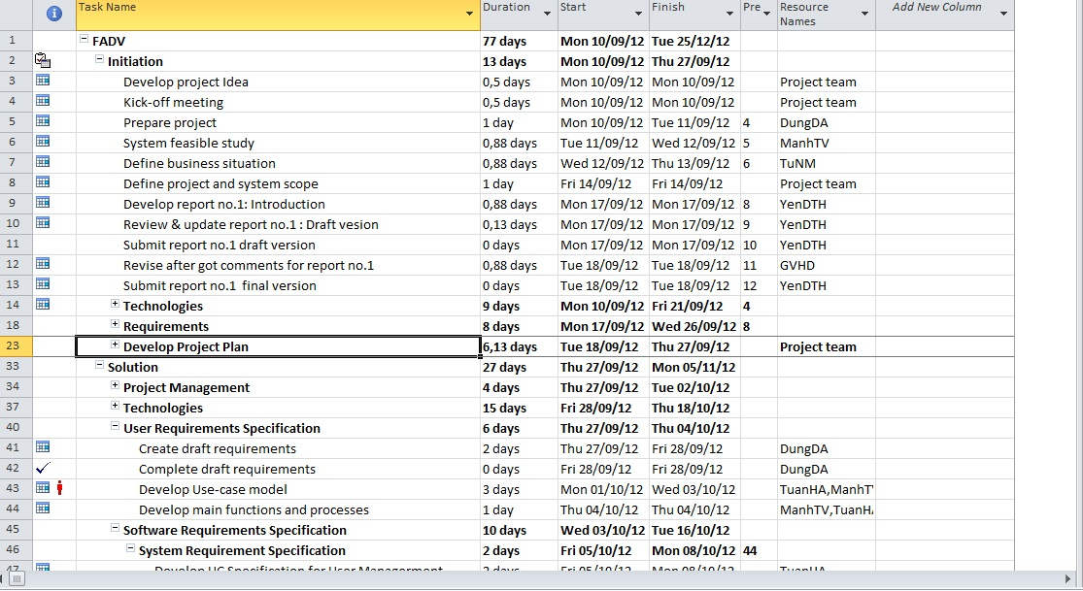
Software Project Management

Slide 9

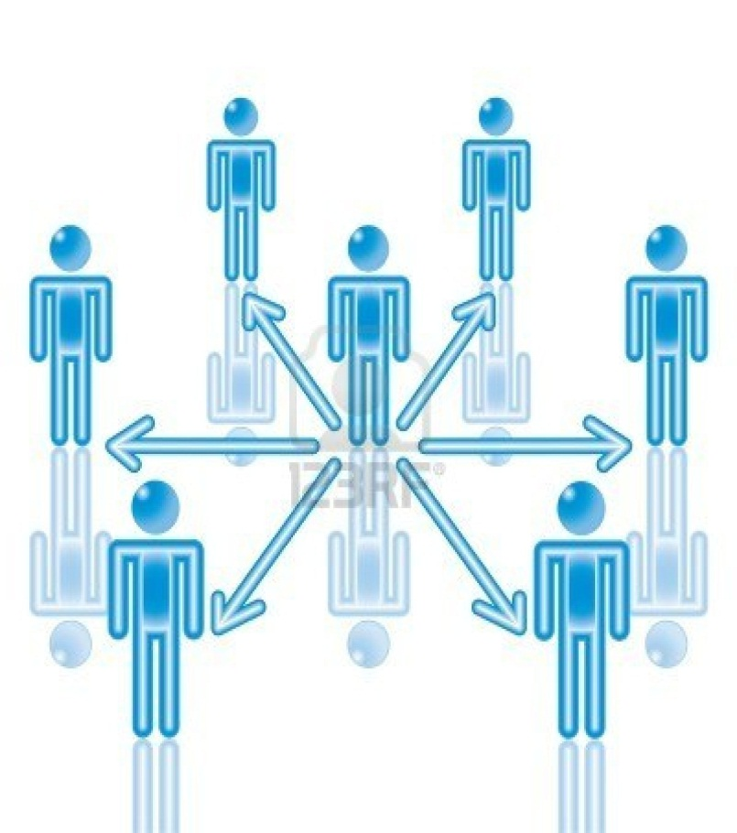

SOFTWARE PROJECT MANAGEMENT
Communication

Slide 10
Functional Requirement
SOFTWARE REQUIREMENT SPECIFICATION
Menu Management
Member Management
Dish Management

Slide 11
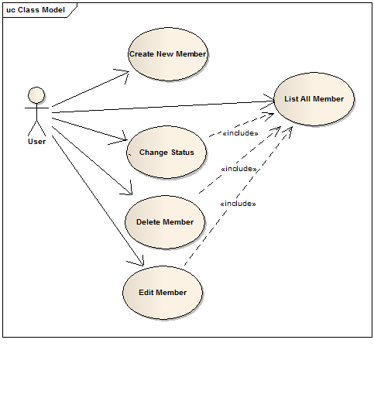
Member
Management
SOFTWARE REQUIREMENT SPECIFICATION
Create New Member
Edit Member
Delete Member
List All Members
Change Status

Slide 12
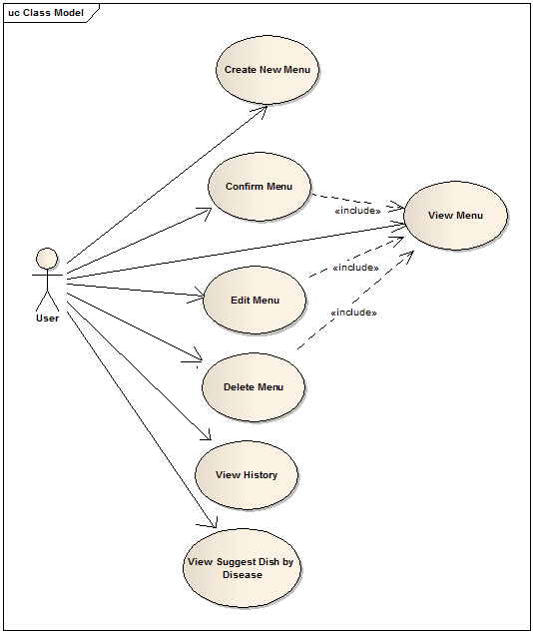
Menu Management
SOFTWARE REQUIREMENT SPECIFICATION
Create New Menu
Confirm Menu
Edit Menu
Delete Menu
View Menu
View Suggest Dish
by Disease
View History

Slide 13
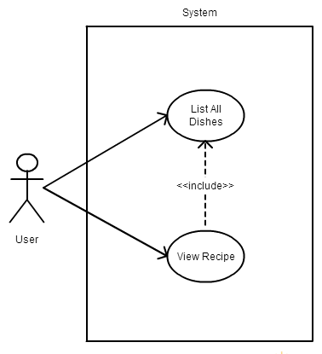
Dish
Management
SOFTWARE REQUIREMENT SPECIFICATION
List All Dishes
View Recipe

Slide 14
Non-Functional Requirement
SOFTWARE REQUIREMENT SPECIFICATION
Reliability
Usability
Performance

Slide 15
Tool & ENVIRONMENT
SOFTWARE REQUIREMENT SPECIFICATION
System software (Platform)
  Mobile programming language: Android 4.0
  Database: SQLite
Deployment environment
  The application runs in Android 4.0 or high
  RAM: 1GB
  Screen: 4.0 inch or high
  UCP: 1.2GHz

Slide 16
SOFTWARE DESIGN
Multilayered Architecture
Increasing level of abstraction.
Enhanced independence of applications’ GUI to lower layer services.
Enhanced flexibility.
Suited to component-based technology.
Promotion of portability.
Presentation Layer
Business Layer
Android Platform
Data Access Layer
Database Layer

Slide 17
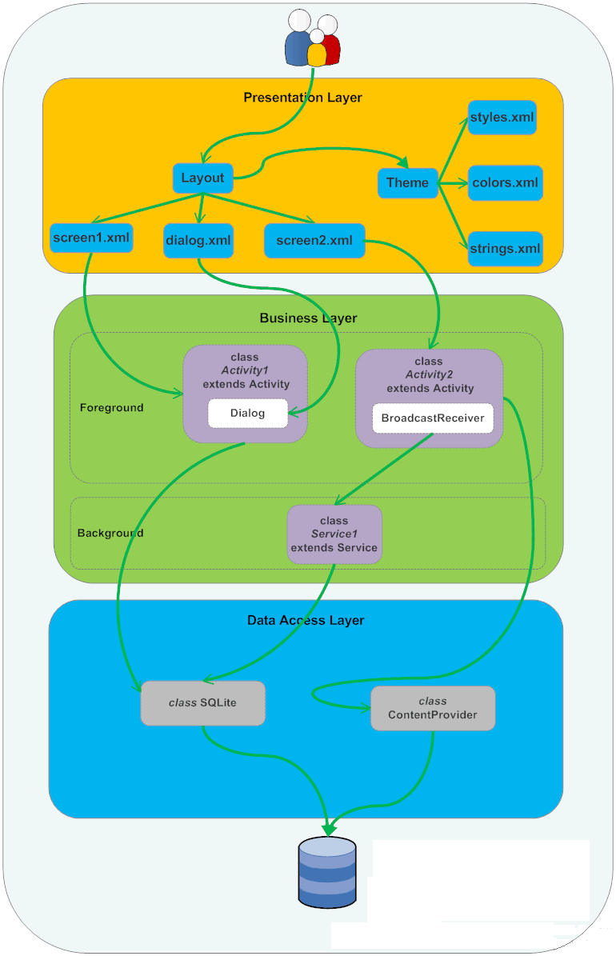
MULTILAYERED ARCHITECTURE

Slide 18
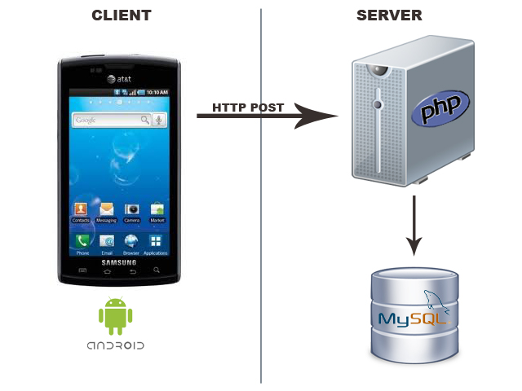
CLIENT – SERVER ARCHITECTURE

Slide 19
PRESENTATION LAYER
SOFTWARE DESIGN
GUI
XML files
Layout
Theme
Java
Activities
styles.xml
colors.xml
strings.xml
XML Layout

Slide 20
BUSINESS
LAYER
SOFTWARE DESIGN
GUI
Receive request & input data
Business processing
Database
processing
Receive result and response

Slide 21
DATA ACCESS LAYER
SOFTWARE DESIGN
SQLiteHelper
DBHelper
Database Connection
Retrieving Data
Insert, Update, Delete operation

Slide 22

DATABASE LAYER
SOFTWARE DESIGN
SQLite 3.7.15
  Embedded database engine
  Cross-platform
  Open-sources
  Reliability

Slide 23
Business
Normal suggest
Suggest best Dish.
Disease suggest
Respond to dinner how harm with dish.
Base from disease
Not duplicate with history.
Corresponding with family.
Base from User information.

Slide 24
Normal suggest
Problem
Suggest dish have enough vital for dinner.
Not duplicate in near time.
Require Answer
Dish must not harm any diner in family.
Solution
Base on trustable information about dinner requirement

Slide 25
Normal suggest
Vital nutrition
Kcal.
History
Unduplicated 9 meals.
P.
L.
G.
Pathology
Allergic with material.
Status
Short term information.

Slide 26
Fuzzy Suggest
Problem
The percent harmful to diner.
Diner have many disease.
Solution
Base on trustable information about dinner requirement.
Disease have many requirement.
Too many exception with one disease.

Slide 27
Fuzzy Suggest
Dish
Vital Contain.
User
Base information.
Disease contain.
Disease
Disease information.
Disease exception.
Material.

Slide 28
Test PLAN AND RESULT
TEST MODEL
Requirements Analysis
System testing
High level design
Integration testing
Detailed design
Unit Testing
Implementation

Slide 29
TEST PLAN AND RESULT
No | Screen | Pass | Fail | Untested | N/A | Number of test case
1 | Home | 14 | 0 | 0 | 0 | 14
2 | Today | 17 | 0 | 0 | 0 | 17
3 | Create new menu | 30 | 1 | 0 | 0 | 30
4 | Member | 87 | 5 | 0 | 0 | 92
5 | Recipe | 11 | 1 | 0 | 0 | 12
6 | History Meal | 2 | 3 | 0 | 0 | 5
7 | Suggest by Diseases | 36 | 0 | 0 | 0 | 36
 | Sub Total | 197 | 10 | 0 | 0 | 206

Slide 30
Lesson Learn
Test PLAN AND RESULT
Technique
Soft-skill
Nutrition
Management

Slide 31
DEMO
Q&A

